Slide 1



Maximum k-Biplex Search on Bipartite Graphs: A Symmetric-BK Branching Approach
Kaiqiang Yu, Cheng Long
Nanyang Technological University

Slide 2
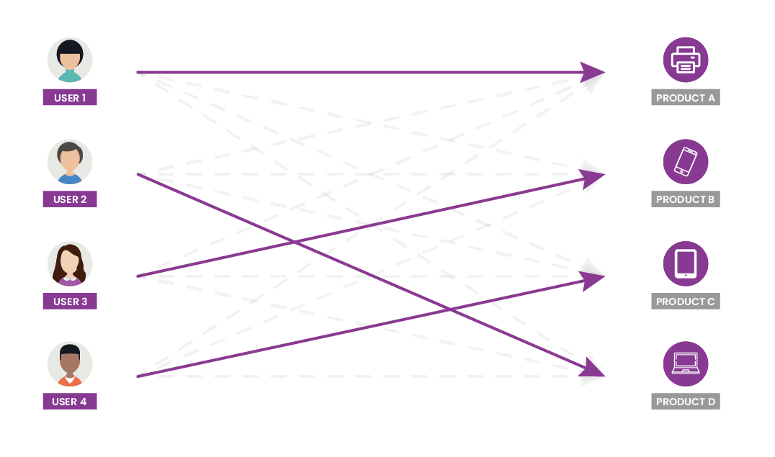
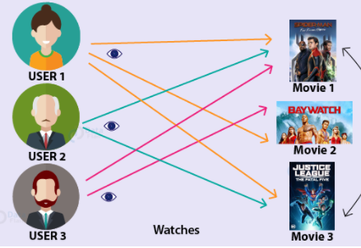
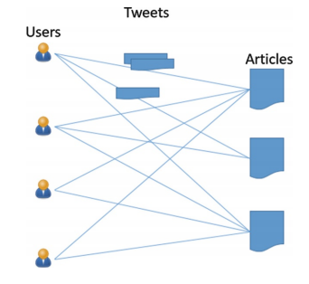

Bipartite Graphs
Graph structure which captures relations/interactions between two sets of entities
Widely exist in various domains such as E-commerce, social networking, academic publication, etc.
Customer-product networks
User-movies networks
Author-publication networks
User-article networks

Slide 3
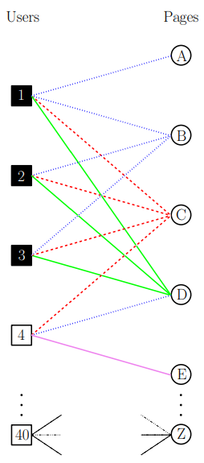
Cohesive Subgraphs Mining on Bipartite Graphs
Given a bipartite graph, find highly connected subgraphs
Applications:
Cohesive bipartite subgraphs in page-like data reveal attempts to inflate page-like counts [Beutel et al., 2013]
Fake news detection [Gangireddy, et al. 2020]
Online recommendation [Günnemann, et al. 2011]
Gangireddy, et al. Unsupervised Fake News Detection: A Graph-based Approach. HyperText. 2020
Günnemann, et al. Flexible Fault Tolerant Subspace Clustering for Data with Missing Values. ICDM 2011

Slide 4
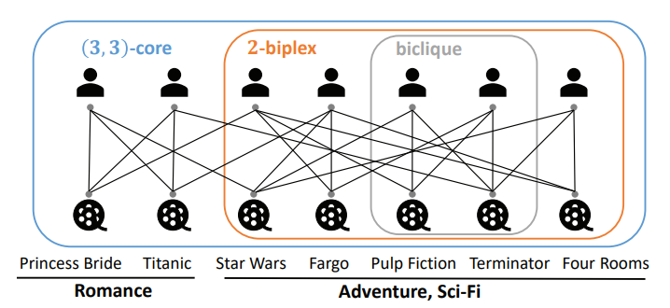
Cohesive Subgraphs in Bipartite Graphs: Definitions
Bi-clique
Any vertex connects all vertices from the other side
(𝛼, 𝛽)-core
Any vertex connects at least a certain number of vertices from the other side
k-biplex
Any vertex disconnects at most 𝑘 vertices from the other side
Dense bipartite subgraphs
Max density
Illustration of bi-clique, k-biplex and (𝛼, 𝛽)-core

Slide 5
Cohesive Subgraphs in Bipartite Graphs: Definitions
k-biplex
A strict enough requirement on the connections
Yet allows some disconnections which are common in real applications (due to data quality issues such as incomplete data)
An existing case study shows that k-biplex works better than other definitions for a fraud detection task [Yu et al. 2022]
Illustration of bi-clique, k-biplex and (𝛼, 𝛽)-core
Yu et al. Efficient Algorithms for Maximal k-Biplex Enumeration. SIGMOD 2022

Slide 6
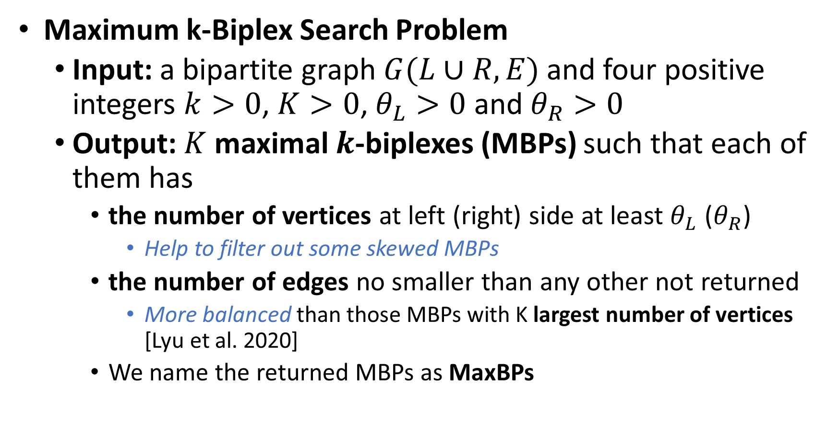
Cohesive Subgraphs in Bipartite Graphs: Problem
Maximum k-Biplex Search Problem
Input: a bipartite graph $G(L∪R, E)$ and four positive integers $k>0$, $K>0$, $θ_{L}>0$ and $θ_{R}>0$
Output: $K$ maximal $k$-biplexes (MBPs) such that each of them has
the number of vertices at left (right) side at least $θ_{L}$ ($θ_{R}$)
Help to filter out some skewed MBPs
the number of edges no smaller than any other not returned
More balanced than those MBPs with K largest number of vertices [Lyu et al. 2020]
We name the returned MBPs as MaxBPs
Lyu et al., Maximum biclique search at billion scale. VLDB 2020

Slide 7
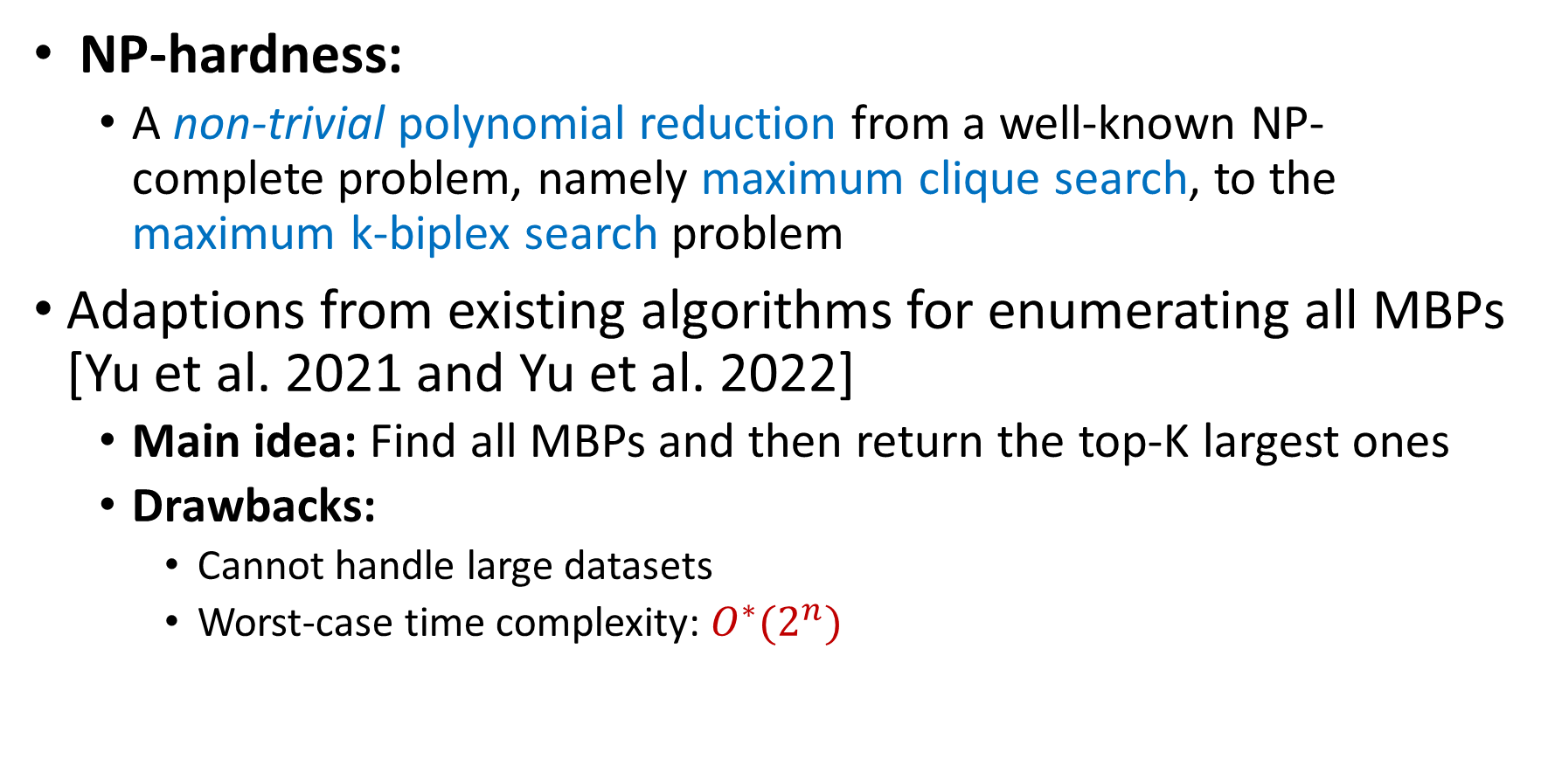
Cohesive Subgraphs in Bipartite Graphs: Challenges
NP-hardness:
A non-trivial polynomial reduction from a well-known NP-complete problem, namely maximum clique search, to the maximum k-biplex search problem
Adaptions from existing algorithms for enumerating all MBPs [Yu et al. 2021 and Yu et al. 2022]
Main idea: Find all MBPs and then return the top-K largest ones
Drawbacks:
Cannot handle large datasets
Worst-case time complexity: $O^{∗}(2^{n})$
[1] Yu et al. 2021. On Efficient Large Maximal Biplex Discovery. IEEE Transactions on Knowledge and Data Engineering (2021)
[2] Yu et al. Efficient Algorithms for Maximal k-Biplex Enumeration. In Proc. ACM SIGMOD Int. Conf. Manage. Data. 860–873

Slide 8
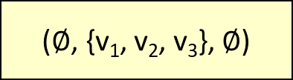
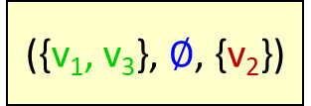
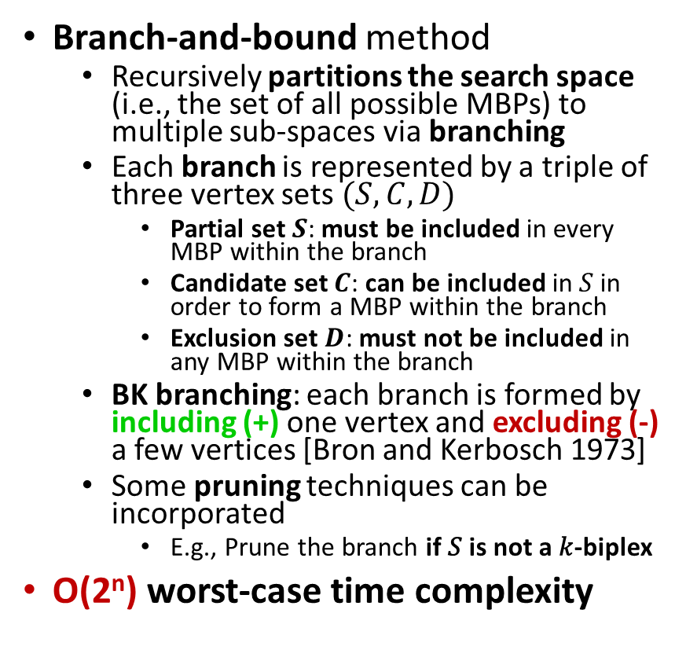
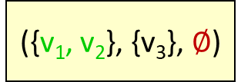
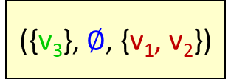
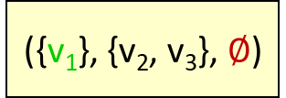
A Basic Solution: BasicBB
Branch-and-bound method
Recursively partitions the search space (i.e., the set of all possible MBPs) to multiple sub-spaces via branching
Each branch is represented by a triple of three vertex sets $(S,C,D)$
Partial set $S$: must be included in every MBP within the branch
Candidate set $C$: can be included in 𝑆 in order to form a MBP within the branch
Exclusion set $D$: must not be included in any MBP within the branch
BK branching: each branch is formed by including (+) one vertex and excluding (-) a few vertices [Bron and Kerbosch 1973]
Some pruning techniques can be incorporated
E.g., Prune the branch if 𝑆 is not a 𝑘-biplex
O(2^{n}) worst-case time complexity
Example: V = {v₁, v₂, v₃}
($∅$, {v₁, v₂, v₃}, $∅$)
({v₁}, {v₂, v₃}, $∅$)
+ v₁
+ v₂
- v₁
+ v₃
- v₁, v₂
({v₂}, {v₃}, {v₁})
({v₃}, $∅$, {v₁, v₂})
+ v₂
+ v₃
- v₂
This branch can terminate
({v₁, v₂}, {v₃}, $∅$)
({v₁, v₃}, $∅$, {v₂})
…
This branch can terminate
Bron and Kerbosch. Finding all cliques of an undirected graph. Commun. ACM, 1973

Slide 9


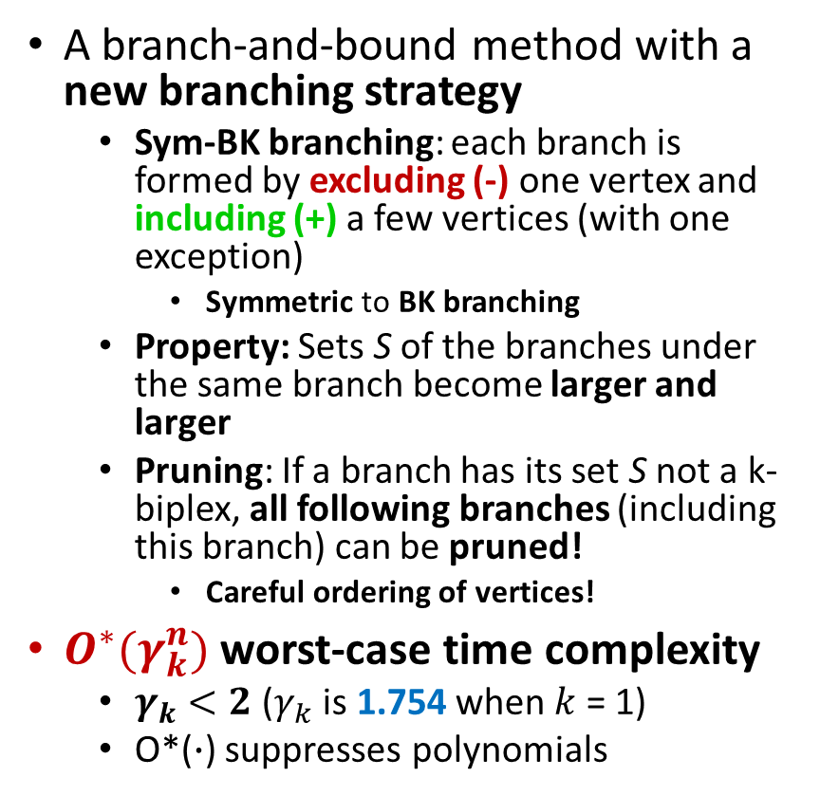



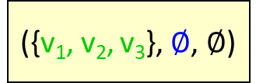
A More Advanced Solution: FastBB
A branch-and-bound method with a new branching strategy
Sym-BK branching: each branch is formed by excluding (-) one vertex and including (+) a few vertices (with one exception)
Symmetric to BK branching
Property: Sets S of the branches under the same branch become larger and larger
Pruning: If a branch has its set S not a k-biplex, all following branches (including this branch) can be pruned!
Careful ordering of vertices!
$O^{∗}(γ_{k}^{n})$ worst-case time complexity
$γ_{k}<2$($γ_{k}$ is 1.754 when $k$ = 1)
O*($∙$) suppresses polynomials
Example: V = {v₁, v₂, v₃}
($∅$, {v₁, v₂, v₃}, $∅$)
This branch can terminate
({v₁, v₂, v₃}, $∅$, $∅$)
($∅$, {v₂, v₃}, {v₁})
+ v₁, v₂, v₃
- v₁
+ v₁
- v₂
+ v₁, v₂
- v₃
({v₁}, {v₃}, {v₂})
({v₁, v₂}, $∅$, {v₃})
- v₂
+ v₂
- v₃
+ v₂, v₃
($∅$, {v₃},{v₁, v₂})
({v₂}, $∅$, {v₁, v₃})
({v₂, v₃}, $∅$, {v₁})
…
This branch can terminate
This branch can terminate

Slide 10
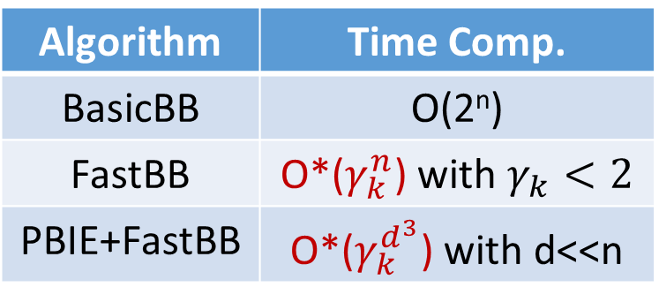
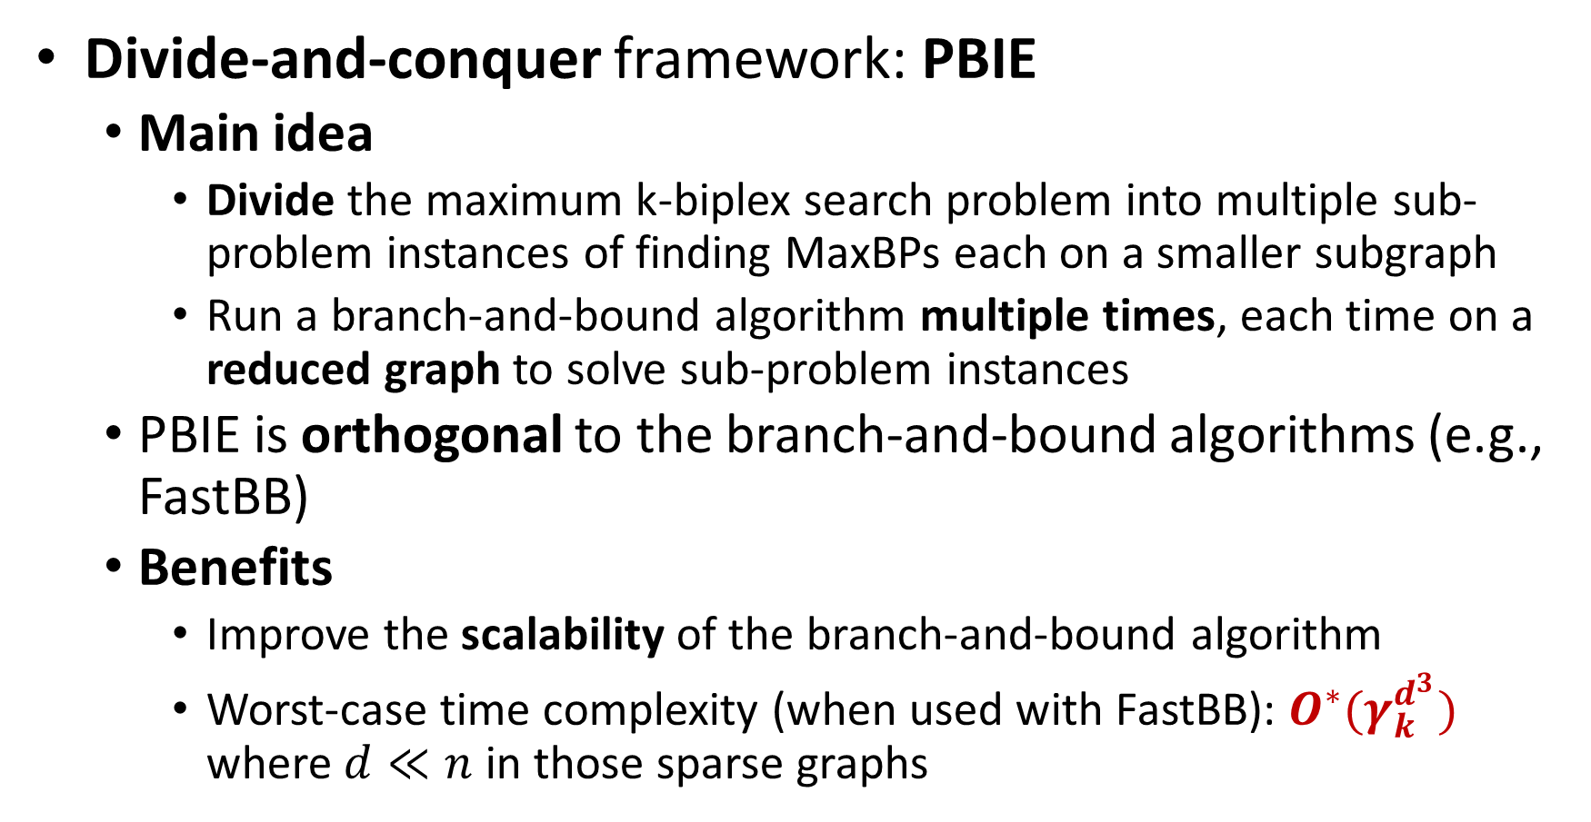
More Techniques for Boosting Scalability
Algorithm | Time Comp.
BasicBB | O(2^{n})
FastBB | O*($γ_{k}^{n}$) with $γ_{k}<2$
PBIE+FastBB | O*($γ_{k}^{d^{3}}$) with d<<n
Divide-and-conquer framework: PBIE
Main idea
Divide the maximum k-biplex search problem into multiple sub-problem instances of finding MaxBPs each on a smaller subgraph
Run a branch-and-bound algorithm multiple times, each time on a reduced graph to solve sub-problem instances
PBIE is orthogonal to the branch-and-bound algorithms (e.g., FastBB)
Benefits
Improve the scalability of the branch-and-bound algorithm
Worst-case time complexity (when used with FastBB): $O^{∗}(γ_{k}^{d^{3}})$ where $d≪n$ in those sparse graphs

Slide 11
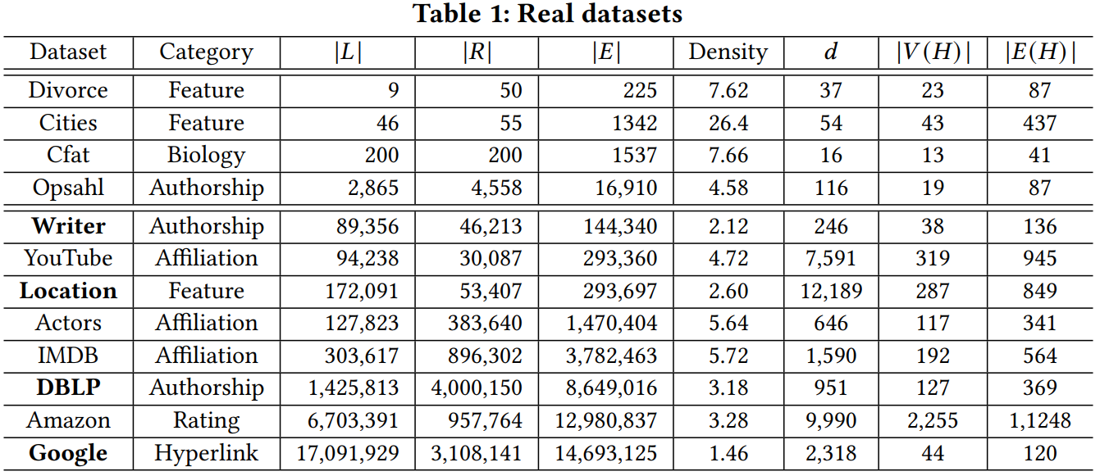
Experiments – Set Up (1)
Datasets
Erdös-Réyni (ER) synthetic datasets
Real datasets

Slide 12
Experiments – Set Up (2)
Algorithms:
Our Algorithm: PBIE+FastBB
Baselines: iMBadp [1], FPadp [2] and iTradp [3]
Adapted from existing algorithms for enumerating maximal k-biplexes
We also compare BasicBB as an ablation study
Metrics:
Running time
[1] Yu et al. On Efficient Large Maximal Biplex Discovery. TKDE 2021
[2] Zhou et al. Enumerating Maximal k-Plexes with Worst-Case Time Guarantee. AAAI 2020.
[3] Yu et al. Efficient Algorithms for Maximal k-Biplex Enumeration. SIGMOD 2022

Slide 13
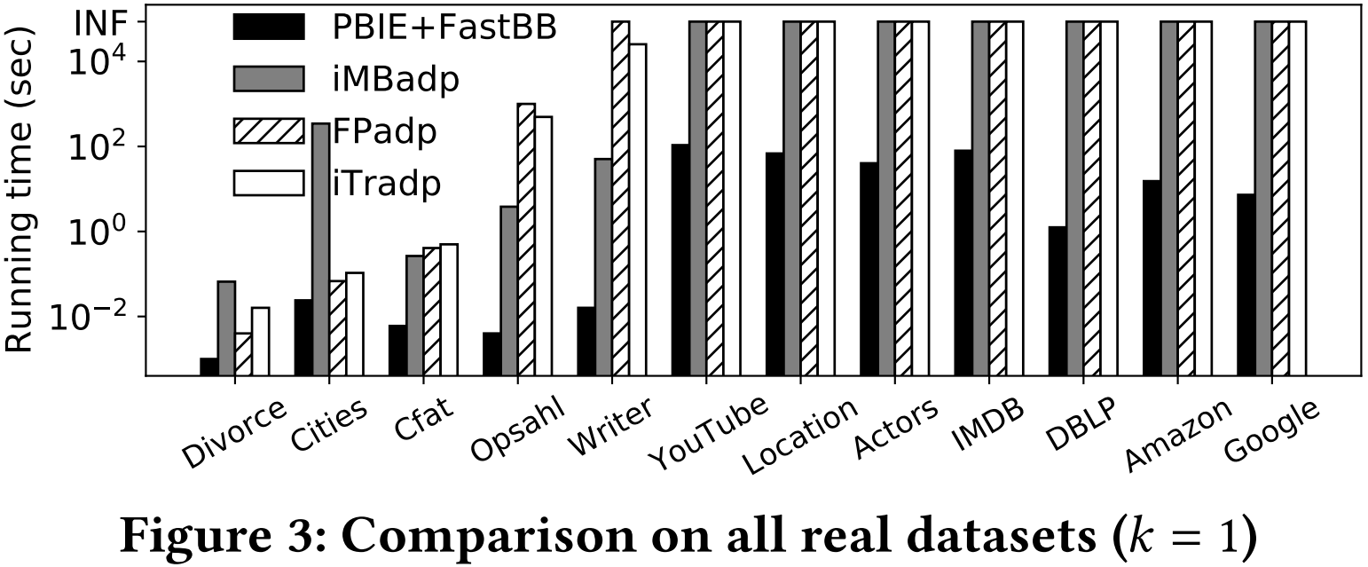

Experiments – Results on All Real Datasets
PBIE+FastBB is up to 4 orders of magnitude faster than baseline methods
PBIE+FastBB can finish on all real datasets tested (with several millions of vertices and edges)
${10}^{4}$ times speedup

Slide 14
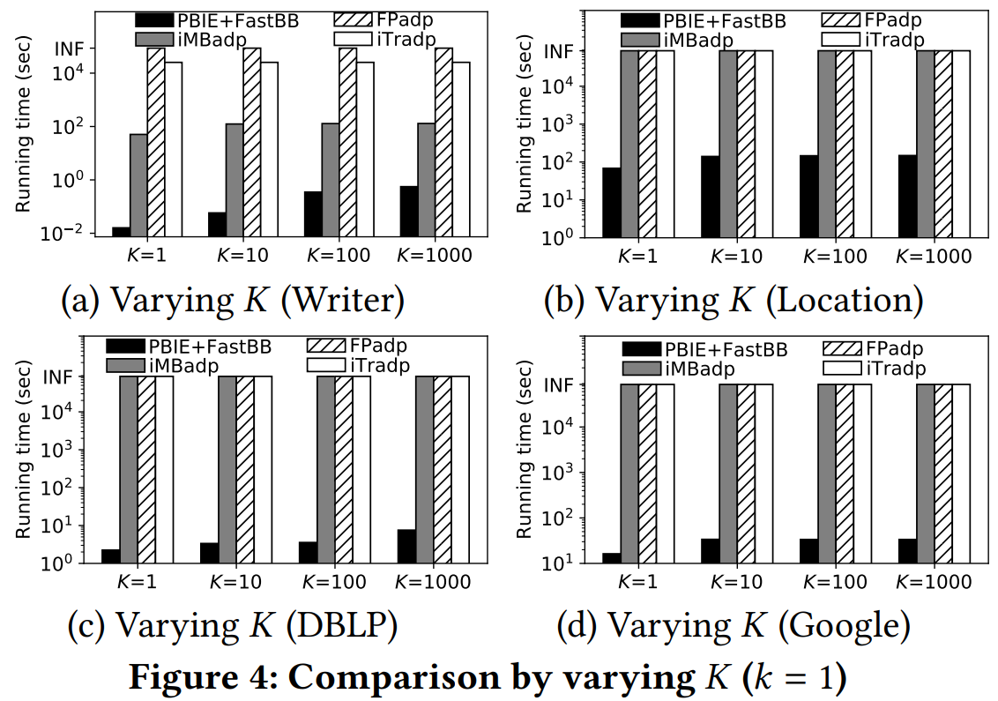
Experiments – Results of Varying K
PBIE+FastBB is significantly faster than baseline methods for various settings of K
All algorithms cost more time when K increases
More MBP structures to be found with large K values

Slide 15
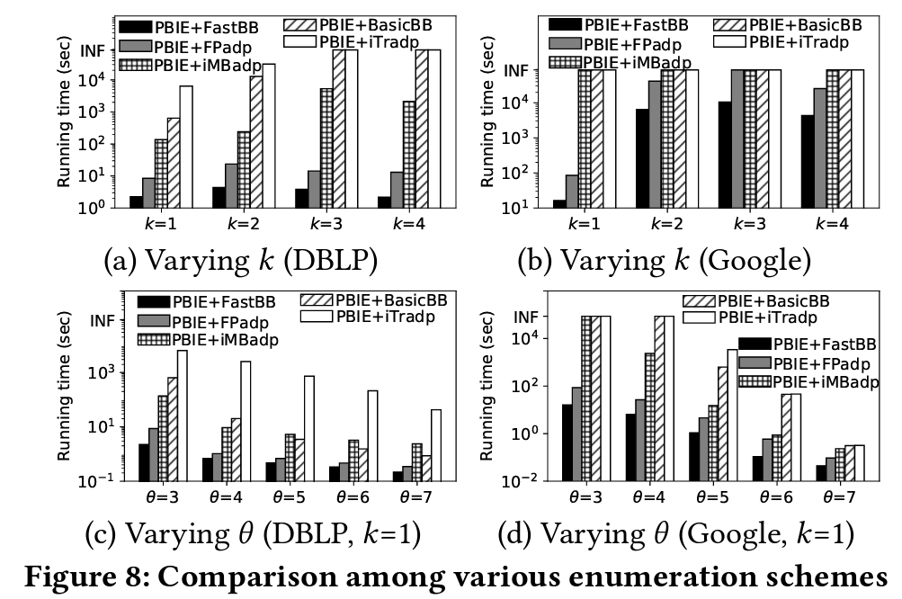
Experiments – Results of Varying Enumeration Schemes
PBIE boosts the performance of all enumeration algorithms
FastBB works the best among different enumeration algorithms

Slide 16
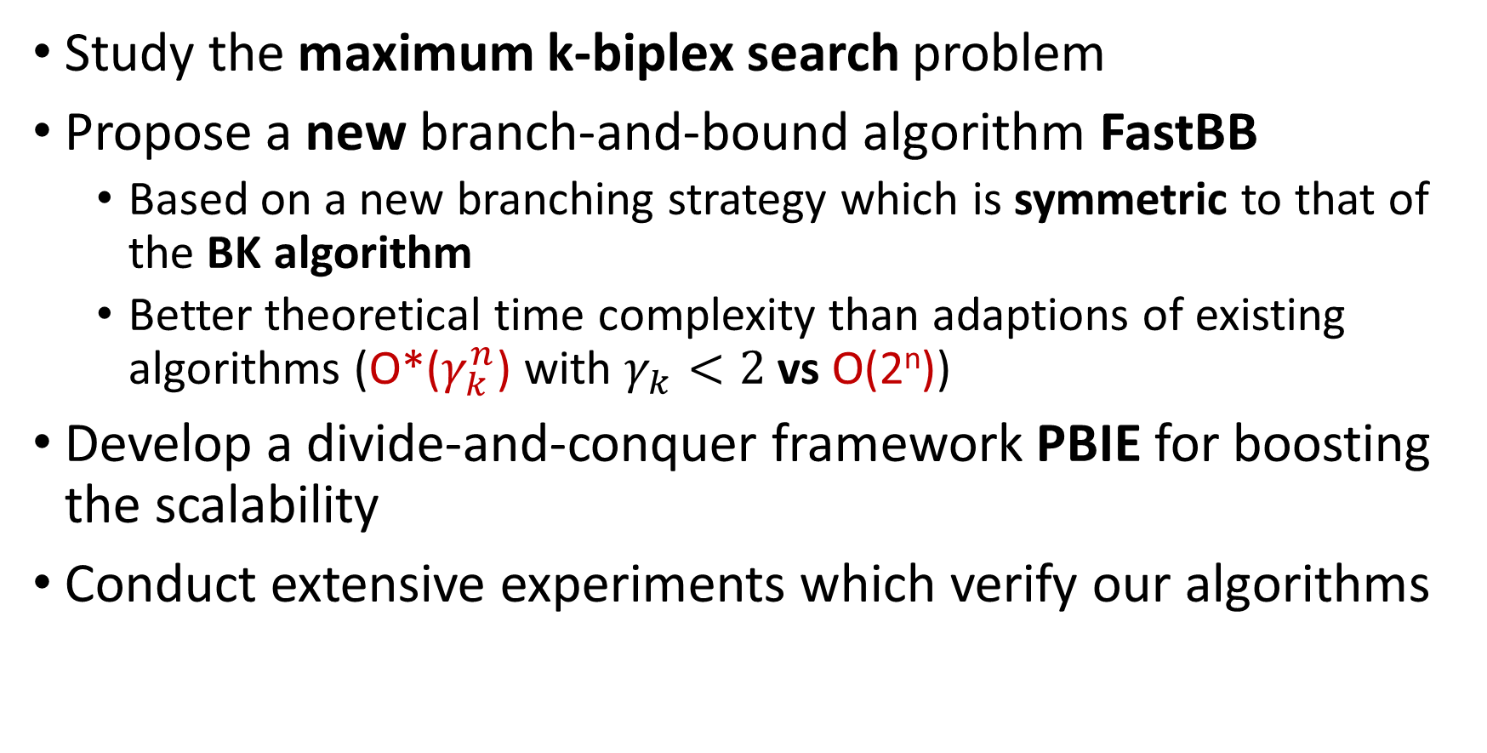
Conclusion
Study the maximum k-biplex search problem
Propose a new branch-and-bound algorithm FastBB
Based on a new branching strategy which is symmetric to that of the BK algorithm
Better theoretical time complexity than adaptions of existing algorithms (O*($γ_{k}^{n}$) with $γ_{k}<2$ vs O(2^{n}))
Develop a divide-and-conquer framework PBIE for boosting the scalability
Conduct extensive experiments which verify our algorithms

Slide 17
Thanks!

Slide 18
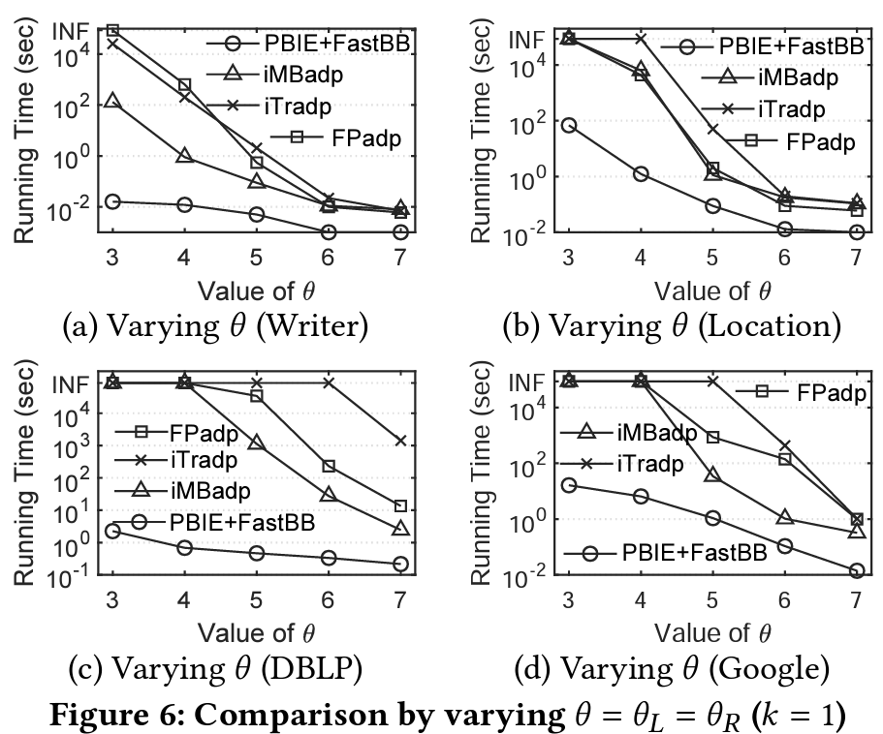
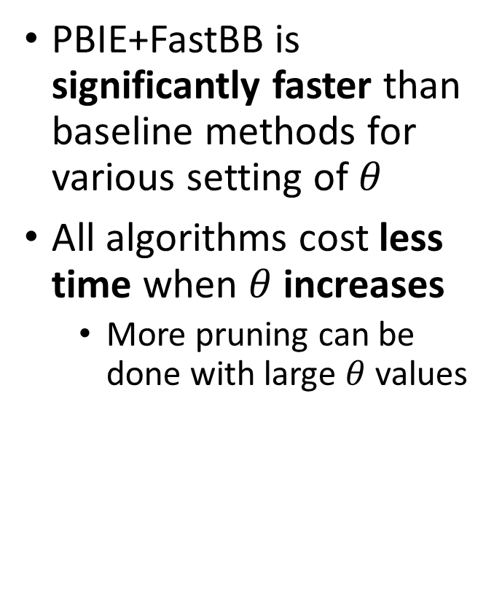
Experiments – Results of Varying $θ$
PBIE+FastBB is significantly faster than baseline methods for various setting of $θ$
All algorithms cost less time when $θ$ increases
More pruning can be done with large $θ$ values

Slide 19
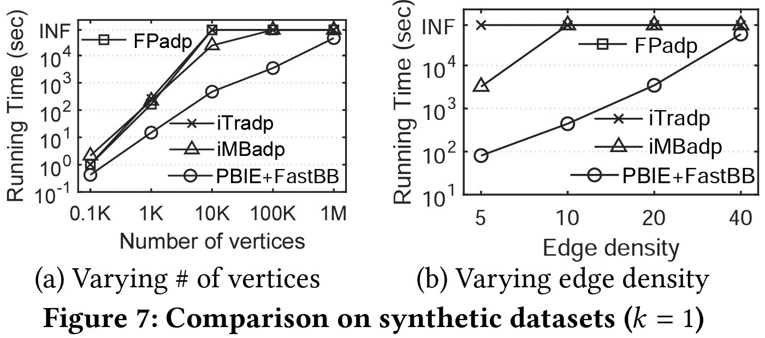
Experiments – Results on Synthetic Datasets
PBIE+FastBB is significantly faster than baseline methods for various setting of the number of vertices and edge density

Slide 20
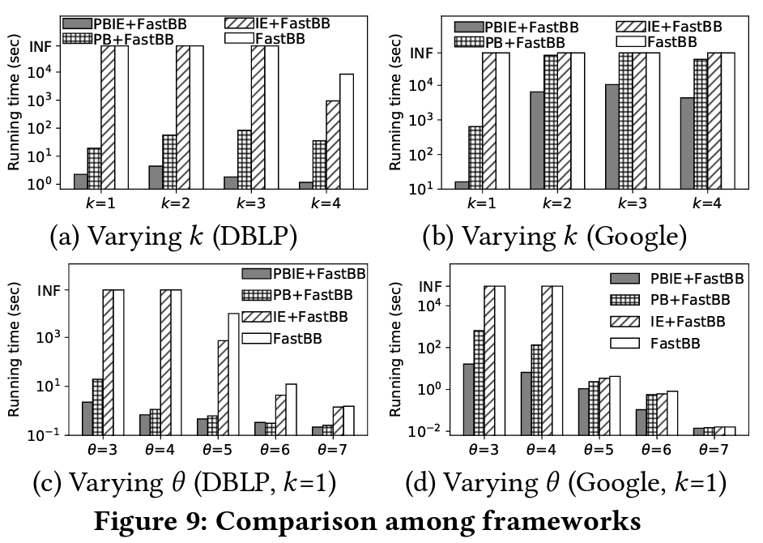
Experiments – Ablation Study on the PBIE Framework
Both PB and IE contribute in the PBIE framework

Slide 21
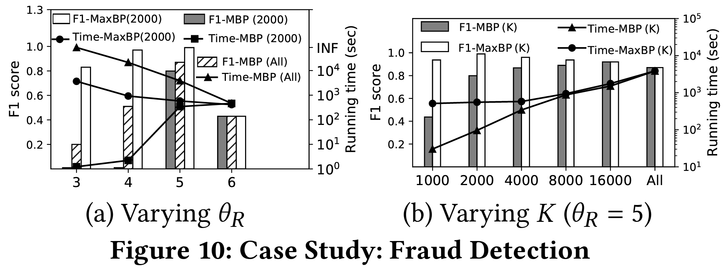
Experiments – Results of Case Study
F1: MaxBP (2000) > MBP (All) > MBP (2000) Running time: MBP (2000) < MaxBP (2000) < MBP (All)

