Slide 1




Efficient Algorithms for Maximal k-Biplex Enumeration
Kaiqiang Yu*, Cheng Long*, Shengxin Liu#, Da Yan⁺
*Nanyang Technological University
#Harbin Institute of Technology, Shenzhen
⁺University of Alabama at Birmingham

Slide 2

Outline
Maximal $k$-biplex Enumeration
Backgrounds
Motivations
Problem definition
Challenges
Existing work
Tree-based method: iMB
Our contributions
Basic version: bTraversal
A novel framework: iTraversal
Experimental results

Slide 3
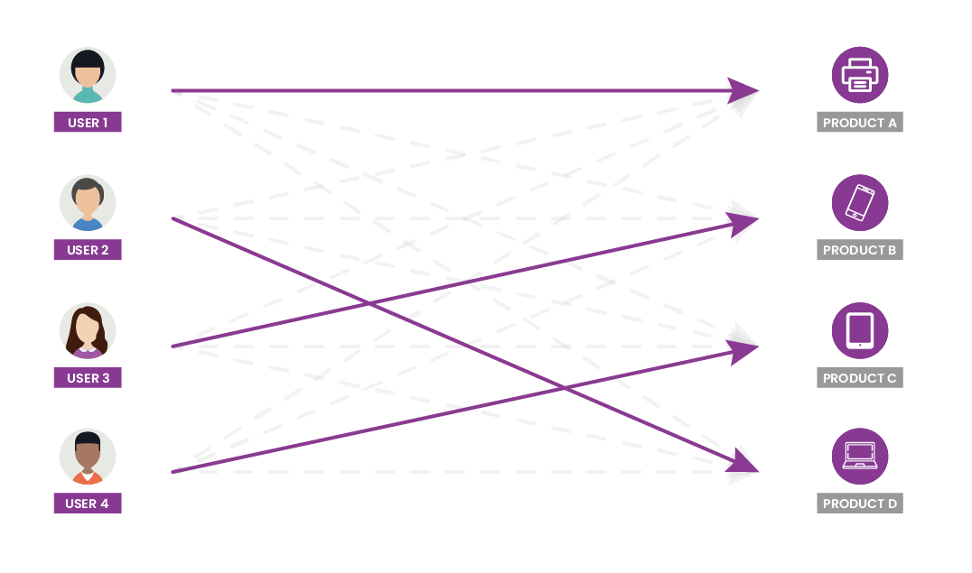
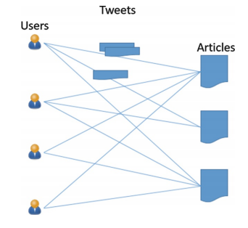
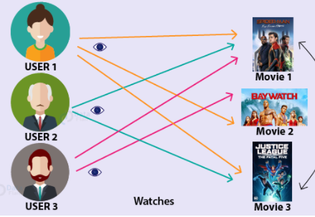

Cohesive bipartite subgraph mining
Bipartite graphs
Cohesive subgraph mining
A fundamental problem in graph data analysis
Given a bipartite graph, extract highly connected subgraphs
Real applications in fake news detection^{[1]} and online recommendation^{[2]}
Customer-product networks
User-page networks
Author-publication networks
User-article networks
[1] Siva Charan Reddy Gangireddy, et al. Unsupervised Fake News Detection: A Graph-based Approach. HT. 75–83, 2020.
[2] Stephan Günnemann, et al. Flexible Fault Tolerant Subspace Clustering for Data with Missing Values. ICDM, 231–240, 2011.

Slide 4
























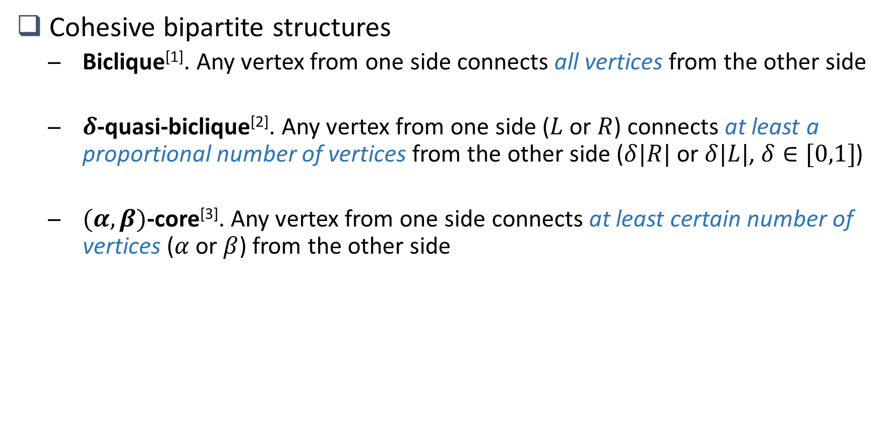
Cohesive Structures
Cohesive bipartite structures
Biclique^{[1]}. Any vertex from one side connects all vertices from the other side
$δ$-quasi-biclique^{[2]}. Any vertex from one side ($L$ or $R$) connects at least a proportional number of vertices from the other side ($δ|R|$ or $δ|L|$, $δ∈[0,1]$)
$(α,β)$-core^{[3]}. Any vertex from one side connects at least certain number of vertices ($α$ or $β$) from the other side
Relaxation
Figure 1. Biclique
Figure 2. 0.5-quasi-biclique
Figure 3. (3,2)-core
[1] Yun Zhang, et al. On finding bicliques in bipartite graphs: a novel algorithm and its application to the integration of diverse biological data types. BMC bioinformatics, 2014.
[2] Xiaowen Liu, et al. Quasi-bicliques: Complexity and Binding Pairs. COCOON, Vol. 5092. Springer, 255–264, 2008
[3] Boge Liu, et al. Efficient (𝛼, 𝛽)-core computation: An index-based approach. WWW. 1130–1141, 2019.

Slide 5
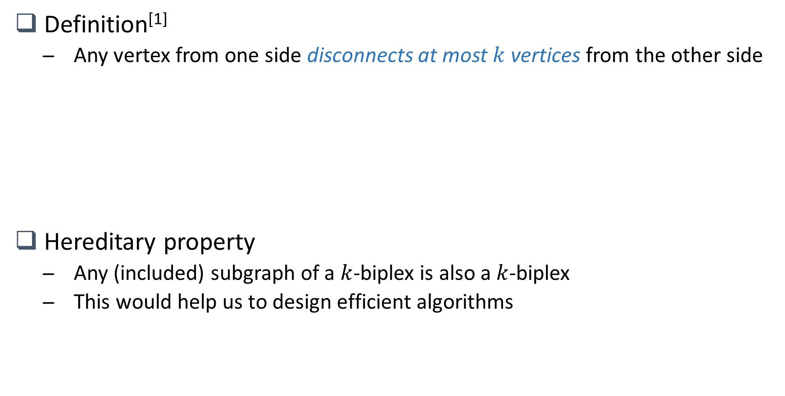
k-biplex
Definition^{[1]}
Any vertex from one side disconnects at most $k$ vertices from the other side
Hereditary property
Any (included) subgraph of a $k$-biplex is also a $k$-biplex
This would help us to design efficient algorithms
Relaxation
Figure 1. 0-biplex (biclique)
Figure 2. 2-biplex
[1] Kelvin Sim, et al. Mining maximal quasi-bicliques: Novel algorithm and applications in the stock market and protein networks. Statistical Analysis and Data Mining, 255–273, 2009.

Slide 6
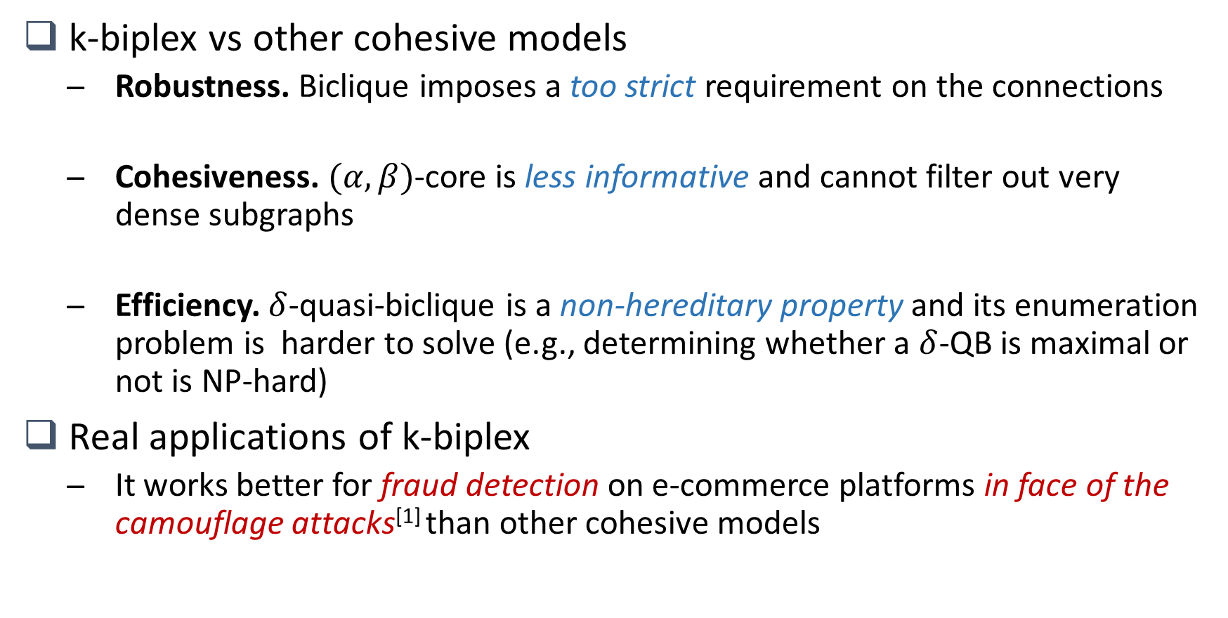
Motivations
k-biplex vs other cohesive models
Robustness. Biclique imposes a too strict requirement on the connections
Cohesiveness. $(α,β)$-core is less informative and cannot filter out very dense subgraphs
Efficiency. $δ$-quasi-biclique is a non-hereditary property and its enumeration problem is harder to solve (e.g., determining whether a $δ$-QB is maximal or not is NP-hard)
Real applications of k-biplex
It works better for fraud detection on e-commerce platforms in face of the camouflage attacks^{[1]} than other cohesive models
[1] Bryan Hooi, Hyun Ah Song, Alex Beutel, Neil Shah, Kijung Shin, and Christos Faloutsos. 2016. FRAUDAR: Bounding Graph Fraud in the Face of Camouflage. In Proc. ACM SIGKDD Int. Conf. Knowl. Discov. Data Mining. ACM, 895–904.

Slide 7


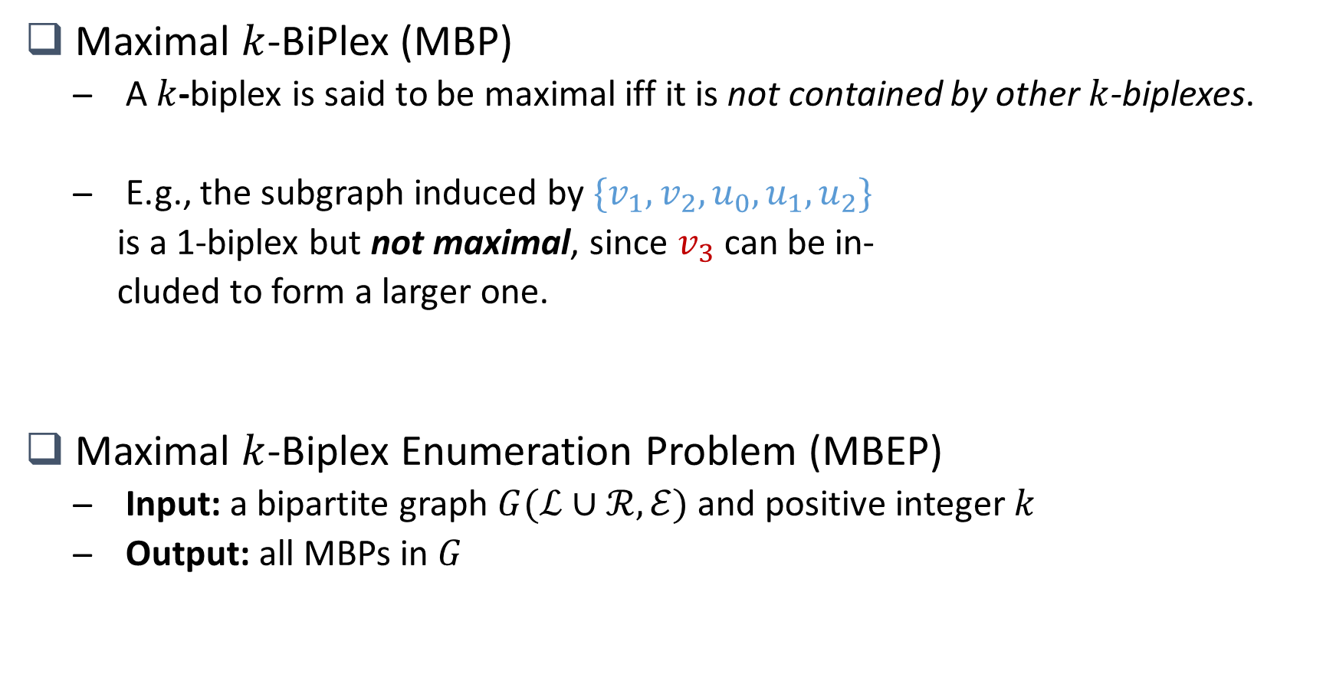






Problem Definition
Maximal $k$-BiPlex (MBP)
A $k$-biplex is said to be maximal iff it is not contained by other $k$-biplexes.
E.g., the subgraph induced by $\{v_{1},v_{2}, u_{0},u_{1},u_{2}\}$
is a 1-biplex but not maximal, since $v_{3}$ can be in-
cluded to form a larger one.
Maximal $k$-Biplex Enumeration Problem (MBEP)
Input: a bipartite graph $G(ℒ∪ℛ, ℰ)$ and positive integer $k$
Output: all MBPs in $G$
$$v_{0}$$
$$u_{0}$$
$$v_{1}$$
$$u_{1}$$
$$v_{2}$$
$$u_{2}$$
$$v_{3}$$
$$u_{3}$$
Figure 1. Maximal 1-biplex

Slide 8
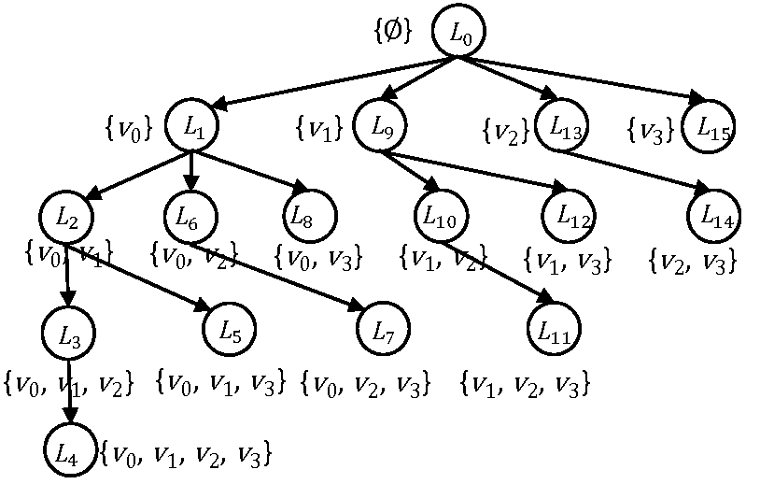













Existing work: iMB (Tree-based algorithm)^{[1]}
Main idea (a variant of BK^{[2]} for bipartite graphs)
Alternative enumeration scheme (enumerate over one side first then refine and enumerate the other side) + Some pruning rules for size constraints
Drawbacks
Inefficiency. Most of its pruning rules are designed based on size constraints
High delay. The time between two consecutive outputs (delay) could be exponential (w.r.t. the number of vertices in $G$)
Refined $ℛ=\{u_{0},u_{1},u_{2},u_{3}\}$
$$v_{0}$$
$$u_{0}$$
$$v_{1}$$
$$u_{1}$$
$$v_{2}$$
$$u_{2}$$
$$v_{3}$$
$$u_{3}$$
Figure 1. Input bipartite graph
Figure 2. Prefix tree over $ℒ$ for k=1
Figure 3. Prefix tree over refined $ℛ$
[1] Kaiqiang Yu, Cheng Long, P Deepak, and Tanmoy Chakraborty. 2021. On Efficient Large Maximal Biplex Discovery. IEEE Trans. Knowl. Data Eng. (2021)
[2] Coen Bron and Joep Kerbosch. 1973. Algorithm 457: finding all cliques of an undirected graph. Commun. ACM 16, 9 (1973), 575–577.

Slide 9


























Basic version: bTraversal
Motivation
Adopt a general reverse search based framework^{[1]} for listing maximal subgraphs satisfying hereditary property in polynomial delay
Main procedure
Step A. Find a random initial solution (MBP)
Step B. Find some new solutions from the current one by ThreeStep
(1) Almost-satisfying subgraph formation
(2) Local solution enumeration
(3) Local solution extension
Step C. Repeat the Step B from each new solution until all solutions are found
Initial solution
New solution
$$u_{0}$$
$$v_{0}$$
$$u_{0}$$
$$v_{0}$$
$$u_{0}$$
$$v_{0}$$
$$u_{0}$$
$$v_{0}$$
$$v_{1}$$
$$v_{2}$$
$$v_{3}$$
$$v_{4}$$
$$u_{1}$$
$$v_{0}$$
$$u_{1}$$
$$u_{4}$$
$$u_{1}$$
$$v_{1}$$
$$v_{1}$$
$$u_{1}$$
$$u_{2}$$
(1)
$$u_{2}$$
(2)
$$u_{2}$$
(3)
$$u_{2}$$
$$u_{2}$$
$$u_{3}$$
$$v_{4}$$
$$u_{3}$$
$$v_{4}$$
$$u_{3}$$
$$v_{4}$$
$$u_{3}$$
$$u_{0}$$
$$u_{1}$$
$$u_{3}$$
$$u_{4}$$
$$v_{4}$$
$$u_{4}$$
$$u_{4}$$
$$H_{loc}$$
Figure 1. Input bipartite graph
$$H_{0}$$
Three-step procedure
$$H_{1}$$
Figure 2. ThreeStep procedure

Slide 10
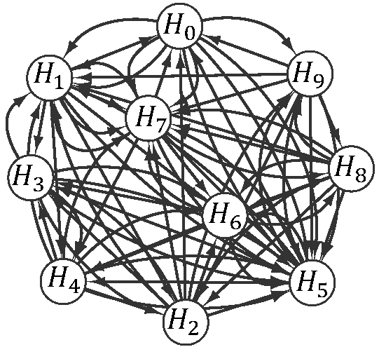
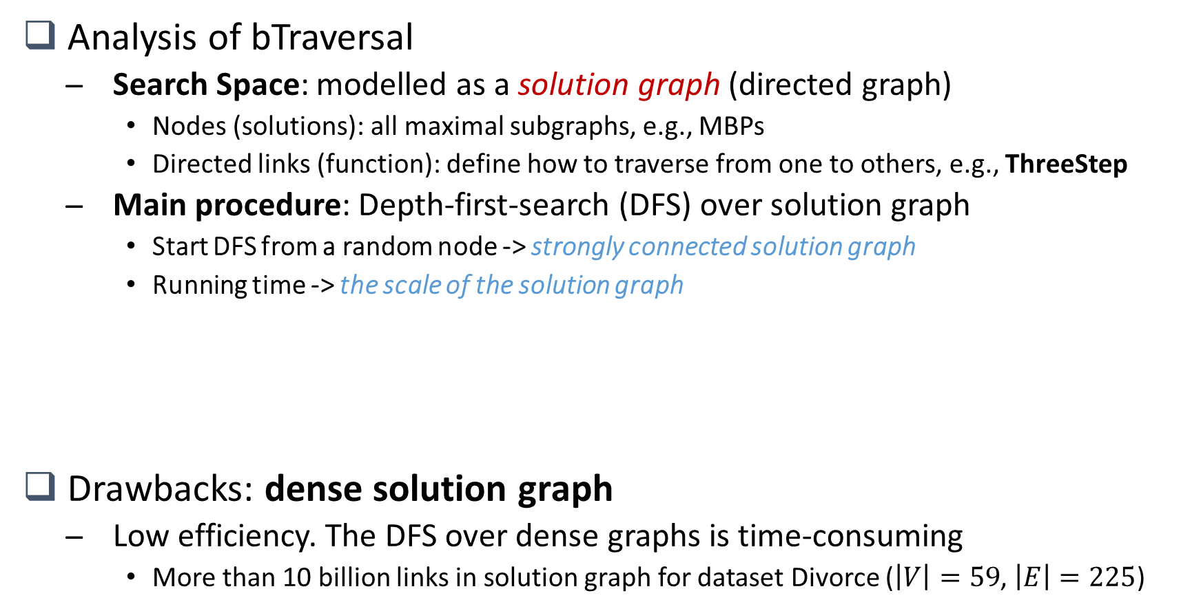
Basic version: bTraversal
Analysis of bTraversal
Search Space: modelled as a solution graph (directed graph)
Nodes (solutions): all maximal subgraphs, e.g., MBPs
Directed links (function): define how to traverse from one to others, e.g., ThreeStep
Main procedure: Depth-first-search (DFS) over solution graph
Start DFS from a random node -> strongly connected solution graph
Running time -> the scale of the solution graph
Drawbacks: dense solution graph
Low efficiency. The DFS over dense graphs is time-consuming
More than 10 billion links in solution graph for dataset Divorce ($\left|V\right|=59$, $\left|E\right|=225$)
Initial solution
New solution
$$u_{0}$$
$$v_{0}$$
$$u_{0}$$
$$v_{0}$$
$$u_{0}$$
$$v_{0}$$
$$u_{0}$$
$$v_{0}$$
$$v_{1}$$
$$v_{2}$$
$$v_{3}$$
$$v_{4}$$
$$u_{1}$$
$$v_{0}$$
$$u_{1}$$
$$u_{4}$$
$$u_{1}$$
$$v_{1}$$
$$v_{1}$$
$$u_{1}$$
$$u_{2}$$
(1)
$$u_{2}$$
(2)
$$u_{2}$$
(3)
$$u_{2}$$
$$u_{2}$$
$$u_{3}$$
$$v_{4}$$
$$u_{3}$$
$$v_{4}$$
$$u_{3}$$
$$v_{4}$$
$$u_{3}$$
$$u_{0}$$
$$u_{1}$$
$$u_{3}$$
$$u_{4}$$
$$v_{4}$$
$$u_{4}$$
$$u_{4}$$
$$H_{loc}$$
Figure 1. Input bipartite graph
$$H_{0}$$
Three-step procedure
$$H_{1}$$
Figure 2. ThreeStep procedure
Figure 3. Solution graph

Slide 11
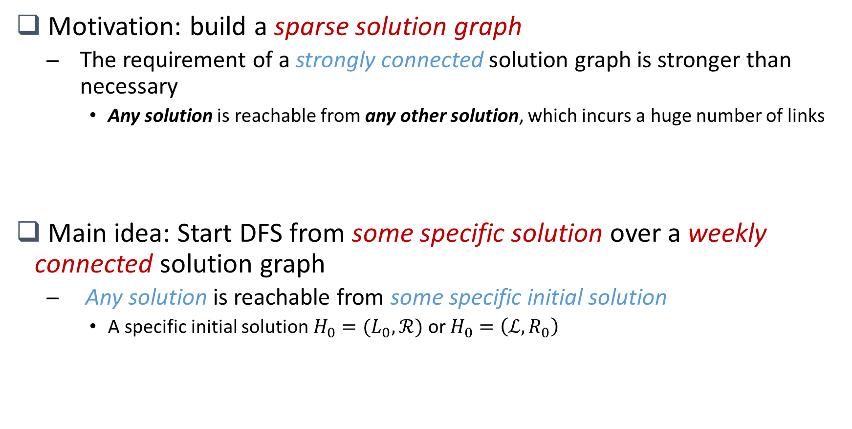
iTraversal: a novel framework
Motivation: build a sparse solution graph
The requirement of a strongly connected solution graph is stronger than necessary
Any solution is reachable from any other solution, which incurs a huge number of links
Main idea: Start DFS from some specific solution over a weekly connected solution graph
Any solution is reachable from some specific initial solution
A specific initial solution $H_{0}=(L_{0},ℛ)$ or $H_{0}=\left(ℒ,R_{0}\right)$

Slide 12

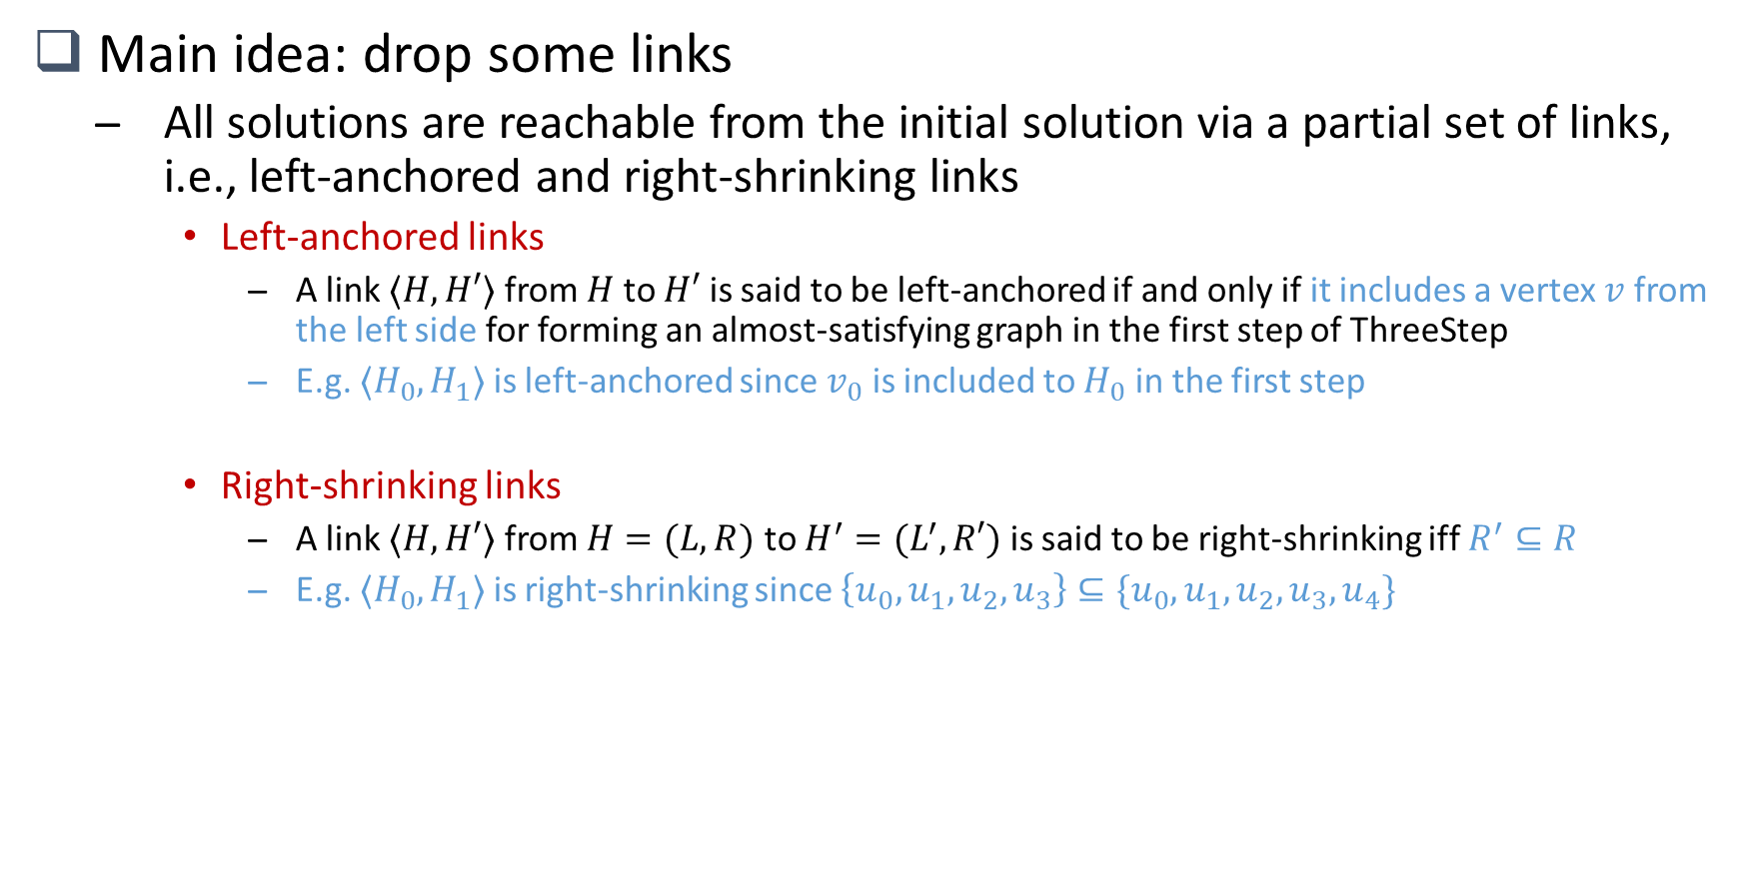






iTraversal: traversal strategies
Main idea: drop some links
All solutions are reachable from the initial solution via a partial set of links, i.e., left-anchored and right-shrinking links
Left-anchored links
A link $⟨H,H′⟩$ from $H$ to $H′$ is said to be left-anchored if and only if it includes a vertex $v$ from the left side for forming an almost-satisfying graph in the first step of ThreeStep
E.g. $⟨H_{0},H_{1}⟩$ is left-anchored since $v_{0}$ is included to $H_{0}$ in the first step
Right-shrinking links
A link $⟨H,H′⟩$ from $H=(L,R)$ to $H^{′}=(L^{′},R′)$ is said to be right-shrinking iff $R^{′}⊆R$
E.g. $⟨H_{0},H_{1}⟩$ is right-shrinking since $\left\{u_{0},u_{1},u_{2},u_{3}\right\}⊆\{u_{0},u_{1},u_{2},u_{3},u_{4}\}$
$$u_{0}$$
$$v_{0}$$
$$u_{0}$$
$$v_{0}$$
$$u_{0}$$
$$v_{0}$$
$$u_{0}$$
$$v_{0}$$
$$v_{1}$$
$$v_{2}$$
$$v_{3}$$
$$v_{4}$$
$$u_{1}$$
$$v_{0}$$
$$u_{1}$$
$$u_{4}$$
$$u_{1}$$
$$v_{1}$$
$$v_{1}$$
$$u_{1}$$
$$u_{2}$$
(1)
$$u_{2}$$
(2)
$$u_{2}$$
(3)
$$u_{2}$$
$$u_{2}$$
$$u_{3}$$
$$v_{4}$$
$$u_{3}$$
$$v_{4}$$
$$u_{3}$$
$$v_{4}$$
$$u_{3}$$
$$u_{0}$$
$$u_{1}$$
$$u_{3}$$
$$u_{4}$$
$$v_{4}$$
$$u_{4}$$
$$u_{4}$$
$$H_{loc}$$
Figure 1. Input bipartite graph
$$H_{0}$$
Three-step procedure
$$H_{1}$$
Figure 2. ThreeStep procedure

Slide 13
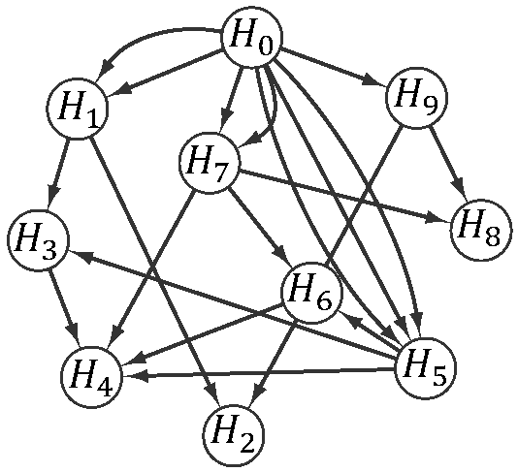
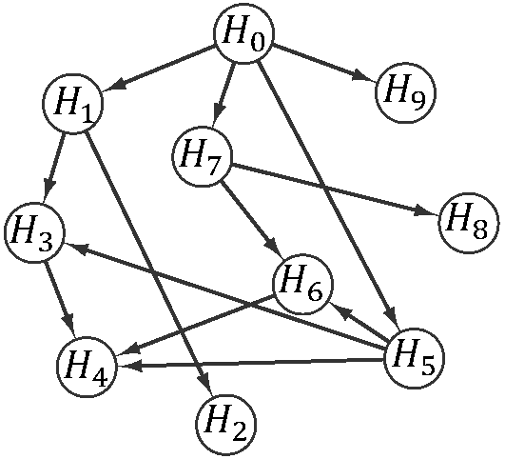
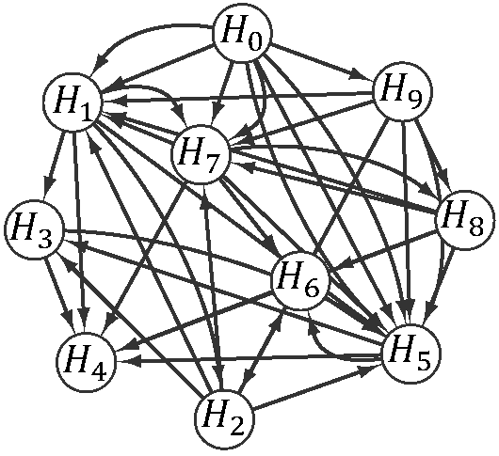
iTraversal: traversal strategies
Solution graph built by proposed traversal strategies
In our experiments, the number of links in the refined solution graph is about 0.1% of that in the original solution graph
Drop non-right-shrinking links
Figure 1. bTraversal
Figure 3. Right-shrinking traversal
Drop non-left-anchored links
Drop excluded links
Figure 4. Exclusion strategy
Figure 2. Left-anchored traversal

Slide 14
iTraversal: improvements and adaptations
Speedup the ThreeStep procedure
An efficient subprocedure EnumAlmostSat (Step 2 of ThreeStep)
Aims: Finds local solutions from the almost-satisfying graph
Main idea: Instead of enumerating all local solutions from the scratch, enumerate the set of vertices to be removed only
Adapt iTraversal to list large MBPs
Consider the property of right-shrinking links
Drop those solutions with size of right side smaller than the threshold directly
Other pruning rules to filter out smaller MBPs

Slide 15
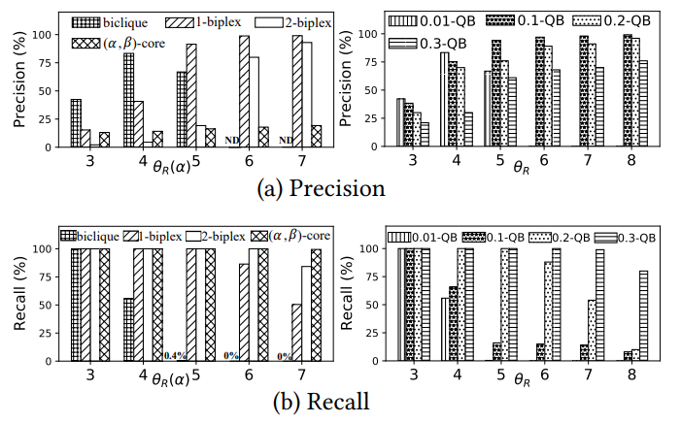
Experimental results: Case study
Fault detection
Datasets: Software (Amazon Review Data^{[1]}) with 400K reviews, 20K products and 300K users.
Camouflage attack: inject a fault block with 2K users, 2K products and 200K reviews.
Aims: Detect fake users and fake products from Software
$k$-biplex performs better than other cohesive models

Slide 16
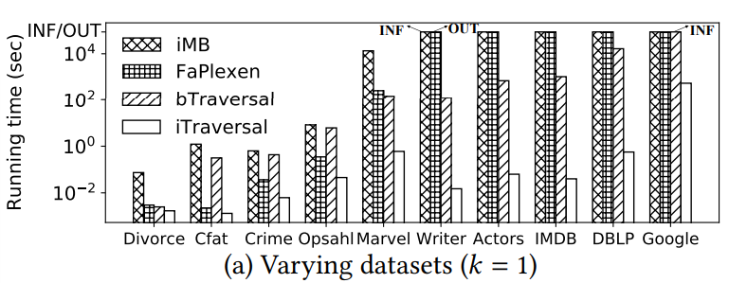
Experimental results: Efficiency
Efficiency of iTraversal
iTraversal is up to four orders of magnitude faster than baselines

Slide 17
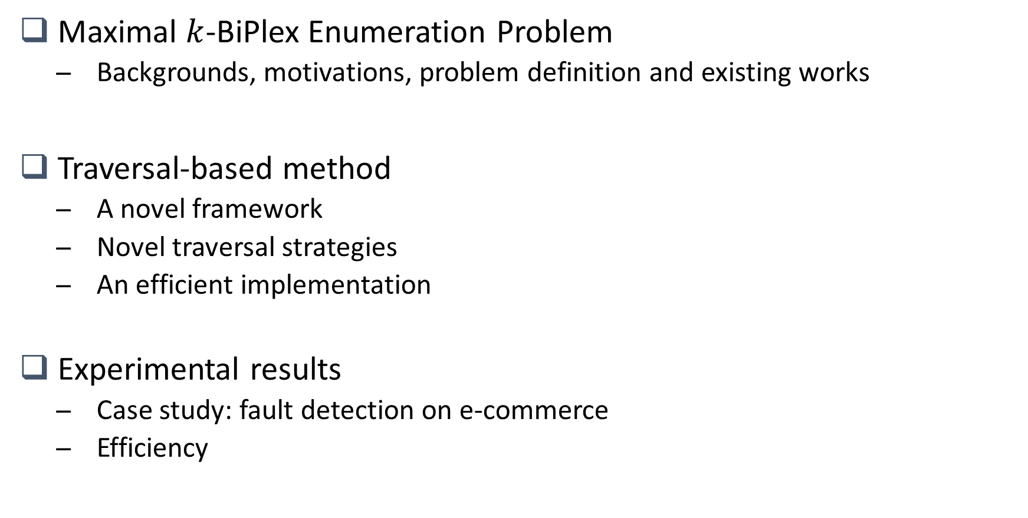
Conclusion
Maximal $k$-BiPlex Enumeration Problem
Backgrounds, motivations, problem definition and existing works
Traversal-based method
A novel framework
Novel traversal strategies
An efficient implementation
Experimental results
Case study: fault detection on e-commerce
Efficiency

Slide 18
Thanks!

