Slide 1

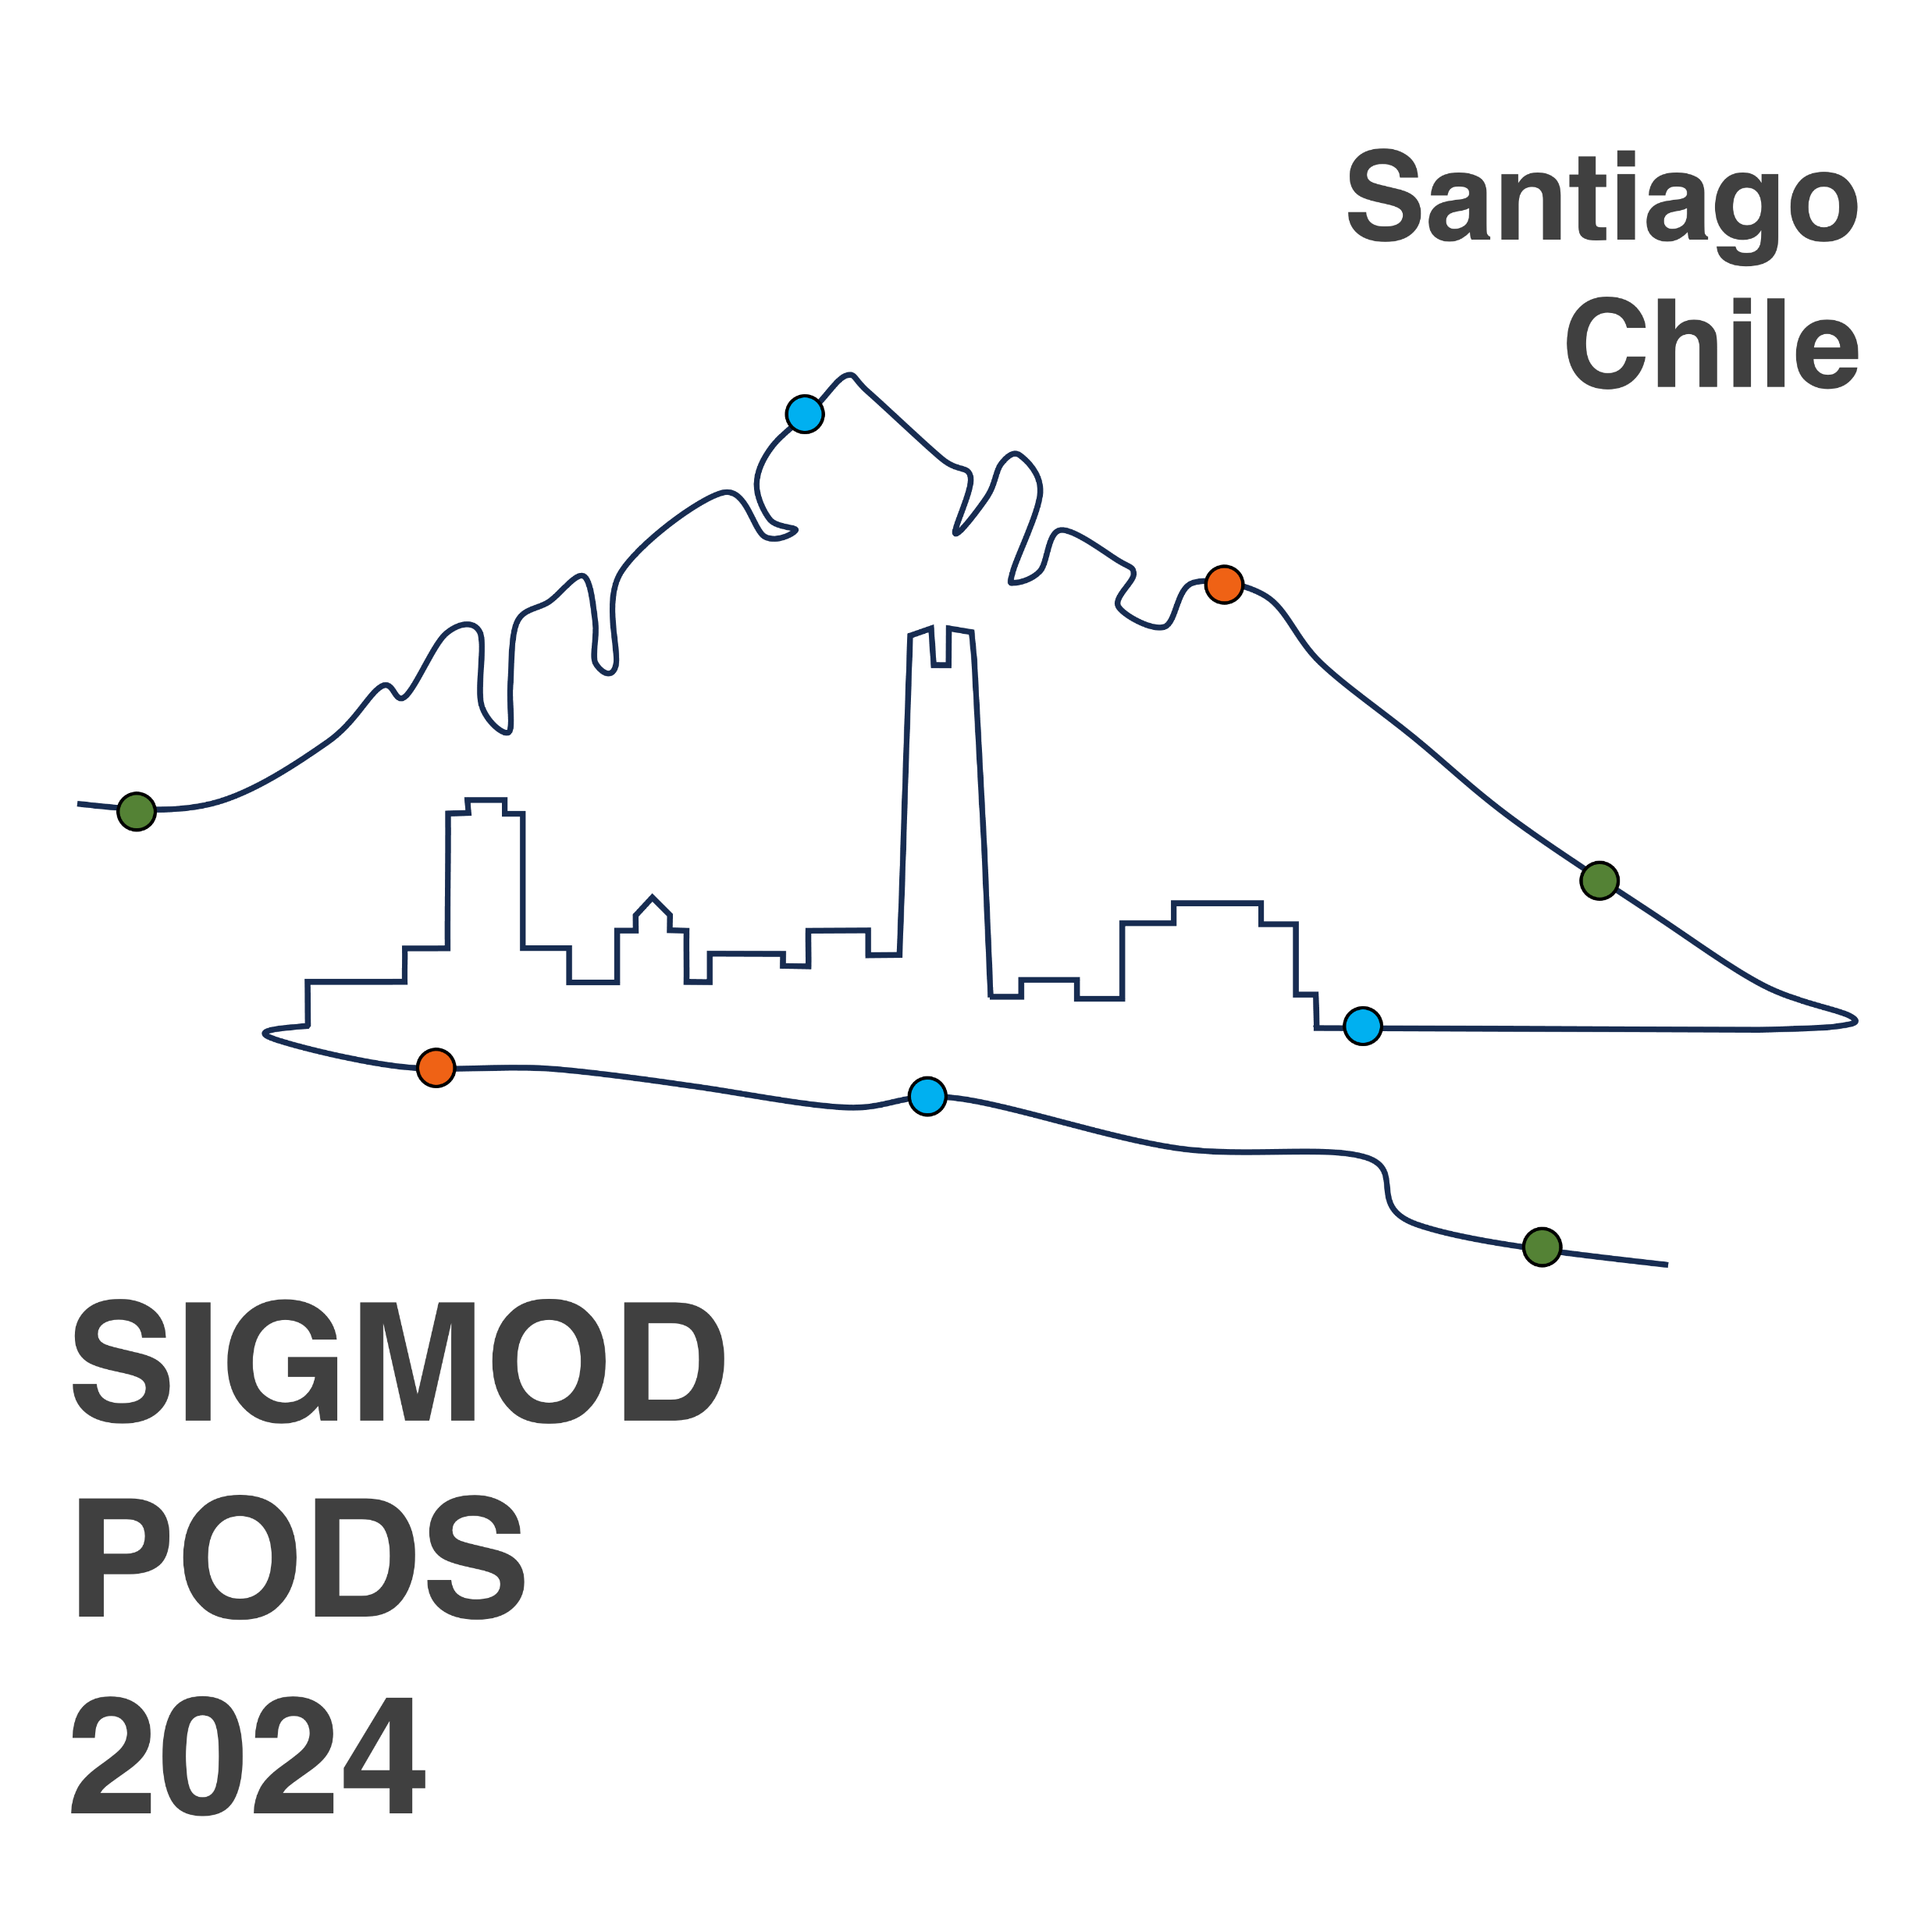

Fast Maximal Quasi-clique Enumeration: A Pruning and Branching Co-Design Approach
Kaiqiang Yu, Cheng Long
Nanyang Technological University

Slide 2

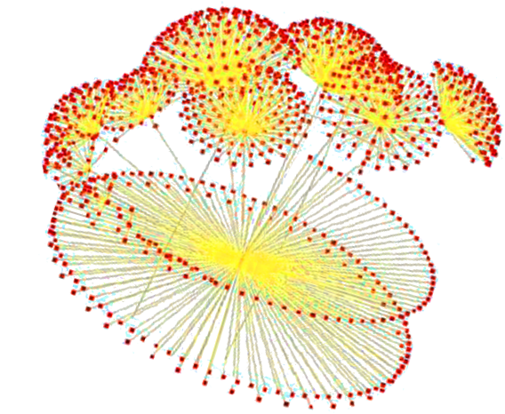
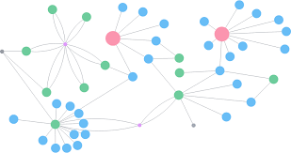
Graphs
Capture relations or interactions between entities
Widely exist in various domains such as social networking, biological networks, etc.
Social networks
Biological networks
Web networks

Slide 3
Cohesive Subgraph Mining
Given a graph, find densely connected subgraphs
Applications:
Community search [Yixiang et al., 2020]
Biological network analysis [Bhattacharyya et al., 2009]
Anomaly detection [Tanner et al., 2010]
Yixiang, et al. A survey of community search over big graphs.VLDBJ. 2020
Bhattacharyya et al. Mining the largest quasi-clique in human protein interactome. In International conference on adaptive and intelligent systems. 2009.
Tanner et al. Koobface: The evolution of the social botnet. In eCrime Researchers Summit. 2010.

Slide 4
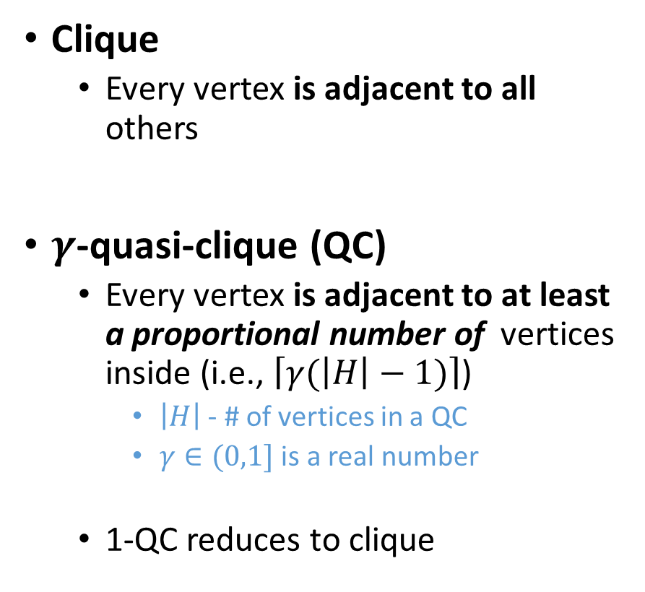
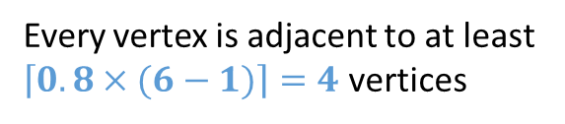
Definitions: Clique vs. Quasi-Clique
Clique
Every vertex is adjacent to all others
$γ$-quasi-clique (QC)
Every vertex is adjacent to at least a proportional number of vertices inside (i.e., $\left\lceil γ(\left|H\right|−1)\right\rceil$)
$\left|H\right|$ - # of vertices in a QC
$γ∈(0,1]$ is a real number
1-QC reduces to clique
Clique
0.8-quasi-clique
Every vertex is adjacent to at least $\left\lceil 0.8×(6−1)\right\rceil =4$ vertices

Slide 5
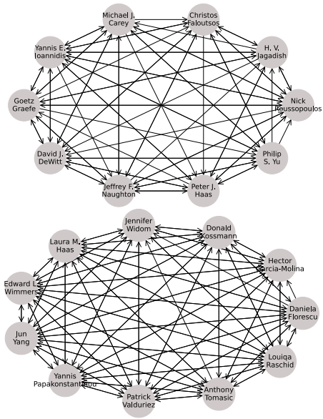
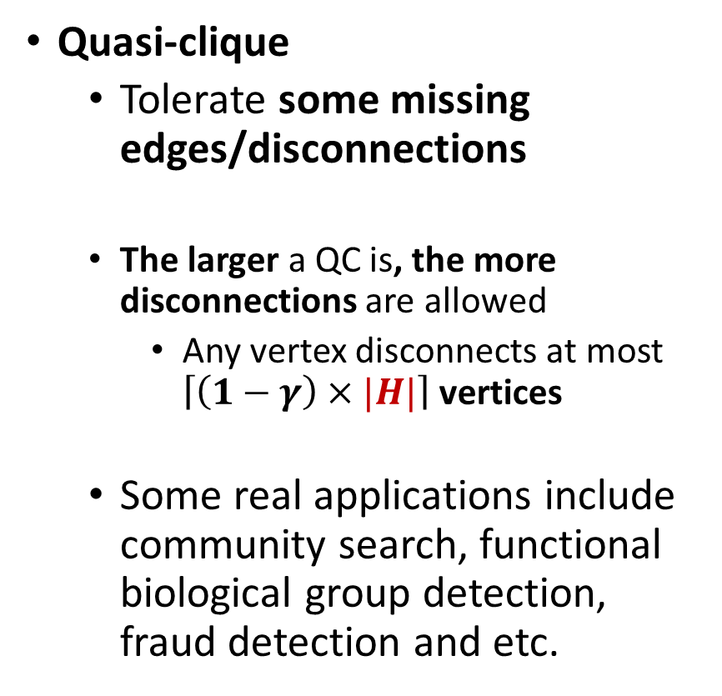
Definitions : Clique vs. Quasi-Clique
Quasi-clique
Tolerate some missing edges/disconnections
The larger a QC is, the more disconnections are allowed
Any vertex disconnects at most $\left\lceil \left(1−γ\right)×|H|\right\rceil$ vertices
Some real applications include community search, functional biological group detection, fraud detection and etc.
0.75-QCs on the citation network reveal research groups [Guo et al. 2022]
Guo et al. Maximal directed quasi-clique mining. ICDE 2022

Slide 6

MQC Enumeration: Problem
Maximal Quasi-Clique Enumeration^{[1-7]}
Input: a graph $G(V, E)$, a fraction $γ$ and a positive integer $θ$
Output: all maximal quasi-cliques (MQCs) with the number of vertices at least $θ$
[1] Khalil et al. Parallel mining of large maximal quasi-cliques. VLDBJ 2022.
[2] Guo et al. Scalable mining of maximal quasi-cliques: an algorithm-system codesign approach. PVLDB 2020
[3] Sanei-Mehri et al. Enumerating top-k quasi-cliques. BigData 2018.
[4] Jiang et al. Mining frequent cross-graph quasi-cliques. TKDD 2009.
[5] Liu et al. Effective pruning techniques for mining quasi-cliques. EMLKDD 2008.
[6] Zeng, et al. Coherent closed quasi-clique discovery from large dense graph databases. KDD 2006
[7] Pei et al. On mining cross-graph quasi-cliques. KDD 2005.

Slide 7
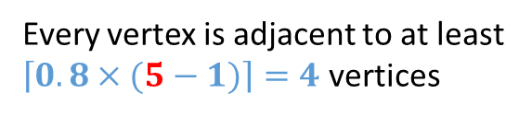
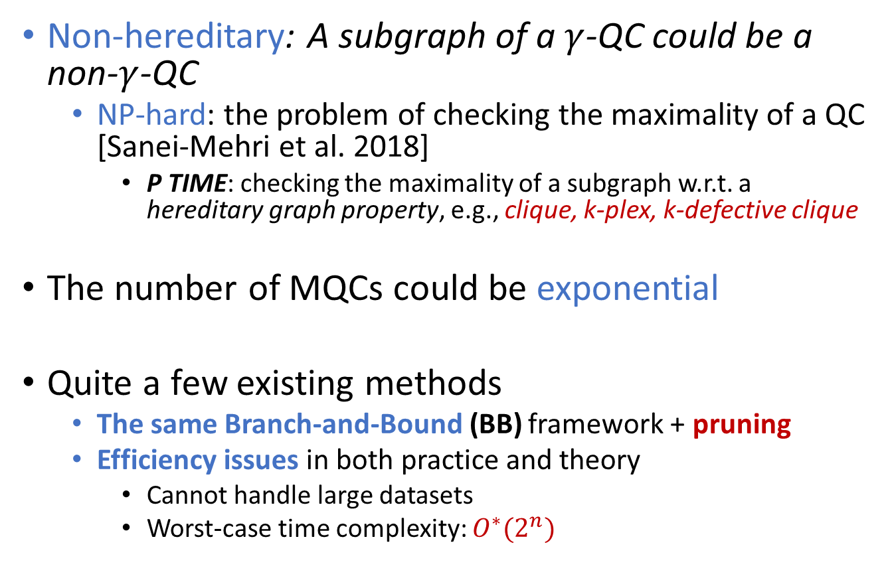
MQC Enumeration: Challenges
Non-hereditary: A subgraph of a $γ$-QC could be a non-$γ$-QC
NP-hard: the problem of checking the maximality of a QC [Sanei-Mehri et al. 2018]
P TIME: checking the maximality of a subgraph w.r.t. a hereditary graph property, e.g., clique, k-plex, k-defective clique
The number of MQCs could be exponential
Quite a few existing methods
The same Branch-and-Bound (BB) framework + pruning
Efficiency issues in both practice and theory
Cannot handle large datasets
Worst-case time complexity: $O^{∗}(2^{n})$
0.8-quasi-clique
non-0.8-quasi-clique
Every vertex is adjacent to at least $\left\lceil 0.8×(5−1)\right\rceil =4$ vertices
Sanei-Mehri et al. Enumerating top-k quasi-cliques. BigData 2018.

Slide 8
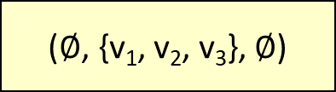
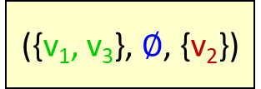
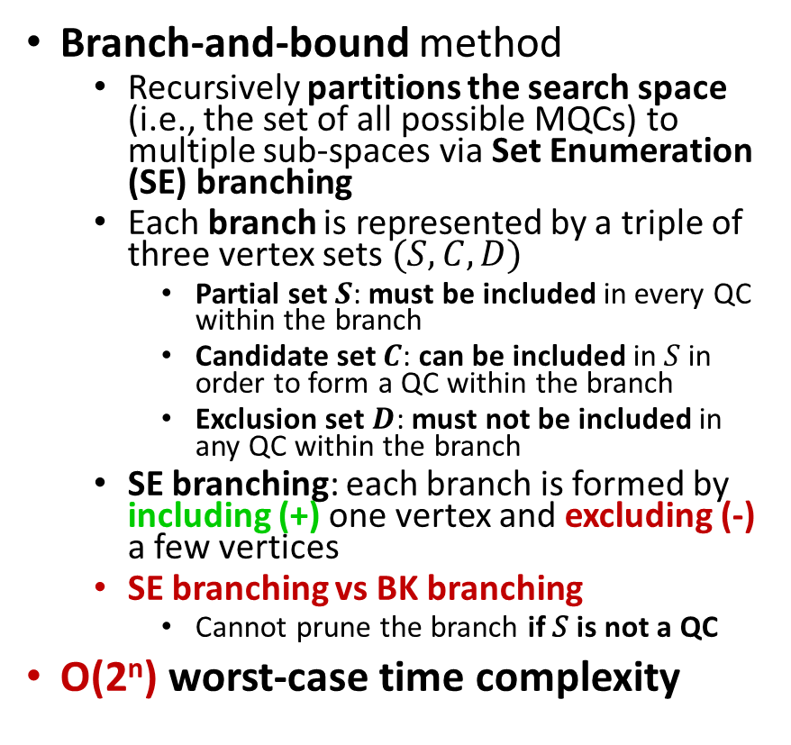
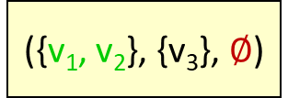
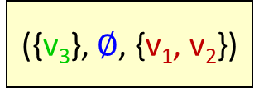
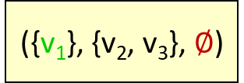
MQC Enumeration: SOTA – Quick+ [Khalil et al. 2022]
Branch-and-bound method
Recursively partitions the search space (i.e., the set of all possible MQCs) to multiple sub-spaces via Set Enumeration (SE) branching
Each branch is represented by a triple of three vertex sets $(S,C,D)$
Partial set $S$: must be included in every QC within the branch
Candidate set $C$: can be included in 𝑆 in order to form a QC within the branch
Exclusion set $D$: must not be included in any QC within the branch
SE branching: each branch is formed by including (+) one vertex and excluding (-) a few vertices
SE branching vs BK branching
Cannot prune the branch if 𝑆 is not a QC
O(2^{n}) worst-case time complexity
Example: V = {v₁, v₂, v₃}
($∅$, {v₁, v₂, v₃}, $∅$)
({v₁}, {v₂, v₃}, $∅$)
+ v₁
+ v₂
- v₁
+ v₃
- v₁, v₂
({v₂}, {v₃}, {v₁})
({v₃}, $∅$, {v₁, v₂})
+ v₂
+ v₃
- v₂
…
This branch can terminate
({v₁, v₂}, {v₃}, $∅$)
({v₁, v₃}, $∅$, {v₂})
…
This branch can terminate
Khalil et al. Parallel mining of large maximal quasi-cliques. VLDBJ 2022.

Slide 9



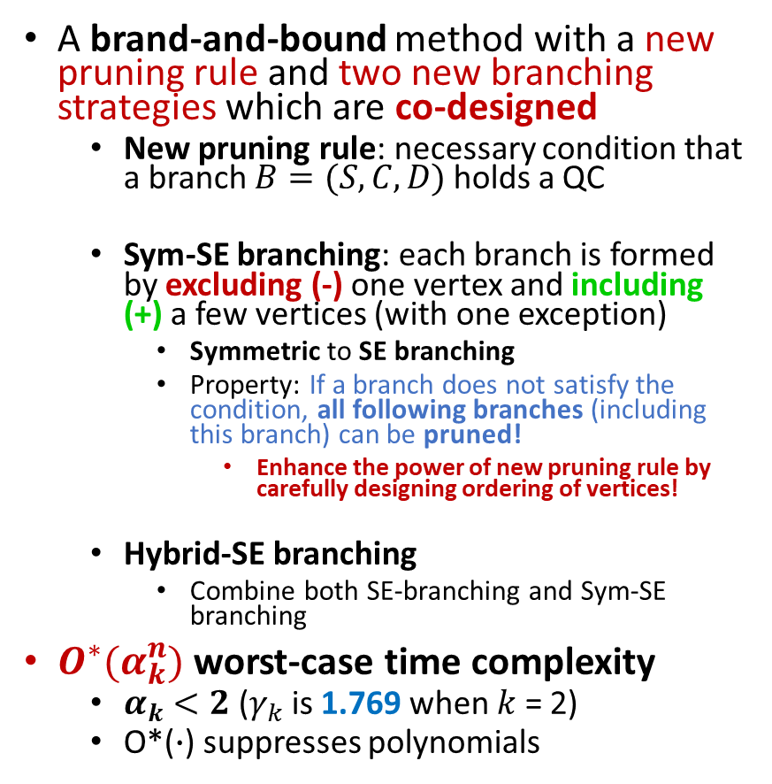


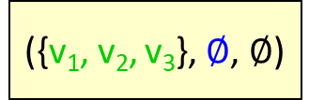
MQC Enumeration: Our solution - FastQC
A brand-and-bound method with a new pruning rule and two new branching strategies which are co-designed
New pruning rule: necessary condition that a branch $B=(S,C,D)$ holds a QC
Sym-SE branching: each branch is formed by excluding (-) one vertex and including (+) a few vertices (with one exception)
Symmetric to SE branching
Property: If a branch does not satisfy the condition, all following branches (including this branch) can be pruned!
Enhance the power of new pruning rule by carefully designing ordering of vertices!
Hybrid-SE branching
Combine both SE-branching and Sym-SE branching
$O^{∗}(α_{k}^{n})$ worst-case time complexity
$α_{k}<2$($γ_{k}$ is 1.769 when $k$ = 2)
O*($∙$) suppresses polynomials
Example: V = {v₁, v₂, v₃}
($∅$, {v₁, v₂, v₃}, $∅$)
This branch can terminate
({v₁, v₂, v₃}, $∅$, $∅$)
($∅$, {v₂, v₃}, {v₁})
+ v₁, v₂, v₃
- v₁
+ v₁
- v₂
+ v₁, v₂
- v₃
({v₁}, {v₃}, {v₂})
({v₁, v₂}, $∅$, {v₃})
- v₂
+ v₂
- v₃
+ v₂, v₃
($∅$, {v₃},{v₁, v₂})
({v₂}, $∅$, {v₁, v₃})
({v₂, v₃}, $∅$, {v₁})
…
This branch can terminate
This branch can terminate

Slide 10
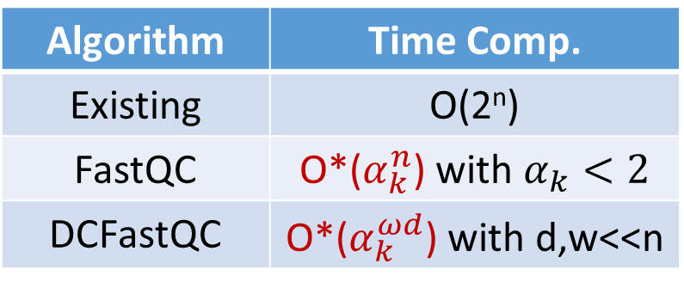
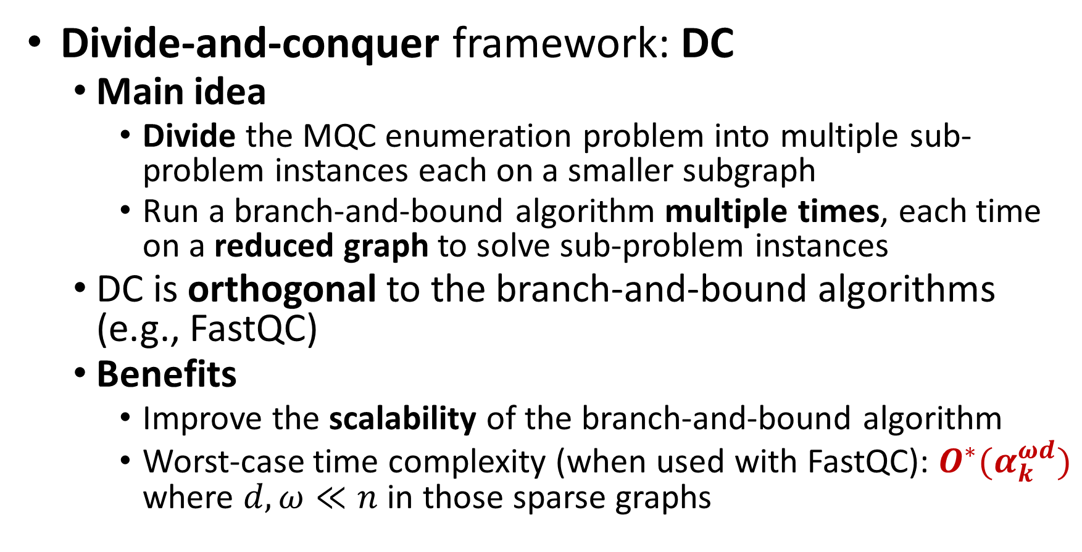
More Techniques for Boosting Scalability
Algorithm | Time Comp.
Existing | O(2^{n})
FastQC | O*($α_{k}^{n}$) with $α_{k}<2$
DCFastQC | O*($α_{k}^{ωd}$) with d,w<<n
Divide-and-conquer framework: DC
Main idea
Divide the MQC enumeration problem into multiple sub-problem instances each on a smaller subgraph
Run a branch-and-bound algorithm multiple times, each time on a reduced graph to solve sub-problem instances
DC is orthogonal to the branch-and-bound algorithms (e.g., FastQC)
Benefits
Improve the scalability of the branch-and-bound algorithm
Worst-case time complexity (when used with FastQC): $O^{∗}(α_{k}^{ωd})$ where $d,ω≪n$ in those sparse graphs

Slide 11
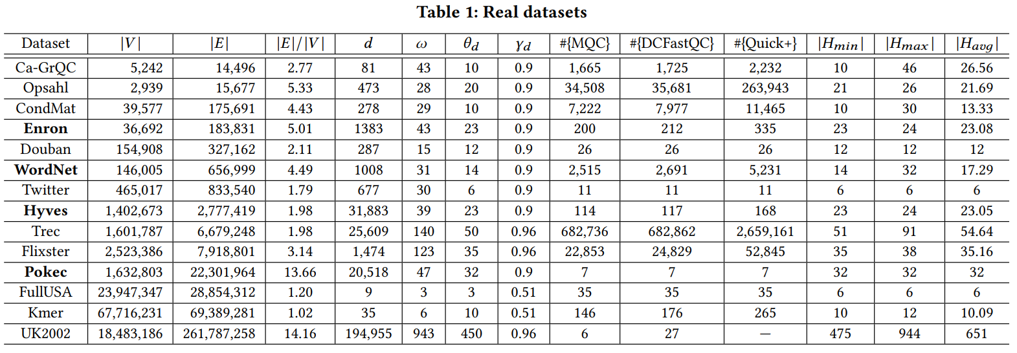
Experiments – Set Up (1)
Datasets
Real datasets

Slide 12
Experiments – Set Up (2)
Algorithms:
Our Algorithm: DCFastQC
Baselines: Quick+ [Khalil et al. 2022]
The state-of-the-art algorithm
Metrics:
Running time
Khalil et al. Parallel mining of large maximal quasi-cliques. VLDBJ 2022

Slide 13
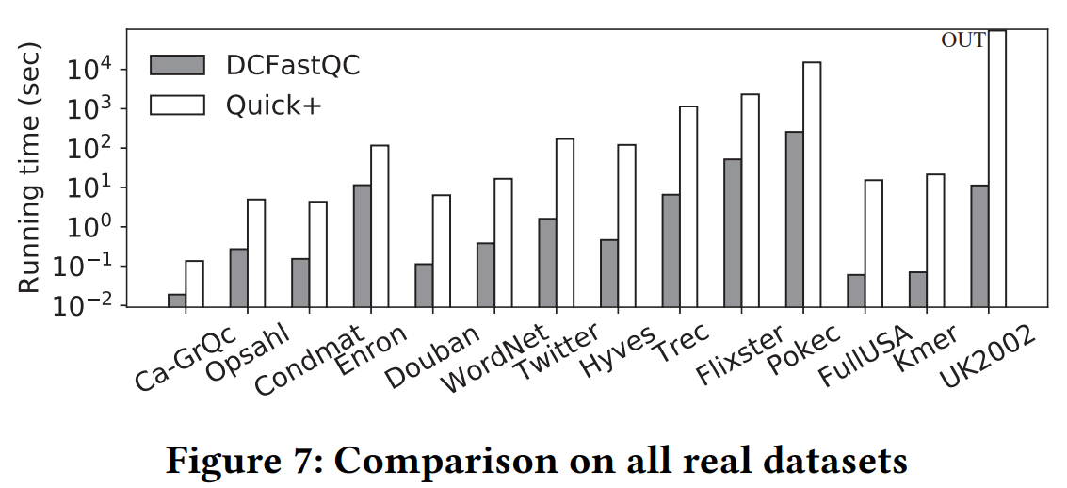

Experiments – Results on All Real Datasets
DCFastQC is up to 3 orders of magnitude faster than the state-of-the-art Quick+
DCFastQC can finish on all real datasets tested (with several millions of vertices and edges)
${10}^{3}$ times speedup

Slide 14
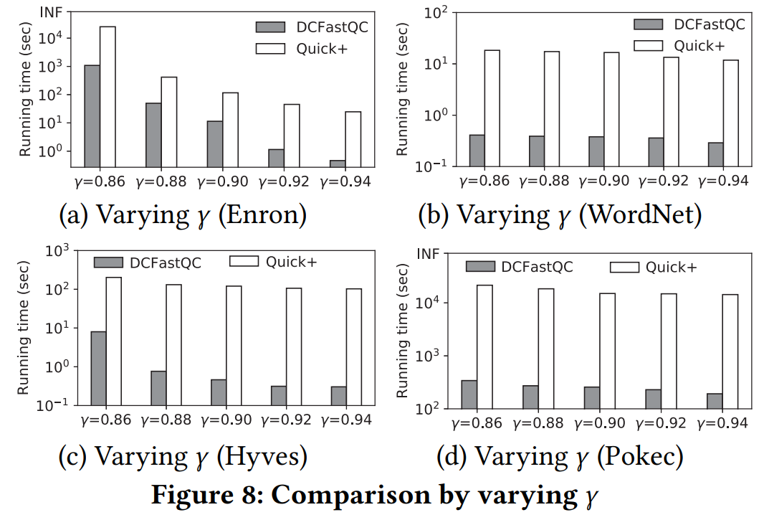
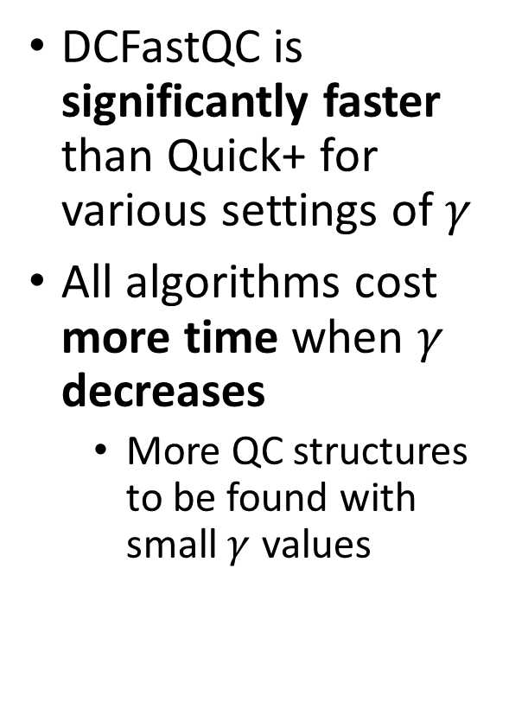
Experiments – Results of Varying $γ$
DCFastQC is significantly faster than Quick+ for various settings of $γ$
All algorithms cost more time when $γ$ decreases
More QC structures to be found with small $γ$ values

Slide 15
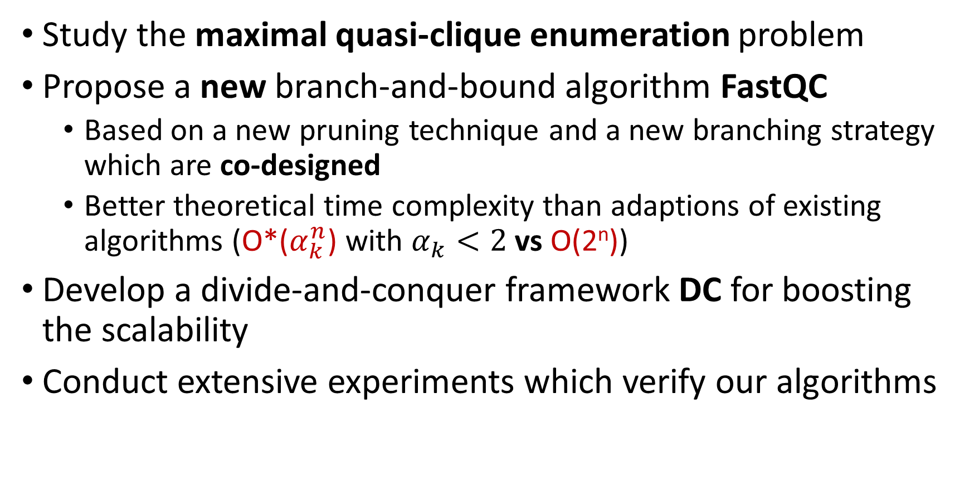
Conclusion
Study the maximal quasi-clique enumeration problem
Propose a new branch-and-bound algorithm FastQC
Based on a new pruning technique and a new branching strategy which are co-designed
Better theoretical time complexity than adaptions of existing algorithms (O*($α_{k}^{n}$) with $α_{k}<2$ vs O(2^{n}))
Develop a divide-and-conquer framework DC for boosting the scalability
Conduct extensive experiments which verify our algorithms

Slide 16
Thanks!

