Slide 1
MACHINE LEARNING • PROJECT REVIEW 1
Product Demand Forecasting
Using Ridge and Lasso Regression
Batch 29
Name: KAIRAV VASHI
Roll No.: 2520030582
Section: 8
Guide: Mr. Asif Shaik
(Assistant Professor, Department of CSE)
A.Y. 2026-27

Slide 2

Problem Statement
Predict a product's order demand on a given day using historical demand data, warehouse, product category, promotions, holidays, and petrol price — so retailers can plan inventory and procurement more accurately.
Project Scope
Type: Supervised Regression
Target: Order_Demand (continuous)
Models: Ridge Regression, Lasso Regression
Evaluation: RMSE, MAE, MAPE, R²
Outcome: A model + coefficient analysis retailers can use for inventory planning
Why Ridge & Lasso?
One-hot encoding Warehouse and Product_Category (30+ categories) creates many correlated features — a classic multicollinearity scenario.
Plain linear regression overfits under these conditions; L2 (Ridge) and L1 (Lasso) regularization directly address this.
Lasso additionally performs automatic feature selection — useful with 30+ engineered category columns.
Product Demand Forecasting — Review 1
2

Slide 3
Dataset Overview
Retail_Dataset.csv — historical daily product order demand, sourced from Kaggle
169,211
4
30
2,117
Records
Warehouses
Product Categories
Unique Products
Feature Columns
Product_Code / Product_id Product identifiers
Warehouse 4 categories (A, C, J, S)
Product_Category 30 categories
Date Daily records
Order_Demand Target variable
Open, Promo Store status & promotion flags
StateHoliday, SchoolHoliday Holiday indicators
Petrol_price Daily fuel price index
Product Demand Forecasting — Review 1
3

Slide 4





Data Cleaning & Preprocessing
Missing Values & Duplicates
Date Parsing
Outlier Treatment
Checked explicitly — none found in either full-row duplicates or duplicate (Product, Date) pairs.
Parsed as M/D/YYYY; extracted Year, Month, Day, and DayOfWeek as separate numeric features.
Order_Demand capped at the 99th percentile so that extreme bulk orders no longer dominate the loss function.
Categorical Encoding
Feature Scaling
One-hot encoded Warehouse, StateHoliday, and Product_Category.
Petrol_price standardized using StandardScaler. Important since Ridge/Lasso penalize coefficient magnitude.
Product Demand Forecasting — Review 1
4

Slide 5
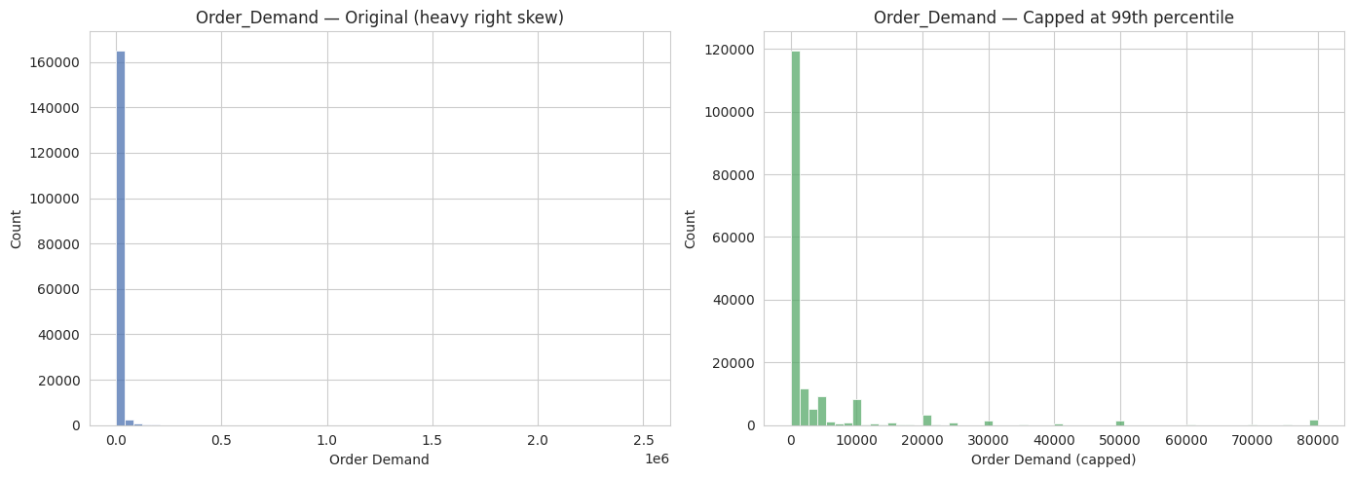
EDA — Demand Distribution
Key Observation
Order_Demand is extremely right-skewed — most orders are small, but rare bulk orders reach 2.5M units.
Left untreated, these extreme values would dominate the regression loss and distort model coefficients.
Capping at the 99th percentile (right chart) produces a distribution the model can actually learn from.
Product Demand Forecasting — Review 1
5

Slide 6
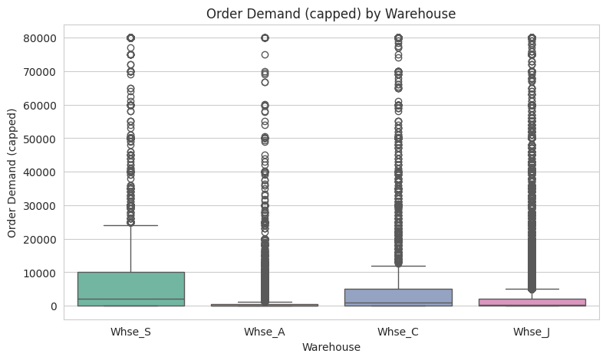

EDA — Demand by Warehouse
Key Observation
Demand varies noticeably across warehouses — Whse_S and Whse_C show higher median demand than Whse_A.
All warehouses show long tails of high-demand outliers, and is likely a strong predictor — supports one-hot encoding it as a feature.
Product Demand Forecasting — Review 1
6

Slide 7
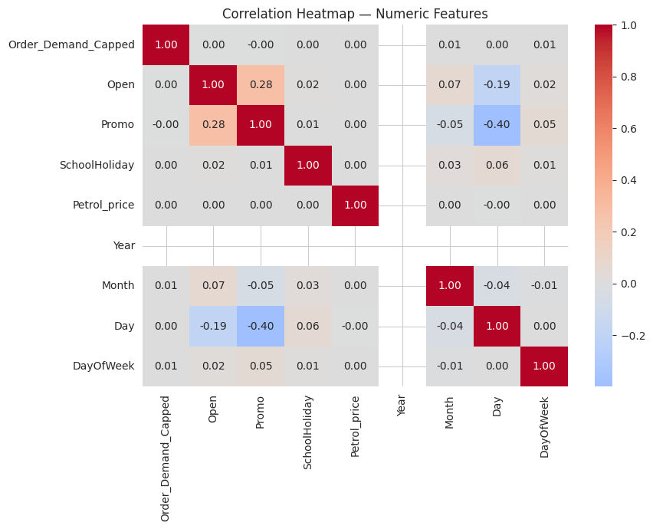
EDA — Feature Correlation
Key Observation
Weak linear correlation between individual numeric features and demand which means categorical features (Warehouse, Category) likely carry more weight.
No strong multicollinearity among these raw numeric features.
Product Demand Forecasting — Review 1
7

Slide 8
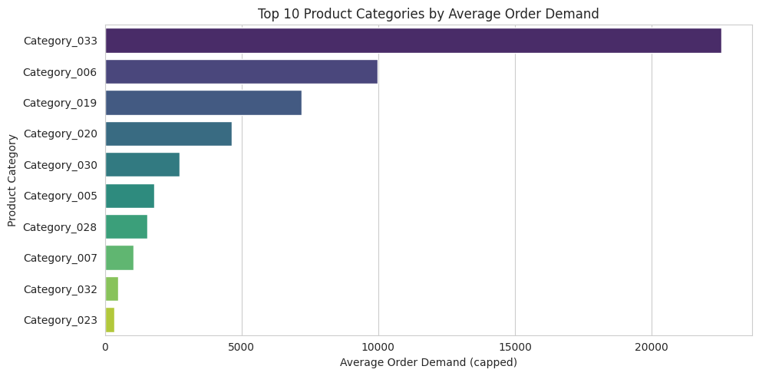
EDA — Demand by Product Category
Key Observation
Category_033 dominates average demand — more than double the next highest category.
A steep drop-off after the top 3 categories suggests category-level effects are highly uneven, not gradual.
Reinforces Product_Category as a key feature, and hints Lasso may zero out several low-impact category dummies.
Product Demand Forecasting — Review 1
8

Slide 9

Proposed Methodology
Ridge (L2) vs Lasso (L1) Regression
Ridge Regression (L2)
Lasso Regression (L1)
Adds a penalty proportional to the sum of squared coefficients.
Shrinks coefficients toward zero but rarely to exactly zero — keeps all features.
Best when most features contribute at least a little to the outcome.
Handles multicollinearity by distributing weight across correlated features.
Adds a penalty proportional to the sum of absolute coefficient values.
Can shrink less useful coefficients exactly to zero — performs automatic feature selection.
Best when only a subset of features (e.g. a few dominant categories) truly matter.
Improves interpretability with 30+ one-hot encoded category columns.
Product Demand Forecasting — Review 1
9

Slide 10

Reference Research Paper
Retail Demand Forecasting: A Comparative Study for Multivariate Time Series
Haque, Amin & Miah (2023)
Trains Lasso, Ridge, LightGBM, XGBoost, and Decision Tree on Walmart retail sales data enriched with macroeconomic variables. Compares RMSE/MAE across models. direct benchmark for this project's model choices.
Product Demand Forecasting — Review 1
10

Slide 11
THANK YOU.

