Slide 1

LEADERSHIP for BUSINESS AGILITY
PADMINI NIDUMOLU

Slide 2
Traditional versus Agile Organizations
Traditional
X Assumes the world is predictable
X Static, siloed, structural hierarchy more matrix-like structure, more rules, and more control in an attempt to cope.
X Organizations were designed for a world that was rapidly disappearing
X Waterfall and results at the end
Agile
Has a “North star” embodied across the organization
Uses rapid decision and learning cycles
Dynamic people model that ignites passion
Uses next-generation-enabling technology
Iterative approach and reflect often

Slide 3
Traditional
Leadership
Transactional
Lean/Agile
Leadership
Transformational
Directing
Controlling
Bureaucratic
Hierarchical
Supportive
Servant Leadership
Democratic
Collaborative

Slide 4
Have you ever been in a situation where a leader conveyed a clear vision of the organizational goals and empowered the teams which led to energized and motivated teams?

Slide 5

When a huge ship needs to turn, it takes massive power to counteract the hydraulic pressure to shift a rudder that may weigh hundreds of tons. To allow the ship to turn quickly, a small rudder that only weighs around a hundred pounds is built into the trailing edge of the big rudder. This trim-tab is turned first and does so easily, allowing the big rudder to follow. Buckminster-Fuller used this as a metaphor to demonstrate how little things can impact matters significantly, or how one person can make a big difference.
https://en.wikipedia.org/wiki/Trim_tab

Slide 6
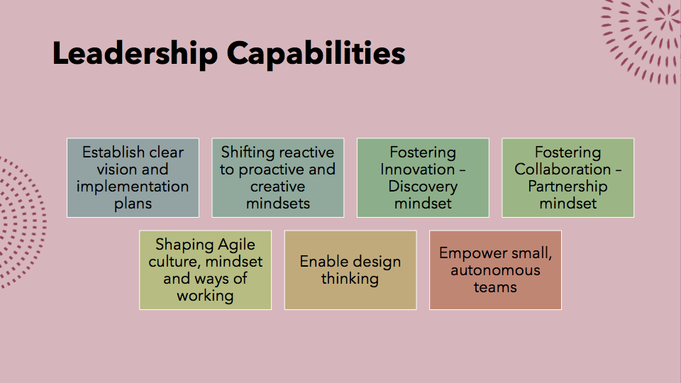

Slide 7
Transformational Leadership
Idealized Influence
Acts as a role model
Gains respect and trust
Intellectual Stimulation
Challenges assumptions
Encourages creativity
Inspirational Motivation
Communicates optimism
Believes in the ability of the teams
Individualized Consideration
Acts as a mentor or a coach
Empathy and support to the teams
4 I's of Transformational Leadership

Slide 8
Leadership Agility
Making effective decision in rapidly changing landscape
Anticipating and implementing best strategy
Turning vision into action
Evaluating successes and failures to spring forward
Servant Leadership

Slide 9
Thawing the Frozen Middle Engaging the Middle Management
Overlooked
Undervalued
Under invested
Overloaded
Difficulty in delegating
Low level of enablement
Broader investment
Recognition with rewards
Even distribution of load
Support upskilling and career growth
Enable and empower
Actively engage

Slide 10
Servant Leadership
A transformational approach that focuses on collaboration, trust and empathy
Not leading by title
Listening
Persuasion
Empathy
Stewardship
Mentor
Coach
Promoting genuine team ownership

Slide 11
Diversity of Leaders
Create access to a diversity of networks delivering diversity of thought, industry, backgrounds and levels
Leadership Initiatives for diversity
Advancing diversity in leadership should be considered an opportunity not a burden

