Slide 1

— Remembrance Day —
TITANIC SURVIVAL PREDICTION
— By Khairulnas —

Slide 2
INTRODUCTION
The sinking of the RMS Titanic is one of the most infamous shipwrecks in history. On April 15, 1912, during her maiden voyage, the Titanic sank after colliding with an iceberg, killing 1502 out of 2224 passengers and crew. This sensational tragedy shocked the international community and led to better safety regulations for ships.
One of the reasons that the shipwreck led to such loss of life was that there were not enough lifeboats for the passengers and crew. Although there was some element of luck involved in surviving the sinking, some groups of people were more likely to survive than others, such as women, children, and the upper-class.

Slide 3
Problem Statement
Predict the survival of passengers on a ship based on features such as passenger class, sex, age, number of siblings/spouses aboard, number of parents/children aboard, ticket fare, and port of embarkation. This is a binary classification problem where the output is whether a passenger survived (1) or did not survive (0).
Causes / Effect and Scope
The sinking of the ship resulted in the loss of many lives. However, not all passengers were equally likely to survive the disaster. Factors such as the passenger's class, sex, age, number of siblings/spouses aboard, number of parents/children aboard, ticket fare, and port of embarkation may have influenced their chances of survival. The problem is to understand how these factors interacted and contributed to the survival or death of the passengers. The effects of this problem are significant as it can provide insights into the social and economic conditions of the time, and the scope of the problem extends to all passengers on the ship.

Slide 4
Objective
The objective is to develop a predictive model that can accurately predict the survival of passengers on a ship based on the factors.
This model can be used to understand the importance of each factor in determining survival, which can provide valuable insights for future safety measures and disaster management strategies. The model's performance will be evaluated based on its accuracy in predicting survival in the provided dataset.

Slide 5
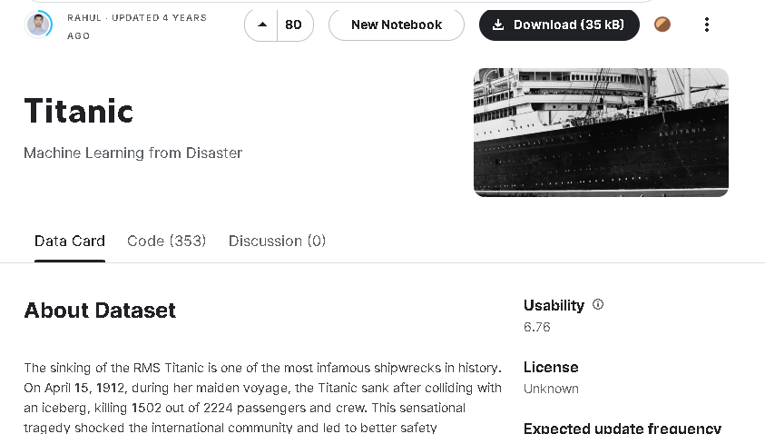
Data Wrangling & preparation
Data Source
https://www.kaggle.com/datasets/rahulsah06/titanic/data
PassengerId: An unique identifier for each passenger.
Survived: Whether the passenger survived or not (0 = No, 1 = Yes).
Pclass: The passenger class (1 = 1st, 2 = 2nd, 3 = 3rd).
Name: The name of the passenger.
Sex: The sex of the passenger (male or female).
Age: The age of the passenger.
SibSp: The number of siblings/spouses the passenger had aboard.
Parch: The number of parents/children the passenger had aboard.
Ticket: The ticket number.
Fare: The fare the passenger paid.
Cabin: The cabin number.
Embarked: The port of embarkation (C = Cherbourg, Q = Queenstown, S = Southampton).

Slide 6
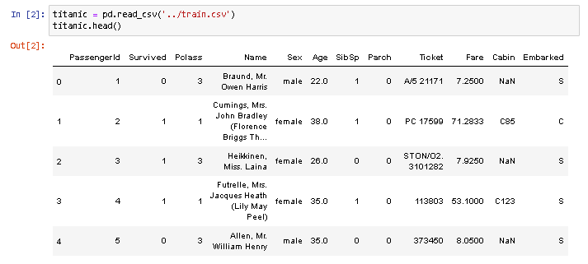
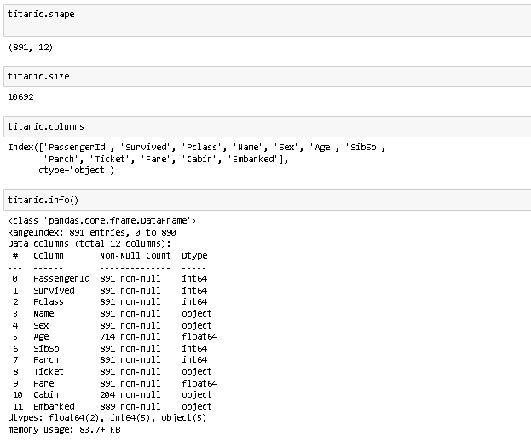
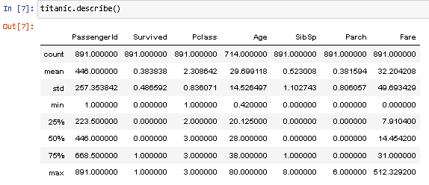

Slide 7
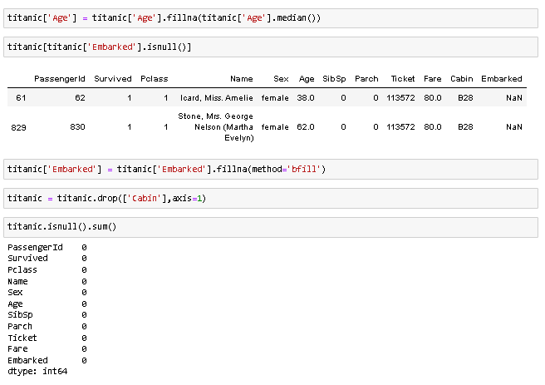
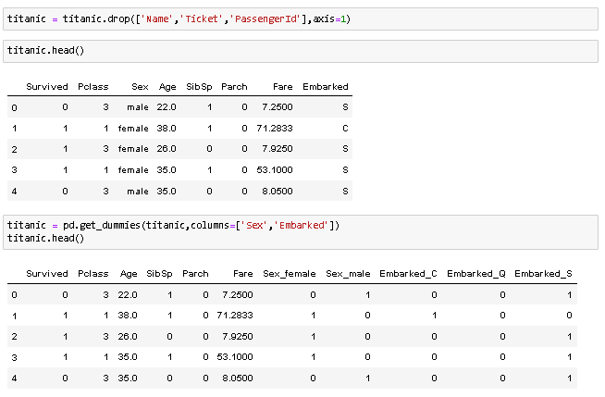
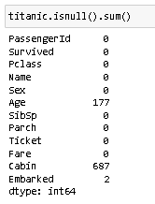
Feature Engineering & Data Cleaning
Fill the nan value with median
Drop the Name ,ticket ,PassengerId and cabin
Convert the sex, embarked categorical values into dummies variables

Slide 8
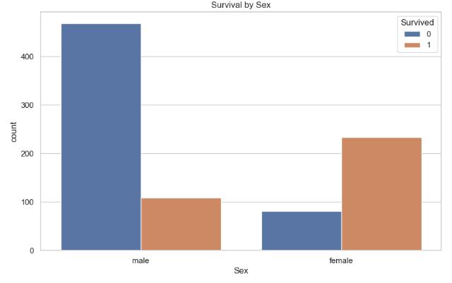
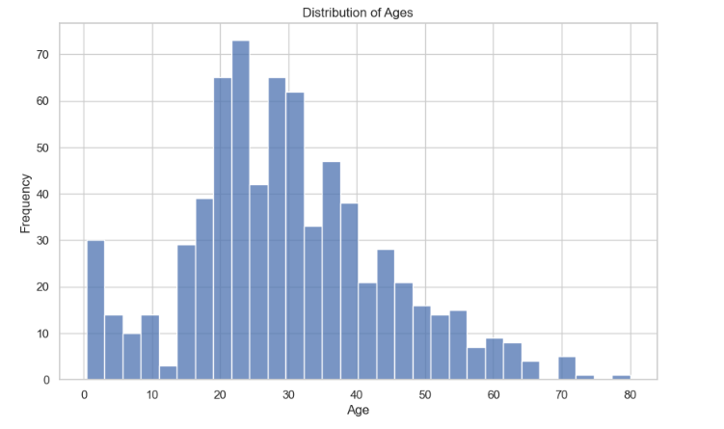
Exploratory Data Analysis (EDA)
Distribution of passenger ages
Survival of passenger by sex
Most of passenger are in range 20s to 30s
This bar chart shows the number of passengers who survived, broken down by sex. It appears that females had a higher survival rate than males.

Slide 9
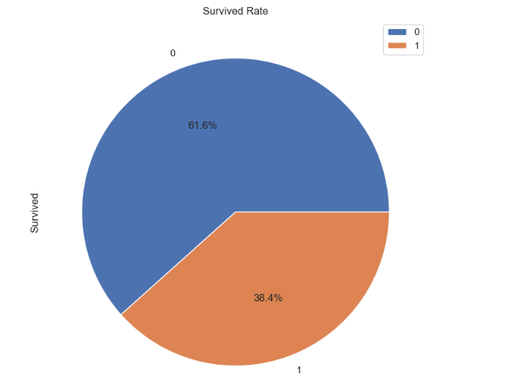
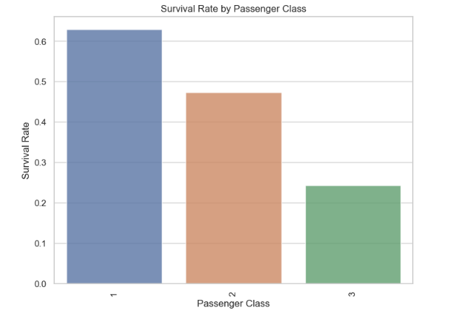
Survival rate of passenger
Survival of passenger for each class
From the Pie Chart, 38.4% passenger survived
From the plot, we can see that the survival rate is highest for the 1st class passengers and lowest for the 3rd class passengers. This suggests that the passenger's class might have had an impact on their survival.

Slide 10
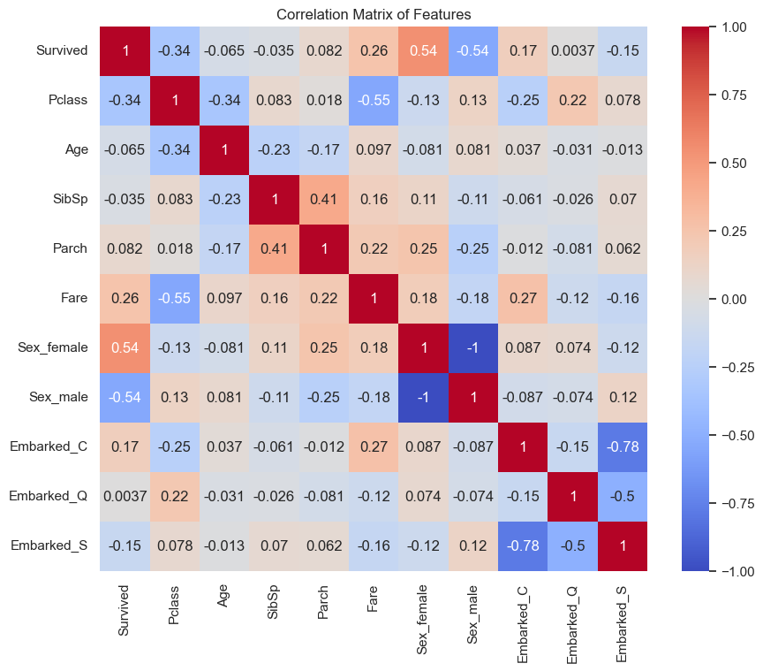
From the heatmap, we can see that some features are highly correlated with each other. For example, 'Sex_female' and 'Sex_male' are highly negatively correlated, which makes sense because if a passenger is not female, they are male, and vice versa. Similarly, 'Pclass' and 'Fare' are also somewhat negatively correlated, indicating that passengers in a higher class (lower 'Pclass' value) tend to pay higher fares.

Slide 11
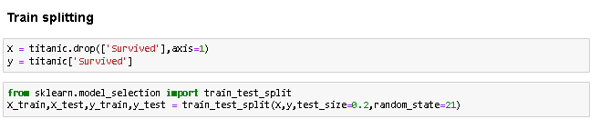
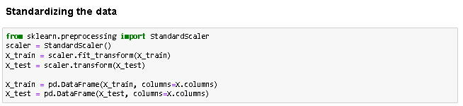
Modelling
Training set
Features (X_train): 712 rows, 10 columns
Target (y_train): 712 rows
Test set
Features (X_test): 179 rows, 10 columns
Target (y_test): 179 rows

Slide 12
Model Implementation
Model | Training accuracy | Model Accuracy
LogisticRegression | 80.48 | 80.45%
DecisionTreeClassifier | 98.46 | 78.77%
RandomForestClassifier | 98.46 | 82.68%
KNeighborsClassifier | 86.24 | 80.45%

Slide 13
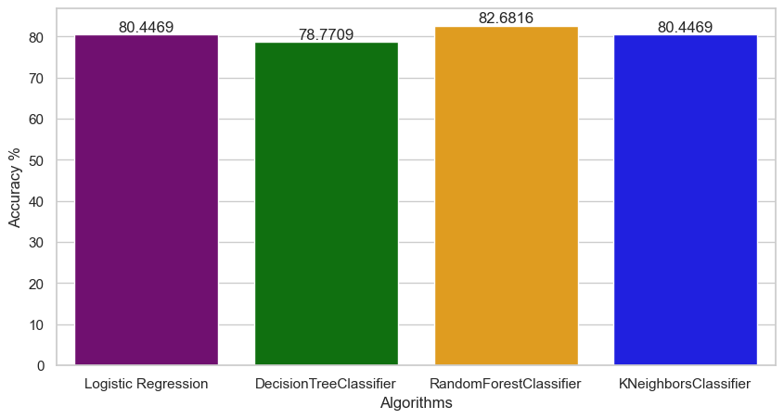

Compare the Model
We noted significant variances in model accuracy while evaluating various machine learning models for predict the survival of passenger. In terms of accuracy, the Random Forest Classifier performed better than the Decision Tree Classifier and Logistic Regression.

Slide 14
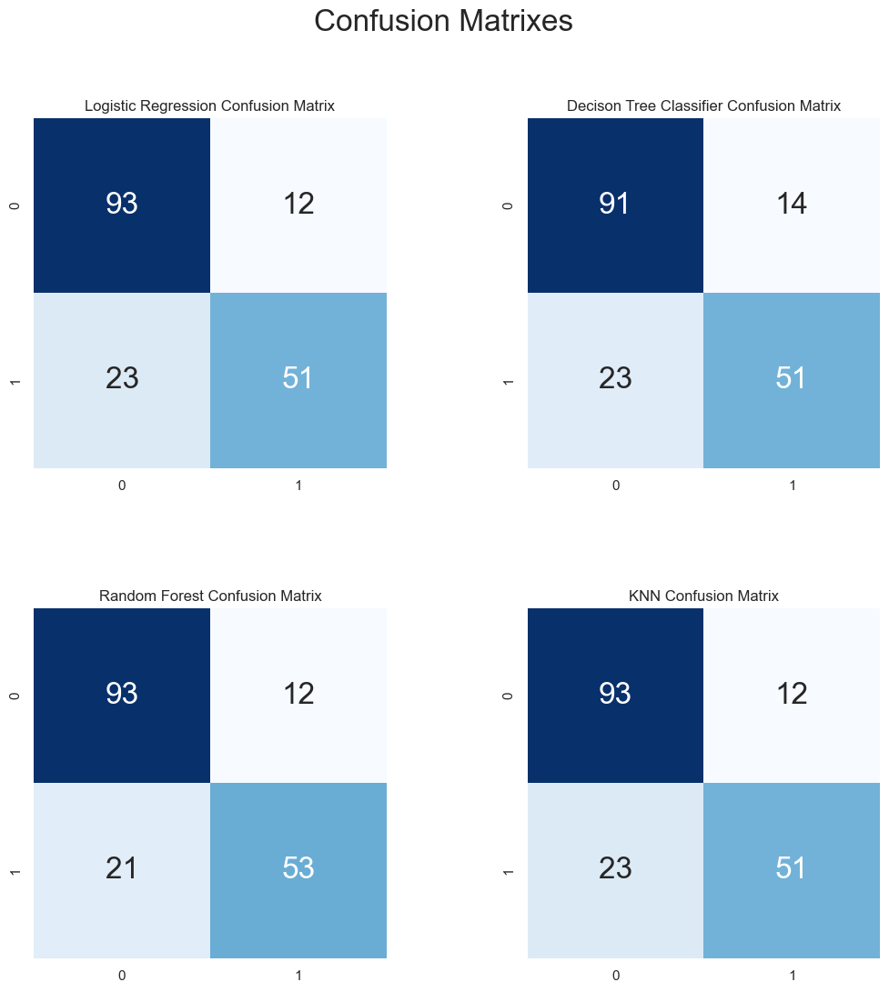

This confusion matrix shows that the Random Forest model is the best overall model, with the highest number of true positives and the lowest number of false positives for both classes.
Overall, the confusion matrices show that all four models are fairly good at classifying class 1 instances, but they all have some difficulty classifying class 2 instances.
The Random Forest model is the best overall model, with the highest number of true positives and the lowest number of false positives for both classes.

Slide 15
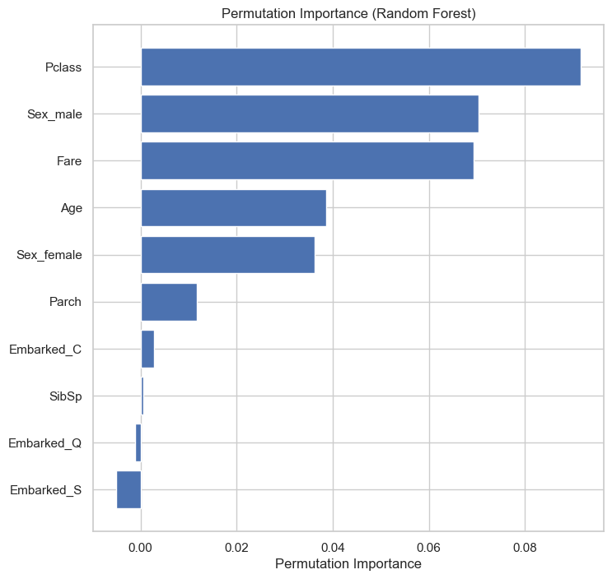
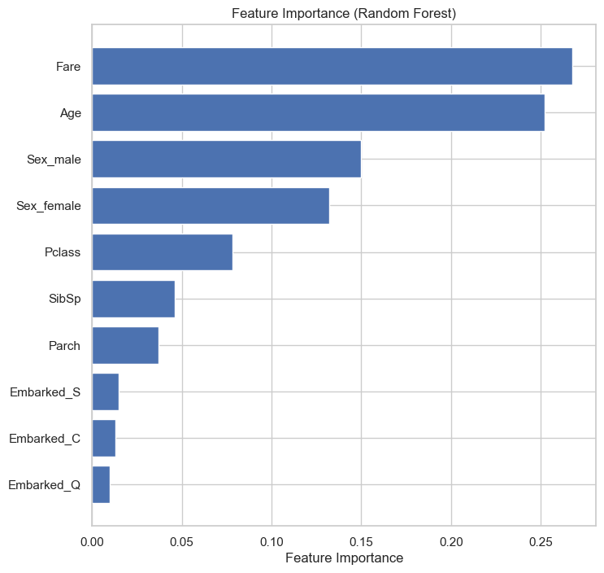
The visualization of the Permutation Importance graph suggest that ‘Pclass', ‘Sex_male', and Fare' are the most important features in the model.
The visualization of the feature importance (Random Forest) graph suggest that ‘Fare', ‘Age', and Sex_male' are the most important features in the model.

Slide 16
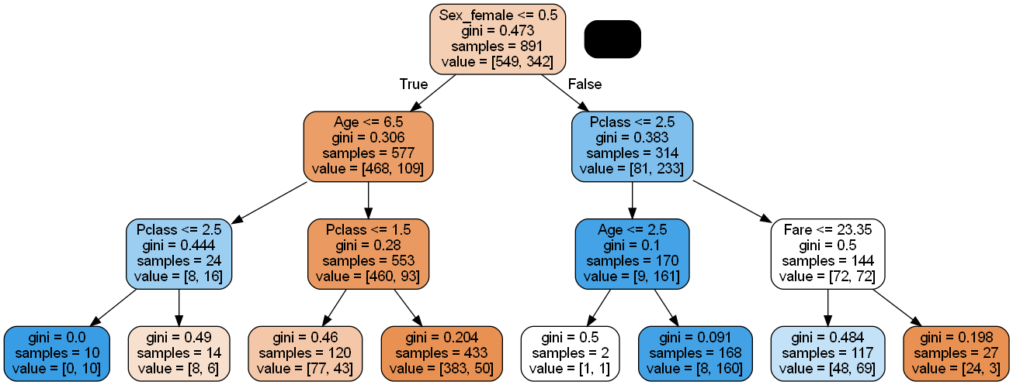
Sex: This split is based on the observation that female passengers were more likely to survive than male passengers on the Titanic.
Age: This split is based on the observation that younger passengers were more likely to survive than older passengers on the Titanic.
Passenger Class: This split is based on the observation that passengers in higher passenger classes were more likely to survive than passengers in lower passenger classes on the Titanic.
Fare: This split is based on the observation that passengers who paid more for their fare were more likely to survive than passengers who paid less for their fare on the Titanic.
The tree starts by splitting on the sex of the passenger.
If the passenger is female, the tree predicts that they are likely to survive.
If the passenger is male, the tree splits on their age.
If the passenger is under 6.5 years old, the tree predicts that they are likely to survive.
If the passenger is over 6.5 years old, the tree splits on their passenger class.
If the passenger is in passenger class 1 or 2, the tree predicts that they are likely to survive.
If the passenger is in passenger class 3, the tree splits on their fare.
If the passenger's fare is over 23.35 dollars, the tree predicts that they are likely to survive..

Slide 17
Recommendation
We could consider tuning the hyperparameters of the Random Forest model or even try different machine learning models.
Additionally, feature engineering could potentially improve the model's performance. For example, creating a new feature that combines 'SibSp' and 'Parch' to represent the total number of family members a passenger has on board might be useful.

Slide 18
Conclusion
We successfully loaded and preprocessed the Titanic dataset, which included handling missing values, converting categorical variables into numeric ones, and dropping unnecessary columns. We then trained a Random Forest Classifier model on the data and achieved an accuracy of approximately 82.68% on the test set.

Slide 19


QnA

