Slide 1
Time Series Analysis with Python

Slide 2

Action 01: Search and install Colab
Notes:
Add graph to generate intuition

Slide 3
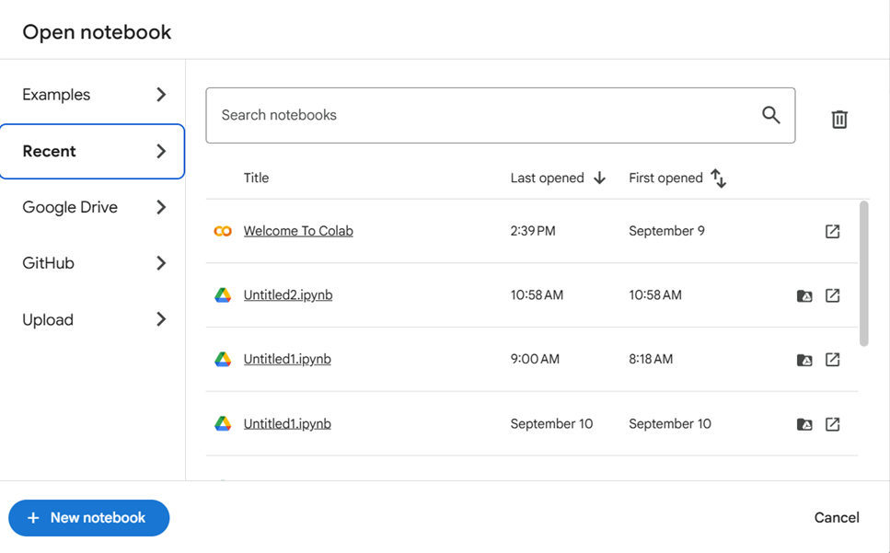
Action 02: Open notebook
Notes:
Add graph to generate intuition

Slide 4
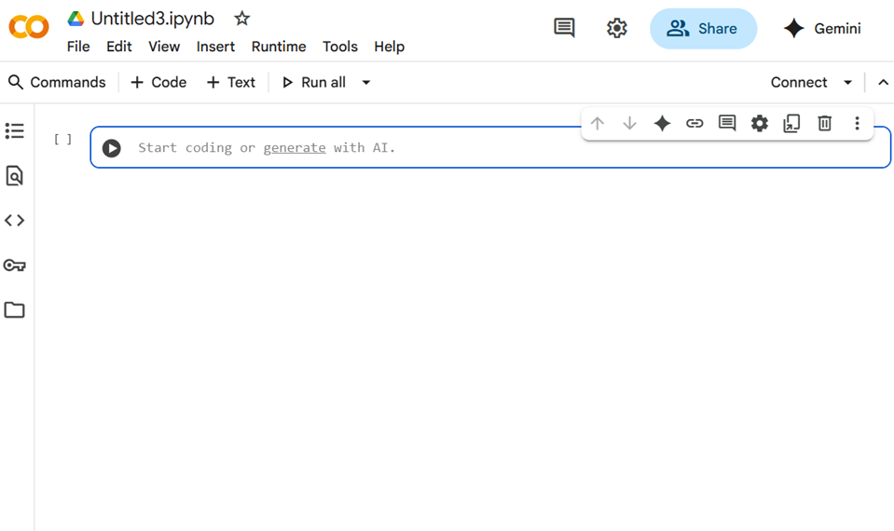
Action 03: Start coding in the opened notebook
Notes:
Add graph to generate intuition

Slide 5
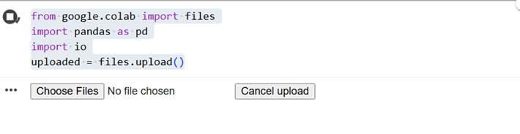
Action 04: Upload files to Colab
from google.colab import files
import pandas as pd
import io
uploaded = files. upload()
Notes:
Add graph to generate intuition

Slide 6
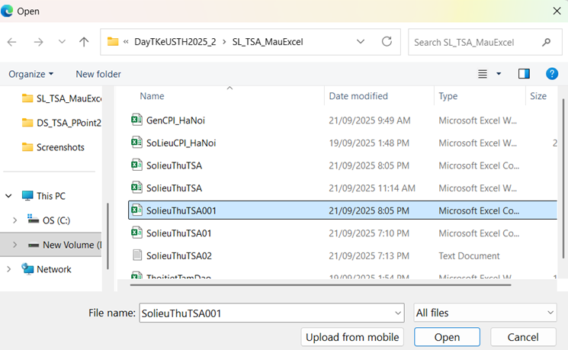
Action 04: Upload files to Colab
Notes:
Add graph to generate intuition

Slide 7
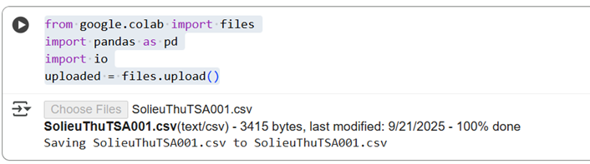
Action 04: Upload files to Colab
Notes:
Add graph to generate intuition

Slide 8
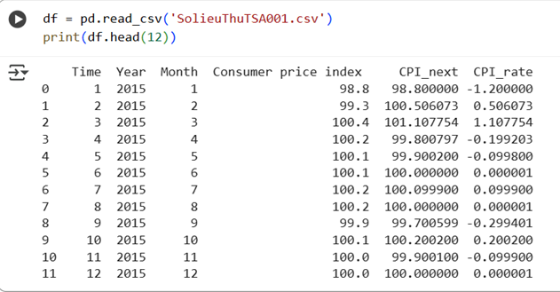
Action 04: Upload files to Colab
df = pd.read_csv('SolieuThuTSA001.csv')
print(df.head(12))
Notes:
Add graph to generate intuition

Slide 9
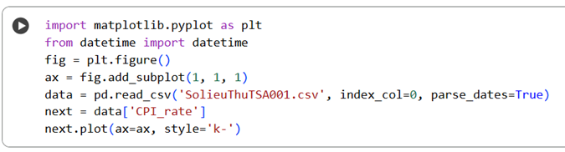
Action 05: Create plot of time series
import matplotlib.pyplot as plt
from datetime import datetime
fig = plt.figure()
ax = fig.add_subplot(1,1,1)
data = pd.read_csv('SolieuThuTSA001.csv')
next = data['CPI_rate']
next.plot(ax=ax, style='k-')
Notes:
Add graph to generate intuition

Slide 10
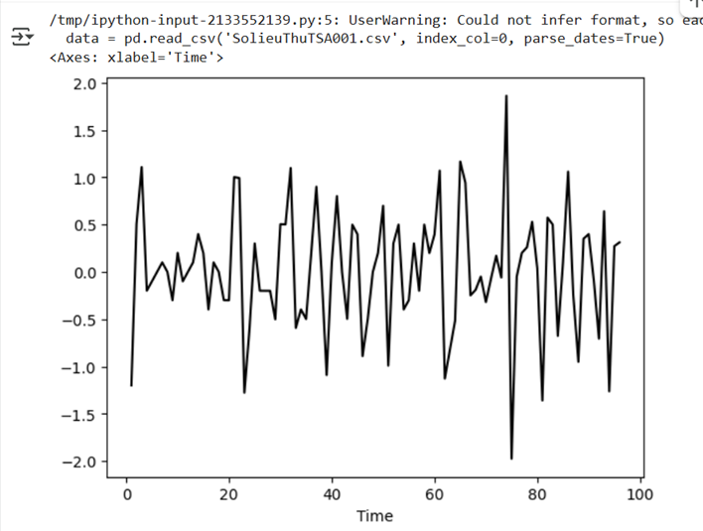
Action 05: Create plot of time series
Notes:
Add graph to generate intuition

Slide 11

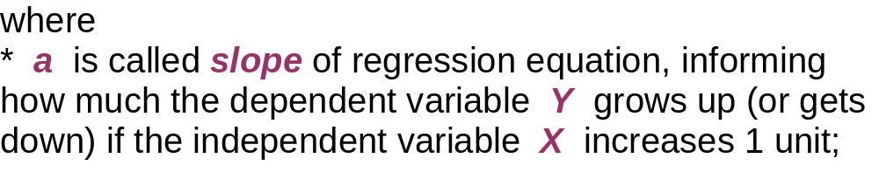
Action 06: Trend checking by regression analysis
* b is called regression constant (intercept), showing the intersection point of regression line and vertical axis, that is the value of Y when X takes value 0;
* e is residual of regression, indicates error of estimation at each point of observation.

Slide 12

Simple Linear Regression Equation
Positive Linear Relationship
y
Regression line
Slope a is positive
Intercept b
x

Slide 13
Simple Linear Regression Equation
Negative Linear Relationship
y
Intercept b
Regression line
Slope a is negative
x

Slide 14
Simple Linear Regression Equation
No Relationship
y
Regression line
Intercept b
Slope a is 0
x

Slide 15

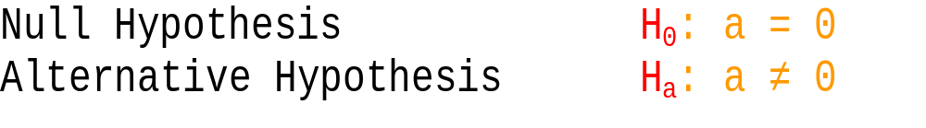
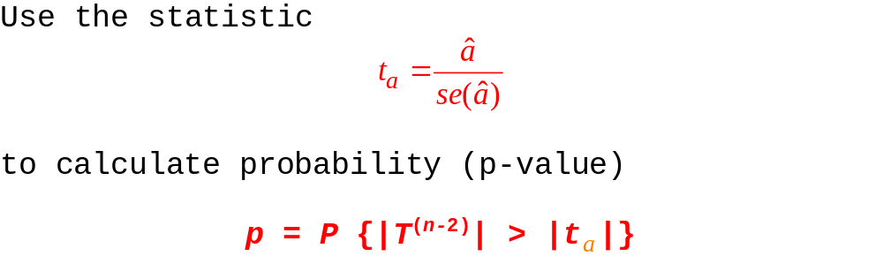

Slide 16
Compare the p-value to the significance level α.
If p ≥ α ➔ Accept the hypothesis, consider a = 0, between Y and X there is no linear relationship, increase of X does not lead Y to increase or decrease, there is no trend .
If p < α ➔ Reject the hypothesis, assert a ≠ 0, the conclusion between Y and X really has a strong linear relationship, the increase in the value of X will lead to an increase (if a > 0, positive trend), or reduce (if a < 0 , negative trend) the value of Y.
The test for intercept coefficient b is also carried out in the same way.

Slide 17

Confidence Interval for a and b
The form of a confidence interval for a and b are:
(a^ – t_{1-α/2}s_{a^}; a^ + t_{1-α/2}s_{a^})
(b^ – t_{1-α/2}s_{b^}; b^ + t_{1-α/2}s_{b^})
where
a^ and b^ are the point estimators,
t_{1-α/2}s_{a^} and t_{1-α/2}s_{b^} are the margins of error,
t_{1-α/2} is the t value providing an area of α/2 in the upper tail of a t distribution with n – 2 degrees of freedom.

Slide 18
Confidence Interval for a (or b)
We can use a confidence interval for a (or b) to test the hypotheses just used in the t test.
H is rejected if 0 (the hypothesized value of a (or b)) is not included in the confidence interval for a (or b, respectively) .

Slide 19
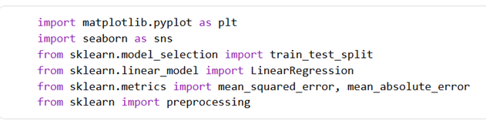
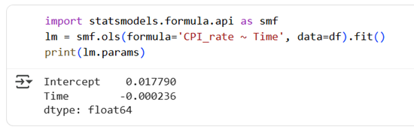
Action 06: Trend checking by regression analysis
Notes:
Add graph to generate intuition

Slide 20
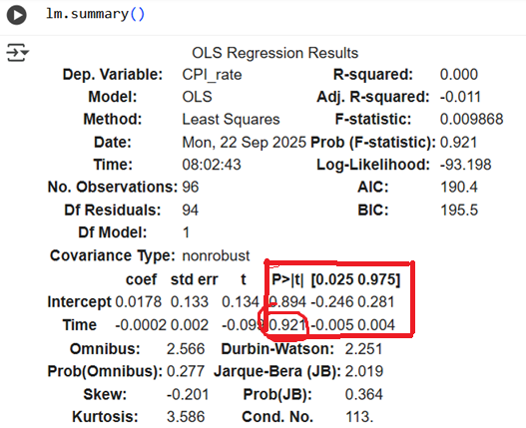
Action 06: Trend checking by regression analysis
H: slope = 0
P-value = 0.921 > 5%
Accept H
Conclude:
Trend not exists
95% CI of slope
= (-0.005;0.004)
contains 0
Accept H
Conclude:
Trend not exists
Notes:
Add graph to generate intuition

Slide 21
import matplotlib.pyplot as plt
import seaborn as sns
from sklearn.model_selection import train_test_split
from sklearn.linear_model import LinearRegression
from sklearn.metrics import mean_squared_error, mean_absolute_error
from sklearn import preprocessing
import statsmodels.formula.api as smf
lm = smf.ols(formula='CPI_rate ~ Time', data=df).fit()
print(lm.params)
lm.summary()

Slide 22
Action 07: Stationarity checking
Most classical and deep learning time series models (ARMA, VAR, Prophet, LSTM) assume that the data is stationary. Non-stationary data can lead to:
  Spurious regressions
  Poor model accuracy
  Invalid statistical inferences
Notes:
Add graph to generate intuition

Slide 23
Action 07: Stationarity checking
Augmented Dickey-Fuller test
This is a statistical test that is dedicatedly built to test whether univariate time series data is stationary or not. Let's define the null and alternate hypotheses,
Ho (Null Hypothesis): The time series data is non-stationary
H1 (alternate Hypothesis): The time series data is stationary
Assume alpha = 0.05, meaning (95% confidence). The test results are interpreted with a p-value if p > 0.05 fails to reject the null hypothesis, else if p <= 0.05 reject the null hypothesis.
Notes:
Add graph to generate intuition

Slide 24
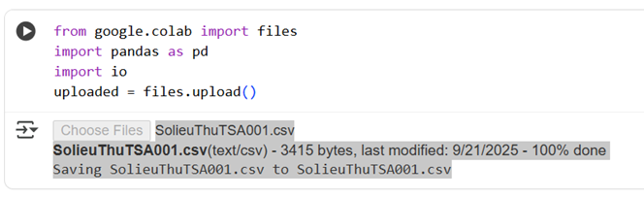
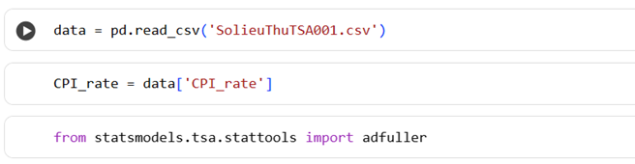
Action 07: Stationarity checking
Notes:
Add graph to generate intuition

Slide 25
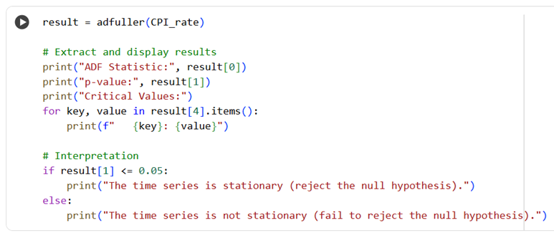
Action 07: Stationarity checking
Notes:
Add graph to generate intuition

Slide 26
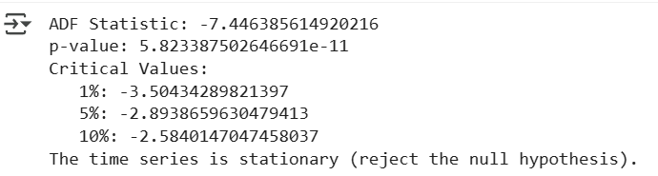
Action 07: Stationarity checking
Notes:
Add graph to generate intuition

Slide 27
CPI_rate = data['CPI_rate']
from statsmodels.tsa.stattools import adfuller
result = adfuller(time_series)
# Extract and display results
print("ADF Statistic:", result[0])
print("p-value:", result[1])
print("Critical Values:")
for key, value in result[4].items():
print(f" {key}: {value}")
# Interpretation
if result[1] <= 0.05:
print("The time series is stationary (reject the null hypothesis).")
else:
print("The time series is not stationary (fail to reject the null hypothesis).")

Slide 28
Action 08: Calculating Autocorrelation
Autocorrelation measures the degree of similarity between a time series and a lagged version of itself over successive time intervals. When the autocorrelation in a time series is high, it becomes easier to predict future values by referring to past values.
To calculate autocorrelation in Python, you can use the acf function from the statsmodels library. Here is an example:
import statsmodels.api as sm
x = [x₁, x₂, …, x₅₁]
# Calculate autocorrelations
autocorrelations = sm.tsa.acf(x)
print(autocorrelations)
Notes:
Add graph to generate intuition

Slide 29
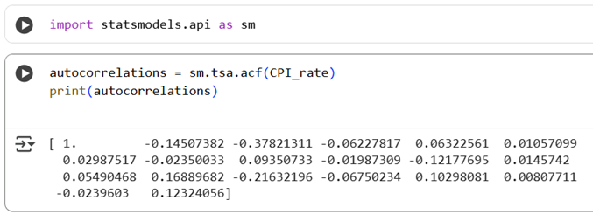
Action 08: Calculating Autocorrelation
import statsmodels.api as sm
autocorrelations = sm.tsa.acf(x)
print(autocorrelations)
Notes:
Add graph to generate intuition

Slide 30
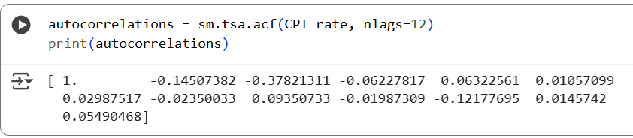
Action 08: Calculating Autocorrelation
The output will be an array of autocorrelation values for different lags. You can also specify the number of lags to use with the nlags argument:
autocorrelations = sm.tsa.acf(x, nlags=5)
print(autocorrelations)
Notes:
Add graph to generate intuition

Slide 31
Action 08: Calculating Autocorrelation
Plotting Autocorrelation
To visualize the autocorrelation function, you can use the plot_acf function from the statsmodels library:
from statsmodels.graphics import tsaplots
import matplotlib.pyplot as plt
# Plot autocorrelation function
fig = tsaplots.plot_acf(CPI_rate, lags=50)
plt.show()
from statsmodels.graphics import tsaplots
import matplotlib.pyplot as plt
# Plot autocorrelation function
fig = tsaplots.plot_acf(CPI_rate, lags=50)
plt.show()
Notes:
Add graph to generate intuition

Slide 32
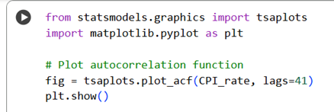
Action 08: Calculating Autocorrelation
Notes:
Add graph to generate intuition

Slide 33
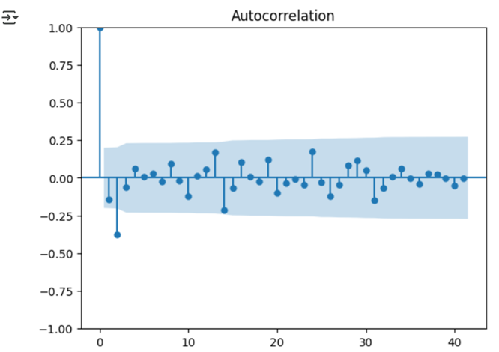
Action 08: Calculating Autocorrelation
Notes:
Add graph to generate intuition

Slide 34
Action 09: Calculating Partial Autocorrelation
The Partial Autocorrelation Function (PACF) is a crucial tool in time series analysis that measures the partial correlation between a stationary time series and its own lagged values, considering and accounting for the values at all shorter lags. This is distinct from the Autocorrelation Function (ACF), which does not factor in the influence of other lags.
import pandas as pd
import numpy as np
from statsmodels.tsa.stattools import pacf
from statsmodels.graphics.tsaplots import plot_pacf
import matplotlib.pyplot as plt
Notes:
Add graph to generate intuition

Slide 35
Action 09: Calculating Partial Autocorrelation
data = pd.read_csv('SolieuThuTSA001.csv')
CPI_rate = data['CPI_rate']
# Computing and Plotting PACF
pacf_values = pacf(CPI_rate, nlags=12)
print("Partial Autocorrelation Function (PACF) values:")
for lag, pacf_val in enumerate(pacf_values):
print(f"Lag {lag}: {pacf_val}")
Notes:
Add graph to generate intuition

Slide 36
Action 09: Calculating Partial Autocorrelation
Partial Autocorrelation Function (PACF) values:
Lag 0: 1.0
Lag 1: -0.14660091544107987
Lag 2: -0.41670783556551094
Lag 3: -0.2542677161630039
Lag 4: -0.22850249203285483
Lag 5: -0.2243194641517822
Lag 6: -0.15154675491645925
Lag 7: -0.19308416231798248
Lag 8: 0.009427360424904765
Lag 9: -0.040035011639930534
Lag 10: -0.10937823669154328
Lag 11: -0.0572427756557631
Lag 12: -0.07805508594341463
Notes:
Add graph to generate intuition

Slide 37
Action 09: Calculating Partial Autocorrelation
# Plot PACF
plt.figure(figsize=(10, 5))
plot_pacf(CPI_rate, lags=40)
plt.title('Partial Autocorrelation Function (PACF)')
plt.xlabel('Lags')
plt.ylabel('PACF')
plt.grid(True)
plt.show()
Notes:
Add graph to generate intuition

Slide 38
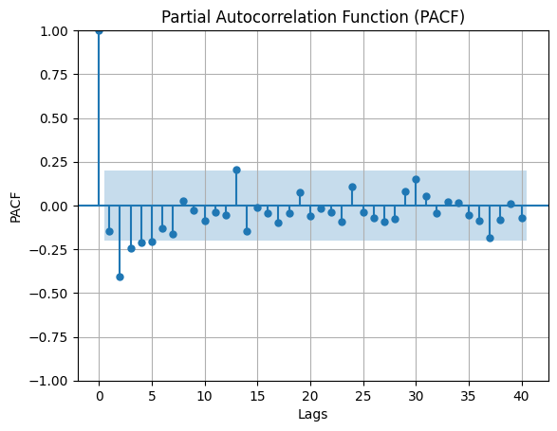
Action 09: Calculating Partial Autocorrelation
Notes:
Add graph to generate intuition

Slide 39
THANK YOU

