Slide 1
Box-Jenkins method in TS analysis

Slide 2
The Box-Jenkins methodology provides an extensive collection of models such as an autoregressive moving average (ARMA) and an autoregressive integrated moving average (ARIMA) models to identify an appropriate model and the best fit of a time series model to past values of this time series in order to make forecasting.

Slide 3
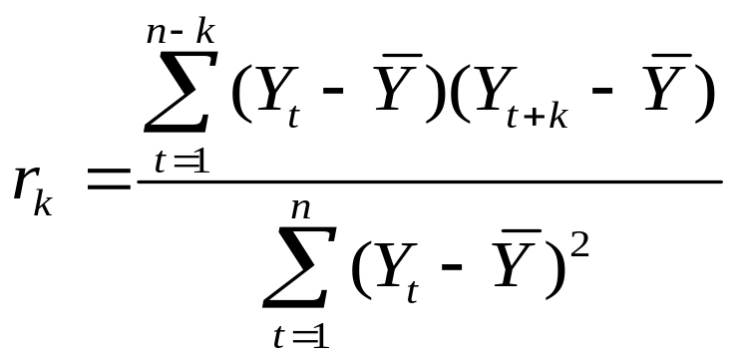
Box-Jenkins forecasting models are identified by examining the behavior of the autocorrelation function (ACF) and the partial autocorrelation function (PACF) for the values of stationary time series Y₁, Y₂, … , Y_{n}.
By considering the time series values Y₁, Y₂, … , Y_{n}, the sample autocorrelation at lag k, denoted by r_{k}
(1)

Slide 4
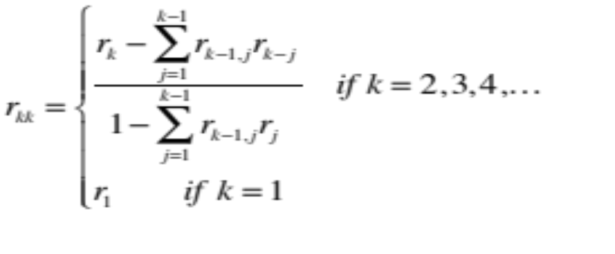
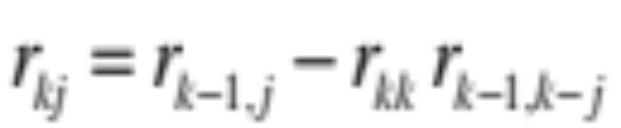
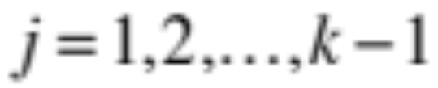
And the sample partial autocorrelation at lag k is :
(2)
Where, for

Slide 5
Autocorrelations
r₁ indicates how successive values of Y relate to each other,
r₂ indicates how Y values two periods apart relate to each other,
and so on.

Slide 6
ACF
Together, the autocorrelations at lags 1, 2, 3, etc. make up the autocorrelation function or ACF and then we plot the autocorrelations by the lags
The ACF values reflect how strongly the series is related to its past values over time

Slide 7
Autoregressive Processes
The autoregressive process of order p is denoted AR(p), and defined by
Y_{t} = μ + ∑ φ_{r} Y_{t-r} + w_{t}
where φ₁ , . . . , φ_{p} are fixed constants and {w_{t}} white noise, a sequence of independent (or uncorrelated) random variables with mean 0 and variance σ ²
p
r=1

Slide 8
Autoregressive Process
An AR process involves the inclusion of lagged dependent variables.
An AR(1) process involves a single lag, an AR(p) model involves p lags.
AR(1) processes are often referred to as the random walk, or driftless random walk if we exclude the constant.

Slide 9
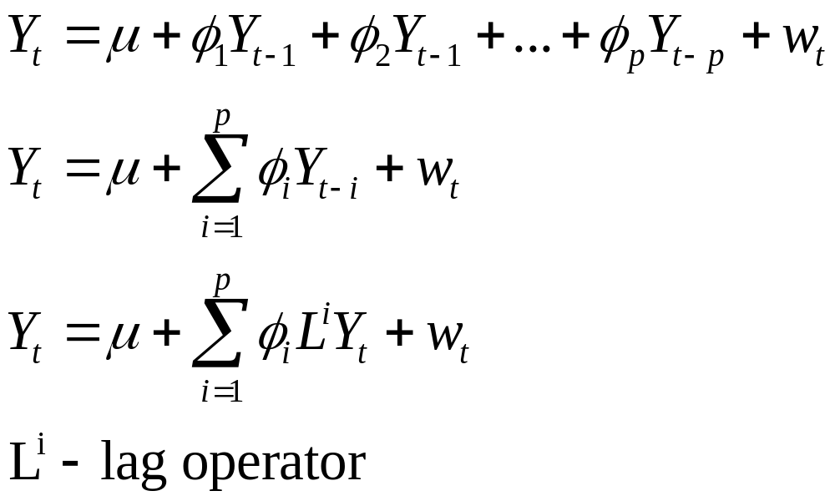
AR Process

Slide 10
Moving Average Processes
The moving average process of order q, denoted MA(q), includes lagged error terms t–1 to t–q, written as
Y_{t} = μ + w_{t} + ∑ θ_{r} w_{t-r}
where θ₁ , θ₂ , … , θ_{q} are the MA parameters and w_{t} is white noise
q
r=1

Slide 11
Moving Average (MA) process
In this simple model, the dependent variable is regressed against lagged values of the error term.
We assume that the assumptions on the mean of the error term being 0 and having a constant variance etc still apply.

Slide 12
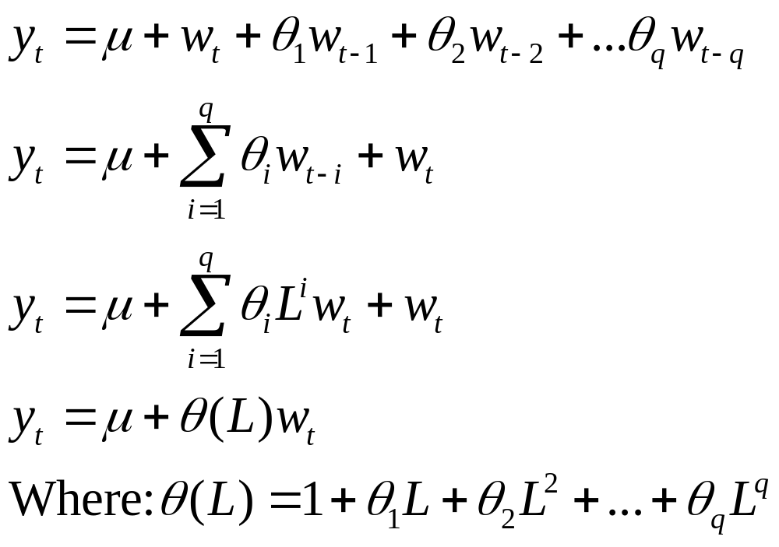
MA process

Slide 13
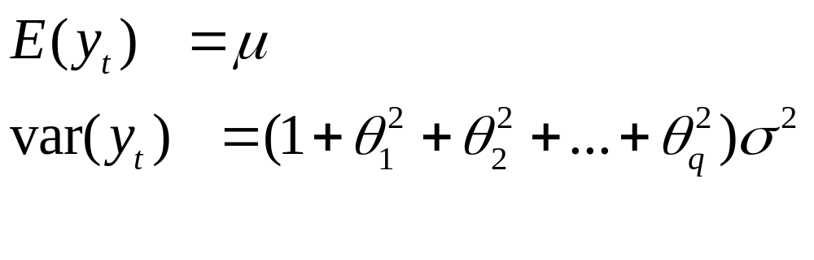
MA process
The MA process has the following properties relating to its mean and variance:

Slide 14
ARMA processes
The autoregressive moving average process, ARMA(p,q) is defined by
Y_{t} – ∑ φ_{r} Y_{t–r} = ∑ θ_{r} w_{t–r}
where again w_{t} is white noise
p
q
r=1
r=0

Slide 15
Implications of Non-stationary data
If the variables in an OLS regression are not stationary, they tend to produce regressions with high R-squared statistics and low DW (Durbin-Watson) statistics, indicating high levels of autocorrelation.
This is caused by the drift in the variables often being related, but not directly accounted for in the regression, hence the omitted variable effect.

Slide 16
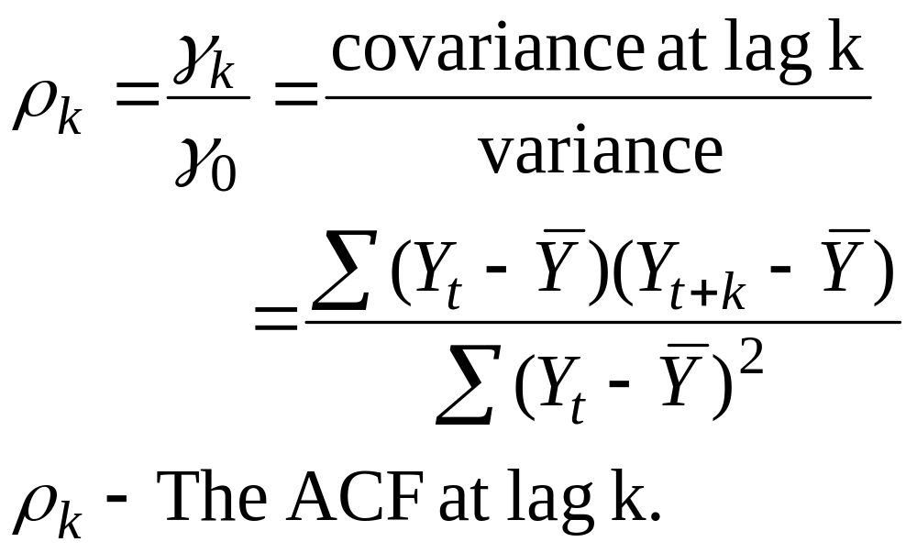
Autocorrelation Function (ACF)

Slide 17
Stationary Data
It is important to determine if our data is stationary before the regression. This can be done in several ways:
- plotting the data
- assessing the autocorrelation function
- Using a specific test on the significance of the autocorrelation coefficients.

Slide 18
Correlogram
The sample correlogram is the plot of the ACF against k.
As the ACF lies between -1 and +1, the correlogram also lies between these values.
It can be used to determine stationarity, if the ACF falls immediately from 1 to 0, then equals about 0 thereafter, the series is stationary.
If the ACF declines gradually from 1 to 0 over a prolonged period of time, then it is not stationary.

Slide 19
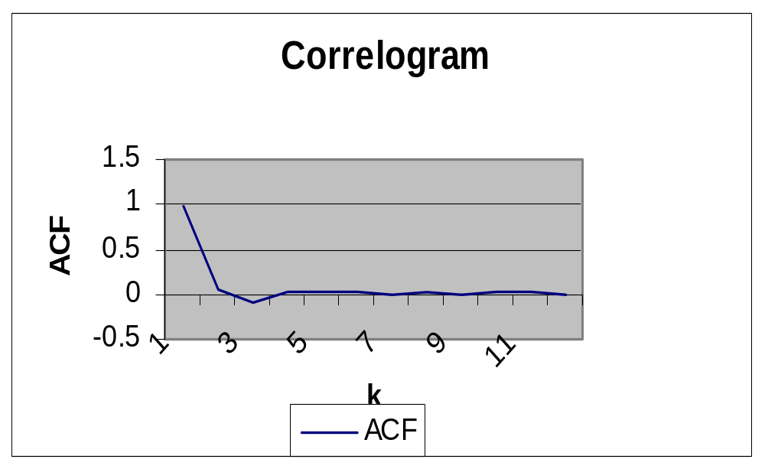
Stationary time series

Slide 20
Statistical Significance of the ACF
The Q statistic can be used to determine if the sample ACFs are jointly equal to zero.
If jointly equal to zero, we can conclude that the series is stationary.
It follows the chi-squared distribution, where the null hypothesis is that the sample ACFs jointly equal zero.

Slide 21
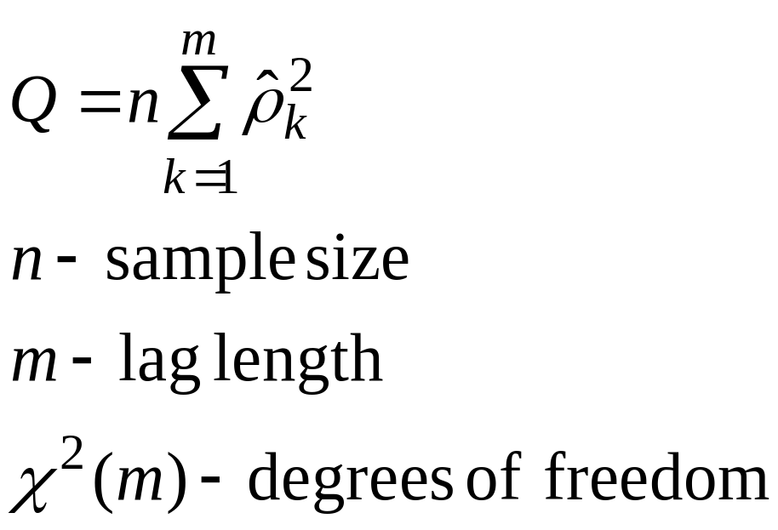
Q statistic

Slide 22
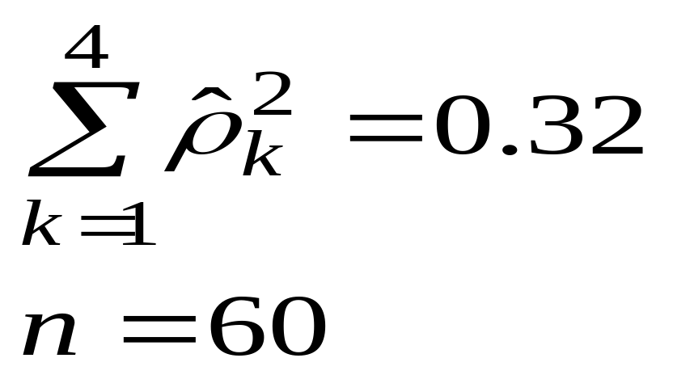
Q-statistic Example
The following information, from a specific variable can be used to determine if a time series is stationary or not.

Slide 23
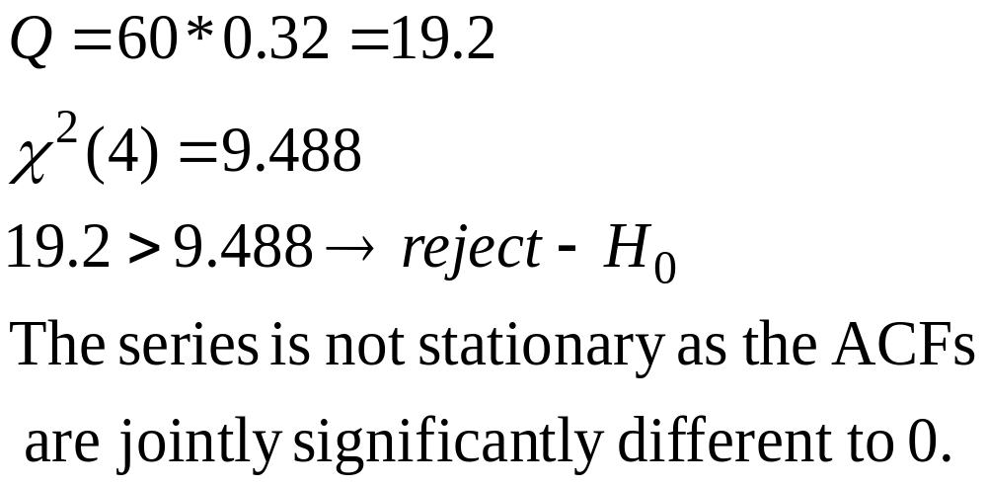
Q-statistic

Slide 24
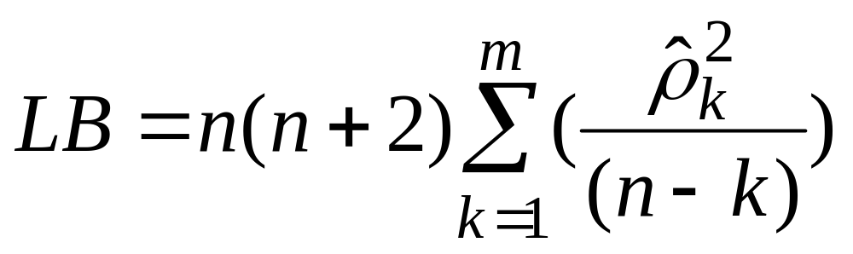
Ljung-Box Statistic
This statistic is the same as the Q statistic in large samples but has better properties in small samples.

Slide 25
Stationarity of the AR process
If an AR model is not stationary, this implies that previous values of the error term will have a non-declining effect on the current value of the dependent variable.
This implies that the coefficients on the MA process would not converge to zero as the lag length increases.
For an AR model to be stationary, the coefficients on the corresponding MA process decline with lag length, converging on 0.

Slide 26
Stationarity test
One way to test whether a time series is stationary is to perform an augmented Dickey-Fuller test, which uses the following null and alternative hypotheses:
H₀: The time series is non-stationary. In other words, it has some time-dependent structure and does not have constant variance over time.
H_{A}: The time series is stationary.
If the p-value from the test is less than some significance level (e.g. α = .05), then we can reject the null hypothesis and conclude that the time series is stationary.

Slide 27
Trend Stationary vs. Difference Stationary
Traditionally in regression-based time series models, a time trend variable, t, was included as one of the regressors to avoid spurious correlation.
This practice is only valid if the trend variable is deterministic, not stochastic.
A trend stationary series has a DGP (data generating process) of:
y_{t} = a₀ + a₁t + ε_{t}

Slide 28
Conclusion
Before conducting a regression, we need to consider whether the variables are stationary or not.
The ACF and correlogram is one way of determining if a series is stationary, as is the Q-statistic
An AR(p) process involves the use of p lags of the dependent variable as explanatory variables
A MA(q) process involves the use of q lags of the error term.

Slide 29
ARIMA Models and Forecasting
If we can describe the way the points in the series are related to each other (the autocorrelations), then we can describe the series using the relationships that we’ve found
AutoRegressive Integrated Moving Average Models (ARIMA) are mathematical models of the autocorrelation in a non-stationary time series
One way to describe time series

Slide 30
Stationarity of the AR process
If an AR model is not stationary, this implies that previous values of the error term will have a non-declining effect on the current value of the dependent variable.
This implies that the coefficients on the MA process would not converge to zero as the lag length increases.
For an AR model to be stationary, the coefficients on the corresponding MA process decline with lag length, converging on 0.

Slide 31
Box-Jenkins Methodology
This is a method for estimating ARIMA models, based on the ACF and PACF as a means of determining the stationarity of the variable in question and the lag lengths of the ARIMA model.
Although the ACF and PACF methods for determining the lag length in an ARIMA model are commonly used, there are other methods termed information criteria which can also be used.

Slide 32
Identification
Identification of the most appropriate model is the most important part of the process, where it becomes as much ‘art’ as ‘science’.
The first step is to determine if the variable is stationary, this can be done with the correlogram. If it is not stationary it needs to be first-differenced. (it may need to be differenced again to induce stationarity)
The next stage is to determine the p and q in the ARIMA (p, I, q) model (the I refers to how many times the data needs to be differenced to produce a stationary series)

Slide 33
Identification
To determine the appropriate lag structure in the AR part of the model, the PACF or Partial correlogram is used, where the number of non-zero points of the PACF determine where the AR lags need to be included.
To determine the MA lag structure, the ACF or correlogram is used, again the non-zero points suggest where the lags should be included.

Slide 34
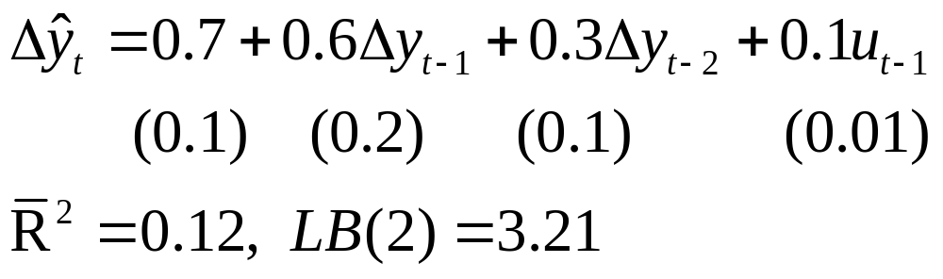
ARIMA Example
Following the Box-Jenkins methodology, the following ARIMA(2,1,1) model was produced:

Slide 35
Parsimonious Model
The aim of this type of modelling is to produce a model that is parsimonious, or as small as possible, whilst passing the diagnostic checks.
A parsimonious model is desirable because including irrelevant lags in the model increases the coefficient standard errors and therefore reduces the t-statistics.
Models that incorporate large numbers of lags, tend not to forecast well, as they fit data specific features, explaining much of the noise or random features in the data.

Slide 36
Forecasting
One of the most important tests of how well a model performs is how well it forecasts.
One of the most useful models for forecasting is the ARIMA model.
To produce dynamic forecasts the model needs to include lags of either the variables or error terms.

Slide 37
Types of Forecast
Forecasts can be either in-sample or out-of-sample forecasts.
In general, the out-of-sample forecasts are a better test of how well the model works, as the forecast uses data not included in the estimation of the model.
To conduct out-of-sample forecasts, we need to leave some observations at the end of our sample for this purpose

Slide 38
Types of Forecasts
A one-step-ahead is a forecast for the next observation only.
A multi-step-ahead forecast is for 1,2,3,…s steps ahead.
A recursive window for the forecast means that the initial estimation date is fixed but the additional observations are added one by one to the estimation time span.
A rolling window is where the estimation time period is fixed but the start and end dates successively increase by 1.

Slide 39
Measuring Forecast Accuracy
To determine how accurate a forecast is, the simplest method is to plot the forecast against the actual values as a direct comparison
In addition, it may be worthwhile to compare the turning points, this is particularly important in finance.
There are a number of methods to determine accuracy of the forecast, often more than one is included in a set of results.

Slide 40
Tests of Forecast Accuracy
Tests of forecast accuracy are based on the difference between the forecast of the variables value at time t and the actual value at time t. The closer the two are together and the smaller the forecast error, the better the forecast.
There are a variety of statistics measuring this accuracy, mostly based on an average of the errors between the actual and forecast values at time t.
However, these statistics provide little information in isolation, as they are unbounded from above and their value depends on the units of the variables being forecast.

Slide 41
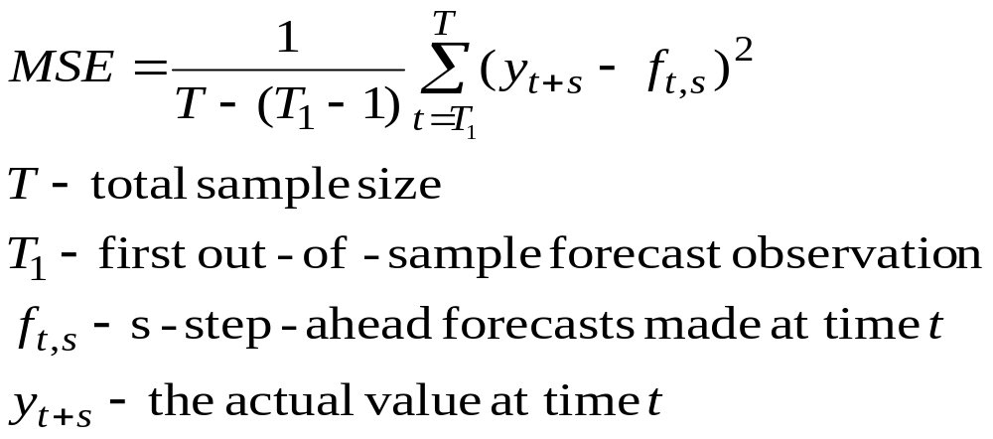
Mean Squared Error (MSE)
The MSE statistic can be defined as:

Slide 42
Forecast Accuracy
There are a number of other measures used and these include:
  Mean Absolute Error
  Mean Average Prediction Error
  Chows test for predictive failure
  Theil’s U-statistic (where the forecast is compared to that of a benchmark model)
  Root Mean Square Error ( the square root of the MSE)

Slide 43
Conclusion
When using AR models, whether the series is stationary of not determine how stable it is.
Box-Jenkins methodology is part art and part science.
Forecasting of time series is an important measure of how well a model works
There are many measures of how accurate a forecast is, usually a number are calculated to determine if the forecast is acceptable, although all have faults.

Slide 44
Thank You

