Slide 1
Machine learning for time-series
Machine learning is the study of algorithms that improve through experience. These algorithms or models can make systematic, repeatable, validated decisions based on data.
The main machine learning problems with time-series:
Forecasting,
Regression,
Classification,
Segmentation,
Anomaly detection.
Notes:
Add graph to generate intuition

Slide 2
Machine learning for time-series
Making predictions about the future is called forecasting. Forecasting can be based only on the time-series values itself or on other variables.
For example, we could be forecasting global temperatures based on the data of the last 100 years, or we could be forecasting the economic wellbeing of a nation.
Notes:
Add graph to generate intuition

Slide 3
Machine learning for time-series
Regression is an umbrella term for statistical approaches for finding relationships between independent variables (features) and dependent variables (targets).
For instance, we could be predicting the exact temperature based on the release of carbon dioxide and methane.
Notes:
Add graph to generate intuition

Slide 4
Machine learning for time-series
When the problem is assigning labels to a time-series (or a part of it), this is called classification.
The main difference to regression is that the prediction is categorical rather than continuous.
Classification can be binary, when there are precisely two classes, or multi-class, when there are more categories.
An example would be detecting eye movements or epilepsy in EEG signals.
Notes:
Add graph to generate intuition

Slide 5
Machine learning for time-series
Segmentation, or clustering, is the process of grouping parts of the time-series into clusters (or segments) of different regimes, behaviors, or baselines.
An example would be different activity levels in brain waves.
Notes:
Add graph to generate intuition

Slide 6
Machine learning for time-series
Anomaly detection, also known as outlier detection, is the task of identifying events that are rare or outside the norm.
Example: An outage of the electricity grid detectable in a sudden drop of the voltage.
Techniques in anomaly detection can range from simple thresholding or statistics to a set of rules, to pattern-based approaches based on the time-series distribution.
Notes:
Add graph to generate intuition

Slide 7
Machine learning for time-series
In supervised learning, the features are mapped to outcomes 𝑦 ∈ 𝑌 in a process called prediction.
Parameters are estimated from labeled observations. We need to have the outcome available for each observation as the target column.
The machine learning algorithm finds a mapping from X to Y.
𝑓: 𝑋 → 𝑌
The function 𝑓 ∈ 𝐹 is just one possible mapping or model of the input distribution X to the output distribution Y.
Notes:
Add graph to generate intuition

Slide 8
Machine learning for time-series
In time-series forecasting, the historical values are extrapolated into the future. The only features are the past values.
For example, we could be estimating the calls into a call center over the next month based on calls during the last 2 years.
The mapping function, f, predicts an outcome 𝑓(𝑋) → Ỹ.
Each function is specified by a set of parameters, and the optimization results in a set of parameters that minimizes the mismatch between Y and Ỹ.
Notes:
Add graph to generate intuition

Slide 9
Machine learning for time-series
To ensure that parameters estimated on a dataset of limited size are still valid for more data, we must go through a validation that makes sure that the quality holds up.
For validation, we usually split the dataset into at least two parts, the training set and the test set. We estimate parameters on a training set, then run the model on the test set to get an idea of the quality of the model on unseen data points.
In machine learning, the process of testing a model on data it hasn't seen in training is called cross-validation (sometimes, out-of-sample testing).
Notes:
Add graph to generate intuition

Slide 10
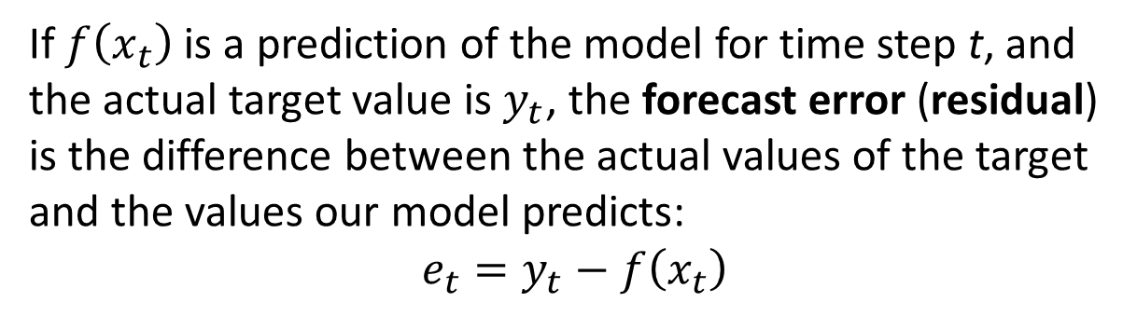
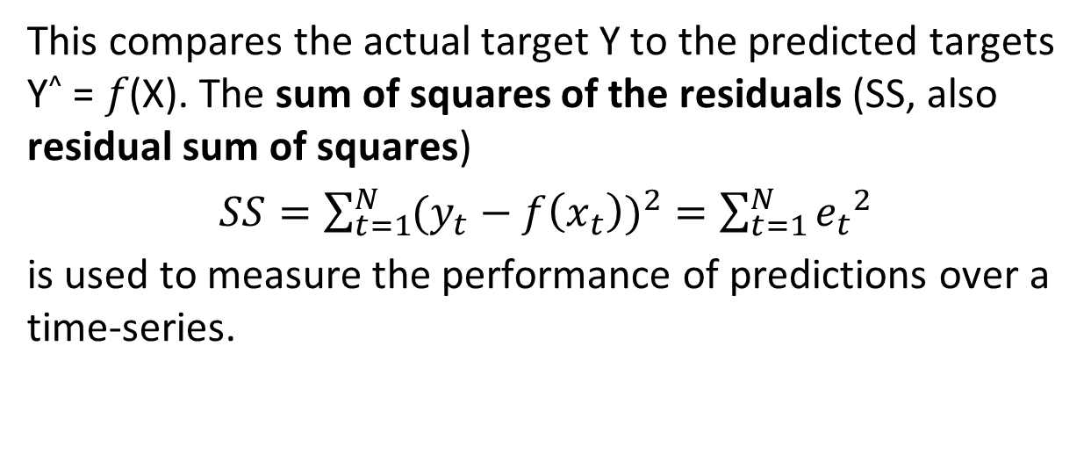
Error metrics for time-series
Notes:
Add graph to generate intuition

Slide 11
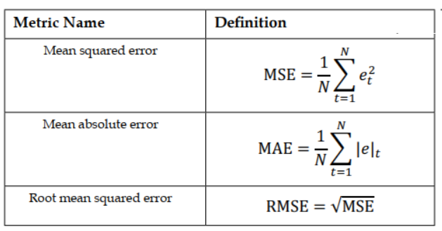
Error metrics for time-series
In practice, the most popular error metrics are the mean squared error (MSE), mean absolute error (MAE), and the root mean squared error (RMSE:
Notes:
Add graph to generate intuition

Slide 12
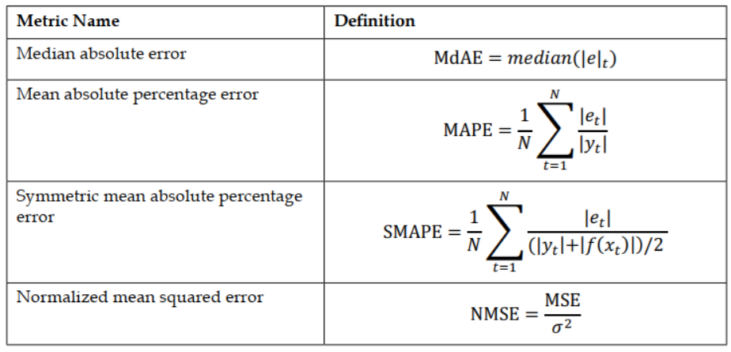
Error metrics for time-series
There are many more error metrics in time-series modeling:
Notes:
Add graph to generate intuition

Slide 13
Box-Jenkins Method in Time Series Forecasting

Slide 14
Autoregressive Integrated Moving Average Model
The Autoregressive Integrated Moving Average Model, or ARIMA for short is a standard statistical model for time series forecast and analysis. This acronym is descriptive, capturing the key aspects of the model itself:
AR: Autoregression. A model that uses the dependent relationship between an observation and some number of lagged observations.
I: Integrated. The use of differencing of raw observations (i.e. subtracting an observation from an observation at the previous time step) in order to make the time series stationary.
MA: Moving Average. A model that uses the dependency between an observation and residual errors from a moving average model applied to lagged observations.
Notes:
Add graph to generate intuition

Slide 15
Autoregressive Integrated Moving Average Model
Each of these components are explicitly specified in the model as a parameter. A standard notation is used of ARIMA(p,d,q) where the parameters are substituted with integer values to quickly indicate the specific ARIMA model being used. The parameters of the ARIMA model are defined as follows:
p: The number of lag observations included in the model, also called the lag order.
d: The number of times that the raw observations are differenced, also called the degree of differencing.
q: The size of the moving average window, also called the order of moving average.
Notes:
Add graph to generate intuition

Slide 16
Configuring AR and MA
Two plots can be used to choose the p and q parameters of the ARMA or ARIMA:
Autocorrelation Function (ACF). The plot summarizes the correlation of an observation with lag values. The x-axis shows the lag and the y-axis shows the correlation coefficient between -1 and 1.
Partial Autocorrelation Function (PACF). The plot summarizes the correlations for
an observation with lag values that is not accounted for by prior lagged observations.
Both plots are drawn as bar charts showing the 95% and 99% confidence intervals as horizontal lines. Bars that cross these confidence intervals are more significant and worth noting. Some useful patterns you may observe on these plots are:
The model is AR if the ACF trails off after a lag and has a hard cut-off in the PACF after a lag. This lag is taken as the value for p.
The model is MA if the PACF trails off after a lag and has a hard cut-off in the ACF after the lag. This lag value is taken as the value for q.
The model is a mix of AR and MA if both the ACF and PACF trail off
The parameter q in ARMA would typically be 3 or less, but this is more a reflection of computing resources rather than statistics.
Notes:
Add graph to generate intuition

Slide 17
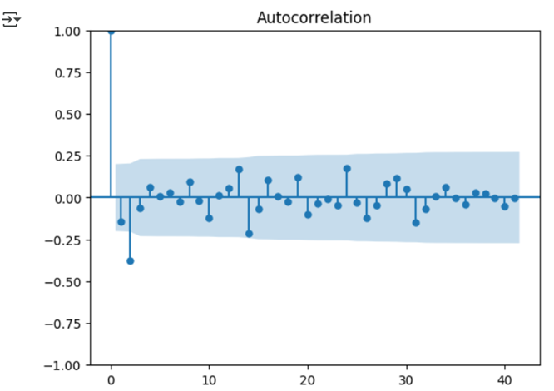
Configuring AR and MA
Notes:
Add graph to generate intuition

Slide 18
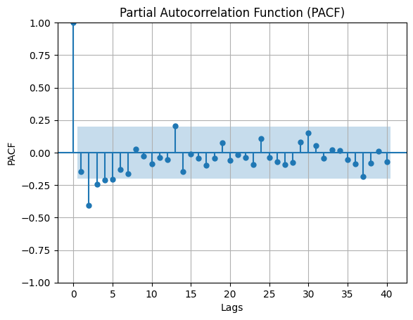
Configuring AR and MA
Notes:
Add graph to generate intuition

Slide 19
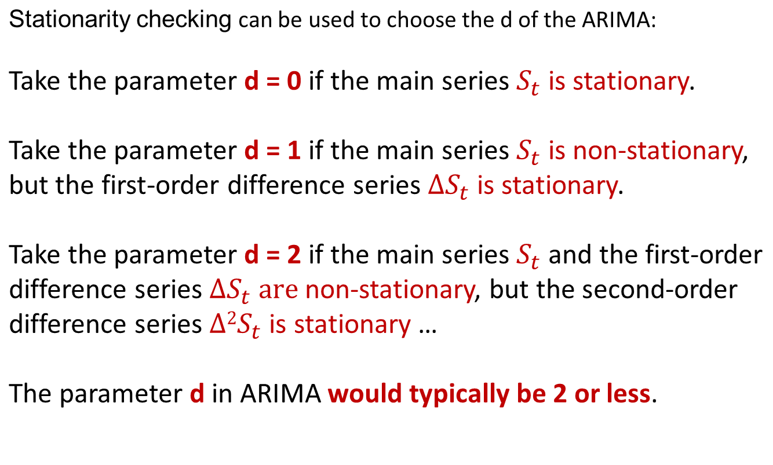
Configuring ARIMA
Notes:
Add graph to generate intuition

Slide 20
Stationarity checking
Augmented Dickey-Fuller test
This is a statistical test that is dedicatedly built to test whether univariate time series data is stationary or not. Let's define the null and alternate hypotheses,
Ho (Null Hypothesis): The time series data is non-stationary
H1 (alternate Hypothesis): The time series data is stationary
Assume alpha = 0.05, meaning (95% confidence). The test results are interpreted with a p-value if p > 0.05 fails to reject the null hypothesis, else if p <= 0.05 reject the null hypothesis.
Notes:
Add graph to generate intuition

Slide 21
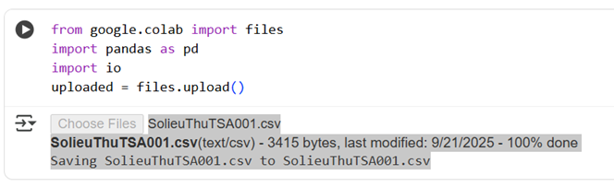
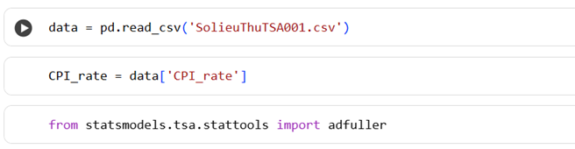
Stationarity checking
Notes:
Add graph to generate intuition

Slide 22
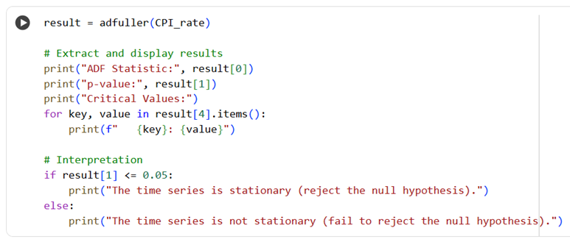
Stationarity checking
Notes:
Add graph to generate intuition

Slide 23
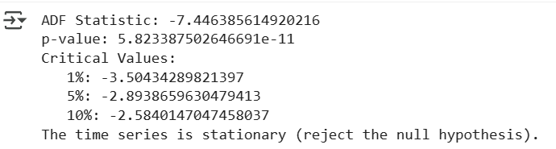
Stationarity checking
Notes:
Add graph to generate intuition

Slide 24
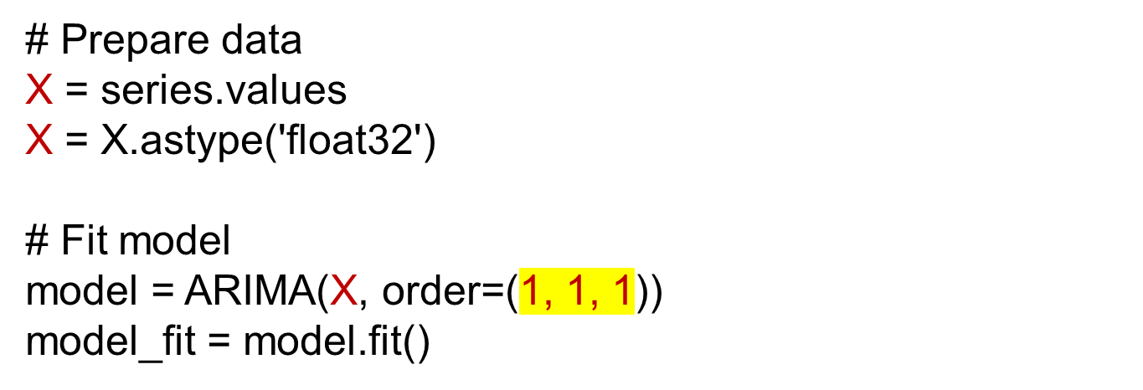
Estimating ARIMA model 1
data = pd.read_csv('SolieuThuTSA001.csv')
series = data['CPI_rate']
pip install statsmodels pandas_datareader
from statsmodels.tsa.arima_model import ARIMA
Notes:
Add graph to generate intuition

Slide 25
Estimating ARIMA model 1
# summary of fit model
print(model_fit.summary())
# line plot of residuals
residuals = DataFrame(model_fit.resid)
residuals.plot()
pyplot.show()
# density plot of residuals
residuals.plot(kind='kde')
pyplot.show()
# summary stats of residuals
print(residuals.describe())
Notes:
Add graph to generate intuition

Slide 26
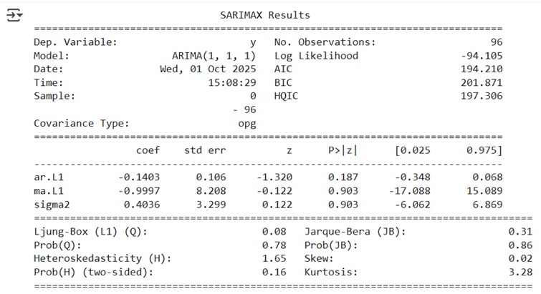
Estimating ARIMA model 1
Notes:
Add graph to generate intuition

Slide 27
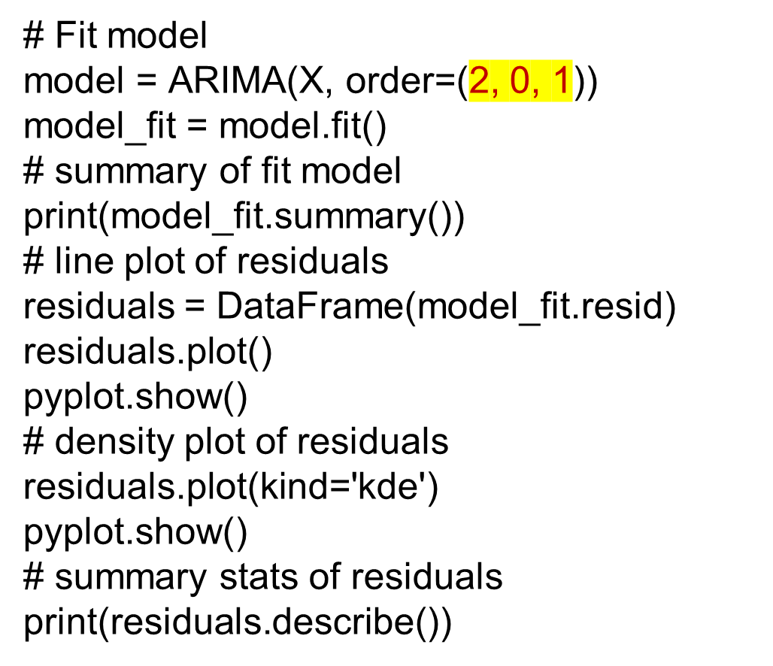
Estimating ARIMA model 2
Notes:
Add graph to generate intuition

Slide 28
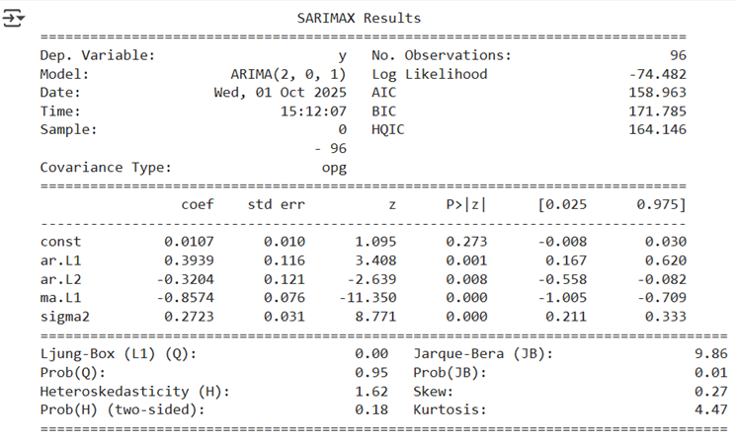
Estimating ARIMA model 2
Notes:
Add graph to generate intuition

Slide 29

Estimating ARIMA model 3
Notes:
Add graph to generate intuition

Slide 30
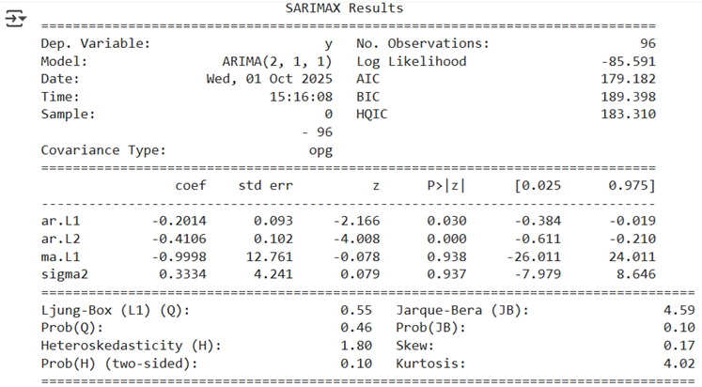
Estimating ARIMA model 3
Notes:
Add graph to generate intuition

Slide 31
Model selection
When we have different models, how do we know which one should we use? Model selection is the methodology for deciding between competing models.
ARMA and ARIMA models are usually estimated with the maximum-likelihood estimation (MLE).
One of the most commonly used model selection criteria for the maximum-likelihood method is the Akaike information criterion (AIC).
Notes:
Add graph to generate intuition

Slide 32


Akaike information criterion
AIC takes the log-likelihood l from the maximum-likelihood method and the number of parameters k in the model.
For an ARIMA model, it is written more specifically:
A model is considered to have higher quality if it has a lower AIC.
Notes:
Add graph to generate intuition

Slide 33


Bayesian Information Criterion
The Bayesian Information Criterion (BIC) looks very much like AIC. It additionally takes N, the sample size in the dataset:
For an ARIMA model, it is written more specifically:
According to BIC, we want a model with few parameters and high log-likelihood, but also a small number of training examples.
A model is considered to have higher quality if it has a lower BIC.
Notes:
Add graph to generate intuition

Slide 34


Hannan–Quinn Information Criterion
The Hannan–Quinn information criterion (HQIC) is an alternative to AIC and BIC. It is given as
For an ARIMA model, it is written more specifically:
A model is considered to have higher quality if it has a lower HQIC.
Notes:
Add graph to generate intuition

Slide 35
Bayesian Information Criterion
The Bayesian Information Criterion (BIC) looks very much like AIC. It additionally takes N, the sample size in the dataset:
For an ARIMA model, it is written more specifically:
According to BIC, we want a model with few parameters and high log-likelihood, but also a small number of training examples.
A model is considered to have higher quality if it has a lower BIC.
Notes:
Add graph to generate intuition

Slide 36
Stability of ARIMA model
Stability in regression models refers to the consistency of the model's coefficients across different time periods or datasets. When coefficients change significantly, it indicates a structural break, which can lead to unreliable predictions.
The stability can be assessed by examining the confidence intervals of the model coefficients. If the CI of a coefficient contains 0, the estimate of this coefficient will easily change from a negative value to a positive value or vice versa. Then the model is unstable, coefficients with CI containing 0 should be removed from the model.
Notes:
Add graph to generate intuition

Slide 37
ARIMA model 1
Parameters ar.L1 and ma.L1 should be removed ➔ p = 0 and q = 0. The model fails.
Notes:
Add graph to generate intuition

Slide 38
ARIMA model 3
Parameter ma.L1 should be removed ➔ q = 0.
Notes:
Add graph to generate intuition

Slide 39
ARIMA model 2
Notes:
Add graph to generate intuition

Slide 40
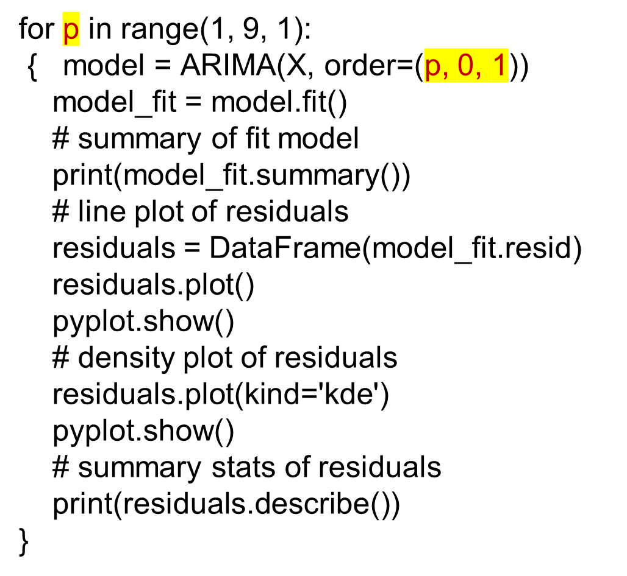
Using “loop” in modelling
Notes:
Add graph to generate intuition

Slide 41
Forecasting ARIMA model
# Mean values Forecasting
from matplotlib import pyplot as plt
STEPS = 20
forecasts_df = model_fit.get_forecast (steps=STEPS).summary_frame()
df1 = series
ax = df1.plot(figsize=(12, 6))
plt.ylabel('CPI_rate')
forecasts_df['mean'].plot(style='k--')
ax.fill_between(
forecasts_df.index,
forecasts_df['mean_ci_lower'],
forecasts_df['mean_ci_upper'],
color='k',
alpha=0.1
)
Notes:
Add graph to generate intuition

Slide 42
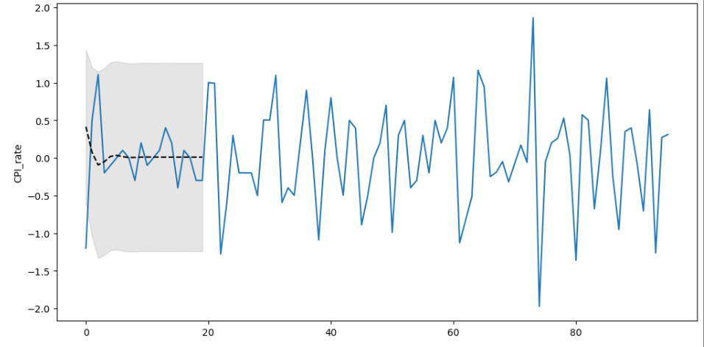
Forecasting ARIMA model
Notes:
Add graph to generate intuition

Slide 43
Forecasting ARIMA model
# Split data series to train part and test part
train = series[series.index <= 80]
test = series[series.index > 80]
plt.plot(train, color = "black")
plt.plot(test, color = "red")
plt.ylabel('CPI_rate')
plt.xlabel('Time')
plt.xticks(rotation=45)
plt.title("Train/Test split for CPI rate Data")
plt.show()
Notes:
Add graph to generate intuition

Slide 44
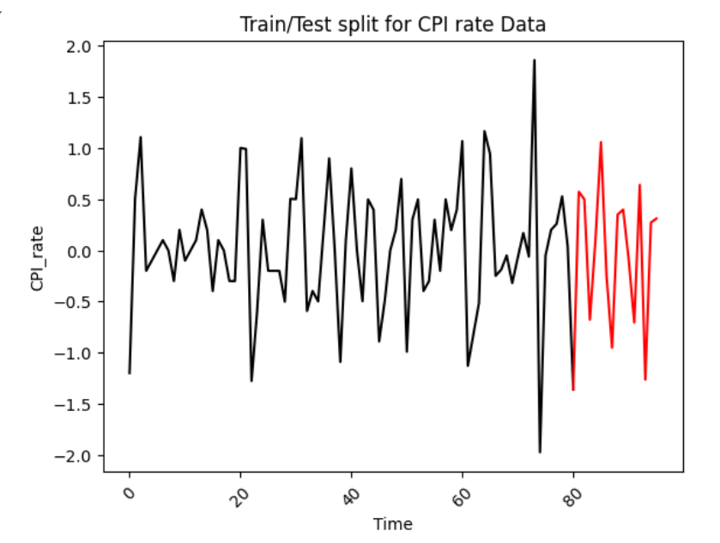
Forecasting ARIMA model
Notes:
Add graph to generate intuition

Slide 45
Forecasting ARIMA model
from statsmodels.tsa.arima.model import ARIMA
ARIMAmodel = ARIMA(y, order = (2, 0, 1))
ARIMAmodel = ARIMAmodel.fit()
y_pred = ARIMAmodel.get_forecast(len(test.index))
y_pred_df = y_pred.conf_int(alpha = 0.05)
y_pred_df["Predictions"] = ARIMAmodel.predict(start = y_pred_df.index[0], end = y_pred_df.index[-1])
y_pred_df.index = test.index
y_pred_out = y_pred_df["Predictions"]
plt.plot(y_pred_out, color='red', label = 'ARIMA Predictions')
plt.plot(test, color='Yellow', label = 'Testing')
plt.plot(train, color='black', label = 'Train')
plt.legend()
Notes:
Add graph to generate intuition

Slide 46
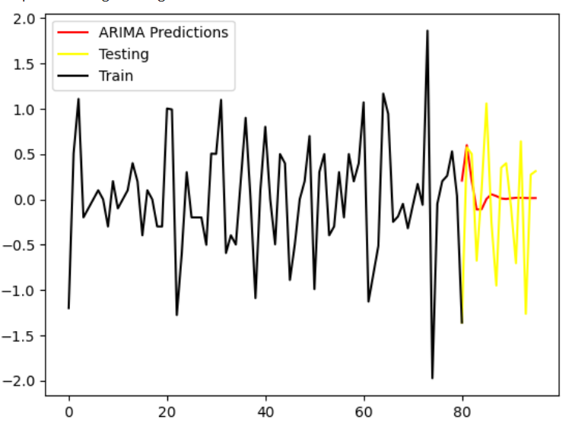
Forecasting ARIMA model
Notes:
Add graph to generate intuition

Slide 47

Forecasting ARIMA model
# Evaluate the accuracy of forecasting
import numpy as np
from sklearn.metrics import mean_squared_error
arma_rmse = np.sqrt(mean_squared_error(test.values, y_pred_df["Predictions"]))
print("RMSE: ",arma_rmse)
Notes:
Add graph to generate intuition

Slide 48
Seasonal ARIMA (SARIMA) Model
Seasonal ARIMA captures historical values, shock events and seasonality.
The general notation for a SARIMA model is expressed as:
SARIMA(p,d,q)(P,D,Q, m). Where:
p: Order of the non-seasonal autoregressive part.
d: Degree of differencing (non-seasonal).
q: Order of the non-seasonal moving average part.
P: Order of the seasonal autoregressive part.
D: Degree of seasonal differencing.
Q: Order of the seasonal moving average part.
m: Number of periods in each season
(e.g., 12 for monthly data with yearly seasonality).
Notes:
Add graph to generate intuition

Slide 49
Seasonal ARIMA (SARIMA) Model
We can define a SARIMA model using the SARIMAX class:
from statsmodels.tsa.statespace.sarimax import SARIMAX
Notes:
Add graph to generate intuition

Slide 50
Seasonal ARIMA (SARIMA) Model
SARIMAXmodel = SARIMAX(y, order = (2, 0, 1), seasonal_order=(2,0,1,12))
SARIMAXmodel = SARIMAXmodel.fit()
y_pred = SARIMAXmodel.get_forecast(len(test.index))
y_pred_df = y_pred.conf_int(alpha = 0.05)
y_pred_df["Predictions"] = SARIMAXmodel.predict(start = y_pred_df.index[0], end = y_pred_df.index[-1])
y_pred_df.index = test.index
y_pred_out = y_pred_df["Predictions"]
plt.plot(test, color='Yellow', label = 'Testing')
plt.plot(train, color='black', label = 'Train')
plt.plot(y_pred_out, color='Blue', label = 'SARIMA Predictions')
plt.legend()
Notes:
Add graph to generate intuition

Slide 51
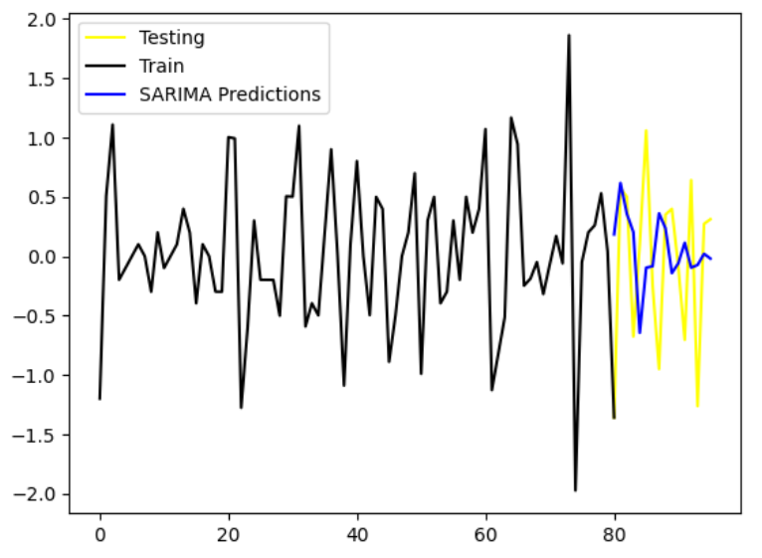
Seasonal ARIMA (SARIMA) Model
Notes:
Add graph to generate intuition

Slide 52

Seasonal ARIMA (SARIMA) Model
import numpy as np
from sklearn.metrics import mean_squared_error
arma_rmse = np.sqrt(mean_squared_error(test.values, y_pred_df["Predictions"]))
print("RMSE: ",arma_rmse)
Notes:
Add graph to generate intuition

Slide 53
THANK YOU

