Slide 1
Unsupervised Methods for Time-Series
The performance of predictive models is undermined by major changes in the data. Recognizing these changes is the domain of unsupervised learning.
At the core of unsupervised learning is the extraction of structure from time-series, most importantly recognizing similarities between subsequences. This is the essence of anomaly detection, where we want to identify sequences that are notably different from the rest of the series.
Notes:
Add graph to generate intuition

Slide 2
Unsupervised Methods for Time-Series
An important challenge of working with time-series is recognizing the changes in the underlying processes. This is called change point detection (CPD) or drift detection.
Data changes over time, and it is crucial to recognize how much it changes. This is worth diving into, because the existence of change points and anomalous points are common problems with real-world applications.
Notes:
Add graph to generate intuition

Slide 3
Anomaly detection for Time-Series
In anomaly detection, we want to identify sequences that are notably different from the rest of the series. Anomalies or outliers can sometimes be the result of measurement error or noise, but they could indicate changes to behavior or aberrant behavior in the system under observation, which could require urgent action.
Definition: An outlier is a data point that deviates so significantly from other observations that it could have been generated by a different mechanism
Notes:
Add graph to generate intuition

Slide 4
Anomaly detection for Time-Series
In the simplest case, we can define an outlier as follows as the z-score of the observation x i with respect to the distribution parameters:
Outlier(𝜇̂, 𝜎̂) = {𝑥: |𝑥- 𝑥̂|/ 𝜎̂) > 𝜖}
The z-score measures the distance of each point from the moving average or sample mean, 𝑥̂, in units of the moving or sample standard deviation 𝜎̂.
𝜇̂ and 𝜎̂ are the estimated mean and standard deviation of the timeseries, 𝜖 is a threshold dependent on the confidence interval that we are interested in, e.g., 2 or 1.96 are corresponding to a confidence interval of 95%. In this way, outliers are points that occur 5% or less of the time.
Notes:
Add graph to generate intuition

Slide 5
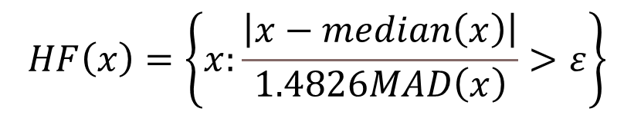
Anomaly detection for Time-Series
The Hampel filter (Hampel identifier)
where MAD is the median absolute deviation,
In the Hampel filter, each observation, x, will be compared to the median. In the case of the normal distribution, the Hampel filter is equivalent to the z-score, and epsilon can be chosen the same way as for the z-score.
Notes:
Add graph to generate intuition

Slide 6
Anomaly detection for Time-Series
Anomaly detection in time series data involves identifying unusual patterns or deviations from expected behavior.
1. Z-Score Method
identifies anomalies based on how far a data point deviates from the mean, measured in standard deviations.
from pandas import read_csv
from matplotlib import pyplot
data = pd.read_csv('SolieuThuTSA001_05.csv')
# Calculate Z-Scores:
mean = data['CPI_rate'].mean()
std_dev = data['CPI_rate'].std()
data['z_score'] = (data['CPI_rate'] - mean) / std_dev
Notes:
Add graph to generate intuition

Slide 7
Anomaly detection for Time-Series
# Identify Anomalies:
threshold = 3 # Customize threshold
anomalies = data[np.abs(data['z_score']) > threshold]
print(anomalies)
Notes:
Add graph to generate intuition

Slide 8
Anomaly detection for Time-Series
# Visualize Results:
import matplotlib.pyplot as plt
plt.plot(data.index, data['CPI_rate'], label='Data')
plt.scatter(anomalies.index, anomalies['CPI_rate'], color='red', label='Anomalies')
plt.legend()
plt.show()
Notes:
Add graph to generate intuition

Slide 9
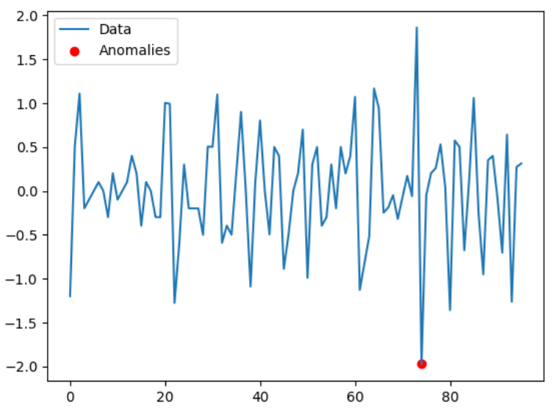
Anomaly detection for Time-Series
Notes:
Add graph to generate intuition

Slide 10
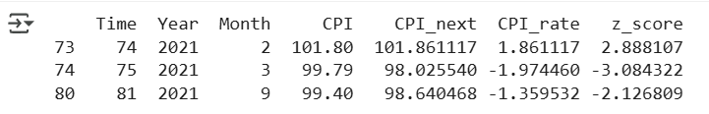
Anomaly detection for Time-Series
# Identify Anomalies:
threshold = 2 # Customize threshold
anomalies = data[np.abs(data['z_score']) > threshold]
print(anomalies)
Notes:
Add graph to generate intuition

Slide 11
Anomaly detection for Time-Series
# Visualize Results:
import matplotlib.pyplot as plt
plt.plot(data.index, data['CPI'], label='Data')
plt.scatter(anomalies.index, anomalies['CPI'], color='red', label='Anomalies')
plt.legend()
plt.show()
Notes:
Add graph to generate intuition

Slide 12
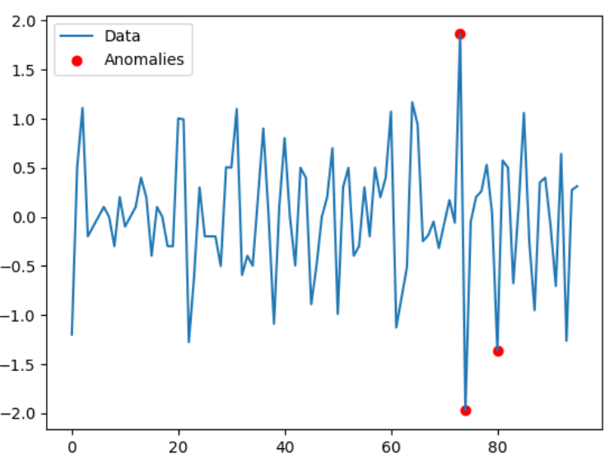
Anomaly detection for Time-Series
Notes:
Add graph to generate intuition

Slide 13
Anomaly detection for Time-Series
2. Isolation Forest
This machine learning method isolates anomalies by randomly partitioning the data.
Import and Prepare Data:
from sklearn.ensemble import IsolationForest
X = data[[‘CPI_rate']].values
Train Isolation Forest:
model = IsolationForest(contamination=0.05, random_state=42)
data['anomaly'] = model.fit_predict(X)
Notes:
Add graph to generate intuition

Slide 14
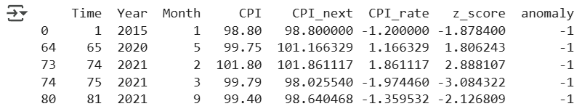
Anomaly detection for Time-Series
Filter Anomalies:
anomalies = data[data['anomaly'] == -1]
print(anomalies)
Visualize Results:
plt.plot(data.index, data[‘CPI_rate'], label='Data')
plt.scatter(anomalies.index, anomalies[‘CPI_rate'], color='red', label='Anomalies')
plt.legend()
plt.show()
Notes:
Add graph to generate intuition

Slide 15
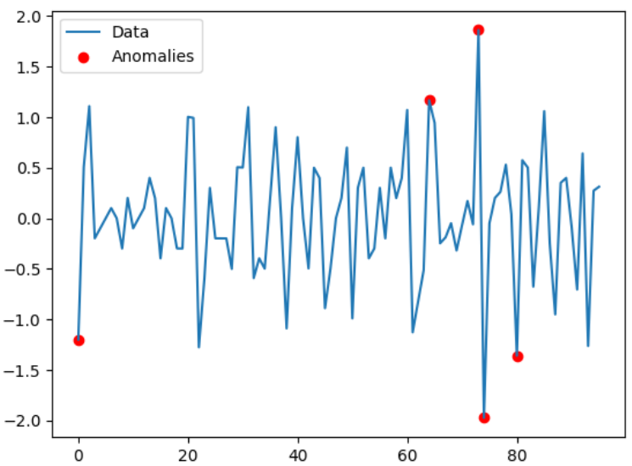
Anomaly detection for Time-Series
Notes:
Add graph to generate intuition

Slide 16
Change Point detection for Time-Series
Ruptures: Change Point Detection in Python
Ruptures is a Python library designed for off-line change point detection, which is the process of identifying points in a signal where statistical properties change. It is particularly useful for analyzing and segmenting non-stationary signals. The library supports both parametric and non-parametric models, offering a variety of exact and approximate algorithms.
pip install ruptures
Notes:
Add graph to generate intuition

Slide 17

Change Point detection for Time-Series
pip install ruptures
import ruptures as rpt
from google.colab import files
import pandas as pd
import io
import numpy as np
uploaded = files. upload()
from pandas import read_csv
from matplotlib import pyplot
data = pd.read_csv('DongNamA_GDP_C.csv')
Notes:
Add graph to generate intuition

Slide 18
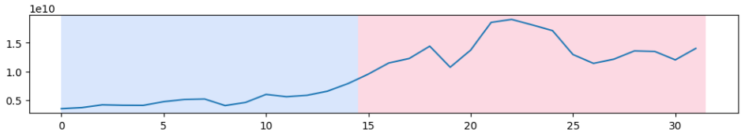
Change Point detection for Time-Series
X = data[['Brunei']].values
# Apply the Pelt algorithm for change point detection
algo = rpt.Pelt(model="rbf").fit(X)
result = algo.predict(pen=10)
# Display the results
rpt.display(X,result)
plt.show()
Notes:
Add graph to generate intuition

Slide 19
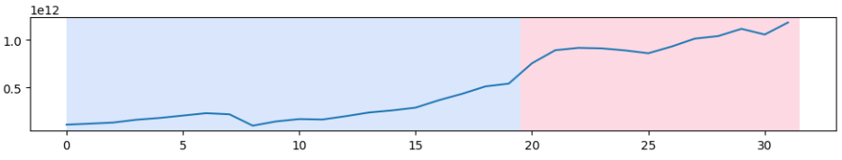
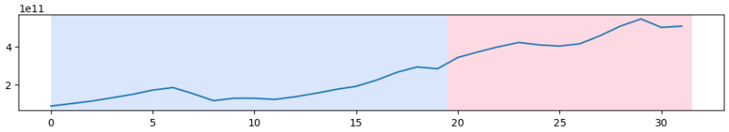
Change Point detection for Time-Series
X = data[['Indonesia']].values
. . .
X = data[['Thailand']].values
Notes:
Add graph to generate intuition

Slide 20
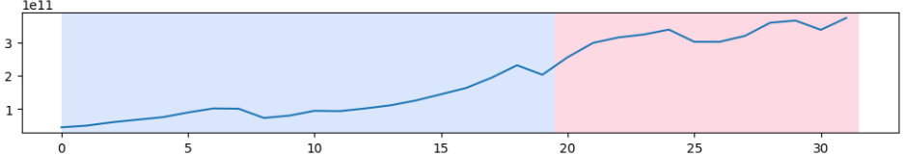
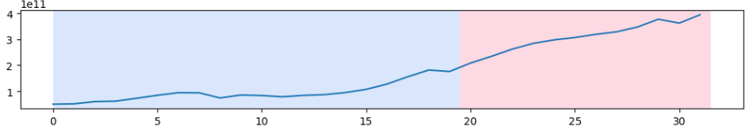
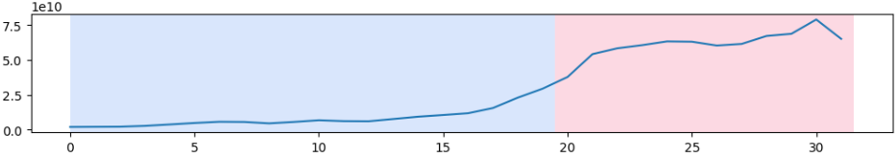
Change Point detection for Time-Series
X = data[['Malaysia']].values
X = data[['Philippines']].values
X = data[['Myanmar']].values
Notes:
Add graph to generate intuition

Slide 21
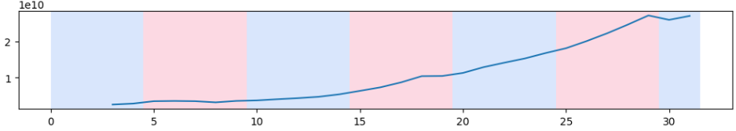
Change Point detection for Time-Series
X = data[['Cambodia']].values
Notes:
Add graph to generate intuition

Slide 22
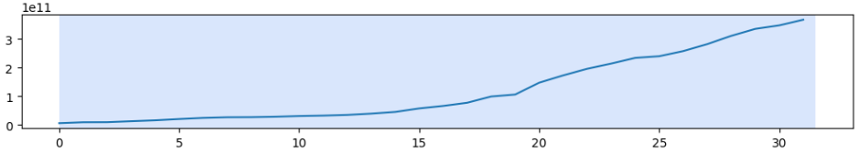
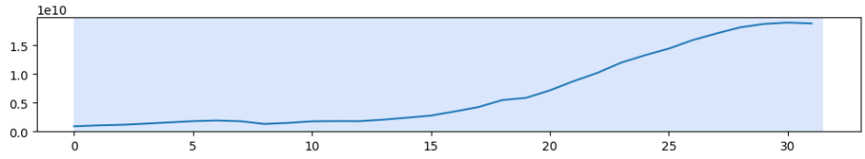
Change Point detection for Time-Series
X = data[['Vietnam']].values
X = data[['LaoPDR']].values
Notes:
Add graph to generate intuition

Slide 23
THANK YOU

