Slide 1



Tunisian Republic
Ministry of Higher Education, and Scientific Research
University of Tunis Manar
National Engineering School of Tunis
Presentation of internship Project
Forecasting exchange rate using machine learning techniques
Presented by : Kais FRAYOU Defended on the : 12/10/2022
Presented by : Chaima BELKACEM Defended on the : 07/11/2022
Supervisor At The Company: Mr. Zied JAIDI
Notes:
Hello Judge , first of all i want to thank you for being present in my internship project presentation. My name is chaima belkacem final year electrical engineering student at ENIT. I am looking forward to introduce you to my graduation project subject which is BPR De and impl for an OOp In sytem. Supervised by MR IKH an dMRS Khaled.

Slide 2

Project Context
Exchange rate models
Variables extraction
AGENDA
Data preprocessing
Machine learning application
Result and interpretation
Conclusion And Perspectives
Notes:
To understand the subject of my graduation project i’ll be elaborating the following items starting with the project context, than the value stream mapping of the olive oil production process, Arena simulation with raw data, IT OT integration, the UHMI, afer that we have the Arena simulation after SIOTH data integration and finally the conclusion and perspectives.

Slide 3





Project Context
Exchange rate models
Variables extraction
Data preprocessing
Result and interpretation
Conclusion And Perspectives
Machine learning application
Project Context
Host Company Presentation
Tunisian currency Issue
and it’s circulation
Frequent statistics
Monetary policy
oversight
Notes:
This project was held within Integration objects which is a tunisian company founded in 2002, it is one of the worldwide leading companies in process automation, operational intelligence and command and control systems .it is certified iso 9001 and iso 27001
Here are IO partners such as Total energy, Shell, Simens etc

Slide 4



Project Context
Exchange rate models
Variables extraction
Data preprocessing
Result and interpretation
Conclusion And Perspectives
Machine learning application
Project Context
Problematic
Predicting with machine learning
Exchange rate
Data collection
Notes:
To ensure the continious improvement of the olive oil industry through the generated data, analysing yhe current situation of the olive oil industry is needed to detect the significant problems than find them solution and echieve the improvemnts .

Slide 5



Project Context
Exchange rate models
Variables extraction
Data preprocessing
Result and interpretation
Conclusion And Perspectives
Machine learning application
Project Context
Tools
Notes:
After mapping the current situation of the olive oil industry, we are going to use the Arena simulation software, and vsm for current situation analysis and problems identification, as for ensuring the continious improvement for the olive oil industry i am going to concept the Iformation system of the ooi using the UHMI and generating more data using sioth data integration platform.
VSM Allows me to create a visual map of the end-to-end process of a product or service.
Arena simulation software helped me analyse the current situation of the system, which helps identifying the process contraints and limitaions also helps with the decision making.

Slide 6


Project Context
Exchange rate models
Variables extraction
Data preprocessing
Result and interpretation
Conclusion And Perspectives
Machine learning application
Project Context
Solution
Notes:
After mapping the current situation of the olive oil industry, we are going to use the Arena simulation software, and vsm for current situation analysis and problems identification, as for ensuring the continious improvement for the olive oil industry i am going to concept the Iformation system of the ooi using the UHMI and generating more data using sioth data integration platform.

Slide 7
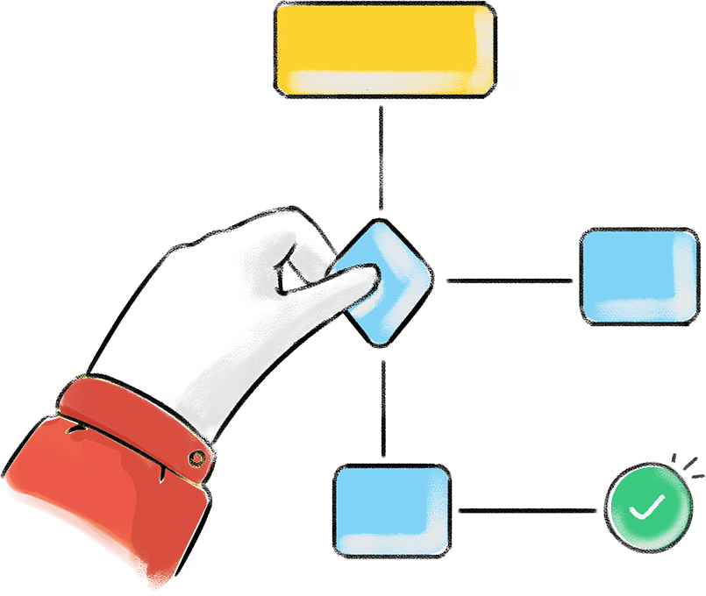
Exchange rate models
Notes:
To have a better understanding of the system i needed to create a visual map of the end to end process product.

Slide 8

Project Context
Exchange rate models
Variables extraction
Data preprocessing
Result and interpretation
Conclusion And Perspectives
Machine learning application
Exchange rate models
Exchange rate
Fundamental models of the equilibruim of real exchange rate
Williamson’s FEER model
BEER model of clark Mcdonald
Financial models of the exchange rate
Portfolio slection models
Models based on the balance of trade
Notes:
We chose to work with 1 milling line and 1 bottling line in this process to simplify the scenarios we are going to simulate , this process processes 1000 kg of olives every 1h . As a first observation of the process we can notice the limited capacity of the decanter so it’s limiting all the other processes capacity for that it is identified as a bottleneck . Based on the framed processes i am goint to model the VSM

Slide 9

Variables extraction
Notes:
After having a more undewith arena simulation software rstanding of the process we are going to simulate the raw data such the capacity of the different resources and process time,

Slide 10
Project Context
Exchange rate models
Variables extraction
Data preprocessing
Result and interpretation
Conclusion And Perspectives
Machine learning application
Variables extraction
Variables selection
Exchange rate TND/Euro
CPI
IPI
Reserves
Commercial balance
Interest rate
M3
Exchange rate (dollar/euro)
Notes:
I modeled the process in Arena simulation software as shown in this slide it is a software for process simulation that generates report containing information about resources performance and process productivity. , the process is simulated over 24h with a quantity arriving of 1000kg/h. befor entering the milling process, a decide module is present to chose to work with milling 1 line that contains the disk mill and the haammer mill, than the second decide to model the waste which 10% of the crusher quantity of olives, so 90% continue in the process. After the decantation and centrifugation we have anothet decide model to to help us get rid of husk and black water waste that represents 80% of the quantity produced to continue the process with 20% of olive oil, finally the decide model to decide the lines to work with in the bottling peocesss.

Slide 11

Project Context
Exchange rate models
Variables extraction
Data preprocessing
Result and interpretation
Conclusion And Perspectives
Machine learning application
Variables extraction
Extraction sites
Get the data from the
International Monetary Fund Website
Data
Notes:
I modeled the process in Arena simulation software as shown in this slide it is a software for process simulation that generates report containing information about resources performance and process productivity. , the process is simulated over 24h with a quantity arriving of 1000kg/h. befor entering the milling process, a decide module is present to chose to work with milling 1 line that contains the disk mill and the haammer mill, than the second decide to model the waste which 10% of the crusher quantity of olives, so 90% continue in the process. After the decantation and centrifugation we have anothet decide model to to help us get rid of husk and black water waste that represents 80% of the quantity produced to continue the process with 20% of olive oil, finally the decide model to decide the lines to work with in the bottling peocesss.

Slide 12

Data preprocessing
Notes:
After having a more undewith arena simulation software rstanding of the process we are going to simulate the raw data such the capacity of the different resources and process time,

Slide 13
Project Context
Exchange rate models
Variables extraction
Data preprocessing
Result and interpretation
Conclusion And Perspectives
Machine learning application
Data preprocessing
Handling missing values
Fill the missing Values with the Median of the dataset
Missing Values
Notes:
I modeled the process in Arena simulation software as shown in this slide it is a software for process simulation that generates report containing information about resources performance and process productivity. , the process is simulated over 24h with a quantity arriving of 1000kg/h. befor entering the milling process, a decide module is present to chose to work with milling 1 line that contains the disk mill and the haammer mill, than the second decide to model the waste which 10% of the crusher quantity of olives, so 90% continue in the process. After the decantation and centrifugation we have anothet decide model to to help us get rid of husk and black water waste that represents 80% of the quantity produced to continue the process with 20% of olive oil, finally the decide model to decide the lines to work with in the bottling peocesss.

Slide 14

Project Context
Exchange rate models
Variables extraction
Data preprocessing
Result and interpretation
Conclusion And Perspectives
Machine learning application
Data preprocessing
Features scaling
Difference between variables ’ scale
Scaled features
Reduce the scale
Normality test
(NOK)
Normalization
Deleting outliers
Notes:
I modeled the process in Arena simulation software as shown in this slide it is a software for process simulation that generates report containing information about resources performance and process productivity. , the process is simulated over 24h with a quantity arriving of 1000kg/h. befor entering the milling process, a decide module is present to chose to work with milling 1 line that contains the disk mill and the haammer mill, than the second decide to model the waste which 10% of the crusher quantity of olives, so 90% continue in the process. After the decantation and centrifugation we have anothet decide model to to help us get rid of husk and black water waste that represents 80% of the quantity produced to continue the process with 20% of olive oil, finally the decide model to decide the lines to work with in the bottling peocesss.

Slide 15
Machine Learning applications
Notes:
After having a more undewith arena simulation software rstanding of the process we are going to simulate the raw data such the capacity of the different resources and process time,

Slide 16
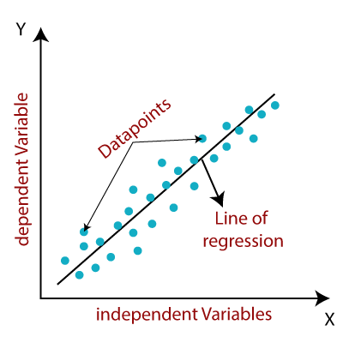
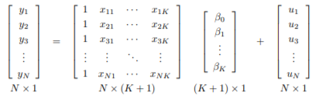

Project Context
Exchange rate models
Variables extraction
Data preprocessing
Result and interpretation
Conclusion And Perspectives
Machine learning application
Machine learning application
Multiple linear regression model
2D Representation
Notes:
I modeled the process in Arena simulation software as shown in this slide it is a software for process simulation that generates report containing information about resources performance and process productivity. , the process is simulated over 24h with a quantity arriving of 1000kg/h. befor entering the milling process, a decide module is present to chose to work with milling 1 line that contains the disk mill and the haammer mill, than the second decide to model the waste which 10% of the crusher quantity of olives, so 90% continue in the process. After the decantation and centrifugation we have anothet decide model to to help us get rid of husk and black water waste that represents 80% of the quantity produced to continue the process with 20% of olive oil, finally the decide model to decide the lines to work with in the bottling peocesss.

Slide 17

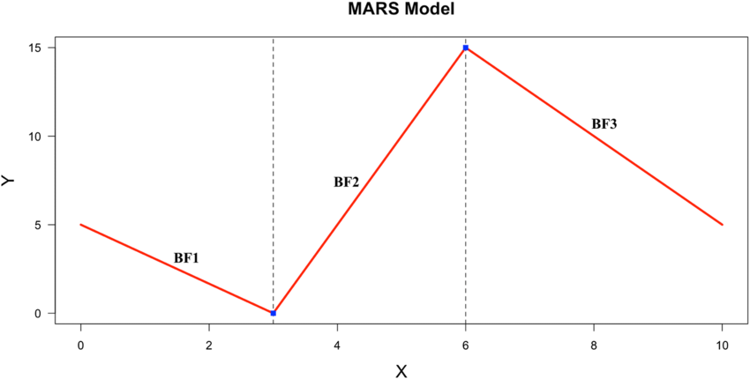
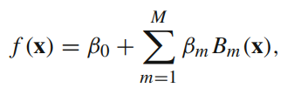
Project Context
Exchange rate models
Variables extraction
Data preprocessing
Result and interpretation
Conclusion And Perspectives
Machine learning application
Machine learning application
Multivariate adaptive regression splines model
Notes:
I modeled the process in Arena simulation software as shown in this slide it is a software for process simulation that generates report containing information about resources performance and process productivity. , the process is simulated over 24h with a quantity arriving of 1000kg/h. befor entering the milling process, a decide module is present to chose to work with milling 1 line that contains the disk mill and the haammer mill, than the second decide to model the waste which 10% of the crusher quantity of olives, so 90% continue in the process. After the decantation and centrifugation we have anothet decide model to to help us get rid of husk and black water waste that represents 80% of the quantity produced to continue the process with 20% of olive oil, finally the decide model to decide the lines to work with in the bottling peocesss.

Slide 18
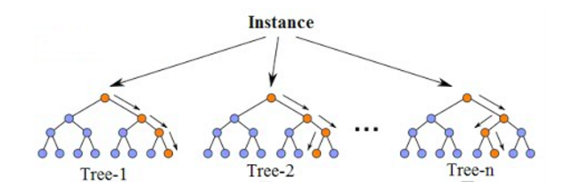
Project Context
Exchange rate models
Variables extraction
Data preprocessing
Result and interpretation
Conclusion And Perspectives
Machine learning application
Machine learning application
Random forest model
=10
Notes:
I modeled the process in Arena simulation software as shown in this slide it is a software for process simulation that generates report containing information about resources performance and process productivity. , the process is simulated over 24h with a quantity arriving of 1000kg/h. befor entering the milling process, a decide module is present to chose to work with milling 1 line that contains the disk mill and the haammer mill, than the second decide to model the waste which 10% of the crusher quantity of olives, so 90% continue in the process. After the decantation and centrifugation we have anothet decide model to to help us get rid of husk and black water waste that represents 80% of the quantity produced to continue the process with 20% of olive oil, finally the decide model to decide the lines to work with in the bottling peocesss.

Slide 19
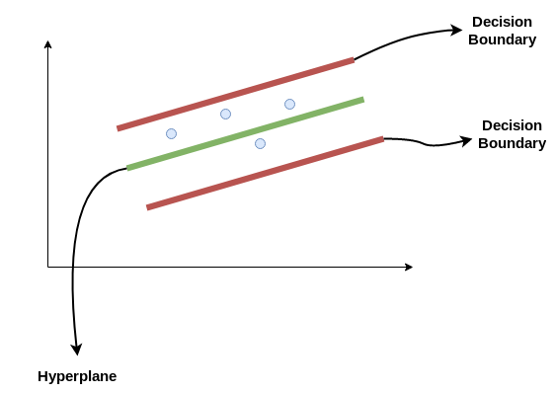
Project Context
Exchange rate models
Variables extraction
Data preprocessing
Result and interpretation
Conclusion And Perspectives
Machine learning application
Machine learning application
Support vector regressor model
Notes:
I modeled the process in Arena simulation software as shown in this slide it is a software for process simulation that generates report containing information about resources performance and process productivity. , the process is simulated over 24h with a quantity arriving of 1000kg/h. befor entering the milling process, a decide module is present to chose to work with milling 1 line that contains the disk mill and the haammer mill, than the second decide to model the waste which 10% of the crusher quantity of olives, so 90% continue in the process. After the decantation and centrifugation we have anothet decide model to to help us get rid of husk and black water waste that represents 80% of the quantity produced to continue the process with 20% of olive oil, finally the decide model to decide the lines to work with in the bottling peocesss.

Slide 20
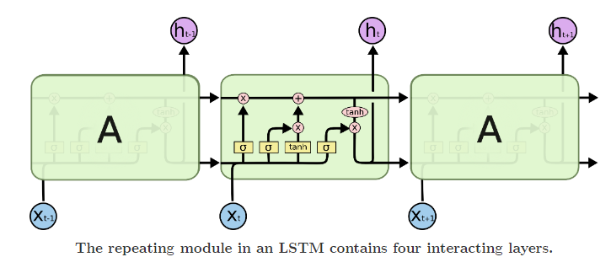
Project Context
Exchange rate models
Variables extraction
Data preprocessing
Result and interpretation
Conclusion And Perspectives
Machine learning application
Machine learning application
Long short-term memory model
Notes:
I modeled the process in Arena simulation software as shown in this slide it is a software for process simulation that generates report containing information about resources performance and process productivity. , the process is simulated over 24h with a quantity arriving of 1000kg/h. befor entering the milling process, a decide module is present to chose to work with milling 1 line that contains the disk mill and the haammer mill, than the second decide to model the waste which 10% of the crusher quantity of olives, so 90% continue in the process. After the decantation and centrifugation we have anothet decide model to to help us get rid of husk and black water waste that represents 80% of the quantity produced to continue the process with 20% of olive oil, finally the decide model to decide the lines to work with in the bottling peocesss.

Slide 21

Results Interpretaion
Notes:
After having a more undewith arena simulation software rstanding of the process we are going to simulate the raw data such the capacity of the different resources and process time,

Slide 22
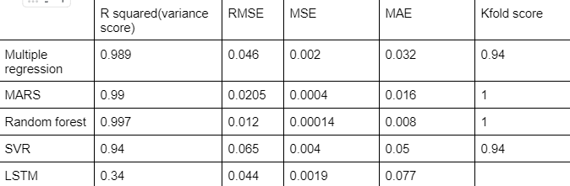
Project Context
Exchange rate models
Variables extraction
Data preprocessing
Result and interpretation
Conclusion And Perspectives
Machine learning application
Result and Interpretation
Best Model
Notes:
I modeled the process in Arena simulation software as shown in this slide it is a software for process simulation that generates report containing information about resources performance and process productivity. , the process is simulated over 24h with a quantity arriving of 1000kg/h. befor entering the milling process, a decide module is present to chose to work with milling 1 line that contains the disk mill and the haammer mill, than the second decide to model the waste which 10% of the crusher quantity of olives, so 90% continue in the process. After the decantation and centrifugation we have anothet decide model to to help us get rid of husk and black water waste that represents 80% of the quantity produced to continue the process with 20% of olive oil, finally the decide model to decide the lines to work with in the bottling peocesss.

Slide 23

Conclusion And Perspectives

Slide 24
Project Context
Exchange rate models
Variables extraction
Data preprocessing
Result and interpretation
Conclusion And Perspectives
Machine learning application
Conclusion And Perspectives
Conclusion
Make a theoratical study about the exchange rate
Coding with python in google collab .
Preparing a data set in order to apply machine learning techniques and compare between
Notes:
as a conclusion we can see that In this project we achieved the following tasks such as …

Slide 25
Project Context
Exchange rate models
Variables extraction
Data preprocessing
Result and interpretation
Conclusion And Perspectives
Machine learning application
Conclusion And Perspectives
Perspectives
Implement the created models in an information system
Apply other methods
make a real time prediction
Try to collect more data
Notes:
For further improvements we can work on …

Slide 26
Thank you for your attention

