Slide 1



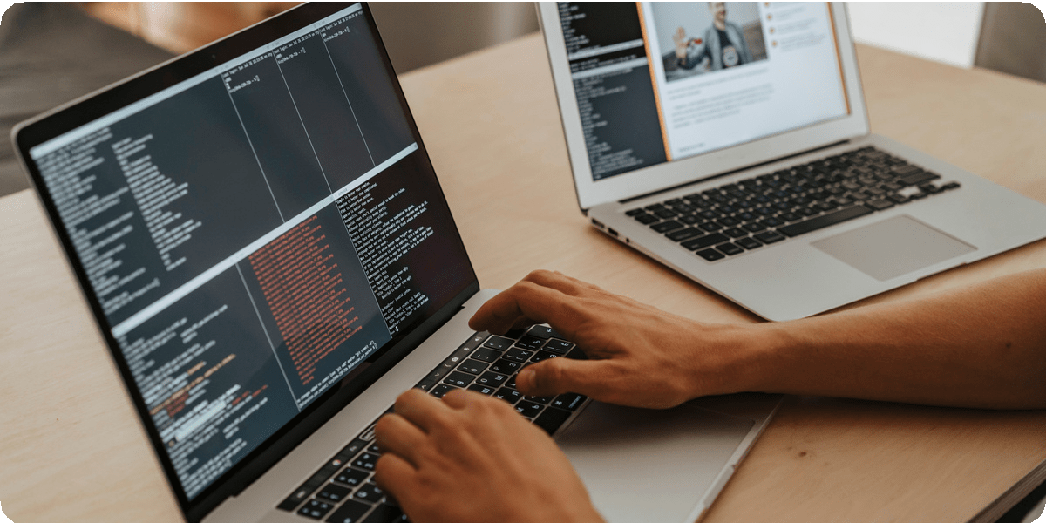
python project
Presentation By
Shaik Kaisar Parvez

Slide 2



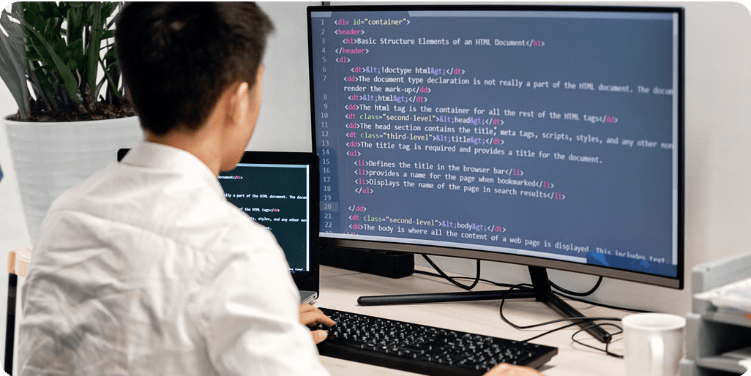




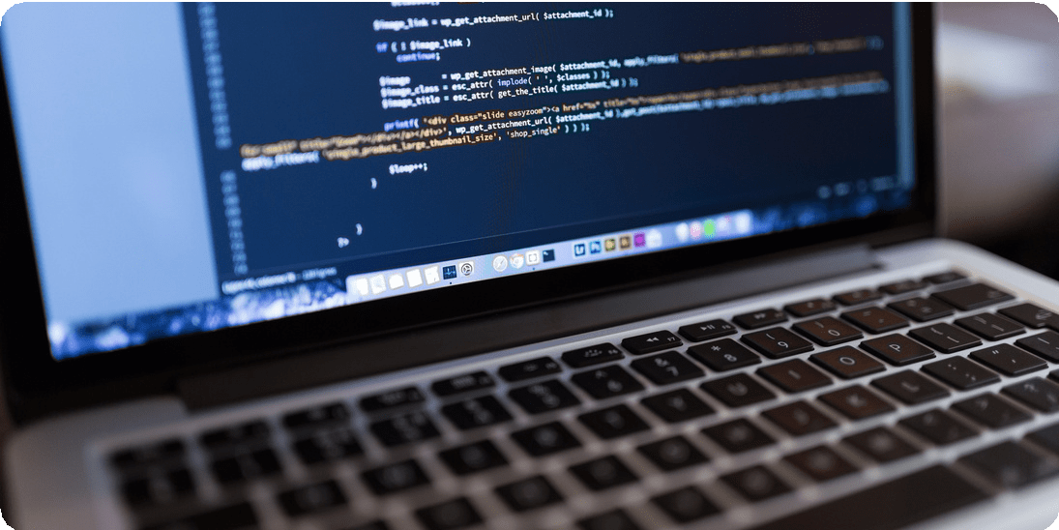
Intro
Imagine you have a friend who speaks only French, and you only speak English. You need a translator to help you understand each other, right?
A programmer is like a translator for computers! They write instructions (called code) in a language that computers understand, telling them what to do.

Slide 3



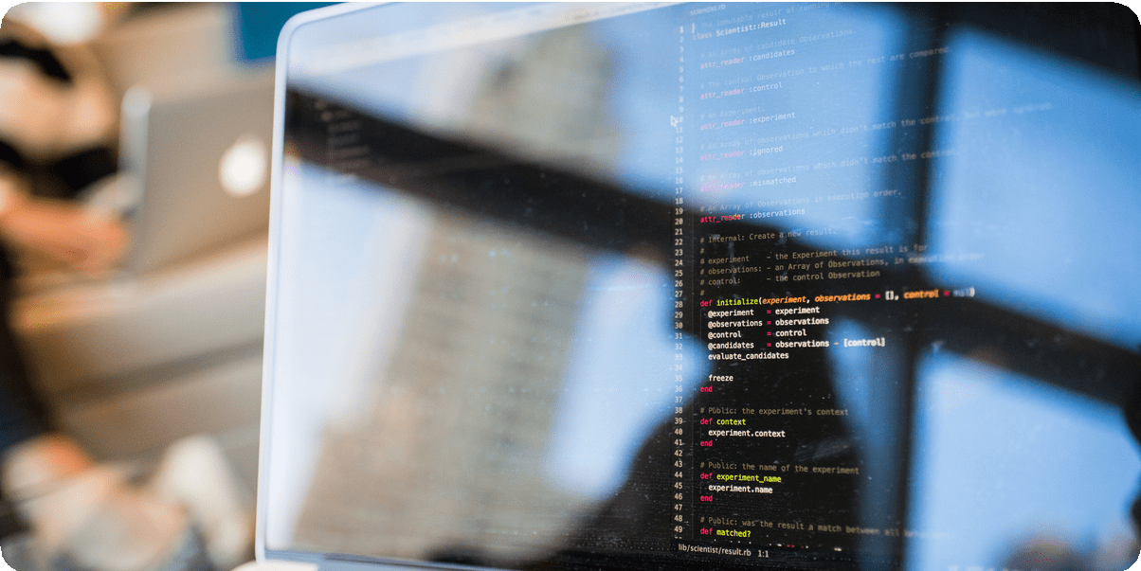




Python: The entire code is written in Python, which is a popular general-purpose programming language.
Regular Expressions (re module): Python's built-in module for working with regular expressions, which are used extensively for pattern matching (finding words in the text).
Programming Languages AND Libraries used
Type Annotations: The code uses Python’s type annotations (List, Tuple, Dict) to define the expected types of function arguments and return values. This helps in understanding what types of inputs the functions expect and
what they return.

Slide 4




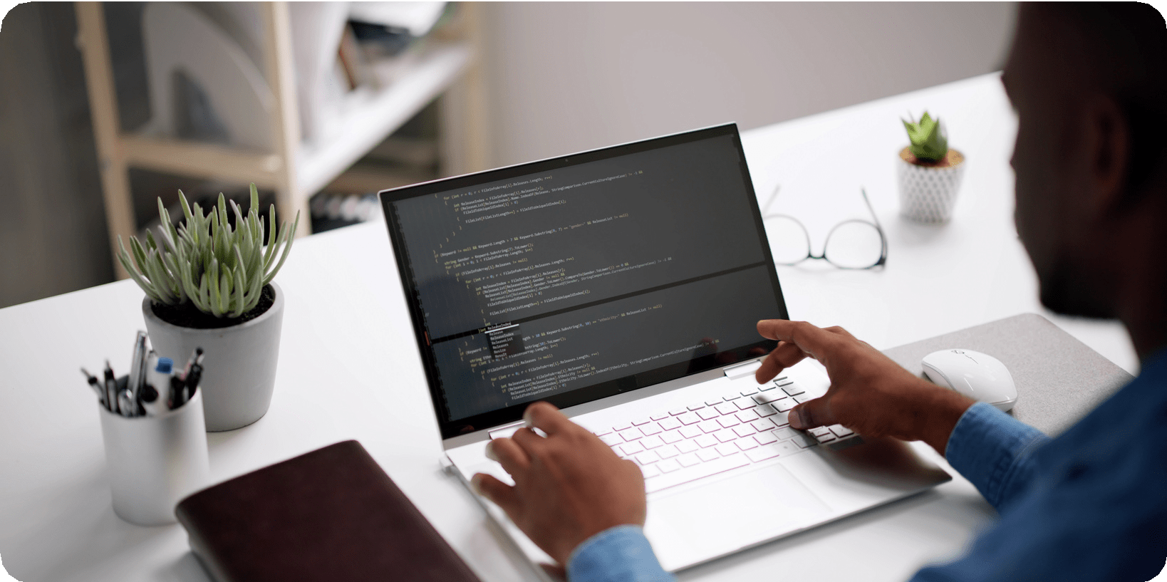




Explicit content
filtering and subtitle modification script
With the rise of digital media platforms such as YouTube, Netflix, and social
However, subtitle files often contain
media, video content has become a primary mode of communication and entertainment. Subtitles are essential in making this content accessible to global audiences, especially for viewers who are deaf, hard of hearing, or non-
explicit or offensive language, which may not be suitable for certain viewers or environments. There is a growing need for automated solutions that can detect and filter such language from subtitle files to make content more universally acceptable.
native speakers.

Slide 5



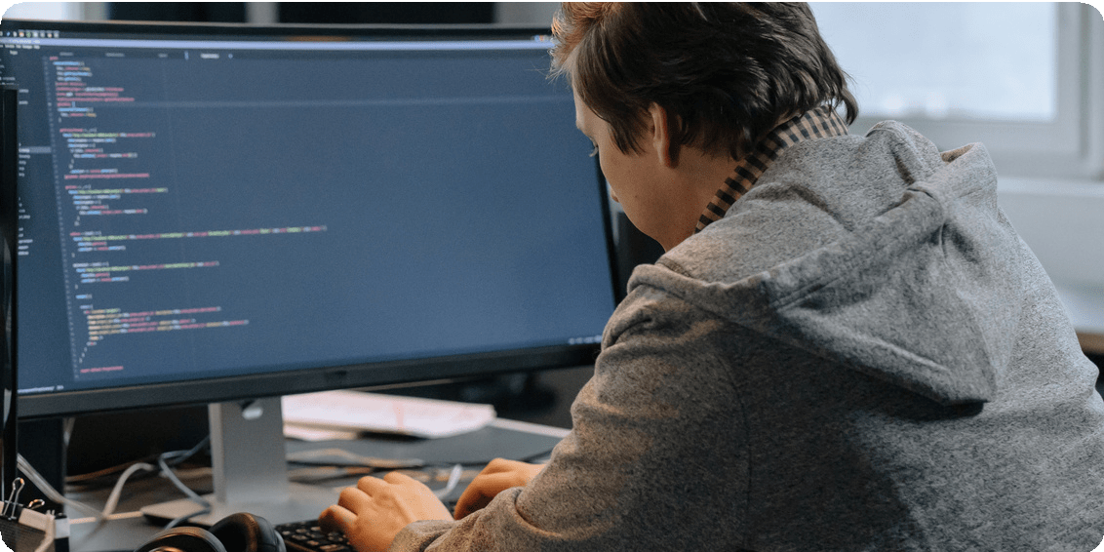
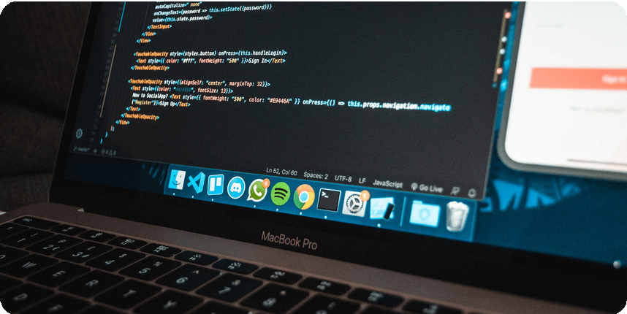
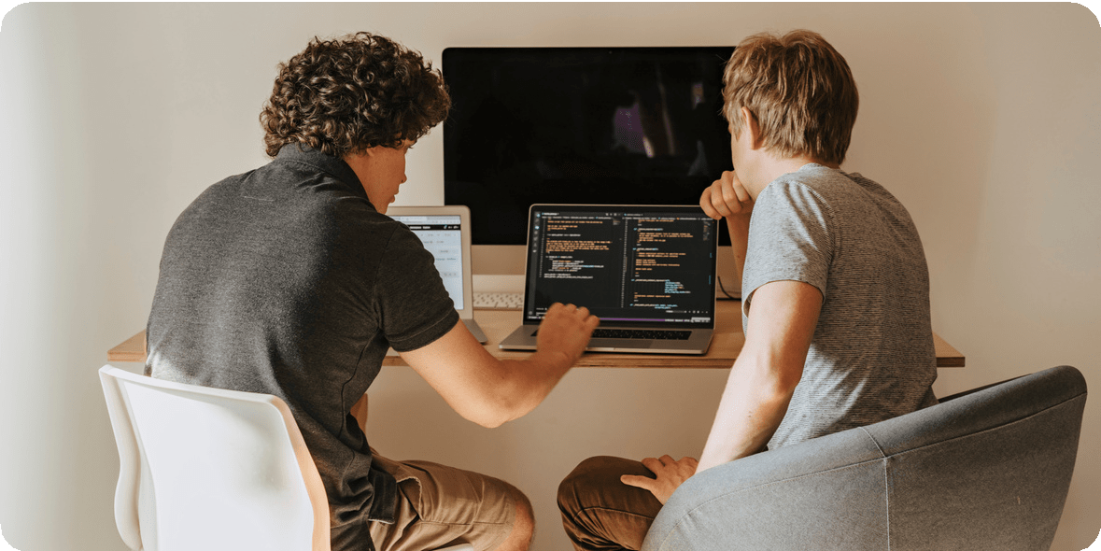
Significance
This project is significant in the context of content moderation and digital accessibility.
and Context
Manually editing subtitle files to remove offensive language is a tedious and error- prone process. By automating this task, the project contributes to responsible content distribution, making it easier for creators, educators, and media houses to maintain a family-friendly or professional tone. It also supports the growing emphasis on inclusive media, where content can be adapted to suit diverse audience needs without compromising on reach or engagement.

Slide 6



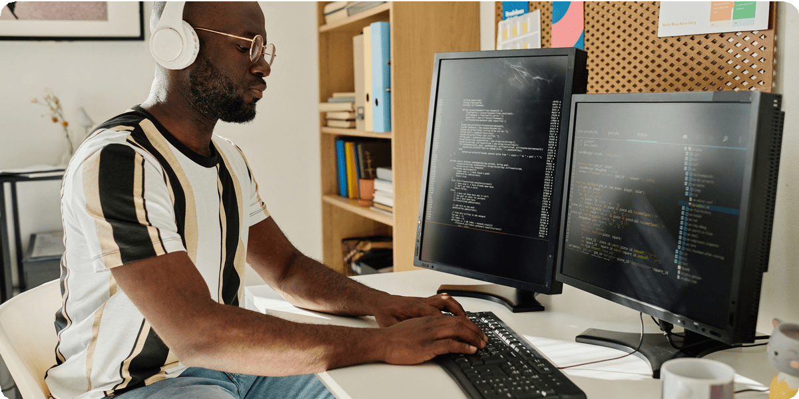
Potential
Word Replacement Limitations: The current script may not handle more complex variations of explicit words (like
Issues/Impro vements:
plural forms, word conjugations, etc.). Expanding the dictionary or using a more sophisticated NLP approach could improve this.
Performance: For large subtitle files, multiple regex operations could become inefficient. Optimizing the regex or using a more performant solution might be beneficial for large datasets.
Edge Case Handling: The code assumes well-formed input.
Additional checks for malformed SRT files (e.g., missing timestamps, extra line breaks) would make the code more robust.

Slide 7









Scope and
Purpose of the Project
The project focuses on developing a Python-based tool that reads .srt subtitle files, identifies explicit words using a predefined dictionary, and either replaces or flags them. It maintains the original subtitle formatting and includes functionality to export timestamps compatible with Audacity for further editing. The overall purpose is to offer an efficient, reliable, and easy-to-use solution for cleaning subtitle content, promoting safer viewing experiences and reducing manual workload for content moderators and creators.

Slide 8
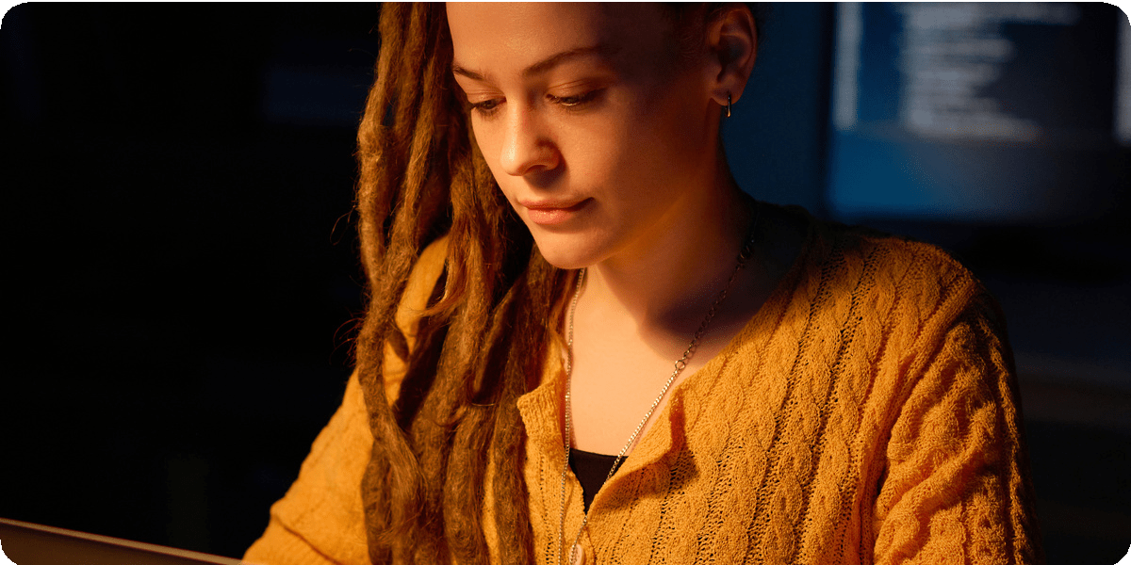



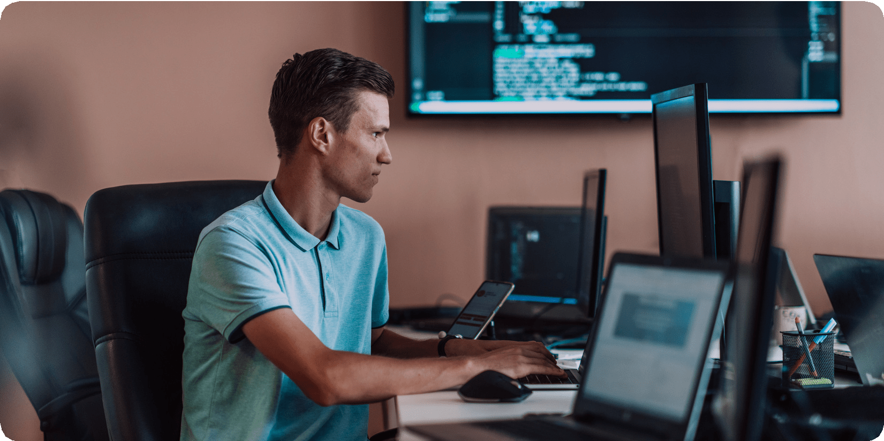


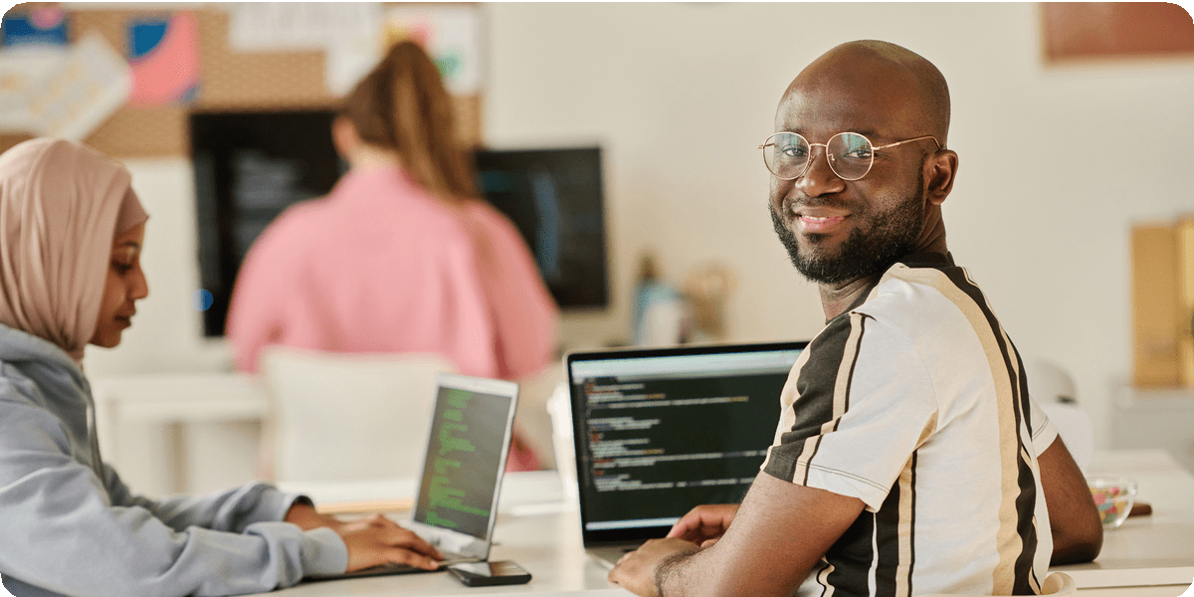
Example Use Case
Input: A subtitle file with explicit content, like "You are a fucking
asshole".
Output: The script can generate:
A filtered SRT file where "fucking" is replaced by "bugging" and "asshole" by "mad fellow".
A censored SRT file where "fucking" and "asshole" are replaced by dashes ("----").
An Audacity label file marking the sections with explicit content.

Slide 9



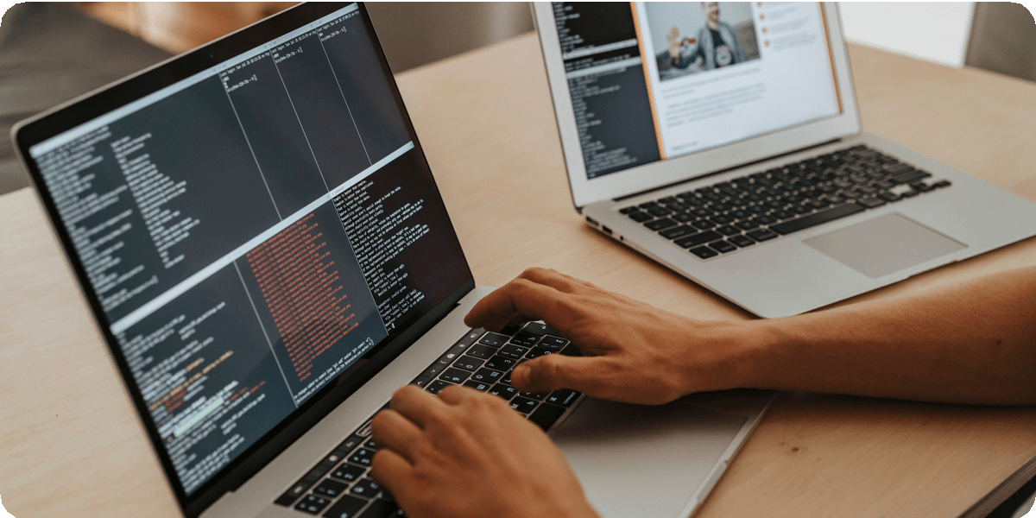
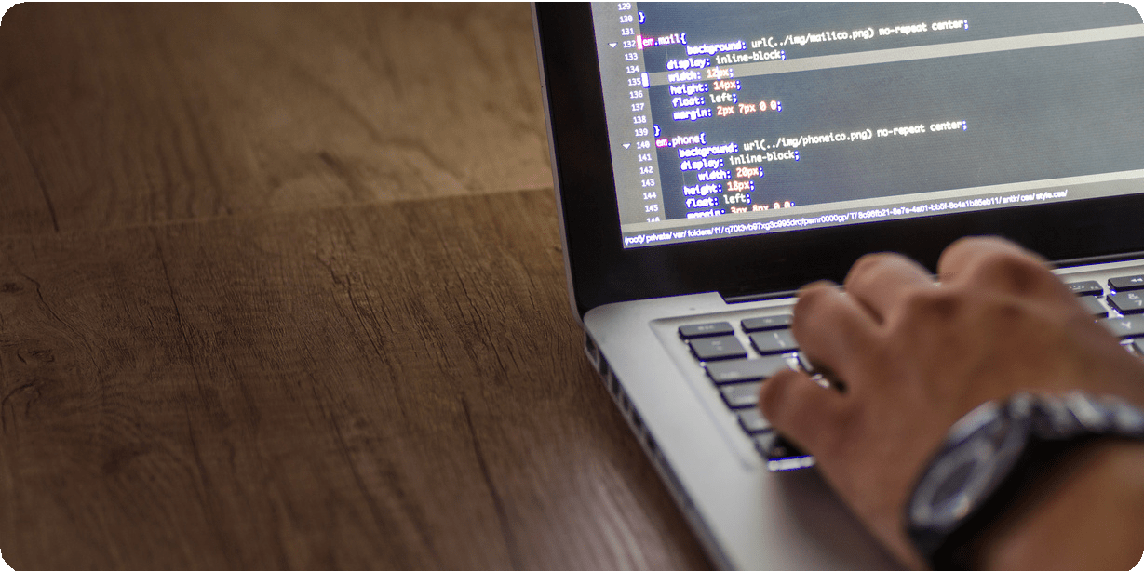



Thank You

