Slide 1

Welcome to Us Bank
Console Application Demo Presentation
Sponsored by Cohort 05232022
Notes:
<number>

Slide 2

The Creator
The Product
The Final Word
Presentation
Notes:
<number>

Slide 3
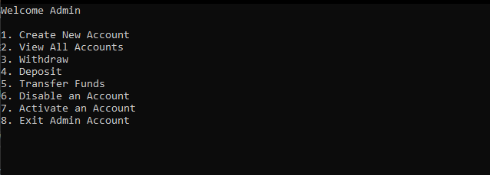
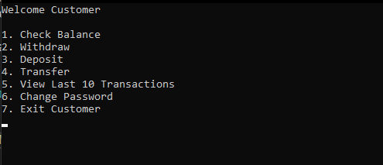
The Product
Notes:
<number>

Slide 4
Implementation
C# on .Net Framework 4.7
OOPS
Sql Server

Slide 5
Quarter 3
OverDraft fees
Limit on negative balance
Quarter 4
Website implementation
Credit Card Accounts
Creation of user name
Future of the Product
Notes:
<number>

Slide 6

Final Word
Thank You
Notes:
<number>

