Slide 1
Using Parallel tools to accelerate drone’s mapping system
Peiqing Chen
Yuxiao Luo

Slide 2
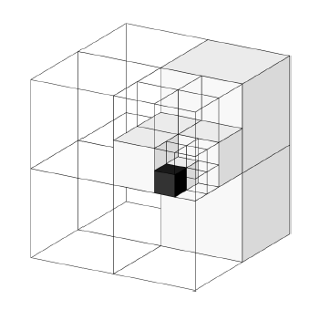
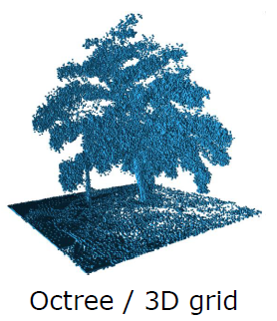
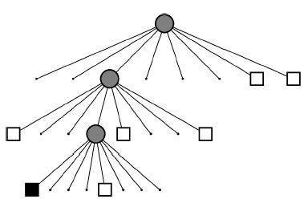
Background on Octomap
A drone’s mapping system that uses multi-level occupancy grid to represent the 3D space
Backend data structure: Octree. Supporting different resolution query
Each node in the Octree has an occupancy probability (to denote how much free / occupied)
Unknown space
Free space
Occupied space
Octree

Slide 3
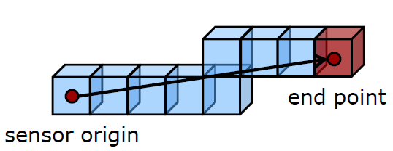
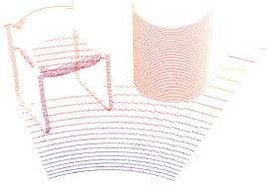


Occupied voxel
Free voxel
Ray tracing for each point in point cloud
Point Cloud generated by sensor (Lidar)
Update occupancy probability into Octree
Recursively updates all ancestors

Slide 4
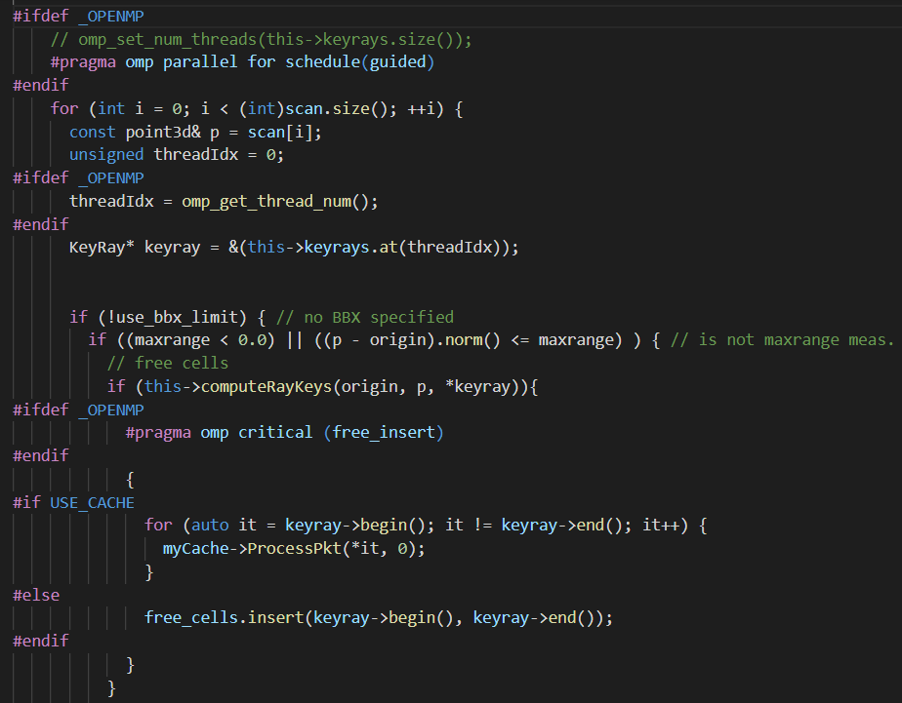
Our design
OpenMP acceleration
Duplicated calculated free voxels from 2 threads
End Point 1
End Point 2
Sensor Origin
Thread 1 | Thread 2 | Thread 3 | Thread 4
Ray tracing in parallel
Duplication check & from 2 sets
50k lines of code (huge code base)

Slide 5
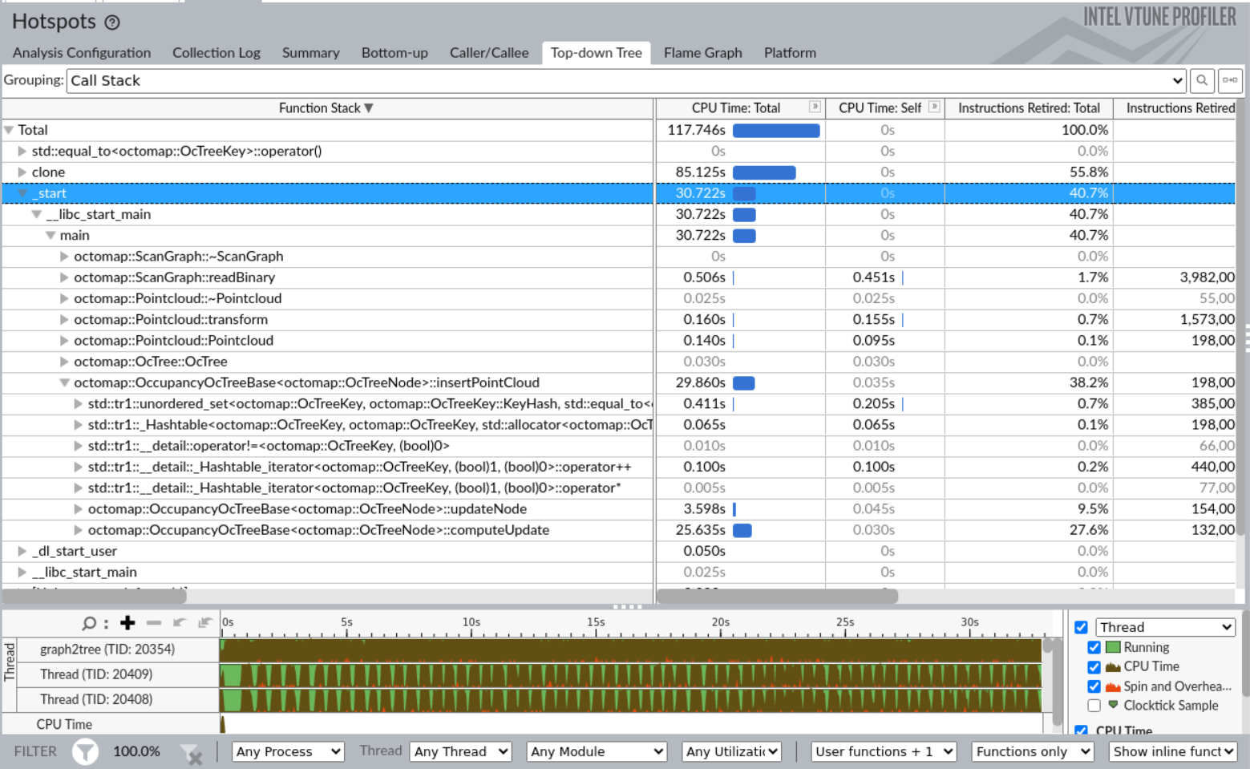
Profiling: vtune-gui

Slide 6
CPU runtime for different components (/seconds)
#of threads | Ray tracing | Total run time | Clone data
1(original) | 33.484 | 41.143 | --
2 | 30.331 | 38.881 | 35.022
3 | 27.910 | 36.776 | 59.730
4 | 24.873 | 33.286 | 85.125
5 | 25.936 | 34.210 | 112.288
6 | 26.317 | 34.435 | 140.299
8 | 27.409 | 35.812 | 200.731
10 | 27.364 | 35.295 | 255.279
40 | 35.293 | 44.156 | 1421.153
25.7% raise
19.9% raise
Even worse than single thread performance

Slide 7
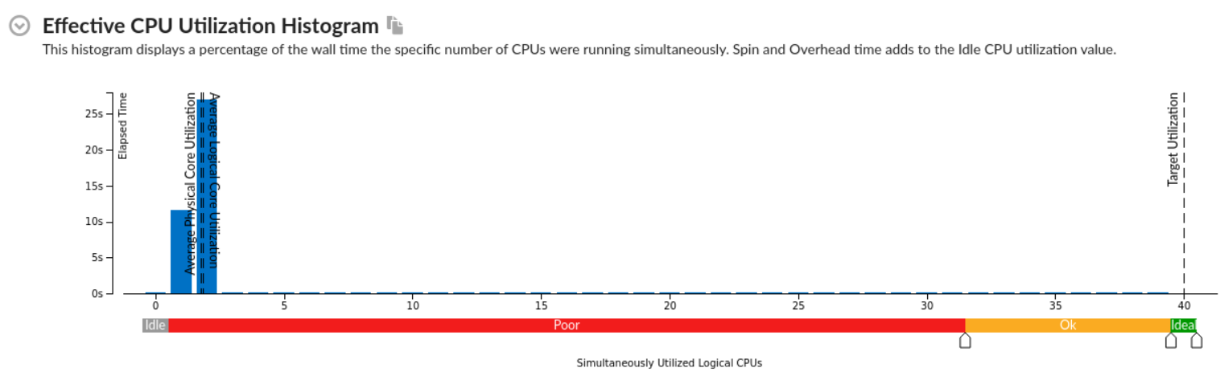
Pay attention to the runtime distribution between threads
Thread # =2

Slide 8
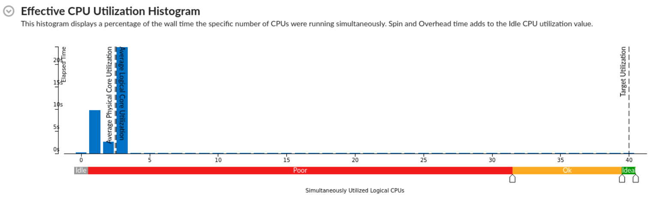
Pay attention to the runtime distribution between threads
Thread # =3

Slide 9
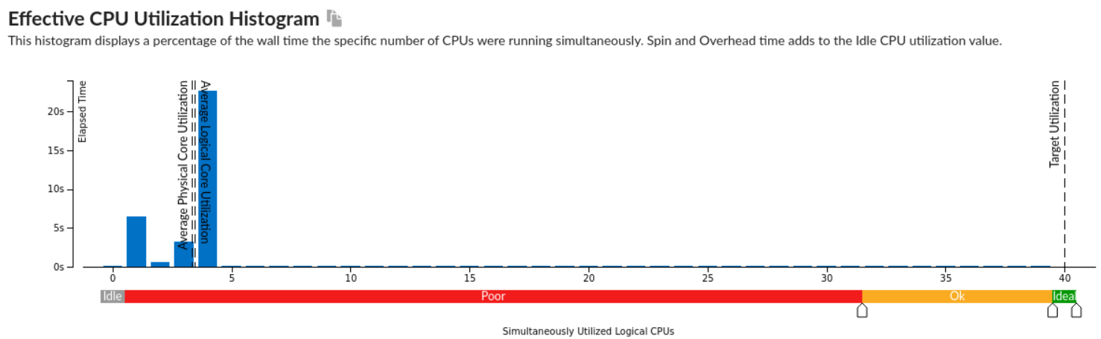
Pay attention to the runtime distribution between threads
Thread # = 4

Slide 10
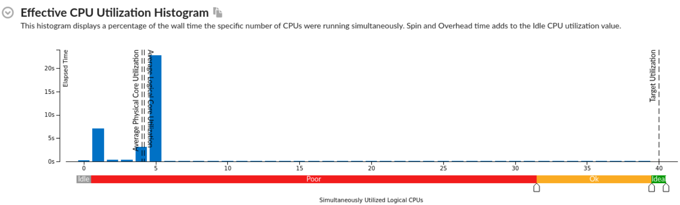
Pay attention to the runtime distribution between threads
Thread # = 5

Slide 11
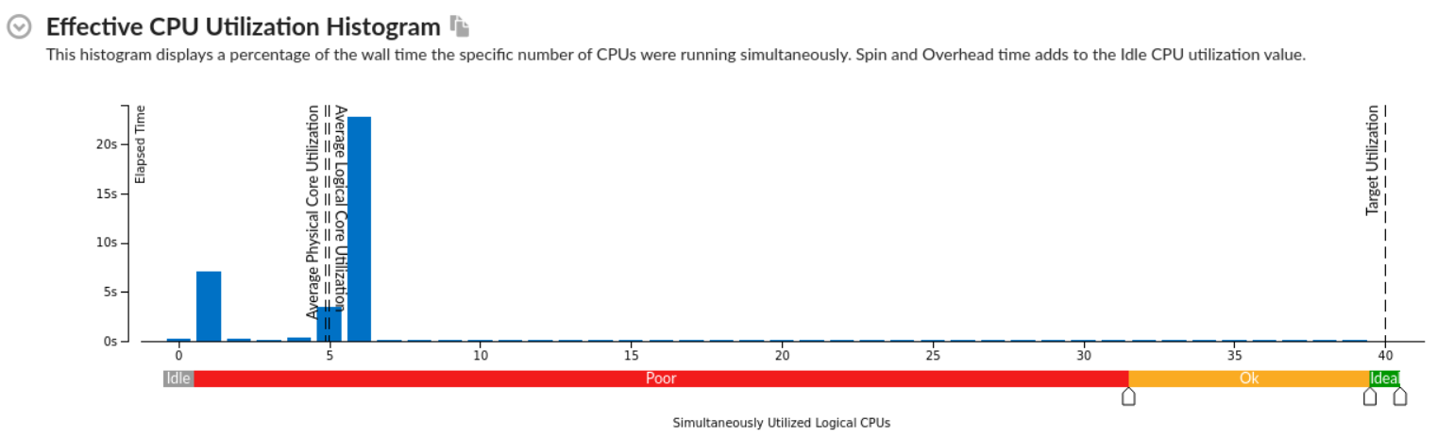
Pay attention to the runtime distribution between threads
Thread # = 6

Slide 12
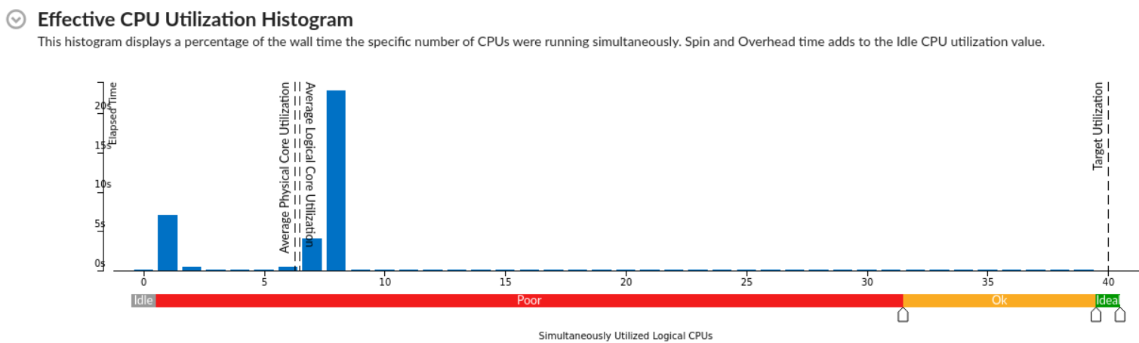
Pay attention to the runtime distribution between threads
Thread # = 8

Slide 13
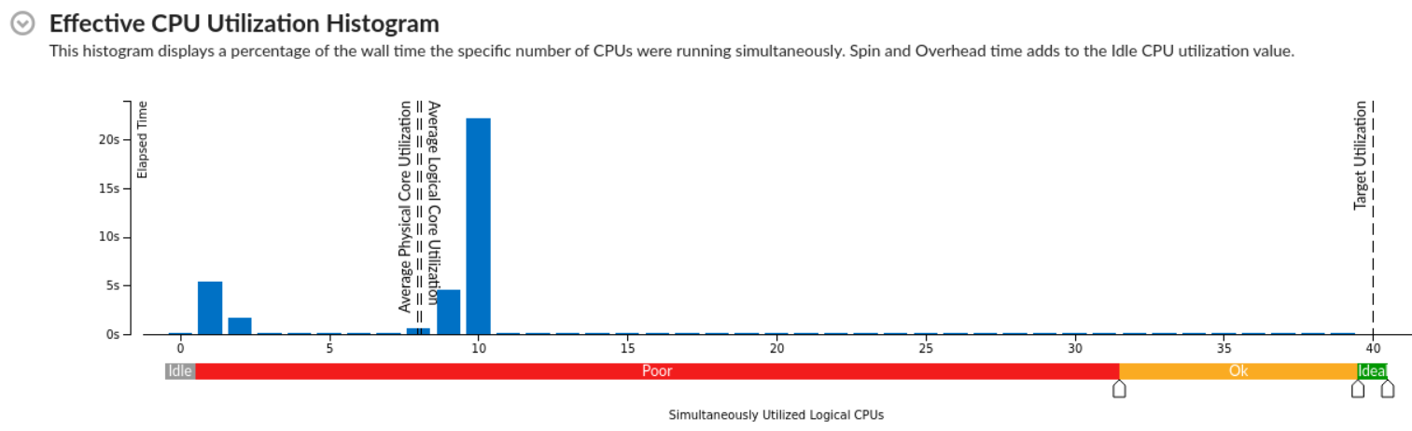
Pay attention to the runtime distribution between threads
Thread # = 10

Slide 14
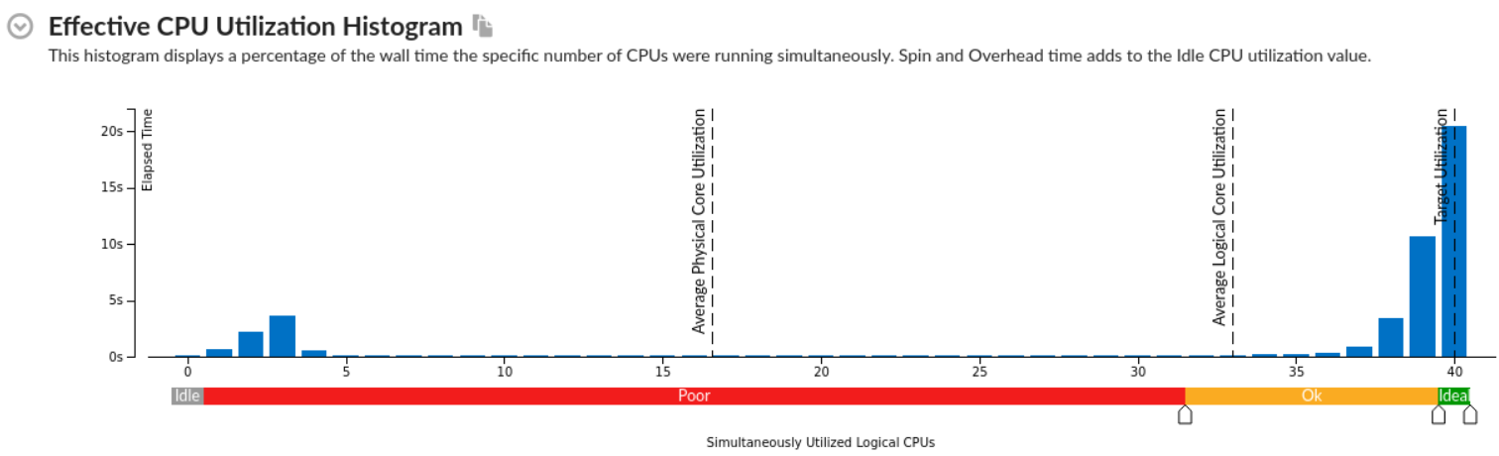
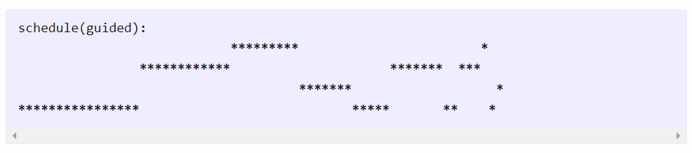
Observation: using guided scheduling, the distribution of iterations for different workers varies.
The guided scheduling type is appropriate when the iterations are poorly balanced between each other. The initial chunks are larger, because they reduce overhead. The smaller chunks fills the schedule towards the end of the computation and improve load balancing. This scheduling type is especially appropriate when poor load balancing occurs toward the end of the computation.
Thread # = 40
Using all available CPU units

Slide 15
The guided scheduling type is appropriate when the iterations are poorly balanced between each other. The initial chunks are larger, because they reduce overhead. The smaller chunks fills the schedule towards the end of the computation and improve load balancing. This scheduling type is especially appropriate when poor load balancing occurs toward the end of the computation.

