Slide 1
The Current Federal Budget - Expenses

Slide 2
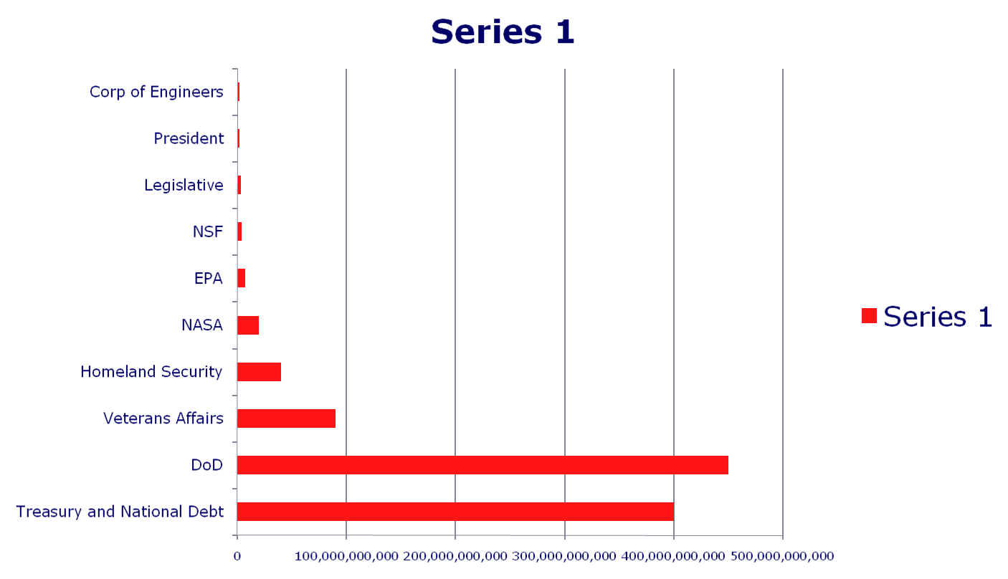
Proposed Federal Budget – Expenses under Libertarian transition

