Slide 1

Programming for Business Computing Introduction
Computer programming
Arithmetic and print
Variable declaration and input
Debugging
Ling-Chieh Kung
Department of Information Management
National Taiwan University
【本著作除另有註明外，採取創用CC「姓名標示－非商業性－禁止改作分享」台灣3.0版授權釋出】

Slide 2
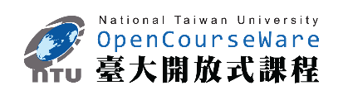

Outline
Computer programming
Arithmetic and print
Variable declaration and input
Debugging
Computer programming
Our first program: arithmetic and print
Our second program: variable declaration and input
Debugging

Slide 3
Computer programming
Computer programming
Arithmetic and print
Variable declaration and input
Debugging
What are computer programs?
The elements working in computers.
Also known as software.
A structured combination of data and instructions used to operate a computer to produce a specific result.
Strength: High-speed computing, large memory, etc.
Weakness: People (programmers) need to tell them what to do.
How may a programmer tell a computer what to do?
Programmers use “programming languages” to write codes line by line and construct “computer programs”.
Running a program means executing the instructions line by line and (hopefully) achieve the programmer’s goal.

Slide 4
Programming languages
Computer programming
Arithmetic and print
Variable declaration and input
Debugging
People and computers talk in programming languages.
A programming language may be a machine language, an assembly language, or a high-level language (or something else).
Machine and assembly languages: Control the hardware directly, but hard to read and program.
High-level languages: Easy to read and program, but need a “translator.”
Most application software are developed in high-level languages.
The language we study in this course, Python, is a high-level language.
Some others: C, C++, Basic, Quick Basic, Visual Basic, Fortran, COBOL, Pascal, Perl, Java, C#, PHP, Matlab, Objective C, R, etc.

Slide 5
Python
Computer programming
Arithmetic and print
Variable declaration and input
Debugging
Python was invented by Guido van Rossum around 1996:
Was just something to do during the Christmas week.
The latest version (in August, 2017) is 3.6.2.
Python is very good for beginners.
It is simple.
It is easy to start.
It is powerful.

Slide 6
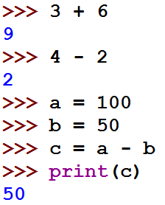
Interpreting a program
Computer programming
Arithmetic and print
Variable declaration and input
Debugging
An interpreter translates programs into assembly programs.
For other high-level programs, a compiler is used.
Python uses an interpreter.
An interpreter interpret a program line by line.
We may write Python in the interactive mode.
Input one line of program, then see the result.
Input the next line, then see the next result.
The statements should be entered after the prompt.

Slide 7
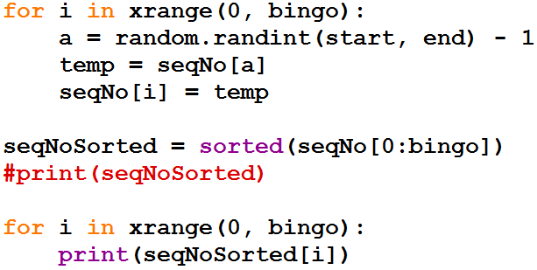
Interpreting a program
Computer programming
Arithmetic and print
Variable declaration and input
Debugging
We may also write Python in the script mode.
Write several lines in a file (with the extension file name .py), and then interpret all the lines one by one at a single execution.
A programming language using an interpreter is also called a scripting language.
E.g., R.

Slide 8


How to run Python
Computer programming
Arithmetic and print
Variable declaration and input
Debugging
To taste Python online:
https://www.python.org/ or other similar websites.
To get the Python interpreter:
Go to https://www.python.org/downloads/, download, double click, and then click and then click… and then you are done.
To try the interactive mode:
Open your console (the command line environment) and type python to initiate the interactive mode.
You may need to set up your “PATH” variables.

Slide 9
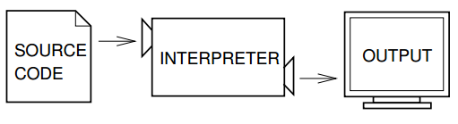
How to run Python
Computer programming
Arithmetic and print
Variable declaration and input
Debugging
To run Python on IDLE (Python GUI):
Click its icon and then play with the prompt.
Do “File → New File” to write and execute a script.
To write Python on an editor and interpret a script with the interpreter:
Open a good text editor (e.g., Notepad++), write a script, save it (.py).
Open the console, locate your script file (.py), interpret it with the instruction python, and see the result.
(Figure 1.1, Think Python)

Slide 10
Outline
Computer programming
Arithmetic and print
Variable declaration and input
Debugging
Computer programming
Our first program: arithmetic and print
Our second program: variable declaration and input
Debugging

Slide 11

Our first program
Computer programming
Arithmetic and print
Variable declaration and input
Debugging
As in most introductory computer programming courses, let’s start from the “Hello World” example:
Let’s try this in the interactive mode!
print("Hello World!")

Slide 12
Our first program
Computer programming
Arithmetic and print
Variable declaration and input
Debugging
The program has only one statement.
In this statement, there is one single operation.
print is a function: Print out whatever after it on the screen.
"Hello World!" is an operand: A message to be printed out.
In Python, each statement must be put in a single line in your editor.
print("Hello World!")

Slide 13
Our first program
Computer programming
Arithmetic and print
Variable declaration and input
Debugging
We of course may print out other messages.
It does not matter whether to use single or double quotation marks here.
As long as they are paired.
print("I love programming!")

Slide 14
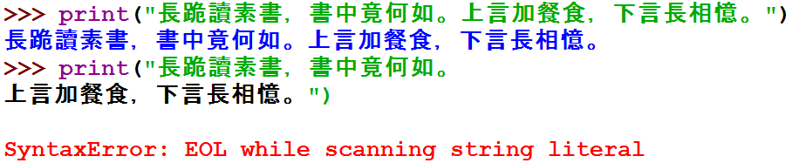
Printing out more complicated messages
Computer programming
Arithmetic and print
Variable declaration and input
Debugging
What if we want to print out
長跪讀素書，書中竟何如。
上言加餐食，下言長相憶。
Something is wrong when we want to create a new line!

Slide 15

A newline character
Computer programming
Arithmetic and print
Variable declaration and input
Debugging
Inside a computer, everything is encoded.
In particular, each character has a corresponding number representing it.
“Creating a new line” actually means “printing out a newline character”.
A right way to do it is:
That \n is the newline character.
print("長跪讀素書，書中竟何如。\n上言加餐食，下言長相憶。")

Slide 16

Escape sequence
Computer programming
Arithmetic and print
Variable declaration and input
Debugging
In Python (and many modern language), the slash symbol “\” starts an escape sequence (character).
An escape sequence represents a “special character” that does not exist on the keyboard.
Escape sequence | Effect | Escape sequence | Effect
\n | A new line | \\ | A slash: \
\t | A horizontal tab | \' | A single quotation: '
 |  | \" | A double quotation: "

Slide 17
The escape sequence \n
Computer programming
Arithmetic and print
Variable declaration and input
Debugging
Try it:
More details about string operations will be discussed later in this semester.
print("《青青河畔草》：\"長跪讀素書，書中竟何如。\n上言加餐食，下言長相憶。\"")
print("《青青河畔草》：「長跪讀素書，書中竟何如。\n上言加餐食，下言長相憶。」")
print('《青青河畔草》：\"長跪讀素書，書中竟何如。\n上言加餐食，下言長相憶。\"')

Slide 18
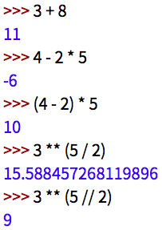
Basic arithmetic
Computer programming
Arithmetic and print
Variable declaration and input
Debugging
Computers are good at doing computation.
All computation starts from simple calculation, i.e., arithmetic.
We may use the operators +, -, *, /, and // to do addition, subtraction, multiplication, floating-point division, and floor division.
We may use ( and ), i.e., a pair of parentheses, to determine the calculation order.
We may use the operator ** to find the square of a number.

Slide 19
Outline
Computer programming
Arithmetic and print
Variable declaration and input
Debugging
Computer programming
Our first program: arithmetic and print
Our second program: variable declaration and input
Debugging

Slide 20
input()
Computer programming
Arithmetic and print
Variable declaration and input
Debugging
The print operator prints out data to the console output.
A function input accepts data input (by the user or other programs) from the console input (typically the keyboard).
A function is a set of codes that together do a particular task. This will be explained in details later in this semester.
In order to get input, we need to first prepare a “container” for the input data. The thing we need is a variable.
When we use a single variable to receive the data, the syntax is
Let’s first learn how to declare variables.
variable = input()

Slide 21
Variables and data types
Computer programming
Arithmetic and print
Variable declaration and input
Debugging
A variable is a container that stores a value.
Once we declare a variable, the system allocates a memory space for it.
A value may then be stored in that space.
A variable has its data type.
At this moment, three data types are important: int (for integer), float (for fractional numbers), and string (for strings).
Three major attributes of a (typical) variable:
Type.
Name.
Value.

Slide 22
Variable declaration
Computer programming
Arithmetic and print
Variable declaration and input
Debugging
Before we use a variable, we must first declare it.
We need to specify its name.
We need to specify its data type, initial value, or both.
Typically in Python we declare a variable with an initial value directly. The interpreter will automatically set the type of a variable according to the assigned initial value.
To see this, put a declared variable into the function type().
a = 689
b = 8.7
c = "Hi everyone, "

Slide 23
Variable declaration
Computer programming
Arithmetic and print
Variable declaration and input
Debugging
Let’s try to see the types of declared variables:
A variable may be overwritten:
a = 689
b = 8.7
c = "Hi everyone, "
print(type(a))
print(type(b))
print(type(c))
a = 689
a = 8.7
print(type(a))

Slide 24
Variable declaration
Computer programming
Arithmetic and print
Variable declaration and input
Debugging
Sometimes we have no idea about an initial value.
In this case, do:
Try to print them out to see their initial values!
a = int()
b = float()
c = ""

Slide 25
Our second program (in progress)
Computer programming
Arithmetic and print
Variable declaration and input
Debugging
This is our second program (to be completed later):
We first declare and initialize two integers.
We then do
There are two operations here:
num1 + num2 is an addition operation. The sum will be returned to the program.
That returned value is then printed out.
As a result, 17 is displayed on the screen.
num1 = 4
num2 = 13
print(num1 + num2)
print(num1 + num2)

Slide 26
Our second program (in progress)
Computer programming
Arithmetic and print
Variable declaration and input
Debugging
What will be displayed on the screen?
num1 = 4
num2 = 13
print(num1 - num2)
print(num1 * num2)
print(num1 // num2)
print(num1 / num2)
print(num1 % num2)
print(num1 ** num2)
Notes:
多加了print(num1 // num2)，紅色字的敘述應該要變動

Slide 27
Our second program
Computer programming
Arithmetic and print
Variable declaration and input
Debugging
Now we are ready to present our second program:
In this example, we allow the user to enter two numbers.
We declare two variables to receive the inputs.
We then use the input function to read input values into the variables.
We then sum them up and print out the sum.
num1 = int()
num2 = int()
num1 = int(input())
num2 = int(input())
print(num1 + num2)

Slide 28
Our second program
Computer programming
Arithmetic and print
Variable declaration and input
Debugging
Alternatively:
The interpreter always stops when it execute the input function.
It stops and waits for user input.
After the user input something, it reads it into the program.
num1 = int(input())
num2 = int(input())
print(num1 + num2)

Slide 29
Our second program
Computer programming
Arithmetic and print
Variable declaration and input
Debugging
How about this?
The return type of input is a string!
The addition operator + will concatenate two strings.
That is why the int function is required in the right implementation.
num1 = input()
num2 = input()
print(num1 + num2)

Slide 30
Outline
Computer programming
Arithmetic and print
Variable declaration and input
Debugging
Computer programming
Our first program: arithmetic and print
Our second program: variable declaration and input
Debugging

Slide 31
Syntax errors vs. logic errors
Computer programming
Arithmetic and print
Variable declaration and input
Debugging
A syntax error occurs when the program does not follow the standard of the programming language.
The interpreter detects syntax errors.
num1 = int()
num2 = int()
num1 = int(inpnt())
num2 = int(input())
print(num1 + num2)

Slide 32
Syntax errors vs. logic errors
Computer programming
Arithmetic and print
Variable declaration and input
Debugging
A logic error occurs when the program does not run as the programmer expect.
Programmers must detect logic errors by themselves.
The process is called debugging.
num1 = int()
num2 = int()
num1 = int(input())
num2 = int(input())
print(num1 + num1)

Slide 33
Steps to do computer programming
Computer programming
Arithmetic and print
Variable declaration and input
Debugging
(The following four pages of slides are modified from the lecture notes by Professor Pangfeng Liu in NTU CSIE.)
First, edit a program.
Second, interpret the program.
If there is a syntax error, fix it.
Edit a program
Interpret the program
Yes
Syntax error?
No

Slide 34
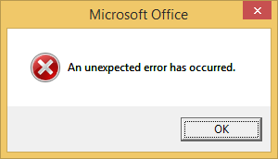
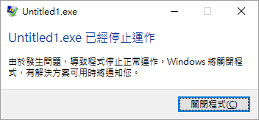
Steps to do computer programming
Computer programming
Arithmetic and print
Variable declaration and input
Debugging
Next, execute the program.
Be aware of runtime errors:
A runtime error is one kind of logic error.
When it happens, the program cannot terminate as we expect.
If there is a runtime error, fix it.
Edit a program
Interpret the program
Yes
Syntax error?
No
Execute the program
Yes
Runtime error?
No

Slide 35
Steps to do computer programming
Computer programming
Arithmetic and print
Variable declaration and input
Debugging
Now your program terminates successfully.
Next, check your answer.
You get a wrong answer if the outcome is incorrect.
Wrong answer is one kind of logic error.
If there is a wrong answer, fix it.
Typically the most time consuming step.
Logic!
Edit a program
Interpret the program
Yes
Syntax error?
No
Execute the program
Yes
Runtime error?
No
Yes
Wrong answer?
No

Slide 36
Steps to do computer programming
Computer programming
Arithmetic and print
Variable declaration and input
Debugging
Now the answer is correct. What is the next step?
Write your next program!
Edit a program
Interpret the program
Yes
Syntax error?
No
No
Execute the program
Yes
Runtime error?
No
Yes
Wrong answer?

Slide 37
Using Notepad++ to run Python directly
Computer programming
Arithmetic and print
Variable declaration and input
Debugging
We may use Notepad++ (or many other editor) to run Python directly.
To do so:
Select “Run” → “Run…”
Enter “cmd /k C:/Python36/python "$(FULL_CURRENT_PATH)" & PAUSE & EXIT”
Select “Save…” and choose a hotkey combination you like.
Please replace the path in red by the path in your computer!

Slide 38


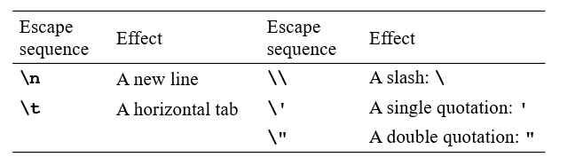

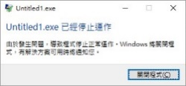
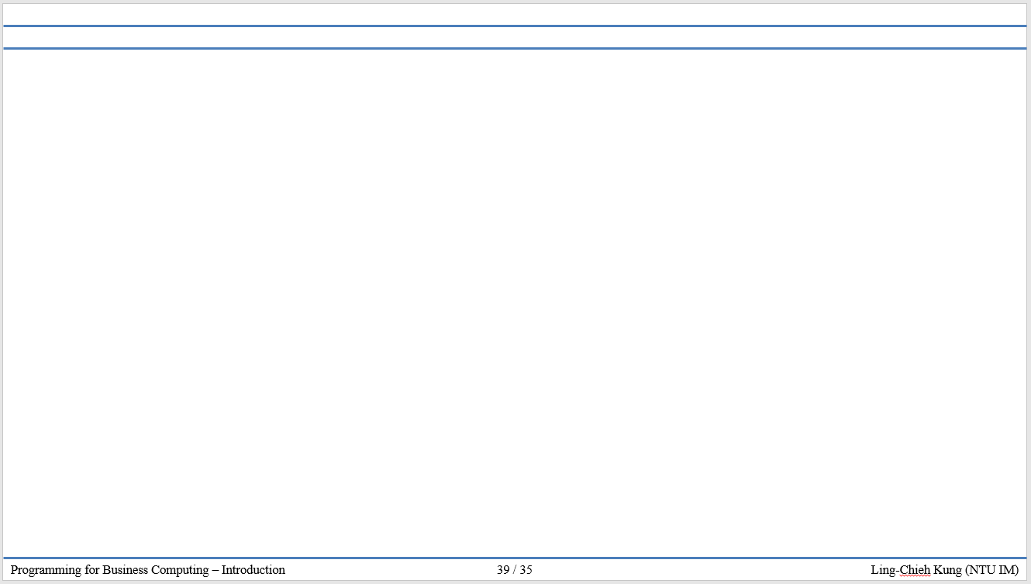
版權聲明
序 | 頁 | 作品 | 版權標章 | 作者 / 來源
1 | 8 |  |  | Python Software Foundation, Guido van Rossum https://www.python.org/ 依據著作權法第46、52、65條合理使用 2017/7/24 visited
2 | 9 |  |  | WordPress, Green Tea Press, Allen B. Downey, Think Python ver2.0.17,P2, CC BY-NC 3.0, 2012/8/3 http://www.greenteapress.com/thinkpython/thinkpython.pdf 2017/7/24 visited
3 | 16 |  |  | 台灣大學 孔令傑, CC BY-NC-ND 3.0
4 | 34 |  |  | Microsoft Office軟體版權著作 https://products.office.com/zh-tw/home 依據著作權法第46、52、65條合理使用 2017/7/24 visited
5 | 34 |  |  | Microsoft Windows軟體版權著作 https://www.microsoft.com/zh-tw 依據著作權法第46、52、65條合理使用 2017/7/24 visited
6 | 1-38 |  |  | 台灣大學 孔令傑, CC BY-NC-ND 3.0

