Slide 1

Programming for Business Computing Computers and Conditionals
Basics of computers
Casting, input, print, and division
Conditionals: the first example
Formatting a program
Ling-Chieh Kung
Department of Information Management
National Taiwan University
【本著作除另有註明外，採取創用CC「姓名標示－非商業性－禁止改作分享」台灣3.0版授權釋出】

Slide 2


Outline
Basics of computers
Casting, input, print, and division
Conditionals: the first example
Formatting a program
Basics of computers
Casting, input, print, and division
Conditionals: the first example
Formatting a program

Slide 3
Computers
Basics of computers
Casting, input, print, and division
Conditionals: the first example
Formatting a program
In a modern computer:
“Input” includes keyboards, mice, touch screens, microphones, etc.
“Output” include screens, speakers, printers, etc.
“Storage” means non-volatile storage, such as hard discs, CDs, DVDs, flash drives, etc.
“CPU & Memory”:
“CPU” (central processing unit) is where arithmetic operations are done.
“Memory” is a volatile storage space.
Input
CPU
Memory
Storage
Output

Slide 4
Programs
Basics of computers
Casting, input, print, and division
Conditionals: the first example
Formatting a program
A program is a file containing source codes.
It is stored in “storage”.
When we execute/run a program:
We create variables in “memory” to store values.
We move values into “CPU” for arithmetic operations, and then move the results back to “memory”.
We may do more:
We (probably) read from “input” and write to “output”.
We (probably) read from “storage” and write to “storage”.
Input
CPU
Memory
Storage
Output

Slide 5
Variables and values
Basics of computers
Casting, input, print, and division
Conditionals: the first example
Formatting a program
When we declare a variable, the operating system (OS) allocates a space in memory for that variable.
Later values can be stored there.
That value can be read, written, and overwritten.
The OS records four things for each variable:
Address.
Name (also called “identifier”).
Value.
Type.

Slide 6
When we execute this program
Basics of computers
Casting, input, print, and division
Conditionals: the first example
Formatting a program
Address
Identifier
Value
num1 = 13
num2 = 4
print(num1 + num2)
(3)
0x20c630
(no name)
17
(1)
0x20c648
num1
13
(2)
0x22fd4c
num2
4
(4)
17
Console
Memory

Slide 7
Types
Basics of computers
Casting, input, print, and division
Conditionals: the first example
Formatting a program
A variable’s type is automatically determined by Python according to the type of the initial value.
In some other programming languages, the programmer must determine it.
E.g.,
makes num1 an integer, num2 a floating-point number, and str1 a string.
These are the most important three types at this moment:
An integer is an integer.
A string is a sequence of characters.
What is a floating-point number?
num1 = 13
num2 = 4.13
str1 = "52"

Slide 8
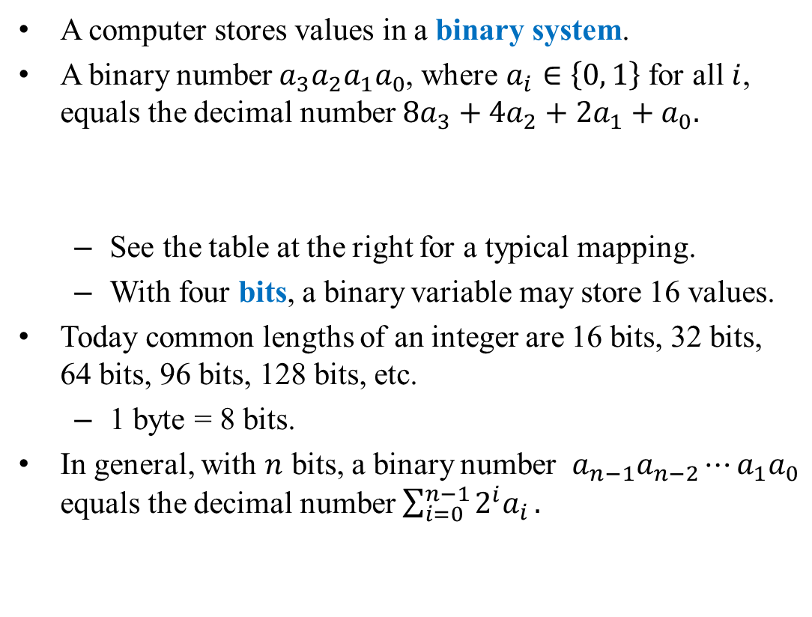


Integers
Basics of computers
Casting, input, print, and division
Conditionals: the first example
Formatting a program
A computer stores values in a binary system.
A binary number $a_{3}a_{2}a_{1}a_{0}$, where $a_{i}∈\left\{0, 1\right\}$ for all $i$, equals the decimal number $8a_{3}+4a_{2}+2a_{1}+a_{0}.$
See the table at the right for a typical mapping.
With four bits, a binary variable may store 16 values.
Today common lengths of an integer are 16 bits, 32 bits, 64 bits, 96 bits, 128 bits, etc.
1 byte = 8 bits.
In general, with $n$ bits, a binary number $a_{n−1}a_{n−2}⋯a_{1}a_{0}$ equals the decimal number $\sum_{i=0}^{n−1}{2^{i}a_{i}}.$
Decimal value | Binary value
0 | 0000
1 | 0001
2 | 0010
3 | 0011
4 | 0100
5 | 0101
… | …
15 | 1111
$$a_{3}$$ | $$a_{2}$$ | $$a_{1}$$ | $$a_{0}$$
$$8a_{3}+4a_{2}+2a_{1}+a_{0}$$

Slide 9



Signed integers
Basics of computers
Casting, input, print, and division
Conditionals: the first example
Formatting a program
Integers may be positive, zero, or negative.
To represent negative numbers, we use the first bit to denote the sign.
A binary number $a_{3}a_{2}a_{1}a_{0}$ equals the decimal number ${\left(−1\right)}^{a_{3}}×\left(4a_{2}+2a_{1}+a_{0}\right)$ in one mapping system.
Decimal value | Binary value
0 | 0000
1 | 0001
2 | 0010
3 | 0011
… | …
–5 | 1101
–6 | 1110
–7 | 1111
$$a_{3}$$ | $$a_{2}$$ | $$a_{1}$$ | $$a_{0}$$
$${\left(−1\right)}^{a_{3}}×\left(4a_{2}+2a_{1}+a_{0}\right)$$

Slide 10
Integers in Python
Basics of computers
Casting, input, print, and division
Conditionals: the first example
Formatting a program
Integers in Python are by default signed.
They can represent negative values.
To create an integer with an initial value, simply do it:
The function type() returns the type of a given variable.
To create an integer without an initial value, use the function int().
i = 52
print(i)
print(type(i))
i = int()
print(i)
print(type(i))

Slide 11




Floating-point numbers
Basics of computers
Casting, input, print, and division
Conditionals: the first example
Formatting a program
To represent fractional numbers, most computers use floating-point numbers.
The rough idea is:
For example,
Moreover, the “binary point” may “float” to make the mapping flexible.
To represent more values or increase precision.
This is why a fractional number is called a floating-point number.
The true standard for floating-point numbers is (a little bit) more complicated.
$$a_{5}$$ | $$a_{4}$$ | $$a_{3}$$ | $$a_{2}$$ | $$a_{1}$$ | $$a_{0}$$
$${\left(−1\right)}^{a_{5}}×({2a}_{1}+a_{0})×2^{{\left(−1\right)}^{a_{4}}×(2a_{3}+a_{2})}$$
$$0$$ | $$1$$ | $$1$$ | $$0$$ | $$1$$ | $$1$$
$$3×2^{−2}=0.75$$

Slide 12
Floating-point numbers in Python
Basics of computers
Casting, input, print, and division
Conditionals: the first example
Formatting a program
A floating-point number (or simply “a float”) in Python are by default signed.
To create a float with an initial value, simply do it:
To create a float without an initial value, use the function float().
i = 52.0
print(i)
print(type(i))
i = float()
print(i)
print(type(i))

Slide 13




Memory allocation
Basics of computers
Casting, input, print, and division
Conditionals: the first example
Formatting a program
When we declare a variable, its type matters.
The OS understands its value based on its type.
An integer and a floating-point number represent different values even if they store the same sequence of bits.
This is why each variable needs to have a type.
$$0$$ | $$1$$ | $$1$$ | $$0$$ | $$1$$ | $$1$$
$$−3×2^{−2}=0.75$$
$$0$$ | $$1$$ | $$1$$ | $$0$$ | $$1$$ | $$1$$
$$27$$

Slide 14
Characters
Basics of computers
Casting, input, print, and division
Conditionals: the first example
Formatting a program
A computer cannot store characters directly.
It represents characters by encoding each character into an integer.
In most PCs, we use the ASCII code.
ASCII = American Standard Code for Information Interchange.
It uses one byte (–128 to 127) to represent English letters, numbers, symbols, and special characters (e.g, the newline character).
E.g., “0” is 48, “A” is 65, “a” is 97, etc.
It does not represent, e.g, Chinese characters.

Slide 15
Characters
Basics of computers
Casting, input, print, and division
Conditionals: the first example
Formatting a program
Try this:
An integer c is created and assigned 52. .
The corresponding character “4” in the ASCII table is printed out.
c is an integer (int), but cAsChr is a character (chr).
c = 52
cAsChr = chr(c)
print(cAsChr)

Slide 16
Characters/strings in Python
Basics of computers
Casting, input, print, and division
Conditionals: the first example
Formatting a program
To create a character with an initial value, simply do it:
Note that the type is “str”, which means a string.
A string is a sequence of characters.
In fact, even a single character is considered a string (of length 1) in Python.
c = "52"
print(c)
print(type(c))
c = "1"
print(c)
print(type(c))

Slide 17
String operations in Python
Basics of computers
Casting, input, print, and division
Conditionals: the first example
Formatting a program
The function len() returns the length (i.e., number of characters) of a string.
Strings are concatenated by the string concatenation operator (+).
s = "52"
print(s)
print(len(s))
s1 = "52"
s2 = " is good"
s = s1 + s2
print(s)
print(len(s))
print(s2 + s1)
print(len(s2 + s1))

Slide 18
Non-English characters and symbols
Basics of computers
Casting, input, print, and division
Conditionals: the first example
Formatting a program
To represent Chinese (and other non-English) characters, we need other encoding standards.
Common standards include UTF-8, Big-5, etc.
Special symbols (like 「, 、, ～, etc.) also need to be encoded.
English characters and symbols are all halfwidth.
All fullwidth symbols are non-English symbols.
We will deal with Chinese later in this semester.

Slide 19
Outline
Basics of computers
Casting, input, print, and division
Conditionals: the first example
Formatting a program
Basics of computers
Casting, input, print, and division
Conditionals: the first example
Formatting a program

Slide 20
Casting
Basics of computers
Casting, input, print, and division
Conditionals: the first example
Formatting a program
We may convert a value from one type to another type.
Type conversion is called casting.
To cast a float or a string to an integer, use int().
What will happen if we try to cast 52.6 or “52 is great” to an integer?
f = 52.0
i = int(f)
print(f)
print(i)
print(type(f))
print(type(i))
s = "52"
i = int(s)
print(s)
print(i)
print(type(s))
print(type(i))

Slide 21
Casting
Basics of computers
Casting, input, print, and division
Conditionals: the first example
Formatting a program
To cast an integer or a string to an float, use float().
Casting an integer to a float creates no error.
What will happen if we try to cast “52 is great” to a float?
i = 52
f = float(i)
print(i)
print(f)
print(type(i))
print(type(f))
s = "52"
f = float(s)
print(s)
print(f)
print(type(s))
print(type(f))

Slide 22
Casting
Basics of computers
Casting, input, print, and division
Conditionals: the first example
Formatting a program
To cast an integer or a float to a string, use str().
len() returns the length (i.e., number of characters) of a string.
i = 52
s = str(i)
print(i)
print(s)
print(type(i))
print(type(s))
print(len(s))
f = 52.0
s = str(f)
print(f)
print(s)
print(type(f))
print(type(s))
print(len(s))

Slide 23
More about input
Basics of computers
Casting, input, print, and division
Conditionals: the first example
Formatting a program
The function input reads a user input from the keyboard (typically).
Whatever the user types, input read it as a string.
Sometimes we need to cast the input by ourselves.
What is the difference between these two programs?
Strings are concatenated by the string concatenation operator (+).
num1 = int(input())
num2 = int(input())
print(num1 + num2)
num1 = input()
num2 = input()
print(num1 + num2)

Slide 24
More about input
Basics of computers
Casting, input, print, and division
Conditionals: the first example
Formatting a program
One may include a prompt (as a message to the user) in input.
When you submit your homework, remove those prompts!
num1 = int(input("Input the first number: "))
num2 = int(input("Input the second number: "))
print(num1 + num2)

Slide 25
More about print
Basics of computers
Casting, input, print, and division
Conditionals: the first example
Formatting a program
The function print prints whatever behind it.
Those things are actually converted to strings before being printed.
As strings can be concatenated, we may put multiple pieces of variables/values (sometimes called “tokens”) behind a print to print all of them.
To do the separation, use the comma operator (,).
As an example:
There are two items in this print operation.
The second item num1 + num2 is first cast to a string.
The two strings are then concatenated to form a string to be printed out.
num1 = int(input())
num2 = int(input())
print("the sum is", num1 + num2)

Slide 26
More about print
Basics of computers
Casting, input, print, and division
Conditionals: the first example
Formatting a program
Note that there is a white space between “s” and the sum.
Python automatically insert a white space between two neighboring items.
Sometimes it is bad:
How to remove the space between the dollar sign and income?
num1 = int(input())
num2 = int(input())
print("the sum is", num1 + num2)
income = int(input())
print("My income is $", income)

Slide 27
More about print
Basics of computers
Casting, input, print, and division
Conditionals: the first example
Formatting a program
There are many ways in Python to remove the white spaces.
The easiest way (though may not be the best way) is to concatenate those items into a string manually (using +).
We need to first cast income (or any other non-string items) into a string by str() to avoid a run-time error.
income = int(input())
print("My income is $" + str(income))

Slide 28
More about print
Basics of computers
Casting, input, print, and division
Conditionals: the first example
Formatting a program
As another example, to print out two input numbers as a vector, we may:
To remove the three bad white spaces, we may: or (which one is better?)
num1 = int(input())
num2 = int(input())
print("the vector is (", num1, ",", num2, ")")
num1 = int(input())
num2 = int(input())
print("the vector is (" + str(num1) + ",", str(num2) + ")")
num1 = int(input())
num2 = int(input())
print("the vector is (" + str(num1) + ", " + str(num2) + ")")

Slide 29
More about division
Basics of computers
Casting, input, print, and division
Conditionals: the first example
Formatting a program
Recall the program we wrote last time:
What is the difference between / and //?
num1 = 13
num2 = 4
print(num1 - num2)
print(num1 * num2)
print(num1 / num2)
print(num1 // num2)
print(num1 % num2)
print(num1 ** num2)

Slide 30
Outline
Basics of computers
Casting, input, print, and division
Conditionals: the first example
Formatting a program
Basics of computers
Casting, input, print, and division
Conditionals: the first example
Formatting a program

Slide 31
Conditionals
Basics of computers
Casting, input, print, and division
Conditionals: the first example
Formatting a program
So far all our programs execute statements line by line.
In practice, we may select what to do (or what to skip) upon some conditions.
To do the selection, we use conditionals.
In Python, we use if, else, and elif.

Slide 32
The first example
Basics of computers
Casting, input, print, and division
Conditionals: the first example
Formatting a program
The income tax rate often varies according to the level of income.
E.g., 2% for income below $10000 but 8% for the part above $10000.
How to write a program to calculate the amount of income tax based on an input amount of income?
print("Please enter your income:")
income = float(input())
if income <= 10000:
tax = 0.02 * income
if income > 10000:
tax = 0.08 * (income - 10000) + 200
print("Tax amount: $" + str(tax))

Slide 33
The first example
Basics of computers
Casting, input, print, and division
Conditionals: the first example
Formatting a program
We use the if statement to control the sequence of executions.
If condition is true, do statements sequentially.
Otherwise, skip those statements.
The statements are said to be inside the if block.
print("Please enter your income:")
income = float(input())
if income <= 10000:
tax = 0.02 * income
if income > 10000:
tax = 0.08 * (income - 10000) + 200
print("Tax amount: $" + str(tax))
if condition:
statements

Slide 34
The if statement
Basics of computers
Casting, input, print, and division
Conditionals: the first example
Formatting a program
The colon (:) is required.
There can be multiple statements inside an if block.
Statements inside an if block must all have one level of indention.
Statements with no indention are considered outside the if block.
a = 0
if a < 1
print("a < 1")
a = 0
if a < 1:
print("a < 1")
print("great!")
a = 0
if a < 1:
print("a < 1")
print("great!")

Slide 35
Indention
Basics of computers
Casting, input, print, and division
Conditionals: the first example
Formatting a program
Statements inside an if block must all have one level of indention.
There is no indention-size restriction; all we need is to make it consistent for all statements inside the same block.
Which are good and which are bad?
a = 0
if a < 1:
print("a < 1")
print("great!")
a = 0
if a < 1:
print("a < 1")
print("great!")
a = 0
if a < 1:
print("a < 1")
print("great!")
a = 0
if a < 1:
print("a < 1")
print("great!")

Slide 36
The if-else statement
Basics of computers
Casting, input, print, and division
Conditionals: the first example
Formatting a program
In many cases, we hope that conditional on whether the condition is true or false, we do different sets of statements.
This is done with the if-else statement.
Do statements 1 if condition returns true.
Do statements 2 if condition returns false.
An else must have an associated if.
if condition:
statements 1
else:
statements 2

Slide 37
The if-else statement
Basics of computers
Casting, input, print, and division
Conditionals: the first example
Formatting a program
The previous example may be improved with the else statement:
income = float(0)
tax = float(0)
print("Please enter your income:")
income = float(input())
if income <= 10000:
tax = 0.02 * income
if income > 10000:
tax = 0.08 * (income - 10000) + 200
print("Tax amount: $" + str(tax))
income = float(0)
tax = float(0)
print("Please enter your income:")
income = float(input())
if income <= 10000:
tax = 0.02 * income
else:
tax = 0.08 * (income - 10000) + 200
print("Tax amount: $" + str(tax))

Slide 38
The if-else statement
Basics of computers
Casting, input, print, and division
Conditionals: the first example
Formatting a program
Is this right or wrong?
income = float(0)
tax = float(0)
print("Please enter your income:")
income = float(input())
if income <= 10000:
tax = 0.02 * income
else:
tax = 0.08 * (income - 10000) + 200
print("Tax amount: $" + str(tax))

Slide 39
The comparison operators
Basics of computers
Casting, input, print, and division
Conditionals: the first example
Formatting a program
We may use the following comparison operators:
>: bigger than
<: smaller than
>=: not smaller than
<=: not bigger than
==: equals
!=: not equals
Note that “equals” is ==, not =!

Slide 40
Outline
Basics of computers
Casting, input, print, and division
Conditionals: the first example
Formatting a program
Basics of computers
Casting, input, print, and division
Conditionals: the first example
Formatting a program

Slide 41
Formatting a program
Basics of computers
Casting, input, print, and division
Conditionals: the first example
Formatting a program
Maintaining the program in a good format is very helpful.
While each programmer may have her own programming style, there are some general guidelines for Python.
Add proper white spaces and empty lines.
Give variables understandable names.
Write comments.

Slide 42
Write spaces and empty lines
Basics of computers
Casting, input, print, and division
Conditionals: the first example
Formatting a program
Some suggestions about white spaces and empty lines are useful.
Add two white spaces around a binary operator.
Add a white space after each comma.
Use empty lines to separate groups of codes.
Which one do you prefer?
print("Please enter one number:")
num1 = int(input())
print("Please enter another number:")
num2 = int(input())
print("The sum is", num1 + num2)
print("Please enter one number:")
num1 =int(input())
print("Please enter another number:")
num2= int(input())
print("The sum is",num1 + num2)

Slide 43
Variable declaration
Basics of computers
Casting, input, print, and division
Conditionals: the first example
Formatting a program
When declare variables:
Give variables understandable names.
Which one do you prefer?
dice1 = int(input())
dice2 = int(input())
sum = dice1 + dice2
print(sum)
a = int(input())
b = int(input())
c = a + b
print(c)

Slide 44
Comments
Basics of computers
Casting, raw_input, print, and division
Conditionals: the first example
Formatting a program
Comments are programmers’ notes and will be ignored by the compiler.
In Python, there are two ways of writing comments:
A single line comment: Everything following a # in the same line are treated as comments.
A block comment: Everything within a pair of """ (may across multiple lines) are treated as comments.
Hotkeys are very helpful. Use them!
"""
Ling-Chieh Kung's work
for the first lecture
"""
print("Hello World! \n") # the program terminates correctly

Slide 45
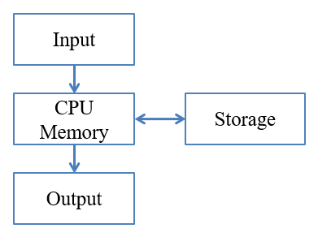
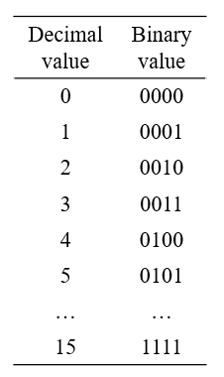
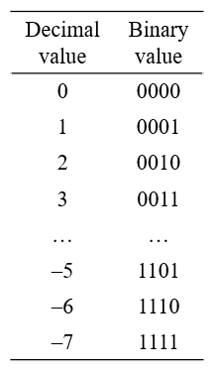
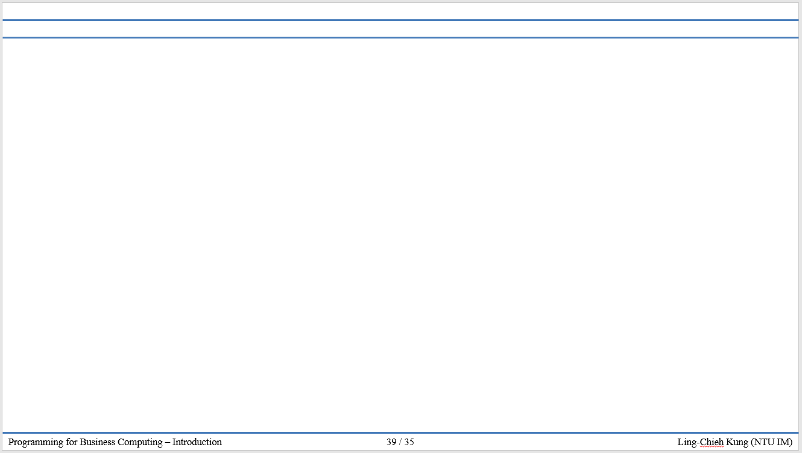
版權聲明
序 | 頁 | 作品 | 版權標章 | 作者 / 來源
1 | 3 4 |  |  | 台灣大學 孔令傑, CC BY-NC-ND 3.0
2 | 8 |  |  | 台灣大學 孔令傑, CC BY-NC-ND 3.0
3 | 9 |  |  | 台灣大學 孔令傑, CC BY-NC-ND 3.0
4 | 1-45 |  |  | 台灣大學 孔令傑, CC BY-NC-ND 3.0

