Slide 1

Programming for Business Computing Conditionals and Iterations
Preparations
Conditionals
Iterations
Ling-Chieh Kung
Department of Information Management
National Taiwan University
【本著作除另有註明外，採取創用CC「姓名標示－非商業性－禁止改作分享」台灣3.0版授權釋出】

Slide 2
Outline
Preparations
Conditionals
Iterations
Preparations
The Boolean data type
Assignment and comparison operators
Conditionals
Iterations

Slide 3
The Boolean data type
Preparations
Conditionals
Iterations
We have introduced three data types: integer, float, and string.
Variables of these types can be created by int(), float(), and str().
Another common data type is the Boolean data type.
There are only two possible values: true and false.
A Boolean variable is also called a binary variable.
Boolean variables can be created by bool().
One may also assign True or False to a variable.
a = False
print(a)
print(type(a))
a = True
print(a)
print(type(a))
a = bool()
print(a)
print(type(a))

Slide 4
The Boolean data type
Preparations
Conditionals
Iterations
Note that bool() gives us False.
In Python (and many other modern languages):
False means 0.
True means not 0.
This explains the following program:
a = bool(0)
print(a)
a = bool(123)
print(a)
a = bool(-4.8)
print(a)

Slide 5
Comparison operators
Preparations
Conditionals
Iterations
A comparison operator compares two operands and returns a Boolean value.
>: bigger than
<: smaller than
>=: not smaller than
<=: not bigger than
==: equals
!=: not equals
a = 10
b = 4
s = "123"
print(a < b)
print(len(s) != b)
print((a + 2) == (b * 3))

Slide 6
Comparison vs. assignment
Preparations
Conditionals
Iterations
Note that to compare whether two values are identical, we use ==, not =.
== is a comparison operator.
= is an assignment operator.
= assigns the value at its right to the variable at its left.
If a variable is at its right, its value is used.
If it is not a variable at its left, there is a syntax error.
a = 10
b = 4
c = a
print(c == a)
4 = d # error!
a + b = 4 # error!

Slide 7
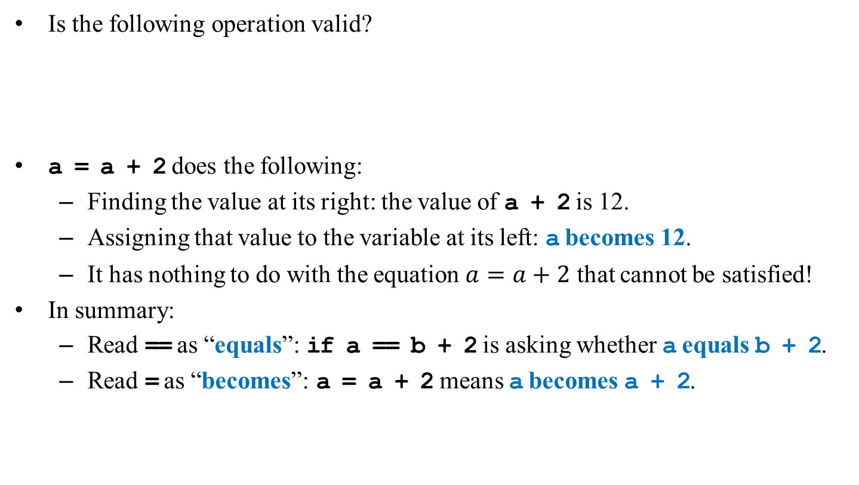
Comparison vs. assignment
Preparations
Conditionals
Iterations
Is the following operation valid?
a = a + 2 does the following:
Finding the value at its right: the value of a + 2 is 12.
Assigning that value to the variable at its left: a becomes 12.
It has nothing to do with the equation $a=a+2$ that cannot be satisfied!
In summary:
Read == as “equals”: if a == b + 2 is asking whether a equals b + 2.
Read = as “becomes”: a = a + 2 means a becomes a + 2.
a = 10
a = a + 2
print(a == 12)

Slide 8
Self assignment
Preparations
Conditionals
Iterations
A statement like a = a + 2 is a self assignment.
A variable is modified from its own value.
As self assignment is common, there are self-assignment operators:
a += 2 means a = a + 2.
a -= 2 means a = a - 2.
We also have *=, /=, //=, **=, %=, etc.
a = 10
a += 2
print(a)
a -= 2
print(a)
a *= 2
print(a)
a //= 2
print(a)
a /= 2
print(a)
a **= 2
print(a)
a %= 2
print(a)

Slide 9
Cascade assignment
Preparations
Conditionals
Iterations
Is the following operation valid?
a = b = 10 assigns 10 to both a and b.
More variables may be assigned the same value in one statement.
And of course, they are different variables.
a = b = 10
a = a + 2
print(a)
print(b)

Slide 10
Outline
Preparations
Conditionals
Iterations
Preparations
Conditionals
if-else
Logical operators
Iterations

Slide 11
The if statement
Preparations
Conditionals
Iterations
We use the if statement to enter or skip a block.
condition returns a Boolean value.
statements in the if block are executed one by one if condition is true.
We may hope that conditional on whether the condition is true or false, we do different sets of statements.
This is done with the if-else statement.
Do statements 1 if condition is true.
Do statements 2 if condition is false.
An else must have an associated if.
A block must be nonempty.
if condition:
statements
if condition:
statements 1
else:
statements 2

Slide 12
Example of the if-else statement
Preparations
Conditionals
Iterations
Given two integers, how to print out the smaller one?
num1 = int(input())
num2 = int(input())
min = num1
if num1 > num2:
min = num2
print(min, "is the smaller")

Slide 13
Nested if-else statement
Preparations
Conditionals
Iterations
An if or an if-else statement can be nested in an if block.
In this example, if both conditions are true, statements A will be executed.
If condition 1 is true but condition 2 is false, statements B will be executed.
If condition 1 is false, statements C will be executed.
An if or an if-else statement can be nested in an else block.
We may do this for any level of if or if-else.
if condition 1:
if condition 2:
statements A
else:
statements B
else:
statements C

Slide 14
Example of nested if-else statements
Preparations
Conditionals
Iterations
Given three integers, how to find the smallest one?
Nested if-else helps:
Some questions:
What will happen if there are multiple smallest values?
Are there better implementations?
a = int(input())
b = int(input())
c = int(input())
if a <= b:
if a <= c:
print(a, "is the smallest")
else:
print(c, "is the smallest")
else:
if b <= c:
print(b, "is the smallest")
else:
print(c, "is the smallest")

Slide 15
Two different implementations
Preparations
Conditionals
Iterations
min = 0
if a <= b:
if a <= c:
min = a
else:
min = c
else:
if b <= c:
min = b
else:
min = c
print(min, "is the smallest")
min = c
if a <= b:
if a <= c:
min = a
else:
if b <= c:
min = b
print(min, "is the smallest")

Slide 16
The ternary if operator
Preparations
Conditionals
Iterations
In many cases, what to do after an if-else selection is simple.
The ternary if operator can be helpful in this case.
If condition is true, do operation A; otherwise, operation B.
Let’s modify the previous example:
operation A if condition else operation B
if a <= b:
min = a if a <= c else c
else:
min = b if b <= c else c

Slide 17
The ternary if operator
Preparations
Conditionals
Iterations
Parentheses are helpful (though not needed):
Ternary if operators can also be nested (but not suggested):
if a <= b:
min = a if (a <= c) else c
else:
min = b if (b <= c) else c
min = (a if a <= c else c) if a <= b else (a if b <= c else c)
min = (a if a <= c else c) if (a <= b) else ((a if b <= c else c))

Slide 18
Indention matters
Preparations
Conditionals
Iterations
What does the following two problems mean?
In Python, an else will only be paired to the if at the same level.
if a == 10:
if b == 10:
print("a and b are both ten.\n")
else:
print("a is not ten.\n")
if a == 10:
if b == 10:
print("a and b are both ten.\n")
else:
print("a is not ten.\n")

Slide 19
The else-if statement
Preparations
Conditionals
Iterations
An if-else statement allows us to respond to one condition.
When we want to respond to more than one condition, we may put an if-else statement in an else block:
For this situation, people typically combine the second if behind else to create an else-if statement:
if a < 10:
print("a < 10.")
else:
if a > 10:
print("a > 10.")
else:
print("a == 10.")
if a < 10:
print("a < 10.")
elif a > 10:
print("a > 10.")
else:
print("a == 10.")

Slide 20
The else-if statement
Preparations
Conditionals
Iterations
An else-if statement is generated by using two nested if-else statements.
It is logically fine if we do not use else-if.
However, if we want to respond to many conditions, using else-if greatly enhances the readability of our program.
if month == 1:
print("31 days")
elif month == 2:
print("28 days")
elif month == 3:
print("31 days")
elif month == 4:
print("30 days")
elif month == 5:
print("31 days")
# ...
elif month == 11:
print("30 days")
else:
print("31 days")

Slide 21
Outline
Preparations
Conditionals
Iterations
Preprocessors and namespaces
Conditionals
if-else
Logical operators
Iterations

Slide 22
Logical operators
Preparations
Conditionals
Iterations
In some cases, the condition for an if statement is complicated.
If I am hungry and I have money, I will buy myself a meal.
If I am not hungry or I have no money, I will not buy myself a meal.
We may use logical operators to combine multiple conditions.
We have three logical operators: and, or, and not.
There is a precedence rule for operators.
You may find the rule in the textbook.
You do not need to memorize them: Just use parentheses.

Slide 23
Logical operators: and
Preparations
Conditionals
Iterations
The “and” operator operates on two conditions.
It returns true if both conditions are true. Otherwise it returns false.
(3 > 2) and (2 > 3) returns false.
(3 > 2) and (2 > 1) returns true.
When we use it in an if statement, the grammar is:
if condition 1 and condition 2:
statements

Slide 24
Logical operators: and
Preparations
Conditionals
Iterations
As an example:
a = int(input())
b = int(input())
c = int(input())
if a < b and b < c:
print("b is in between a and c")
else:
print("b is outside a and c")

Slide 25
Logical operators: and
Preparations
Conditionals
Iterations
An “and” operation can replace a nested if statement.
a = int(input())
b = int(input())
c = int(input())
if a < b and b < c:
print("b is in between a and c")
else:
print("b is outside a and c")
a = int(input())
b = int(input())
c = int(input())
if a < b:
if b < c:
print("b is in between a and c")
else:
print("b is outside a and c")

Slide 26
Logical operators: and
Preparations
Conditionals
Iterations
Sometimes conditions may be combined without a logical operator:
Nevertheless, avoid weird expressions (unless you know what you are doing):
Each condition must be complete by itself:
if a < b < c:
print("b is in between a and c")
if a < b < c > 10: # not good
print("b is in between a and c")
else:
print("b is outside a and c")
if b > a and < c: # error!
print("a is between 10 and 20")

Slide 27
Logical operators: or
Preparations
Conditionals
Iterations
The “or” operator returns true if at least one of the two conditions is true. Otherwise it returns false.
(3 > 2) or (2 > 3) returns true.
(3 < 2) or (2 < 1) returns false.
When the or operator is used in an if statement, the grammar is
if condition 1 or condition 2:
statements

Slide 28
Logical operator: not
Preparations
Conditionals
Iterations
The “not” operator returns the opposite of the condition.
not (2 > 3) returns true.
not (2 > 1) returns false.
It may be used when naturally there is nothing to do in the if block:
key = input("continue? ")
if key != "y" and key != "Y": # error!
else:
print("Game over!") # logic error!
key = input("continue? ")
if not (key == "y" or key == "Y"):
print("Game over!")

Slide 29
Outline
Preparations
Conditionals
Iterations
Preprocessors and namespaces
Conditionals
Iterations
while
for

Slide 30
The while statement
Preparations
Conditionals
Iterations
In many cases, we want to repeatedly execute a set of codes.
One way to implement repetition is to use the while statement.
Guess what do these programs do?
while is nothing but an if that repeats.
The statements in a while block are repeated if the condition is satisfied.
sum = 0
i = 1
while i <= 100:
sum = sum + i
i = i + 1
print(sum)
# do something
exit = input("Press y or Y to exit: ")
while not (exit == "y" or exit == "Y"):
# do something
exit = input("Press y or Y to exit: ")

Slide 31
Modifying loop counters
Preparations
Conditionals
Iterations
Sometimes we need to add 1 to or subtract 1 from a loop counter.
Binary self assignment operators (e.g., +=) may help.
sum = 0
i = 1
while i <= 100:
sum = sum + i
i = i + 1
print(sum)
sum = 0
i = 1
while i <= 100:
sum = sum + i
i += 1
print(sum)
sum = 0
i = 1
while i <= 100:
sum += i
i += 1
print(sum)

Slide 32

Example
Preparations
Conditionals
Iterations
Given an integer $n$, is $n=2^{k}$ for some integer $k≥0$?
n = int(input())
k = 0
m = 1
while n > m:
m *= 2
k += 1
# print(m, k)
if m == n:
print(n, "is 2 to the power of", k)

Slide 33
Infinite loops
Preparations
Conditionals
Iterations
An infinite loop is a loop that does not terminate.
In many cases an infinite loop is a logical error made by the programmer.
When it happens, check your program.
n = int(input())
k = 0
m = 1
while n != m:
m *= 2
k += 1
if m == n:
print(n, "is 2 to the power of", k)

Slide 34
break and continue
Preparations
Conditionals
Iterations
When we implement a repetition process, sometimes we need to further change the flow of execution of the loop.
A break statement brings us to exit the loop immediately.
When continue is executed, statements after it in the loop are skipped.
The looping condition will be checked immediately.
If it is satisfied, the loop starts from the beginning again.

Slide 35
Example
Preparations
Conditionals
Iterations
Which of the following programs work?
n = int(input())
m = n
k = 0
while m > 1:
if m % 2 != 0:
break
m //= 2
k += 1
if m == 1:
print(n, "is 2 to the power of", k)
n = int(input())
m = n
k = 0
while m > 1:
if m % 2 != 0:
continue
m //= 2
k += 1
if m == 1:
print(n, "is 2 to the power of", k)

Slide 36
break and continue
Preparations
Conditionals
Iterations
The effect of break and continue is just on the current level.
If a break is used in an inner loop, the execution jumps to the outer loop.
If a continue is used in an inner loop, the execution jumps to the condition check of the inner loop.
What will be printed out at the end of this program?
a = 1
b = 1
while a <= 10:
while b <= 10:
if b == 5:
break
print(a * b)
b += 1
a += 1
print(a) # ?

Slide 37
Infinite loops with a break
Preparations
Conditionals
Iterations
We may intentionally create an infinite loop and terminate it with a break.
E.g., we may wait for an “exit” input and then leave the loop with a break.
# do something
exit = input("Press y or Y to exit: ")
while not (exit == "y" or exit == "Y"):
# do something
exit = input("Press y or Y to exit: ")
while True:
# do something
exit = input("Press y or Y to exit: ")
if exit == "y" or exit == "Y":
break

Slide 38
Infinite loops with a break
Preparations
Conditionals
Iterations
The above mentioned technique is widely used to eliminate redundant codes.
Redundancy introduces potential inconsistency.
In some other languages, this technique is offered as a “do-while loop”.
In Python, just do it by yourself.
# do something
exit = input("Press y or Y to exit: ")
while not (exit == "y" or exit == "Y"):
# do something
exit = input("Press y or Y to exit: ")

Slide 39
break and continue
Preparations
Conditionals
Iterations
Using break gives a loop multiple exits.
It becomes harder to track the flow of a program.
It becomes harder to know the state after a loop.
Using continue highlights the need of getting to the next iteration.
Having too many continue still gets people confused.
Be careful not to hurt the readability of a program too much.

Slide 40
Outline
Preparations
Conditionals
Iterations
Preprocessors and namespaces
Conditionals
Iterations
while
for

Slide 41
The for statement
Preparations
Conditionals
Iterations
Another way of implementing a loop is to use a for statement.
The typical way of using a for statement is:
variable: A variable called the loop counter.
list: A list of variables that will be “traversed.”
statements: The things that we really want to do.
In each iteration, variable will take a value in list (from the first to the last).
for variable in list:
statements

Slide 42
Example
Preparations
Conditionals
Iterations
To create a list, simply list them:
A string can also be treated as a list.
Each character will be considered in each iteration.
for i in 1, 2, 3:
if i % 2 != 0:
print(i)
a = 1
b = 2
c = 3
for i in a, c, b:
print(i)
str = "abwyz"
for i in str:
print(i * 3)

Slide 43
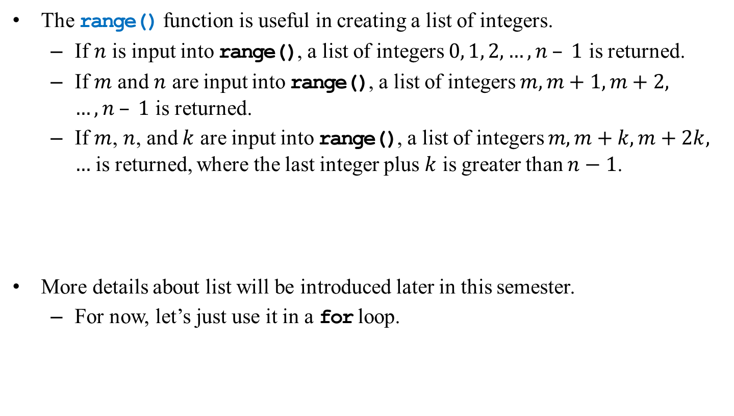
range()
Preparations
Conditionals
Iterations
The range() function is useful in creating a list of integers.
If $n$ is input into range(), a list of integers $0, 1, 2, …, n – 1$ is returned.
If $m$ and $n$ are input into range(), a list of integers $m, m+1, m+2, …, n – 1$ is returned.
If $m$, $n$, and $k$ are input into range(), a list of integers $m, m+k, m+2k, …$ is returned, where the last integer plus $k$ is greater than $n−1$.
More details about list will be introduced later in this semester.
For now, let’s just use it in a for loop.
print(range(10))
print(range(2, 10))
print(range(2, 10, 3))

Slide 44
for vs. while
Preparations
Conditionals
Iterations
Let’s calculate the sum of 1 + 2 + … + 100:
We used while. How about for?
To use for:
We first prepare a list of values 1, 2, …, and 100.
Then we sum them up.
sum = 0
i = 1
while i <= 100:
sum = sum + i
i = i + 1
print(sum)
sum = 0
for i in range(1, 101):
sum = sum + i
print(sum)

Slide 45
Modifying the loop counter?
Preparations
Conditionals
Iterations
What will be the outcome of this program?
Manual modifications of the loop counter is of no effect!
sum = 0
for i in range(1, 101):
sum = sum + i
i = i + 10
print(sum)

Slide 46
Nested loops
Preparations
Conditionals
Iterations
Like the selection process, loops can also be nested.
Outer loop, inner loop, most inner loop, etc.
Nested loops are not always necessary, but they can be helpful.
Particularly when we need to handle a multi-dimensional case.

Slide 47
Nested loops: Example 1
Preparations
Conditionals
Iterations
Please write a program to output some integer points on an (x, y)-plane like this:
(1, 1) (1, 2) (1, 3)
(2, 1) (2, 2) (2, 3)
(3, 1) (3, 2) (3, 3)
Note that there is a comma at the end of the inner print.
It says “do not change to a new line.”
We change to a new line only in the outer loop by printing out a newline character.
This can still be done with only one level of loop. but using a nested loop is much easier.
for x in range(3):
x += 1
for y in range(3):
y += 1
print("(" + str(x) + ", " + str(y) + ")"),
print("\n"),

Slide 48
Nested loops: Example 2
Preparations
Conditionals
Iterations
Please write a program to output a multiplication table:
How would you make the lower and upper bounds flexible?
How would you align the outputs in the same column?
for x in range(1, 5):
for y in range(1, 5):
print(str(x) + " * " + str(y) + " = " + str(x * y) + ";"),
print("\n"),

Slide 49
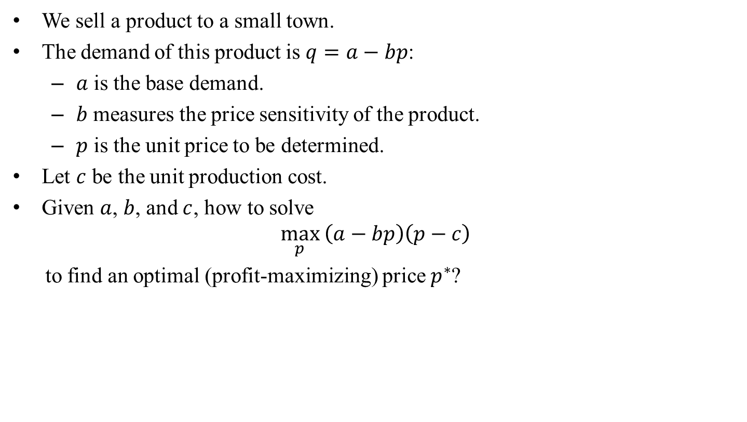
Case study: Monopoly pricing
Preparations
Conditionals
Iterations
We sell a product to a small town.
The demand of this product is $q=a−bp$:
$a$ is the base demand.
$b$ measures the price sensitivity of the product.
$p$ is the unit price to be determined.
Let $c$ be the unit production cost.
Given $a$, $b$, and $c$, how to solve
$$\max_{p}\left(a−bp\right)\left(p−c\right)$$ to find an optimal (profit-maximizing) price $p^{∗}$?

Slide 50
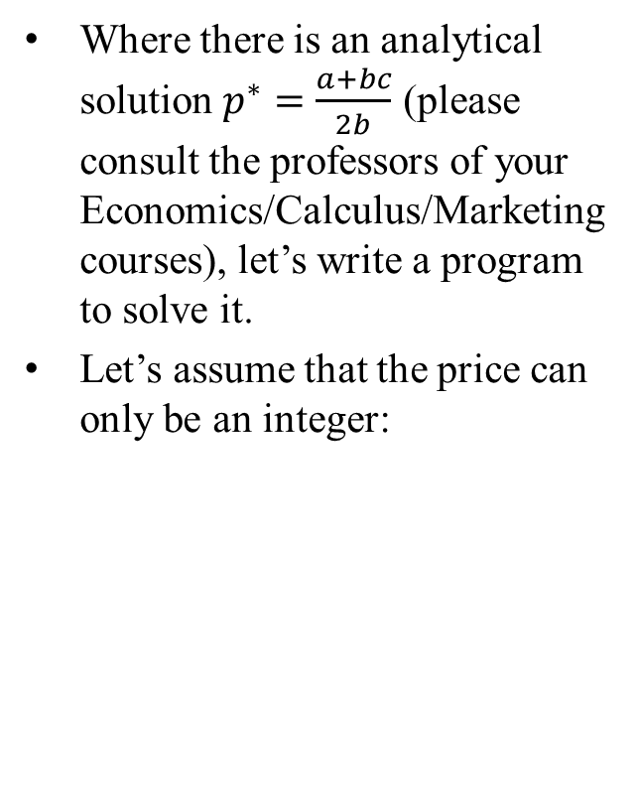
Case study: Monopoly pricing
Preparations
Conditionals
Iterations
Where there is an analytical solution $p^{∗}=\frac{a+bc}{2b}$ (please consult the professors of your Economics/Calculus/Marketing courses), let’s write a program to solve it.
Let’s assume that the price can only be an integer:
a = int(input("base demand = "))
b = int(input("price sensitivity = "))
c = int(input("unit cost = "))
maxProfit = 0
optimalPrice = 0
for p in range(c + 1, a // b):
profit = (a - b * p) * (p - c)
# print(p, profit)
if profit > maxProfit:
maxProfit = profit
optimalPrice = p
print("optimal price = " + str(optimalPrice))
print("maximized profit = " + str(maxProfit))

Slide 51
Good programming style
Preparations
Conditionals
Iterations
Use the loop that makes your program the most readable.
When you need to execute a loop for a fixed number of iterations, use a for statement with a counter declared only for the loop.
This also applies if you know the maximum number of iterations.
If the number of (maximum) number of iterations is uncertain, use while.

Slide 52
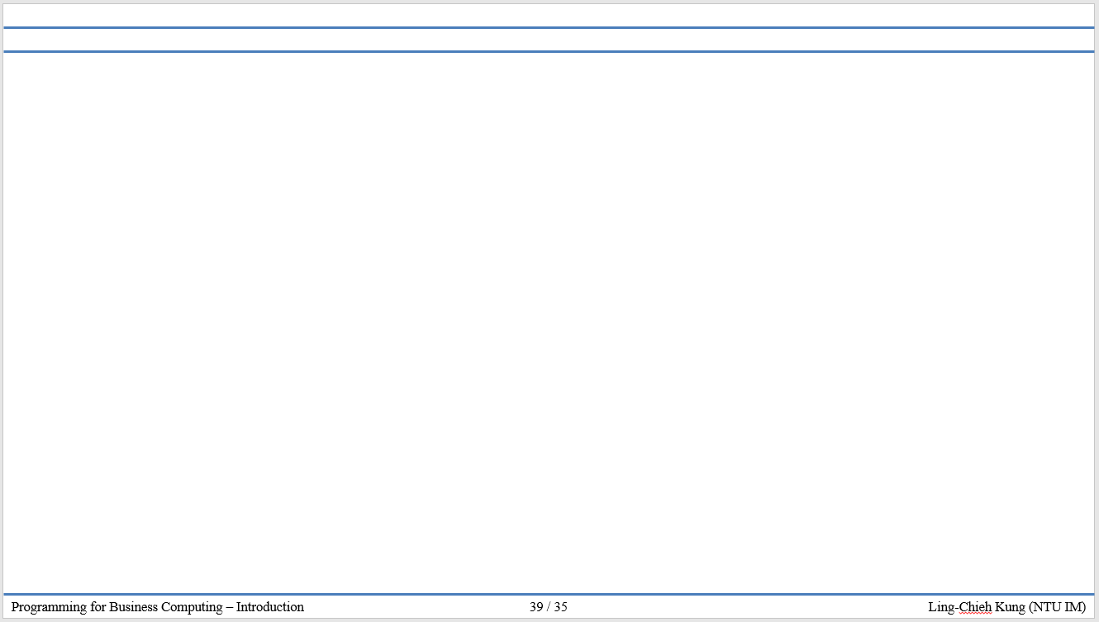
版權聲明
序 | 頁 | 作品 | 版權標章 | 作者 / 來源
1 | 1-52 |  |  | 台灣大學 孔令傑, CC BY-NC-ND 3.0

