Slide 1

Programming for Business Computing Applications in Operations Management
Preparations
Scheduling
Inventory Control
Demand forecasting
Ling-Chieh Kung
Department of Information Management
National Taiwan University
【本著作除另有註明外，採取創用CC「姓名標示－非商業性－禁止改作分享」台灣3.0版授權釋出】

Slide 2


Operations Management
Preparations
Scheduling
Inventory Control
Demand forecasting
Operations Management (OM) deals with “operations.”
Operations are activities inside a company.
It was Production Management at the beginning.
Today it includes (or is highly related to) Service Management, Decision Analysis, Supply Chain Management, etc.
Typically OM issues:
Production planning and scheduling.
Facility location.
Inventory control.
Logistics and transportation.
We will solve some OM problems by writing computer programs.
Basically we implement algorithms.

Slide 3
Algorithms
Preparations
Scheduling
Inventory Control
Demand forecasting
An algorithm is a step-by-step procedure for solving a problem.
For a given task, it precisely describes what to do at each moment to complete that task.
As an example, suppose that I want to sort Poker cards on my hands:
First put one card at the first position.
Look at the second card. Leave it there is it is bigger than the first one; exchange it with the first one otherwise.
Look at the third card and put it as the first, second, or third card to make the first three cards sorted.
…
For the ith card, “insert” it to a position that makes the first ith card sorted.
Anyway, it is a detailed description of actions such that each action is doable.

Slide 4
Outline
Preparations
Scheduling
Inventory Control
Demand forecasting
Preparations: strings and lists
Scheduling
Inventory control
Demand forecasting

Slide 5
Reading many values in a line
Preparations
Scheduling
Inventory Control
Demand forecasting
In many cases we need to read a lot of values into our program.
An easy way to express an input is:
Values will be put in a line, separated by white spaces (or commas or other delimiters).
For example, five student grades may be put in these ways:
One type of plain-text file, CSV (comma-separated values), uses commas to separate each row into multiple columns.
This is why it can be open by MS Excel (or something similar).
How to read these data into our program?
98 65 57 48 80
98,65,57,48,80

Slide 6
Reading many values as a string
Preparations
Scheduling
Inventory Control
Demand forecasting
Python is very good at string processing.
To read in a line of data, simply invoke input().
But gradeStr is a string, not five numbers!
We need to do three things:
Splitting the string into five pieces (substrings).
Converting the five substrings into five numbers.
Put the five numbers into a list.
gradeStr = input()
print(gradeStr)

Slide 7
String splitting
Preparations
Scheduling
Inventory Control
Demand forecasting
A string can be split by invoking split().
We may choose the delimiter when invoking split().
What is grades?
gradeStr = input() # 1 2 3 4 5
grades = gradeStr.split()
print(grades) # ['1', '2', '3', '4', '5']
gradeStr = input() # 1,2,3,4,5
grades = gradeStr.split(',')
print(grades) # ['1', '2', '3', '4', '5']

Slide 8
Lists
Preparations
Scheduling
Inventory Control
Demand forecasting
The outcome of invoking split() is a list.
A list is an ordered container that stores items.
An item may be an integer, a float, a string, or of other types.
Each item can be accessed by the indexing operator [].
The first item is indexed at 0!
The length of a list can be obtained by invoking len().
gradeStr = input() # 1 2 3 4 5
grades = gradeStr.split()
print(grades[0], grades[2] * 2) # 1 33
gradeStr = input() # 1 2 3 4 5
grades = gradeStr.split()
print(len(grades)) # 5

Slide 9
List declaration
Preparations
Scheduling
Inventory Control
Demand forecasting
We may declare an empty list as follows:
We may declare a list of three 0s as follows:
We may declare a list of items with various data types:
aList = []
print(aList, len(aList)) # [] 0
aList = [0] * 3
print(aList, len(aList)) # [0, 0, 0] 3
aList = [0, "hi", True]
print(aList) # [0, 'hi', True]

Slide 10
Putting items into a list
Preparations
Scheduling
Inventory Control
Demand forecasting
We may add items into a list by invoking append().
Note that the last item is an integer, not a string.
We may even put a list into a list:
gradeStr = input() # 1 2 3 4 5
grades = gradeStr.split()
grades.append(-1)
print(grades) # ['1', '2', '3', '4', '5', -1]
gradeStr = input() # 1 2 3
grades = gradeStr.split()
grades.append([9, 7, 5])
print(grades) # ['1', '2', '3', [9, 7, 5]]

Slide 11
Traversing a list in a loop
Preparations
Scheduling
Inventory Control
Demand forecasting
What does the following programs do?
print(range(1, 101))
sum = 0
for i in range(1, 101):
sum = sum + i
print(sum)
gradeStr = input() # 1 2 3 4 5
gradeList = gradeStr.split()
print(gradeList) # ['1', '2', '3', '4', '5']
grades = []
for g in gradeList:
grades.append(int(g))
print(grades) # [1, 2, 3, 4, 5]

Slide 12
List modification
Preparations
Scheduling
Inventory Control
Demand forecasting
What does the following program do?
gradeStr = input() # 1 2 3 4 5
grades = gradeStr.split()
print(grades) # ['1', '2', '3', '4', '5']
for i in range(len(grades)):
grades[i] = int(grades[i]) * 2
print(grades) # [2, 4, 6, 8, 10]

Slide 13
An example
Preparations
Scheduling
Inventory Control
Demand forecasting
What does the following program do?
What will you do if you cannot use a list?
# months is a list used as a lookup table
months = ["Jan", "Feb", "Mar", "Apr", "May", "Jun",
"Jul", "Aug", "Sep", "Oct", "Nov", "Dec"]
n = input("Enter a month number (1-12): ")
print("The month is", months[n - 1] + ".")

Slide 14
List operations
Preparations
Scheduling
Inventory Control
Demand forecasting
Method | Meaning
<list>.append(x) | Add element x to end of list.
<list>.sort() | Sort (order) the list. A comparison function may be passed as a parameter.
<list>.reverse() | Reverse the list.
<list>.index(x) | Returns index of first occurrence of x.
<list>.insert(i, x) | Insert x into list at index i.
<list>.count(x) | Returns the number of occurrences of x in list.
<list>.remove(x) | Deletes the first occurrence of x in list.
<list>.pop(i) | Deletes the ith element of the list and returns its value.

Slide 15
Examples of list operations
Preparations
Scheduling
Inventory Control
Demand forecasting
What does the following program do?
lst = [3, 1, 4, 1, 5, 9]
lst.append(2)
print(lst) # [3, 1, 4, 1, 5, 9, 2]
lst.sort()
print(lst) # [1, 1, 2, 3, 4, 5, 9]
lst.reverse()
print(lst) # [9, 5, 4, 3, 2, 1, 1]
print(lst.index(4)) # 2
lst.insert(4, "Hi")
print(lst) # [9, 5, 4, 3, 'Hi', 2, 1, 1]
print(lst.count(1)) # 2
lst.remove(1)
print(lst) # [9, 5, 4, 3, 'Hi', 2, 1]
print(lst.pop(3)) # 3
print(lst) # [9, 5, 4, 'Hi', 2, 1]

Slide 16
Outline
Preparations
Scheduling
Inventory Control
Demand forecasting
Preparations: strings and lists
Scheduling
Inventory control
Demand forecasting

Slide 17
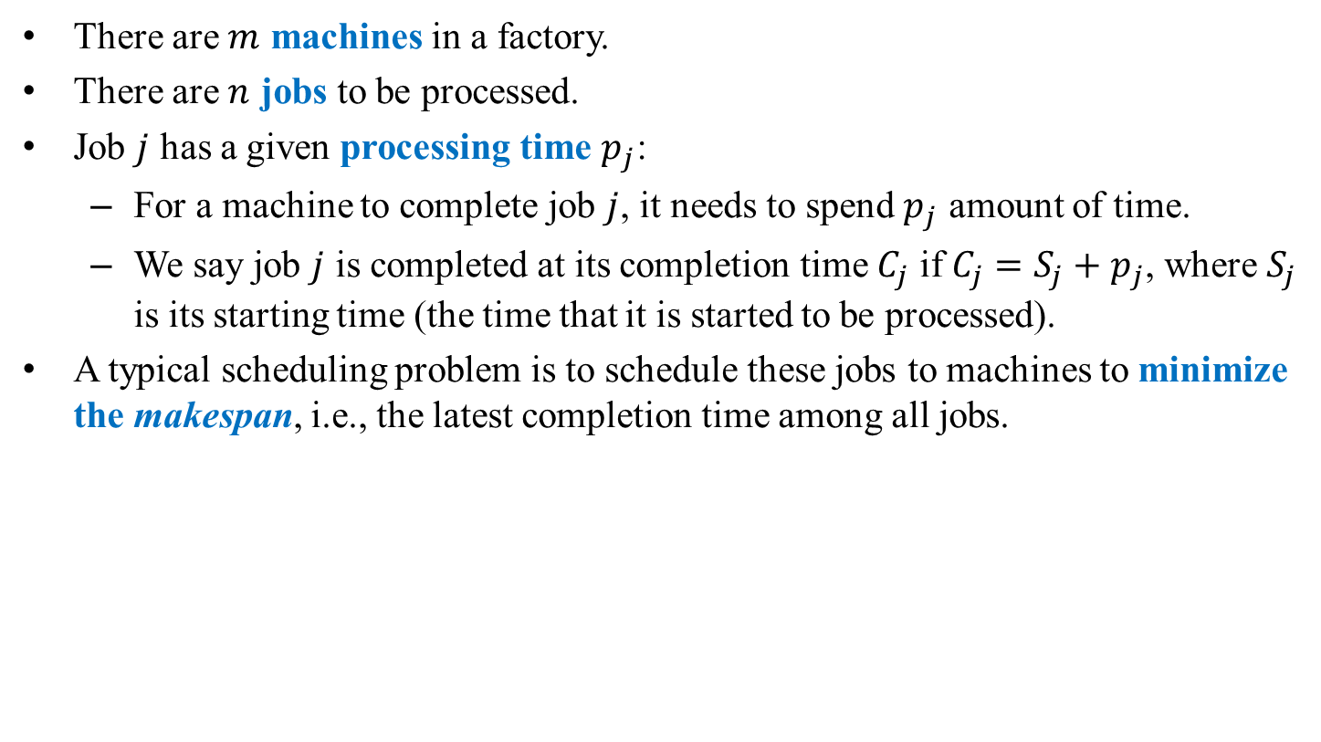
Scheduling: Makespan minimization
Preparations
Scheduling
Inventory Control
Demand forecasting
There are $m$ machines in a factory.
There are $n$ jobs to be processed.
Job $j$ has a given processing time $p_{j}$:
For a machine to complete job $j$, it needs to spend $p_{j}$ amount of time.
We say job $j$ is completed at its completion time $C_{j}$ if $C_{j}=S_{j}+p_{j}$, where $S_{j}$ is its starting time (the time that it is started to be processed).
A typical scheduling problem is to schedule these jobs to machines to minimize the makespan, i.e., the latest completion time among all jobs.

Slide 18
Example
Preparations
Scheduling
Inventory Control
Demand forecasting
There are ten jobs with processing times 3, 3, 3, 4, 4, 5, 5, 6, 7, and 8.
There are three machines.
Schedule 1: Makespan = 18.
Schedule 2: Makespan = 16.
3 | 3 |  |  | 3 |  | 6
4 |  | 4 |  |  | 7
5 |  |  | 5 |  |  |  | 8
3 | 3 |  |  | 4 |  |  | 6
4 |  | 5 |  |  |  | 7
5 |  |  | 3 |  | 8

Slide 19
Makespan minimization
Preparations
Scheduling
Inventory Control
Demand forecasting
Makespan minimization is for load balancing.
To fairly allocation jobs.
To save utility fees.
To go home as early as possible.
It turns out that this problem is “hard.”
Most researchers believe that an optimal schedule is too time-consuming to obtain in general.
Several heuristic algorithms have been developed.
Typically easy to implement, easy to execute, and time-efficient.
Typically not too bad (near optimal).

Slide 20
Longest processing time first (LPT)
Preparations
Scheduling
Inventory Control
Demand forecasting
One well-known algorithm for makespan minimization is the longest processing time first (LPT) rule.
First, sort jobs in the descending order of their processing times.
Then in each iteration schedule a job to the machine that is currently the least loaded (having the earliest completion time).
We call LPT an iterative algorithm.
It runs in iterations.
In each iteration, it performs a similar action.
We call LPT a greedy algorithm.
In each iteration, it makes the choice that is the best at that moment.
In fact, even if we skip the sorting step, the algorithm still performs “well.”

Slide 21
LPT implementation (without sorting)
Preparations
Scheduling
Inventory Control
Demand forecasting
Let’s implement LPT without the sorting step.
First, read inputs and do the preparations:
# read and prepare n, m, and p n = int(input("Number of jobs: "))
m = int(input("Number of machines: "))
pStr = input("Processing times: ")
p = pStr.split(' ')
for i in range(n):
p[i] = int(p[i])
# machine completion times
loads = [0] * m
assignment = [0] * n

Slide 22
LPT implementation (without sorting)
Preparations
Scheduling
Inventory Control
Demand forecasting
Second, we do the iterative assignment:
# in iteration j, assign job j to the least loaded machine
for j in range(n):
# find the least loaded machine
leastLoadedMachine = 0
leastLoad = loads[0]
for i in range(1, m):
if loads[i] < leastLoad:
leastLoadedMachine = i
leastLoad = loads[i]
# schedule a job
loads[leastLoadedMachine] += p[j]
assignment[j] = leastLoadedMachine + 1

Slide 23
LPT implementation (without sorting)
Preparations
Scheduling
Inventory Control
Demand forecasting
Finally, we check the result:
# the result
print("Job assignment: " + str(assignment))
print("Machine loads: " + str(loads))

Slide 24
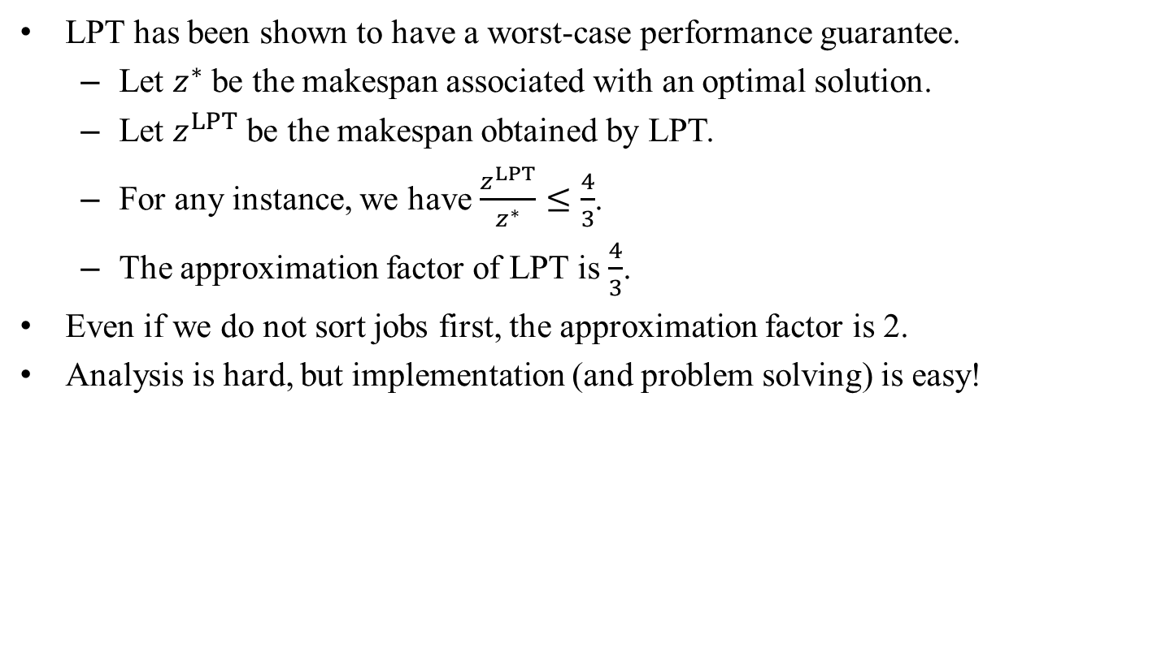
Remarks
Preparations
Scheduling
Inventory Control
Demand forecasting
LPT has been shown to have a worst-case performance guarantee.
Let $z^{∗}$ be the makespan associated with an optimal solution.
Let $z^{LPT}$ be the makespan obtained by LPT.
For any instance, we have $\frac{z^{LPT}}{z^{∗}}≤\frac{4}{3}$.
The approximation factor of LPT is $\frac{4}{3}$.
Even if we do not sort jobs first, the approximation factor is 2.
Analysis is hard, but implementation (and problem solving) is easy!

Slide 25
Another job allocation problem
Preparations
Scheduling
Inventory Control
Demand forecasting
Consider another problem of assigning jobs to agents.
A job has a required processing time.
By completing a job, an agent earns a benefit.
Each agent has a maximum amount of time to work.
How to allocate jobs to agents to maximize the benefit earned by the agent earning the lowest benefit?
Let’s modify LPT:
Sort jobs in the descending order of benefits.
In each iteration, assign a job to the agent currently having the lowest total benefit, if that does not violate the maximum working time constraint.
How would you implement it?

Slide 26
Outline
Preparations
Scheduling
Inventory Control
Demand forecasting
Preparations: strings and lists
Scheduling
Inventory control
Demand forecasting

Slide 27
Inventory control
Preparations
Scheduling
Inventory Control
Demand forecasting
Inventory are commonly needed in practice.
Retailers keep inventory of products.
Manufacturers keep inventory of raw materials.
Why inventory?
To be a buffer between supply and demand.
To balance between fixed ordering cost and variable holding cost.
To control inventory, people develop inventory policies.
When to order.
How many to order.
From whom to order (if there are multiple suppliers).
Etc.

Slide 28
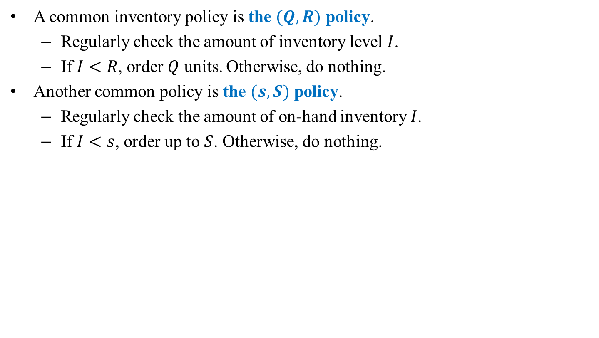
Common inventory policies
Preparations
Scheduling
Inventory Control
Demand forecasting
A common inventory policy is the $(Q, R)$ policy.
Regularly check the amount of inventory level $I$.
If $I<R$, order $Q$ units. Otherwise, do nothing.
Another common policy is the $(s, S)$ policy.
Regularly check the amount of on-hand inventory $I$.
If $I<s$, order up to $S$. Otherwise, do nothing.

Slide 29
Automatic ordering
Preparations
Scheduling
Inventory Control
Demand forecasting
Obviously, today people may implement automatic ordering.
If we build a continuous review system:
Whenever one item is sold through the POS (point-of-sales) system, check the inventory level.
If the reorder point is reached, place an order.
If we build a periodic review system:
Check the inventory level at the end of each “period,” (e.g., a day).
If the reorder point is reached, place an order.
Let’s implement a periodic review system.

Slide 30

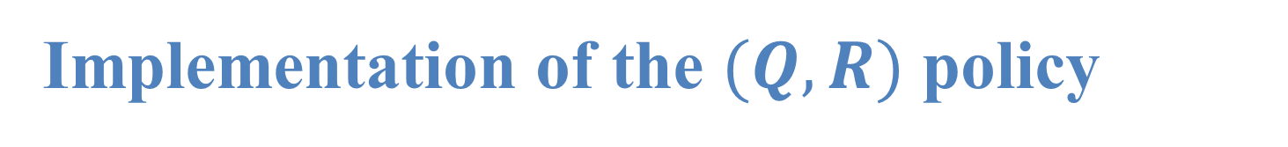
Implementation of the $(Q, R)$ policy
Preparations
Scheduling
Inventory Control
Demand forecasting
Let’s implement the $(Q, R)$ policy:
How to implement the $(s, S)$ policy?
Q = int(input("Order quantity Q: "))
R = int(input("Reorder point R: "))
I = int(input("Initial inventory I: "))
print("Inventory: " + str(I))
while True:
sales = int(input("Sales in a day: "))
I = I - sales if I - sales >= 0 else 0
if I < R:
I = I + Q
print("Inventory: " + str(I))

Slide 31

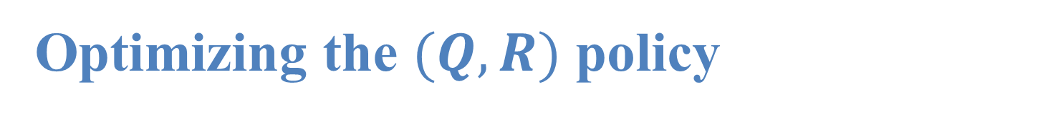
Optimizing the $(Q, R)$ policy
Preparations
Scheduling
Inventory Control
Demand forecasting
How to choose the policy parameters $Q$ and $R$?
Three relevant costs:
Inventory cost: Cash generates investment returns, but inventory does not.
Ordering cost: The fixed cost incurred for each order (e.g., shipping cost).
Shortage cost: The loss sales and goodwill upon shortage.
Objective: Minimize the sum of inventory, ordering, and shortage cost.

Slide 32
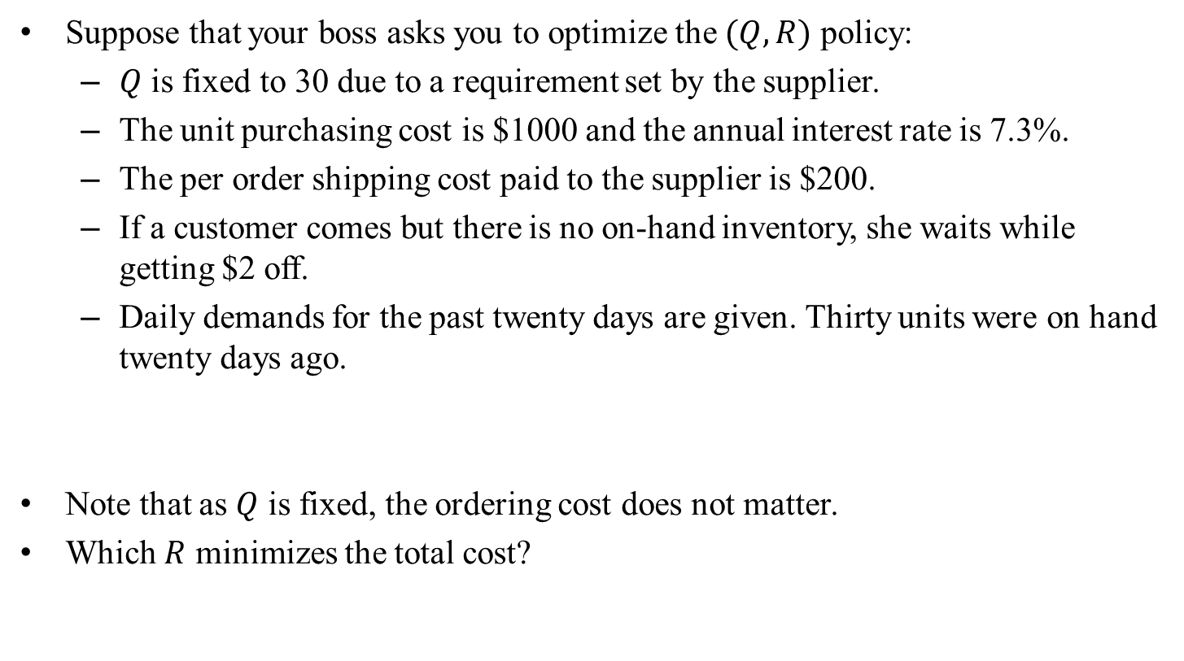
An instance
Preparations
Scheduling
Inventory Control
Demand forecasting
Suppose that your boss asks you to optimize the $(Q, R)$ policy:
$Q$ is fixed to 30 due to a requirement set by the supplier.
The unit purchasing cost is $1000 and the annual interest rate is 7.3%.
The per order shipping cost paid to the supplier is $200.
If a customer comes but there is no on-hand inventory, she waits while getting $2 off.
Daily demands for the past twenty days are given. Thirty units were on hand twenty days ago.
Note that as $Q$ is fixed, the ordering cost does not matter.
Which $R$ minimizes the total cost?
14,23,26,17,17,12,24,19,10,18,22,31,19,16,22,28,20,27,20,32

Slide 33

What if…
Preparations
Scheduling
Inventory Control
Demand forecasting
What if we have chosen $R=10$:
The total cost (for the past twenty days) with $R=10$ is $191.
Is it good or bad?
Sales |  | 14 | 23 | 26 | 17 | 17 | …
Before replenishment | 20 | 6 | 13 | –13 | 0 | 13
After replenishment |  | 36 | 13 | 17 | 30 | 13
Inventory cost |  | $7.2 | $2.6 | $3.4 | $6 | $2.6
Shortage cost |  | $0 | $0 | $26 | $0 | $0

Slide 34

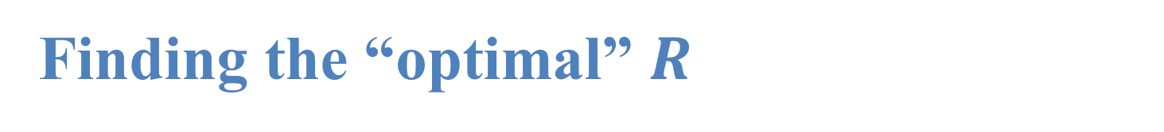
Finding the “optimal” $R$
Preparations
Scheduling
Inventory Control
Demand forecasting
To find $R$ that minimizes the expected total cost for the future, we need to estimate/forecast/predict future demands.
A proxy is to find $R$ that minimizes the total cost for the past twenty days.
For each value of $R=0, 1, 2, 3,…$, suppose that we have implemented the $(Q, R)$ policy, what is the cost for the past twenty days?
If the demand pattern is going to remain unchanged, this should be good.
This works only if we have past demand, not only past sales.

Slide 35
Implementation
Preparations
Scheduling
Inventory Control
Demand forecasting
First, we get the given information ready:
# past sales
salesStr = "14,23,26,17,17,12,24,19,10,18,22,31,19,16,22,28,20,27,20,32"
sales = salesStr.split(',')
for i in range(len(sales)):
sales[i] = int(sales[i])
# given information
stgCost = 2
invCost = 1000 * 0.073 / 365
Q = 30
I = 20

Slide 36

Implementation
Preparations
Scheduling
Inventory Control
Demand forecasting
# finding the best R
bestR = 0
costOfBestR = 100000000
for R in range(Q):
totalCost = 0
# finding the total cost of this R
for s in sales:
I -= s
if I < 0:
totalCost += -I * stgCost
I += Q
elif I < R:
I += Q
totalCost += I * invCost
# update bestR when necessary
if totalCost < costOfBestR:
bestR = R
costOfBestR = totalCost
print(bestR)
We then search for the best $R$ and print it out.

Slide 37
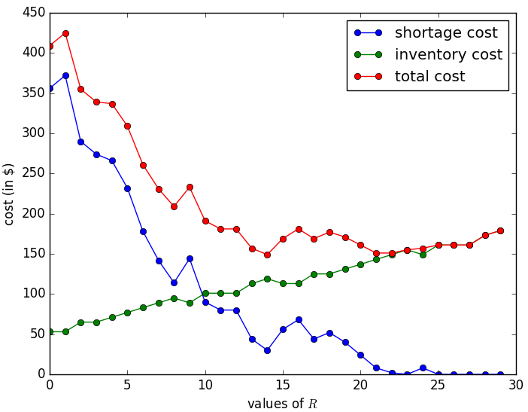
Visualization
Preparations
Scheduling
Inventory Control
Demand forecasting

Slide 38

Further questions
Preparations
Scheduling
Inventory Control
Demand forecasting
What if we also want to optimize $Q$?
What if we have multiple products with independent ordering operations?
What if we have multiple products, and it is preferred to combine their purchasing orders?
What if sales are lost rather than backlogged?

Slide 39
Outline
Preparations
Scheduling
Inventory Control
Demand forecasting
Preparations: strings and lists
Scheduling
Inventory control
Demand forecasting

Slide 40
Demand forecasting
Preparations
Scheduling
Inventory Control
Demand forecasting
Sometimes we really need to predict future demands.
To prepare inventory.
To hire workers.
To plan for capacity.
To negotiate prices.
We do demand forecasting typically according to past sales.
While there are many ways, an easiest way is the moving average method.
It is one kind of time series methods.
It uses nothing but the past sales information.

Slide 41
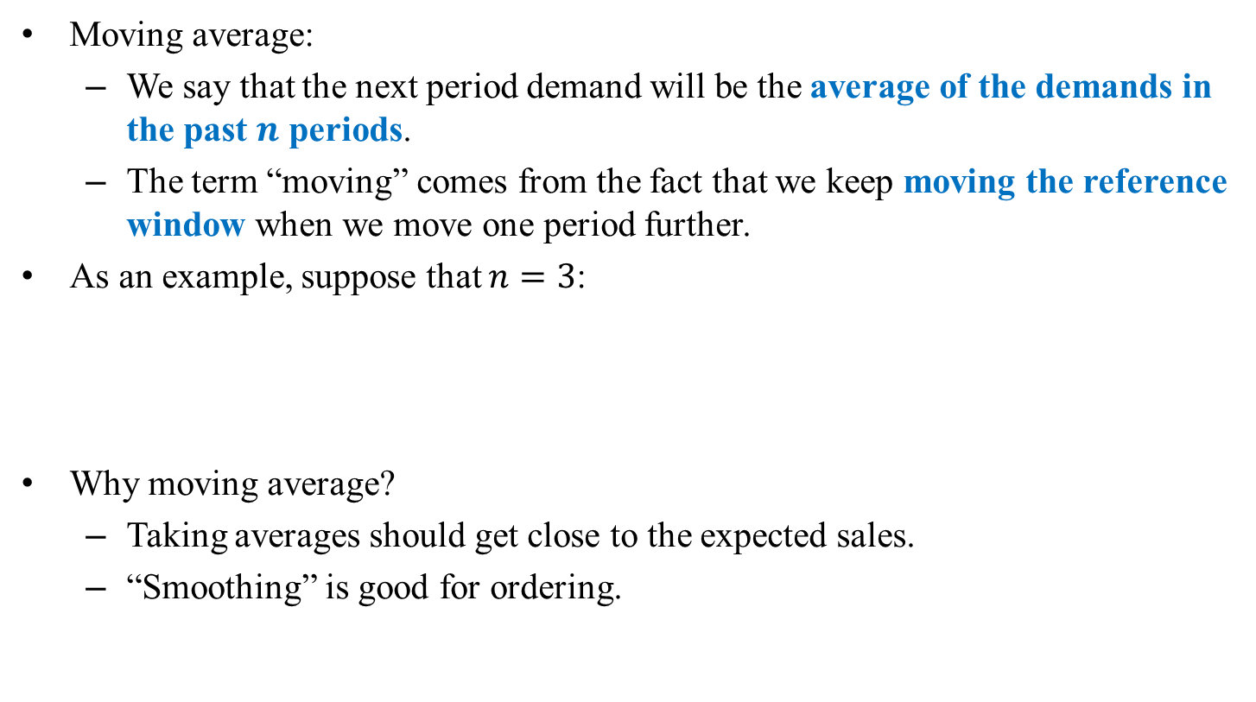
Moving average
Preparations
Scheduling
Inventory Control
Demand forecasting
Moving average:
We say that the next period demand will be the average of the demands in the past $n$ periods.
The term “moving” comes from the fact that we keep moving the reference window when we move one period further.
As an example, suppose that $n=3$:
Why moving average?
Taking averages should get close to the expected sales.
“Smoothing” is good for ordering.
Sales | 14 | 23 | 26 | 17 | 17 | 12 | 24 | 19 | 10 | 18
Forecast | N/A | N/A | N/A | 21 | 22 | 20 | 15.3 | 17.7 | 18.3 | 17.7

Slide 42
Implementation of moving average
Preparations
Scheduling
Inventory Control
Demand forecasting
Let’s implement moving average.
First, we get the given data ready:
# past sales
salesStr = "12,23,21,15,24,8,9,12,17,32,28,33,24"
sales = salesStr.split(',')
T = len(sales)
for t in range(T):
sales[t] = int(sales[t])
# setting up n
n = int(input("n: "))
forecast = []

Slide 43
Implementation of moving average
Preparations
Scheduling
Inventory Control
Demand forecasting
We then calculate the forecasts and print them out:
# do the forecasting
for t in range(n, T + 1):
sum = 0
for i in range(1, n + 1):
sum += sales[t - i]
forecast.append(sum / n)
# printing out the results
for t in range(n):
print(sales[t], "--")
for t in range(n, T):
print(sales[t], forecast[t - n])
print("--", forecast[T - n])

Slide 44
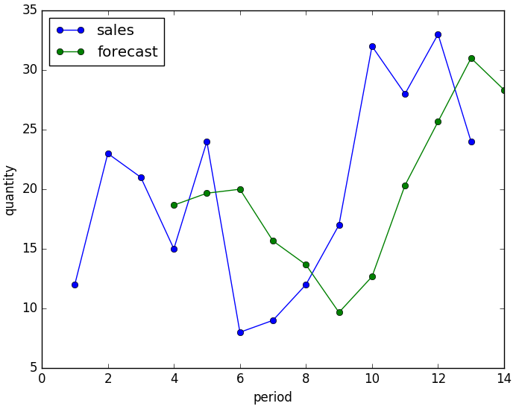
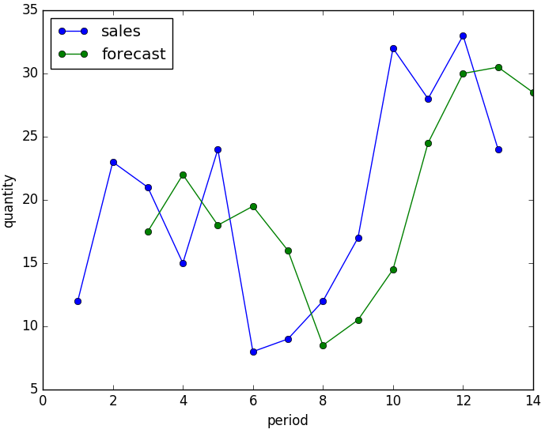



Visualization
Preparations
Scheduling
Inventory Control
Demand forecasting
The sales and forecasts when $n=3$ and $n=2$:
The forecasts for period 14 are 28.3 and 28.5, respectively.

Slide 45

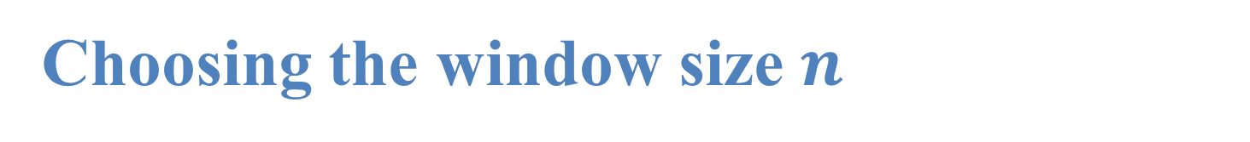
Choosing the window size $n$
Preparations
Scheduling
Inventory Control
Demand forecasting
The window size $n$ is typically set to be within 2 and 6.
How to choose $n$?
In practice, sometimes $n$ is chosen with domain knowledge.
For most products, however, this is impossible.
One thing we may do is to let the computer learn from historical observations.
Let’s consider past sales and ask “what if we have chosen $n$ to be …”

Slide 46

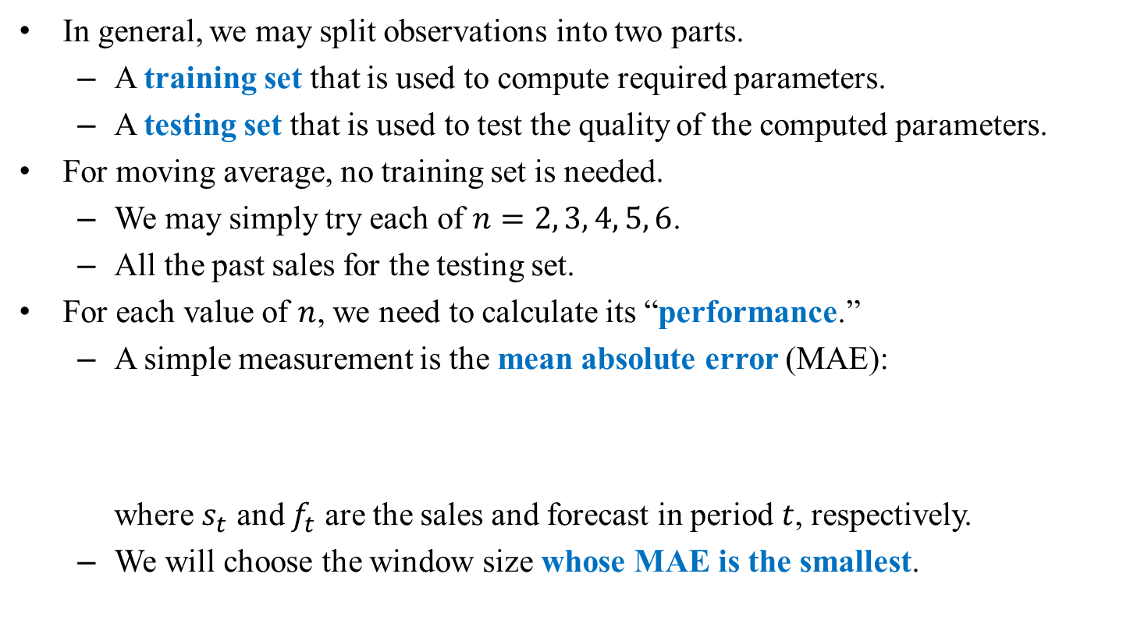
Training and testing sets
Preparations
Scheduling
Inventory Control
Demand forecasting
In general, we may split observations into two parts.
A training set that is used to compute required parameters.
A testing set that is used to test the quality of the computed parameters.
For moving average, no training set is needed.
We may simply try each of $n=2, 3, 4, 5, 6$.
All the past sales for the testing set.
For each value of $n$, we need to calculate its “performance.”
A simple measurement is the mean absolute error (MAE): where $s_{t}$ and $f_{t}$ are the sales and forecast in period $t$, respectively.
We will choose the window size whose MAE is the smallest.
$$MAE=\sum_{t=1}^{T}{|s_{t}−f_{t}|},$$

Slide 47

Implementation
Preparations
Scheduling
Inventory Control
Demand forecasting
Let’s implement the learning process.
First, let’s get the given information ready.
Compared to the program on Page 37, now we do not input a value of $n$.
Our program will search for the best $n$.
# past sales
salesStr = "12,23,21,15,24,8,9,12,17,32,28,33,24"
sales = salesStr.split(',')
T = len(sales)
for t in range(T):
sales[t] = int(sales[t])

Slide 48

Implementation
Preparations
Scheduling
Inventory Control
Demand forecasting
We then search for the best $n$:
For each $n$, we calculate its MAE and update the best $n$ when necessary.
The function abs() finds the absolute value of the input value.
# finding n with the smallest MAE
minMAE = 10000000
bestN = 0
for n in range(2, 7):
forecast = []
# do the forecasting
for t in range(n, T + 1):
sum = 0
for i in range(1, n + 1):
sum += sales[t - i]
forecast.append(sum / n)
# calculate MAE
SAE = 0
for t in range(n, T):
SAE += abs(sales[t] - forecast[t - n])
MAE = SAE / (T - n)
if MAE < minMAE:
bestN = n
minMAE = MAE

Slide 49
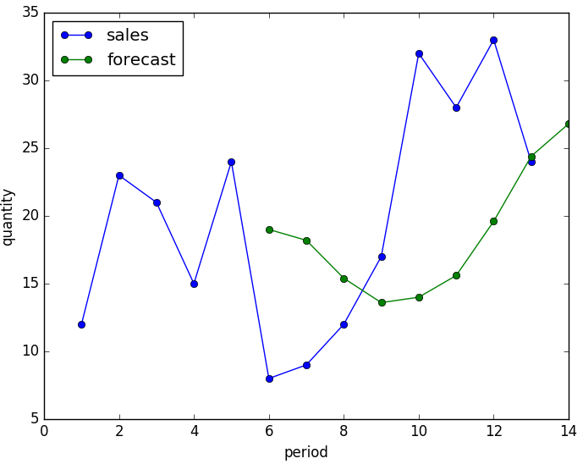




Visualization
Preparations
Scheduling
Inventory Control
Demand forecasting
For the demands (12, 23, 21, 15, 24, 8, 9, 12, 17, 32, 28, 33, 24), we conclude that the best $n$ is 2.
Others do not do well in following the rapid increasing trend.
($n=5$)
($n=2$)

Slide 50
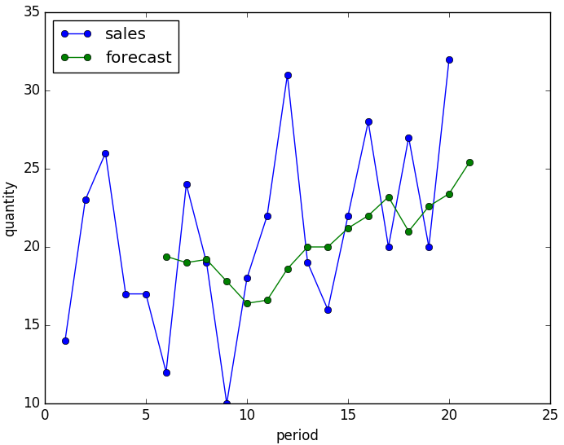
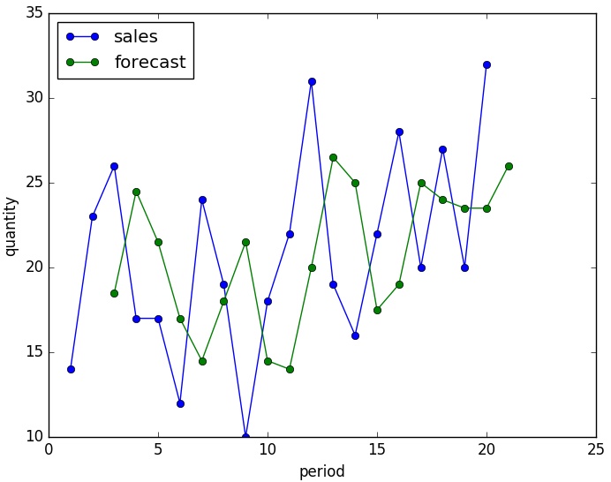


Visualization
Preparations
Scheduling
Inventory Control
Demand forecasting
For the demands (14, 23, 26, 17, 17, 12, 24, 19, 10, 18, 22, 31, 19, 16, 22, 28, 20, 27, 20, 32), we conclude that the best $n$ is 5.
A small $n$ responds to random demand fluctuations too much.
($n=5$)
($n=2$)

Slide 51
Further questions
Preparations
Scheduling
Inventory Control
Demand forecasting
What if we want to put a higher weight to a closer period?
What if we want to adopt a different accuracy measurement?
E.g., mean squared error (MSE), mean absolute percentage error (MAPE).
What if there is a weekend effect?
What if we also have the weather information?

Slide 52
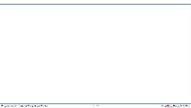
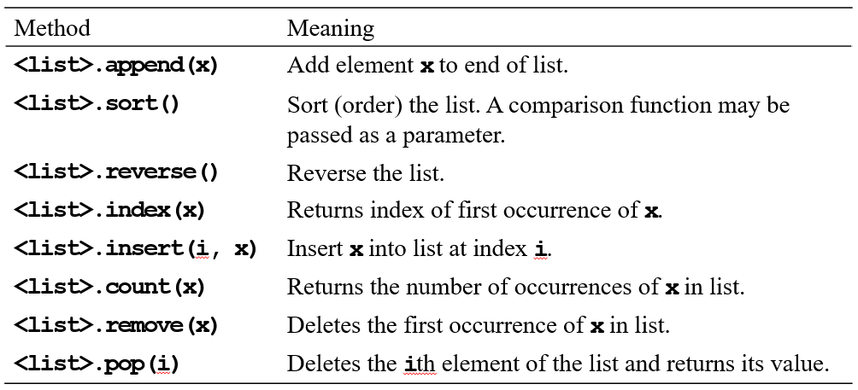
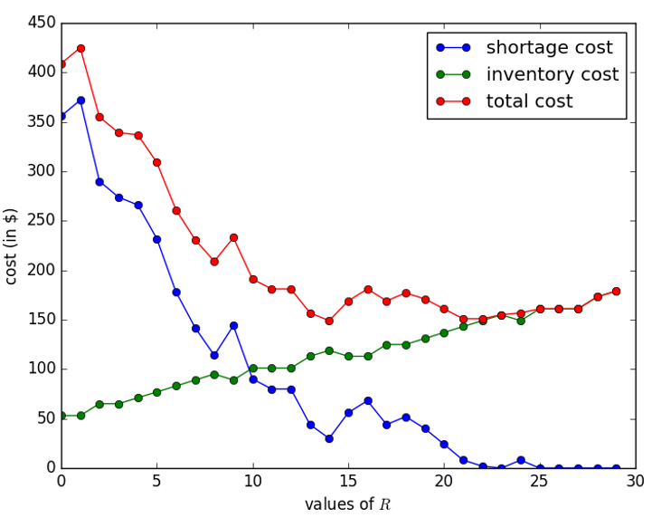
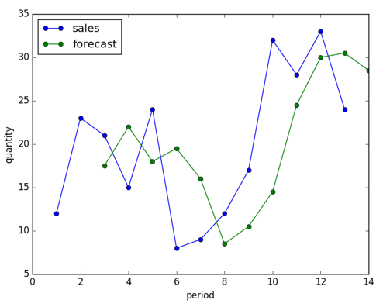
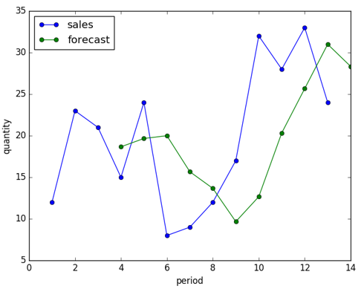
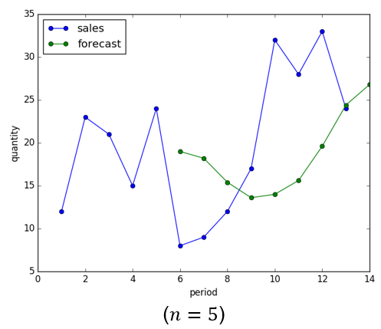
版權聲明
序 | 頁 | 作品 | 版權標章 | 作者 / 來源
1 | 1-53 |  |  | 台灣大學 孔令傑, CC BY-NC-ND 3.0
2 | 14 |  |  | 台灣大學 孔令傑, CC BY-NC-ND 3.0
3 | 37 |  |  | 台灣大學 孔令傑, CC BY-NC-ND 3.0
4 | 44 49 |  |  | 台灣大學 孔令傑, CC BY-NC-ND 3.0
5 | 44 |  |  | 台灣大學 孔令傑, CC BY-NC-ND 3.0
6 | 49 |  |  | 台灣大學 孔令傑, CC BY-NC-ND 3.0

Slide 53
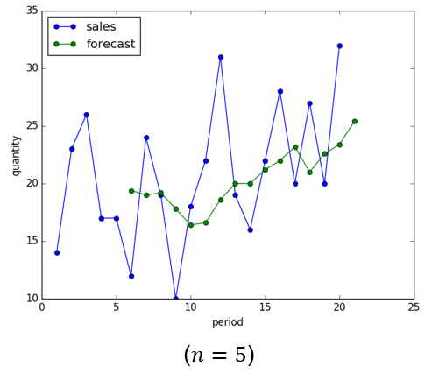
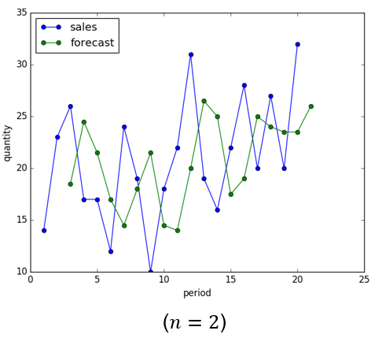
版權聲明
序 | 頁 | 作品 | 版權標章 | 作者 / 來源
7 | 50 |  |  | 台灣大學 孔令傑, CC BY-NC-ND 3.0
8 | 50 |  |  | 台灣大學 孔令傑, CC BY-NC-ND 3.0

