Slide 1

Programming for Business Computing 商管程式設計
Functions and fruitful functions
Hsin-Min Lu
盧信銘
台大資管系
【本著作除另有註明外，採取創用CC「姓名標示－非商業性－禁止改作分享」台灣3.0版授權釋出】

Slide 2


Functions
A function is a named sequence of statements that performs a computation.
To use a function, you need to:
Define the function, and
Call the function by its name
You can pass input variables (i.e., arguments) to the function.
☼
Input variables (arguments)
A Function
Return values

Slide 3
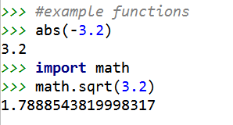
More About Functions
Python has many useful built-in functions
The correct verb for using a function is “call” or “invoke.” (呼叫、執行) ☼

Slide 4


Let’s Start with a Song
Print the Lyrics of “Five Little Ducks”
#Five little ducks print("Five little ducks went out one day") print("Over the hills and far away") print("Mother duck said quack quack quack") print("But only four little ducks came back") print() print("Four little ducks went out one day") print("Over the hills and far away") print("Mother duck said quack quack quack") print("But only three little ducks came back") print() print("Three little ducks went out one day") print("Over the hills and far away") print("Mother duck said quack quack quack") print("But only two little ducks came back")
☼
Notes:
Picture: https://pixabay.com/en/duck-toy-cute-children-s-toys-1437312/

Slide 5
Output of the Small Program
Five little ducks went out one day
Over the hills and far away
Mother duck said quack quack quack
But only four little ducks came back
Four little ducks went out one day
Over the hills and far away
Mother duck said quack quack quack
But only three little ducks came back
Three little ducks went out one day
Over the hills and far away
Mother duck said quack quack quack
But only two little ducks came back
☼

Slide 6
How can we do better?
Notice that there are a lot of duplications…
The second and third lines have repeated for three times.
… print("Over the hills and far away") print("Mother duck said quack quack quack") …
We can define the function for these two lines.
def over_mother(): print("Over the hills and far away") print("Mother duck said quack quack quack")
Now the program become shorter…
☼

Slide 7
Five Little Ducks, Version 2
#Five little ducks, v2 def over_mother(): print("Over the hills and far away") print("Mother duck said quack quack quack") print("Five little ducks went out one day") over_mother() print("But only four little ducks came back") print() print("Four little ducks went out one day") over_mother() print("But only three little ducks came back") print() print("Three little ducks went out one day") over_mother() print("But only two little ducks came back")
☼

Slide 8
How Far Can We Go?
Still, the first line of each part is very similar.
Five little ducks went out one day
Four little ducks went out one day
Three little ducks went out one day
We can define a function that output the three similar lines:
def n_ducks(num): print("%s little ducks went out one day" % num)
Do the same for the last line:
def only_n(num): print("But only %s little ducks came back" % num)
☼

Slide 9
Arguments and Parameters
When you define a function, you can allow the function to take input variables.
The “place” to receive input variables are “parameters.”
For example,
def n_ducks(num): print("%s little ducks went out one day" % num)
“num” is a parameter that can receive input variables.
We assign the value of “num” by passing a “argument” to it. For example,
n_ducks("Five")
"Five" is a argument (input value).
The variable num will be assign with the value “Five.”
☼

Slide 10
Five Little Ducks, Version 3
#Five little ducks, v3 def over_mother(): print("Over the hills and far away") print("Mother duck said quack quack quack") def n_ducks(num): print("%s little ducks went out one day" % num) def only_n(num): print("But only %s little ducks came back" % num) n_ducks("Five") over_mother() only_n("Four") print() n_ducks("Four") over_mother() only_n("Three") print() n_ducks("Three") over_mother() only_n("Two")
☼

Slide 11
And More…
We can further define a new function that combines the three functions.
We need two parameters, for the first and last lines.
def sing_unit(num1, num2): n_ducks(num1) over_mother() only_n(num2)
Now we can print out the lyrics by:
sing_unit("Five", "Four") print() sing_unit("Four", "Three") print() sing_unit("Three", "Two")
☼

Slide 12
What Happens When You Call a Function?
At the point of calling, the original program suspended execution.
The parameters of the function are assigned to the values of arguments.
Execute the body of the function.
Control return to the original point just after where the function was called.
☼

Slide 13
Calling a Function
sing_unit("Five", "Four")
num1: “Five”, num2: “Four”
def sing_unit(num1, num2): n_ducks(num1) over_mother() only_n(num2)
num: “Five”
def n_ducks(num): print("%s little ducks went out one day" % num)
def over_mother(): print("Over the hills and far away") print("Mother duck said quack quack quack") def only_n(num): print("But only %s little ducks came back" % num)
☼

Slide 14
Defining Functions
Function definition begins with “def.”
Function name and its parameters.
def get_result(var1, var2):
“““Compute final result.””” line1
line2
return total_counter
Provide documentation about this function.
Colon.
The indentation matters…
First line with less indentation is considered to be outside of the function definition.
Indentation (縮排) can be spaces or tabs. Need to be consistent!
The keyword ‘return’ indicates the value to be sent back to the caller. ☼
☼
Notes:
No header file or declaration of types of function or arguments

Slide 15
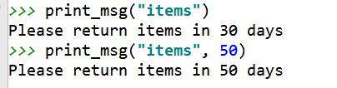
Default Arguments
A function can have multiple parameters.
You can assign default values to some of these parameters.
def print_msg(item, ndays=30): print("Please return %s in %d days" % (item, ndays)) print_msg("items") print_msg("items", 50)
Output:
☼

Slide 16
Calling with Parameter Names
You can use parameter names when calling a function.
When parameter names are used, the order of arguments does not matter.
def print_msg(item, ndays=30): print("Please return %s in %d days" % (item, ndays))
☼

Slide 17
Scope of Variables and Parameters
Parameters and variables defined within a function are local (區域變數).
Local variables only exist inside the function.
Variables defined on the outer part of a py file are called global variables (全域變數). You can access the global variables within a function.
The only way for a function to see a variable from another function is for that variable to be passed as a parameter.
☼

Slide 18
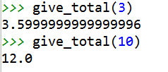
Local and Global Variables
Consider the scenario that we are creating a function named “give_total” that compute the total amount due for a product.
“give_total” takes only one input, n, which is the number of product purchased.
Assume that the unit price of the product is $1.2.
def give_total(n): unitp = 1.2 total = unitp * n return total
☼

Slide 19
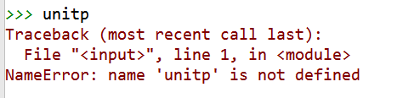

Local and Global Variables (Cont’d)
We cannot access unitp outsize of the function:
Because: unitp is a local variable that live inside the “give_total” function.
How about we define a global variable of the same name?
Can we overwrite the local unitp?
No, you cannot!
☼

Slide 20
Local and Global Variables (Cont’d)
On the other hand, you can have read only access of global inside a function.
Assume that we have a global variable weekend that tell us whether today is weekend.
def give_total(n): print("Weekend=%d" % weekend) unitp = 1.2 total = unitp * n return total weekend = True m=give_total(5)
Execution result: Weekend=1
☼

Slide 21
Local and Global Variables (Cont’d)
If you need to change the value of weekend inside a function, you need to use the “global” keyword to declare that this is a global variable.
Otherwise, outside world will not see the changes.
☼

Slide 22

Example: Changing Global Variable
#give_total, v2 def give_total(n): unitp = 1.2 weekend = False print("New Weekend=%d" % weekend) total = unitp * n return total weekend = True print("Outside, before calling: Weekend=%d" % weekend) m1=give_total(5) print("Outside: Weekend=%d" % weekend)
Result:
☼

Slide 23
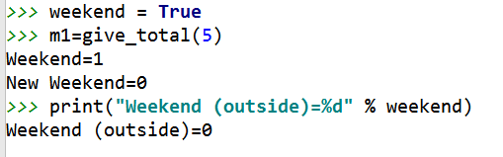
Example: The “global” keyword
def give_total(n): global weekend print("Weekend=%d" % weekend) unitp = 1.2 weekend = False print("New Weekend=%d" % weekend) total = unitp * n return total
☼

Slide 24
Return Values of Functions
Function can provide output variables to its caller.
Act just like functions in mathematics.
You can “chain” the output to the input.
Think about the give_total function we encountered.
def give_total(n): unitp = 1.2 total = unitp * n return total
This function returns the total amount due for a purchase.
Input variables (arguments)
A Function
Return values
☼

Slide 25
Return Values of Functions (Cont’d.)
def give_total(n): unitp = 1.2 total = unitp * n return total
When return are reached, Python leaves the function and gives the control back to the caller of the function.
Moreover, Python sends back the values provided in the return statement as the execution results. ☼

Slide 26
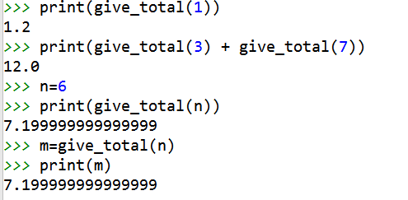
Additional Execution Example
☼

Slide 27
Returning Many Values
Compute the minimum and maximum of four input variables.
def min_max(x1, x2, x3, x4): r1 = min(x1, x2, x3, x4) r2 = max(x1, x2, x3, x4) return r1, r2 a1=input("Provide input value a1:") a2=input("Provide input value a2:") a3=input("Provide input value a3:") a4=input("Provide input value a4:") out1, out2 = min_max (a1, a2, a3, a4) print("Minimal =", out1) print("Maximal =", out2)
Here out1 gets the first value and out2 gets the second.
☼

Slide 28
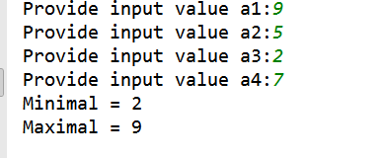
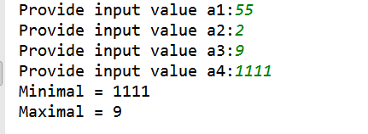
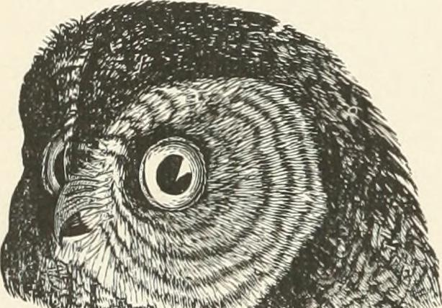

Let’s Try This Out!
First attempt:
Second attempt:
Wait! Something is wrong… 哪裡怪?
☼

Slide 29

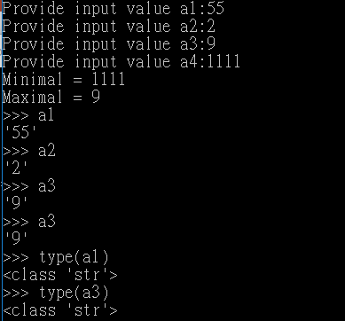
Happy Debugging…
Run the program in interactive mode.
In notepad++, Press F5 (or “Run”→”Run”), and enter the following commands:
python3 -u -i "$(FULL_CURRENT_PATH)"
In cmd, use this: python3 -u -i “your_program.py”
Cause: a1, a2, a3, a4 are strings.
The rule to compare strings is different from floats.
☼

Slide 30
How to Fix the Bug?
Convert to float!
def min_max(x1, x2, x3, x4): r1 = min(x1, x2, x3, x4) r2 = max(x1, x2, x3, x4) return r1, r2 a1=input("Provide input value a1:") a2=input("Provide input value a2:") a3=input("Provide input value a3:") a4=input("Provide input value a4:") out1, out2 = min_max (float(a1), float(a2), float(a3), float(a4))
print("Minimal =", out1) print("Maximal =", out2)
☼

Slide 31
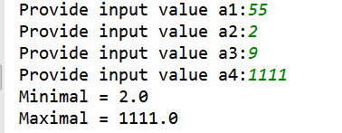
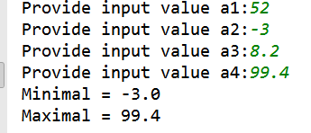
Now We are Good!
Consider the previous example:
Additional testing:
☼

Slide 32
Function Return Values
Question: What will happen if your function does not have the “return” keyword?
Answer: Python will still execute your function until the end.
All Python functions return a value.
If you did not provide the return value, Python will hand back a special object, denoted None.
A common bug is writing a value-returning function and omitting the return! ☼
☼

Slide 33
Example Code
def myabs(x):
if x< 0:
return -x
if x> 0:
return x
print(myabs(-3.5))
print(myabs(0))
What will be the result of the function calls?
☼

Slide 34
Example Code (Cont’d.)
myabs(-3.5) gives 3.5
myabs(0) gives None!
What is going on?
myabs does not handle the case x=0 !!!
How do we fix it?
def myabs(x):
if x< 0:
return -x
if x>= 0:
return x
print(myabs(-3.5))
print(myabs(0))
☼

Slide 35
Arguments and Return Values
We use return values to send information back to the caller of a function.
Question: Can we send back information using arguments (the inputs of functions)?
It depends.
Different programming languages have different designs.
Some languages such as C or C++ can use the so call “Call by Reference” approach to send back information using arguments.
Another approach is “Call by Value.”
Make copies of all input arguments before passing them into a function.
☼

Slide 36
Python’s Call by Assignment
The detailed mechanisms are too complicated for beginners.
We will focus on the consequence of this design.
Simply put, it depends on whether the argument is immutable or mutable.
First, we need to know that there are two types of objects in Python: immutable and mutable.
Example of immutable objects: string, int, float
Also: decimal, complex, bool, tuple, range, frozenset, bytes
Example of mutable objects: list
Also: dict, set, bytearray, user-defined classes.
☼
Notes:
https://docs.python.org/3/faq/programming.html
http://blog.chrisyttang.org/2016/07/23/python-passing-a-variable-by-reference-or-value/

Slide 37
Mutable and Immutable Objects
Lists are mutable, meaning they can be changed. Strings can not be changed.
>>> myList = [34, 26, 15, 10]
>>> myList[2]
15
>>> myList[2] = 0
>>> myList
[34, 26, 0, 10]
>>> myString = "Hello World"
>>> myString[2]
'l'
>>> myString[2] = "p"
Traceback (most recent call last):
File "<pyshell#16>", line 1, in -toplevel-
myString[2] = "p"
TypeError: object doesn't support item assignment
☼

Slide 38

Passing in Immutable Objects
Outside world cannot see changes made to immutable objects inside the function.
Similar to “call by value.”
def swap1(x1, x2): tmp=x1 x1=x2 x2=tmp print("Inside swap1: x1=", x1, "x2=", x2) x1, x2 = 100, 5 print("Outside: x1=", x1, "x2=", x2) swap1(x1, x2) print("Outside: x1=", x1, "x2=", x2)
Output:
☼

Slide 39

Passing in Mutable Object
Outside world can see changes made to mutable objects inside the function.
Similar to “call by reference.”
def swap2(xlist): tmp=xlist[0] xlist[0] = xlist[1] xlist[1] = tmp print("Inside swap2: xlist=", xlist) xlist = [100, 5] print("Outside: xlist=", xlist) swap2(xlist) print("Outside: xlist=", xlist)
Output:
☼

Slide 40

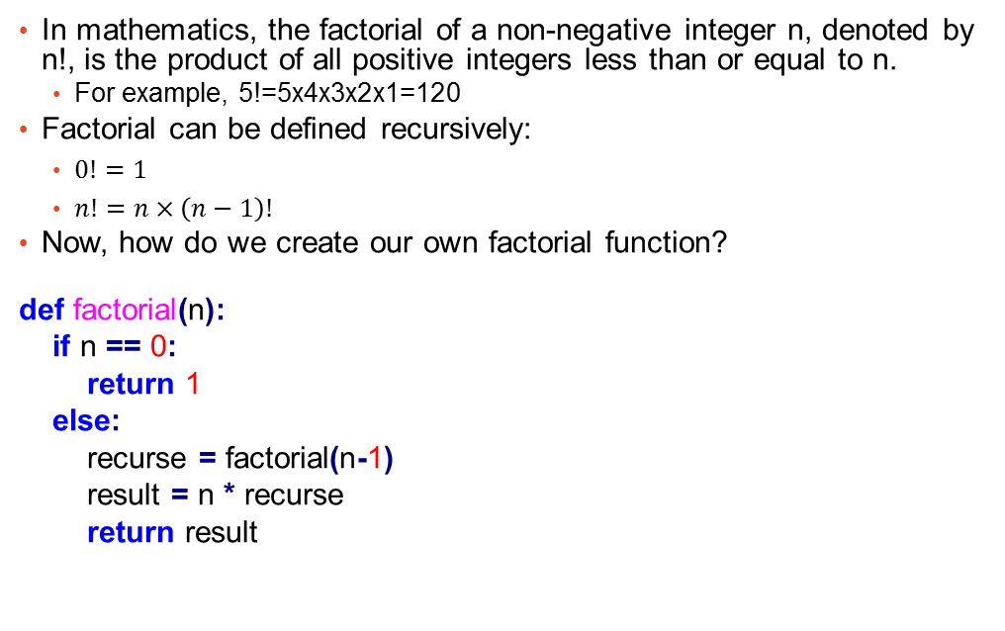
Recursion for factorial function
In mathematics, the factorial of a non-negative integer n, denoted by n!, is the product of all positive integers less than or equal to n.
For example, 5!=5x4x3x2x1=120
Factorial can be defined recursively:
$0!=1$
$n!=n×\left(n−1\right)!$
Now, how do we create our own factorial function?
def factorial(n):
if n == 0:
return 1
else:
recurse = factorial(n-1)
result = n * recurse
return result
☼

Slide 41

Recursion: factorial(3)
def factorial(n):
if n == 0:
return 1
else:
recurse = factorial(n-1)
result = n * recurse
return result
When we run “factorial(3)”
Since 3 is not 0, call factorial(2)
In factorial(2): since 2 is not 0, call factorial(1)
In factorial(1): since 1 is not 0, call factorial(0)
In factorial(0): return 0
☼
Notes:
Figure 6.1 (page 57) of Think Python

Slide 42
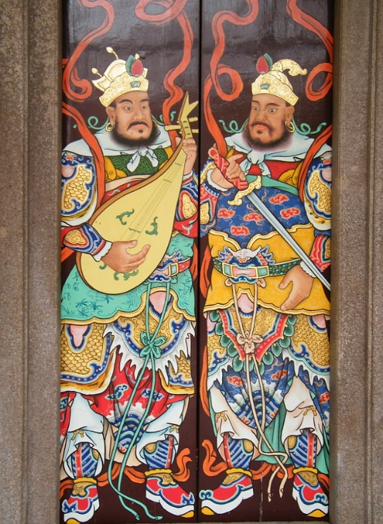

Handling Illegal Inputs
What will happen if we call factorial(1.5)?
RuntimeError: maximum recursion depth exceeded in cmp
Why? Because we encounter an infinite recursion because n will never be 0.
Also negative values should not be allowed.
Need to check for valid input ➔ Create guardian (門神)
def factorial(n):
if not isinstance(n, int):
print('Factorial is only defined for integers.')
return None
elif n<0:
print('Factorial is not defined for negative values.')
return None
elif n==0:
return 1
else:
return n * factorial(n-1) ☼

Slide 43
Now it’s working fine
>>> factorial('Qoo')
Factorial is only defined for integers.
>>> factorial(-3)
Factorial is not defined for negative values.
>>> factorial(3.2)
Factorial is only defined for integers.
>>> factorial(4)
24 ☼
def factorial(n):
if not isinstance(n, int):
print('Factorial is only defined for integers.')
return None
elif n<0:
print('Factorial is not defined for negative values.')
return None
elif n==0:
return 1
else:
return n * factorial(n-1)

Slide 44

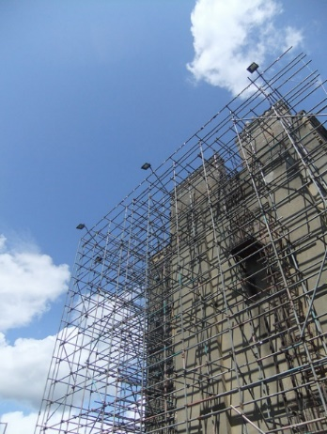
Debugging
It is common to encounter problems when developing your program.
Using functions allow you to focus on a few functions that are causing problems.
Common possible causes:
The input is wrong. Invalid arguments
The logic of the function is wrong
The output of the function is used in the wrong way
How do we pin down the causes?
Print out status
Also used extensively when developing new programs
Scaffolding ➔ remove these redundant print command afterward.
Using built-in debugging function (pdb). ☼

Slide 45
Debugging: Print out status
def factorial(n): space = ' ' * (4*n) print(space, 'factorial', n) if not isinstance(n, int): print('Factorial is only defined for integers.') return None elif n<0: print('Factorial is not defined for negative values.') return None elif n==0: print(space, 'returning 1') return 1 else: result = n * factorial(n-1) print(space, 'returning', result) return result
☼

Slide 46
Debugging: Print out status
>>> factorial(4)
factorial 4
factorial 3
factorial 2
factorial 1
factorial 0
returning 1
returning 1
returning 2
returning 6
returning 24
☼

Slide 47
提示：作業 2-1
第一題：觀念題。先想想，再嘗試。
第二題：製作標準常態機率密度函數與累積機率分布函數
輸出：我們統一規定輸出至小數六位，四捨五入，不足補零
範例程式： ans1=0.112 print("%7.6f" % ans1) 執行結果： 0.112000
☼

Slide 48

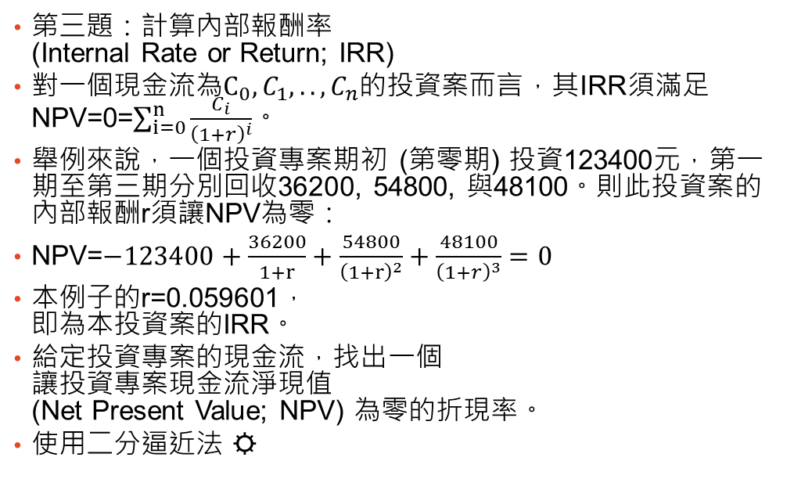
提示：作業 2-1
第三題：計算內部報酬率 (Internal Rate or Return; IRR)
對一個現金流為$C_{0}, C_{1}, .., C_{n}$的投資案而言，其IRR須滿足 NPV=0=$\sum_{i=0}^{n}{\frac{C_{i}}{{\left(1+r\right)}^{i}}}$。
舉例來說，一個投資專案期初 (第零期) 投資123400元，第一期至第三期分別回收36200, 54800, 與48100。則此投資案的內部報酬r須讓NPV為零：
NPV=$−123400+\frac{36200}{1+r}+\frac{54800}{{\left(1+r\right)}^{2}}+\frac{48100}{{\left(1+r\right)}^{3}}=0$
本例子的r=0.059601， 即為本投資案的IRR。
給定投資專案的現金流，找出一個 讓投資專案現金流淨現值 (Net Present Value; NPV) 為零的折現率。
使用二分逼近法 ☼
Net Present Value (NPV)
Discount rate

Slide 49
Thank You!
Questions?

Slide 50
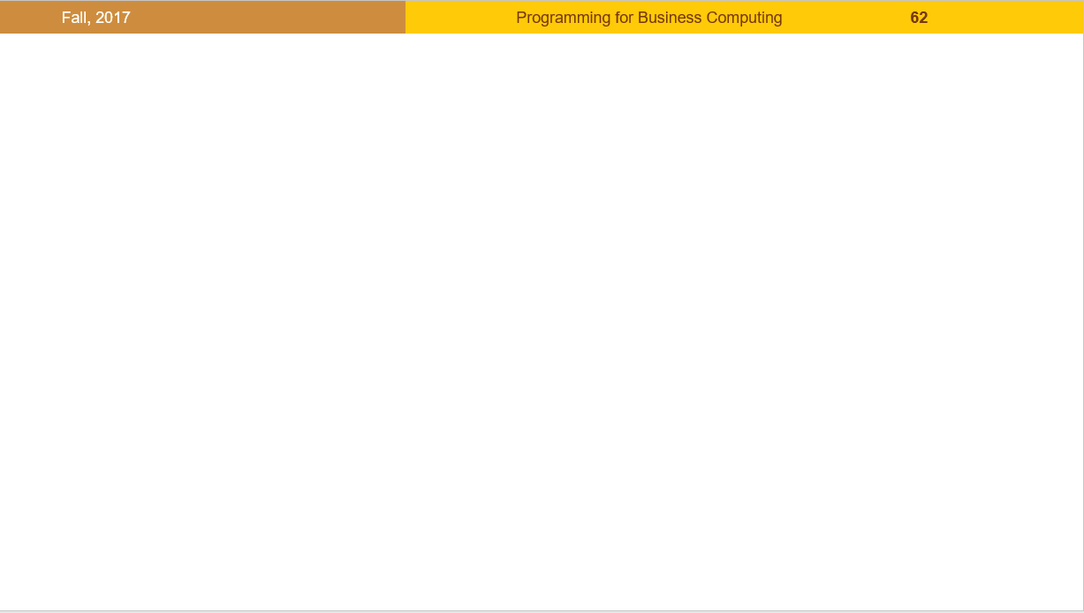





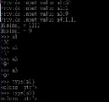
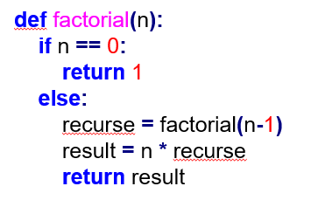
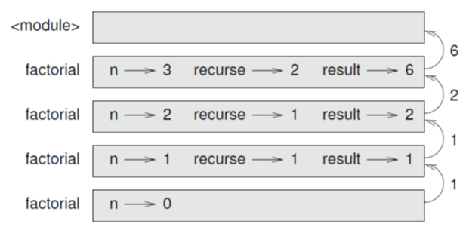
版權聲明
序 | 頁 | 作品 | 版權標章 | 作者 / 來源
1 | 1-51 |  |  | 台灣大學 盧信銘, CC BY-NC-ND 3.0
2 | 4 |  |  | Flicker, Ken Lane, WNC Mountain State Fair 2013 https://flic.kr/p/fUdXxN 2017/8/24 visited
3 | 28 |  |  | Flickr, Internet Archive Book Images https://flic.kr/p/otkJrQ 依據Internet Archive‘s Terms of Use及著作權法第46、52、65條合理使用
4 | 29 |  |  | 台灣大學 盧信銘, CC BY-NC-ND 3.0
5 | 40 41 |  |  | WordPress, Green Tea Press, Allen B. Downey, Think Python, example from Section 6.5, P56, CC BY-NC 3.0, 2012/8/3 http://greenteapress.com/wp/ 2017/8/24 visited
6 | 41 |  |  | WordPress, Green Tea Press, Allen B. Downey, Think Python, figure 6.1, P57, CC BY-NC 3.0, 2012/8/3 http://greenteapress.com/wp/ 2017/8/24 visited

Slide 51



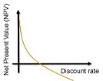
版權聲明
序 | 頁 | 作品 | 版權標章 | 作者 / 來源
7 | 42 |  |  | Wikimedia, Ixioini, 汕头 存心善堂 左侧门门神 南方增长天王,2010/2/11 https://zh.wikipedia.org/wiki/File:%E5%AD%98%E5%BF%83%E5%96%84%E5%A0%82%E9%97%A8%E7%A5%9E1.jpg 2017/8/24 visited
8 | 44 |  |  | Flicker, Alex Liivet, Scaffolding https://flic.kr/p/9XVdLR 2017/8/24 visited
9 | 48 |  |  | 台灣大學 盧信銘, CC BY-NC-ND 3.0

