Slide 1

Programming for Business Computing 商管程式設計
Strings
Hsin-Min Lu
盧信銘
台大資管系
【本著作除另有註明外，採取創用CC「姓名標示－非商業性－禁止改作分享」台灣3.0版授權釋出】

Slide 2


The String Data Type
Processing text data is an important task for PC users.
Think about the time you spent on using word processors such as MS words.
A large portion of online interactions are posting text messages.
In Python, text is represented in by the string data type.
A string is a sequence of characters enclosed within quotation marks (") or apostrophes ('). ☼

Slide 3
The String Data Type (Cont’d.)
>>> str1="Hello"
>>> str2='ntu'
>>> print(str1, str2)
Hello ntu
>>> type(str1)
<class 'str'>
>>> type(str2)
<class 'str'> ☼

Slide 4
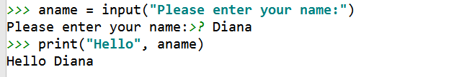
The String Data Type (Cont’d.)
We have encountered the input() function before.
input() takes user input string and return it to the caller.
A string is a sequence of characters.
Access the individual characters in a string through indexing.
From left to right.
Starting from 0.
☼

Slide 5
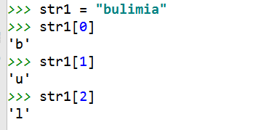
String Indexing
b
u
l
i
m
i
a
0 1 2 3 4 5 6
Recall the way to invoke a function is function_name()
☼

Slide 6
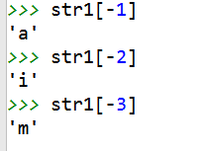
String Indexing (Cont’d.)
b
u
l
i
m
i
a
0 1 2 3 4 5 6
In a string of n characters, the last character is at position n-1.
Index from the right to left using negative indexes.
☼

Slide 7
Slicing Strings
Slicing: access a contiguous sequence of characters from a string.
Syntax: <string>[<start>:<end>]
Both start and end are ints
Beginning at position start and runs up to but doesn’t include the position end.
>>> str1[3:5]
'im'
>>> str1[2:6]
'limi'
>>> str1[2:8]
'limia'
>>> str1[2:10]
'limia'
>>> str1[2:]
'limia'
>>> str1[:5]
'bulim'
b
u
l
i
m
i
a
0 1 2 3 4 5 6
☼

Slide 8
Some String Operations
Can we put two strings together into a longer string?
Concatenation “glues” two strings together (+).
Repetition builds up a string by multiple concatenations of a string with itself (*).
>>> "spam" + "eggs"
'spameggs'
>>> "Spam" + "And" + "Eggs"
'SpamAndEggs'
>>> 3 * "spam"
'spamspamspam'
>>> "spam" * 5
'spamspamspamspamspam'
>>> (3 * "spam") + ("eggs" * 5)
'spamspamspameggseggseggseggseggs‘
>>> len("career")
6
☼

Slide 9
The String Data Type
The function len will return the length of a string.
a1="career" print(len(a1)) for ch in a1: print("Get a character:", ch)
Output:
6
Get a character: c
Get a character: a
Get a character: r
Get a character: e
Get a character: e
Get a character: r
☼

Slide 10
String Operations
Operator | Meaning
+ | Concatenation
* | Repetition
<string>[] | Indexing
<string>[:] | Slicing
len(<string>) | Length
for <var> in <string> | Iteration through characters
☼

Slide 11
Strings, Lists, and Sequences
Strings and lists are quite similar.
Both are a special kind of sequence.
There are some common operations that can be applied to both types.
Some examples:
>>> [1,2] + [3,4]
[1, 2, 3, 4]
>>> [1,2]*3
[1, 2, 1, 2, 1, 2]
>>> grades = ['A', 'B', 'C', 'D', 'F']
>>> grades[0]
'A'
>>> grades[2:4]
['C', 'D']
>>> len(grades)
5
☼

Slide 12
Strings, Lists, and Sequences
Strings are always sequences of characters, but lists can be sequences of arbitrary values.
Lists can have numbers, strings, or both! myList = [1, "Spam ", 4, "U"] ☼

Slide 13
Mutable and Immutable, Again
Lists are mutable, ➔they can be changed.
Strings can not be changed.
>>> myList = [34, 26, 15, 10]
>>> myList[2]
15
>>> myList[2] = 0
>>> myList
[34, 26, 0, 10]
>>> myString = "Hello World"
>>> myString[2]
'l'
>>> myString[2] = "p"
Traceback (most recent call last):
File "<pyshell#16>", line 1, in -toplevel-
myString[2] = "p"
TypeError: object doesn't support item assignment
☼

Slide 14
Example: Converting Date Format
Two commonly used date format is yyyymmdd and ddmmyy.
yyyymmdd: 20141203, 19990212
ddmmyy: 03122014, 12021999
def ymd2dmy(dstr):
"""Convert date format from ymd to dmy
E.g. 20150312 to 12032015"""
y1 = dstr[0:4]
m1 = dstr[4:6]
d1 = dstr[6:8]
return d1 + m1 + y1
☼

Slide 15
Converting Date Format
Output:
>>> d1 = "20150512"
>>> d2 = ymd2dmy(d1)
>>> print("Converted date is", d2)
Converted date is 12052015
>>>
>>> d1 = "20171123"
>>> d2 = ymd2dmy(d1)
>>> print("Converted date is", d2)
Converted date is 23112017
def ymd2dmy(dstr):
y1 = dstr[0:4]
m1 = dstr[4:6]
d1 = dstr[6:8]
return d1 + m1 + y1
☼

Slide 16
Example: Validating Taiwan ID String
Taiwan ID number of a string of length 10.
First digit must be a upper case letter (between A to Z).
Second digit must be either 1 or 2.
The remaining digits are numbers.
Example ID string: A123456789.
Use a simple checksum rule to validate whether an ID is valid or not.
According to this rule, A123456789 is valid, but A123456788 is not.
We are going to see how to validate Taiwan ID.
☼

Slide 17
Length and the First Digit
Use len() to check length
>>> str1="A123456789"
>>> len(str1)
10
How to validate the first digit?
As mentioned before, a string is a sequence of characters.
Each character is stored using some sort of internal encoding.
Traditional, English characters are stored using the ASCII system (American Standard Code for Information Interchange).
☼

Slide 18
ASCII System
0 – 127 are used to represent the characters typically found on American keyboards.
65 – 90 are “A” – “Z”
97 – 122 are “a” – “z”
48 – 57 are “0” – “9”
The others are punctuation and control codes used to coordinate the sending and receiving of information. ☼
☼

Slide 19
Finding Internal Codes
The ord function returns the numeric (ordinal) code of a single character.
The chr function converts a numeric code to the corresponding character.
>>> ord("A")
65
>>> ord("a")
97
>>> chr(97)
'a'
>>> chr(65)
'A' ☼

Slide 20
Checking the First Digit
Note that the internal codes are arranged so that upper case letters are occupied in a continuous chunk of code range
A → 65, B → 66, C → 67, …, Z → 90.
We can use this characteristic to validate the first digit.
The first internal encoding of the first digit need to be between 65 and 90.
☼

Slide 21
Checking the First Digit
>>> idstr = "A123456789"
>>> code1 = ord(idstr[0])
>>> if (code1 < 65 or code1 > 90):
... print("not valid")
... else:
... print("valid")
...
valid
>>>
>>> idstr = "b123456789"
>>> code1 = ord(idstr[0])
>>> if (code1 < 65 or code1 > 90):
... print("not valid")
... else:
... print("valid")
...
not valid
☼

Slide 22
Validation Rules for Taiwan ID
1. Map the first digit to a two-digit number.
E.g. A → 10, B → 11, C → 12, D → 13, .. Z → 33
Note: not in the order of A to Z.
2. Attach the two-digit number to the remaining 9-digit ID.
3. Compute a checksum by multiplying the digit at each position to a weight: [1, 9, 8, 7, 6, 5, 4, 3, 2, 1, 1]
4. Sum over all results, divide the sum by 10 and compute the remainder.
5. If the remainder is 0, then it is valid. Otherwise, this is a invalid ID.
☼

Slide 23
Mapping Table
A | 10 | H | 17 | O | 35 | V | 29
B | 11 | I | 34 | P | 23 | W | 32
C | 12 | J | 18 | Q | 24 | X | 30
D | 13 | K | 19 | R | 25 | Y | 31
E | 14 | L | 20 | S | 26 | Z | 33
F | 15 | M | 21 | T | 27
G | 16 | N | 22 | U | 28
☼

Slide 24
Example
ID: A123456789
Convert ‘A’ to ‘10’
New ID: 10123456789
Apply the weight: [1, 9, 8, 7, 6, 5, 4, 3, 2, 1, 1]
➔ 1*1 + 0*9 + 1*8 + 2*7 + 3*6 + 4*5 + 5*4 + 6*3 + 7*2 + 8*1 + 9*1 = 130
130 / 10 = 13, remainder = 0
➔ Valid ID.
☼

Slide 25
The Validation Process in Python
Mapping the first letter to a two-digit number
>>> idstr="A123456789"
>>> code1 = ord(idstr[0])
>>> cmap = [10, 11, 12, 13, 14, 15, 16, 17, \
... 34, 18, 19, 20, 21, 22, 35, 23, 24, \
... 25, 26, 27, 28, 29, 32, 30, 31, 33]
>>> num1 = cmap[code1 - 65]
>>> newid = str(num1) + idstr[1:]
>>> print("newid=", newid)
newid= 10123456789
☼

Slide 26
Mapping the First Digit
cmap is a list that contains 26 elements
The first element is for letter A, the second element is for letter B, and so on.
>>> code1 = ord(idstr[0])
➔ code1 is the ASCII code of the first digit
>>> num1 = cmap[code1 - 65]
➔ num1 is 0 for A, 1 for B, and so on
>>> newid = str(num1) + idstr[1:]
➔ Concatenate the two-digit number with the remaining ID.
☼

Slide 27
Compute the Checksum
>>> weight = [1, 9, 8, 7, 6, 5, 4, 3, 2, 1, 1]
>>> checksum = 0
>>> for i in range(0, 11):
... checksum += weight[i] * int(newid[i])
...
>>> remainder = checksum % 10
>>> print("checksum=", checksum)
checksum= 130
>>> print("remainder=", remainder)
remainder= 0
☼

Slide 28
Putting Everything Together
Create a function that return True if the ID is valid, return False otherwise.
def verify_twid(idstr):
"""Verify Taiwan ID Number.
Return True if valid; False otherwise"""
#check length
if len(idstr) != 10:
return False
#check first letter
code1 = ord(idstr[0])
if (code1 < 65 or code1 > 90):
return False
#check the remaining letters
for i in range(1,10):
code2 = ord(idstr[i])
if (code2 < 48 or code2 > 57):
return False
☼

Slide 29
def verify_twid(idstr):
#... Continue from previous slide …
#check the second character
code2 = ord(idstr[1])
if (code2 < 49 or code2 > 50):
return False
#convert first English character to two-digit number.
cmap = [10, 11, 12, 13, 14, 15, 16, 17, 34, 18, 19, 20, 21, 22, 35, 23, 24, 25, 26, 27, 28, 29, 32, 30, 31, 33]
num1 = cmap[code1 - 65]
newid = str(num1) + idstr[1:]
weight = [1, 9, 8, 7, 6, 5, 4, 3, 2, 1, 1]
checksum = 0
for i in range(0, 11):
checksum += weight[i] * int(newid[i])
if checksum % 10 == 0:
return True
else:
return False
☼

Slide 30
verify_twid() in Action
>>> id1="A123456789"
>>> print(verify_twid(id1))
True
>>> verify_twid("B123456789")
False
>>> verify_twid("C999")
False
>>> verify_twid("123999")
False
>>> verify_twid("Z199999999")
False
>>> verify_twid("Z199999990")
True
☼

Slide 31
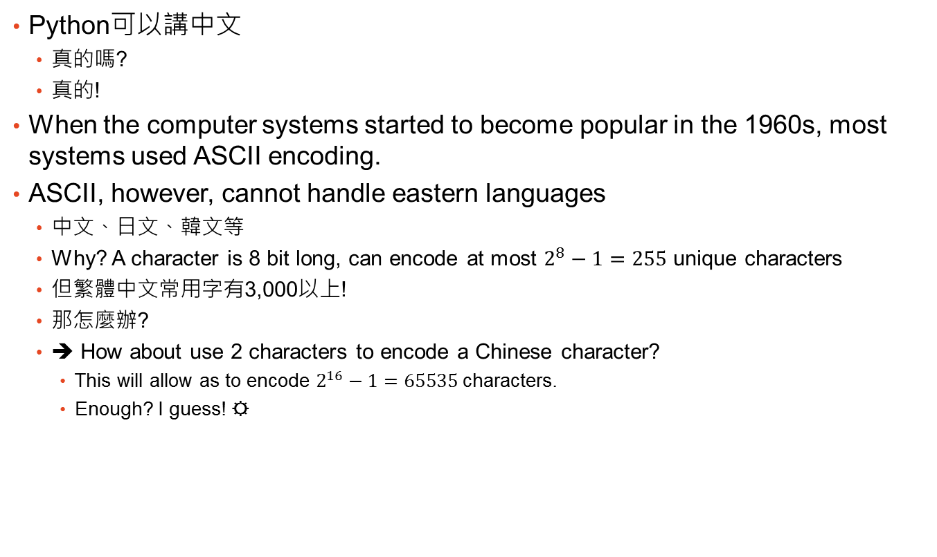
我要Python講中文
Python可以講中文
真的嗎?
真的!
When the computer systems started to become popular in the 1960s, most systems used ASCII encoding.
ASCII, however, cannot handle eastern languages
中文、日文、韓文等
Why? A character is 8 bit long, can encode at most $2^{8}−1=255$ unique characters
但繁體中文常用字有3,000以上!
那怎麼辦?
➔ How about use 2 characters to encode a Chinese character?
This will allow as to encode $2^{16}−1=65535$ characters.
Enough? I guess! ☼
☼

Slide 32
我要Python講中文
Double-byte (2 bytes = 16 bits) character sounds good.
But there are a few complications.
各家電腦廠商 (香港、台灣)各自有自家的編碼法，以至於檔案無法互相流通。
大陸用簡體中文耶 (但是早期他們在鐵幕裡)
日本有漢字，跟我們繁體中文有點像，又不是很一樣。
1983年資訊工業策進會為五大中文套裝軟體所設計中文共通內碼，稱為Big-5 (大五碼)
使用大五碼的軟體在市場上打下一片天地，Big5也成為中文編碼的業界標準。
Big5為中文世界(台灣、香港)第一個廣為接受的編碼標準
大陸則使用GB2312 ☼
☼

Slide 33


我要Python講中文
其實ASCII只說英文這件事在世界各地都是個問題。
Unicode (一個非營利組織) 為了解決這個問題，開始發展世界統一的文字編碼。
1992年六月收錄20,902中日韓文字。
目前大部分的作業系統支援Unicode
Windows, Linux, Mac, Andriod, iPhone, etc.
常見的Unicode編碼方式有兩種
UTF-8 (Linux預設): one, two, or three bytes for a character.
UTF-16 (Microsoft Windows預設): one or two bytes for a character.
You should use UTF-8 in most cases. ☼

Slide 34
Python Speaks Unicode
Python string support Unicode.
How to use Unicode (Chinese characters) in your Python scripts.
心法: 要告訴Python你的程式是什麼編碼
# -*- coding: utf8 -*-
(放在第一行，指定UTF8編碼)
或是
#!/usr/bin/python
# -*- coding: utf8 -*-
(放在第二行) ☼

Slide 35
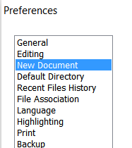
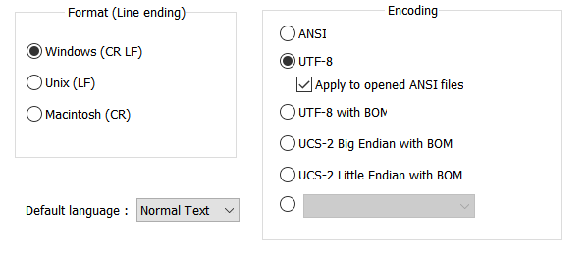

Make Sure Your Text Editor Use UTF-8
In Notepad++: Settings → Preferences → New Document
Select UTF-8, and check “Apply to opened ANSI files”
☼

Slide 36
中文訊息
Try the following simple python script.
# -*- coding: utf8 -*-
msg=u'中文測試'
print(msg)
If you see error message like this, you need to fix the encoding of your file:
Traceback (most recent call last):
File "<stdin>", line 1, in <module>
File "testcmsg1.py", line 2
SyntaxError: 'utf8' codec can't decode byte 0xa4 in position 0: invalid start byte
☼

Slide 37
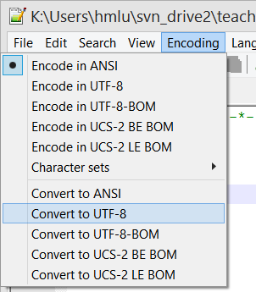
中文訊息
如果你的檔案不是UTF-8編碼…
If you are using Notepad++, goto “Encoding” ➔ “Convert to UTF-8” ➔ save the file
Try again! You will see:
中文測試
Need to be very careful about your Chinese encoding ☼

Slide 38
中文訊息
msg=u'中文測試'
字串前面加u表示這個是個Unicode字串。叫Python用適當的解碼方式轉換成Unicode。
Python Ver. 3.X 可以不用加u。但Python Ver. 2.X如果沒加，則需要後續作encoding處理。
看看這個例子:
# -*- coding: utf8 -*-
msg=u'中文測試'
print("msg=", msg)
print("len(msg)=", len(msg))
msg2='中文測試'
print("msg2=", msg2)
print("len(msg2)=", len(msg2))
Output:
msg= 中文測試
len(msg)= 4
msg2= 中文測試
len(msg2)= 4 ☼

Slide 39
chr and ord
We are look at the internal encoding of characters
>>> chr(65)
'A'
>>> ord('A')
65
>>> ord('鴨')
40232
>>> chr(40232)
'鴨'
chi(i) returns the character with internal encoding i
ord(str) returns the internal encoding of str
☼

Slide 40
Getting the internal code of a message
Suppose you want to pass a secret message to you pal but you do not want other people to easily know what the message is.
You can to convert the text into internal encoding
# -*- coding: utf8 -*-
msg='晚上七點水源星巴克見'
for achr in msg:
print(ord(achr), end= " ")
print()
Here is the output:
26202 19978 19971 40670 27700 28304 26143 24052 20811 35211
☼

Slide 41
Getting the internal code of a message
The code starts with a declaration on the encoding of the program.
The for loop takes a character one time, and pass it to ord()
Note the print line: print(ord(achr), end= " ")
What is the purpose of end= " " ?☼
☼

Slide 42
I want to know what this message is about
Now you pal get this message, he or she wants to know what this is about
26202 19978 19971 40670 27700 28304 26143 24052 20811 35211
Start with a string that contain the code, and split the string by space
code='26202 19978 19971 40670 27700 28304 26143 24052 20811 35211'
tmpcode = code.split(' ')
Now the tmpcode contains a list of strings, each a code for a character
>>> tmpcode
['26202', '19978', '19971', '40670', '27700', '28304', '26143', '24052', '20811', '35211'] ☼
☼

Slide 43
I want to know what this message is about
We can retrieve the code of each character using its index:
>>> tmpcode[0]
'26202'
>>> tmpcode[3]
'40670'
Note that each element is a string.
We want to use char() to convert the code into message, one character a time.
However, char() takes int as input.
We can convert string to int by the int() function.
>>> int(tmpcode[3])
40670 ☼

Slide 44
I want to know what this message is about
After getting a character, we need to concatenate them together.
So we start with a empty unicode string
msg = ""
Concatenate the first character to msg:
msg = msg + chr(int(tmpcode[0]))
Another way to write this line:
msg += chr(int(tmpcode[0])) ☼

Slide 45
I want to know what this message is about
Putting everything together
code='26202 19978 19971 40670 27700 28304 26143 24052 20811 35211'
tmpcode = code.split(' ')
msg = ""
for acode in tmpcode:
msg += chr(int(acode))
print ("msg =", msg)
The output is:
msg = 晚上七點水源星巴克見 ☼

Slide 46
Common String Operations
capitalize(): Capitalize the first character.
title(): Capitalize the first character of each word.
upper(): Convert all characters to uppercase.
replace(old, new): Replace the occurrences of old with new.
Examples:
>>> s = "athletes could not join the parade"
>>> print(s.capitalize())
Athletes could not join the parade
>>> print(s.title())
Athletes Could Not Join The Parade
>>> print(s.upper())
ATHLETES COULD NOT JOIN THE PARADE
>>> print(s.replace("athletes", "guests"))
guests could not join the parade
☼

Slide 47
Common String Operations (Cont’d.)
See Python 3 Document for a list of complete methods. (Section 4.7.1)
https://docs.python.org/3/library/stdtypes.html#string-methods
>>> #count: Return the number of non-overlapping occurrences
>>> s2 = "media and mania"
>>> print(s2.count("ia"))
2
>>> #in operation
>>> uletter = "ABCDEFGHIJKLMNOPQRSTUVWXYZ"
>>> 'A' in uletter
True
>>> 'z' in uletter
False
>>> 'AD' in uletter
False
>>> 'MN' in uletter
True
☼

Slide 48
Common String Operations (Cont’d.)
>>> #find: Return the lowest index in the string where the given substring is found
>>> s3 = "02-33661184"
>>> s3.find('-')
2
>>>
>>> #is numeric characters
>>> s4 = "1235"
>>> s4.isnumeric()
True
>>> s5 = "1235.2"
>>> s5.isnumeric()
False
☼

Slide 49
Common String Operations (Cont’d.)
>>> #is upper characters
>>> s6 = "HI"
>>> s6.isupper()
True
>>> s7 = "Hi"
>>> s7.isupper()
False
>>>
>>> #split a string by a given separator string.
>>> s8 = "Not a useful tool."
>>> print(s8.split(" "))
['Not', 'a', 'useful', 'tool.']
>>>
☼

Slide 50
Common String Operations (Cont’d.)
>>> #remove extra spaces
>>> s9 = " many spalce "
>>> print(s9.strip())
many spalce
>>>
>>> #remove given characters.
>>> 'www.example.com'.strip('cmowz.')
'example'
☼

Slide 51
Formatting Strings
We often need to provide output in a specific format.
Give “pretty print”
For example, output gasoline price using a specific format ($23.4).
Output stock price with two decimal places (e.g., 32.12).
Add extra “0” upfront (e.g. ID: 000325).
Generating reports following a specific format:
Name: Joe Smith Phone: 02-12345543
First Contact: 2006-12-32 Age: 40
☼

Slide 52
String Formatting
Consider this example: We have a variable that store the price of a product, and we want to output the price with only two decimal places:
>>> prc=13.87623
>>> print("Current price: %0.2f" % prc)
Current price: 13.88
For numbers, % means the remainder operation.
For strings, % is a string formatting operator. ☼
☼

Slide 53
String Formatting
The formatting specifier has the form: %<width>.<precision><type-char>
Type-char can be decimal, float, string (decimal is base-10 ints)
<width> and <precision> are optional.
<width> tells us how many spaces to use to display the value. 0 means to use as much space as necessary.
>>> prc=13.87623
>>> print("Current price: %0.2f" % prc)
Current price: 13.88
☼

Slide 54
String Formatting
If the given <width> is not enough, Python will expand the space until the result fits.
<precision>: number of places to display after the decimal (for floating point numbers only).
%0.2f: use as much space as necessary and two decimal places to display a floating point number. ☼

Slide 55
String Formatting
>>> "%s同學您好, 您借的書已逾期%d天，請盡速歸還。" % ("王大雄", 55)
'王大雄同學您好, 您借的書已逾期55天，請盡速歸還。'
>>> '整數： %5d[欄位長度為5]' % (7)
'整數： 7[欄位長度為5]'
>>> '整數： %10d[欄位長度為10]' % (99)
'整數： 99[欄位長度為10]'
>>> '浮點數： %10.5f[欄位長度為10，五位小數點' % (3.1415926)
'浮點數： 3.14159[欄位長度為10，五位小數點'
>>> '浮點數： %0.5f[欄位長度為0，五位小數點' % (3.1415926)
'浮點數： 3.14159[欄位長度為0，五位小數點'
>>> '比較兩個格式： %f 與 %0.20f' % (3.14, 3.14)
'比較兩個格式： 3.140000 與 3.14000000000000012434' ☼

Slide 56
String Formatting
Output values are right-justified by default (if the width is wider than needed)
To left-justify use a negative width (e.g., %-10.3f)
You may see random digits if showing a float with long decimal places. This is caused by internal representation for float. ☼

Slide 57
Concatenate Strings and Floats
You can use “+” to concatenate strings.
Be very careful if you are concatenate string and other data types (e.g. float).
>>> value = 3.14
>>> print ("The value is" + value + ".")
Traceback (most recent call last):
File "<input>", line 1, in <module>
TypeError: must be str, not float
If value is an int or float, Python thinks the + is a mathematical operation,
not concatenation, and “.” is not a number! ☼

Slide 58
作業2-2
第一題：CSV檔案格式的處理。
Case 1: simple
Input: 3.2,4,3,9999.2,232.5
Output:
3.2
4
3
9999.2
232.5
Case 2: comma allowed.
Input: str10,"str12, str13",str14,"str888,999",str56
Output:
str10
"str12, str13"
str14
"str888,999"
str56
☼

Slide 59
作業2-2
第二題：Pretty print
Input: 2.5,0.26,13,42,8,8.1,3.1,211,1,13.32,5.25,9/9/2016 10:00
Output: 002.5 00.26 13 42 8 008.1 003.1 211 1 13.32 05.25 9/9/2016 10:00
第三題：word segmentation
Input: money, address, home-coming; zeeda+apple.
Output:
money
address
home-coming
zeeda
apple

Slide 60
Thank You!
Questions?

Slide 61
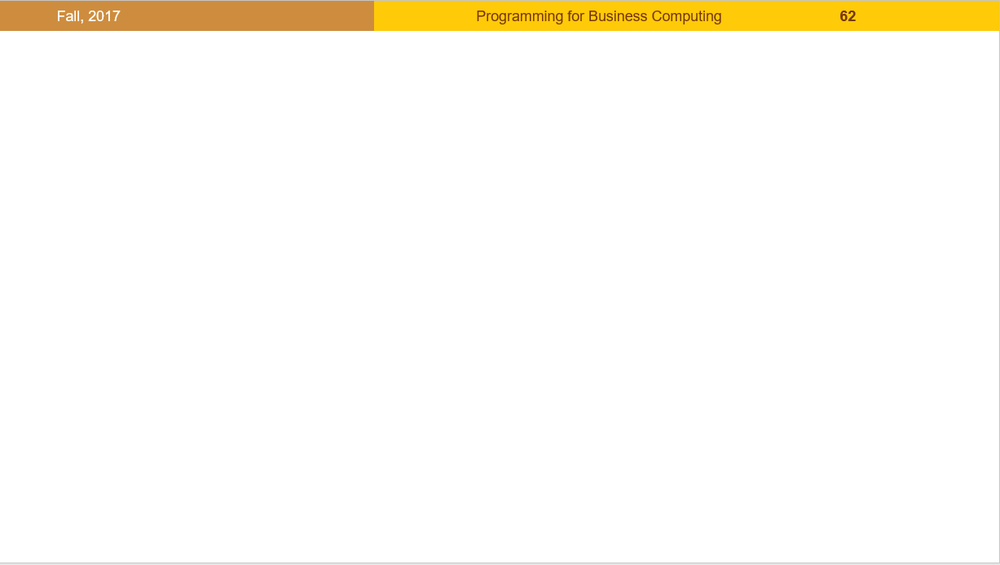


版權聲明
序 | 頁 | 作品 | 版權標章 | 作者 / 來源
1 | 1-61 |  |  | 台灣大學 盧信銘, CC BY-NC-ND 3.0
2 | 33 |  |  | Unicode，Inc., Logo http://www.unicode.org/copyright.html 依據中華民國著作權法第46、52及65條合理使用 2017/8/24 visited
3 | 35 |  |  | 台灣大學 盧信銘, CC BY-NC-ND 3.0
4 | 35 |  |  | 台灣大學 盧信銘, CC BY-NC-ND 3.0
5 | 37 |  |  | 台灣大學 盧信銘, CC BY-NC-ND 3.0

