Slide 1

Programming for Business Computing 商管程式設計
Data Structures
Hsin-Min Lu
盧信銘
台大資管系
【本著作除另有註明外，採取創用CC「姓名標示－非商業性－禁止改作分享」台灣3.0版授權釋出】

Slide 2


Data Structures in Python
A data structure is a particular way of organizing data in a computer so that it can be used efficiently.
Python has many built-in data structures
list (discussed before)
tuple
dictionary
set
datetime (to handle date and time data)
… and more.
We are going to cover selected data structures that are important for you.
☼

Slide 3
Tuples

Slide 4
Tuples
☼
Same as lists, but
Immutable
Enclosed in parentheses
A tuple with a single element must have a comma inside the parentheses: a = (11,)
>>> mytuple = (11, 22, 33)
>>> mytuple[0] 11
>>> mytuple[-1] 33
>>> mytuple[0:1] (11,)
#The comma is required!

Slide 5
Why?
☼
It is clear that [11] and 11 are different (list of one element and integer 11)
But,
(11) is an acceptable expression
(11) without the comma is the integer 11
(11, ) with the comma is a tuple containing the integer 11
A small (but critical) piece of info that you need to know.

Slide 6
Tuples are immutable
☼
>>> mytuple = (11, 22, 33)
>>> saved = mytuple
>>> mytuple += (44,)
>>> mytuple (11, 22, 33, 44)
>>> saved (11, 22, 33)

Slide 7
Things that do not work
mytuple += 55 Traceback (most recent call last):Z … TypeError: can only concatenate tuple (not "int") to tuple
Be aware of this ….
☼

Slide 8
Sorting tuples
Tuples are immutable!
sorted( ) returns a list!
☼
>>> atuple = (33, 22, 11)
>>> atuple.sort() Traceback (most recent call last): … AttributeError: 'tuple' object has no attribute 'sort'
>>> atuple = sorted(atuple)
>>> atuple [11, 22, 33]

Slide 9
Tuple and List Share Similar Operations
☼
>>> atuple = (11, 22, 33)
>>> len(atuple) 3
>>> 44 in atuple False

Slide 10
Converting Lists into Tuples
☼
>>> alist = [11, 22, 33]
>>> atuple = tuple(alist)
>>> atuple (11, 22, 33)
>>> newtuple = tuple('Hello World!')
>>> newtuple ('H', 'e', 'l', 'l', 'o', ' ', 'W', 'o', 'r', 'l', 'd', '!')

Slide 11
Example: Taiwan ID Checksum
Recall the process of computing Taiwan ID checksum.
Convert the first letter to a two-digit number
Apply weight to all 11 digits.
Sum over all digits.

Slide 12
def cksum_twid(idstr):
"""Compute Checksum for Taiwn ID"""
code1 = ord(idstr[0])
#convert first English character to two-digit number.
cmap = [10, 11, 12, 13, 14, 15, 16, 17, 34, 18, 19, 20, 21, 22, 35, 23, 24, 25, 26, 27, 28, 29, 32, 30, 31, 33]
num1 = cmap[code1 - 65]
newid = str(num1) + idstr[1:]
weight = [1, 9, 8, 7, 6, 5, 4, 3, 2, 1, 1]
checksum = 0
for i in range(0, 11):
checksum += weight[i] * int(newid[i])
print("checksum=%d" % checksum)
id1 = "A123456789"
cksum_twid(id1)
Output: checksum=130

Slide 13
Zipping two Variables
zip: Make an iterator that aggregates elements from each of the iterables.
newid = '10123456789'
weight = [1, 9, 8, 7, 6, 5, 4, 3, 2, 1, 1]
for apair in zip(newid, weight):
print(apair)
Output:
('1', 1)
('0', 9)
('1', 8)
('2', 7)
('3', 6)
('4', 5)
('5', 4)
('6', 3)
('7', 2)
('8', 1)
('9', 1)
☼

Slide 14
New Version Using “zip()”
def cksum_twid_v2(idstr):
"""Compute Checksum for Taiwn ID"""
code1 = ord(idstr[0])
#convert first English character to two-digit number.
cmap = [10, 11, 12, 13, 14, 15, 16, 17, 34, 18, 19, 20, 21, 22, 35, 23, 24, 25, 26, 27, 28, 29, 32, 30, 31, 33]
num1 = cmap[code1 - 65]
newid = str(num1) + idstr[1:]
weight = [1, 9, 8, 7, 6, 5, 4, 3, 2, 1, 1]
checksum = 0
for apair in zip(newid, weight):
checksum += apair[1] * int(apair[0])
print("checksum=%d" % checksum)
#running the function
id1 = "A123456789"
cksum_twid_v2(id1)
Output: checksum=130
☼

Slide 15
The Lambda Operator
Lambda is a way to define simple functions.
>>> def f1 (x):
... return x**2
...
>>> print (f1(8))
64
>>>
>>> f2 = lambda x: x**2
>>> print (f2(8))
64
☼

Slide 16
The Map Operator
map() provides an easy way to apply an function to a list or tuples.
Consider the situation when we want to square all numbers in a list.
>>> list1=[3,5,1.2, 4, 9]
>>> out1=map(f1, list1)
>>> print(list(out1))
[9, 25, 1.44, 16, 81]
>>>
>>> #using lambda
>>> out2=map(lambda x: x**2, list1)
>>> print(list(out2))
[9, 25, 1.44, 16, 81]
☼

Slide 17
Checksum Using Map and Lambda
def cksum_twid_v3(idstr):
"""Compute Checksum for Taiwn ID"""
code1 = ord(idstr[0])
#convert first English character to two-digit number.
cmap = [10, 11, 12, 13, 14, 15, 16, 17, 34, 18, 19, 20, 21, 22, 35, 23, 24, 25, 26, 27, 28, 29, 32, 30, 31, 33]
num1 = cmap[code1 - 65]
newid = str(num1) + idstr[1:]
weight = [1, 9, 8, 7, 6, 5, 4, 3, 2, 1, 1]
out1 = map(lambda apair: apair[1] * int(apair[0]),
zip(newid, weight))
checksum=sum(out1)
print("checksum=%d" % checksum)
id1 = "A123456789"
cksum_twid_v3(id1)
Output: checksum=130
☼

Slide 18
Dictionary

Slide 19
The dictionary data structure
In Python, a dictionary is mapping between a set of indices (keys) and a set of values
The items in a dictionary are key-value pairs
Keys can be any Python data type
Because keys are used for indexing, they should be immutable
Values can be any Python data type
Values can be mutable or immutable
☼

Slide 20
Creating a Dictionary
>>> eng2cn = dict()
>>> print(eng2cn)
{}
>>>
>>> eng2cn['one'] = '一'
>>> eng2cn['two'] = '二'
>>> eng2cn['three'] = '三'
>>> eng2cn['four'] = '四'
>>> print(eng2cn)
{'one': '一', 'two': '二', 'three': '三', 'four': '四'}
☼

Slide 21
Creating a dictionary
>>> eng2cn = {'two': '二', 'three': '三', 'four': '四', 'one': '一'}
>>> print(eng2cn)
{'two': '二', 'three': '三', 'four': '四', 'one': '一'}
In general, the order of items in a dictionary is unpredictable
Dictionaries are indexed by keys (including integers). ☼

Slide 22
Dictionary indexing
>>> print(eng2cn['one'])
一
>>> print(eng2cn['two'])
二
>>> print(eng2cn['five'])
Traceback (most recent call last):
File "<input>", line 1, in <module>
KeyError: 'five'
* If the index is not a key in the dictionary, Python raises an exception ☼

Slide 23
Dictionary indexing
if 'five' in eng2cn: print(eng2cn['five']) #no output
>>> print(eng2cn.get('five'))
None
☼

Slide 24
The in operator
Note that the in operator works differently for dictionaries than for other sequences
For strings, lists, and tuples, x in y means whether x is an item in the sequence
For dictionaries, x in y checks whether x is a key in the dictionary ☼

Slide 25
Keys and values
The keys method returns a list of the keys in a dictionary
The values method returns a list of the values
>>> print(eng2cn.keys())
dict_keys(['two', 'three', 'four', 'one'])
>>> print(eng2cn.values())
dict_values(['二', '三', '四', '一'])

Slide 26
Keys and values
The items method returns a list of tuple pairs of the key-value pairs in a dictionary
>>> print(eng2cn.items())
dict_items([('two', '二'), ('three', '三'), ('four', '四'), ('one', '一')])
☼

Slide 27

Example:
def histogram(seq):
d = dict()
for element in seq:
if element not in d:
d[element] = 1
else:
d[element] += 1
return d
h = histogram('brontosaurus')
print(h)
Output:
{'a': 1, 'b': 1, 'o': 2, 'n': 1, 's': 2, 'r': 2, 'u': 2, 't': 1}
☼

Slide 28
Example:
Another way to output results:
def print_hist(hist):
for key in hist:
print(key, hist[key])
h = histogram('brontosaurus')
print_hist(h)
Output:
a 1
b 1
o 2
n 1
s 2
r 2
u 2
t 1
☼

Slide 29
Example:
Change the print_hist function:
def print_hist2(hist):
for key, value in hist.items():
print (key, value)
h = histogram('brontosaurus')
print_hist2(h)
Output:
a 1
b 1
o 2
n 1
s 2
r 2
u 2
t 1
☼

Slide 30
Sorting the keys
Change the print_hist function:
def print_hist3(hist):
keys = hist.keys()
for key in sorted(keys):
print (key, hist[key])
h = histogram('brontosaurus')
print_hist3(h)
Output:
a 1
b 1
n 1
o 2
r 2
s 2
t 1
u 2
☼

Slide 31
Using lists as values
Inverting the mapping: What are the letters with a given count?
def invert_dict(d):
inv = dict()
for key in d:
val = d[key]
if val not in inv:
inv[val] = [key]
else:
inv[val].append(key)
return inv
☼

Slide 32
Inverting the Mapping: Example
def invert_dict(d):
inv = dict()
for key in d:
val = d[key]
if val not in inv:
inv[val] = [key]
else:
inv[val].append(key)
return inv
hist = histogram('parrot')
print (hist)
inverted = invert_dict(hist)
print (inverted)
Output:
{'a': 1, 'p': 1, 'r': 2, 't': 1, 'o': 1}
{1: ['a', 'p', 't', 'o'], 2: ['r']}
☼

Slide 33
Sets

Slide 34
Sets
>>> cset = {11, 11, 22}
>>> cset {11, 22} ☼
Identified by curly braces
{'Marry', 'Bob', 'John'}
{'Dean'} is a singleton
Sets can only contain unique elements
Duplicates are eliminated
Immutable like tuples and strings ☼

Slide 35
Sets are Immutable
>>> aset = {11, 22, 33}
>>> bset = aset
>>> #union of two sets
>>> aset = aset | {55}
>>>
>>> aset
{33, 11, 22, 55}
>>> bset
{33, 11, 22}
☼

Slide 36
Sets have no Order
>>> {1, 2, 3, 4, 5, 6, 7}
{1, 2, 3, 4, 5, 6, 7}
>>> {11, 22, 33}
{33, 11, 22}
☼

Slide 37
Sets do not Support Indexing
>>> myset = {'大象', '長頸鹿', '蝸牛'}
>>> myset
{'蝸牛', '長頸鹿', '大象'}
>>> myset[0]
Traceback (most recent call last):
File "<input>", line 1, in <module>
TypeError: 'set' object does not support indexing ☼

Slide 38
Examples
>>> alist = ['大象', '長頸鹿', '蝸牛', '大象', '猴子']
>>> aset = set(alist)
>>> aset
{'猴子', '蝸牛', '長頸鹿', '大象'}
>>> #set does not support + operation
>>> aset = aset + {'蟒蛇'}
Traceback (most recent call last):
File "<input>", line 1, in <module>
TypeError: unsupported operand type(s) for +: 'set' and 'set'
☼

Slide 39
Boolean Operations on sets
>>> aset = {11, 22, 33}
>>> bset = {12, 23, 33}
Union of two sets
>>> aset | bset {33, 22, 23, 11, 12}
Intersection of two sets:
>>> aset & bset {33} ☼

Slide 40
Boolean Operations on sets
>>> aset = {11, 22, 33}
>>> bset = {12, 23, 33}
Difference:
>>> aset - bset {11, 22}
Symmetric difference:
>>> aset ^ bset {11, 12, 22, 23} ☼
Contains all elements that are either
in set A but not in set B or
in set B but not in set A

Slide 41
datetime

Slide 42
Handling Date and Time in Python
Python has a build-in library “datetime” that can process date and time data.
Need to do “import datetime” first
>>> import datetime
>>> #create datetime by year, month, day
>>> d1=datetime.datetime(2005,5,3)
>>> d1
datetime.datetime(2005, 5, 3, 0, 0)
>>> print(d1)
2005-05-03 00:00:00
☼

Slide 43
The datetime Object
>>> #create datetime by
>>> # year, month, day, hour, minute, second
>>> d2=datetime.datetime(2017, 2, 5, 8, 5, 20)
>>> d2
datetime.datetime(2017, 2, 5, 8, 5, 20)
>>> print(d2)
2017-02-05 08:05:20
>>> #extract the date components
>>> d2.date()
datetime.date(2017, 2, 5)
>>> #extract the time component
>>> d2.time()
datetime.time(8, 5, 20)
☼

Slide 44
Getting Dat-of-Week, and Today’s Date
>>> #get day-of-week
>>> ##Monday is 0 and Sunday is 6
>>> d2.date().weekday()
6
>>> #return today's date
>>> datetime.date.today()
datetime.date(2017, 8, 22)
☼

Slide 45
Getting the Value of Each Slot
>>> #get value of each slot
>>> d2.year
2017
>>> d2.month
2
>>> d2.day
5
>>> d2.hour
8
>>> d2.minute
5
>>> d2.second
20
☼

Slide 46
Difference of Datetime
>>> d3=datetime.datetime(1998, 2, 5, 8, 5, 20)
>>> d4=datetime.datetime(1999, 2, 1, 22, 4, 15)
>>> diff = d4 - d3
>>> #difference in days + seconds
>>> diff
datetime.timedelta(361, 50335)
>>> print(diff)
361 days, 13:58:55
>>> #get individual slots
>>> diff.days
361
>>> diff.seconds
50335
☼

Slide 47
Time Shifting by timedelta
>>> diff2 = datetime.timedelta(days=3,seconds=4)
>>> d5 = datetime.datetime(2000,1,1,0,0,0)
>>> d6 = d5 + diff2
>>> print(d6)
2000-01-04 00:00:04
☼

Slide 48
Datetime ⬅➔String
>>> #datetime to string
>>> d7 = datetime.datetime(2002,5,2,13,15,45)
>>> print(str(d7))
2002-05-02 13:15:45
>>> print(d7.strftime('%Y-%m-%d'))
2002-05-02
>>> print(d7.strftime('%B %d, %Y'))
May 02, 2002
>>> print(d7.strftime('%Y-%m-%d %H:%M:%S'))
2002-05-02 13:15:45
>>> print(d7.strftime('%Y-%m-%d %I:%M:%S %p, %A'))
2002-05-02 01:15:45 PM, Thursday
>>>
☼

Slide 49
Datetime ⬅➔String
>>> #string to datetime.
>>> dstr = "2007-03-04 21:08:12"
>>> d9 = datetime.datetime.strptime(dstr, "%Y-%m-%d %H:%M:%S")
>>> d9
datetime.datetime(2007, 3, 4, 21, 8, 12)
Full document here: https://docs.python.org/3/library/datetime.html#strftime-strptime-behavior
☼

Slide 50
Thank You!
Questions?

Slide 51
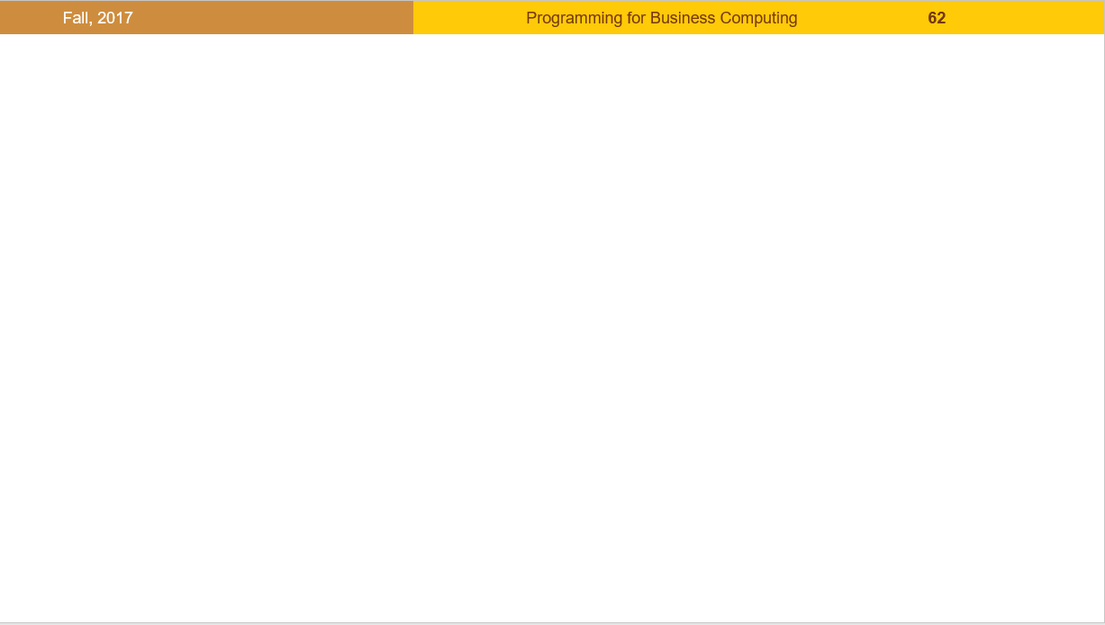
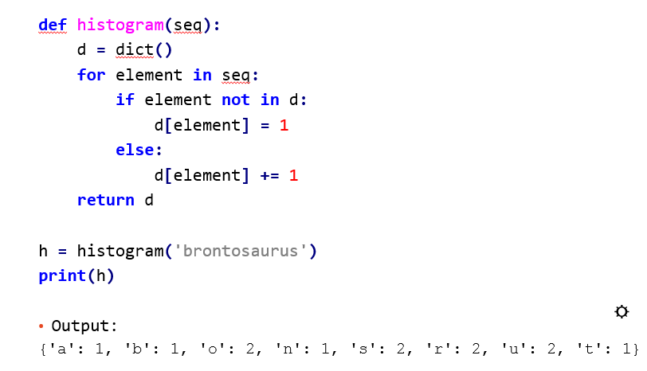
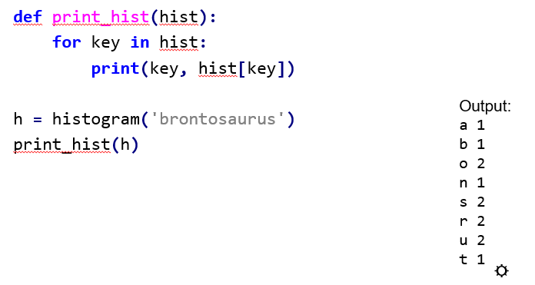
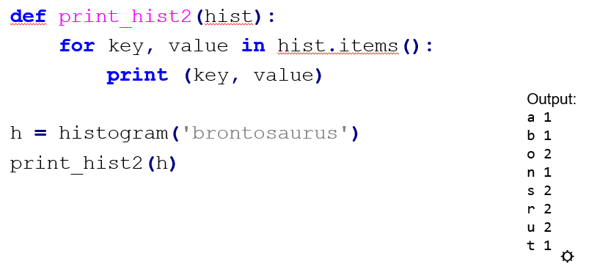
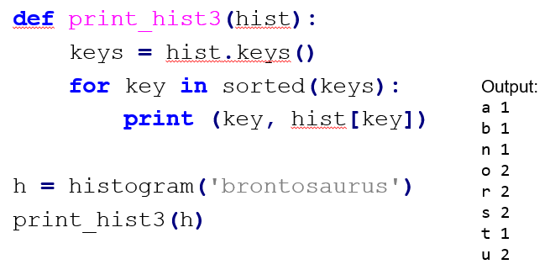
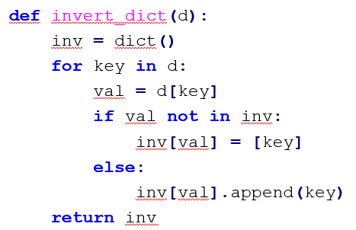
版權聲明
序 | 頁 | 作品 | 版權標章 | 作者 / 來源
1 | 1-52 |  |  | 台灣大學 盧信銘, CC BY-NC-ND 3.0
2 | 27 |  |  | WordPress, Green Tea Press, Allen B. Downey, Think Python , example from Section 11.2, P103, CC BY-NC 3.0, 2012/8/3 http://greenteapress.com/wp/ 2017/8/24 visited
3 | 28 |  |  | WordPress, Green Tea Press, Allen B. Downey, Think Python , example from Section 11.2, P104, CC BY-NC 3.0, 2012/8/3 改作: 盧信銘 http://greenteapress.com/wp/ 2017/8/24 visited
4 | 29 |  |  | WordPress, Green Tea Press, Allen B. Downey, Think Python , example from Section 11.2, P104, CC BY-NC 3.0, 2012/8/3 , 改作: 盧信銘 http://greenteapress.com/wp/ 2017/8/24 visited
5 | 30 |  |  | WordPress, Green Tea Press, Allen B. Downey, Think Python , example from Section 11.2, P104, CC BY-NC 3.0, 2012/8/3 改作: 盧信銘 http://greenteapress.com/wp/ 2017/8/24 visited
6 | 31 32 |  |  | WordPress, Green Tea Press, Allen B. Downey, Think Python , example from Section 11.2, P105, CC BY-NC 3.0, 2012/8/3 http://greenteapress.com/wp/ 2017/8/24 visited

Slide 52
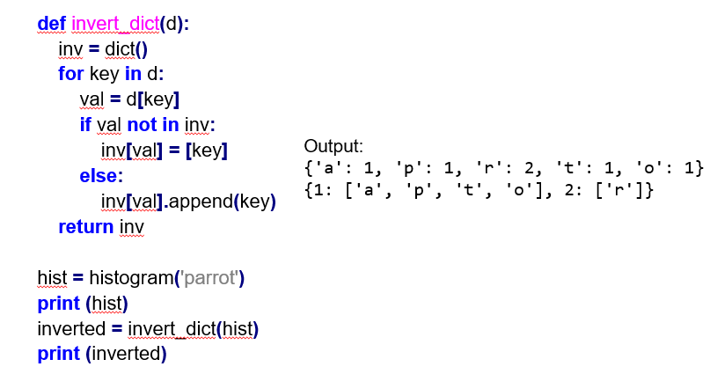
版權聲明
序 | 頁 | 作品 | 版權標章 | 作者 / 來源
7 | 32 |  |  | WordPress, Green Tea Press, Allen B. Downey, Think Python , example from Section 11.2, P105, CC BY-NC 3.0, 2012/8/3 http://greenteapress.com/wp/ 2017/8/24 visited

