Slide 1

Programming for Business Computing 商管程式設計
Applications in finance
Hsin-Min Lu
盧信銘
台大資管系
【本著作除另有註明外，採取創用CC「姓名標示－非商業性－禁止改作分享」台灣3.0版授權釋出】

Slide 2


Objectives
To understand the typical process to analyze real world financial datasets.
To understand how to leverage Python to analyze financial datasets.
Data preprocessing: read write files, read write csv files
Regression: estimate statistical models
Processing many stocks: looping
Visualize result: matplotlib

Slide 3
股票市場
股票市場分為初級市場與次級市場
初級市場：又稱為「發行市場」，是指企業提供新的證券銷售給社會大眾的市場，又稱為「第一市場」。
次級市場：又稱為「流通市場」，是指社會大眾購買新證券之後，這些證券後續買賣的市場。
我們平常看到的股價與交易資訊大都來自次級市場。 ☼

Slide 4
交易所
臺灣證券交易所股份有限公司 (Taiwan Stock Exchange Corporation, TSEC)
成立於 1961 年 10 月 3 日，1962 年 2 月 9 日開業，為臺灣證券集中市場。
交易所為「股份有限公司」，為公司制
交易時間：星期一至星期五每日 09:00~13:30。
休假停市日除經特別公告外，與金融業的例行假日相同。
臺灣地區遇天然災害時，證券集中市場之休市視當地縣市首長宣佈公教機關是否上班為準 (例如颱風來襲，臺北市若宣佈停止上班，則臺灣證交所休市)。 ☼

Slide 5

市場概況
單位：10億元
公開發行公司 | 上市公司 | 上櫃公司 | 興櫃公司
家數 | 854 | 685 | 284
市值 | 26,891.50 | 2,680.56 | 893.02
2014年12月，資料來源：台灣證券交易所、櫃檯買賣中心
☼

Slide 6

台灣股市與國際市場比較
項目 | 統計值 | 全球排名
•2014年底上市公司家數 (國內外第一上市) | 854 | 第15名
•TDR家數 | 26
2014年底總市值 (新台幣10億元) | 26,891.5 | 第18名
2014年總成交金額* (新台幣10億元) | 21,898.5 | 第16名
2014年成交金額周轉率 | 82.6% | 第13名
2014年底ETF掛牌數 | 25 | 第23名
資料來源：證券暨期貨市場重要指標、WFE Statistics 註：全球排名係依WFE全體會員共56家交易所計算
註：成交金額比重係依2014年資料計算
☼

Slide 7

股票歷史日資料
證券代碼 | 簡稱 | TSE 產業別 | 年月日 | 開盤價(元) | 最高價(元) | 最低價(元) | 收盤價(元)
COID | Name | IND1 | MDATE | OPEN | HIGH | LOW | CLOSE
1101 | 台泥 | 1 | 1/3/2005 | 10.4 | 10.8 | 10.4 | 10.65
1102 | 亞泥 | 1 | 1/3/2005 | 7.81 | 7.95 | 7.78 | 7.92
1103 | 嘉泥 | 1 | 1/3/2005 | 11.21 | 11.5 | 11.14 | 11.36
1104 | 環泥 | 1 | 1/3/2005 | 6.24 | 6.34 | 6.19 | 6.34
1108 | 幸福 | 1 | 1/3/2005 | 6.45 | 6.66 | 6.42 | 6.62
1109 | 信大 | 1 | 1/3/2005 | 6.87 | 6.96 | 6.84 | 6.9
1101 | 台泥 | 1 | 1/4/2005 | 10.65 | 10.65 | 10.5 | 10.5
1102 | 亞泥 | 1 | 1/4/2005 | 7.88 | 7.88 | 7.71 | 7.74
☼

Slide 8
How do we Analyze Stock Return Data?
We are going to adopt Capital Asset Pricing Model (CAPM) to analyze stock return data.
CAPM was invented by Jack Treynor (1961), William F. Sharpe (1964), John Lintner (1965) and Jan Mossin (1966) independently.
Sharpe, Markowitz and Merton Miller jointly received the 1990 Nobel Memorial Prize in Economics for this contribution to the field of financial economics.
Standard textbook approach.
☼

Slide 9
CAPM in Five Minutes
Assumptions:
Investors are rational and risk-averse.
Investors aim to maximize economic utilities.
Investors broadly diversified across a range of investments.
Investors are price takers.
Investors can lend and borrow unlimited amounts under the risk free rate of interest.
Investors can trade without transaction or taxation costs.
All information is available at the same time to all investors.
All investors have homogeneous expectations.
☼

Slide 10
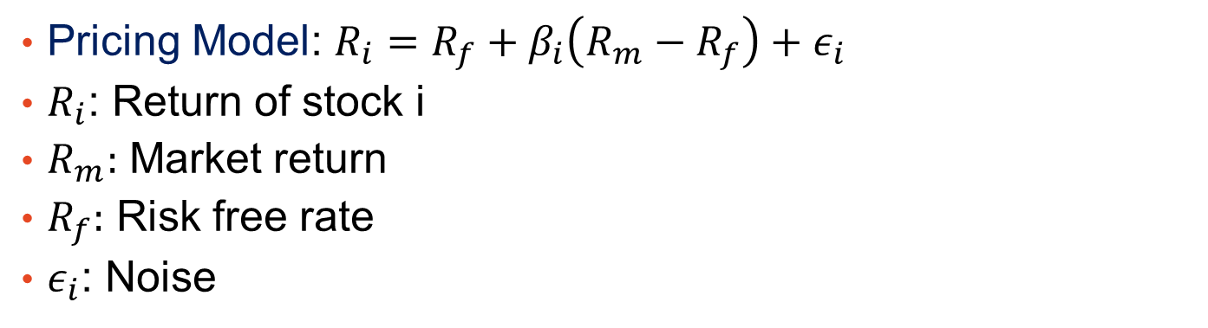
CAPM in Five Minutes (Cont’d.)
Assumptions
Maximize Expected Utility
Pricing Model for Individual Stocks
Pricing Model: $R_{i}=R_{f}+β_{i}\left(R_{m}−R_{f}\right)+ε_{i}$
$R_{i}$: Return of stock i
$R_{m}:$ Market return
$R_{f}:$ Risk free rate
$ε_{i}$: Noise
☼

Slide 11
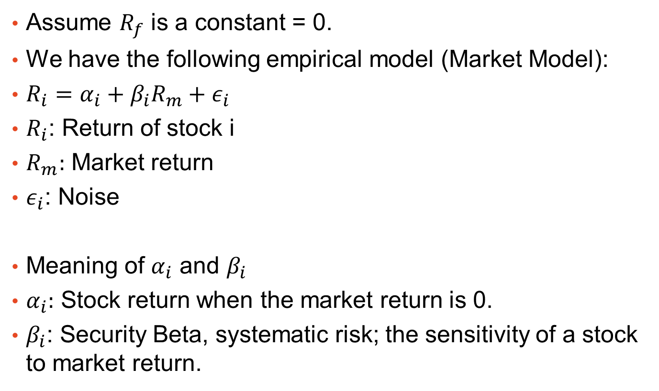
The Market Model
Assume $R_{f}$ is a constant = 0.
We have the following empirical model (Market Model):
$R_{i}=α_{i}+β_{i}R_{m}+ε_{i}$
$R_{i}$: Return of stock i
$R_{m}:$ Market return
$ε_{i}$: Noise
Meaning of $α_{i}$ and $β_{i}$
$α_{i}:$ Stock return when the market return is 0.
$β_{i}$: Security Beta, systematic risk; the sensitivity of a stock to market return.
☼

Slide 12
Data Analysis Steps
Running the model for every stock-year using daily returns.
Market return: Need to download market return first (台灣股票加權指數報酬)
Stock return: Download daily return of all stocks and compute regression model for each stock.
資料來源：台灣經濟新報
頻率：日資料 (使用除權息調整的資料)
包含股票：所有普通股
☼

Slide 13
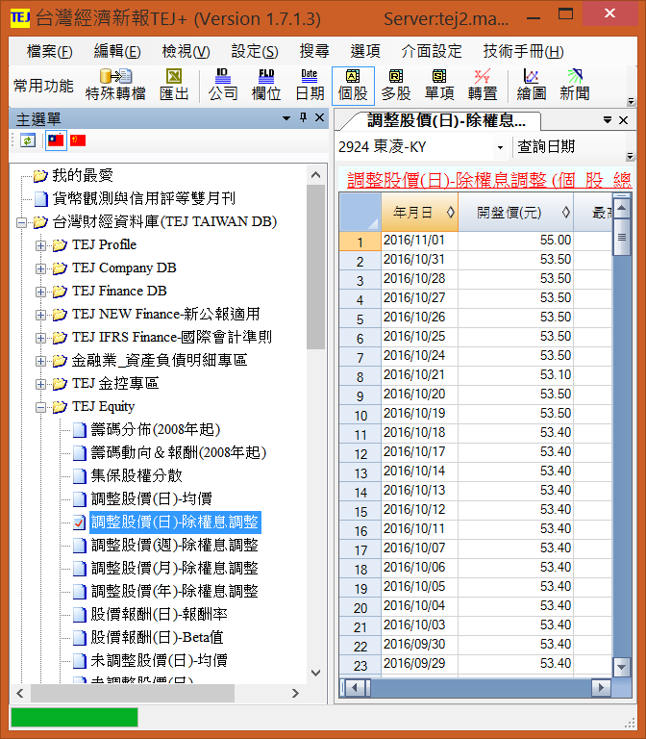
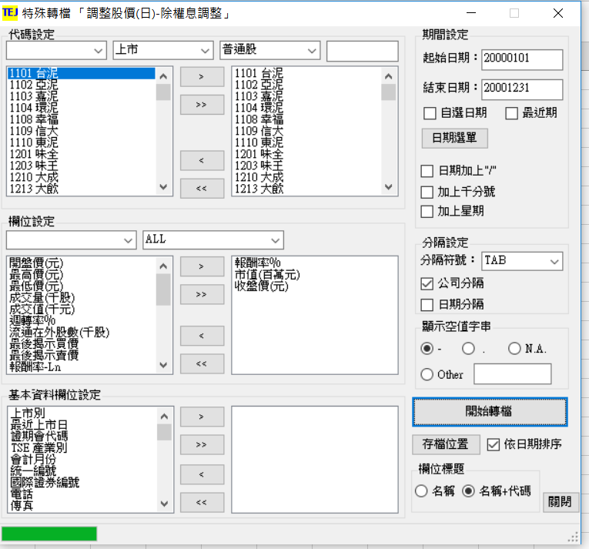

Slide 14
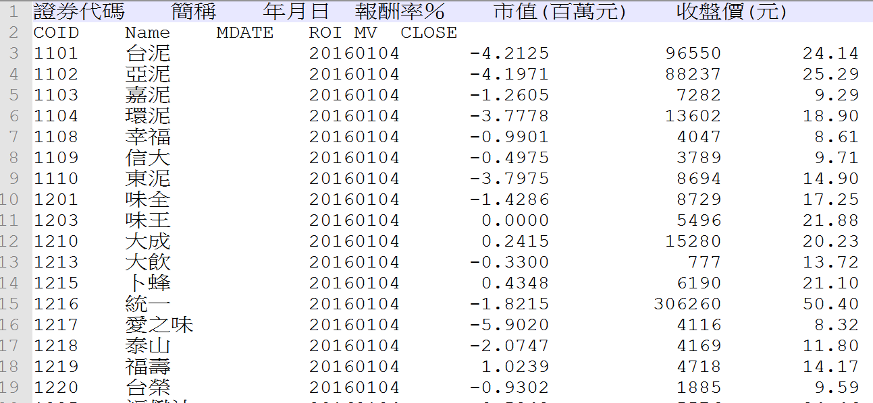

我想看看我下載的資料
使用Notepad++…
☼

Slide 15
Issues
The data is “TAB” separated, not “Comma” separated.
Two head lines, one Chinese, one English.
Data order is not suitable for our analysis:
Current order is by date, then by stock
A better way is to order by stock, then by date.
Still need to have market return data.
Need to “merge” market return with stock return by date.
☼

Slide 16
Data Processing Steps
Preprocess: Remove Chinese headline, convert to standard CSV file, remove all extra spaces.
Sort data by stock and then by date.
Prepare market return data
For each stock:
Merge stock return with market data by date.
Run regression.
Record the result.

Slide 17
Preprocessing (Step 1)
We need to read and write file.
We need to read and write CSV files.
The process of opening a file involves associating a file on disk with a variable.
We can manipulate the file by manipulating this variable.
Read from the file
Write to the file ☼

Slide 18
File Processing
When done with the file, it needs to be closed. Closing the file causes any outstanding operations and other bookkeeping for the file to be completed.
In some cases, not properly closing a file could result in data loss.
Typical file manipulation routine:
File opened
Read or write contents from/to the file
Close the file ☼

Slide 19
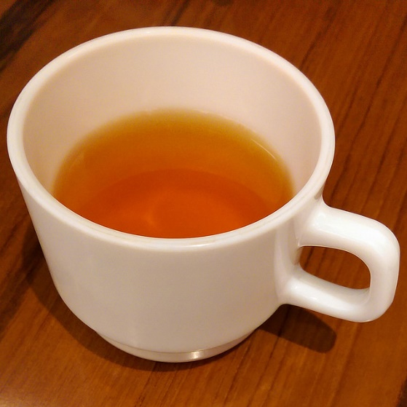

File Processing
Working with files in Python
Associate a file with a variable using the open function <filevar> = open(<name>, <mode>, encoding = <encoding>)
Name is a string with the actual file name on the disk.
<filevar> is often called “file handler”
For text file, the mode is either ‘r’ or ‘w’ depending on whether we are reading or writing the file.
For non-text files, the mode is “rb” or “wb” for reading or wrting the file
<encoding> is the encoding to be used, default to system setting.
Example: infile = open("numbers.dat", "r") ☼

Slide 20
File Processing
Let’s try this out.
stockfn = "raw_yr2016.txt"
fh1 = open(stockfn, 'r')
Traceback (most recent call last):
File "<input>", line 1, in <module>
FileNotFoundError: [Errno 2] No such file or directory: 'raw_yr2016.txt'
Failed! Why?
Python cannot find the file?
☼

Slide 21
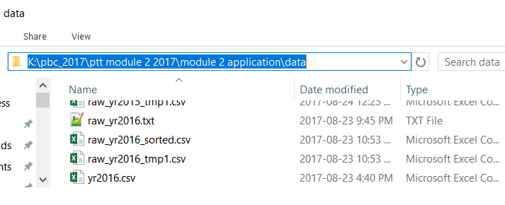

File Name and Path
You need to specify the full path (absolute path; 絕對路徑) so that Python can always access the file correctly.
Absolute path can be found by opening the folder containing the file, and clicking the folder name.
In this example, the absolute path is:
K:\pbc_2017\ptt module 2 2017\module 2 application\data\raw_yr2016.txt

Slide 22
File Name and Path (Cont’d.)
For Windows Users: Because of historical reason, Windows System use backslash (\) in file path. Other operating systems use slack (/).
Backslash has a special meaning in string representation.
Backslash is “escape character.”
The character following escape character are interpreted differently.
For example, if you are using double quote, and you need to define a string with double quote, then you can use backslash to achieve this.
>>> str1 = "A \"test\" string"
>>> print(str1)
A "test" string
☼

Slide 23
Escaping Escape Character
In Python, you cannot use Windows absolute path directly. Instead, you need to change backslash to double backslash.
E.g. K:\pbc_2017\ptt module 2 2017\module 2 application\data\raw_yr2016.txt
➔ K:\\pbc_2017\\ptt module 2 2017\\module 2 application\\data\\raw_yr2016.txt
>>> fn0 = "K:\pbc_2017\ptt module 2 2017\module 2 application\data\raw_yr2016.txt"
>>> print(fn0)
K:\pbc_2017\ptt module 2 2017\module 2 application\data
aw_yr2016.txt
>>> fn1 = "K:\\pbc_2017\\ptt module 2 2017\\module 2 application\\data\\raw_yr2016.txt"
>>> print(fn1)
K:\pbc_2017\ptt module 2 2017\module 2 application\data\raw_yr2016.txt
Incorrect File Name
☼

Slide 24
Opening and Reading Files
Now we can read the file!
cp950 is big5!
>>> stockfn = "K:\\pbc_2017\\ptt module 2 2017\\module 2 application\\data\\raw_yr2016.txt"
>>> fh1 = open(stockfn, 'r', encoding = 'cp950')
>>> aline=fh1.readline()
>>> print(aline)
證券代碼 簡稱 年月日 報酬率％ 市值(百萬元) 收盤價(元)
>>> aline=fh1.readline()
>>> print(aline)
COID Name MDATE ROI MV CLOSE
>>> fh1.close()

Slide 25
Reading CSV Files
We want to interpret the file as a CSV file.
But there are a few differences:
1. We want to use the second line as the heading.
2. We need to interpret TAB as the delimitate character (分隔字元).
Python has built-in CSV processing library (import csv).
Create a csv reader object by passing file handler to csv.reader.
E.g.: reader2 = csv.reader(fh1, delimiter='\t')
☼

Slide 26
>>> import csv
>>> stockfn = "K:\\pbc_2017\\ptt module 2 2017\\module 2 application\\data\\raw_yr2016.txt"
>>> #set newline='' for csv processing
>>> fh1 = open(stockfn, 'r', encoding = 'cp950', newline='')
>>> cheader=fh1.readline()
>>> reader2 = csv.reader(fh1, delimiter='\t')
>>> print(next(reader2))
['COID', 'Name', 'MDATE', 'ROI', 'MV', 'CLOSE']
>>> print(next(reader2))
['1101 ', '台泥 ', '20160104', ' -4.2125', ' 96550', ' 24.14']
>>> print(next(reader2))
['1102 ', '亞泥 ', '20160104', ' -4.1971', ' 88237', ' 25.29']
>>> fh1.close()
☼

Slide 27
Removing Extra Space, and Save
Recall that next(reader2) returns a list of strings.
We want to strip all extra white spaces, and save the result to a different file.
To do so, we need to first create a output file:
fh3 = open(stockfn_tmp1, 'w', encoding = 'utf-8', newline='') writer3 = csv.writer(fh3)
For each row read from the original file, remove extra space for each element in the list:
arow = map(lambda x: x.strip(), arow) writer3.writerow(arow)
☼

Slide 28
import csv stockfn = "K:\\pbc_2017\\ptt module 2 2017\\module 2 application\\data\\raw_yr2016.txt"
#set newline='' for csv processing fh1 = open(stockfn, 'r', encoding = 'cp950', newline='')
cheader=fh1.readline()
reader1 = csv.reader(fh1, delimiter='\t')
#create output file
stockfn_tmp1 = "K:\\pbc_2017\\ptt module 2 2017\\module 2 application\\data\\ raw_yr2016_tmp1.csv"
fh3 = open(stockfn_tmp1, 'w', encoding = 'utf-8', newline='')
writer3 = csv.writer(fh3) for arow in reader1: arow = map(lambda x: x.strip(), arow) writer3.writerow(arow)
fh3.close()
fh1.close()
☼

Slide 29
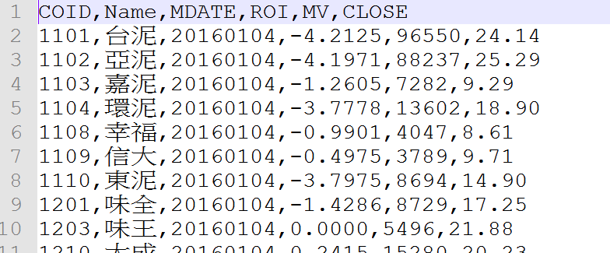

Output File
First step completed.
☼

Slide 30
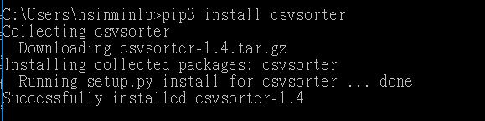
Sorting CSV File
We are going to use an external library (csvsorter) to do the job.
Run: pip3 install csvsorter
We will be able to import csvsorter and use its functions in our program.
☼

Slide 31
More About CSVSORTER
CSVSORTER partitions a large CSV file, sort them by pieces, and combine.
It will write temporary files at your working directory.
To see your working directory,
>>> import os
>>> os.getcwd()
'C:\\Program Files (x86)\\Notepad++‘
If running from Notepad++, then the working directory is where you installed Notepad++.
You will not have write permission in this folder.

Slide 32
Working Directory
We need to set the working directory to somewhere else.
For example, the directory of your project.
>>> wd="K:\\pbc_2017\\ptt module 2 2017\\module 2 application"
>>> os.chdir(wd)
>>> cwd = os.getcwd()
>>> print("Current working directory:", cwd)
Current working directory: K:\pbc_2017\ptt module 2 2017\module 2 application

Slide 33
CSVSORTER
Specify which columns are used to sort
>>> import csvsorter
>>> stockfn_tmp1 = "K:\\pbc_2017\\ptt module 2 2017\\module 2 application\\data\\raw_yr2016_tmp1.csv"
>>> stockfn_sorted = "K:\\pbc_2017\\ptt module 2 2017\\module 2 application\\data\\raw_yr2016_sorted.csv"
>>> csvsorter.csvsort(stockfn_tmp1, [0,2], output_filename=stockfn_sorted, has_header=True)
Merging 1 splits
☼

Slide 34
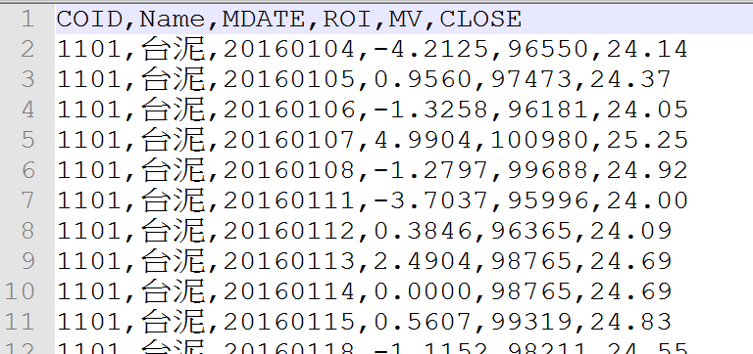
Sorted CSV File
Step 2 completed.

Slide 35
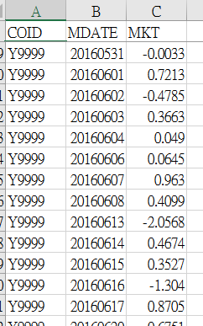
Prepare Market Data
Download market return data, convert to CSV by Excel.
Keep MDATE (date) and MKT (daily market return).
How are we going to use MKT?
We need to “merge” with stock return by date.
How can we do this efficiently?
We can use the dictionary structure.
➔ Use MDATE as key and MKT as value.
➔ Easily find MKT of matching date.
☼

Slide 36
Market Return to Dictionary
csv.DictReader(): allow access columns by its names.
import csv mktfn = "K:\\pbc_2017\\ptt module 2 2017\\module 2 application\\data\\mkt1996_2016.csv“
fh1 = open(mktfn, 'r', newline='') reader1 = csv.DictReader(fh1) mktret = dict() for arow in reader1: mktret[arow['MDATE']] = float(arow['MKT']) fh1.close() print("Read %d market return data" % len(mktret))
Output: Read 5345 market return data
Get market return by:
>>> mktret['20160105']
-0.4825
☼

Slide 37
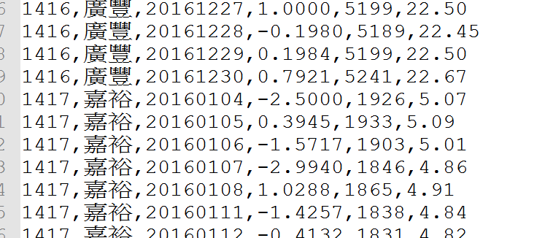
Running Regression
We are going to read in stock return data line-by-line.
Since the data is sorted by stock ID, and then by date, we know that when the stock ID is different from the previous line, then we encountered a new stock.
How do we know that current stock has finished?
Need to remember the stock ID of the previous line!
☼

Slide 38
Loop Through the Sorted CSV File
Again, create a CSV reader.
This time, use csv.DictReader()
Allow access elements by column name.
fh4 = open(stockfn_sorted, 'r', encoding = 'utf-8', newline='') reader2 = csv.DictReader(fh4) # loop through files… for arow in reader2: # process return fh4.close()
☼

Slide 39
Prepare Variables to Store Stock Returns and Dates
We are going to use lists to store stock returns (sret) and dates (sdate) for each stock.
Simply append to the end of the list.
Need to detect the end of one stock data (using last_coid).
#to store stock returns and dates sret=[] sdate=[] last_coid = "" for arow in reader2: this_coid = arow["COID"].strip() this_name = arow['Name'].strip() if(this_coid) != last_coid: if(len(sret) > minlen): #run regression here #reset sret and sdate sret = [float(arow['ROI'].strip())] sdate = [arow['MDATE'].strip()] else: sret.append(float(arow['ROI'].strip())) sdate.append(arow['MDATE'].strip()) last_coid = this_coid last_name = this_name fh4.close()
☼

Slide 40
Prepare to Run Regression
If we encountered a different stock ID, then its time to run regression for the previous stock ID.
Pass sret, sdate, and mktret to compute_model().
Need to reset sret and sdate so that the next stock has a new start!
if(this_coid) != last_coid: if(len(sret) > minlen): print("Run regression for COID:", last_coid) out1 = compute_model(sret, sdate, mktret) #record out1 here #reset sret and sdate sret = [float(arow['ROI'].strip())] sdate = [arow['MDATE'].strip()] else: sret.append(float(arow['ROI'].strip())) sdate.append(arow['MDATE'].strip())
☼

Slide 41
Creating the market return list
Using date to extract market return
>>> sdate = ['20160118', '20160119', '20160120', '20160121', '20160122']
... xlist = []
... for i in range(0, len(sdate)):
... xlist.append(mktret[sdate[i]])
...
>>> xlist
[0.6335, 0.5595, -1.983, -0.456, 1.2026]
>>> mktret['20160119']
0.5595
☼

Slide 42
compute_model()
We need to construct the market return list first before running regression.
def compute_model(ylist, sdate, mktret): """ylist: list of stock return sdate: list of return dates mktret: market return dictonary""" xlist = [] for i in range(0, len(sdate)): xlist.append(mktret[sdate[i]]) if len(xlist) != len(ylist): raise Exception("Data lenght Error!") return simple_reg(xlist, ylist)
raise Exception() cause Python to report Error!
☼

Slide 43
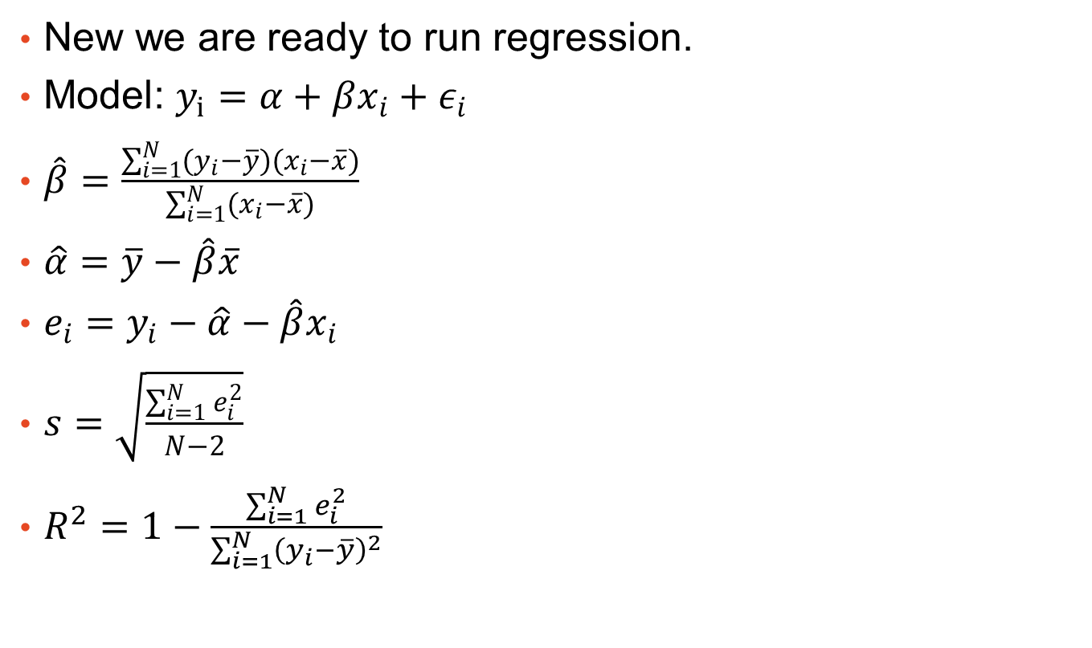
simple_reg()
New we are ready to run regression.
Model: $y_{i}=α+βx_{i}+ε_{i}$
$\hat{β}=\frac{\sum_{i=1}^{N}{(y_{i}−\overline{y})(x_{i}−\overline{x})}}{\sum_{i=1}^{N}{(x_{i}−\overline{x})}}$
$\hat{α}=\overline{y}−\hat{β}\overline{x}$
$e_{i}=y_{i}−\hat{α}−\hat{β}x_{i}$
$s=\sqrt{\frac{\sum_{i=1}^{N}{e_{i}^{2}}}{N−2}}$
$R^{2}=1−\frac{\sum_{i=1}^{N}{e_{i}^{2}}}{\sum_{i=1}^{N}{{\left(y_{i}−\overline{y}\right)}^{2}}}$
☼

Slide 44
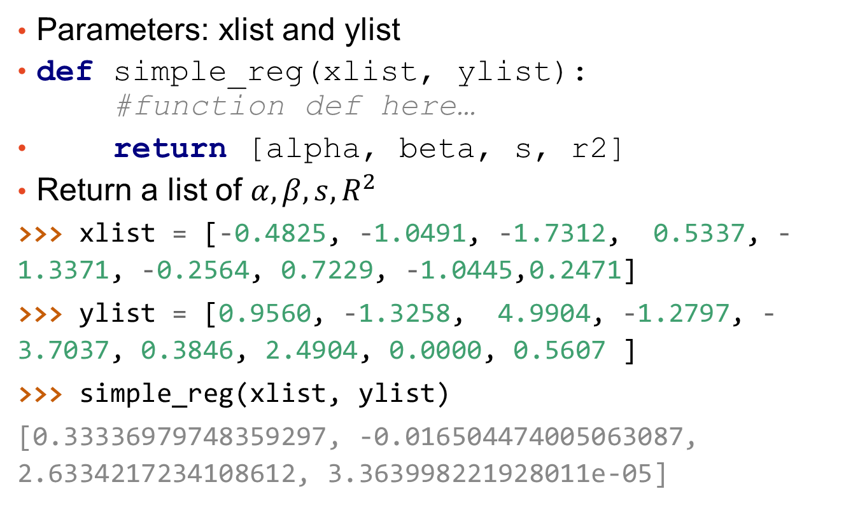
simple_reg()
Parameters: xlist and ylist
def simple_reg(xlist, ylist): #function def here…
return [alpha, beta, s, r2]
Return a list of $α, β, s, R^{2}$
>>> xlist = [-0.4825, -1.0491, -1.7312, 0.5337, -1.3371, -0.2564, 0.7229, -1.0445,0.2471]
>>> ylist = [0.9560, -1.3258, 4.9904, -1.2797, -3.7037, 0.3846, 2.4904, 0.0000, 0.5607 ]
>>> simple_reg(xlist, ylist)
[0.33336979748359297, -0.016504474005063087, 2.6334217234108612, 3.363998221928011e-05]
☼

Slide 45
Record Result For Each Stock
Before entering the for loop
coidlist = [] namelist = [] alphalist = [] betalist = [] slist = [] r2list = []
After running regression for each stock:
out1 = compute_model(sret, sdate, mktret) coidlist.append(last_coid) namelist.append(last_name) alphalist.append(out1[0]) betalist.append(out1[1]) slist.append(out1[2]) r2list.append(out1[3])
☼

Slide 46
Remember to Process the Last Stock
Still need to run regression for the last stock after finish looping.
Outside of the for loop:
#the last stock if(len(sret) > minlen): print("Run regression for COID:", last_coid) out1=compute_model(sret, sdate, mktret) coidlist.append(last_coid) namelist.append(last_name) alphalist.append(out1[0]) betalist.append(out1[1]) slist.append(out1[2]) r2list.append(out1[3])
☼

Slide 47
Putting Everything Together
Running the program:
Read 5345 market return data
Merging 1 splits
Run regression for COID: 1101
Run regression for COID: 1102
Run regression for COID: 1103
…
Run regression for COID: 9958
Run regression for COID: 9958
Average R2= 0.132214; nstock=906
☼

Slide 48
Plotting Result
Using matplotlib
import matplotlib.pyplot as plt from matplotlib.font_manager import FontProperties ChineseFont2 = FontProperties(fname = 'C:\\Windows\\Fonts\\mingliu.ttc') fig, ax = plt.subplots() ax.scatter(betalist, alphalist) for i, txt in enumerate(namelist): ax.annotate(txt, (betalist[i],alphalist[i]), fontproperties = ChineseFont2) plt.show()
☼

Slide 49
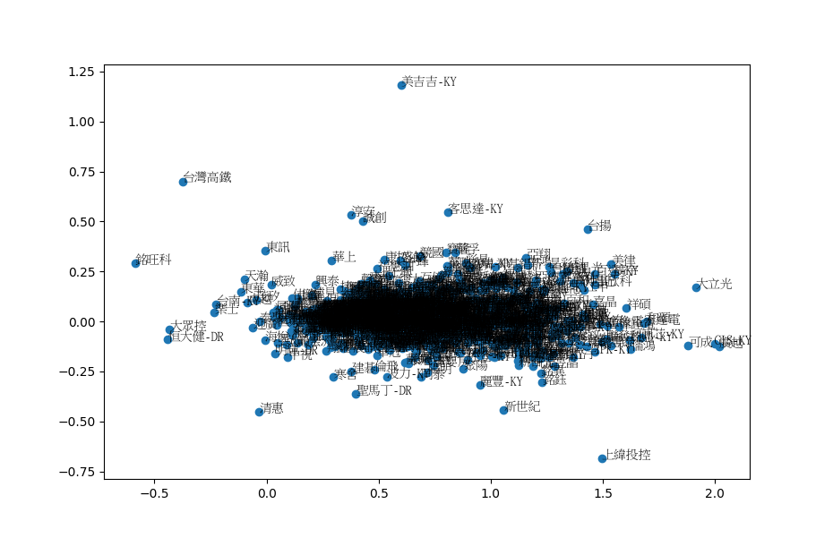
Plotting the Result (x: beta; y: alpha)
☼

Slide 50
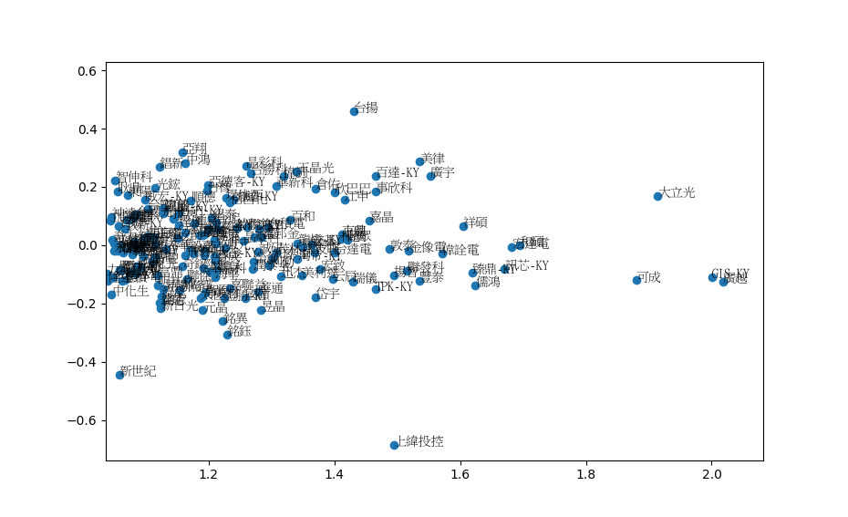
Plotting the Result (x: beta; y: alpha)
☼

Slide 51
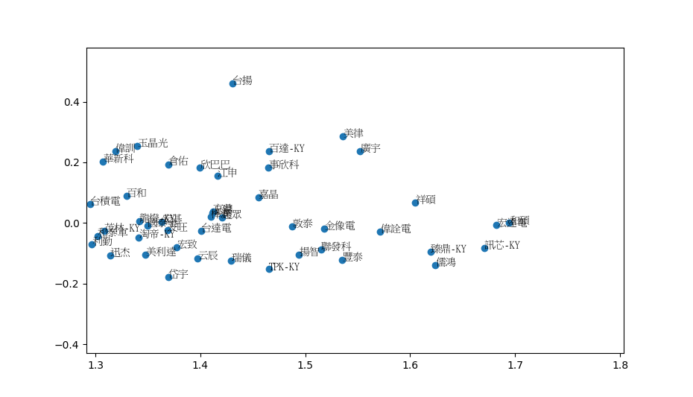
Plotting the Result (x: beta; y: alpha)
☼

Slide 52
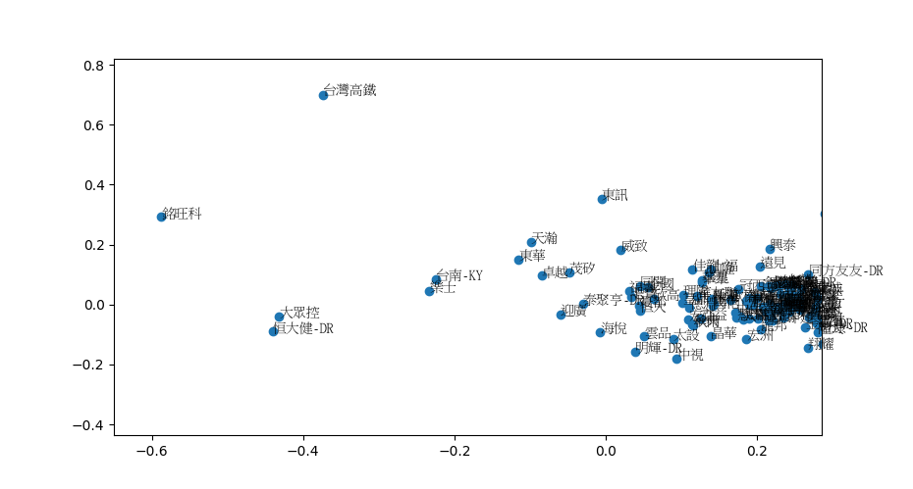
Plotting the Result (x: beta; y: alpha)
☼

Slide 53
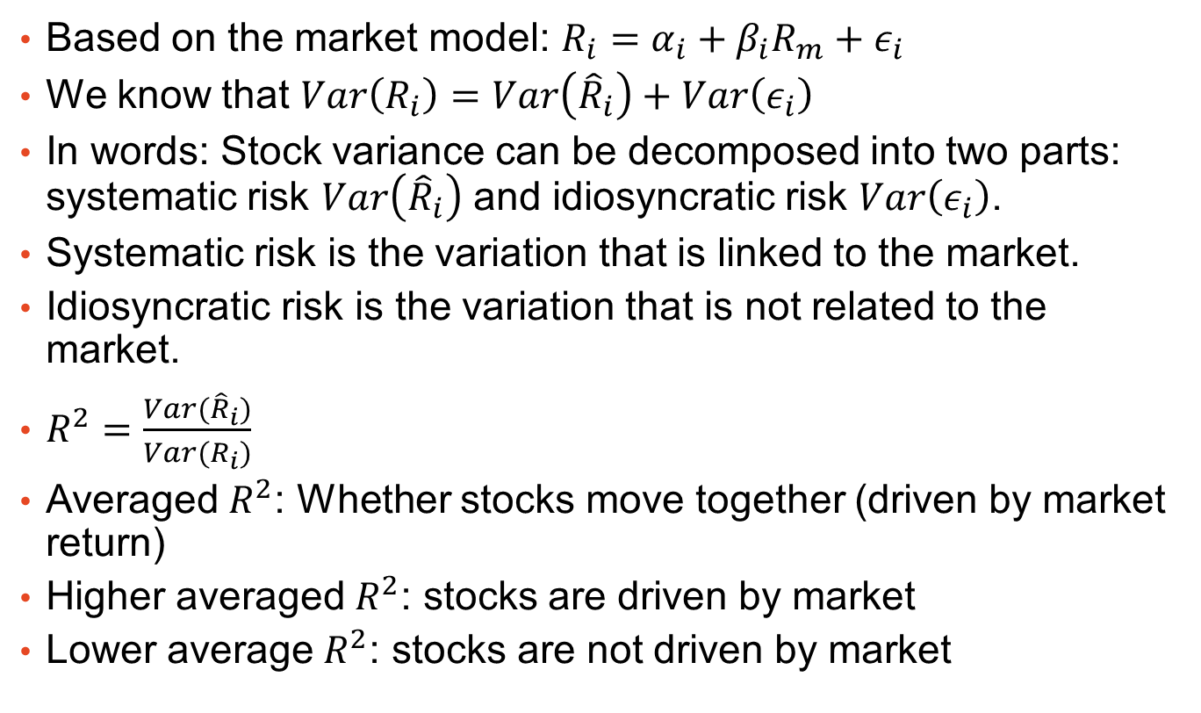
Variance Decomposition
Based on the market model: $R_{i}=α_{i}+β_{i}R_{m}+ε_{i}$
We know that $Var\left(R_{i}\right)=Var\left({\hat{R}}_{i}\right)+Var\left(ε_{i}\right)$
In words: Stock variance can be decomposed into two parts: systematic risk $Var\left({\hat{R}}_{i}\right)$ and idiosyncratic risk $Var\left(ε_{i}\right)$.
Systematic risk is the variation that is linked to the market.
Idiosyncratic risk is the variation that is not related to the market.
$R^{2}=\frac{Var({\hat{R}}_{i})}{Var(R_{i})}$
Averaged $R^{2}$: Whether stocks move together (driven by market return)
Higher averaged $R^{2}$: stocks are driven by market
Lower average $R^{2}$: stocks are not driven by market
☼

Slide 54

Run the Same Model For Different Years
Year 2000 to 2016.
Collect averaged $R^{2}$.
☼

Slide 55
Market Index Level vs. Averaged R2
A clear negative relationship
Stocks move together when market index is low.
☼

Slide 56
Final Words
We have demonstrate how to process real world datasets with simple python scripts.
Because of the pedagogical nature of this course, we have avoid “advanced” libraries and tools that may be more attractive in some situations.
You will need to explore the landscape before jumping into coding. ☼
☼

Slide 57
Thank You!
Questions?

Slide 58

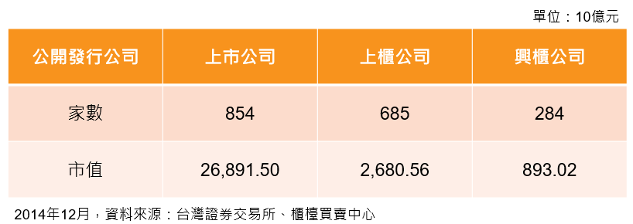
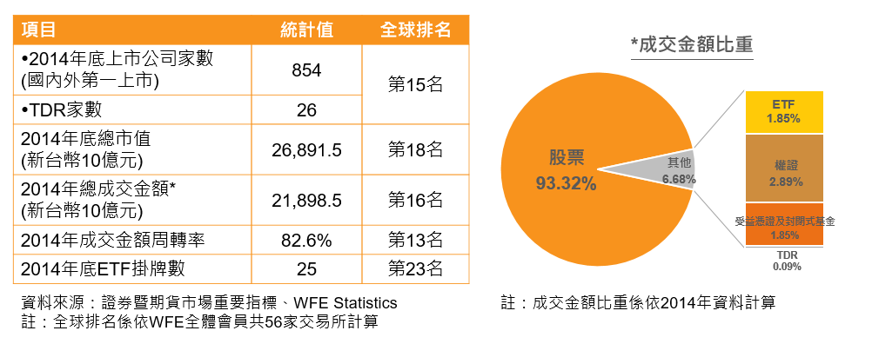
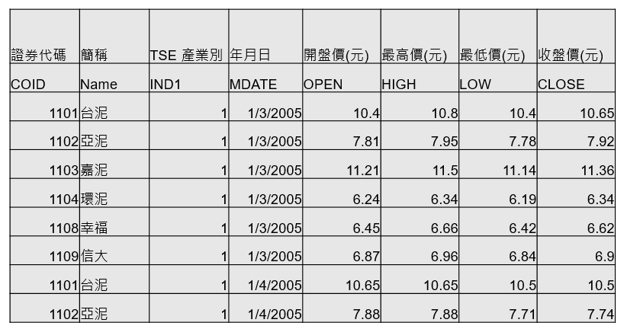

版權聲明
序 | 頁 | 作品 | 版權標章 | 作者 / 來源
1 | 5 |  |  | Taiwan Stock Exchange Corporation ,臺灣資本市場概況-歡迎外資來台投資, p4, 改作: 盧信銘 http://www.twse.com.tw/downloads/zh/investor/foreignInvest/TCMI_CH_1501.pdf 依據著作權法第46、52、65條合理使用 2017/8/30 visited
2 | 6 |  |  | Taiwan Stock Exchange Corporation ,臺灣資本市場概況-歡迎外資來台投資, p7, 改作: 盧信銘 http://www.twse.com.tw/downloads/zh/investor/foreignInvest/TCMI_CH_1501.pdf 2017/8/30 visited
3 | 7 |  |  | 台灣經濟新報, 台灣經濟新報資料庫系統 操作:盧信銘 http://www.tej.com.tw/twsite/Default.aspx?TabId=396 依據著作權法第46、52、65條合理使用 2017/8/30 visited
4 | 13 |  |  | 台灣經濟新報, 台灣經濟新報資料庫系統 操作:盧信銘 http://www.tej.com.tw/twsite/Default.aspx?TabId=396 依據著作權法第46、52、65條合理使用 2017/8/30 visited
5 | 13 |  |  | 台灣經濟新報, 台灣經濟新報資料庫系統,操作:盧信銘 http://www.tej.com.tw/twsite/Default.aspx?TabId=396 依據著作權法第46、52、65條合理使用 2017/8/30 visited
6 | 14 |  |  | 台灣大學 盧信銘, CC BY-NC-ND 3.0

Slide 59




版權聲明
序 | 頁 | 作品 | 版權標章 | 作者 / 來源
6 | 19 |  |  | Flicker, photographyplayers, IMAG3003(4x4) https://goo.gl/xVwppL 2017/8/24 visited
7 | 21 |  |  | 擷取自Microsoft Windows 10 使用者介面 © Microsoft 2017 https://www.microsoft.com/zh-tw 依據著作權法第46、52、65條合理使用 2017/8/30 visited
8 | 29 33 |  |  | 台灣大學 盧信銘, CC BY-NC-ND 3.0
9 | 30 |  |  | 台灣大學 盧信銘, CC BY-NC-ND 3.0
10 | 34 |  |  | 台灣大學 盧信銘, CC BY-NC-ND 3.0
11 | 35 |  |  | 台灣大學 盧信銘, CC BY-NC-ND 3.0

Slide 60

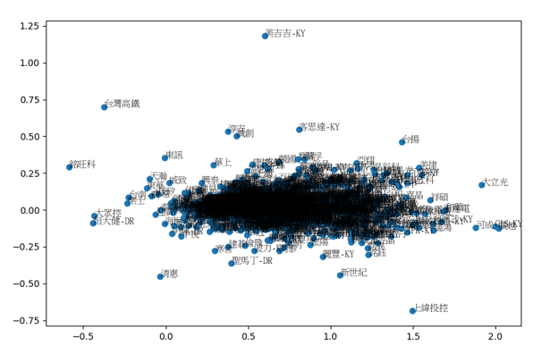
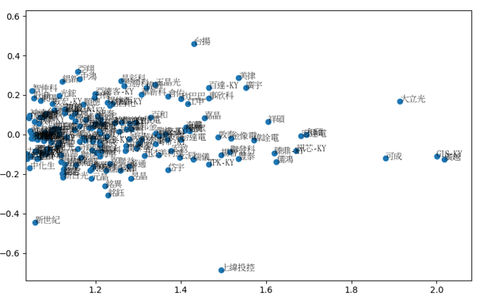
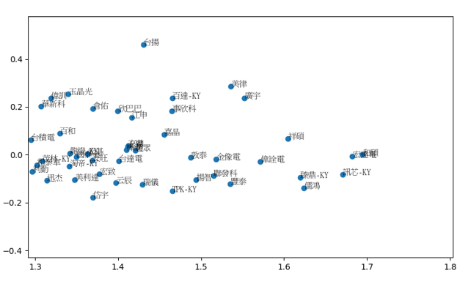
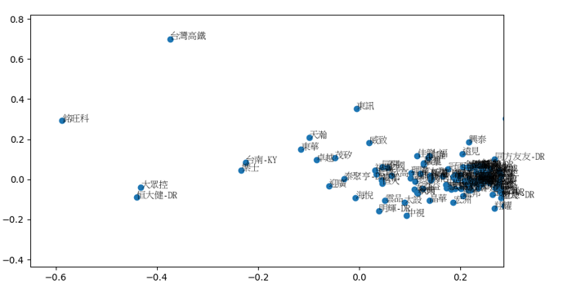
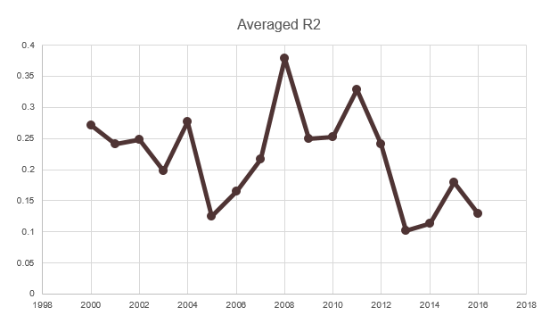
版權聲明
序 | 頁 | 作品 | 版權標章 | 作者 / 來源
12 | 37 |  |  | 台灣大學 盧信銘, CC BY-NC-ND 3.0
13 | 49 |  |  | 台灣大學 盧信銘, CC BY-NC-ND 3.0
14 | 50 |  |  | 台灣大學 盧信銘, CC BY-NC-ND 3.0
15 | 51 |  |  | 台灣大學 盧信銘, CC BY-NC-ND 3.0
16 | 52 |  |  | 台灣大學 盧信銘, CC BY-NC-ND 3.0
17 | 54 |  |  | 台灣大學 盧信銘, CC BY-NC-ND 3.0

Slide 61
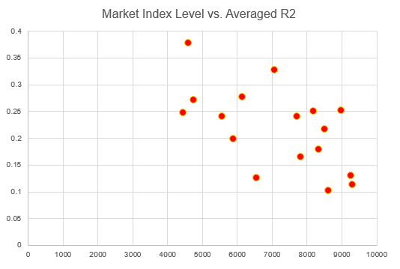

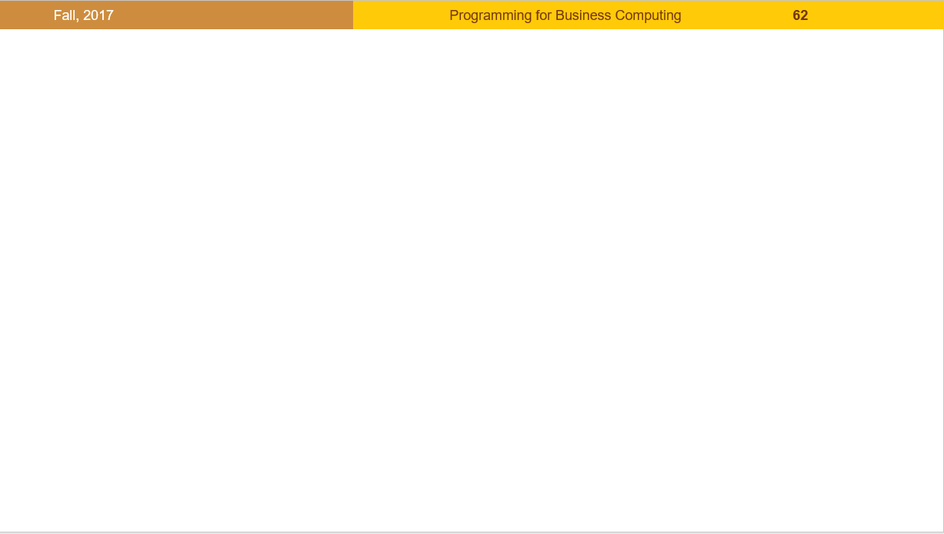
版權聲明
序 | 頁 | 作品 | 版權標章 | 作者 / 來源
17 | 55 |  |  | 台灣大學 盧信銘, CC BY-NC-ND 3.0
18 | 1-61 |  |  | 台灣大學 盧信銘, CC BY-NC-ND 3.0

