Slide 1

Programming for Business Computing Classes and Plotting
Basics of classes
Advances of classes
Plotting with matplotlib.pyplot
Ling-Chieh Kung
Department of Information Management
National Taiwan University
【本著作除另有註明外，採取創用CC「姓名標示－非商業性－禁止改作分享」台灣3.0版授權釋出】

Slide 2


Outline
Basics of classes
Advances of classes
Plotting with matplotlib.pyplot
Basics of classes
Advances of classes
Plotting with matplotlib.pyplot

Slide 3
Motivating example: dates
Basics of classes
Advances of classes
Plotting with matplotlib.pyplot
In many applications we deal with dates.
Suppose that we do not know the datetime library.
A date is consist of three attributes.
Year: an integer from 1 to 3000.
Month: an integer from 1 to 12.
Day: an integer from 1 to 31 (depending on month).
If we want to store the birthdays of a group of students, what should we do?

Slide 4
Birthday dictionary
Basics of classes
Advances of classes
Plotting with matplotlib.pyplot
How to prevent a date like 2016/14/20 or 2015/09/31?
Be aware of leap years!
bdDict = dict()
while True:
name = input("name: ")
if(name == ""):
break
birthday = input("birthday (yyyy/mm/dd): ")
if(birthday == ""):
break
bdDict[name] = birthday
print(bdDict)

Slide 5
Is it a leap year?
Basics of classes
Advances of classes
Plotting with matplotlib.pyplot
A year is a leap year if:
It is a multiple of 4 and not a multiple of 100.
It is a multiple of 400.
def isLeap(year):
if(year % 400 == 0):
return True
elif((year % 4 == 0) and (year % 100 != 0)):
return True
else:
return False

Slide 6
Is it a good date?
Basics of classes
Advances of classes
Plotting with matplotlib.pyplot
def isGoodDate(birthday): # birthday is a yyyy/mm/dd string
year, month, day = birthday.split("/")
year = int(year)
month = int(month)
day = int(day)
if((1 <= year <= 3000) and (1 <= month <= 12)):
daysInMonth = [31, 28, 31, 30, 31, 30, 31, 31, 30, 31, 30, 31]
if(isLeap(year) == True):
daysInMonth[1] = 29
if(1 <= day <= daysInMonth[month - 1]):
return True
return False

Slide 7
Fail-safe birthday dictionary
Basics of classes
Advances of classes
Plotting with matplotlib.pyplot
bdDict = dict()
while True:
name = input("name: ")
if(name == ""):
break
birthday = input("birthday (yyyy/mm/dd): ")
if(isGoodDate(birthday) == True):
bdDict[name] = birthday
else:
print("bad date!")
if(birthday == ""):
break
print(bdDict)

Slide 8
What if…
Basics of classes
Advances of classes
Plotting with matplotlib.pyplot
This is good, but what if we want to know:
The number of people born in a given year?
The names of people born in a given month?
It would be better (in many cases) if we store three integers instead of a string.
Especially when the above operations must be done frequently.
Option 1: Three dictionaries whose keys are names and values are years, months, and days, respectively.
It is hard to use and easy to be inconsistent.
Option 2: One dictionary whose key is name and value is a three-dimensional list (or tuple or dictionary).
It is non-intuitive and/or inefficient.
Is there a more intuitive way?

Slide 9
Self-defined data types: class
Basics of classes
Advances of classes
Plotting with matplotlib.pyplot
It is all about data types.
We have basic data types like character, integer, float, Boolean, etc.
We have composite date types like string, list, tuple, dictionary, etc.
May we define a new data type to store dates?
In Python, we define our own data type by defining a class.
In a class, we define attributes called instance variables.
An attribute is also called a member of a class.
A class can then be used to declare objects (variables whose type is a class).

Slide 10
Defining a class and declaring an object
Basics of classes
Advances of classes
Plotting with matplotlib.pyplot
To define a class, we use the keyword class:
Inside the class definition block, we declare instance variables one by one.
Then we may use the class to declare objects:
We use the dot operator to access a member:
class Date:
year = 1
month = 1
day = 1
d = Date()
print(d.month)
print(d.day)
print(d) # what is this?

Slide 11
Modifying an object
Basics of classes
Advances of classes
Plotting with matplotlib.pyplot
We may modify an object by modifying any of its member.
In fact, we may “declare a member” outside the class definition block:
Do not do this!
Unless you really know what you are doing.
d = Date()
d.month = 12
d.day = 31
print(d.month, d.day)
d = Date()
d.month = 12
d.weekday = "Mon"
print(d.month, d.weekday)

Slide 12
Why classes and objects?
Basics of classes
Advances of classes
Plotting with matplotlib.pyplot
The most obvious reason of using classes and objects is to group multiple variables into one variable.
Each variable has its variable name.
Recall our birthday dictionary example and our hope to store three integers.
Option 1: Three dictionaries whose keys are names and values are years, months, and days, respectively.
Option 2: One dictionary whose key is name and value is a three-dimensional list (or tuple or dictionary).
Option 3: One dictionary whose key is name (a string) and value is birthday (a Date).
Let’s revise our program with the class Date.

Slide 13
Revising the birthday dictionary (1/4)
Basics of classes
Advances of classes
Plotting with matplotlib.pyplot
class Date: # the basic setting
year = 1
month = 1
day = 1
def isLeap(year): # not changed
if(year % 400 == 0):
return True
elif((year % 4 == 0) and (year % 100 != 0)):
return True
else:
return False

Slide 14
Revising the birthday dictionary (2/4)
Basics of classes
Advances of classes
Plotting with matplotlib.pyplot
def isGoodDate(bDay): # bDay is a Date object
if((1 <= bDay.year <= 3000) and (1 <= bDay.month <= 12)):
daysInMonth = [31, 28, 31, 30, 31, 30, 31, 31, 30, 31, 30, 31]
if(isLeap(bDay.year) == True):
daysInMonth[1] = 29
if(1 <= bDay.day <= daysInMonth[bDay.month - 1]):
return True
return False
def strToDate(birthday): # birthday is a yyyy/mm/dd string
d = Date()
year, month, day = birthday.split("/")
d.year = int(year)
d.month = int(month)
d.day = int(day)
return d

Slide 15
Revising the birthday dictionary (3/4)
Basics of classes
Advances of classes
Plotting with matplotlib.pyplot
bdDict = dict()
while True:
name = input("name: ")
if(name == ""):
break
birthday = input("birthday (yyyy/mm/dd): ") # birthday is a string
birthday = strToDate(birthday) # now birthday is a Date
if(isGoodDate(birthday) == True):
bdDict[name] = birthday # now the value of a dictionary entry is a Date
else:
print("bad date!")
if(birthday == ""):
break
print(bdDict) # what will be printed out?

Slide 16
Revising the birthday dictionary (4/4)
Basics of classes
Advances of classes
Plotting with matplotlib.pyplot
def printBdayDict(bdDict):
for p in bdDict.keys():
b = bdDict[p] # b is a Date
print(p + " was born on " + str(b.year) + "/" + str(b.month) + "/" + str(b.day))
bdDict = dict()
while True:
// omitted; see previous page
printBdayDict(bdDict)

Slide 17
Summary
Basics of classes
Advances of classes
Plotting with matplotlib.pyplot
In short:
An object is a collection of variables (sometimes objects).
Moreover, these variables have names.
More benefits are to be introduced.

Slide 18
Outline
Basics of classes
Advances of classes
Plotting with matplotlib.pyplot
Basics of classes
Advances of classes
Plotting with matplotlib.pyplot

Slide 19
Motivating example
Basics of classes
Advances of classes
Plotting with matplotlib.pyplot
“ubike.csv” contains the YouBike information for the 30 stations in Da-An district from 2015/9/7 to 2015/10/8.
The numbers of available bikes and empty slots of all stations are collected once per hour.
The latitudes and longitudes of all stations are collected.
And more.
We may write programs to do a lot of analyses.
Let’s see how to use classes to modularize our program.
This is a demonstration of an important programming design philosophy: object-oriented programming (OOP).

Slide 20
The class Station
Basics of classes
Advances of classes
Plotting with matplotlib.pyplot
In our program, there are many stations.
Each station has its name, number of total spaces, latitude, and longitude.
The current status of a station is represented by the number of available bikes (assumed to be the number of total spaces minus empty spaces).
Each station may be considered as an object.
Let’s define a class Station with five attributes:
class Station:
name = 0
space = 0
latitude = 0
longitude = 0
available = 0

Slide 21
Member functions
Basics of classes
Advances of classes
Plotting with matplotlib.pyplot
A station has its attributes represented by its member variables.
A station also has some operations that may be applied on it.
We may “replenish” it by adding bikes to (or removing bikes from) it.
We may calculate its distance to another station.
We may send some bikes from it to another station.
Beside member variables (attributes), we may also define member functions (operations) for a class.
Before we define them, let’s see how to use them (if they have been defined).

Slide 22
Invoking member functions
Basics of classes
Advances of classes
Plotting with matplotlib.pyplot
To invoke a member function, we also use the dot operatior.
When we invoke an object’s member function, we call the object the invoking object and the function the invoked member function.
gg = Station()
gg.name = "Gong-Guan Exit 2"
gg.space = 30
gg.latitude = 25.01476
gg.longitude = 121.534538
gg.available = 0
gg.printStatus() # print the status
print(gg.status()) # return the status
gg.replenish(20) # add 20 bikes
print(gg) # what's this?

Slide 23
Member function: printStatus()
Basics of classes
Advances of classes
Plotting with matplotlib.pyplot
Let’s start by defining a function printing a station’s information.
We define a function printStatus() inside the class Station.
A member function’s first parameter is always the invoking object itself.
Through this parameter, we access the invoking object’s member variables and member functions.
It does not need to be named as “self.”
class Station:
name = 0
space = 0
latitude = 0
longitude = 0
available = 0
def printStatus(self):
print(self.name + ": " + str(self.available) + "/" + str(self.space))

Slide 24
Member function: printStatus()
Basics of classes
Advances of classes
Plotting with matplotlib.pyplot
class Station:
name = 0
space = 0
latitude = 0
longitude = 0
available = 0
def printStatus(self):
print(self.name + ": " + str(self.available) + "/" + str(self.space))
gg = Station()
gg.name = "Gong-Guan Exit 2"
gg.space = 30
gg.latitude = 25.01476
gg.longitude = 121.534538
gg.printStatus() # Gong-Guan Exit 2: 0/30

Slide 25
Invoking a member function
Basics of classes
Advances of classes
Plotting with matplotlib.pyplot
Pay attention to the way of invoking a member function!
If we execute printStatus(gg):
“NameError: name 'printStatus' is not defined”
The function is a member function (which belongs to a class), not a global function (which belongs to everyone).
If we execute gg.printStatus(gg):
“TypeError: printStatus() takes exactly 1 argument (2 given)”
The invoking object is considered as the first argument (even if there is nothing inside the pair of parentheses).
gg.printStatus() # good
printStatus(gg) # syntax error
gg.printStatus(gg) # syntax error

Slide 26
Member function: replenish()
Basics of classes
Advances of classes
Plotting with matplotlib.pyplot
Let’s replenish (positively or negatively) a station.
An input argument specifies the number of bikes intended to be “added” to the station (may be negative).
The number of available bikes and spaces should be checked.
class Station:
// (member variables omitted)
def replenish(self, num):
if self.available + num <= self.space and self.available + num >= 0:
self.available += num
elif self.available + num > self.space:
self.available = self.space
else:
self.available = 0

Slide 27
Member function: replenish()
Basics of classes
Advances of classes
Plotting with matplotlib.pyplot
Our programs will get bigger and more complicated.
To remind us about our program, we write comments.
We write comments especially for functions.
To indicate the meanings of parameters.
To indicate the pre-condition and post-condition: What happens before and after the function is invoked.
// pre-condition: num is the number of biked intended to be added to the station
// num > 0 means adding; num < 0 means removing
// post condition: the station's available number of bikes becomes
// min(available + num, space) if num > 0 or
// max(available + num, 0) if num < 0
def replenish(self, num):
// (definition omitted)

Slide 28
Member function: replenish()
Basics of classes
Advances of classes
Plotting with matplotlib.pyplot
gg = Station()
gg.name = "Gong-Guan Exit 2"
gg.space = 30
gg.latitude = 25.01476
gg.longitude = 121.534538
gg.printStatus() # Gong-Guan Exit 2: 0/30
gg.replenish(20)
gg.printStatus() # Gong-Guan Exit 2: 20/30
gg.replenish(13)
gg.printStatus() # Gong-Guan Exit 2: 30/30
gg.replenish(-50)
gg.printStatus() # Gong-Guan Exit 2: 0/30

Slide 29
Member function: distance()
Basics of classes
Advances of classes
Plotting with matplotlib.pyplot
We may calculate a station’s distance to another station.
import math
def haversine(lat1, lon1, lat2, lon2):
lon1, lat1, lon2, lat2 = map(math.radians, [lon1, lat1, lon2, lat2])
dlon = lon2 - lon1
dlat = lat2 - lat1
a = math.sin(dlat / 2) ** 2
a += math.cos(lat1) * math.cos(lat2) * math.sin(dlon / 2) ** 2
return 6367 * (2 * math.asin(math.sqrt(a)))
class Station:
// (member variables omitted)
def distance(self, s):
return haversine(self.latitude, self.longitude, s.latitude, s.longitude)

Slide 30
Member function: sendBike()
Basics of classes
Advances of classes
Plotting with matplotlib.pyplot
We may send some bikes to another station.
Note that we may invoke another member function in a member function!
class Station:
// (member variables omitted)
// pre-condition: self is the invoking station, s is another station,
// num is the number of bikes intended to be sent from self to s
// num > 0 means from self to s; num < 0 means from s to self
// post-condition: self's number of available bikes will be deducted by
// num according to the rule specified in replenish(); that of s will
// be added by num according to the same rule
def sendBike(self, s, num):
self.replenish(-num)
s.replenish(num)

Slide 31
Member function: sendBike()
Basics of classes
Advances of classes
Plotting with matplotlib.pyplot
gg = Station()
gg.name = "Gong-Guan Exit 2"
gg.space = 30
gg.latitude = 25.01476
gg.longitude = 121.534538
ntust = Station()
ntust.name = "NTUST"
ntust.space = 46
ntust.latitude = 25.0131
ntust.longitude = 121.539723
print(gg.distance(ntust))
print(ntust.distance(gg))
gg.replenish(20) # 20
gg.printStatus()
gg.replenish(13) # 30
gg.printStatus()
gg.sendBike(ntust, 18)
gg.printStatus() # 12
ntust.printStatus() # 18

Slide 32
Member function: status()
Basics of classes
Advances of classes
Plotting with matplotlib.pyplot
Let’s define a function that returns a string of current status.
Why bother?
status() can be a building block of other tasks.
It better modularizes the program.
class Station:
name = 0
space = 0
latitude = 0
longitude = 0
available = 0
def status(self):
return self.name + ": " + str(self.available) + "/" + str(self.space)
print(ntust.status())

Slide 33
Member function: init()
Basics of classes
Advances of classes
Plotting with matplotlib.pyplot
In many cases, we want to avoid tedious and lengthy member variable initialization statements.
Let’s write a member function that initializes member variables based on input arguments.
gg = Station()
gg.name = "Gong-Guan Exit 2"
gg.space = 30
gg.latitude = 25.01476
gg.longitude = 121.534538
ntust = Station()
ntust.name = "NTUST"
ntust.space = 46
ntust.latitude = 25.0131
ntust.longitude = 121.539723

Slide 34
Member function: init()
Basics of classes
Advances of classes
Plotting with matplotlib.pyplot
Implementation:
Note how to distinguish a member variable and a parameter!
class Station:
// (member variables omitted)
def init(self, name, space, latitude, longitude):
self.name = name
self.space = space
self.available = 0
self.latitude = latitude
self.longitude = longitude
gg = Station() gg.init("Gong-Guan Exit 2", 30, 25.01476, 121.534538)
gg.replenish(20)
gg.printStatus() # Gong-Guan Exit 2: 20/30

Slide 35
Constructor: __init__()
Basics of classes
Advances of classes
Plotting with matplotlib.pyplot
Even though we have defined init(), we cannot force one (ourselves) to invoke it.
We may play with uninitialized objects.
To resolve this issue, Python (and many other languages) allows us to define a constructor for a class.
It is a member function called __init__().
It is automatically invoked when an object is created.
The correct number of arguments must be prepared when creating an object.

Slide 36
Constructor: __init__()
Basics of classes
Advances of classes
Plotting with matplotlib.pyplot
Implementation:
class Station:
// (member variables omitted)
def __init__(self, name, space, latitude, longitude):
self.name = name
self.space = space
self.available = 0
self.latitude = latitude
self.longitude = longitude
gg = Station("Gong-Guan Exit 2", 30, 25.01476, 121.534538)
gg.replenish(20)
gg.printStatus() # Gong-Guan Exit 2: 20/30
ntust = Station() # syntax error

Slide 37
Printing out an object directly
Basics of classes
Advances of classes
Plotting with matplotlib.pyplot
Recall the function status(), which returns a string of the current status.
We may print out the returned string.
However, we cannot print out the object directly.
class Station:
// (member variables omitted)
def status(self):
return self.name + ": " + str(self.available) + "/" + str(self.space)
gg = Station("Gong-Guan Exit 2", 30, 25.01476, 121.534538)
print(gg.status()) # Gong-Guan Exit 2: 0/30
print(gg) # what is this?

Slide 38
A special function: __str__()
Basics of classes
Advances of classes
Plotting with matplotlib.pyplot
Let’s change the name of status() to __str__() to see the magic:
When we print out an object:
If a function named __str__() is defined, its returned value is printed out.
Otherwise, the memory information is printed out.
class Station:
// (member variables omitted)
def __str__(self):
return self.name + ": " + str(self.available) + "/" + str(self.space)
gg = Station("Gong-Guan Exit 2", 30, 25.01476, 121.534538)
print(gg) # Gong-Guan Exit 2: 0/30

Slide 39
Outline
Basics of classes
Advances of classes
Plotting with matplotlib.pyplot
Basics of classes
Advances of classes
Plotting with matplotlib.pyplot

Slide 40
Making plots with matplotlib
Basics of classes
Advances of classes
Plotting with matplotlib.pyplot
In many cases, we want to make plots.
Information visualization.
We will introduce how to use matplotlib, an open-source Python library, to make basic statistical plots.
Histograms, line charts, bar charts, pie charts, and scatter plots.
http://matplotlib.org/index.html
First, we need to install matplotlib.
http://matplotlib.org/users/installing.html
Open your console/terminal/cmd, and execute:
Do not forget to set the PATH variable or go to your Python script directory.
pip install -U pip setuptools pip install matplotlib

Slide 41
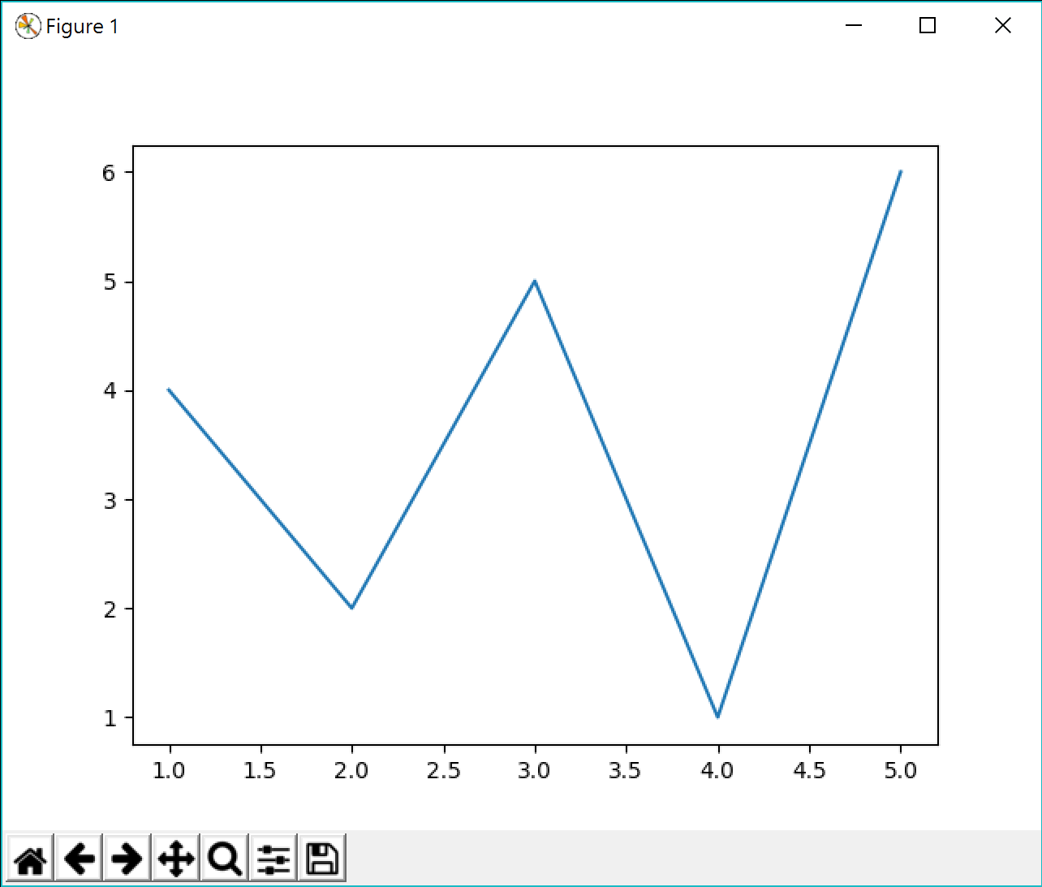

Testing matplotlib
Basics of classes
Advances of classes
Plotting with matplotlib.pyplot
import matplotlib.pyplot as py
x = range(1, 6)
y = [4, 2, 5, 1, 6]
py.plot(x, y)
py.show()
Copyright (c) 2012-2013 Matplotlib Development Team; All Rights Reserved

Slide 42
Data source
Basics of classes
Advances of classes
Plotting with matplotlib.pyplot
To introduce the plotting tools in matplotlib, let’s consider the data set contained in “midterm2.csv”.
Student IDs are replaced by unique labels.
SubmissionID,StudentID,Problem,Status,Score,CodeLength,SubmissionTime
43629,7,4,Runtime Error,0,879,12:20:52
43628,31,3,Runtime Error,0,521,12:20:38
43627,106,2,Wrong Answer,0,10,12:20:27
43626,101,4,Wrong Answer,0,2330,12:20:27
43625,56,2,Wrong Answer,30,616,12:20:22
43624,13,2,Wrong Answer,0,1261,12:20:15
43623,84,2,Runtime Error,0,402,12:20:12
43622,78,2,Runtime Error,0,481,12:20:11
43621,31,3,Wrong Answer,0,521,12:20:11
43620,58,3,Wrong Answer,0,704,12:20:09
43619,46,2,Compile Error,0,1789,12:20:06

Slide 43
Submission times
Basics of classes
Advances of classes
Plotting with matplotlib.pyplot
We are interested in the students’ submission times.
Is it true that students (altogether) make more submits when it is closer to the end of the exam?
To answer this question, we may:
First, find the submission times, which is defined as the number of seconds since the exam starts (at 9:20:00) of a submission.
Second, draw a histogram for them: Number of submissions in [0, 1000), [1000, 2000), …, and [10000, 11000).

Slide 44
Data processing
Basics of classes
Advances of classes
Plotting with matplotlib.pyplot
First, we find the submission times:
import csv, datetime
def findSubTimes(fileName):
fh = open(fileName, "r")
csvFile = csv.DictReader(fh)
next(csvFile)
subTimes = [] # to store submission times
for row in csvFile:
dt = datetime.datetime.strptime(row["SubmissionTime"], "%H:%M:%S").time()
sub = (dt.hour - 9) * 3600 + (dt.minute - 20) * 60 + dt.second
subTimes.append(sub)
fh.close()
return subTimes
print(findSubTimes("midterm2.csv")) # just testing

Slide 45
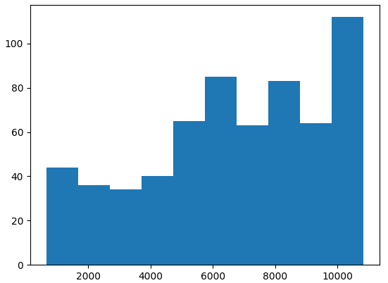
Making a histogram
Basics of classes
Advances of classes
Plotting with matplotlib.pyplot
Second, we make a histogram:
import matplotlib.pyplot as py
subTimes = findSubTimes("midterm2.csv")
py.hist(subTimes)
py.show()
Copyright (c) 2012-2013 Matplotlib Development Team; All Rights Reserved

Slide 46
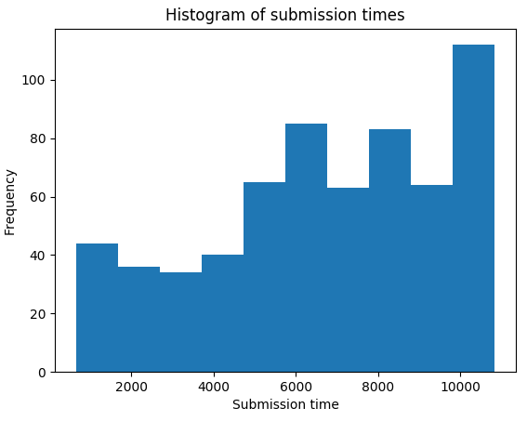
Decorating a histogram
Basics of classes
Advances of classes
Plotting with matplotlib.pyplot
A plot should have x-label, y-label, and title (caption).
import matplotlib.pyplot as py
subTimes = findSubTimes("midterm2.csv")
py.hist(subTimes)
py.xlabel('Submission time')
py.ylabel('Frequency')
py.title('Histogram of submission times')
py.show()
Copyright (c) 2012-2013 Matplotlib Development Team; All Rights Reserved

Slide 47
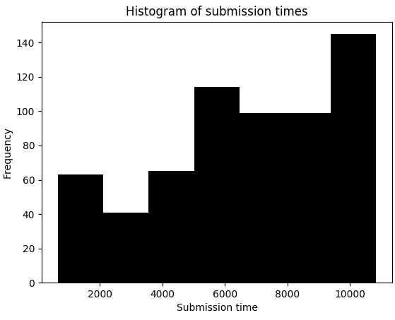
Setting up a histogram
Basics of classes
Advances of classes
Plotting with matplotlib.pyplot
We may want to change bar colors and choose the number of classes.
import matplotlib.pyplot as py
subTimes = findSubTimes("midterm2.csv")
py.hist(subTimes, bins = 7, facecolor = "black")
py.xlabel('Submission time')
py.ylabel('Frequency')
py.title('Histogram of submission times')
py.show()
Copyright (c) 2012-2013 Matplotlib Development Team; All Rights Reserved

Slide 48
Setting up a histogram
Basics of classes
Advances of classes
Plotting with matplotlib.pyplot
We may specify all classes by ourselves.
import matplotlib.pyplot as py
subTimes = findSubTimes("midterm2.csv")
py.hist(subTimes, bins = range(0, 12000, 1000), facecolor = "gray")
py.ylim(0, 120)
py.xlim(0, 11000)
py.xlabel('Submission time')
py.ylabel('Frequency')
py.title('Histogram of submission times')
py.show()

Slide 49
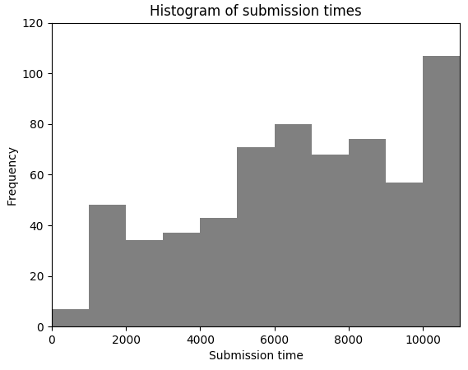
Setting up a histogram
Basics of classes
Advances of classes
Plotting with matplotlib.pyplot
Copyright (c) 2012-2013 Matplotlib Development Team; All Rights Reserved

Slide 50
Setting up a histogram
Basics of classes
Advances of classes
Plotting with matplotlib.pyplot
We may want to obtain the frequencies (and/or class endpoints).
import matplotlib.pyplot as py
subTimes = findSubTimes("midterm2.csv")
n, bins, patches = py.hist(subTimes, bins = range(0, 12000, 1000))
print(n) # the frequencies
print(bins) # the class endpoints

Slide 51
Inter-submission times
Basics of classes
Advances of classes
Plotting with matplotlib.pyplot
We are interested in knowing the distribution of inter-submission times.
It is exponentially distributed?
Copyright (c) 2012-2013 Matplotlib Development Team; All Rights Reserved

Slide 52
Data processing
Basics of classes
Advances of classes
Plotting with matplotlib.pyplot
import csv, datetime
def findInterSubTimes(filePath):
fh = open(filePath, "r")
csvFile = csv.DictReader(fh)
next(csvFile)
interSubTimes = []
preTime = 0
for row in csvFile:
dt = datetime.datetime.strptime(row["SubmissionTime"], "%H:%M:%S").time()
sub = (dt.hour - 9) * 3600 + (dt.minute - 20) * 60 + dt.second
if preTime > 0:
interSubTimes.append(preTime - sub)
preTime = sub
fh.close()
return interSubTimes

Slide 53
Making a histogram
Basics of classes
Advances of classes
Plotting with matplotlib.pyplot
import matplotlib.pyplot as py
interSubTimes = findInterSubTimes("midterm2.csv")
py.hist(interSubTimes, bins = range(0, 110, 10), facecolor = "gray")
py.xlim(0, 110)
py.ylim(0, 100)
py.xlabel('Inter-submission time')
py.ylabel('Frequency')
py.title('Histogram of inter-submission times')
py.show()

Slide 54
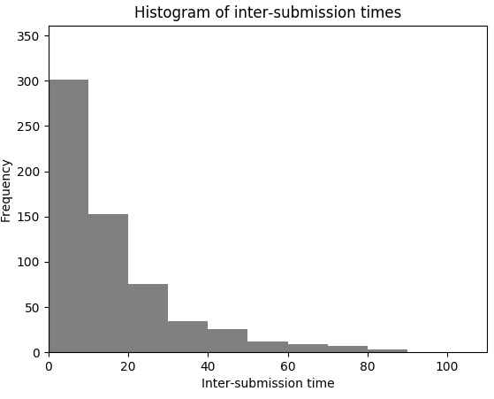
Making a histogram
Basics of classes
Advances of classes
Plotting with matplotlib.pyplot
Copyright (c) 2012-2013 Matplotlib Development Team; All Rights Reserved

Slide 55
Each student’s number of submissions
Basics of classes
Advances of classes
Plotting with matplotlib.pyplot
Students may have different number of submissions.
Beside using a histogram to visualize the distribution of the number of submissions, we may also use a bar chart to visualize all these numbers.

Slide 56
Making a bar chart
Basics of classes
Advances of classes
Plotting with matplotlib.pyplot
import csv, datetime
def findSubFreq(filePath):
fh = open(filePath, "r")
csvFile = csv.DictReader(fh)
next(csvFile)
subFreqDict = dict()
for row in csvFile:
sid = int(row["StudentID"])
if sid in subFreqDict:
subFreqDict[sid] += 1
else:
subFreqDict[sid] = 1
fh.close()
return subFreqDict
import matplotlib.pyplot as py
subFreq = findSubFreq("midterm2.csv")
ind = range(0, len(subFreq))
width = 0.35
py.bar(ind, subFreq.values(), width)
py.show()

Slide 57
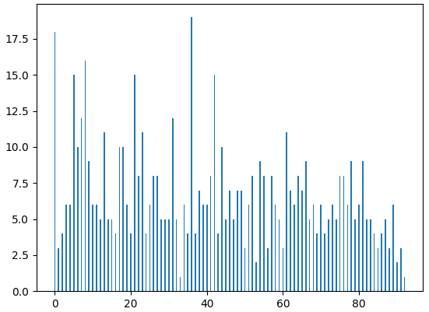
Making a bar chart
Basics of classes
Advances of classes
Plotting with matplotlib.pyplot
Copyright (c) 2012-2013 Matplotlib Development Team; All Rights Reserved

Slide 58
Making a pie chart
Basics of classes
Advances of classes
Plotting with matplotlib.pyplot
When one submits, the result may be “Accepted”, “Wrong Answer”, “Runtime Error”, “Compile Error”, and “Time Limit Exceed”.
We may use a pie chart to visualize their proportions.

Slide 59
Making a pie chart
Basics of classes
Advances of classes
Plotting with matplotlib.pyplot
import csv, datetime
def findProp(filePath):
fh = open(filePath, "r")
csvFile = csv.DictReader(fh)
next(csvFile)
propDict = dict()
for row in csvFile:
result = row["Status"]
if result in propDict:
propDict[result] += 1
else:
propDict[result] = 1
fh.close()
return propDict
import matplotlib.pyplot as py
pf = findProp("midterm2.csv")
f = list(pf.values())
r = list(pf.keys())
py.pie(f, labels = r, autopct = "%1.1f%%")
py.show()

Slide 60
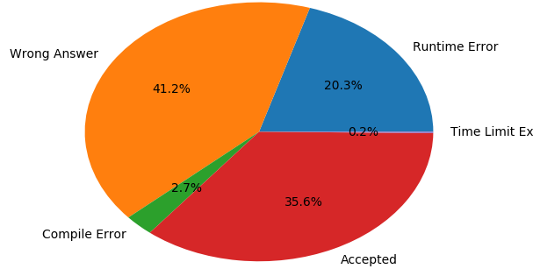
Making a pie chart
Basics of classes
Advances of classes
Plotting with matplotlib.pyplot
Copyright (c) 2012-2013 Matplotlib Development Team; All Rights Reserved

Slide 61
Road to AC
Basics of classes
Advances of classes
Plotting with matplotlib.pyplot
How was each problem be answered?
The speed of getting “Accepted”.
The difference between problems.
We may draw a line chart and use four lines to represent the cumulative numbers of “Accepted” up to a certain time point, one for each problem.
Note that this is not an easy task if MS Excel is the only tool!
How to process the data and calculate these numbers?

Slide 62
Making a line chart (attempt 1)
Basics of classes
Advances of classes
Plotting with matplotlib.pyplot
import matplotlib.pyplot as py
p1 = [0, 6, 38, 52, 57, 62, 65, 70, 75, 81, 85, 88]
p2 = [0, 0, 0, 1, 2, 2, 2, 3, 7, 14, 20, 24]
p3 = [0, 0, 1, 3, 8, 17, 27, 33, 38, 44, 48, 49]
p4 = [0, 0, 0, 4, 6, 9, 18, 30, 42, 52, 58, 62]
times = range(0, 12000, 1000)
py.plot(times, p1)
py.plot(times, p2)
py.plot(times, p3)
py.plot(times, p4)
py.xlabel('Time')
py.ylabel('Number of "Accepted"')
py.show()

Slide 63
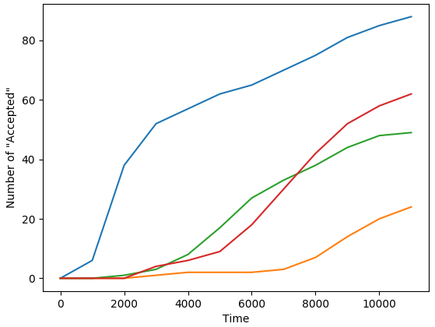
Making a line chart (attempt 1)
Basics of classes
Advances of classes
Plotting with matplotlib.pyplot
Copyright (c) 2012-2013 Matplotlib Development Team; All Rights Reserved

Slide 64
Making a line chart (attempt 2)
Basics of classes
Advances of classes
Plotting with matplotlib.pyplot
import matplotlib.pyplot as py
p1 = [0, 6, 38, 52, 57, 62, 65, 70, 75, 81, 85, 88]
p2 = [0, 0, 0, 1, 2, 2, 2, 3, 7, 14, 20, 24]
p3 = [0, 0, 1, 3, 8, 17, 27, 33, 38, 44, 48, 49]
p4 = [0, 0, 0, 4, 6, 9, 18, 30, 42, 52, 58, 62]
times = range(0, 12000, 1000)
py.plot(times, p1, 'o')
py.plot(times, p2, 'o')
py.plot(times, p3, 'o')
py.plot(times, p4, 'o')
py.xlabel('Time')
py.ylabel('Number of "Accepted"')
py.show()

Slide 65
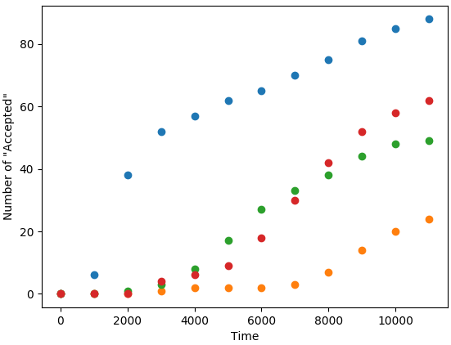
Making a line chart (attempt 2)
Basics of classes
Advances of classes
Plotting with matplotlib.pyplot
Copyright (c) 2012-2013 Matplotlib Development Team; All Rights Reserved

Slide 66
Making a line chart (attempt 3)
Basics of classes
Advances of classes
Plotting with matplotlib.pyplot
import matplotlib.pyplot as py
p1 = [0, 6, 38, 52, 57, 62, 65, 70, 75, 81, 85, 88]
p2 = [0, 0, 0, 1, 2, 2, 2, 3, 7, 14, 20, 24]
p3 = [0, 0, 1, 3, 8, 17, 27, 33, 38, 44, 48, 49]
p4 = [0, 0, 0, 4, 6, 9, 18, 30, 42, 52, 58, 62]
times = range(0, 12000, 1000)
py.plot(times, p1, 'ro', label = "Problem 1")
py.plot(times, p2, 'gs', label = "Problem 2")
py.plot(times, p3, 'b+', label = "Problem 3")
py.plot(times, p4, 'k.', label = "Problem 4")
py.legend(loc = 'upper left')
py.xlabel('Time')
py.ylabel('Number of "Accepted"')
py.show()

Slide 67
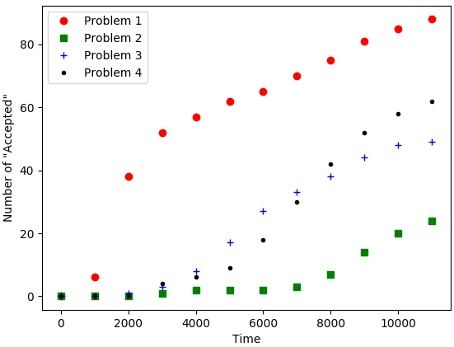
Making a line chart (attempt 3)
Basics of classes
Advances of classes
Plotting with matplotlib.pyplot
Copyright (c) 2012-2013 Matplotlib Development Team; All Rights Reserved

Slide 68
Making a line chart (attempt 4)
Basics of classes
Advances of classes
Plotting with matplotlib.pyplot
import matplotlib.pyplot as py
p1 = [0, 6, 38, 52, 57, 62, 65, 70, 75, 81, 85, 88]
p2 = [0, 0, 0, 1, 2, 2, 2, 3, 7, 14, 20, 24]
p3 = [0, 0, 1, 3, 8, 17, 27, 33, 38, 44, 48, 49]
p4 = [0, 0, 0, 4, 6, 9, 18, 30, 42, 52, 58, 62]
times = range(0, 12000, 1000)
py.plot(times, p1, label = "Problem 1", marker = 'o')
py.plot(times, p2, label = "Problem 2", marker = 'o')
py.plot(times, p3, label = "Problem 3", marker = 'o')
py.plot(times, p4, label = "Problem 4", marker = 'o')
py.legend(loc = 'upper left')
py.xlabel('Time')
py.ylabel('Number of "Accepted"')
py.show()

Slide 69
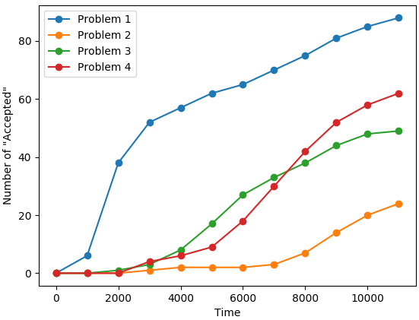
Making a line chart (attempt 4)
Basics of classes
Advances of classes
Plotting with matplotlib.pyplot
Copyright (c) 2012-2013 Matplotlib Development Team; All Rights Reserved

Slide 70
Summary
Basics of classes
Advances of classes
Plotting with matplotlib.pyplot
Use classes to organize and modularize your program.
Comments are important!
Process data and visualize them with libraries.
Almost everything you want have been implemented and put somewhere on the Internet.
Search, copy, modify, try, understand, and create!

Slide 71
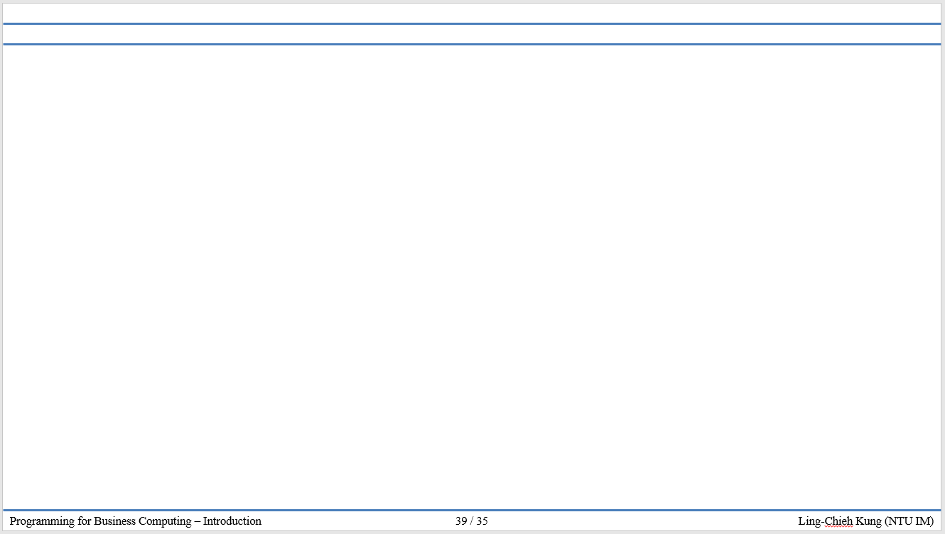

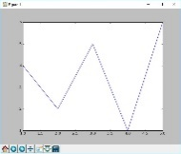




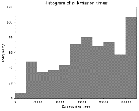
版權聲明
序 | 頁 | 作品 | 版權標章 | 作者 / 來源
1 | 1-73 |  |  | 台灣大學 孔令傑, CC BY-NC-ND 3.0
2 | 41 |  |  | 2002 - 2012 John Hunter, Darren Dale, Eric Firing, Michael Droettboom and the Matplotlib development team; 2012 - 2016 The Matplotlib development team. Last updated on May 10, 2017. Created using Sphinx 1.5.5. 依據著作權法第46、52、65條及Matplotlib版權聲明合理使用 Matplotlib only uses BSD compatible code, and its license is based on the PSF license. https://matplotlib.org/ 2017/9/27 visited
3 | 45 |  |  | 2002 - 2012 John Hunter, Darren Dale, Eric Firing, Michael Droettboom and the Matplotlib development team; 2012 - 2016 The Matplotlib development team. Last updated on May 10, 2017. Created using Sphinx 1.5.5. 依據著作權法第46、52、65條及Matplotlib版權聲明合理使用 Matplotlib only uses BSD compatible code, and its license is based on the PSF license. https://matplotlib.org/ 2017/9/27 visited
4 | 46 |  |  | 2002 - 2012 John Hunter, Darren Dale, Eric Firing, Michael Droettboom and the Matplotlib development team; 2012 - 2016 The Matplotlib development team. Last updated on May 10, 2017. Created using Sphinx 1.5.5. 依據著作權法第46、52、65條及Matplotlib版權聲明合理使用 Matplotlib only uses BSD compatible code, and its license is based on the PSF license. https://matplotlib.org/ 2017/9/27 visited
5 | 47 |  |  | 2002 - 2012 John Hunter, Darren Dale, Eric Firing, Michael Droettboom and the Matplotlib development team; 2012 - 2016 The Matplotlib development team. Last updated on May 10, 2017. Created using Sphinx 1.5.5. 依據著作權法第46、52、65條及Matplotlib版權聲明合理使用 Matplotlib only uses BSD compatible code, and its license is based on the PSF license. https://matplotlib.org/ 2017/9/27 visited
6 | 49 |  |  | 2002 - 2012 John Hunter, Darren Dale, Eric Firing, Michael Droettboom and the Matplotlib development team; 2012 - 2016 The Matplotlib development team. Last updated on May 10, 2017. Created using Sphinx 1.5.5. 依據著作權法第46、52、65條及Matplotlib版權聲明合理使用 Matplotlib only uses BSD compatible code, and its license is based on the PSF license. https://matplotlib.org/ 2017/9/27 visited

Slide 72
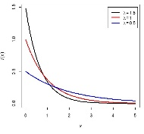

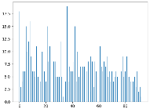
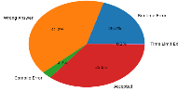
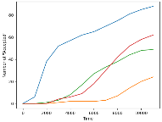
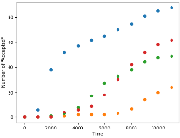
版權聲明
序 | 頁 | 作品 | 版權標章 | 作者 / 來源
7 | 51 |  |  | 2002 - 2012 John Hunter, Darren Dale, Eric Firing, Michael Droettboom and the Matplotlib development team; 2012 - 2016 The Matplotlib development team. Last updated on May 10, 2017. Created using Sphinx 1.5.5. 依據著作權法第46、52、65條及Matplotlib版權聲明合理使用 Matplotlib only uses BSD compatible code, and its license is based on the PSF license. https://matplotlib.org/ 2017/9/27 visited
8 | 54 |  |  | 2002 - 2012 John Hunter, Darren Dale, Eric Firing, Michael Droettboom and the Matplotlib development team; 2012 - 2016 The Matplotlib development team. Last updated on May 10, 2017. Created using Sphinx 1.5.5. 依據著作權法第46、52、65條及Matplotlib版權聲明合理使用 Matplotlib only uses BSD compatible code, and its license is based on the PSF license. https://matplotlib.org/ 2017/9/27 visited
9 | 57 |  |  | 2002 - 2012 John Hunter, Darren Dale, Eric Firing, Michael Droettboom and the Matplotlib development team; 2012 - 2016 The Matplotlib development team. Last updated on May 10, 2017. Created using Sphinx 1.5.5. 依據著作權法第46、52、65條及Matplotlib版權聲明合理使用 Matplotlib only uses BSD compatible code, and its license is based on the PSF license. https://matplotlib.org/ 2017/9/27 visited
10 | 60 |  |  | 2002 - 2012 John Hunter, Darren Dale, Eric Firing, Michael Droettboom and the Matplotlib development team; 2012 - 2016 The Matplotlib development team. Last updated on May 10, 2017. Created using Sphinx 1.5.5. 依據著作權法第46、52、65條及Matplotlib版權聲明合理使用 Matplotlib only uses BSD compatible code, and its license is based on the PSF license. https://matplotlib.org/ 2017/9/27 visited
11 | 63 |  |  | 2002 - 2012 John Hunter, Darren Dale, Eric Firing, Michael Droettboom and the Matplotlib development team; 2012 - 2016 The Matplotlib development team. Last updated on May 10, 2017. Created using Sphinx 1.5.5. 依據著作權法第46、52、65條及Matplotlib版權聲明合理使用 Matplotlib only uses BSD compatible code, and its license is based on the PSF license. https://matplotlib.org/ 2017/9/27 visited
12 | 65 |  |  | 2002 - 2012 John Hunter, Darren Dale, Eric Firing, Michael Droettboom and the Matplotlib development team; 2012 - 2016 The Matplotlib development team. Last updated on May 10, 2017. Created using Sphinx 1.5.5. 依據著作權法第46、52、65條及Matplotlib版權聲明合理使用 Matplotlib only uses BSD compatible code, and its license is based on the PSF license. https://matplotlib.org/ 2017/9/27 visited

Slide 73
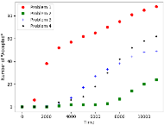
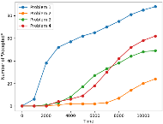
版權聲明
序 | 頁 | 作品 | 版權標章 | 作者 / 來源
13 | 67 |  |  | 2002 - 2012 John Hunter, Darren Dale, Eric Firing, Michael Droettboom and the Matplotlib development team; 2012 - 2016 The Matplotlib development team. Last updated on May 10, 2017. Created using Sphinx 1.5.5. 依據著作權法第46、52、65條及Matplotlib版權聲明合理使用 Matplotlib only uses BSD compatible code, and its license is based on the PSF license. https://matplotlib.org/ 2017/9/27 visited
14 | 69 |  |  | 2002 - 2012 John Hunter, Darren Dale, Eric Firing, Michael Droettboom and the Matplotlib development team; 2012 - 2016 The Matplotlib development team. Last updated on May 10, 2017. Created using Sphinx 1.5.5. 依據著作權法第46、52、65條及Matplotlib版權聲明合理使用 Matplotlib only uses BSD compatible code, and its license is based on the PSF license. https://matplotlib.org/ 2017/9/27 visited

