Slide 1

Programming for Business Computing Graphical User Interface
Basic concepts
Example 1: A simple square root calculator
Example 1B: A cool square root calculator
Example 2: A scatter plot plotter
Ling-Chieh Kung
Department of Information Management
National Taiwan University
【本著作除另有註明外，採取創用CC「姓名標示－非商業性－禁止改作分享」台灣3.0版授權釋出】

Slide 2


Outline
Basic concepts
Example 1: A simple square root calculator
Example 1B: A cool square root calculator
Example 2: A scatter plot plotter
Basic concepts
Example 1A: A simple square root calculator
Example 1B: A cool square root calculator
Example 2: A scatter plot plotter

Slide 3
User interface
Basic concepts
Example 1: A simple square root calculator
Example 1B: A cool square root calculator
Example 2: A scatter plot plotter
Our program interact with users through a user interface (UI).
User interface design is important.
Intuitiveness.
Fail-safe.
User experience (UX).
So far we worked with text-based interfaces.
Command lines/consoles/terminals.
Let’s try to build a graphical user interface (GUI) now.
Also called “front-end development”.

Slide 4
Developing a GUI
Basic concepts
Example 1: A simple square root calculator
Example 1B: A cool square root calculator
Example 2: A scatter plot plotter
Easier to use than a text-based user interface.
Better user experience.
Easier to do fail safe.
Checkbox vs. entering Y/N.
Dropdown list vs. entering 1/2/3/4/5.
Worse performance.
Compared to a text-based user interface.

Slide 5
Learning to develop a GUI
Basic concepts
Example 1: A simple square root calculator
Example 1B: A cool square root calculator
Example 2: A scatter plot plotter
Using Python to develop a GUI is not hard.
Easier than using C, C++, Java, etc.
However, still harder than web development.
Today, you develop a GUI only if you want to make desktop software or smartphone app to sell.
If you just want to implement an algorithm, use a text-based UI.
If you want to develop an application, write a web page.
Still, (slightly) learning how to write a GUI in Python is good.
Getting the fundamental ideas of GUI.
Getting more ideas about classes.
Getting more ideas about software development and online search.
And getting something to demonstrate to your parents and friends.

Slide 6
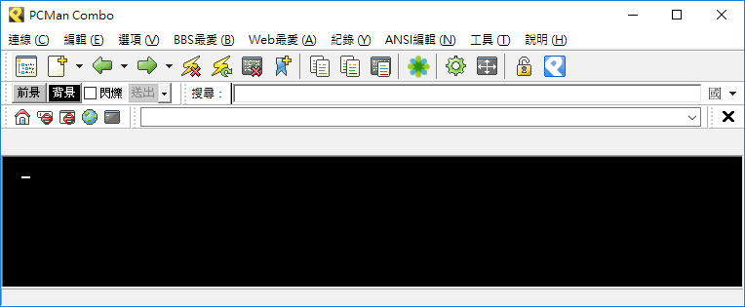

Basic structure of a GUI: window
Basic concepts
Example 1: A simple square root calculator
Example 1B: A cool square root calculator
Example 2: A scatter plot plotter
A desktop application is typically presented in a window (or multiple windows).
A window has a header:
An icon, a title, and three buttons (minimize, maximize/getting back, close).

Slide 7

Basic structure of a GUI: widgets
Basic concepts
Example 1: A simple square root calculator
Example 1B: A cool square root calculator
Example 2: A scatter plot plotter
There are widgets (components, elements).
Many of them are called icons.
buttons
checkboxes
labels
textboxes
a menu
canvases
dropdown lists

Slide 8
Our GUI development
Basic concepts
Example 1: A simple square root calculator
Example 1B: A cool square root calculator
Example 2: A scatter plot plotter
To develop a GUI, we first create a window.
We will write a class by “inheriting” an existing window class in a library.
We then create components by creating objects (using existing classes)
Button objects, label objects, etc.
They are member variables of our window class.
We specify their looks and locations by modifying their member variables.
Finally, we determine their behaviors.
We define member functions of our window class.
We specify the function to invoke upon an event (e.g., when a button is clicked).
The example programs are for Windows.
For Mac, please refer to the supplemental handout.

Slide 9
Outline
Basic concepts
Example 1: A simple square root calculator
Example 1B: A cool square root calculator
Example 2: A scatter plot plotter
Basic concepts
Example 1A: A simple square root calculator
Example 1B: A cool square root calculator
Example 2: A scatter plot plotter

Slide 10
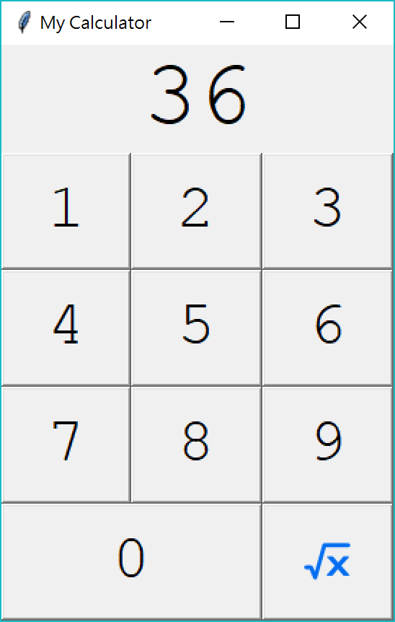

A square root calculator
Basic concepts
Example 1: A simple square root calculator
Example 1B: A cool square root calculator
Example 2: A scatter plot plotter
Our first example is a square root calculator.
A simpler version of a calculator.
A user may click on the number pad to enter a number (as a nonnegative integer).
She may then click on the square root icon to get the square root of the input number (as a float number rounded to the second digit after the decimal point).
We need to:
Create a window.
Create one label and eleven buttons.
Implement event-triggered functions.
Arrange them nicely.

Slide 11
Calculator 0.1: Creating a window
Basic concepts
Example 1: A simple square root calculator
Example 1B: A cool square root calculator
Example 2: A scatter plot plotter
First, we import tkinter the standard Python library for creating GUI, and give it an alias tk.
We then write a class Calculator by inheriting from a class Frame.
Frame is a class defining an “empty” window frame.
To inherit from a class, put the class name inside the pair of parentheses.
Inheriting an existing class allows our own class having everything defined in the “parent class”.
import tkinter as tk
class Calculator(tk.Frame):
def __init__(self):
tk.Frame.__init__(self)
self.grid()
cal = Calculator()
cal.master.title("My Calculator")
cal.mainloop()

Slide 12
Calculator 0.1: Creating a window
Basic concepts
Example 1: A simple square root calculator
Example 1B: A cool square root calculator
Example 2: A scatter plot plotter
We then define our constructor:
Invoking the parent’s constructor.
Invoking a member function (defined in Frame) to prepare “grids” to place widgets.
import tkinter as tk
class Calculator(tk.Frame):
def __init__(self):
tk.Frame.__init__(self)
self.grid()
cal = Calculator()
cal.master.title("My Calculator")
cal.mainloop()

Slide 13
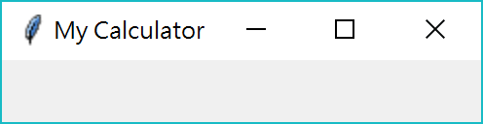
Calculator 0.1: Creating a window
Basic concepts
Example 1: A simple square root calculator
Example 1B: A cool square root calculator
Example 2: A scatter plot plotter
Now we use the class to create a Calculator object.
First, create the object.
Second, use a member function (defined in Frame) to set up the title.
Lastly, invoke mainloop() to let it keep listening to events (like invoking input() and waiting for user input).
The result:
import tkinter as tk
class Calculator(tk.Frame):
def __init__(self):
tk.Frame.__init__(self)
self.grid()
cal = Calculator()
cal.master.title("My Calculator")
cal.mainloop()

Slide 14
Calculator 0.2: Adding widgets
Basic concepts
Example 1: A simple square root calculator
Example 1B: A cool square root calculator
Example 2: A scatter plot plotter
Let’s add a label and a button.
To add widgets into a window, we need to decide where to place them.
A window is divided into grids, intersections of rows and columns.
Here we have 5 rows and 3 columns.
A widget may span for multiple rows or columns.
Later we will put the label at (row = 0, column = 0) and the button at (row = 1, column = 0).
column
0 1 2
row 0
row 1
row 2
row 3
row 4

Slide 15
Calculator 0.2: Adding widgets
Basic concepts
Example 1: A simple square root calculator
Example 1B: A cool square root calculator
Example 2: A scatter plot plotter
We define a member function createWidgets().
We use the class Label to create a member label object.
The first argument says that this label belongs to this window.
The second argument sets the initial text to “0”.
The label object is a member of this window.
The class Button works similarly.
import tkinter as tk
class Calculator(tk.Frame):
def __init__(self):
tk.Frame.__init__(self)
self.grid()
self.createWidgets()
def createWidgets(self):
self.lblNum = tk.Label(self, text = "0")
self.btnNum1 = tk.Button(self, text = "1")
self.lblNum.grid(row = 0, column = 0)
self.btnNum1.grid(row = 1, column = 0)
cal = Calculator()
cal.master.title("My Calculator")
cal.mainloop()

Slide 16
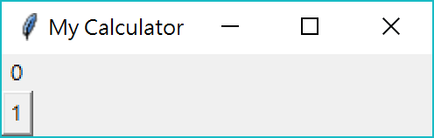
Calculator 0.2: Adding widgets
Basic concepts
Example 1: A simple square root calculator
Example 1B: A cool square root calculator
Example 2: A scatter plot plotter
Each of the two widgets need to invoke grid() to set up its location.
We specify the row and column indices of each widget.
The result:
import tkinter as tk
class Calculator(tk.Frame):
def __init__(self):
tk.Frame.__init__(self)
self.grid()
self.createWidgets()
def createWidgets(self):
self.lblNum = tk.Label(self, text = "0")
self.btnNum1 = tk.Button(self, text = "1")
self.lblNum.grid(row = 0, column = 0)
self.btnNum1.grid(row = 1, column = 0)
cal = Calculator()
cal.master.title("My Calculator")
cal.mainloop()

Slide 17
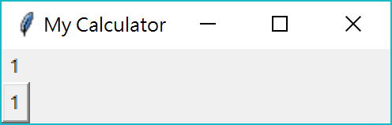
Calculator 0.3: Event-triggered functions
Basic concepts
Example 1: A simple square root calculator
Example 1B: A cool square root calculator
Example 2: A scatter plot plotter
We now implement an event-triggered function for the button.
The member function clickBtnNum1() sets the label’s text to be “1”.
By invoking the configure() member function.
command = self.clickBtnNum1 adds an event listener to the button.
When one clicks the button, a “click” event triggers clickBtnNum1().
Without Calculator, this would become a (weird) global function.
def createWidgets(self):
self.lblNum = tk.Label(self, text = "0")
self.btnNum1 = tk.Button(self, text = "1", command = self.clickBtnNum1)
self.lblNum.grid(row = 0, column = 0)
self.btnNum1.grid(row = 1, column = 0)
def clickBtnNum1(self):
self.lblNum.configure(text = "1")

Slide 18
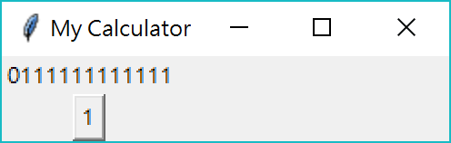
Calculator 0.4: Event-triggered functions
Basic concepts
Example 1: A simple square root calculator
Example 1B: A cool square root calculator
Example 2: A scatter plot plotter
We now implement an event-triggered function for the button.
What does this implementation do?
self.lblNum.cget("text") returns the current text of a label object.
Clicking the button appends one more “1” to the current text.
def createWidgets(self):
self.lblNum = tk.Label(self, text = "0")
self.btnNum1 = tk.Button(self, text = "1", command = self.clickBtnNum1)
self.lblNum.grid(row = 0, column = 0)
self.btnNum1.grid(row = 1, column = 0)
def clickBtnNum1(self):
self.lblNum.configure(text = self.lblNum.cget("text") + "1")

Slide 19
Calculator 0.5: heights, widths, fonts
Basic concepts
Example 1: A simple square root calculator
Example 1B: A cool square root calculator
Example 2: A scatter plot plotter
Let’s adjust the look of our widgets.
All widgets have attributes height and width.
For a label or button of texts, height is the number of lines and width is the number of characters.
For a label or button of images, height and width are pixels.
Most widgets have the attribute font.
We may use the class font in tkinter to define a font object.
Assigning a font object to font sets the font family/type/size of the widget.
To import the class, add into your Python program.
import tkinter.font as tkFont

Slide 20
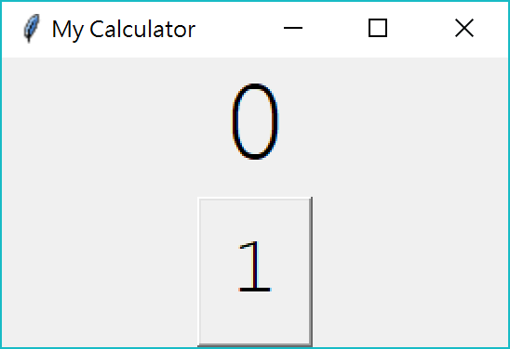
Calculator 1.0: heights, widths, fonts
Basic concepts
Example 1: A simple square root calculator
Example 1B: A cool square root calculator
Example 2: A scatter plot plotter
f1 and f2 are two font objects.
The label contains one line of seven 48-point Courier New characters.
The button contains one line of two 32-point Courier New characters.
Calculator 1.0 (which is just 0.5) is in “Calculator1.py”.
def createWidgets(self):
f1 = tkFont.Font(size = 48, family = "Courier New")
f2 = tkFont.Font(size = 32, family = "Courier New")
self.lblNum = tk.Label(self, text = "0", height = 1, width = 7, font = f1)
self.btnNum1 = tk.Button(self, text = "1", command = self.clickBtnNum1,
height = 1, width = 2, font = f2)
self.lblNum.grid(row = 0, column = 0)
self.btnNum1.grid(row = 1, column = 0)

Slide 21
Calculator 1.1: all widgets
Basic concepts
Example 1: A simple square root calculator
Example 1B: A cool square root calculator
Example 2: A scatter plot plotter
Let’s put all eleven buttons into the window.
def createWidgets(self):
f1 = tkFont.Font(size = 48, family = "Courier New")
f2 = tkFont.Font(size = 32, family = "Courier New")
self.lblNum = tk.Label(self, text = "0", height = 1, width = 7, font = f1)
self.btnNum1 = tk.Button(self, text = "1", height = 1, width = 2, command = self.clickBtnNum1, font = f2)
self.btnNum2 = tk.Button(self, text = "2", height = 1, width = 2, command = self.clickBtnNum1, font = f2)
# let all buttons' trigger clickBtnNum1() for a while
# btnNum3 to btnNum9 omitted
self.btnNum0 = tk.Button(self, text = "0", height = 1, width = 2,
command = self.clickBtnNum1, font = f2)
self.btnSqrt = tk.Button(self, text = "s", height = 1, width = 2,
command = self.clickBtnNum1, font = f2)

Slide 22
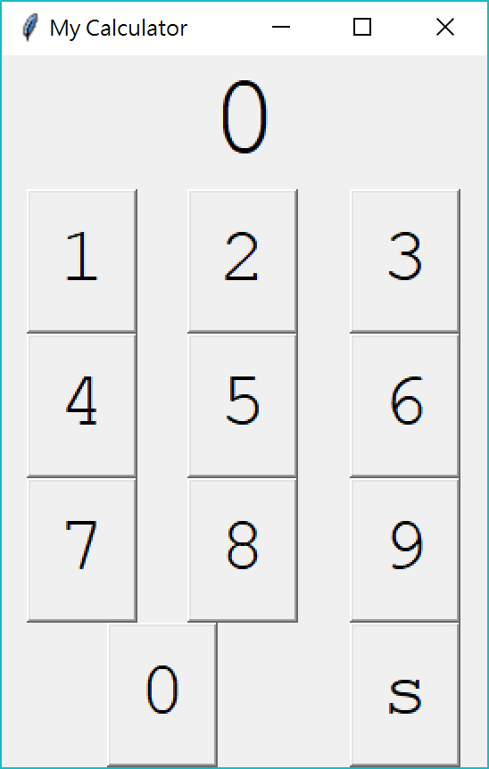
Calculator 1.1: all widgets
Basic concepts
Example 1: A simple square root calculator
Example 1B: A cool square root calculator
Example 2: A scatter plot plotter
Let’s set up their locations.
The attribute columnspan specifies the number of columns spanned by the widget.
The attribute rowspan specifies the number of columns spanned by the widget.
def createWidgets(self):
# font and widget creation omitted
self.lblNum.grid(row = 0, column = 0, columnspan = 3)
self.btnNum1.grid(row = 1, column = 0)
self.btnNum2.grid(row = 1, column = 1)
# btnNum3 to btnNum9 omitted
self.btnNum0.grid(row = 4, column = 0, columnspan = 2)
self.btnSqrt.grid(row = 4, column = 2)

Slide 23
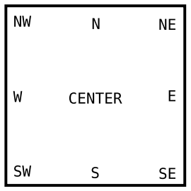
Calculator 1.2: expanding widgets
Basic concepts
Example 1: A simple square root calculator
Example 1B: A cool square root calculator
Example 2: A scatter plot plotter
How to take away the margins between widgets?
The grid() function has a parameter sticky whose value decides how to stick a widget to a side (and remove the margin).
sticky = tk.E sticks the widget to the east (right).
sticky = tk.NE sticks the widget toward the north (top) and east (right).
To sticks the widget to multiple sides, write, e.g., sticky = tk.E + tk.NW

Slide 24
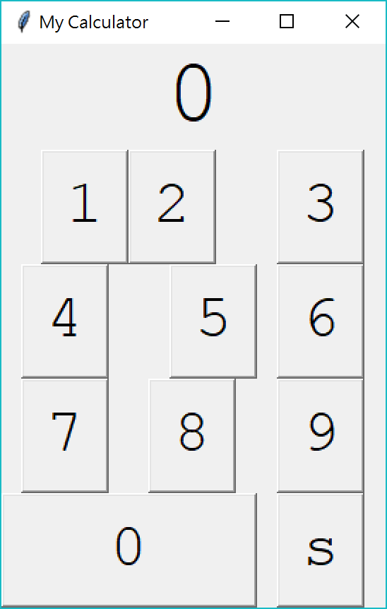
Calculator 1.2: expanding widgets
Basic concepts
Example 1: A simple square root calculator
Example 1B: A cool square root calculator
Example 2: A scatter plot plotter
Let’s try it:
self.btnNum1.grid(row = 1, column = 0, sticky = tk.E)
self.btnNum2.grid(row = 1, column = 1, sticky = tk.W)
self.btnNum3.grid(row = 1, column = 2, sticky = tk.N)
self.btnNum4.grid(row = 2, column = 0, sticky = tk.S)
self.btnNum5.grid(row = 2, column = 1, sticky = tk.NE)
self.btnNum6.grid(row = 2, column = 2)
self.btnNum7.grid(row = 3, column = 0)
self.btnNum8.grid(row = 3, column = 1)
self.btnNum9.grid(row = 3, column = 2)
self.btnNum0.grid(row = 4, column = 0,
columnspan = 2,
sticky = tk.NE + tk.SW)
self.btnSqrt.grid(row = 4, column = 2)

Slide 25
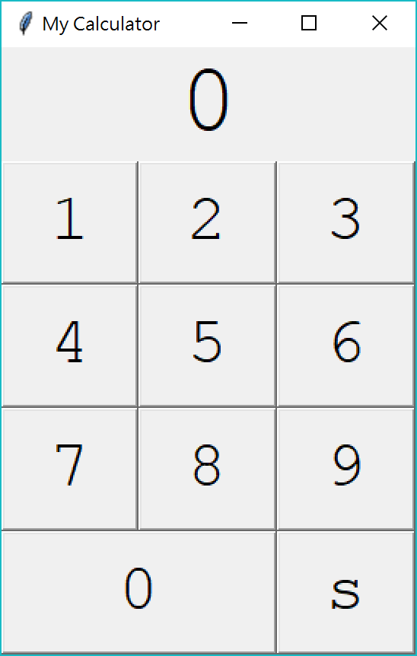
Calculator 1.2: expanding widgets
Basic concepts
Example 1: A simple square root calculator
Example 1B: A cool square root calculator
Example 2: A scatter plot plotter
Let’s remove all margins:
self.lblNum.grid(row = 0, column = 0, columnspan = 3,
sticky = tk.NE + tk.SW)
self.btnNum1.grid(row = 1, column = 0,
sticky = tk.NE + tk.SW)
self.btnNum2.grid(row = 1, column = 1,
sticky = tk.NE + tk.SW)
# btnNum3 to btnNum9 omitted
self.btnNum0.grid(row = 4, column = 0, columnspan = 2,
sticky = tk.NE + tk.SW)
self.btnSqrt.grid(row = 4, column = 2,
sticky = tk.NE + tk.SW)

Slide 26
Calculator 1.3: adding functions
Basic concepts
Example 1: A simple square root calculator
Example 1B: A cool square root calculator
Example 2: A scatter plot plotter
Let’s add a function for button 2:
And then repeat this for all buttons (except square root).
def createWidgets(self):
# all others omitted
self.btnNum1 = tk.Button(self, text = "1", height = 1, width = 2,
command = self.clickBtnNum1, font = f2)
self.btnNum2 = tk.Button(self, text = "2", height = 1, width = 2,
command = self.clickBtnNum2, font = f2)
def clickBtnNum1(self):
self.lblNum.configure(text = self.lblNum.cget("text") + "1")
def clickBtnNum2(self):
self.lblNum.configure(text = self.lblNum.cget("text") + "2")

Slide 27
Calculator 1.3: adding functions
Basic concepts
Example 1: A simple square root calculator
Example 1B: A cool square root calculator
Example 2: A scatter plot plotter
Let’s add a function for the square root button:
Take the current number, cast it to a float, find its square root, round it, convert it to a string, and then override the current number.
This is good, but…
What happens if we then click a button of any number?
def createWidgets(self):
# all others omitted
self.btnSqrt = tk.Button(self, text = "s", height = 1, width = 2,
command = self.clickBtnSqrt, font = f2)
def clickBtnSqrt(self):
curNum = float(self.lblNum.cget("text"))
self.lblNum.configure(text = str(round(math.sqrt(curNum), 2)))

Slide 28
Calculator 1.3: adding functions
Basic concepts
Example 1: A simple square root calculator
Example 1B: A cool square root calculator
Example 2: A scatter plot plotter
Let’s add a flag for whether we should reset the number:
Should we modify the functions for other buttons in the same way?
class Calculator(tk.Frame): # all others omitted
shouldReset = True # the flag
def clickBtnNum1(self):
if self.shouldReset == True:
self.lblNum.configure(text = "1")
self.shouldReset = False
else:
self.lblNum.configure(text = self.lblNum.cget("text") + "1")
def clickBtnSqrt(self):
curNum = float(self.lblNum.cget("text"))
self.lblNum.configure(text = str(round(math.sqrt(curNum), 2)))
self.shouldReset = True

Slide 29
Calculator 2.0: adding functions
Basic concepts
Example 1: A simple square root calculator
Example 1B: A cool square root calculator
Example 2: A scatter plot plotter
Let’s use a more modularized way:
Calculator 2.0 (which is just 1.3) is in “Calculator2.py”
class Calculator(tk.Frame): # all others omitted
def setNumStr(self, content):
if self.shouldReset == True:
self.lblNum.configure(text = content)
self.shouldReset = False
else:
self.lblNum.configure(text = self.lblNum.cget("text") + content)
def clickBtnNum1(self):
self.setNumStr("1")
def clickBtnNum2(self):
self.setNumStr("2")

Slide 30
Outline
Basic concepts
Example 1: A simple square root calculator
Example 1B: A cool square root calculator
Example 2: A scatter plot plotter
Basic concepts
Example 1A: A simple square root calculator
Example 1B: A cool square root calculator
Example 2: A scatter plot plotter

Slide 31
Calculator 2.1: the square root image
Basic concepts
Example 1: A simple square root calculator
Example 1B: A cool square root calculator
Example 2: A scatter plot plotter
The current version is good, but the label of the square root button is not good.
Which one do you prefer?
Let’s use an image rather than a text as the label.

Slide 32
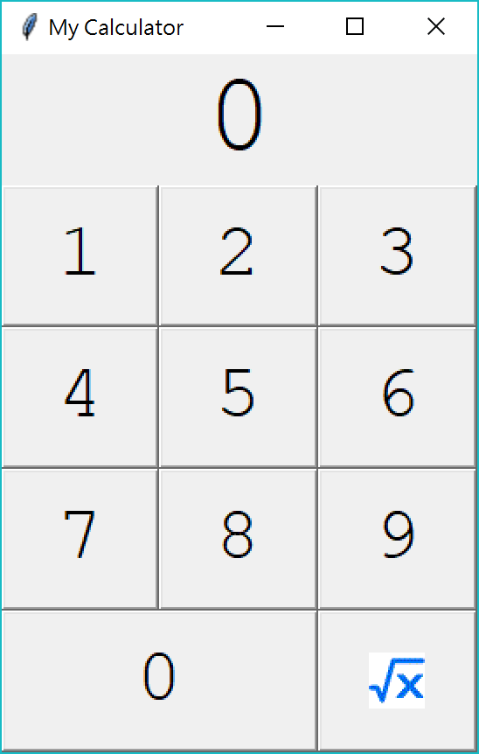

Calculator 2.1: the square root image
Basic concepts
Example 1: A simple square root calculator
Example 1B: A cool square root calculator
Example 2: A scatter plot plotter
First, we need to prepare an image of square root.
While many images are in PNG, JPG, and BMP format, the default tkinter class PhotoImage only support GIF, PGM, PPM, and XBM formats.
Suppose that we have a GIF image, we do:
Don’t forget to use cmd to run the program.
Okay but not perfect.
self.imageSqrt = tk.PhotoImage(file = "sqrt.gif")
self.btnSqrt = tk.Button(self, image = self.imageSqrt,
command = self.clickBtnSqrt)

Slide 33
Calculator 3.0: using PIL
Basic concepts
Example 1: A simple square root calculator
Example 1B: A cool square root calculator
Example 2: A scatter plot plotter
To use a PNG format, we may install the library PIL (Python Image Library) by install Pillow.
https://python-pillow.org/.
To install Pillow, run “pip install Pillow” in cmd.
We now write:
Calculator 3.0 (which is just 2.2) is in “Calculator3.py”.
from PIL import ImageTk
class Calculator(tk.Frame):
# all others omitted
self.imageSqrt = ImageTk.PhotoImage(file = "sqrt.png")
self.btnSqrt = tk.Button(self, image = self.imageSqrt,
command = self.clickBtnSqrt)

Slide 34
Challenge
Basic concepts
Example 1: A simple square root calculator
Example 1B: A cool square root calculator
Example 2: A scatter plot plotter
If we write the calculator works well, but the image disappears!
Why?
from PIL import ImageTk
class Calculator(tk.Frame):
# all others omitted
imageSqrt = Image.PhotoImage(file = "sqrt.png")
self.btnSqrt = tk.Button(self, image = imageSqrt,
command = self.clickBtnSqrt)

Slide 35
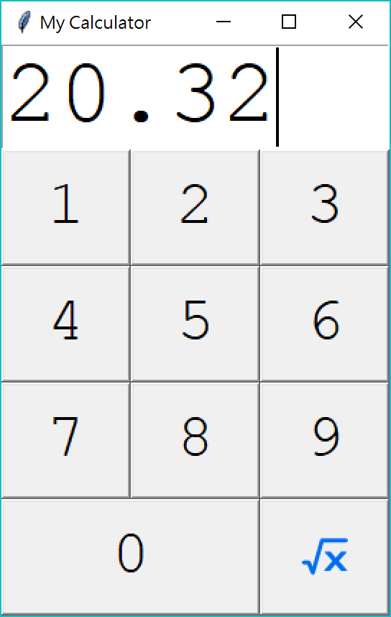
Calculator 4.0: textbox
Basic concepts
Example 1: A simple square root calculator
Example 1B: A cool square root calculator
Example 2: A scatter plot plotter
Let’s allow a user to type in numbers.

Slide 36
Calculator 4.0: textbox
Basic concepts
Example 1: A simple square root calculator
Example 1B: A cool square root calculator
Example 2: A scatter plot plotter
First, we change the label to a textbox, i.e., we change to
We also change the code of setting its location, i.e., we change to
self.lblNum = tk.Label(self, height = 1, width = 7, text = "0", font = f1)
self.txtNum = tk.Text(self, height = 1, width = 7, font = f1)
self.lblNum.grid(row = 0, column = 0, columnspan = 3, sticky = tk.NE + tk.SW)
self.txtNum.grid(row = 0, column = 0, columnspan = 3, sticky = tk.NE + tk.SW)

Slide 37
Calculator 4.0: textbox
Basic concepts
Example 1: A simple square root calculator
Example 1B: A cool square root calculator
Example 2: A scatter plot plotter
When one clicks a number button, we change to
When one types a number, the textbox always gets that number inserted.
def setNumStr(self, content):
if self.shouldReset == True:
self.lblNum.configure(text = content)
self.shouldReset = False
else:
self.lblNum.configure(text = self.lblNum.cget("text") + content)
def setNumStr(self, content):
if self.shouldReset == True:
self.txtNum.delete("1.0", tk.END) # 1.0: the first line,
self.txtNum.insert("1.0", content) # the 0th character
self.shouldReset = False # tk.END: the last character
else:
self.txtNum.insert(tk.END, content)

Slide 38
Calculator 4.0: textbox
Basic concepts
Example 1: A simple square root calculator
Example 1B: A cool square root calculator
Example 2: A scatter plot plotter
When one clicks the square root button, we change to
Calculator 4.0 is in “Calculator4.py”.
def clickBtnSqrt(self):
curNum = float(self.lblNum.cget("text"))
self.lblNum.configure(text = str(round(math.sqrt(curNum), 2)))
self.shouldReset = True
def clickBtnSqrt(self):
curNum = float(self.txtNum.get("1.0", tk.END))
self.txtNum.delete("1.0", tk.END)
self.txtNum.insert("1.0", str(round(math.sqrt(curNum), 2)))
self.shouldReset = True

Slide 39
Outline
Basic concepts
Example 1: A simple square root calculator
Example 1B: A cool square root calculator
Example 2: A scatter plot plotter
Basic concepts
Example 1A: A simple square root calculator
Example 1B: A cool square root calculator
Example 2: A scatter plot plotter

Slide 40
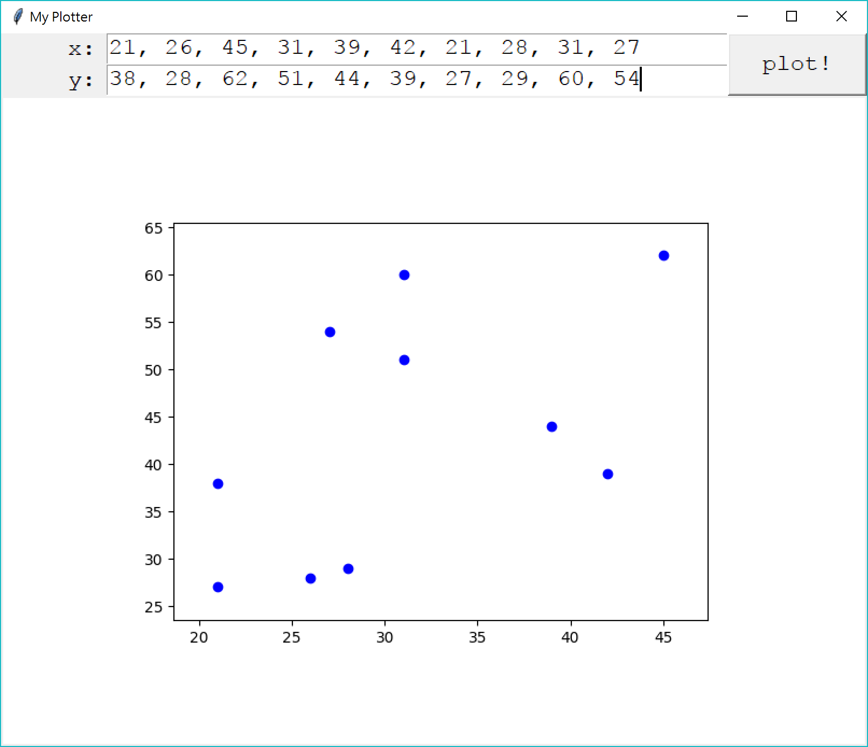
A scatter plot plotter
Basic concepts
Example 1: A simple square root calculator
Example 1B: A cool square root calculator
Example 2: A scatter plot plotter
In our second example, we will:
Use two textboxes to let users input comma-separated values.
Use a canvas to place a scatter plot based on the user input.

Slide 41
Plotter 1.0: window and widgets
Basic concepts
Example 1: A simple square root calculator
Example 1B: A cool square root calculator
Example 2: A scatter plot plotter
import tkinter as tk
import tkinter.font as tkFont
class Plotter(tk.Frame):
def __init__(self):
tk.Frame.__init__(self)
self.grid()
self.createWidgets()
def createWidgets(self):
f = tkFont.Font(size = 16, family = "Courier New")
self.lblX = tk.Label(self, text = "x:", height = 1, width = 3, font = f)
self.lblY = tk.Label(self, text = "y:", height = 1, width = 3, font = f)
self.txtX = tk.Text(self, height = 1, width = 40, font = f)
self.txtY = tk.Text(self, height = 1, width = 40, font = f)
self.btnLoad = tk.Button(self, text = "plot!", height = 1, width = 5, font = f)
self.cvsMain = tk.Canvas(self, width = 800, height = 600, bg = "white")

Slide 42
Plotter 1.0: window and widgets
Basic concepts
Example 1: A simple square root calculator
Example 1B: A cool square root calculator
Example 2: A scatter plot plotter
self.lblX.grid(row = 0, column = 0, sticky = tk.E)
self.lblY.grid(row = 1, column = 0, sticky = tk.E)
self.txtX.grid(row = 0, column = 1, sticky = tk.NE + tk.SW)
self.txtY.grid(row = 1, column = 1, sticky = tk.NE + tk.SW)
self.btnLoad.grid(row = 0, rowspan = 2, column = 2, sticky = tk.NE + tk.SW)
self.cvsMain.grid(row = 2, column = 0, columnspan = 3, sticky = tk.NE + tk.SW)
pl = Plotter()
pl.master.title("My Plotter")
pl.mainloop()
The sticky setting pushes the texts in the two labels to the right.
Plotter 1.0 is in “Plotter1.py”.

Slide 43
Plotter 2.0: drawing scatter plots
Basic concepts
Example 1: A simple square root calculator
Example 1B: A cool square root calculator
Example 2: A scatter plot plotter
To draw a scatter plot, we first:
Extract the texts in the two textboxes (and process them).
Draw a scatter plot by matplotlib.pyplot.
import matplotlib.pyplot as pyplot
class Plotter(tk.Frame): # all others omitted
def createWidgets(self):
self.btnLoad = tk.Button(self, text = "plot!", height = 1, width = 5,
command = self.clickBtnLoad, font = f)
def clickBtnLoad(self):
x = self.txtX.get("1.0", tk.END).split(",") # 1.0: the first line, for i in range(len(x)): # the 0th character
x[i] = float(x[i]) # tk.END: until the last character
y = self.txtY.get("1.0", tk.END).split(",")
for i in range(len(y)):
y[i] = float(y[i])
pyplot.plot(x, y, 'bo')
pyplot.show()

Slide 44
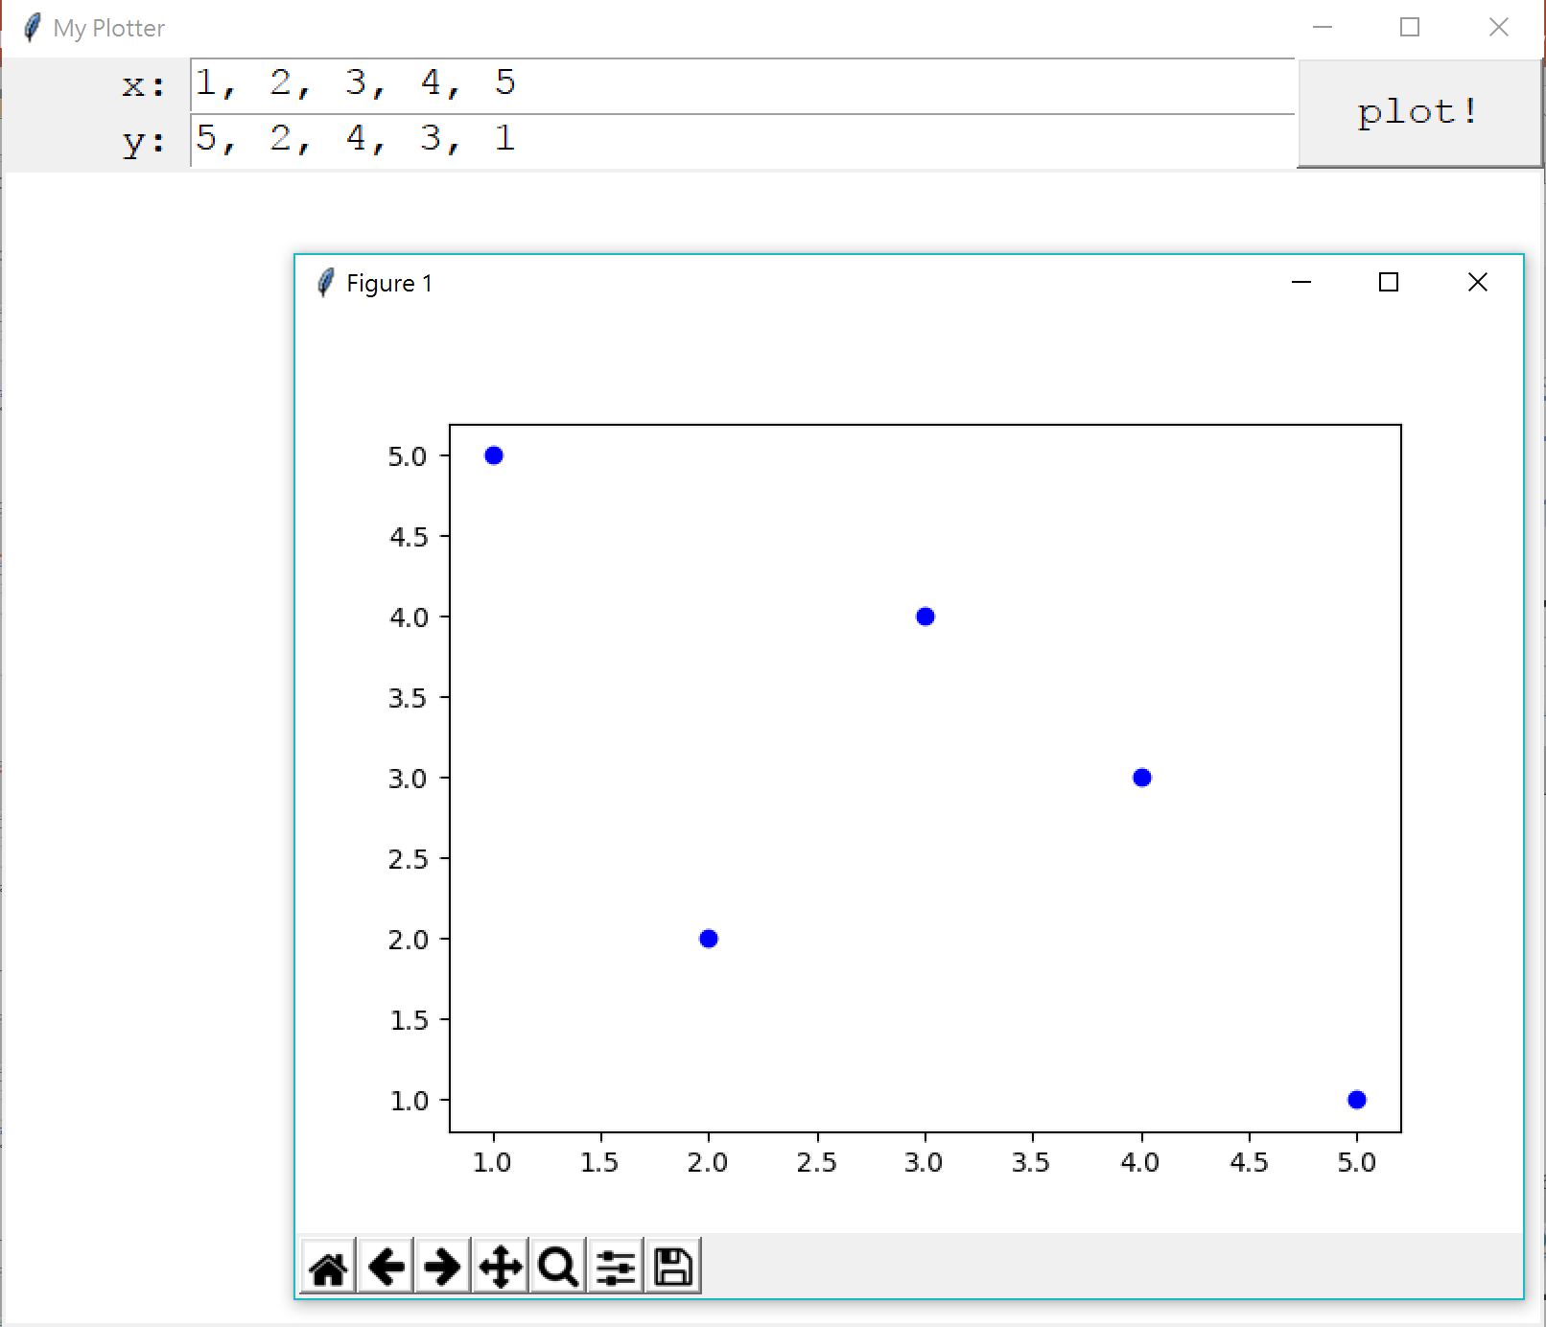
Plotter 2.0: drawing scatter plots
Basic concepts
Example 1: A simple square root calculator
Example 1B: A cool square root calculator
Example 2: A scatter plot plotter
That was good, but:
The scatter plot is not on the canvas.
xlim and ylim of the scatter plot is not set properly.
Plotter 2.0 is in “Plotter2.py”.

Slide 45
Plotter 3.0: revision
Basic concepts
Example 1: A simple square root calculator
Example 1B: A cool square root calculator
Example 2: A scatter plot plotter
Let’s write a function for making a “nice” scatter plot.
And save it as a file.
class Plotter(tk.Frame): # all others omitted
def makeScatter(self, x, y):
pyplot.figure() # to create a new figure
pyplot.plot(x, y, 'bo')
rangeX = max(x) - min(x)
pyplot.xlim(min(x) - rangeX * 0.1, max(x) + rangeX * 0.1)
rangeY = max(y) - min(y)
pyplot.ylim(min(y) - rangeY * 0.1, max(y) + rangeY * 0.1)
pyplot.savefig("temp.png")

Slide 46
Plotter 3.0: revision
Basic concepts
Example 1: A simple square root calculator
Example 1B: A cool square root calculator
Example 2: A scatter plot plotter
Now we put the saved file onto the canvas.
from PIL import ImageTk
class Plotter(tk.Frame): # all others omitted
def clickBtnLoad(self):
x = self.txtX.get("1.0", tk.END).split(",")
for i in range(len(x)):
x[i] = float(x[i])
y = self.txtY.get("1.0", tk.END).split(",")
for i in range(len(y)):
y[i] = float(y[i])
self.makeScatter(x, y)
self.imageMain = ImageTk.PhotoImage(file = "temp.png")
self.cvsMain.create_image(400, 300, image = self.imageMain, anchor = tk.CENTER)

Slide 47
Plotter 3.0: revision
Basic concepts
Example 1: A simple square root calculator
Example 1B: A cool square root calculator
Example 2: A scatter plot plotter
Let’s delete the file after it is used.
import os
class Plotter(tk.Frame): # all others omitted
def clickBtnLoad(self):
# string processing...
self.makeScatter(x, y)
self.imageMain = ImageTk.PhotoImage(file = "temp.png")
self.cvsMain.create_image(400, 300, image = self.imageMain, anchor = tk.CENTER)
os.system("del temp.png")

Slide 48
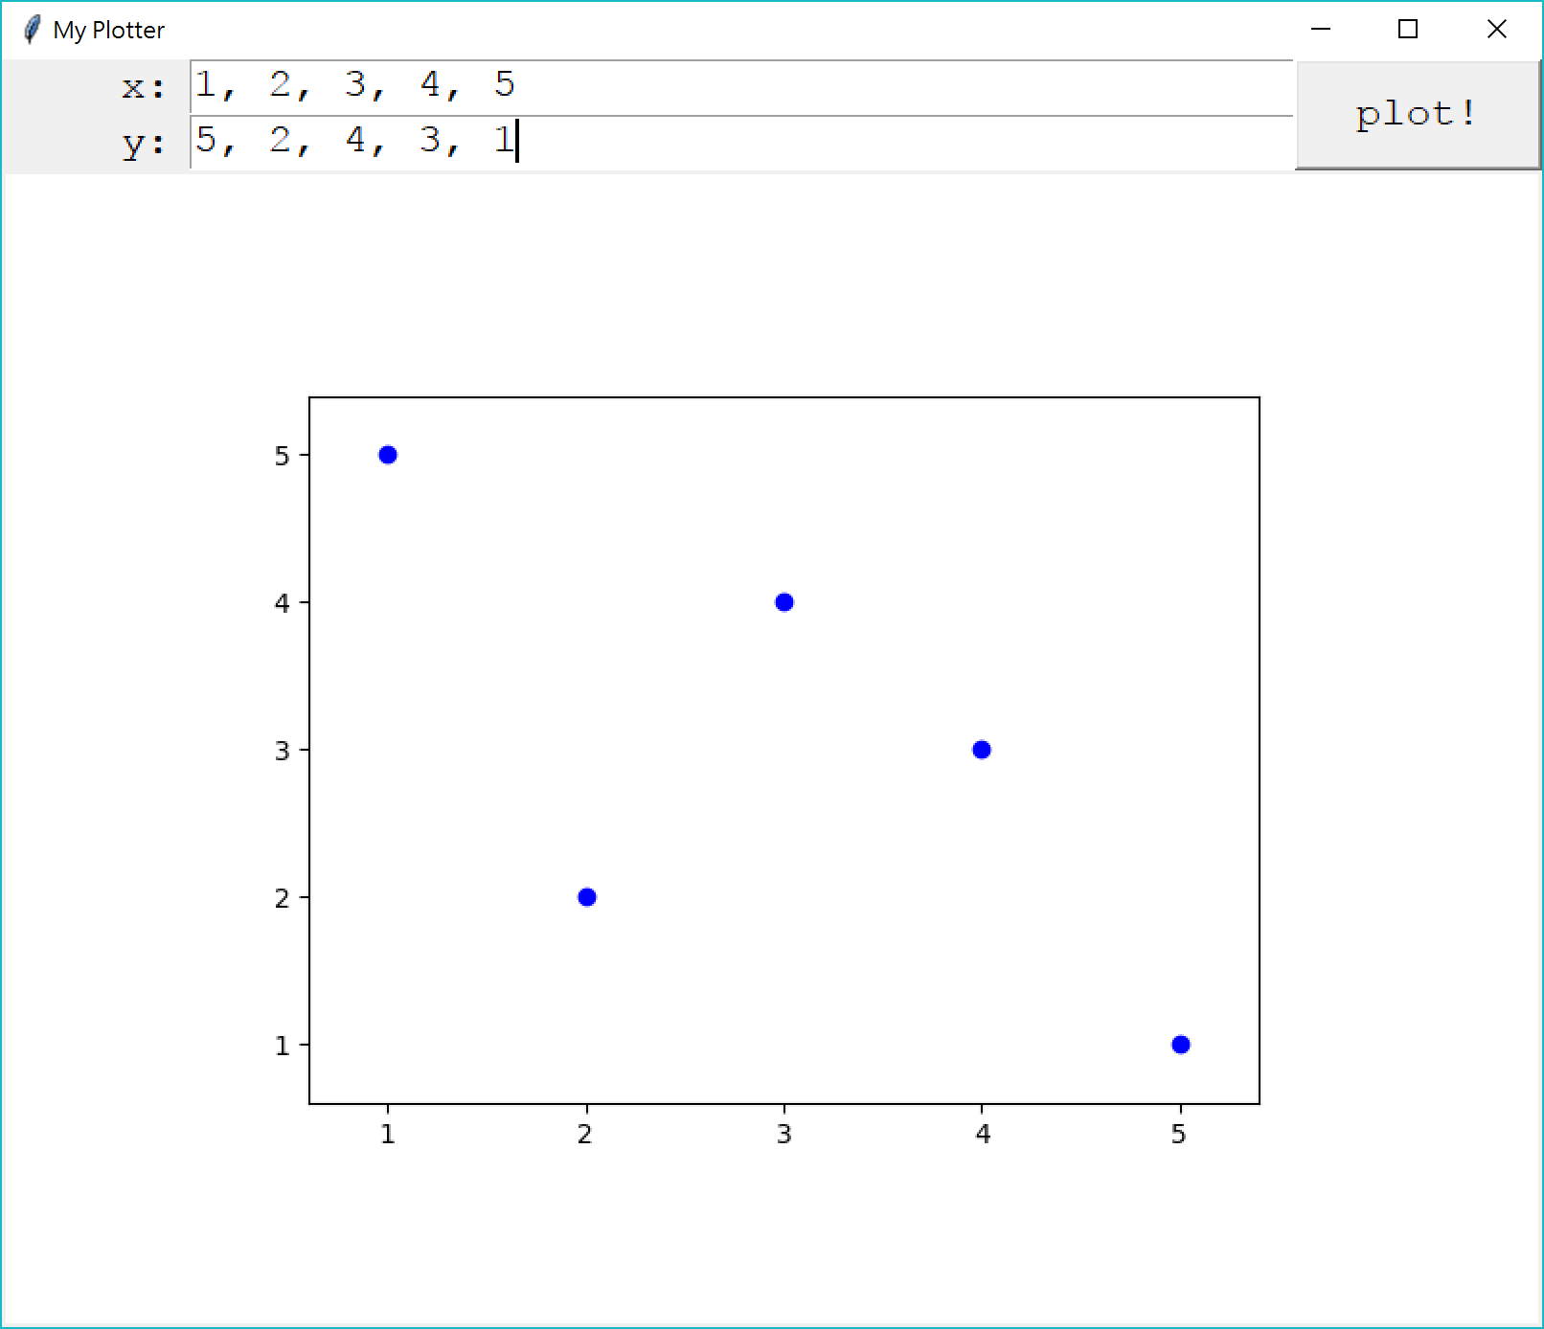
Plotter 3.0: revision
Basic concepts
Example 1: A simple square root calculator
Example 1B: A cool square root calculator
Example 2: A scatter plot plotter
Plotter 3.0 is in “Plotter3.py”.

Slide 49
Plotter 4.0: coordinates
Basic concepts
Example 1: A simple square root calculator
Example 1B: A cool square root calculator
Example 2: A scatter plot plotter
May we add coordinate labels onto the plot? Yes!
class Plotter(tk.Frame): # all others omitted
def makeScatter(self, x, y):
fig = pyplot.figure()
ax = fig.add_subplot(111)
rangeX = max(x) - min(x)
ax.set_xlim(min(x) - rangeX * 0.1, max(x) + rangeX * 0.1)
rangeY = max(y) - min(y)
ax.set_ylim(min(y) - rangeY * 0.1, max(y) + rangeY * 0.1)
pyplot.plot(x, y, 'bo')
for i, j in zip(x, y):
ax.annotate(str(j), xy = (i, j))
pyplot.savefig("temp.png")

Slide 50
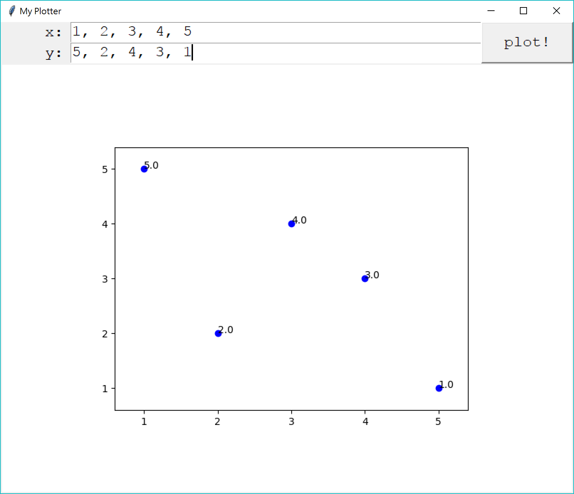
Plotter 4.0: coordinates
Basic concepts
Example 1: A simple square root calculator
Example 1B: A cool square root calculator
Example 2: A scatter plot plotter
Plotter 4.0 is in “Plotter4.py”.

Slide 51
Remarks
Basic concepts
Example 1: A simple square root calculator
Example 1B: A cool square root calculator
Example 2: A scatter plot plotter
GUI development motivated OOP.
Most of us in the future will not write programs to build a GUI.
However, the following concepts are good to know:
Objects, classes, and inheritance.
Modularization (e.g., each button is an object).
Event listeners.
To add more widgets and make more powerful applications, search online!

Slide 52
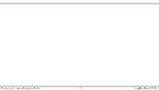


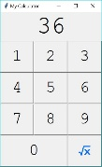



版權聲明
序 | 頁 | 作品 | 版權標章 | 作者 / 來源
1 | 1-53 |  |  | 台灣大學 孔令傑, CC BY-NC-ND 3.0
2 | 6 7 |  |  | 2005–2017 PCMan BBS Project, 洪任諭 http://pcman.ptt.cc/ 依據著作權法第46、52、65條合理使用 2017/10/13 visited
3 | 10 14 31 33 |  |  | Python Software Foundation, Guido van Rossum https://www.python.org/ 依據著作權法第46、52、65條合理使用 2017/10/13 visited
4 | 13 |  |  | Python Software Foundation, Guido van Rossum https://www.python.org/ 依據著作權法第46、52、65條合理使用 2017/10/13 visited
5 | 16 |  |  | Python Software Foundation, Guido van Rossum https://www.python.org/ 依據著作權法第46、52、65條合理使用 2017/10/13 visited
6 | 17 |  |  | Python Software Foundation, Guido van Rossum https://www.python.org/ 依據著作權法第46、52、65條合理使用 2017/10/13 visited

Slide 53

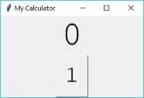

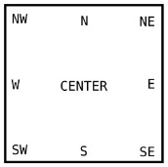


版權聲明
序 | 頁 | 作品 | 版權標章 | 作者 / 來源
7 | 18 |  |  | Python Software Foundation, Guido van Rossum https://www.python.org/ 依據著作權法第46、52、65條合理使用 2017/10/13 visited
8 | 19 |  |  | Python Software Foundation, Guido van Rossum https://www.python.org/ 依據著作權法第46、52、65條合理使用 2017/10/13 visited
9 | 22 |  |  | Python Software Foundation, Guido van Rossum https://www.python.org/ 依據著作權法第46、52、65條合理使用 2017/10/13 visited
10 | 23 |  |  | Python Software Foundation, Guido van Rossum https://www.python.org/ 依據著作權法第46、52、65條合理使用 2017/10/13 visited
11 | 24 |  |  | Python Software Foundation, Guido van Rossum https://www.python.org/ 依據著作權法第46、52、65條合理使用 2017/10/13 visited
12 | 25 31 |  |  | Python Software Foundation, Guido van Rossum https://www.python.org/ 依據著作權法第46、52、65條合理使用 2017/10/13 visited

Slide 54


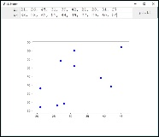
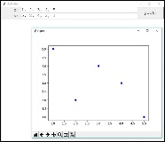
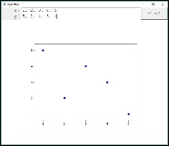
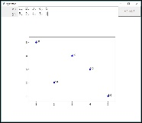
版權聲明
序 | 頁 | 作品 | 版權標章 | 作者 / 來源
13 | 32 |  |  | Python Software Foundation, Guido van Rossum https://www.python.org/ 依據著作權法第46、52、65條合理使用 2017/10/13 visited
14 | 35 |  |  | Python Software Foundation, Guido van Rossum https://www.python.org/ 依據著作權法第46、52、65條合理使用 2017/10/13 visited
15 | 40 |  |  | Python Software Foundation, Guido van Rossum https://www.python.org/ 依據著作權法第46、52、65條合理使用 2017/10/13 visited
16 | 44 |  |  | Python Software Foundation, Guido van Rossum https://www.python.org/ 依據著作權法第46、52、65條合理使用 2017/10/13 visited
17 | 48 |  |  | Python Software Foundation, Guido van Rossum https://www.python.org/ 依據著作權法第46、52、65條合理使用 2017/10/13 visited
18 | 50 |  |  | Python Software Foundation, Guido van Rossum https://www.python.org/ 依據著作權法第46、52、65條合理使用 2017/10/13 visited

