Slide 1

Skeena:
Efficient and Consistent Cross-Engine Transactions
Jianqiu Zhang, Kaisong Huang, Tianzheng Wang
Simon Fraser University
King Lv
Huawei Cloud Database Innovation Lab

Slide 2
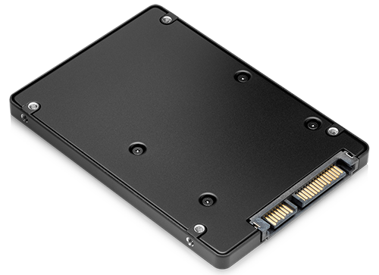
Traditional Database Engines are
Storage-Centric

Slide 3
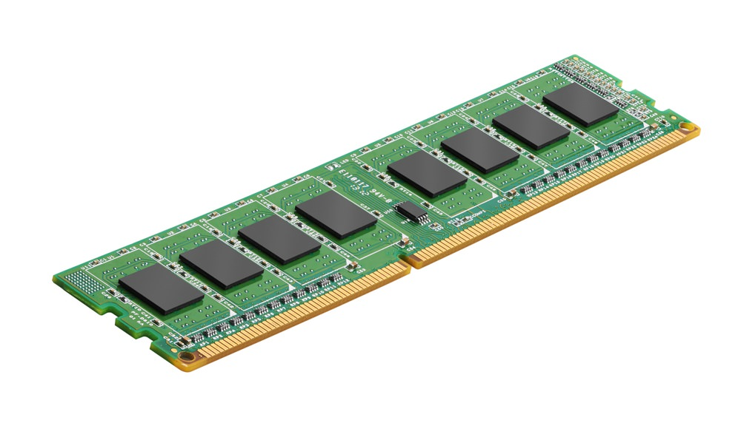

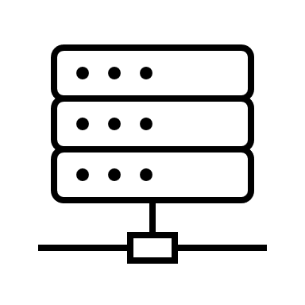


Memory-Optimized Database Engines
Multicore processors
100s GB of memory
+ Many more…
Working-set fully in-memory, million TPS

Slide 4



Suppose you are a DBMS architect...
Let's use a main-memory database engine.
DRAM is expensive.
Compatibility issues
Difficult to change the entire app.

Slide 5



Multi-Engine DBMS to the Rescue
memory-optimized engine
“fast”
>1 engines within one system
Normally are “fast-slow”
Place tables in suitable engines
Engines implement their own transaction management
Execute engine-level sub-transactions
SELECT * FROM Orders, Products
Common
SQL layer
Orders
Sounds trivial – just start + commit engine-level sub-transactions?
Products
storage-centric engine
“slow”

Slide 6


Example: Inconsistent Snapshots
Example: Inconsistent Snapshots
Snapshot Isolation
…
Snapshots
Time
BEGIN TRANSACTION
…
COMMIT

Slide 7
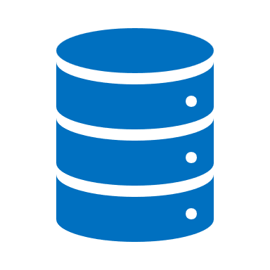


Example: Inconsistent Snapshots
When we have two engines,
When we have one engine,
Engine E1
timeline
…
S1
S1
T1
T1
T sees a fresher snapshot of E1
than S does
1000
2000
3000
3000+n
Engine E2
timeline
…
T2
S2
S sees a fresher snapshot of E2
than T does
10
20
30
30+n
S and T start before each other!
Key challenge: enforce global snapshot ordering

Slide 8
Even More Challenges
Inconsistent snapshots
Serializability
Atomicity and durability

Slide 9
Desirable Properties for Cross-Engine
Low overhead
Retain the performance of the faster side
Engine autonomy
Leave engines as-is, if possible
Full functionality
Various isolation levels
Easy adoption

Slide 10


Poorly Supported in Existing Systems
Many restrictions:
Not supported when the isolation level of both engines is Snapshot Isolation
HiEngine [SIGMOD’22 Industry 2]
Cross-engine transactions on the roadmap

Slide 11


Skeena
Photo: Sam
A central coordinator that enables processing transactions across different engines

Slide 12
Skeena in a Nutshell
Consists of a cross-engine snapshot registry (CSR) that tracks and selects snapshots as well as a commit protocol for multi-engine database systems
A cheap way to enforce global ordering
Leverages the characteristics of “fast-slow” multi-engine database systems
Follows the memory-optimized engine’s ordering (cheaper to get)

Slide 13


Cross-Engine Snapshot Registry (CSR)
1000
3000
Engine E1
timeline
S
T
Engine E2
timeline
100
200
T sees a fresher E1
S sees a fresher E2
Transaction | E1 Timestamp | E2 Timestamp
S | 1000
T | 3000 | 100
200
S and T start before each other!
**without CSR**
100
**with CSR**
**with CSR**
**without CSR**

Slide 14
Querying CSR
Fast engine
timestamp
Slow engine
timestamp
Approaches:
full table scan
building indexes for each engine’s timestamp
1000
40
2000
60
3000
60

Slide 15
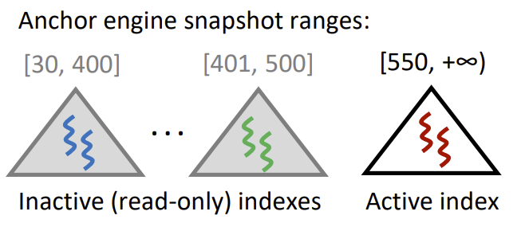
Lightweight CSR by Skeena
Anchor Engine
Always access “fast” side
Table -> Range Index
Multi-Index
Capacity is fixed but configurable
Add new index when full
Recycle by the threshold
=

Slide 16
Atomic Commit Protocol
1. Sub-transactions pre-commit
Obtain commit order (timestamp/LSN) from each engine
2. CSR commit check
Whether the transaction can commit without violating correctness criteria (e.g., snapshot consistency)
3. Sub-transactions post-commit
Mark new records as visible, finalize log records, etc.
4. Post-committed transactions go through the commit pipeline
(More details in paper)

Slide 17



Easy Integration in MySQL
SELECT * FROM …
Common SQL Layer (parser, networking...)
Skeena = 555 LoC
Memory-optimized engine, ERMIA*
Storage-centric engine, InnoDB
ERMIA code changes = 0 LoC
InnoDB code changes < 100 LoC
(200K LoC in total)
* ERMIA: Fast Memory-Optimized Database System for Heterogeneous Workloads, SIGMOD 2016

Slide 18
Experimental Setup
40-core dual-socket Xeon 6242R
Client/server each on a different socket
Single vs. cross-engine performance
Benchmarks
YCSB-like microbenchmarks
TPC-C

Slide 19
Single-Engine Performance Unaffected
Experimental configurations:
Prepared 250 tables x 250,000 records/tbl for each engine
The buffer pool size of InnoDB is 2GB, and the total data size in InnoDB is 13.5GB
Scheme | Read-only (TPS)
ERMIA | 1,427,071
ERMIA-S | 1,430,137
InnoDB | 456,672
InnoDB-S | 453,781
Takeaway:
Comparable performance with or without Skeena

Slide 20



Judicious Use of Both Engines
Recommended table placements:
• Payment-Opt: Only Customer in ERMIA to optimize Payment and Order-Status
• New-Order-Opt: Customer and Item in ERMIA to optimize New-Order
• Archive: All in ERMIA except History in InnoDB for lower storage cost
Memory-optimized for performance
Storage-centric for low-cost

Slide 21
Conclusion
Cross-engine transactions: useful but poorly supported
Correctness issues
Functionality limitations
Skeena: efficient and consistent cross-engine transactions
Cross-engine snapshot registry (CSR) to tracks and select snapshots
Pipelined commit for atomicity
Easy to adopt Skeena in real-world systems
Negligible overheads
Maintains the benefits of memory-optimized engines
Find out more in our paper and code repo!
https://github.com/sfu-dis/skeena
Thank you!

