Slide 1
Black-Scholes Functions
금융공학 프로그래밍 II
Fall 2017

Slide 2
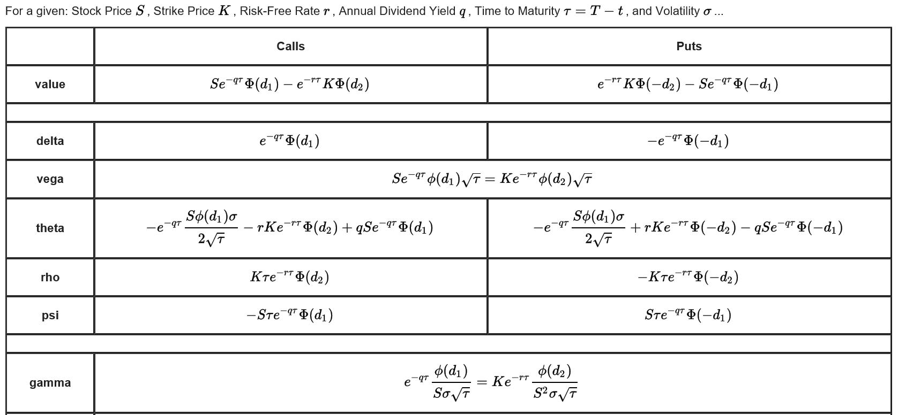
Black-Scholes Formula
From Wikipedia

Slide 3
Normal distribution pdf & cdf
pdf is straight forward.
cdf is not easy. (error function을 이용함)
double normalCFD(double value) {
return 0.5 * erfc(-value * M_SQRT1_2);
}
표준정규분포의 cdf
M_SQRT1_2 = 1/(√2)

Slide 4
Normal Dist. PDF & CDF
#define _USE_MATH_DEFINES
#include <cmath>
#include "normal.h"
double normpdf(double x, double mu, double sigma)
{
return 1.0/sqrt(2*M_PI)/sigma*exp(-0.5*(x-mu)*(x-mu)/(sigma*sigma));
}
double normcdf(double x, double mu, double sigma)
{
double v = (x - mu) / sigma;
return 0.5 * erfc(-v * M_SQRT1_2);
}

Slide 5
analytic_blackscholes.h
#ifndef _Analytic_BlackScholes_H
#define _Analytic_BlackScholes_H
enum OptionType { Call=1, Put=-1 };
double bsprice(double s,
double k,
double r,
double q,
double t,
double sigma,
OptionType type);
#endif

Slide 6
analytic_blackscholes.cpp
#include <cmath>
#include "analytic_blackscholes.h"
#include "normal.h"
double bsprice(double s,
double k,
double r,
double q,
double t,
double sigma,
OptionType type) {
double d1 = (log(s / k) + (r - q + 0.5*sigma*sigma)*t) / (sigma*sqrt(t));
double d2 = d1 - sigma*sqrt(t);
double nd1 = normcdf(type*d1);
double nd2 = normcdf(type*d2);
double price = type*(s*exp(-q*t)*nd1 - k*exp(-r*t)*nd2);
return price;
}

Slide 7
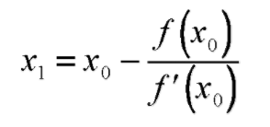
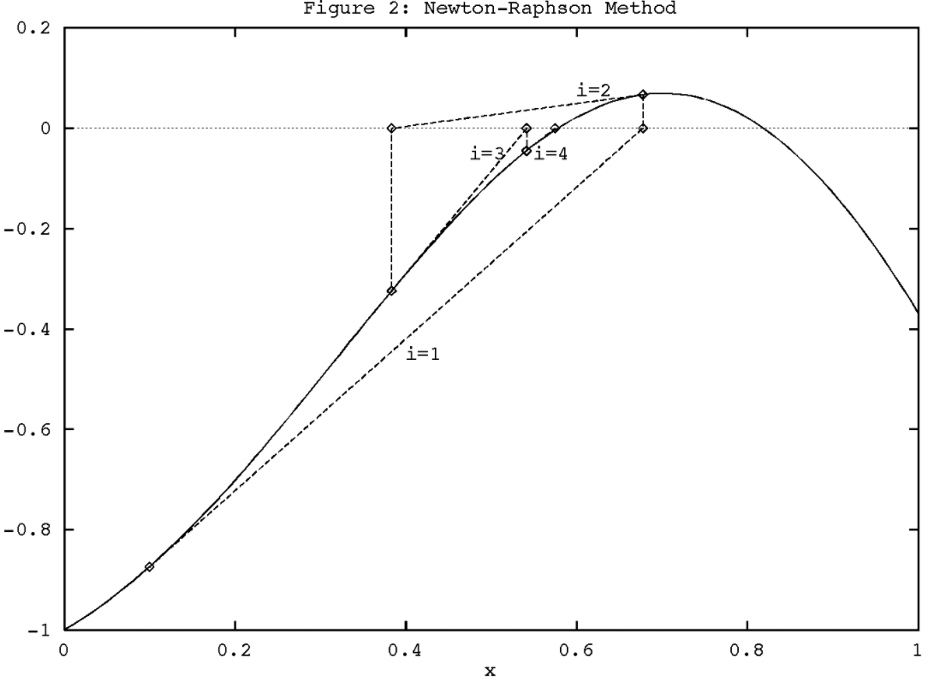
Newton-Raphson Method
The most widely used methods for root finding.

Slide 8
Calculating Vega
double bsvega(double s,
double k,
double r,
double q,
double t,
double sigma,
OptionType type) {
double d1 = (log(s / k) + (r - q + 0.5*sigma*sigma)*t) / (sigma*sqrt(t));
double npd1 = normpdf(d1);
double vega = s*exp(-q*t)*npd1*sqrt(t);
return vega;
}

Slide 9
Calculating Implied Volatility
double bsImpliedVol(double s,
double k,
double r,
double q,
double t,
double optionPrice,
OptionType type,
double init,
double tol) {
double x = init;
double e = 1;
while (e > tol) {
double diff = bsprice(s, k, r, q, t, x, type) - optionPrice;
e = abs(diff);
x = x - diff / bsvega(s, k, r, q, t, x, type);
}
return x;
}

Slide 10
Random number
rand() / srand(seed)
rand() : 0과 RAND_MAX 사이의 임의의 정수 리턴
srand(seed) : pseudo-random number 생성을 위한 seed 값 설정
Seed number 는 unsigned int 형임
v1 = rand() % 100; // v1 in the range 0 to 99
v2 = rand() % 100 + 1; // v2 in the range 1 to 100
v3 = rand() % 30 + 1985; // v3 in the range 1985-2014

Slide 11
Sample Code
#include <iostream>
int main() {
for (int i = 0; i < 10; ++i) {
// srand(10);
std::cout << rand() << std::endl;
}
return 0;
}
srand(10)을 실행할 경우와 아닌 경우 결과 비교

Slide 12
<random> Library
#include <random>
C++ 11 에서 추가된 header
Generators: uniform distribution 의 난수 생성
Distributions: generator에서 생성된 난수를 해당 분포로 transform
Generator
default_random_engine
mt19937
mt19937_64
Distributions
binomial_distribution
poisson_distribution
exponential_distribution
normal_distribution
lognormal_distribution etc.

Slide 13
Sample Code
#include <iostream>
#include <random>
#include <string>
int main() {
const int nrolls = 10000; // number of experiments
const int nstars = 100; // maximum number of stars to distribute
std::default_random_engine generator;
std::normal_distribution<double> distribution(5.0, 2.0);
int p[10] = {};
for (int i = 0; i<nrolls; ++i) {
double number = distribution(generator);
if ((number >= 0.0) && (number<10.0)) ++p[int(number)];
}
std::cout << "normal_distribution (5.0,2.0):" << std::endl;
for (int i = 0; i<10; ++i) {
std::cout << i << "-" << (i + 1) << ": ";
std::cout << std::string(p[i] * nstars / nrolls, '*') << std::endl;
}
return 0;
}

