Slide 1
Program Name goes here
Link to github Repository:
github
Links to trello board / project management tools:
planner
You MUST provide evidence showing how the problem has been decomposed, how the components have been developed and trialled, and of how they have been assembled and tested to create a final, working outcome.

Slide 2
Relevant Implications
Explain the relevant implications here. Please watch this video to learn how to do this.
Notes:
Explain the relevant implications here. Then as you work, develop your code, discuss how the implications are being met.

Slide 3
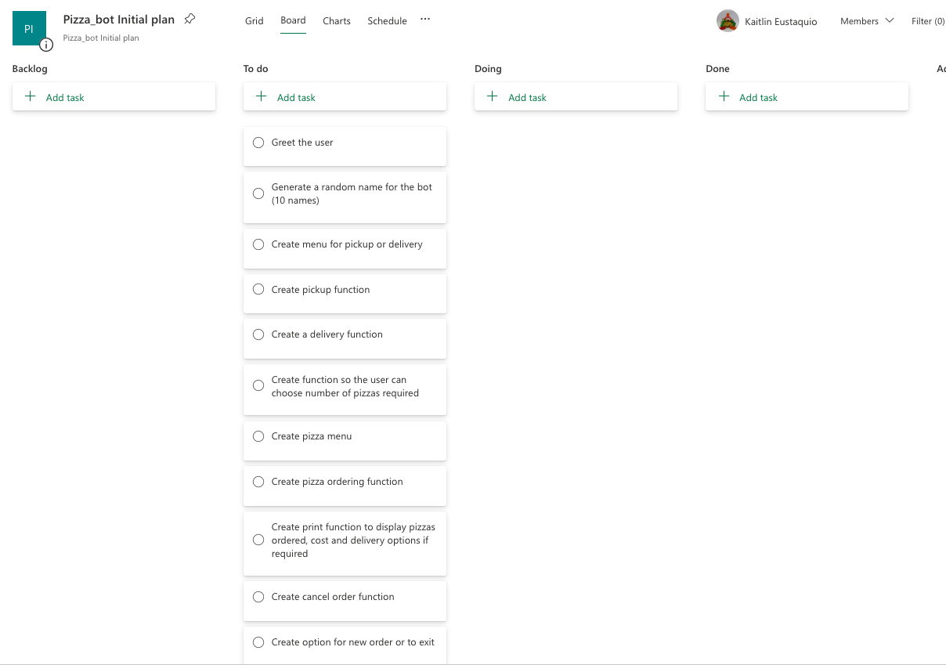
Decomposition
Notes:
Paste screenshots of your initial Trello board / task decomposition on this slide. If you have a long list, you might need to break it up into several columns. Delete this instruction when you are done.

Slide 4
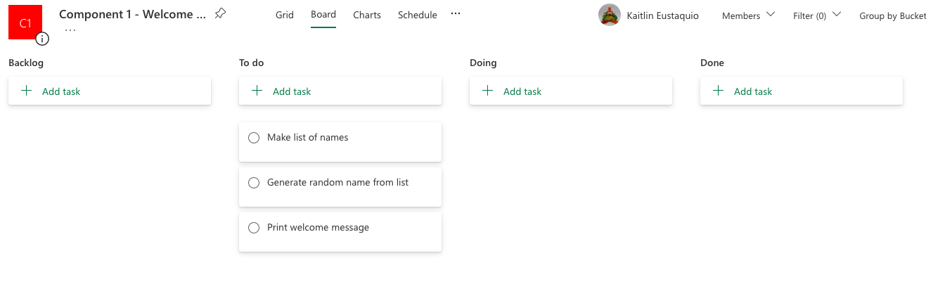
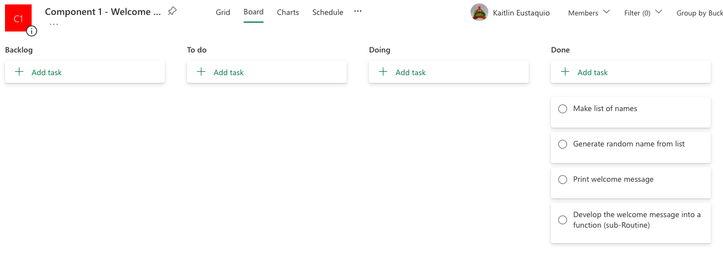
Component 1

Slide 5
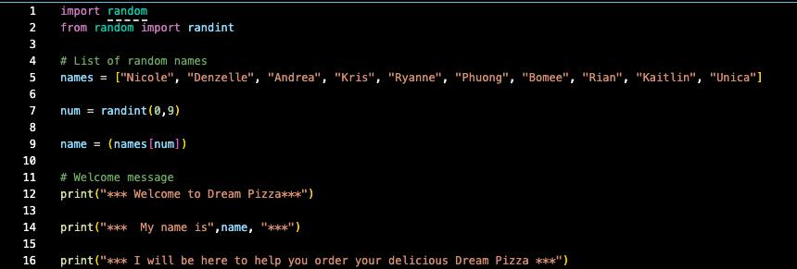

Component 1 v1- Test Plan (and screenshot)
Test Case | Expected Values
Run program | Print welcome message with random name from list of names – Runs correctly

Slide 6
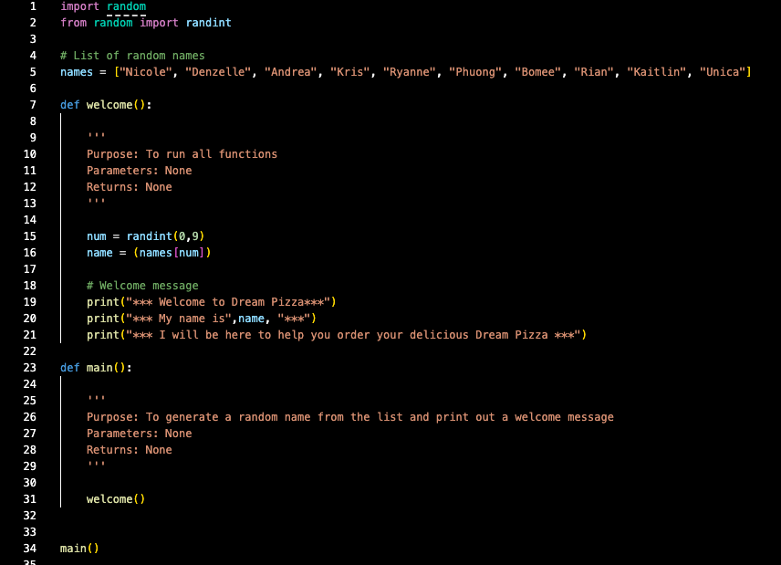

Component 1 v2- Test Plan (and screenshot)
Test Case | Expected Values
Run program | Main and welcome run correctly. Welcome message prints with random name.

Slide 7
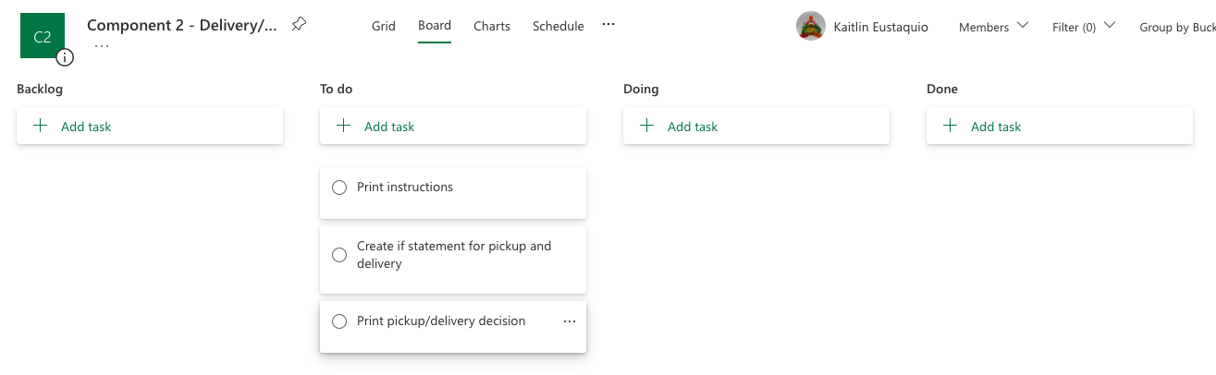
Component 2 (Trello screenshot)

Slide 8
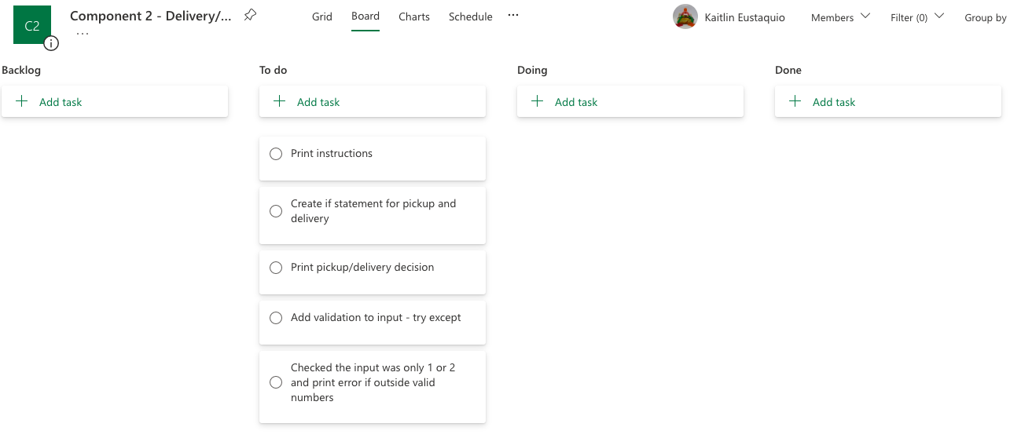
Component 2 (Trello screenshot)

Slide 9
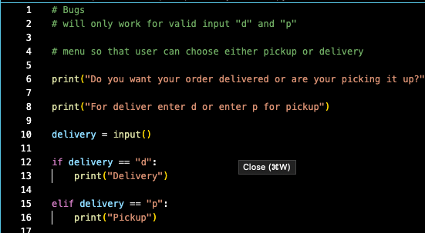



Component 2 v1 - Test Plan (?and screenshot)
Test Case | Expected Values
Run program | Enter p and the program prints pickup Enter d and the program prints delivery Enter invalid and the program stops

Slide 10
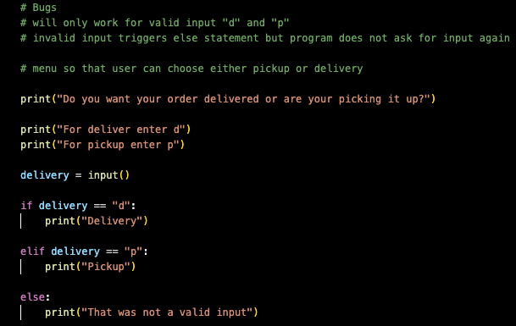



Component 2 v2 - Test Plan (and screenshot)
Test Case | Expected Values
Run program | Enter p and the program prints pickup Enter d and the program prints delivery Enter invalid and the program prints error message

Slide 11
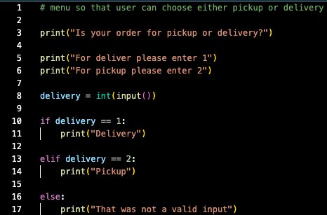



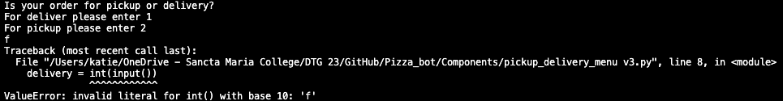
Component 2 v3 - Test Plan (and screenshot)
Test Case | Expected Values
Run program | Enter 1 and the program prints pickup Enter 2 and the program prints delivery Enter invalid integer and the program prints error message Enter invalid and the program displays value error

Slide 12
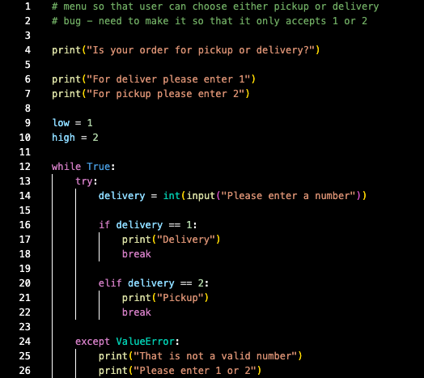
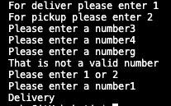
Component 2 v4 - Test Plan (and screenshot)
Test Case | Expected Values
Run program | Enter 1 and the program prints pickup Enter 2 and the program prints delivery Enter invalid and the program prints error message and ask for input again Enter invalid integer and the program does nothing

Slide 13
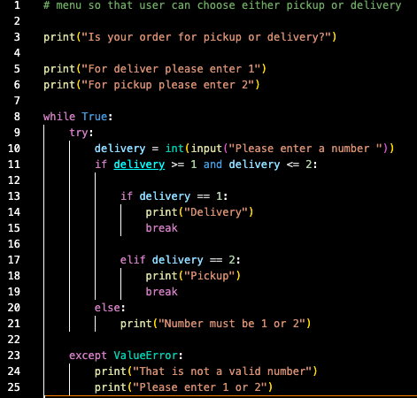
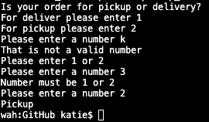
Component 2 v5 - Test Plan (and screenshot)
Test Case | Expected Values
Run program | Enter 1 and the program prints pickup Enter 2 and the program prints delivery Enter invalid and the program prints error message and asks for input again Enter invalid integer and the program prints error message and asks for input again

Slide 14
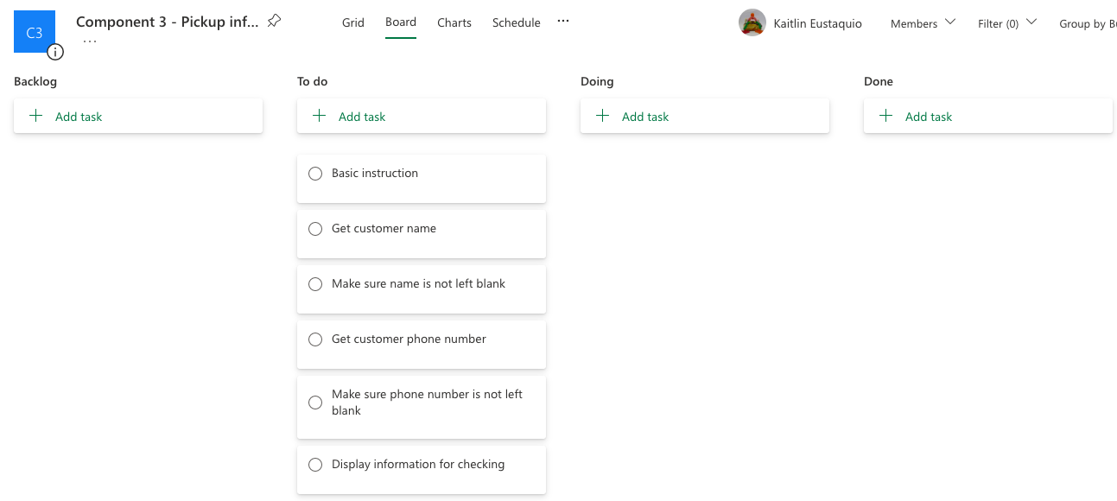
Component 3 (Trello screenshot)

Slide 15
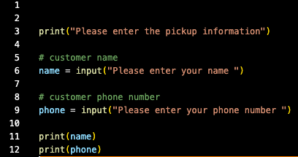



Component 3 v1 - Test Plan (and screenshot)
Test Case | Expected Values
Input name Input number Left input blank | Name printed correctly, can input both integers and letters Number printed correctly, can input both integers and letters Accepted blank and printed blank input

Slide 16
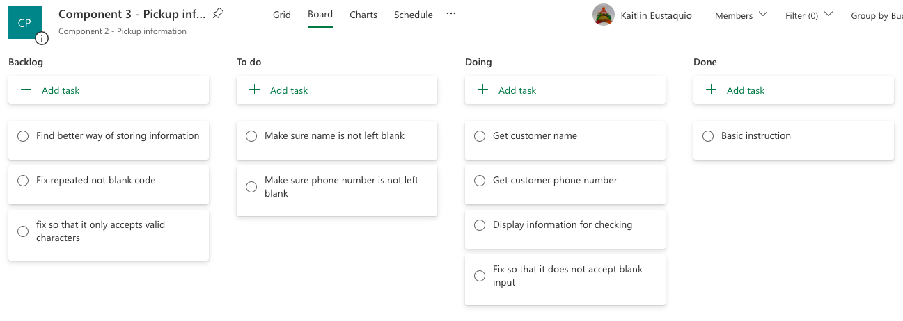
Component 3 (Trello screenshot)

Slide 17
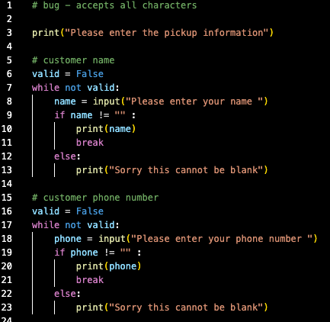
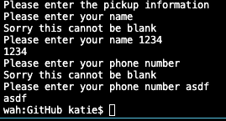
Component 3 v2 - Test Plan (and screenshot)
Test Case | Expected Values
Input name Input number Left input blank | Name printed correctly, can input both integers and letters Number printed correctly, can input both integers and letters Prints error message and asks for input again

Slide 18
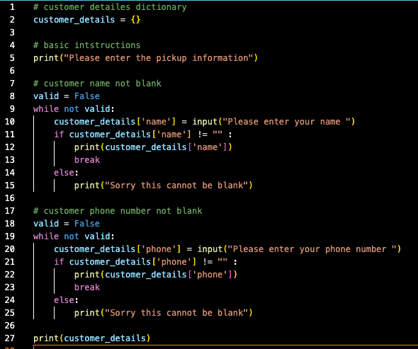
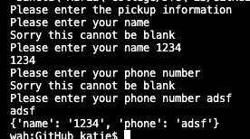
Component 3 v3 - Test Plan (and screenshot)
Test Case | Expected Values
Input name Input number Left input blank | Printed correctly, can input both integers and letters Printed correctly, can input both integers and letters Prints error message and asks for input again

Slide 19
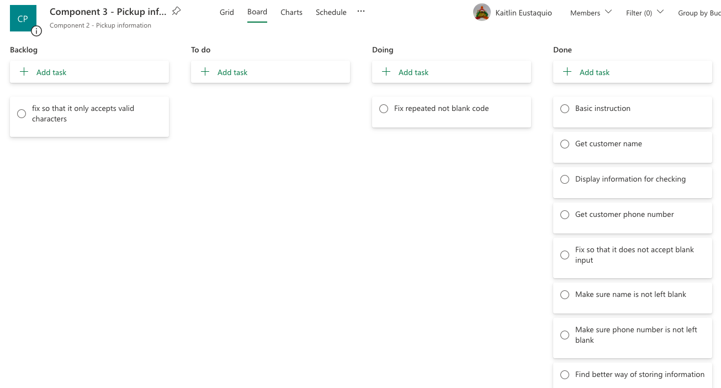
Component 3 (Trello screenshot)

Slide 20
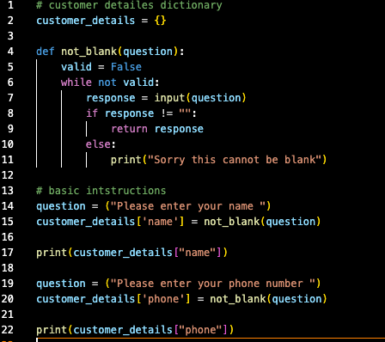
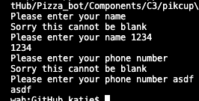
Component 3 v4 - Test Plan (and screenshot)
Test Case | Expected Values
Input name Input number Left input blank | Printed correctly, can input both integers and letters Printed correctly, can input both integers and letters Prints error message and asks for input again

Slide 21
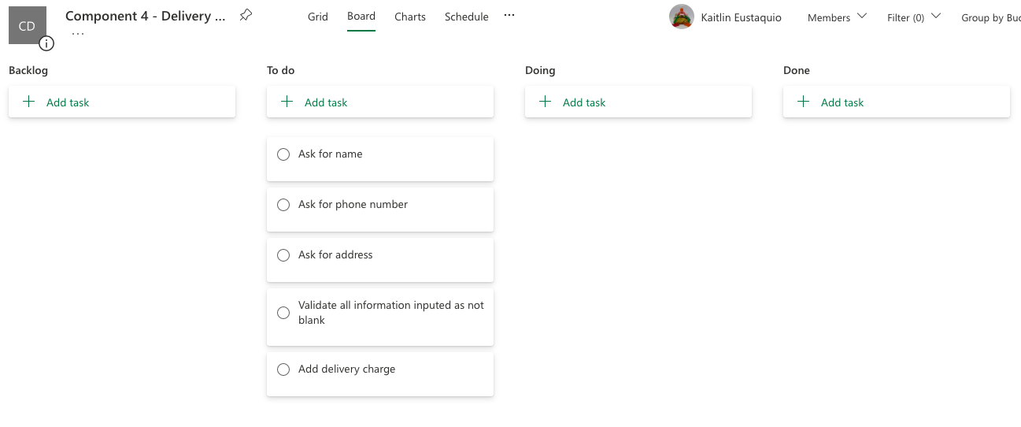
Component 4 (Trello screenshot)

Slide 22
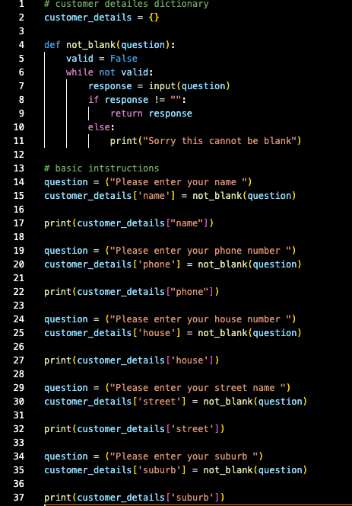
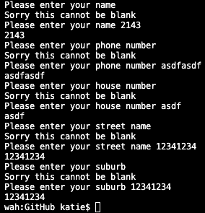
Component 4 v1 - Test Plan (and screenshot)
Test Case | Expected Values
Input name Input number Input address (house number, street name, suburb) Left input blank | Printed correctly, can input both integers and letters Printed correctly, can input both integers and letters Printed correctly, can input both integers and letters Prints error message and asks for input again

Slide 23
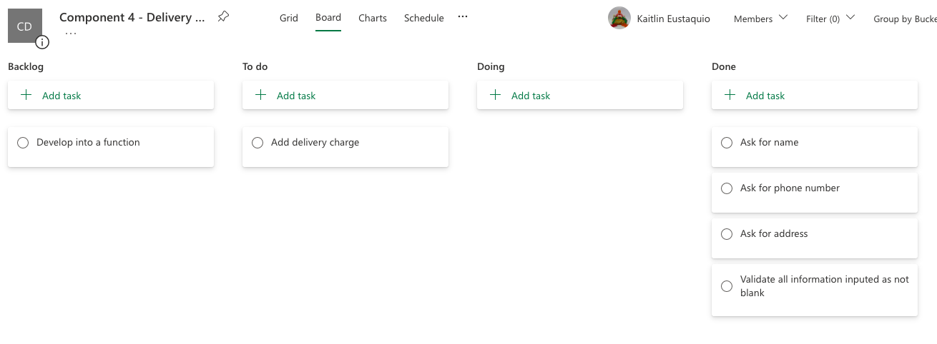
Component 4 (Trello screenshot)

Slide 24
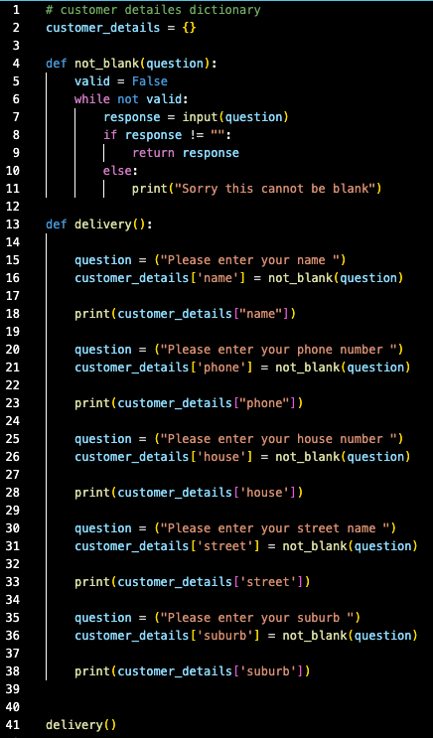
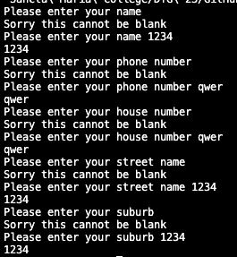
Component 4 v2 - Test Plan (and screenshot)
Test Case | Expected Values
Input name Input number Input address (house number, street name, suburb) Left input blank | Printed correctly, can input both integers and letters Printed correctly, can input both integers and letters Printed correctly, can input both integers and letters Prints error message and asks for input again

Slide 25
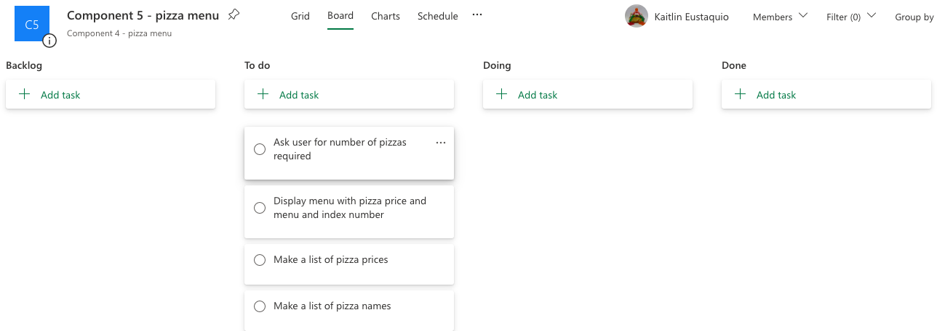
Component 5 (Trello screenshot)

Slide 26
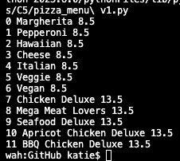
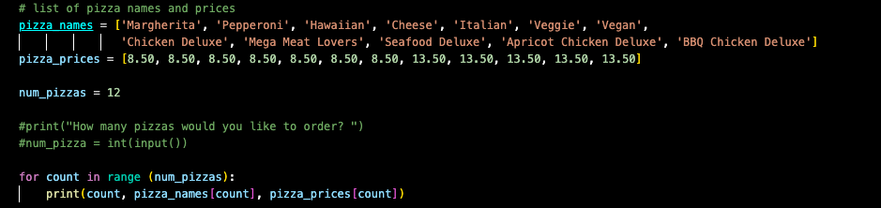
Component 5 v1 - Test Plan (and screenshot)
Test Case | Expected Values
Run file | Printed a list with index number, pizzas and prices

Slide 27
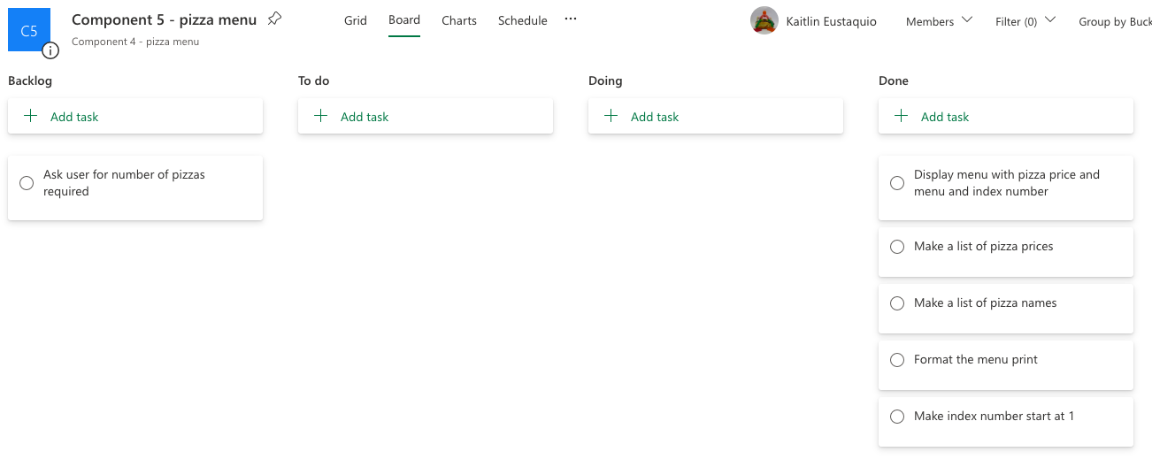
Component 5 (Trello screenshot)

Slide 28
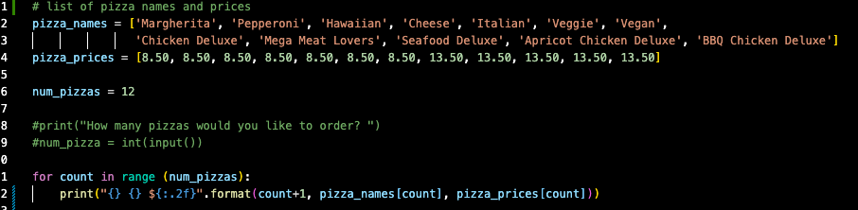
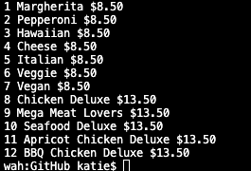
Component 5 v2 - Test Plan (and screenshot)
Test Case | Expected Values
Run file | Printed a list with index number, pizzas and prices. Price formatted to 2 decimal places and dollar sign. Starts at 1

Slide 29
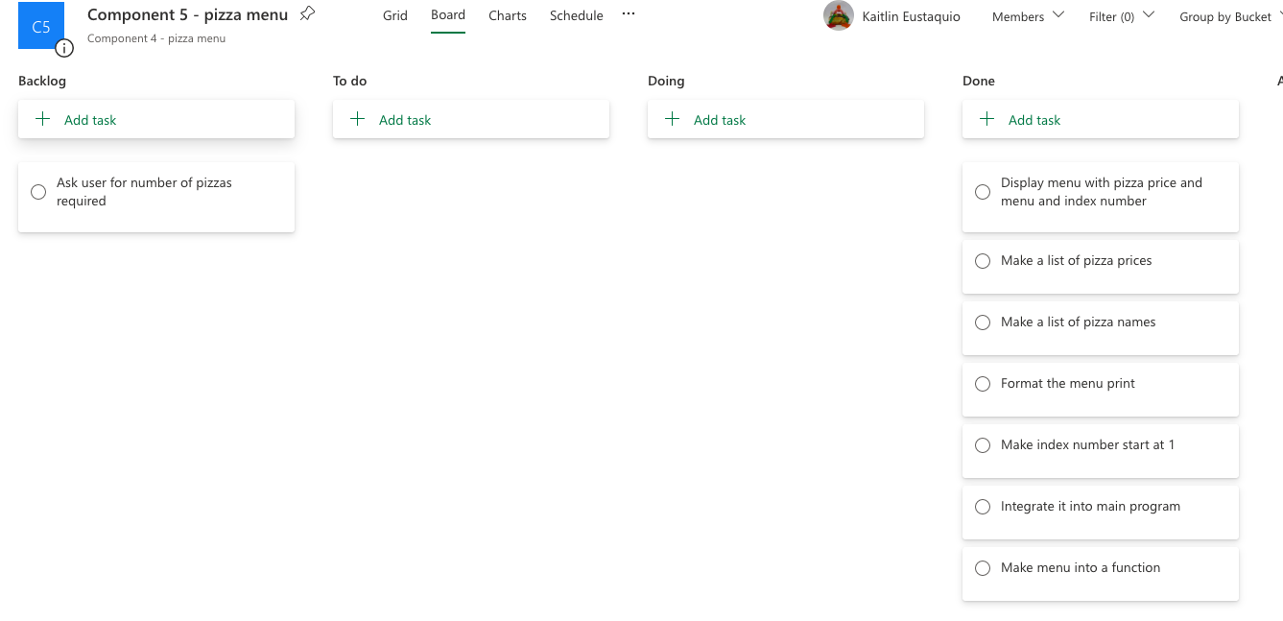
Component 5 (Trello screenshot)

Slide 30
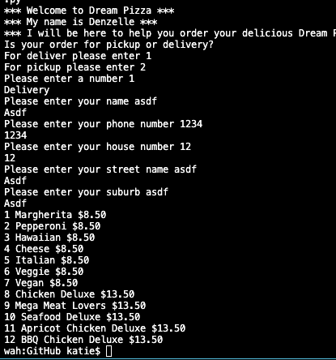
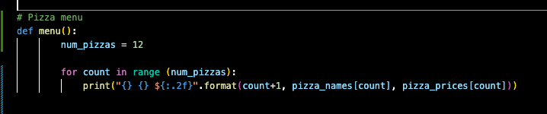
Component 5 v3 – integrated to main program
Test Case | Expected Values
Run file | Printed a list with index number, pizzas and prices. Price formatted to 2 decimal places and dollar sign. Starts at 1

Slide 31
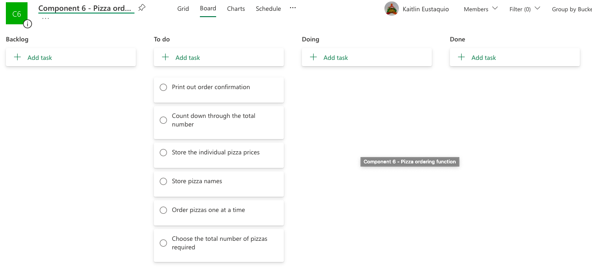
Component 6 (Trello screenshot)

Slide 32
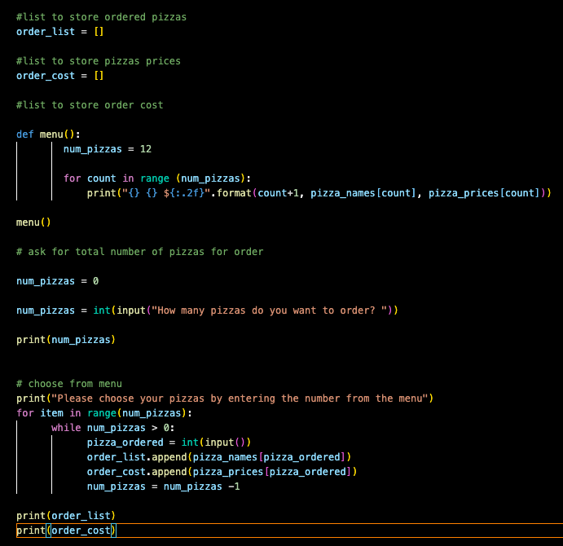
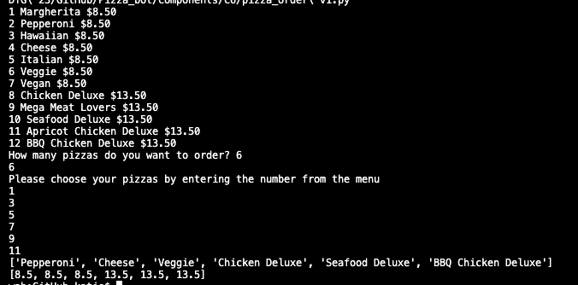
Component 6 v1 - Test Plan (and screenshot)
Test Case | Expected Values
Entered 6 pizzas | Stepped through the menu choice 6 times

Slide 33
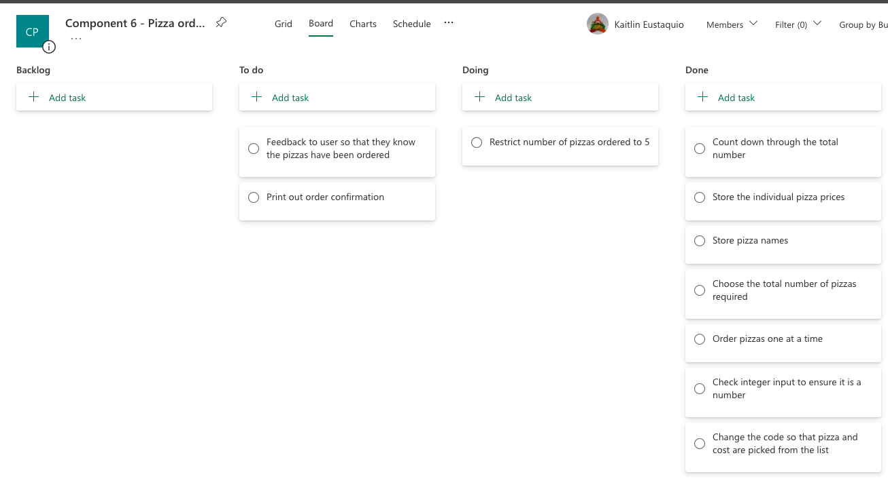
Component 6 (Trello screenshot)

Slide 34
Component v - Test Plan (and screenshot)
Test Case | Expected Values

Slide 35
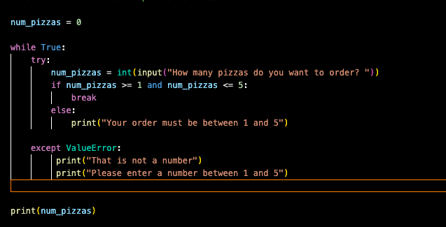
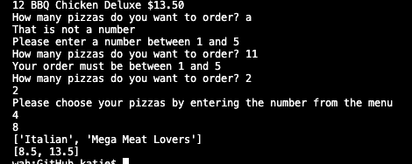
Component v - Test Plan (and screenshot)
Test Case | Expected Values
Input not a number Input a number above 5 Input 2 Input 4 and 8 | Printed that is not a number and asks for input again Printed number must be 1-5 and asks for input again Accepted input and prints choose which pizzas Correctly picks pizzas and costs and prints chosen pizza and its cost

Slide 36
Component v - Test Plan (and screenshot)
Test Case | Expected Values

Slide 37
Component v - Test Plan (and screenshot)
Test Case | Expected Values

Slide 38
Component v - Test Plan (and screenshot)
Test Case | Expected Values

Slide 39
Version Control Evidence
Your version control evidence should go here. This could be in the form of annotated screenshots which show you you managed this process or you could make a brief screencast explaining how you implemented version control.
Notes:
Your version control evidence should go here. This could be in the form of annotated screenshots which show you you managed this process or you could make a brief screencast explaining how you implemented version control.

Slide 40
Discusses how the information from planning, testing and trialling of components assisted in the development of a high-quality outcome
Notes:
Discusses how the information from planning, testing and trialling of components assisted in the development of a high-quality outcome

