Slide 1
Joins
Paige Pfenninger and Kaitlyn Keil

Slide 2
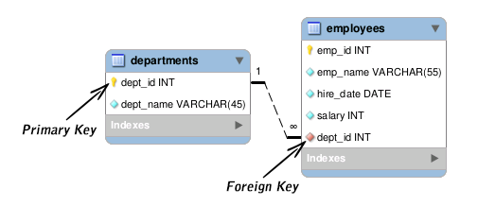
Definition
Relational database operation
Combine data tables based on some attribute, called the ‘join attribute’
Similar to taking a product and selecting for conditions
Result in tuples that are the combination of the former tables
Often used to connect primary keys with foreign keys
https://www.tutorialrepublic.com/sql-tutorial/sql-constraints.php
Notes:
Kaitlyn

Slide 3
Join Types

Slide 4
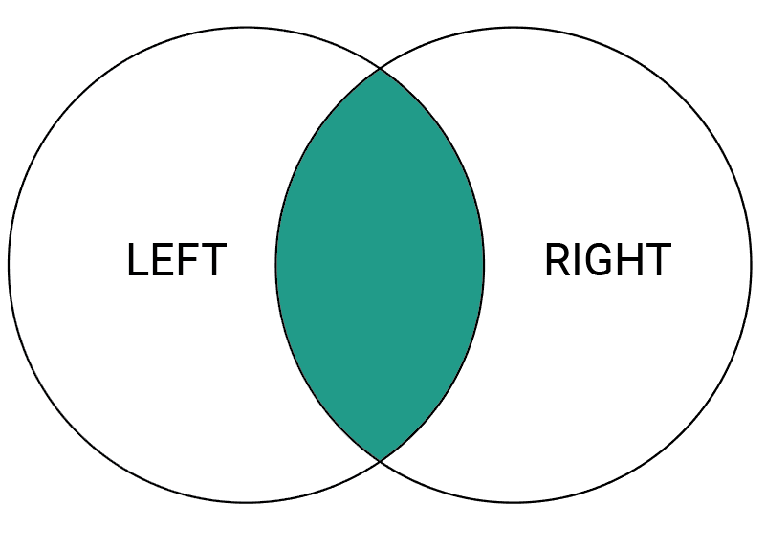
Inner Join
Occurs on some column name (or names)
Returns only the tuple combinations that satisfy the predicate
Naively, product and select on join predicate
SELECT *
FROM table1 INNER JOIN table2
ON table1.column_name > table2.column_name;
Notes:
Paige

Slide 5
Equi Join
Equi Joins are a subclass of inner joins.
Inner joins can use several different relational operators, whereas the relational operator in an equi join must be = (equal to)
Subcategory: Natural Joins
Automatically does Equi Join on a column with the same name in both relations
SELECT *
FROM table1 INNER JOIN table2
ON table1.column_name = table2.column_name;
Notes:
Paige

Slide 6
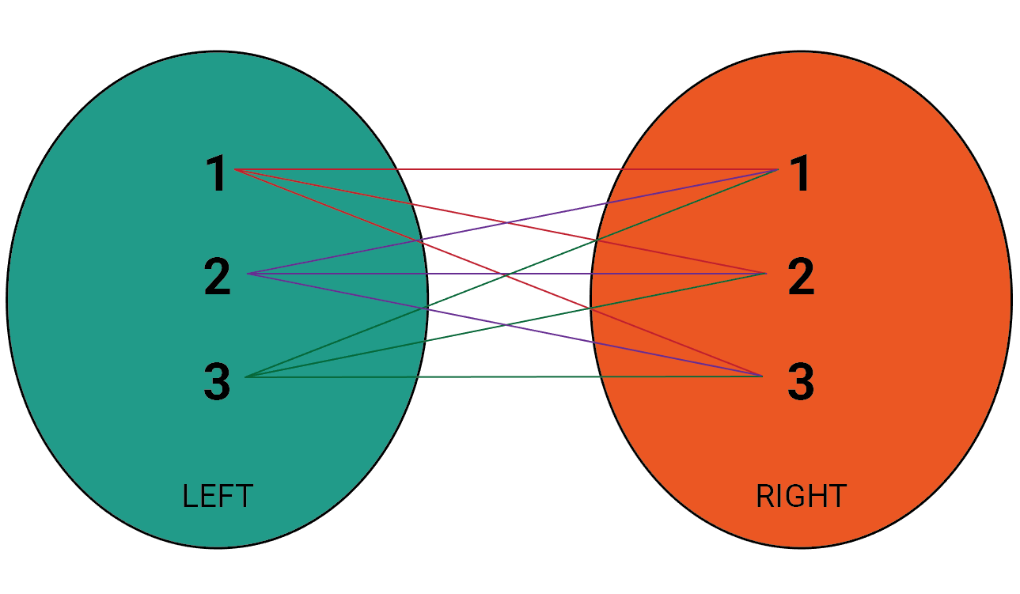
Cross Join
If no WHERE clause is specified, the cross join is just a Cartesian product
Otherwise, functions the same as an inner join
Useful when trying to find all possible combinations
SELECT *
FROM table1
CROSS JOIN table2;
Notes:
Paige

Slide 7
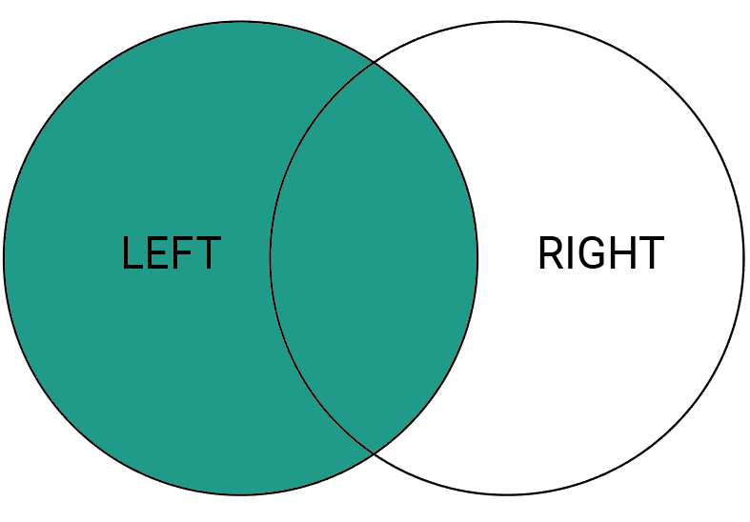
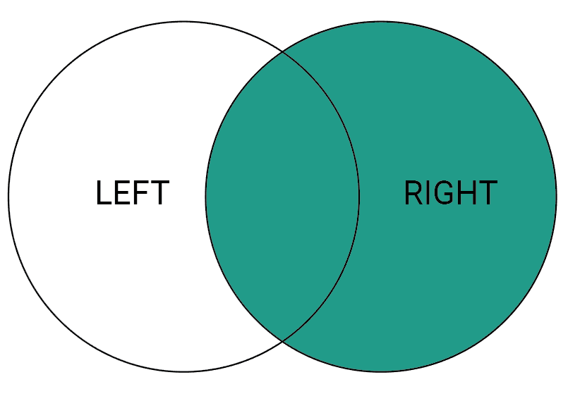
Left/Right Outer Join
Retains rows of the specified relation even if no match exists
If no match, populates the row with null values
Has all the entries of the left/right, plus all values from inner join
SELECT *
FROM table1 LEFT JOIN table2
ON table1.column_name = table2.column_name;
SELECT *
FROM table1 RIGHT JOIN table2
ON table1.column_name = table2.column_name;
Notes:
Paige

Slide 8
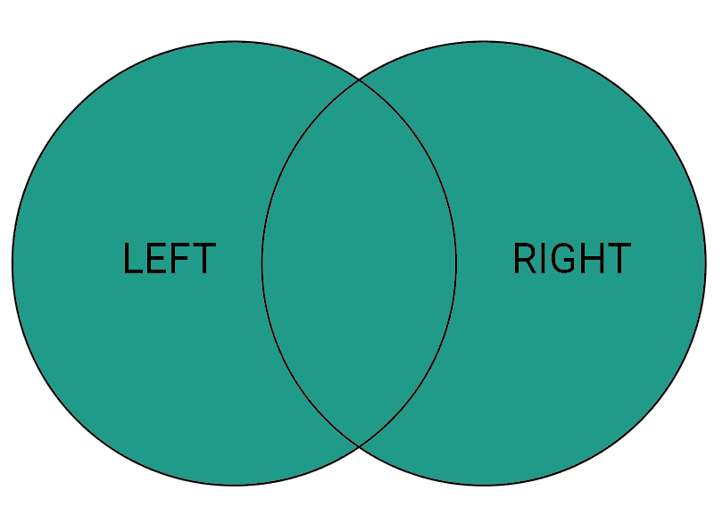
Full Outer Join
Retains all the entries of both relations, with predicate-satisfying tuples connected
If no match, populates the row with null values
No data loss
SELECT *
FROM table1 OUTER JOIN table2
ON table1.column_name = table2.column_name;
Notes:
Paige

Slide 9
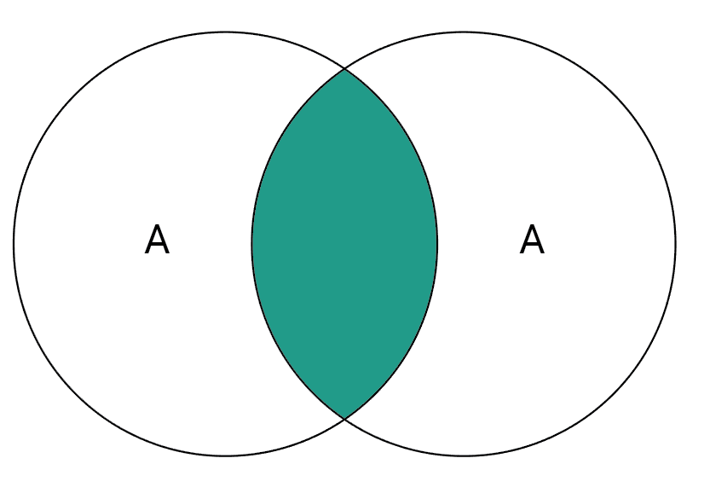
Self Join
Joins a table to itself
To work properly, must examine two separate columns
Consider EMPLOYEE with an emp_id and a emp_supv
Performs as if it has two copies of the relation without doubling it
Generally requires renaming
SELECT a.emp_id AS "Emp_ID",a.emp_name AS "Employee Name",
b.emp_id AS "Supervisor ID",b.emp_name AS "Supervisor Name"
FROM employee a, employee b
WHERE a.emp_supv = b.emp_id;
Notes:
paige

Slide 10
Reason
In advanced queries:
Allows the user to specify scan order of relations
Allows for filtering before joining
Generally more readable
NULL handling
NOT using it is basically just an implicit join
Notes:
Kaitlyn

Slide 11
Issues
Can be very slow if not optimized in some way
Primary keys can be difficult in final result
Multiple entries with same primary key
NULL primary keys
Continues to be essentially product and select
Notes:
Kaitlyn

Slide 12
Implementations

Slide 13
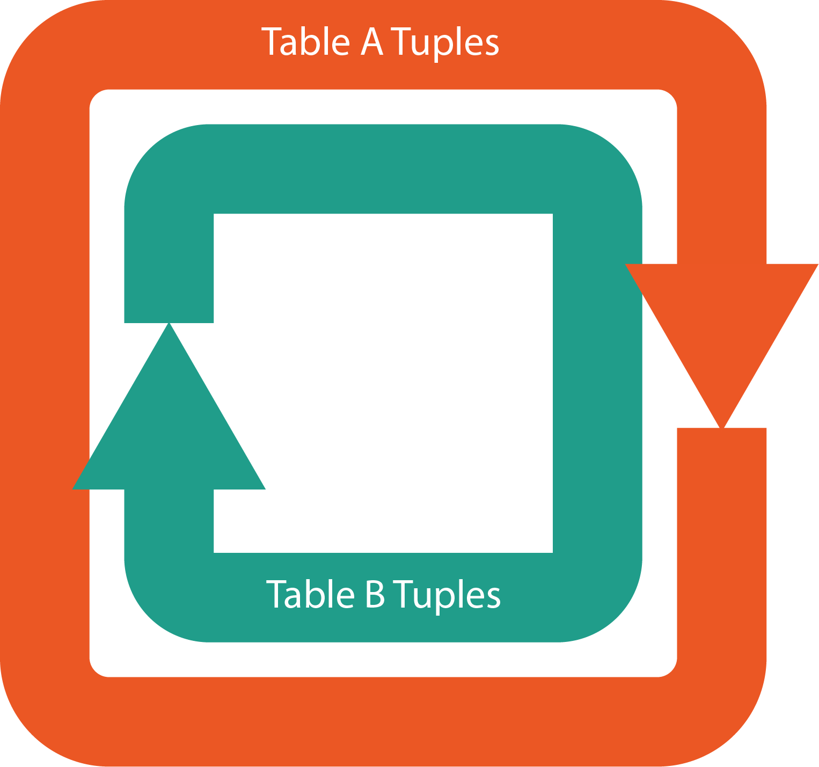
Nested Loop
For each tuple in Table A:
Checks join attribute against each tuple in Table B
Adds tuples which satisfy predicate to temporary table
Generally simple but slow
Works well for comparisons that aren’t equality
Notes:
Paige

Slide 14
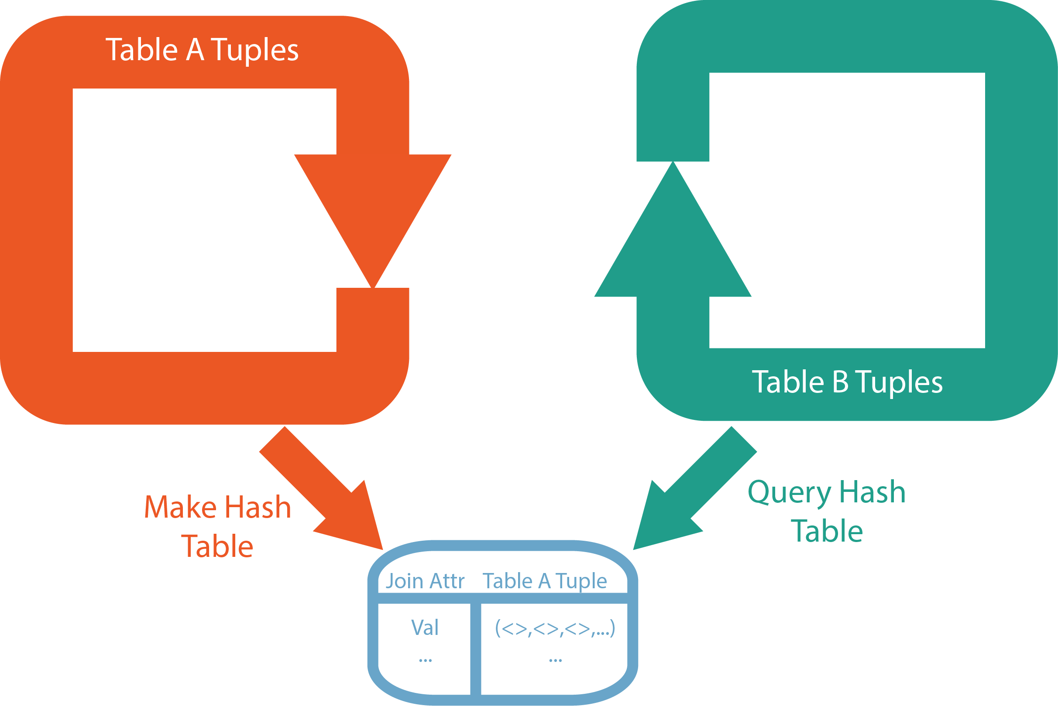
Hash
For equality comparisons, nested loops might be too long
For hash joins:
Iterate over first table to build temporary hash table
Key is join attribute
Iterate over second table and probe for join attribute
If found, add tuple to results
Speed at the cost of memory
Notes:
Kaitlyn

Slide 15
Merge
Faster than nested and less memory-intensive than hash
Sorts both tables on join attribute
Loops through both simultaneously, advancing when one value is behind
Good for comparing greater than/less than as well as equality
Notes:
Kaitlyn

Slide 16
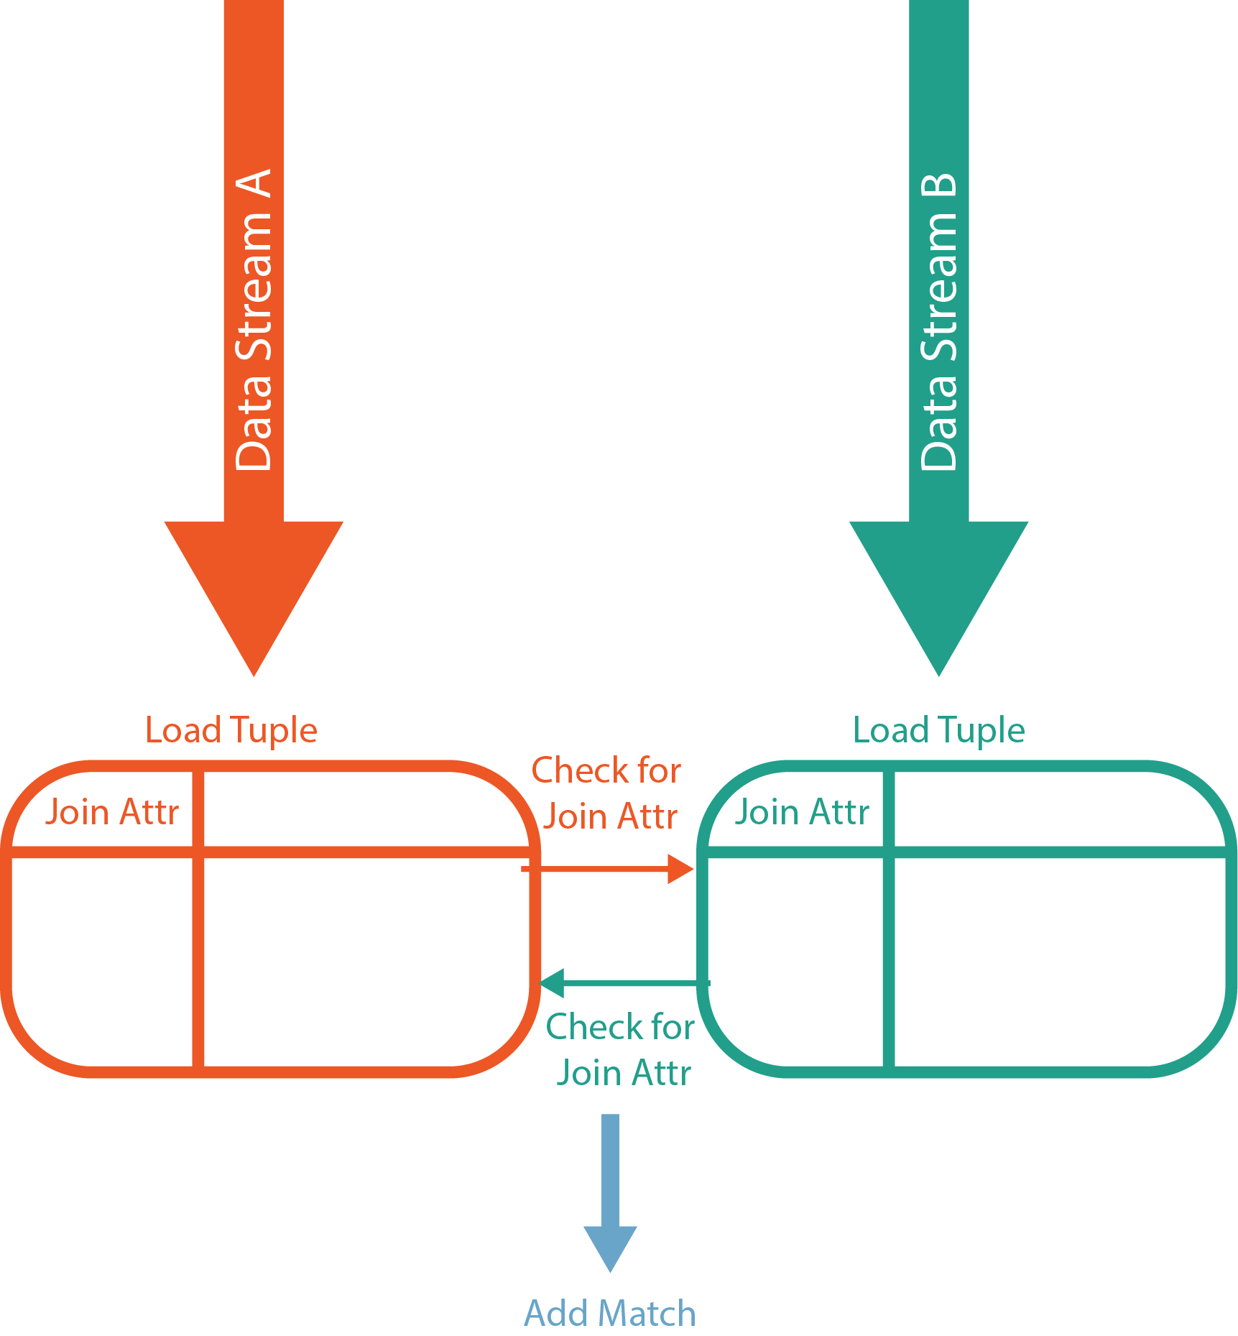
Symmetric Hash
Enhancement of Hash Join algorithm
Designed for data streams specifically
Creates a hash table from each side
Each new entry checks if there is an already existing one
If so, adds the new tuple
Notes:
Kaitlyn

Slide 17
Block Nested Loop
As many blocks as possible in Table A are loaded into memory.
Table B is then scanned while looking for matches in Table A. Any matches found are put into result stream
Repeat process until all blocks in Table A have been loaded into memory
Generally only used for outer joins and semi joins
Notes:
Paige

Slide 18
Questions

Slide 19
Works Cited
https://www.periscopedata.com/blog/how-joins-work
http://www.sql-join.com/
https://en.wikipedia.org/wiki/Join_(SQL)
https://mariadb.com/kb/en/library/block-based-join-algorithms/

