Slide 1



Central Asia Edition
A low-pressure, inclusive digital health platform for everyday recovery, posture repair and local home-care services.
Health Recovery
5-in-1
Not high-intensity fitness
Content + AI + local services

Slide 2
Investment Storyline
01
Positioning
Serve the 90% mainstream population that traditional fitness apps overlook.
Pitch Goal
Show that LightFit is ready to launch, differentiated enough to defend, and financially scalable.
02
Product
Low-threshold recovery content, AI support, privacy-first data and home services.
03
Market
Central Asia offers fast smartphone adoption and low health-app penetration.
04
Model
Five revenue engines build subscription income and service-led upside.
05
Execution
36-month rollout from two core markets to five-country coverage.

Slide 3
Executive Snapshot
The business plan frames LightFit as a ready-to-launch health recovery platform.
INVESTMENT SNAPSHOT
90%
ordinary users underserved by high-intensity fitness apps
5-in-1
emotion, posture, sedentary recovery, special care, home service
v7.2
core product version completed and tested
M18
single-month breakeven target
¥113.76M
projected total revenue in Year 3
6M
projected registered users by Year 3
Core thesis
Move away from “fitness anxiety” and toward inclusive, local, privacy-first health recovery for everyday users.

Slide 4
Strategic Positioning: Recovery Instead of Fitness Anxiety
LightFit enters a blue-ocean need: low-pressure, everyday health recovery
Traditional fitness apps
LightFit
High intensity
Long sessions
Body-shape anxiety
Cloud data
Gym-like discipline
No equipment
3–15 min sessions
Posture + fatigue relief
Local encryption
Home-service loop
shift the category
Category claim
A lifestyle health-management app for ordinary people, not a training tool for fitness enthusiasts.

Slide 5
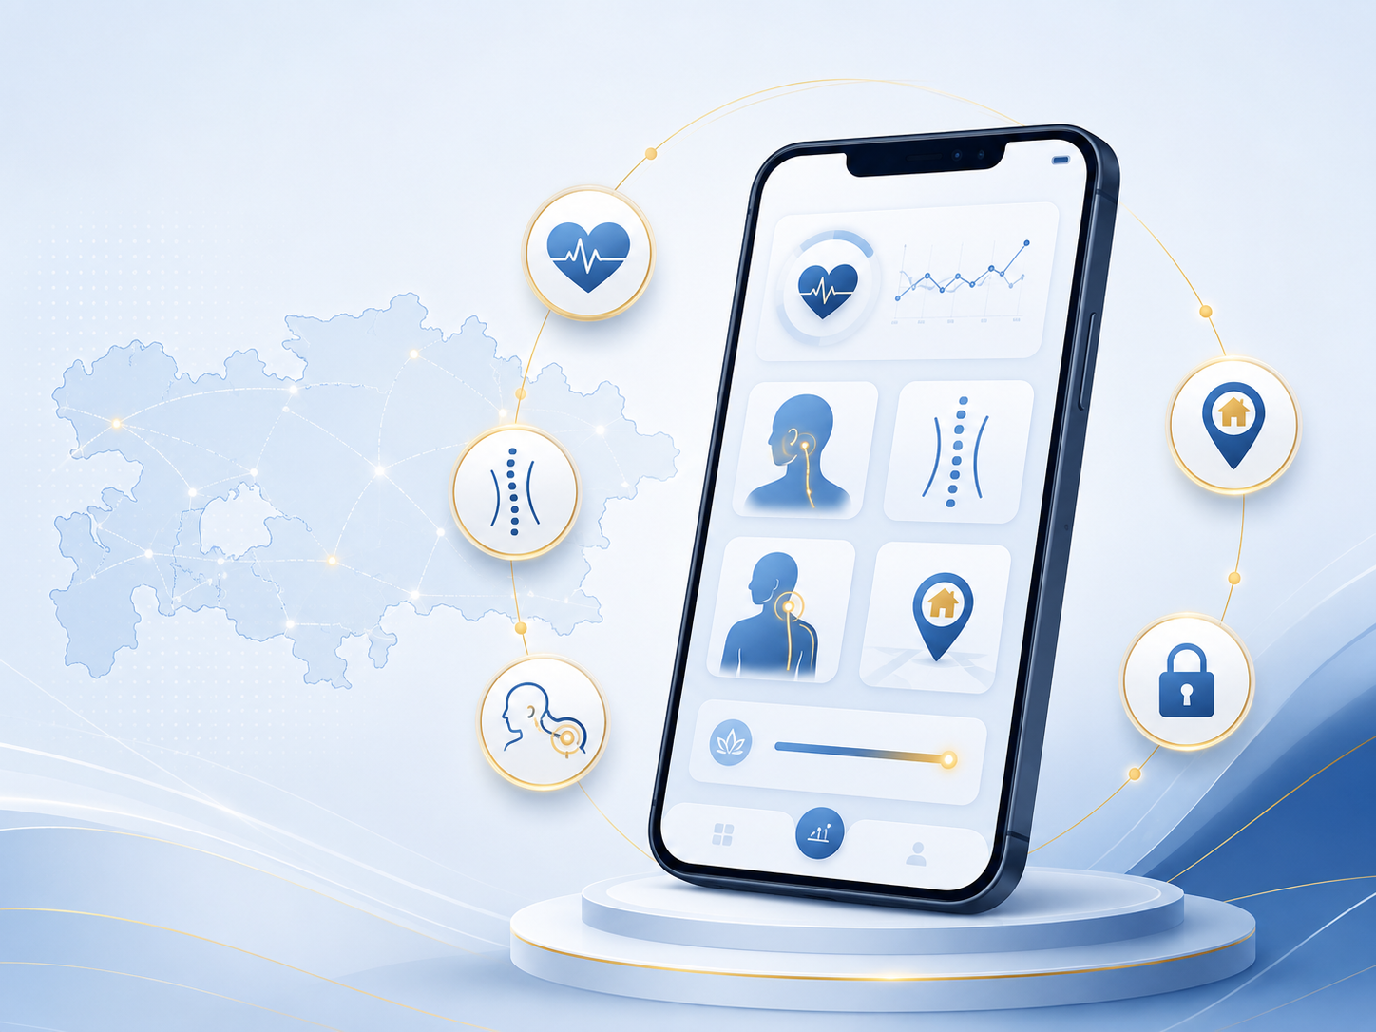
Target Users: Mainstream Demand + Underserved Groups
divides users into a 75% core mainstream segment and a 25% special-care segment
75%
Urban office workers, students, stress-driven sub-health users, shoulder/neck/lower-back discomfort groups.
Core mainstream users
25%
Seniors, pregnant/postpartum women, people with disabilities, occupational-disease groups.
Special-care users
3–5 min
Fast, light, equipment-free micro-sessions that fit work, dormitory, home and low-network scenarios.
Core experience
The strategic advantage is not “more workouts”; it is safe access to health recovery for people who are ignored by mainstream fitness products.

Slide 6
Product Ecosystem: Five-in-One Recovery Platform
LightFit connects content, AI, privacy, and offline services into one daily recovery loop.
1
Emotion Fit
5
Home Services
Breathing · meditation · white noise
Massage · rehabilitation appointments
LightFit Recovery Core
One coordinated loop
2
Posture Repair
4
Special Care
AI posture check · guided correction
Seniors · pregnancy · disability · students
3
Sedentary Recovery
Neck · shoulder · waist · back relief

Slide 7
Core Functional Modules
The app translates user state into lightweight actions and measurable feedback.
1
2
3
4
5
4
Check-in
Recommend
Correct
Coach
Report
5-level mood + 3-level body state
easy / standard / challenge modes
AI posture detection + tailored repair
AI health advisor in four languages
weekly/monthly/annual health charts
offline rules engine
3-minute easy mode
accuracy target 95%+
89.5% answer accuracy
99.8% chart load success
Designed from Central Asian usage constraints: unstable networks, lower-end devices, multilingual habits and high privacy sensitivity.

Slide 8
Special Population Moat
The business plan positions special-care content as a category-level gap and defensive moat.
Seniors
fall-prevention, joint care, low-impact movement
“Want to move, but afraid or unsure how”
Pregnancy & Postpartum
safe stretching, relaxation and recovery content
LightFit converts that hesitation into safe, adaptive routines and a trusted service network
Disability Support
accessible guidance and adapted motion libraries
Occupational Pain
teachers, drivers, chefs, programmers and chronic fatigue
Industry gap
Content moat
Students
no comparable all-group adapted app in the plan
exclusive local partnerships + professional modules
posture, eye-care and stress-relief modules

Slide 9
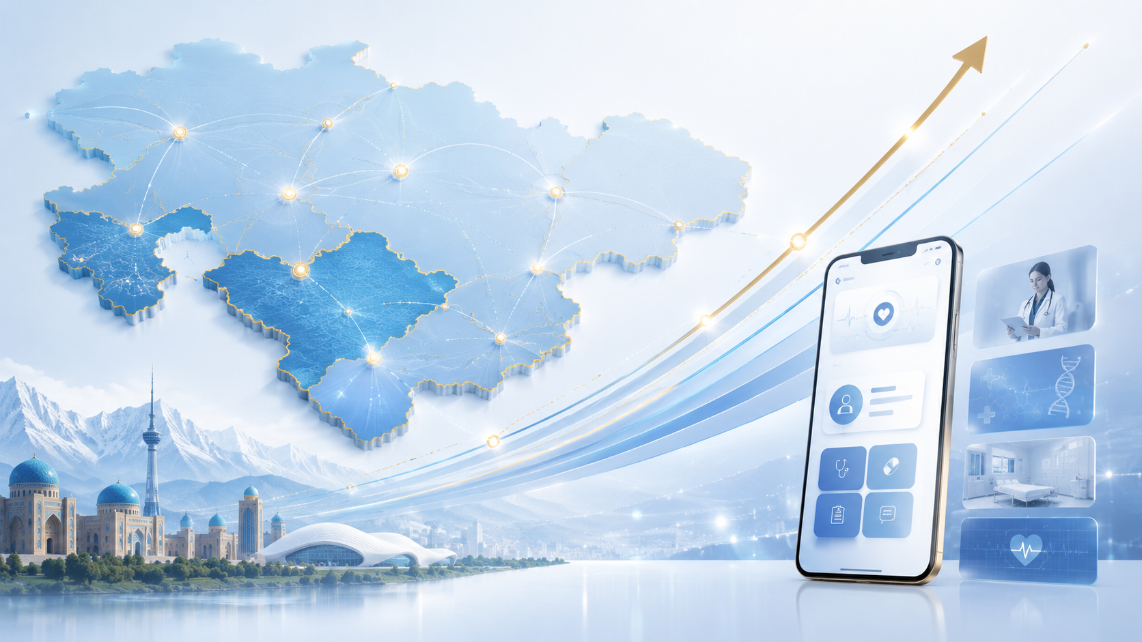
Localization: From Translation to Native Experience
Language
1
Chinese, English, Russian and Kazakh; future Uzbek, Kyrgyz, Tajik and Turkmen.
Culture & Religion
2
Respect prayer times, Ramadan rhythms, modest imagery and dietary restrictions.
Life Scenarios
3
Office, dormitory, family living and weak-network usage.
Service Ecosystem
4
Local certified massage and rehab providers with transparent pricing.
Differentiation is created by local behavior design, not by translating a generic fitness product.

Slide 10
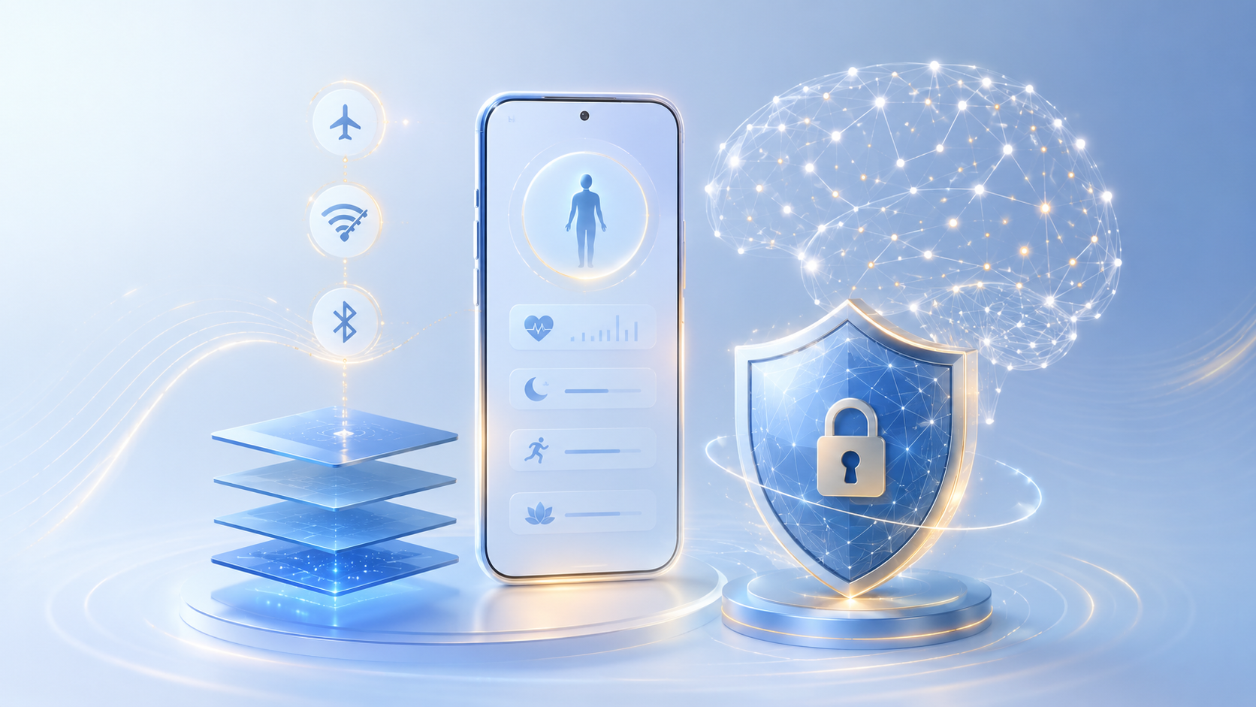
Technology Architecture: Lightweight, Offline and Privacy-First
The technical stack is selected around Central Asia’s device, network and privacy constraints.
<2MB
<1s
app package size
cold-start speed
90%
AES-256-GCM
core functions offline
local encrypted storage
✓
Technical moat
Zero-framework native build + Web Crypto local storage + PWA distribution make LightFit hard to copy without rebuilding from scratch.

Slide 11
Delivery Readiness: v7.2 Completed, v9.0 within 12 Months
The project is positioned as ready for app-store packaging, PWA distribution and local launch
Now
M1–M2
M3–M4
M5–M6
M10–M12
v7.2
v7.3
v8.0
v8.1
v9.0
Core functions tested: AI posture detection, multilingual system, home service, local encryption.
Uzbek + Kyrgyz, service rating system, special-care content upgrade.
AI health advisor agent, family health management, B-end enterprise health system.
Sleep monitoring, light e-commerce, more service cities.
Wearables integration, chronic disease module, five-country coverage.
Delivery package: source code, deployment docs, user manual, admin guide, test report, 3-month tech support and 1-year updates.

Slide 12
Market Foundation: Central Asia Is Digitally Ready
Country
Population
Smartphone
Core cities
Income/mo
78%
Kazakhstan
19.7M
95.7%
Almaty, Astana
¥1,760
average smartphone penetration in Central Asia
Uzbekistan
36.0M
89%
Tashkent, Samarkand
¥1,980
>90%
Kyrgyzstan
6.7M
72%
Bishkek
¥850
core-city smartphone penetration
Tajikistan
9.8M
65%
Dushanbe
¥620
Turkmenistan
6.4M
70%
Ashgabat
¥1,200
The launch focus is Kazakhstan + Uzbekistan: more than 41M combined smartphone users in the plan.

Slide 13
Market Size: From ¥1.64B to ¥14.1B
¥14.1B
estimated 2029 total market size
20%
market penetration by 2029
9.4M
actual user scale estimate in 2029

Slide 14
Competitive Strategy: Avoid the Red Ocean
LightFit avoids direct competition with high-intensity fitness apps and builds local moats
Red Ocean
Blue Ocean
fitness enthusiasts
intense workouts
global generic content
cloud-first data
one-way online courses
ordinary users
health recovery
Central Asia-native
zero sensitive cloud data
online-to-offline loop
Moat logic
Special content + local service supply + privacy architecture + local brand recognition.

Slide 15
Business Model: Five Revenue Engines
The plan avoids single-source risk through a subscription-led, service-expanded monetization mix.
VIP subscription
50%
core income: courses, posture check, plans, AI access
Home service commission
25%
growth engine: transparent local service booking
Light e-commerce
10%
selected recovery and light-fitness products
Revenue Mix
B-end cooperation
10%
enterprise health, schools and communities
AI API upsell
5%
advanced AI consultations and premium usage

Slide 16
Pricing & Unit Economics
LightFit uses an accessible ¥18 monthly entry price, then expands ARPU through services.
Keep Intl.
¥58
1
CAC
¥20 → ¥10
declines as brand and referrals scale
Nike TC
¥49
2
LTV
Local gym
¥300 → ¥600
rises through service and e-commerce attachment
¥200+
LightFit
¥18
3
LTV/CAC
>15x
above the plan’s healthy standard of 3x
Penetration pricing is designed to match Central Asian purchasing power while preserving upside from high-margin add-ons.

Slide 17
Financial Forecast: Scale with Profitability
500K
6M
Year-1 registered users
Year-3 registered users
24%→63%
net margin improvement
M18
single-month breakeven

Slide 18
Go-to-Market: Low-Cost Growth Engine
Acquisition is built around short-form content, community trust, KOC referral and offline partners.
Short video
Comments
App download
Registration
Retention
pain-point demos
community questions
visitor trial
plan creation
reports + services
Acquisition Mix
60%
20%
15%
5%
short video seeding
vertical communities
local KOC word-of-mouth
offline institution partners

Slide 19
Risk Control: Built into Product, Operations and Governance
Competition
build special-care content moat, local service supply and data-driven AI advantage
Localization
local team review, religion/culture compliance, phased country expansion
Technology
offline-first architecture, multi-model AI routing, local model deployment plan
Service & Data
certification, training, insurance, GPS safety, AES local encryption
Finance & Talent
conservative forecast, cashflow checkpoints, local hiring and training
The plan states the overall risk profile is controllable and no fatal single-point risk has been identified.

Slide 20
36-Month Expansion Roadmap
From two-country cold start to five-country coverage and a broader health-service ecosystem.
M0–M1
M2–M6
M7–M24
M25–M36
Localization ready
Launch + validation
Scale expansion
Five-country coverage
payments, translation, local providers
app stores, cold start, paid conversion
4 countries, AI agent, service cities
6M users, annual revenue >¥100M
Vision
Make health simpler and more inclusive through technology — and become Central Asia’s leading everyday health-management platform.

