Slide 1

NovaBank Application
Nguyễn Duy Khang B2005843 Hồ Minh Nhựt B2005889

Slide 2
Contents:
01
Function
02
Database
03
Interfaces

Slide 3
I - Functions:
1. Search.
2. Insert Customer.
3. Update Customer.
4. Delete Customer.
5. Insert Employee.
6. Update Employee.
7. Delete Employee.
8. Promotion.
9. Bill Print.

Slide 4
Functions:
10. Money Withdraw.
11. Money Deposit.
12. Money Transfer.
13. Debt Log.
14. Transaction Log.

Slide 5
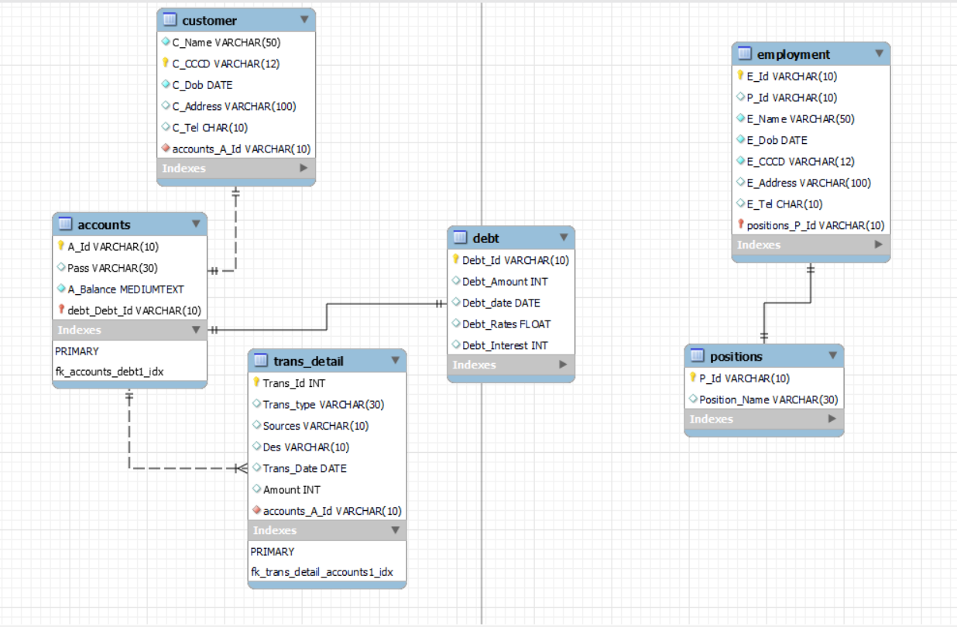
II - Database:

Slide 6
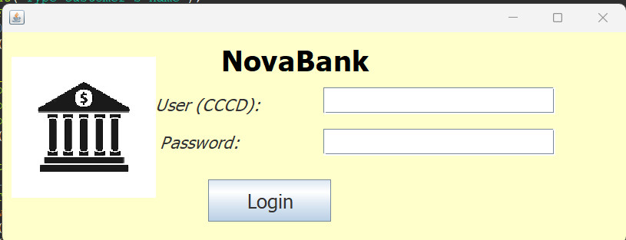
III - Interfaces:
Login

Slide 7
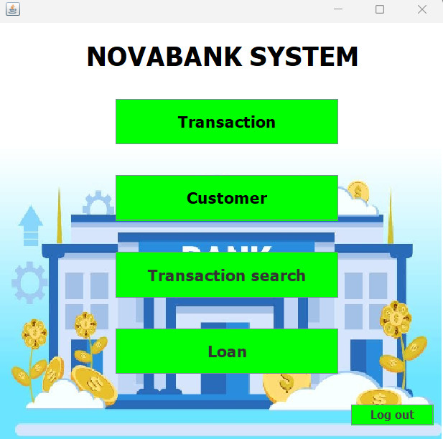
Interfaces:
Menu

Slide 8
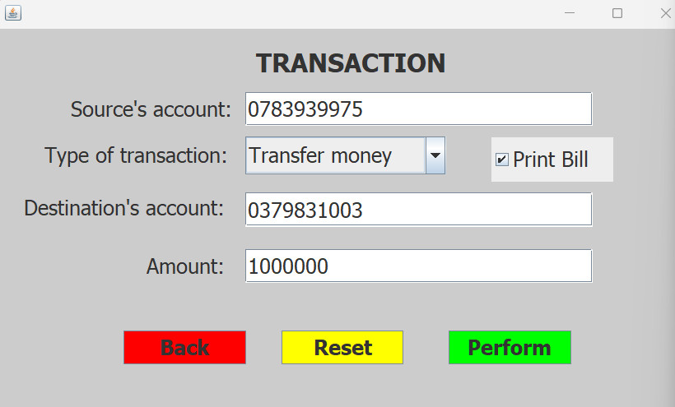
Interfaces:
Transaction

Slide 9
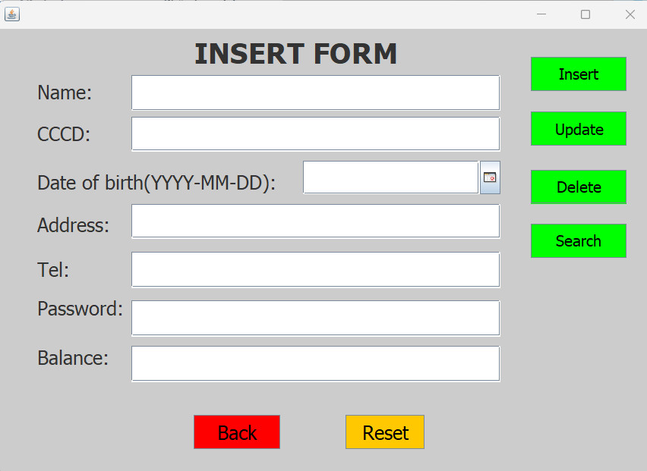
Interfaces:
Insert Form

Slide 10
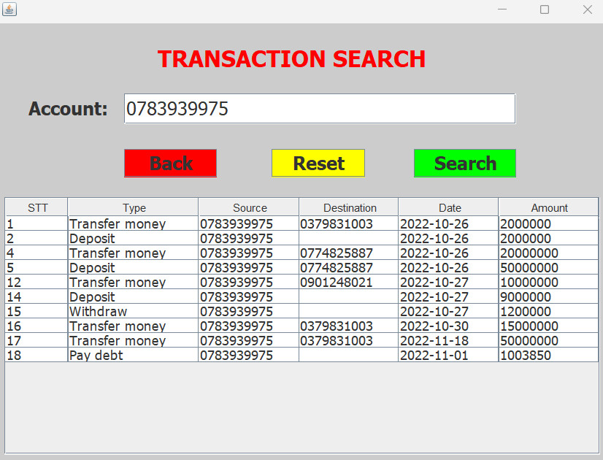
Interfaces:
Transaction Search

Slide 11
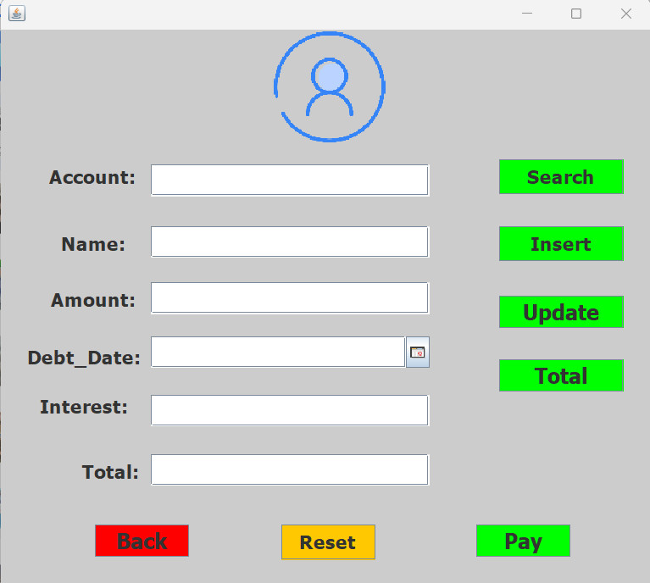
Interfaces:
Debt Form

Slide 12
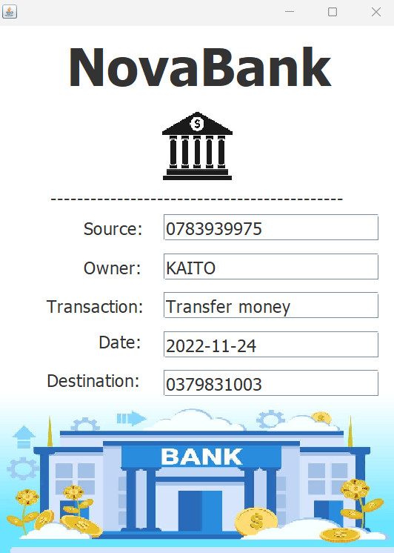
Interfaces:
Bill

Slide 13
Thanks! For your lessons!

