Slide 1

Stroke risk prediction
Student: Gonța Mihail
Group: IA-212
Coordinator : Viorel Munteanu

Slide 2

Problem
This research investigates the factors influencing stroke occurrence by analyzing a dataset with 11 clinical features. The objective is to identify key determinants, develop a predictive model for risk assessment, and explore unexpected correlations. The study also introduces a machine learning model to enhance predictive accuracy. The findings aim to contribute valuable insights to the understanding of stroke risk assessment, guiding future research and potential interventions.

Slide 3
Aim
This project aims to develop a predictive model leveraging historical data to assess the likelihood of an individual experiencing a stroke.

Slide 4
Assumptions
Is there a correlation between age and strokes, and if so, how is this correlation distributed?
Can body mass index and glucose levels contribute to the likelihood of experiencing a stroke?
Is the assumption valid that smoking can trigger strokes?
Is there a link between heart disease and an increased susceptibility to strokes?
Does high blood pressure resulting from workload contribute to the risk of strokes?
Is it accurate to claim that males, particularly those facing high work-related stress, are more prone to strokes?
How are continuous and categorical data related, and what is the significance of this relationship?
What is the importance of features and how can they be selected to enhance the accuracy of stroke predictions?

Slide 5
Objectives
Data pre-processing
Exploratory analysis
Creating a model
Model evaluation

Slide 6
Dataset variables
Variable | Data Type | Description
gender | Factor | Categorical variable indicating the gender (Male/Female)
age | Numeric | Age of the individuals in the dataset
hypertension | Factor | Categorical variable indicating the presence of hypertension (0: No, 1: Yes)
heart_disease | Factor | Categorical variable indicating the presence of heart disease (0: No, 1: Yes)
ever_married | Factor | Categorical variable indicating marital status (Yes/No)
work_type | Factor | Categorical variable indicating the type of work (children, govy job, never worked, private, self-employed)
Residence_type | Factor | Categorical variable indicating the residence type (Urban/Rural)
avg_glucose_level | Numeric | Average glucose level in the blood
bmi | Numeric | Body Mass Index (BMI)
smoking_status | Factor | Categorical variable indicating smoking status (smokes, formerly smoked, never smoked)
stroke | Factor | Categorical variable indicating stroke occurrence (0: No, 1: Yes)

Slide 7
Materials & Methods
Data source (kaggle): https://www.kaggle.com/datasets/fedesoriano/stroke-prediction-dataset/
Dada preprocessing – the encountered instances where certain observations exhibited missing data, such as "N/A" for BMI, "Unknown" for smoking status, and an ambiguous gender denoted as "Other," so those were removed from the dataset, including the unnecessary level of gender variable.
EDA - process involved visualization tools such as R and ggplot2 that were used to analyze data sets related to stroke events.
VIP (Variable Importance in Projection) - was employed to assess the importance of features in predicting stroke using logistic regression models.
Logistic Regression – was used, since the majority of the variables are categorical
AIC/ROC – methods were used to asses performance of logistic regression models in predicting strokes

Slide 8
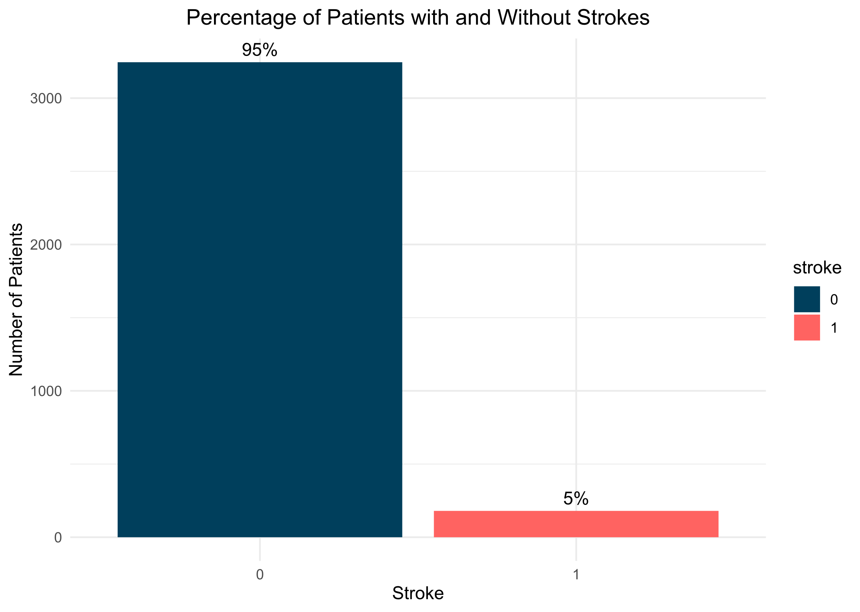
EDA
As we can observe, the distribution of data in our sample shows that 5 out of 100 people suffer a stroke. The observed bias yields a 95% accuracy for a naive random prediction model, underscoring the need to address imbalance through oversampling or undersampling during modeling for optimal results.

Slide 9
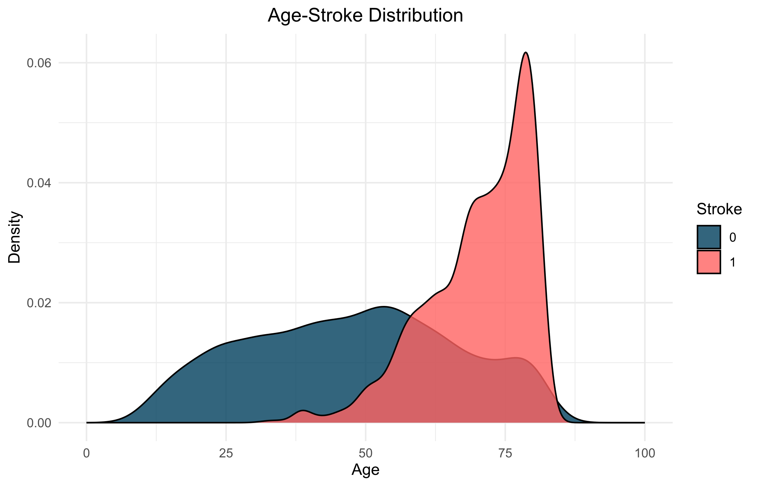
EDA
The significance of age as a feature in predicting strokes is underscored by the non-normal distribution of age feature values, necessitating transformation for later analysis. Categorical features reveal a notable trend: older individuals exhibit a higher prevalence of strokes compared to their younger counterparts.

Slide 10
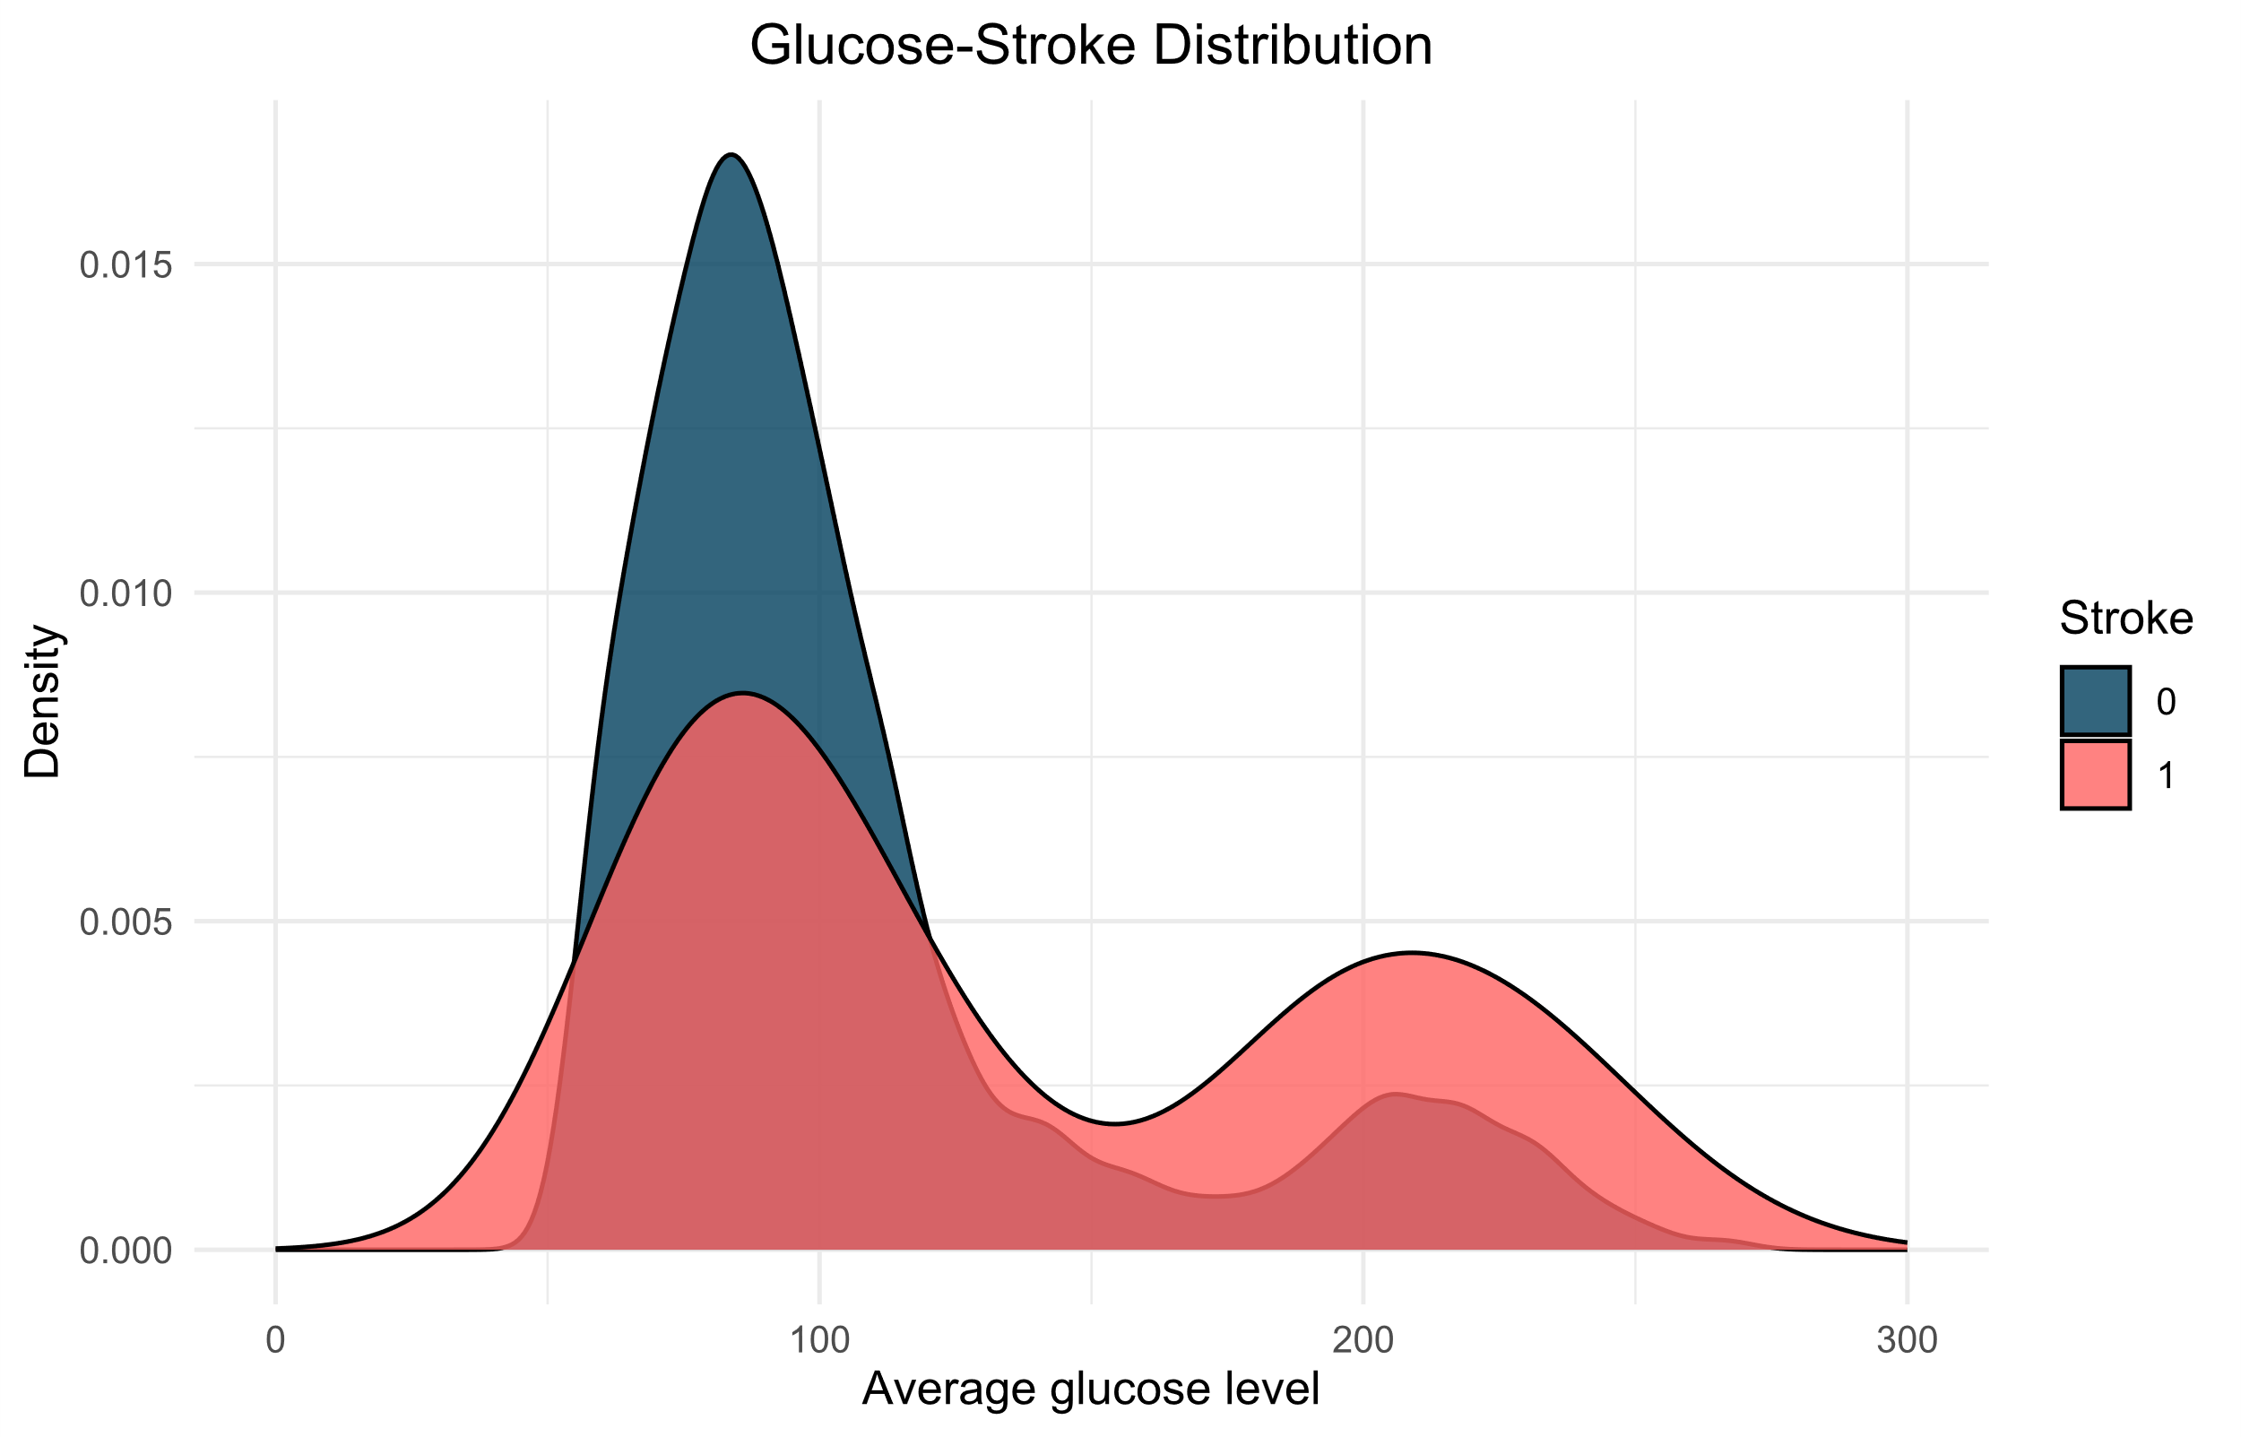
EDA
Unexpectedly, strokes are more common in individuals with normal glucose levels. High blood glucose levels are often referred to as one of the causes of stroke risk. But as we can see in the plot, the distribution of glucose levels exhibits a notable leftward skew, suggesting a predominant prevalence of lower glucose concentrations within the studied population.

Slide 11
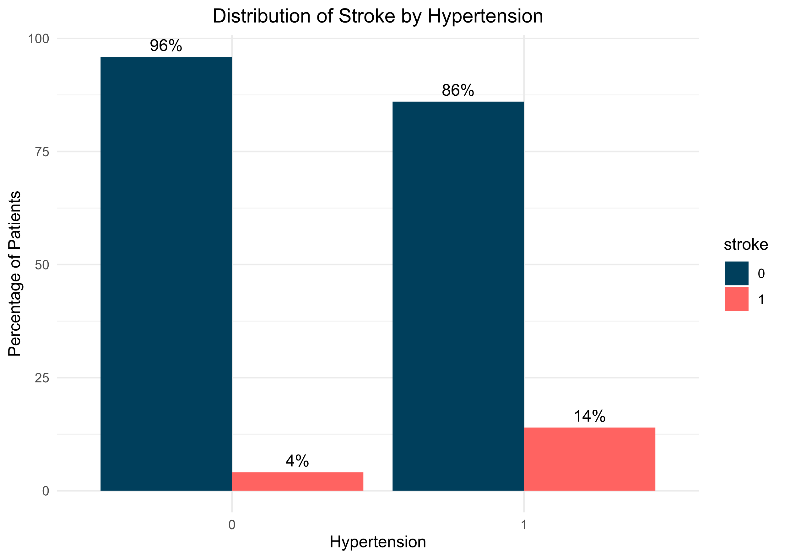
EDA
The distribution of hypertension, within populations underscores a notable health concern, as individuals afflicted by this condition confront a substantially heightened risk of experiencing a stroke. The data elucidates a significant discrepancy, revealing that those with hypertension face an approximate 10% higher incidence of strokes compared to their counterparts without hypertension.

Slide 12
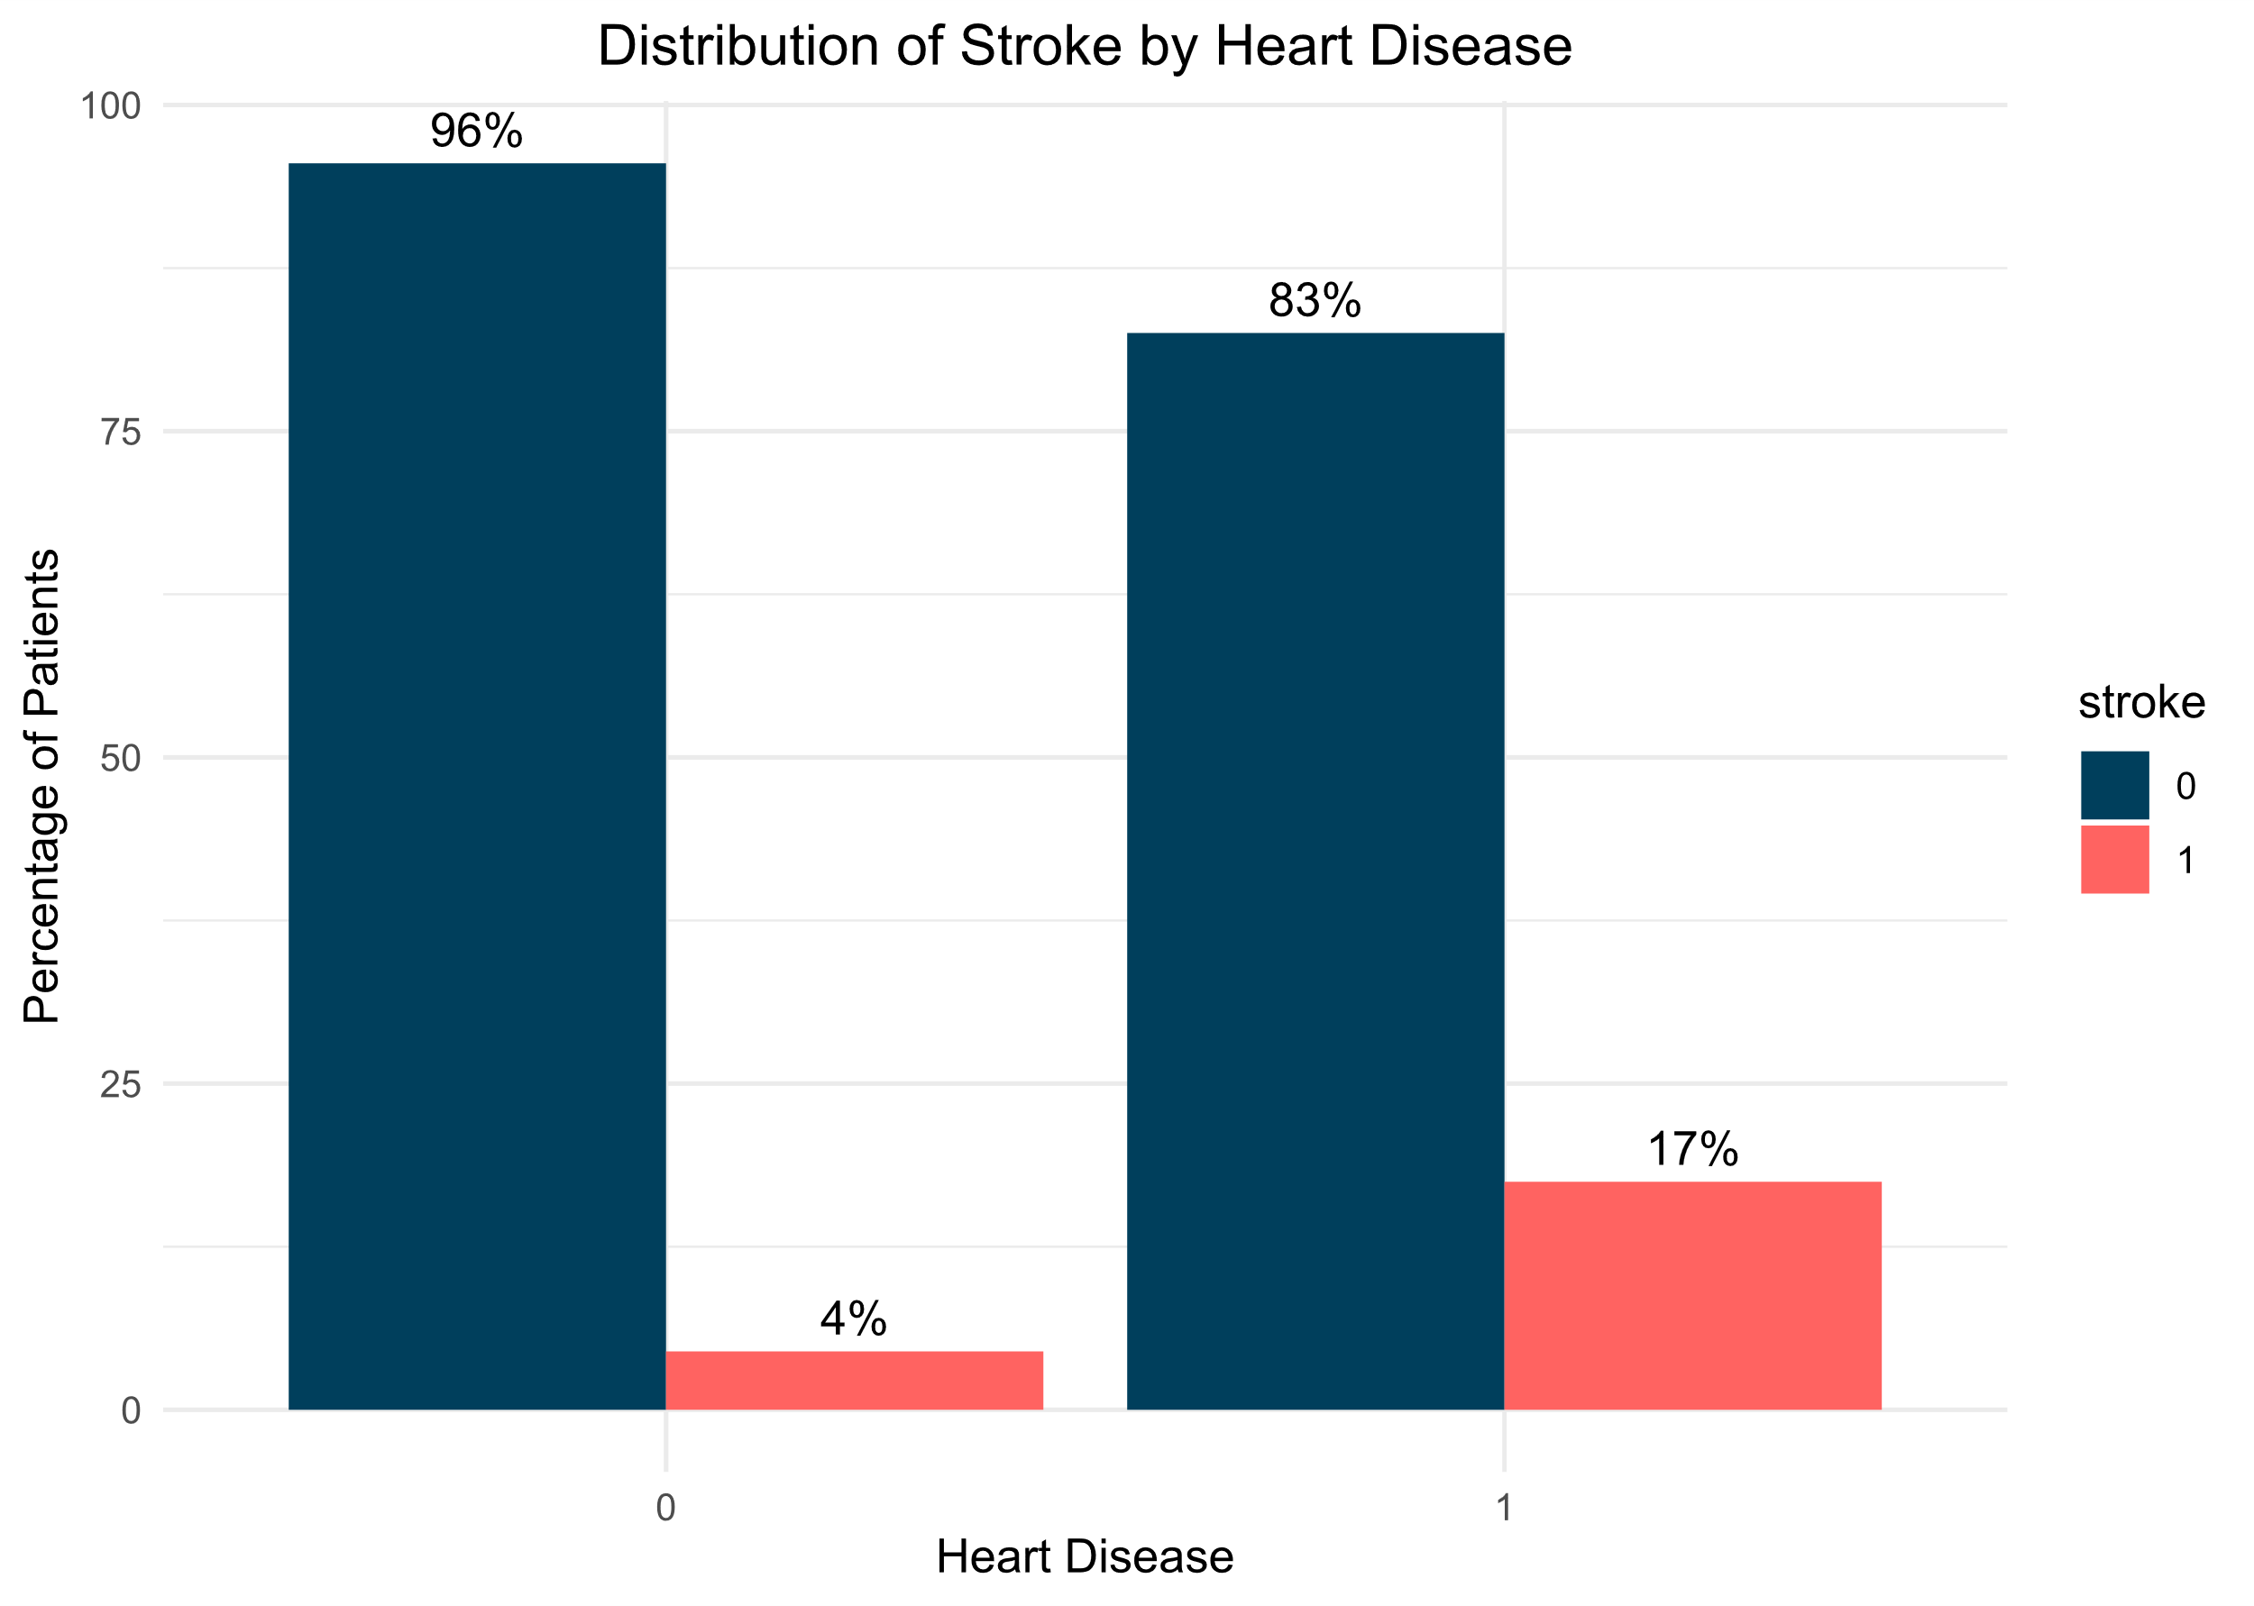
EDA
The distribution of heart disease within populations serves as a critical indicator of the potential risks individuals face, particularly concerning stroke incidence. Within this context, it becomes evident that individuals with pre-existing heart conditions encounter a significantly elevated risk, with almost 13% experiencing strokes.

Slide 13
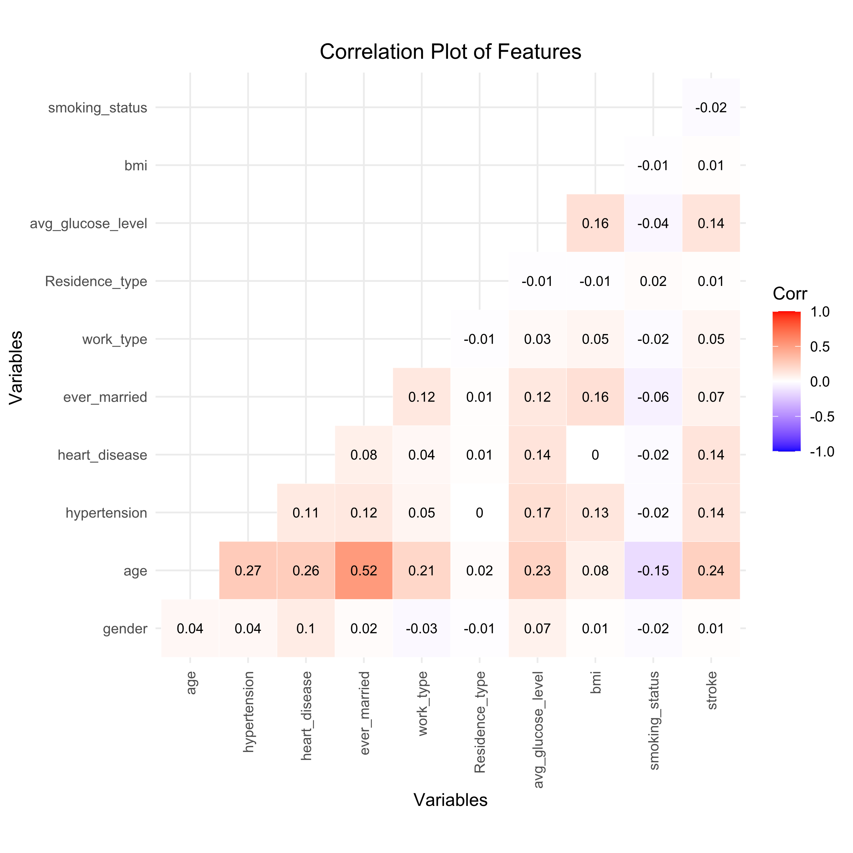
EDA

Slide 14
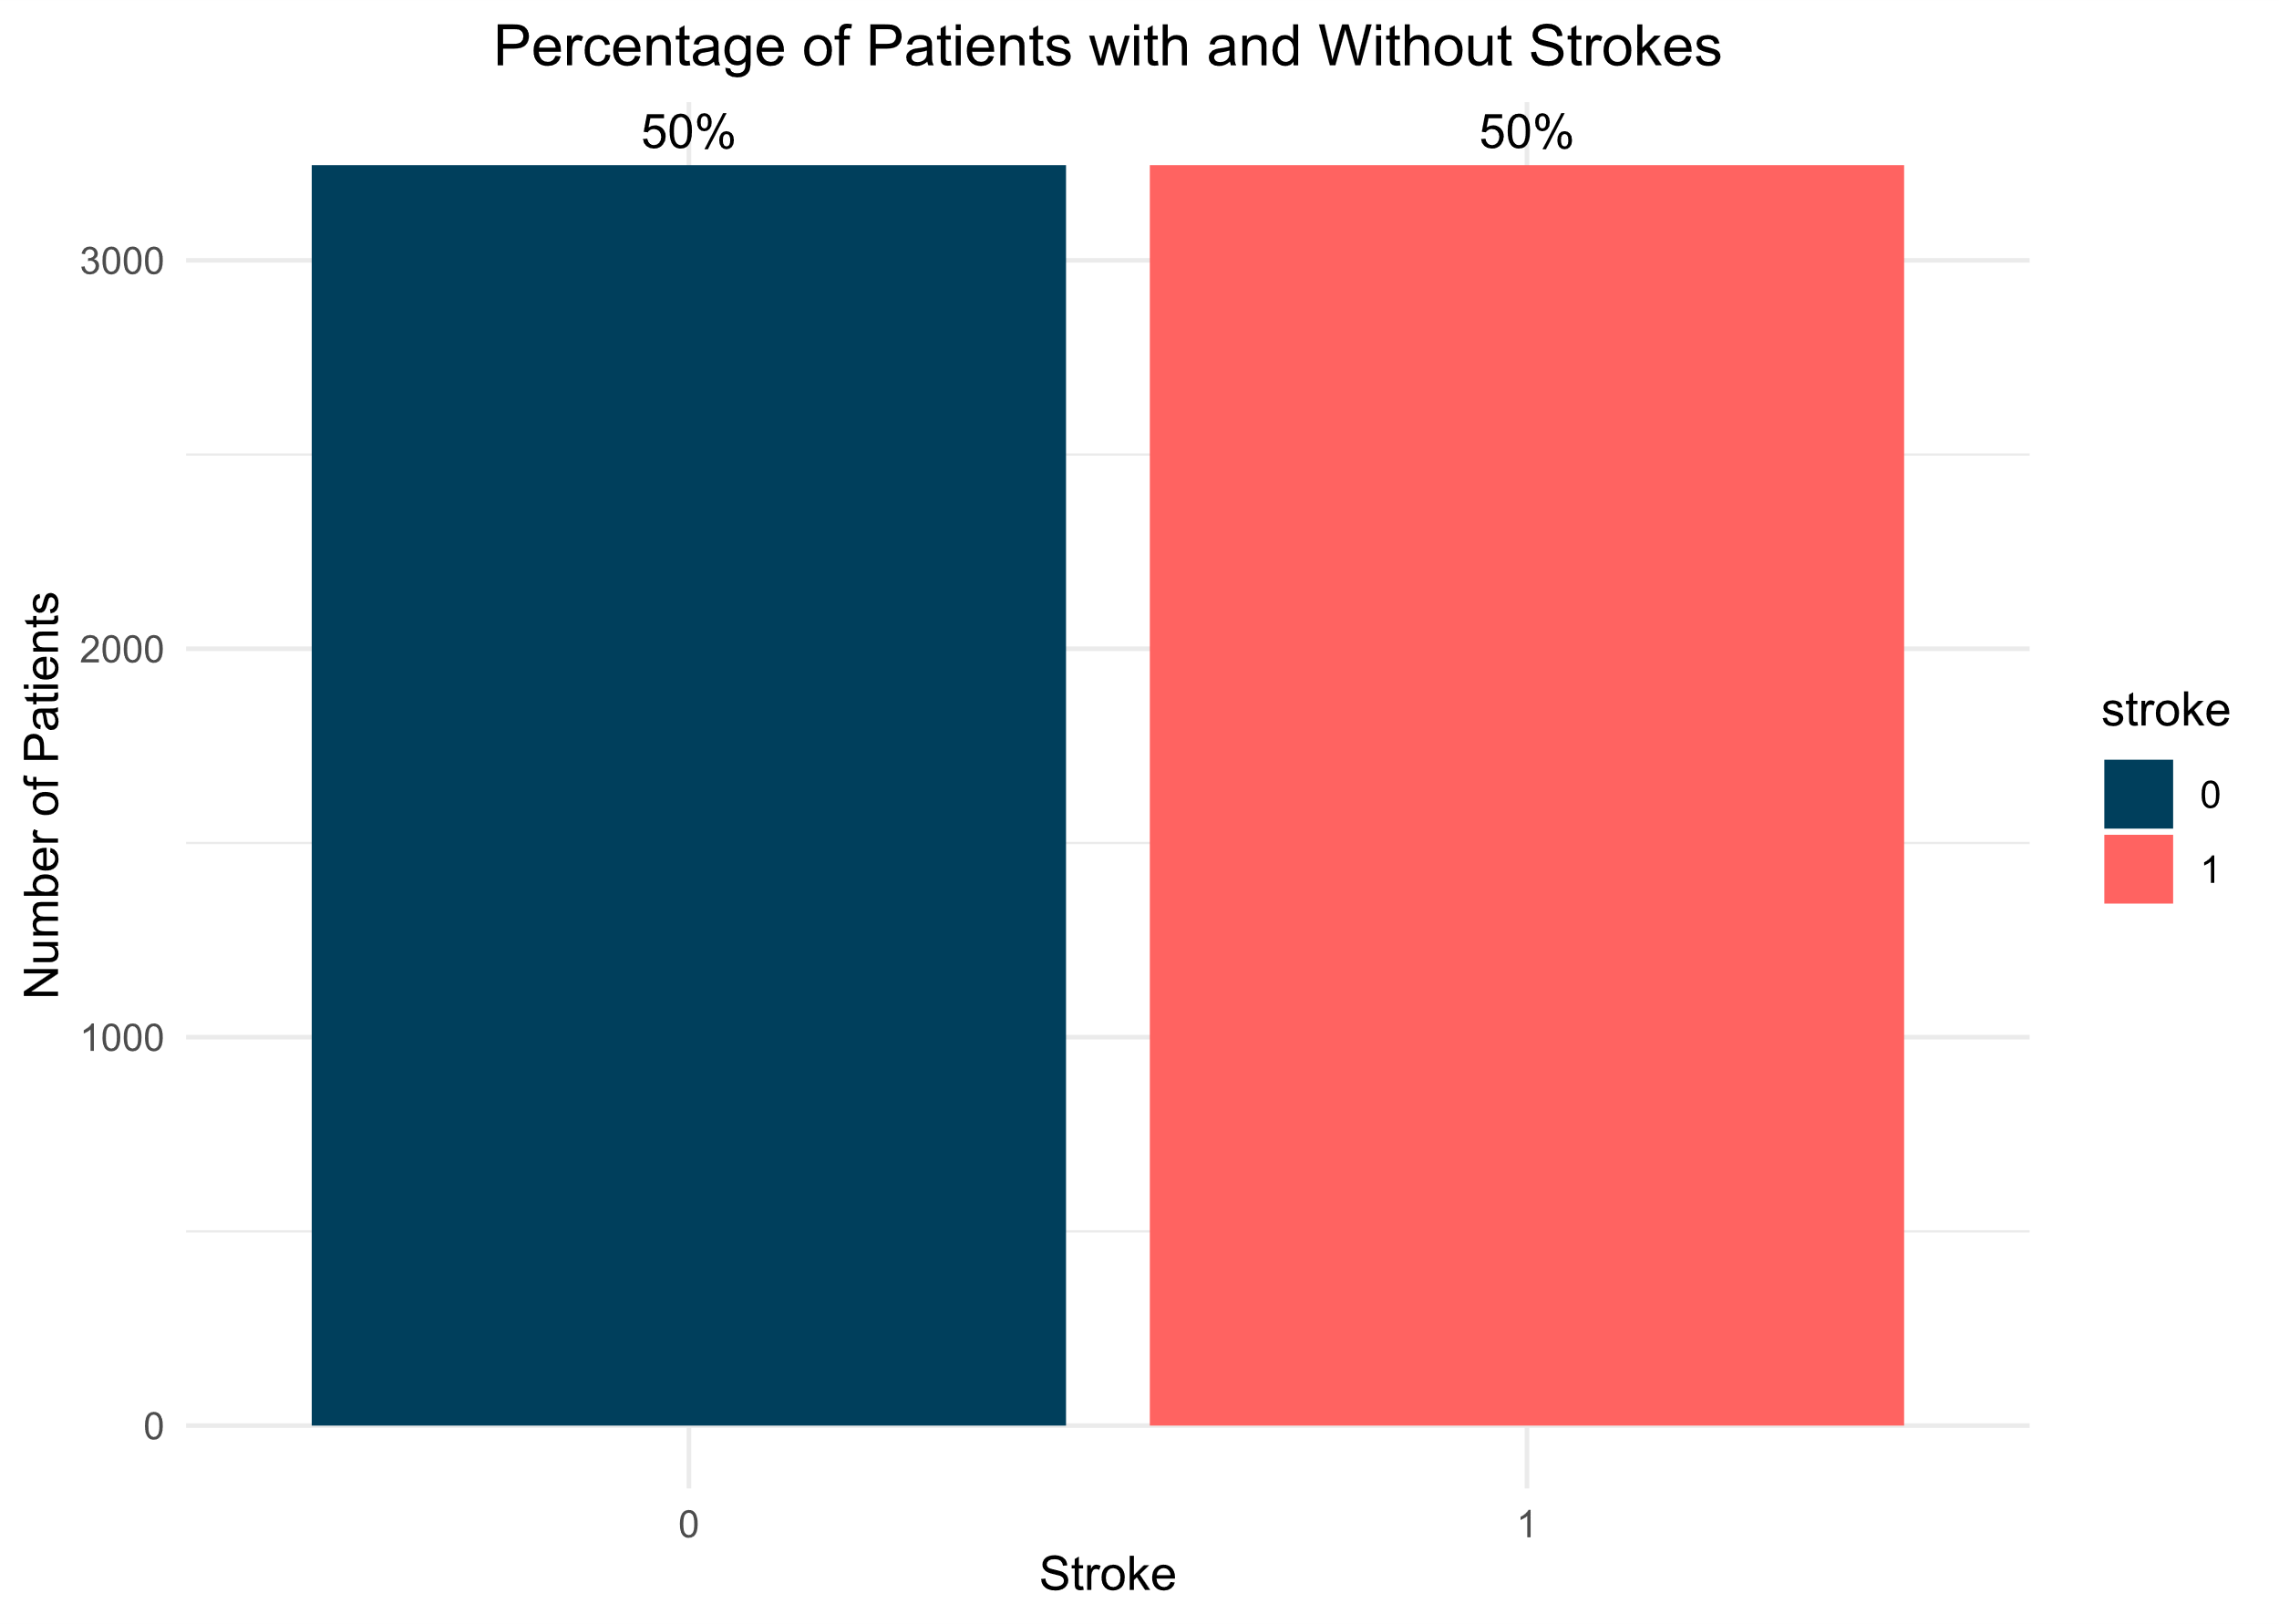
Data Balancing
The Majority Weighted Minority Oversampling Technique (MWMOTE) was used to address class imbalance in the dataset. This technique oversamples the minority class, focusing on instances with fewer neighbors. It assigns weights to majority class instances based on their proximity to the minority class, guiding the generation of synthetic samples to balance the class distribution. This makes the model more capable of learning challenging instances.

Slide 15
Logistic Regression Models
Initially two models were created by using the ‘glm’ method and ‘binomial’ family ; the first one included all the features. The second one included the most important features, discovered through the EDA process: age, average glucose level, hypertension, and heart disease.
Model | K | AICc | Delta_AICc | AICcWt | Cum.Wt | LL
glm_model_2 | 6 | 3913.31 | 0.00 | 0.7 | 0.7 | -1950.64
glm_model_1 | 11 | 3915.00 | 1.7 | 0.3 | 1.0 | -1946.47
The created models performed mostly the same and it was decided to keep all clinical features.
Metric | Result
Accuracy | 81.13%
Sensitivity (True Positive Rate) | 85.12%
Specificity (True Negative Rate) | 77.15%
Kappa Statistic | 0.6226
Positive Predictive Value (PPV) | 78.83%
Negative Predictive Value (NPV) | 83.83%
Balanced Accuracy | 81.13%

Slide 16
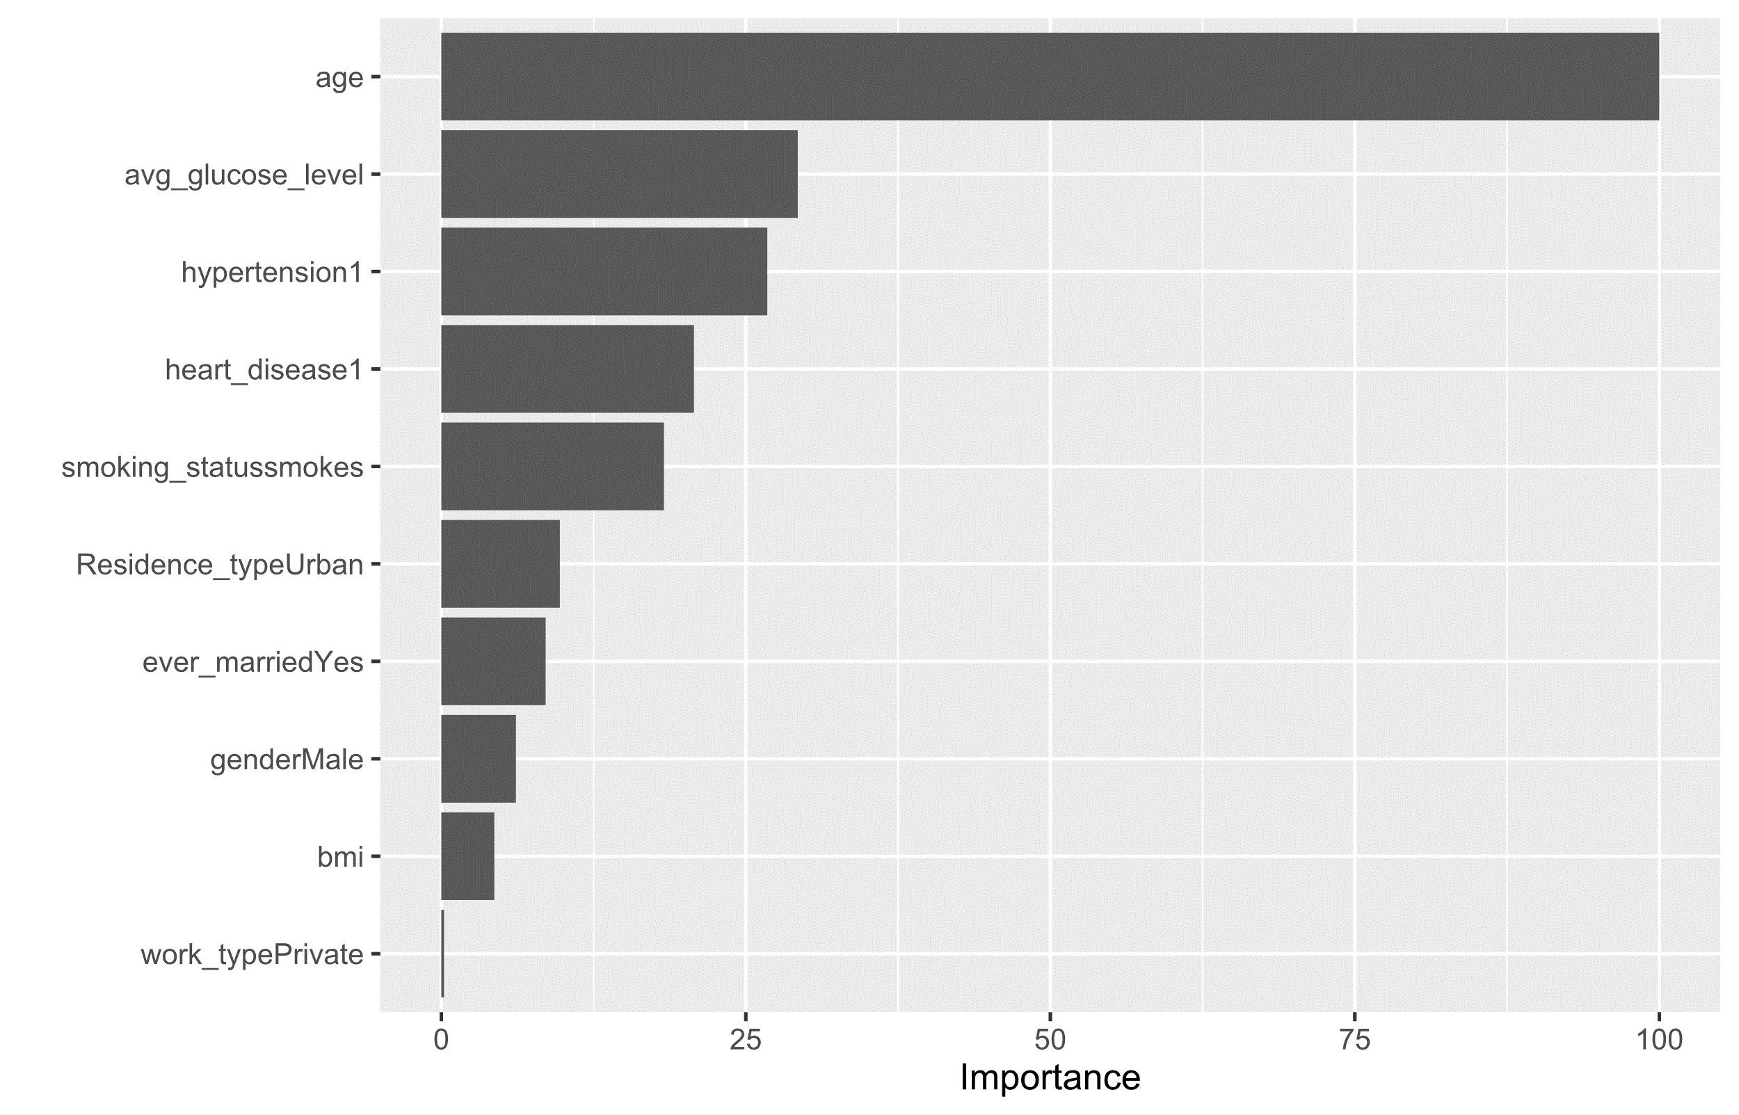
Logistic Regression Models

Slide 17
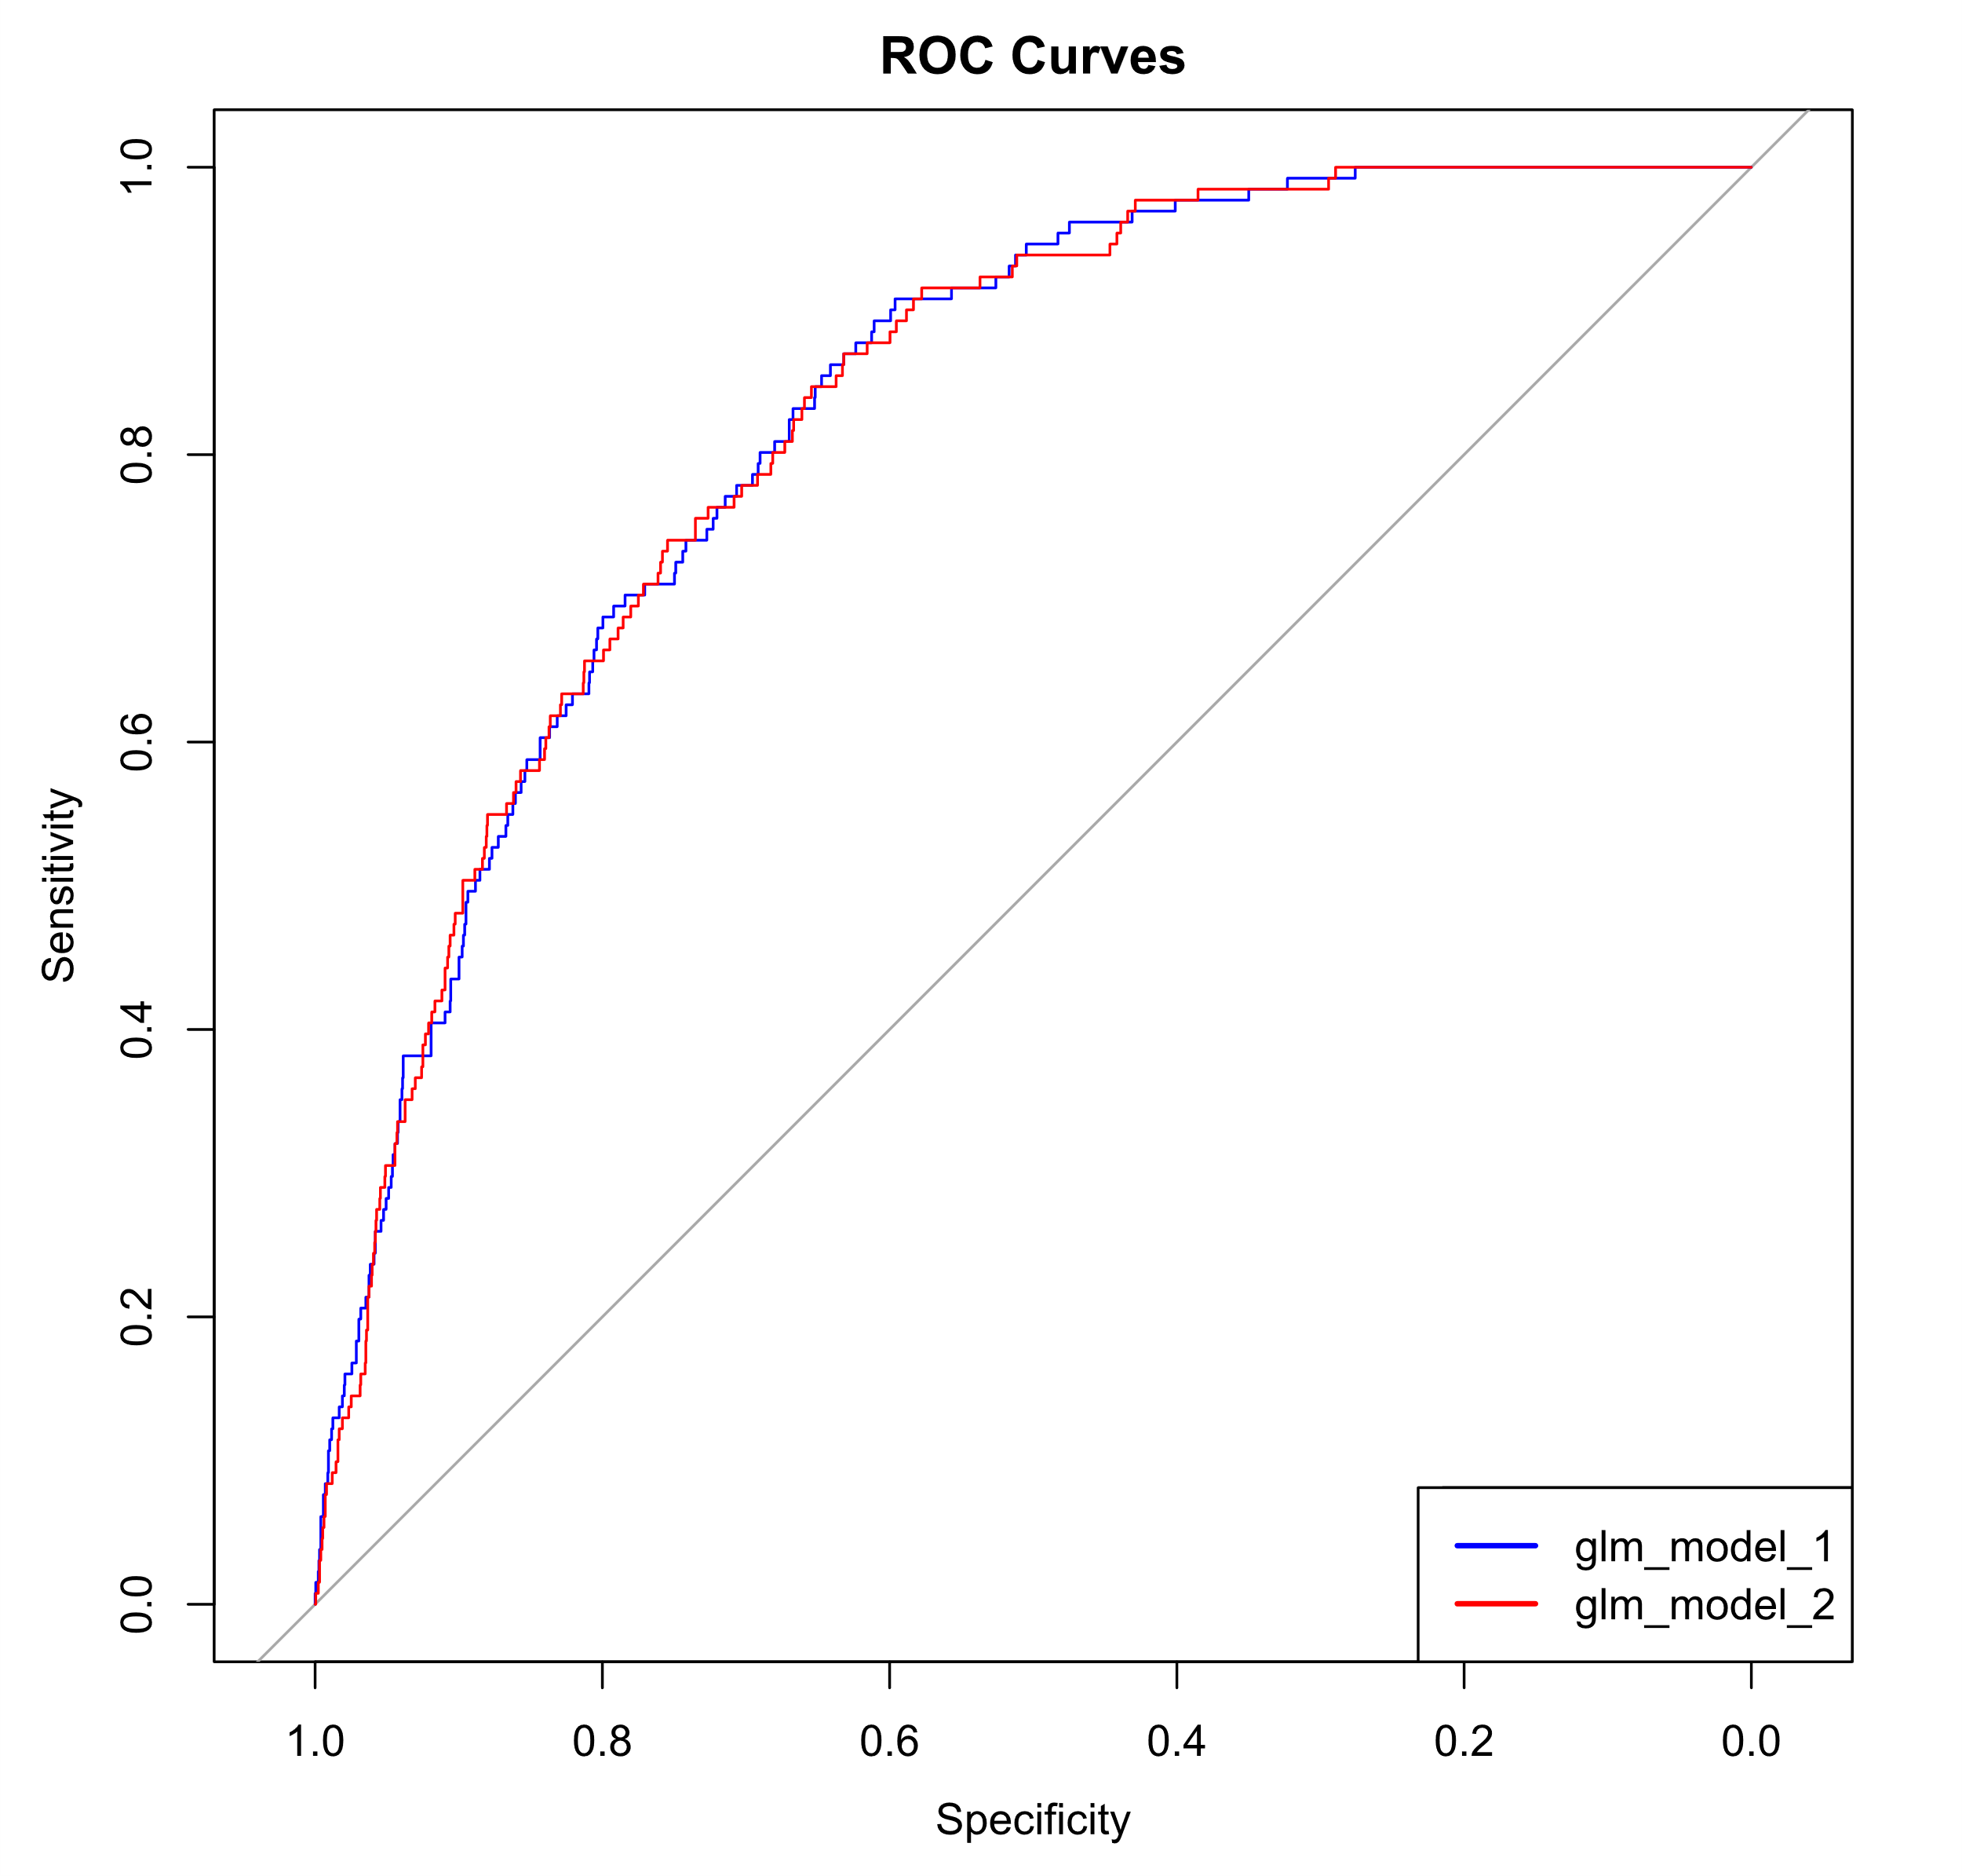
Logistic Regression Models

Slide 18
Logistic Regression Models
Initially two models were created by using the ‘glm’ method and ‘binomial’ family ; the first one included all the features. The second one included the most important features, discovered through the EDA process: age, average glucose level, hypertension, and heart disease.
Model | K | AICc | Delta_AICc | AICcWt | Cum.Wt | LL
glm_model_2 | 6 | 3913.31 | 0.00 | 0.7 | 0.7 | -1950.64
glm_model_1 | 11 | 3915.00 | 1.7 | 0.3 | 1.0 | -1946.47
The created models performed mostly the same and it was decided to keep all clinical features.
Metric | Result
Accuracy | 81.13%
Sensitivity (True Positive Rate) | 85.12%
Specificity (True Negative Rate) | 77.15%
Kappa Statistic | 0.6226
Positive Predictive Value (PPV) | 78.83%
Negative Predictive Value (NPV) | 83.83%
Balanced Accuracy | 81.13%

Slide 19
Trees Model
Another model (xgBoost) from tree-based family was created by including all the features of the dataset. XGBoost (Extreme Gradient Boosting) is a model from the tree-based family. It is an implementation of gradient boosting designed to be efficient and scalable, and it uses an ensemble of decision trees to make predictions.
Metric | GLM Model | XGBoost Model
Accuracy | 81.13% | 96.15%
Sensitivity (True Positive Rate) | 85.12% | 94.97%
Specificity (True Negative Rate) | 77.15% | 97.33%
Kappa Statistic | 0.6226 | 0.923
Positive Predictive Value (PPV) | 78.83% | 97.27%
Negative Predictive Value (NPV) | 83.83% | 95.09%
Balanced Accuracy | 81.13% | 96.15%
The XGBoost model outperformed the GLM model across all metrics in the confusion matrix, demonstrating superior accuracy (96.15% compared to 81.13%).

Slide 20
Conclusions
In conclusion, this research delves into the concerning rise in strokes, the second leading cause of global mortality, particularly among young adults. By harnessing a Kaggle-sourced dataset comprising 11 clinical features, our study employs rigorous data preprocessing, exploratory data analysis, and logistic regression models to unravel key determinants of stroke occurrence. The investigation yields surprising revelations regarding the influence of glucose levels and BMI, highlighting the imperative for nuanced risk assessments.
Variable Importance in Projection analysis underscores the pivotal role of age, average glucose level, smoking status, heart disease, and hypertension in shaping stroke outcomes. The logistic regression model, with a balanced accuracy of 81.13%, stands as a robust tool for predictive modeling. However, the XGBoost model surpasses expectations with an impressive accuracy of 96.15%, showcasing its potential for refined risk prediction.
This research not only advances our comprehension of stroke risk factors but also establishes a solid groundwork for future predictive modeling endeavors. The findings underscore the critical significance of considering age, glucose levels, and lifestyle factors in assessing stroke risk, paving the way for early intervention and prevention strategies. By shedding light on unexpected correlations and leveraging advanced modeling techniques, our study contributes to the ongoing dialogue on stroke prevention, ultimately aiming to improve public health outcomes.

