Slide 1

zCore PCIe driver & display
on HiFive Unmatched
Members: 安之达
1

Slide 2
Contents
1.
Introduction of zCore drivers
2.
My Effort
3.
Achievement
4.
Troubles
5.
Further Target
2

Slide 3
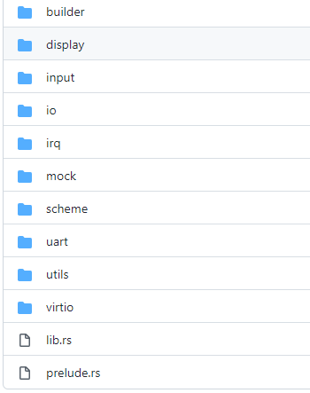
Introduction of zCore drivers
Virtio: for qemu
Display: include a small cursor, can be used by different type of display
Uart: serial io, using uart16550
4

Slide 4
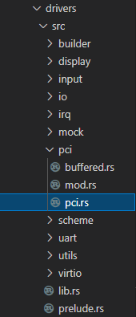
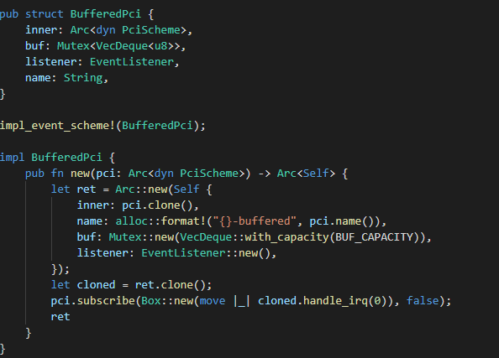
My Effort
5

Slide 5
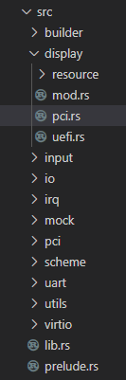
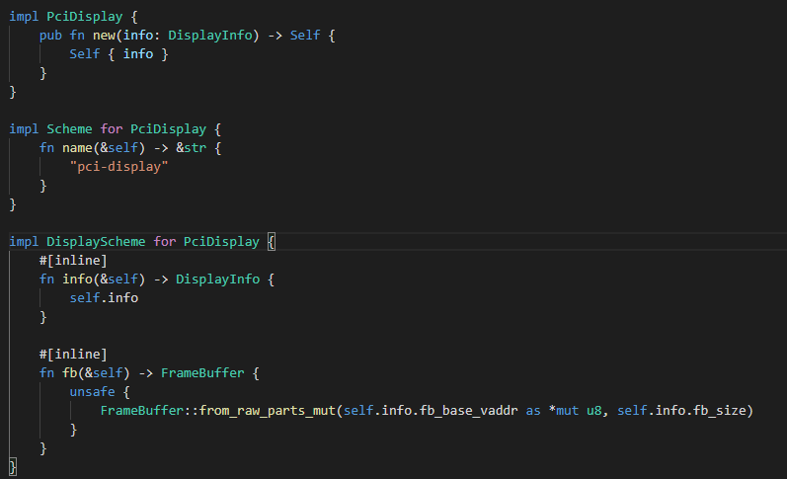
My Effort
5

Slide 6
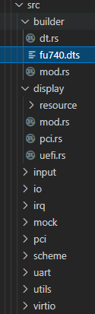
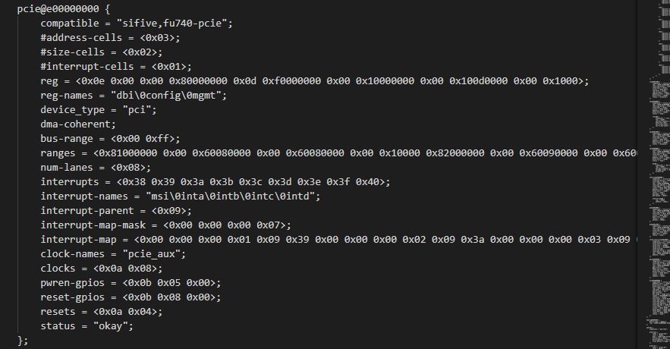
My Effort
5

Slide 7
Achievement
6

Slide 8
Further Target
6

