Slide 1

zCore on HiFive Unmatched
Members: 安之达 田凯夫
1

Slide 2
Contents
1.
Introduction of zCore
2.
HiFive Unmatched
3.
zCore on HiFive Unmatched
4.
Troubles
5.
Further Target
2

Slide 3
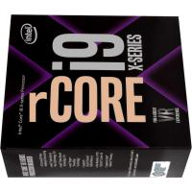
Introduction of zCore
A Zircon micro kernel based on Rust
Work on kernel mode, provide the same syscall as Zircon
Work on user mode as a normal user process on Linux or MacOS (User-Mode OS)
Contain a small rCore
4

Slide 4
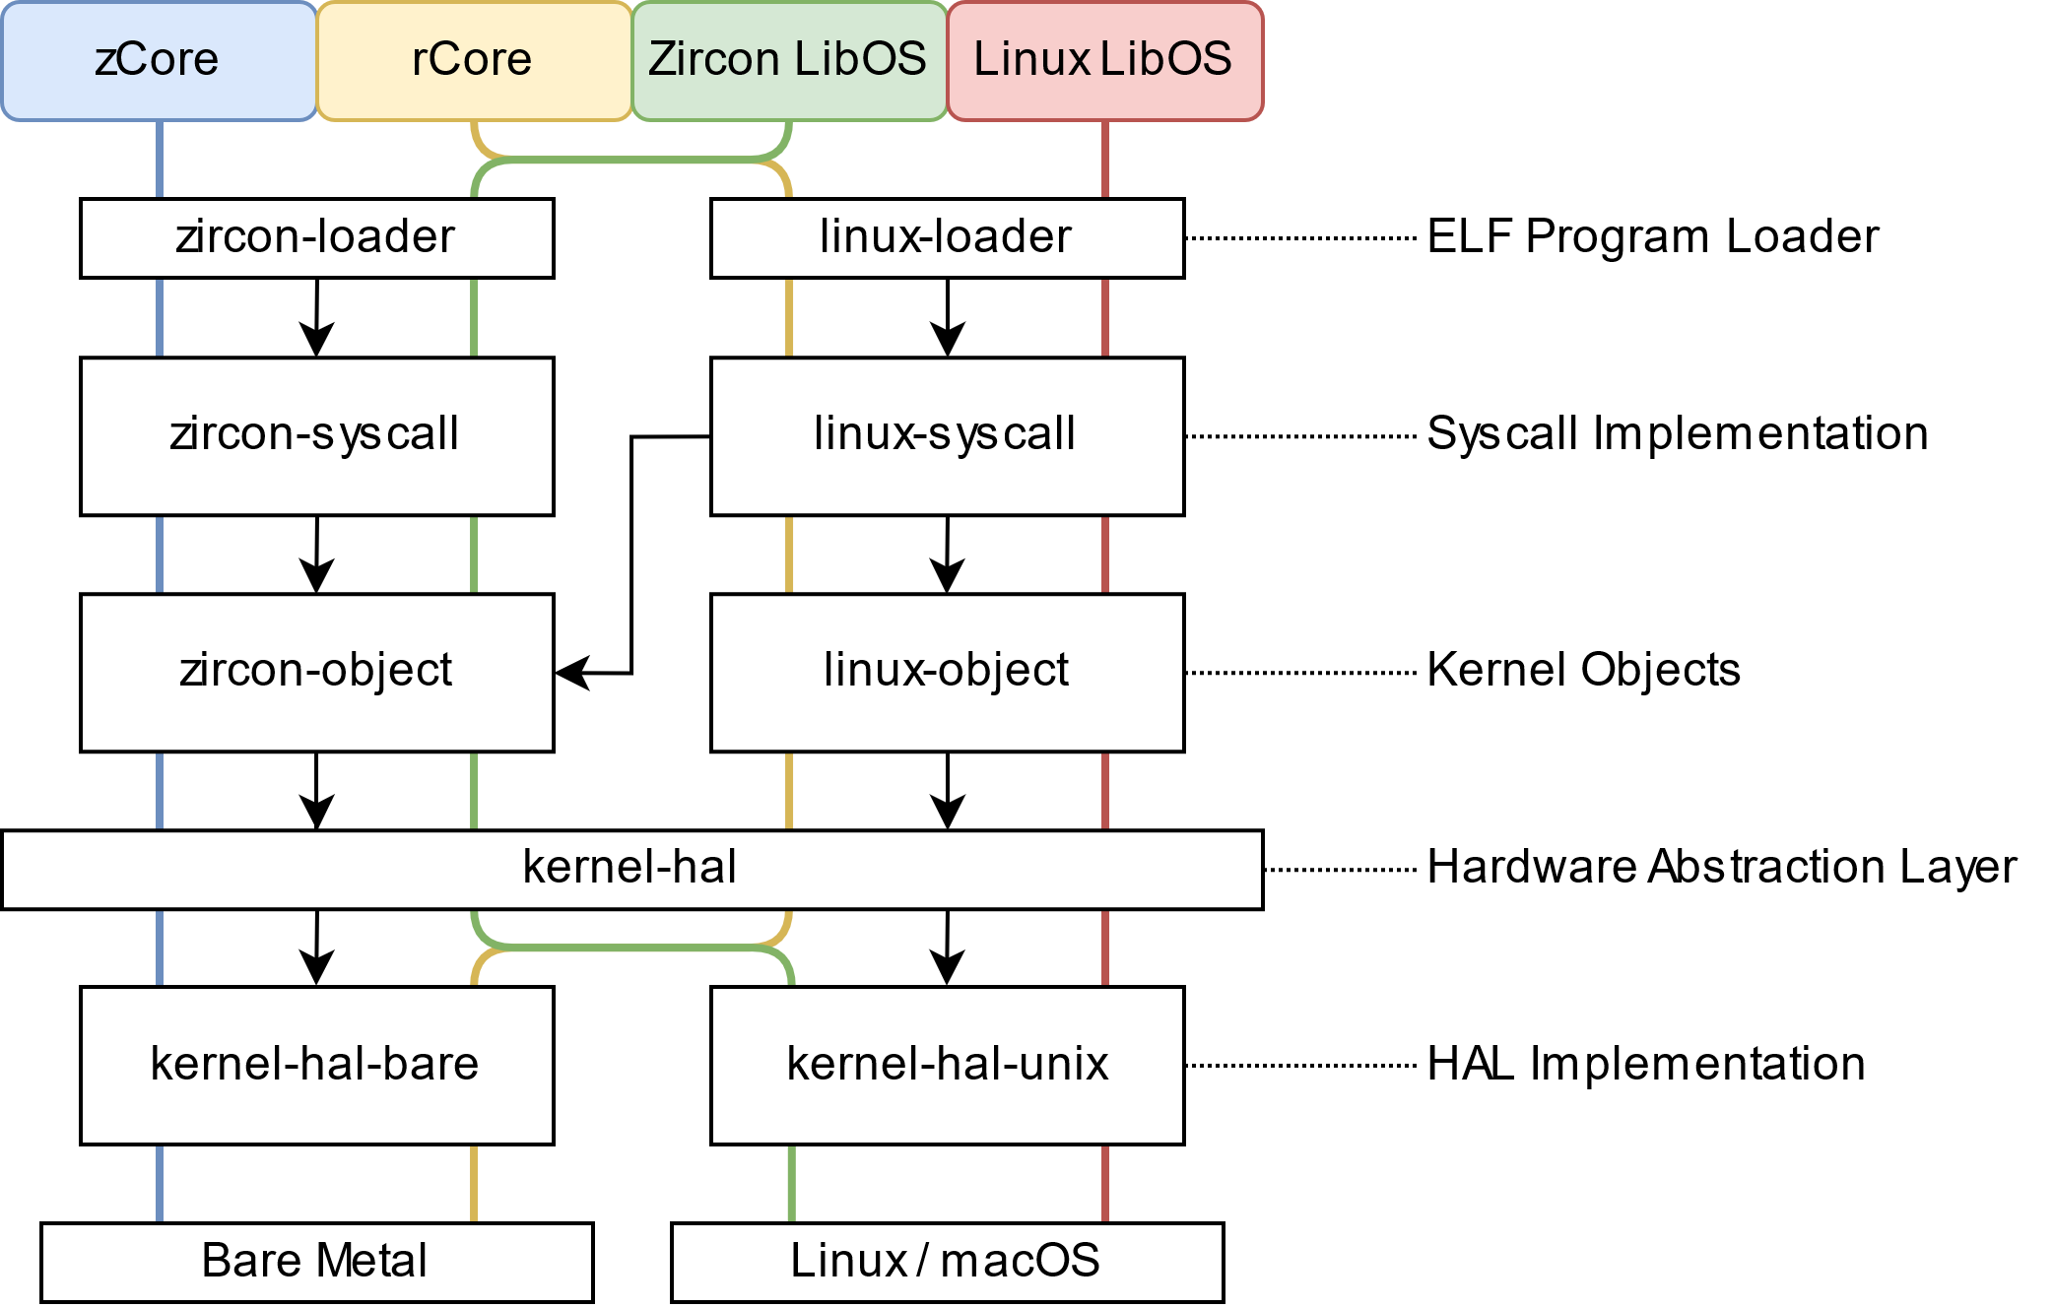
Introduction of zCore
Structure of “Core”
3

Slide 5
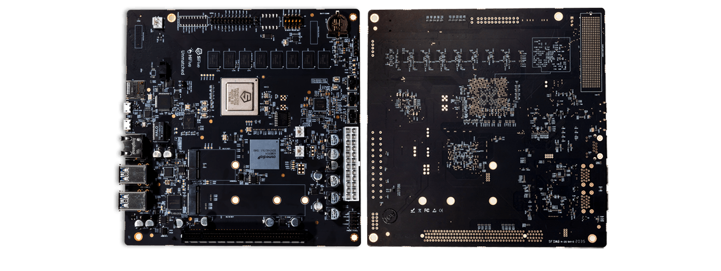
HiFive Unmatched
· Powered by the SiFive Freedom U740, a high-performance multi-core, 64-bit dual-issue, superscalar RISC-V processor.
· 4 + 1
5

Slide 6
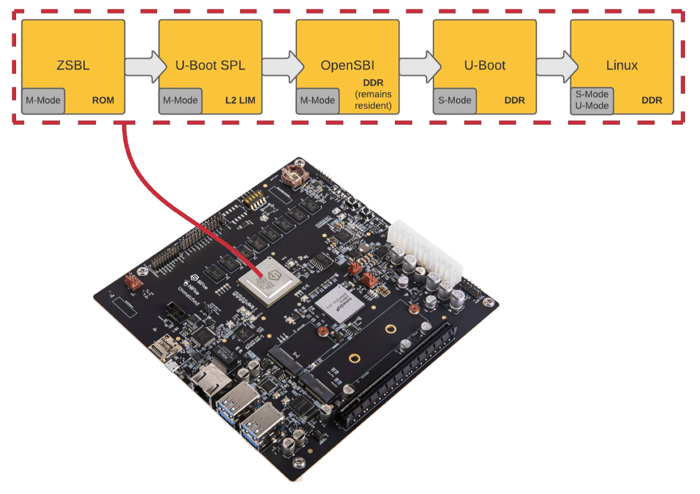
zCore on HiFive Unmatched
6

Slide 7
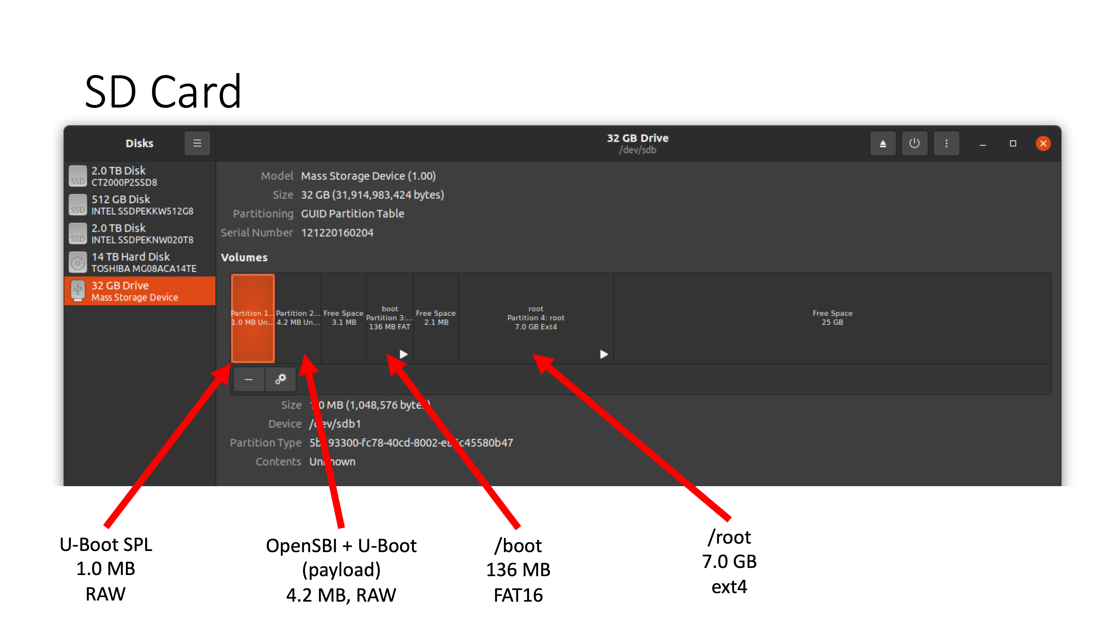
zCore on HiFive Unmatched
6

Slide 8
zCore on HiFive Unmatched
How to load zCore on the board
1.
Compile zCore --- with a new Makefile
2.
Pack the kernel into U-Image
3.
Put it on SD card
4.
Boot
Seem simple…
But some unexpected bugs occurred…
6

Slide 9

Troubles
Hardware:
Confusing SD Card
Software:
How to build a zCore binary file for HiFive
6

Slide 10
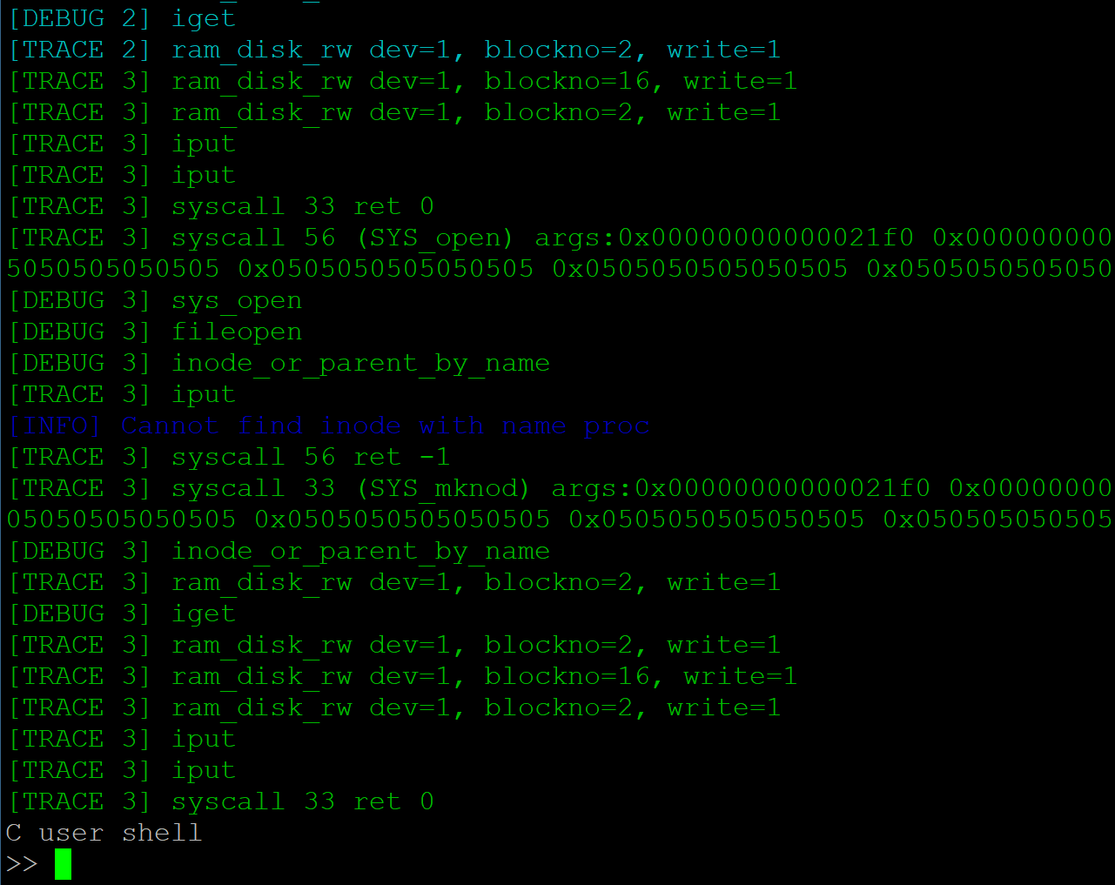
Troubles
First, we tried to repeat the work of uCore-SMP, seemed well:
6

Slide 11
Troubles
However we failed to build the same binary file for zCore…
6

Slide 12


Troubles
Finally, with senior’s help, we found the bugs and fixed it.
The fatal problem is the primary physical address:
And we add a boot file
6

Slide 13
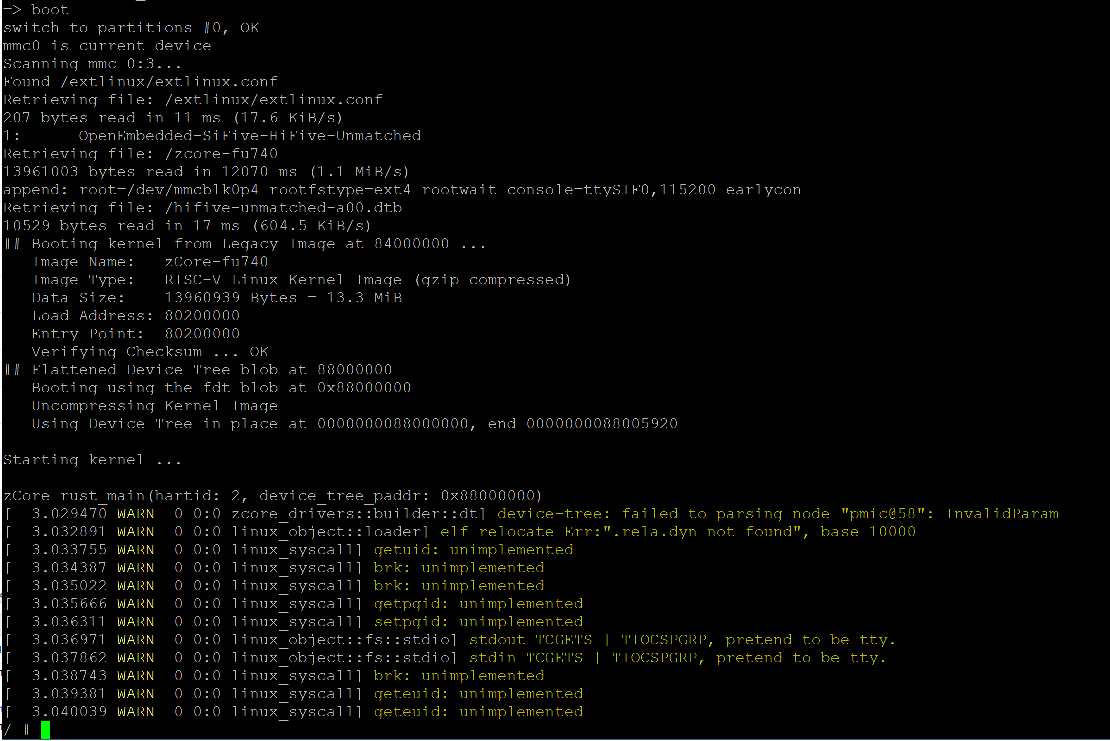
Achievement
6

Slide 14
Further Target
An:
Add Graphics Driver (refer to AMD drvier)
Build a basic GUI
Tian:
Implementation for peripheral drivers (Serial, SSD).
Referring to some mechanisms of TOCK, attempt to create a relatively small kernel named tCore.
Run the kernel on S7 RISC-V Core (known as Small Core).
QUESTIONS:
How to schedule different kernels? What is the kind of role the kernel on Small Core will play?
6

Slide 15
Thanks to:
陶天骅学长提供的uCore-SMP在HiFive上的移植经验
贾越凯学长提供的zCore知识以及编译指令修改参考
陈渝老师提供的参考论文
向勇老师以及全体操作系统课程助教、同学提供的交流环境
再次感谢！
14

