Slide 1


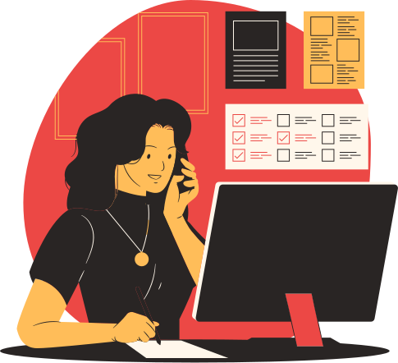

OLDMEAD ELEMENTARY SCHOOL
Netiquette for Online Classes
Teacher Cia's Class

Slide 2


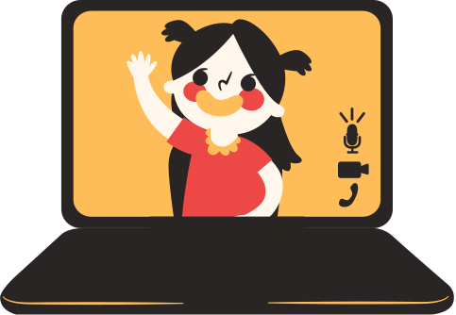
Welcome to our
online classroom!
Our virtual classroom is a safe space where we learn at our own pace and encourage others to do their best.

Slide 3

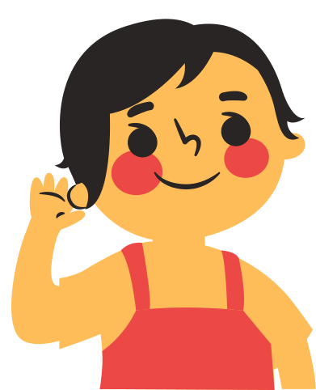

"Teachers open the door, but you must enter by yourself."
CHINESE PROVERB

Slide 4
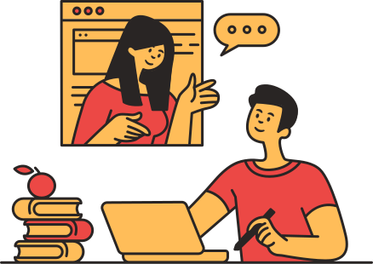
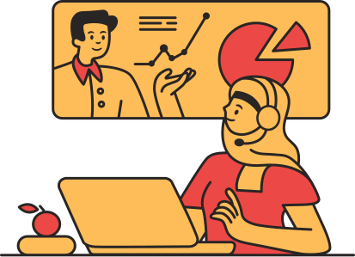
Ground rules for orderly, fruitful online classes
CLASSROOM REMINDERS
Best practices for maximizing learning
ONLINE
ETIQUETTE
Observing good behavior
in our virtual classroom

Slide 5


Classroom Rules
Good habits for a great learning environment

Slide 6
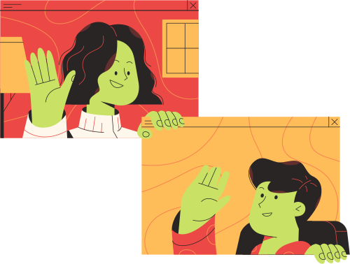
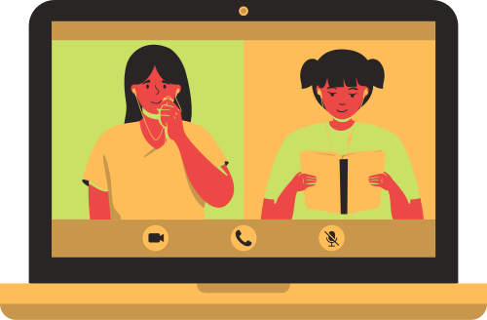
Be conscious of class attendance.
COME TO CLASS AS MUCH AS YOU CAN.
If you have health, connectivity, or other problems that stop you from attending classes, let the teacher know immediately.

Slide 7
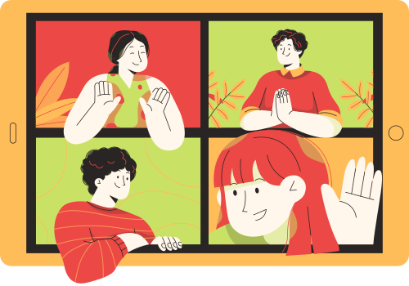
Submit assignments
on time.
FOLLOW GUIDELINES FOR TURNING IN YOUR ASSIGNMENTS.
Make sure to follow the deadline, format, and other instructions before you pass your assignments. This way, the teacher can easily find and open your files.

Slide 8
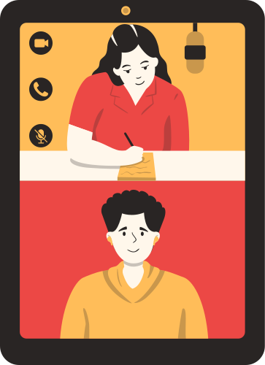
Practice independent learning.
PART OF LEARNING IS SEARCHING
FOR ANSWERS ON YOUR OWN.
If you have a question, check if you can find the answer online or in your books, notes, or lesson outline. If you still have trouble, we can find the answer together.

Slide 9
Feel free to participate!
DON'T BE AFRAID TO VOICE OUT YOUR IDEAS.
When asked, you can express your thoughts and opinions during discussion time. Remember to wait for others to finish speaking first.

Slide 10

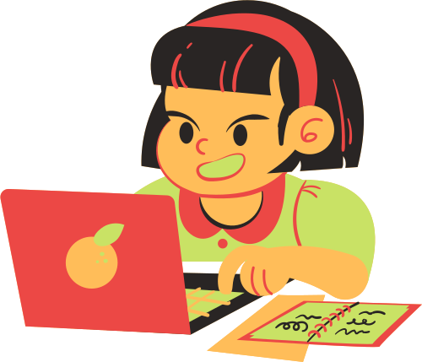
Online Etiquette
Basic rules to observe while classes are going on

Slide 11


Listen to the teacher.
Pay attention to the lesson.
Be all ears during classes. Turn off loud music and other noise that will stop you from hearing the audio.

Slide 12

No yelling, please.
Shouting is banned in our classroom.
Talk in your normal voice. If you have problems with the audio, let the teacher know in the chat box.

Slide 13

Use the chat box properly.
Only talk about class-related topics in the chat box.
Please don't share pictures, comments, or links not related to the discussion.

Slide 14

Use polite words.
Don't forget to say please and thank you.
Use these kind words whenever you ask your teacher or classmates for help.

Slide 15
Other Classroom Reminders
Respect others' ideas.
Be focused.
Ask questions.
Put away toys, gadgets, and other distractions.
Use the raise-hand button if you have a question.
Listen to what your classmates have to say
Check grammar and spelling.
Be prepared.
Have fun!
Gather pens, pencils, notebooks, and other materials before class.
Don't be afraid to make mistakes.
Be formal and don't use text shortcuts in chat boxes.

Slide 16
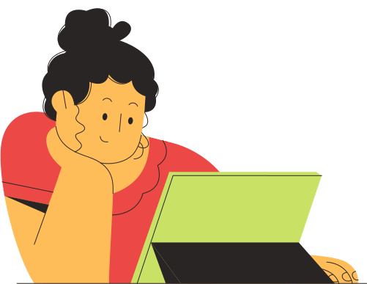
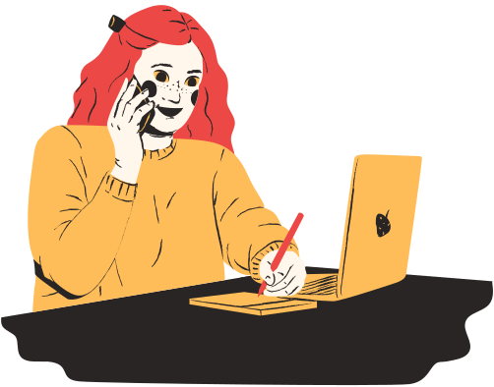
Got any questions?
You can always reach out to Teacher Cia.
EMAIL ADDRESS
hello@reallygreatsite
MOBILE NUMBER
123-456-7890
CONSULTATION HOURS
5 PM to 7 PM

Slide 17
Classroom Rules
Good habits for a great learning environment

Slide 18
Be conscious of class attendance.
COME TO CLASS AS MUCH AS YOU CAN.
If you have health, connectivity, or other problems that stop you from attending classes, let the teacher know immediately.

Slide 19
Feel free to participate!
DON'T BE AFRAID TO VOICE OUT YOUR IDEAS.
When asked, you can express your thoughts and opinions during discussion time. Remember to wait for others to finish speaking first.

Slide 20


Thank You
For Listening

