Slide 1
LEAD SCORING CASE STUDY
Group Members
Akshita Gupta
Kaivalya Kulkarni
Ashish Yadav

Slide 2

X Education sells online courses to industry professionals.
X Education gets a lot of leads, its lead conversion rate is very poor. For example, if, say,
they acquire 100 leads in a day, only about 30 of them are converted.
To make this process more efficient, the company wishes to identify the most potential leads, also known as ‘Hot Leads’.
If they successfully identify this set of leads, the lead conversion rate should go up as the sales team will now be focusing more on communicating with the potential leads rather than making calls to everyone.
X education wants to know most promising leads.
For that they want to build a Model which identifies the hot leads.
Deployment of the model for the future use.

Slide 3
STEPS INVOLVED
Data cleaning :
Handling Duplicate Data.
Handling NA values and missing values.
Dropping columns, if it contains large amount of missing values and not useful for the analysis.
Imputation of the values, if necessary.
Exploratory Data Analysis (EDA):
Univariate Data Analysis: Boxplots
Bivariate Data Analysis: correlation coefficients and pattern between the variables etc. using heatmap.
Data Preparation: Feature Scaling & Dummy Variables and encoding of the data.
Logistic Regression for model building
.
Validation of the model.

Slide 4
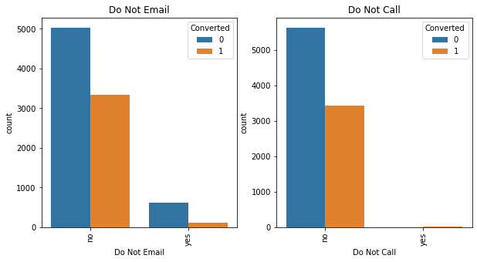
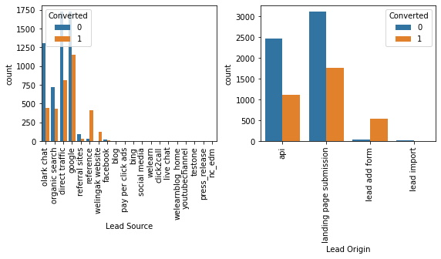
Exploratory Data Analysis (EDA):

Slide 5
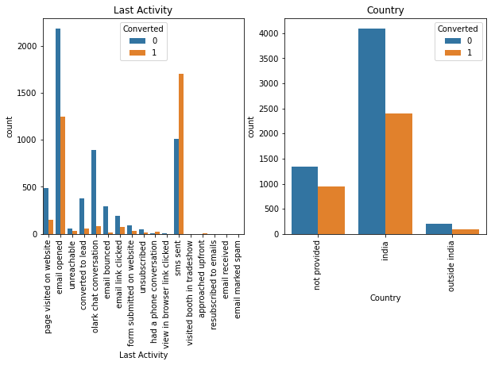
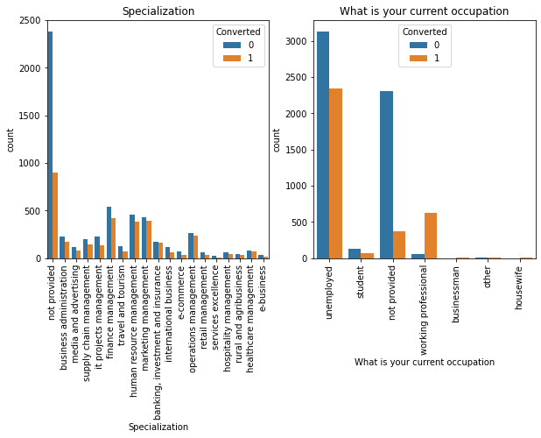

Slide 6
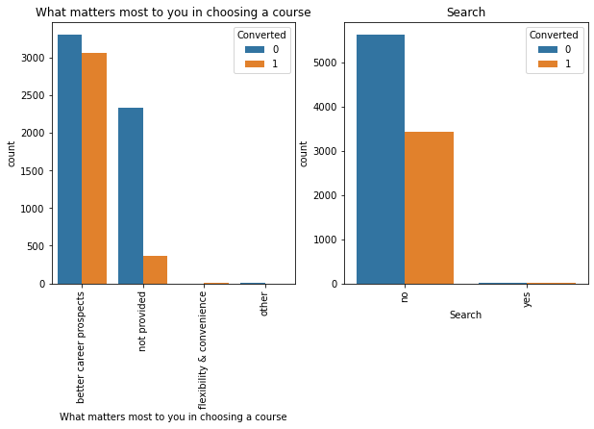
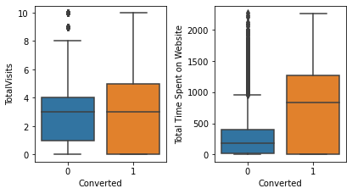

Slide 7
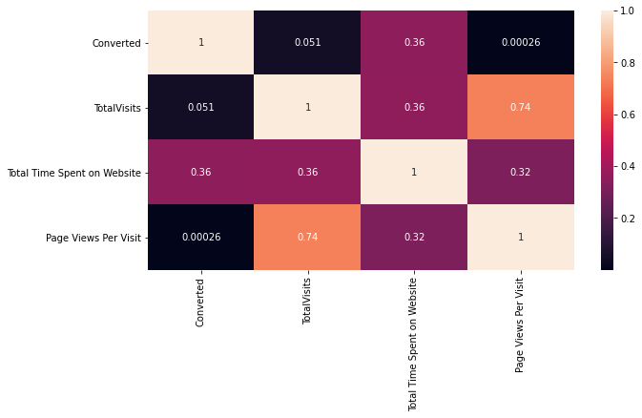
Correlation Between numerical columns (Heat Map)

Slide 8
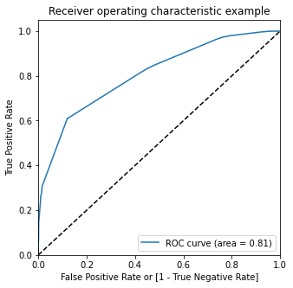
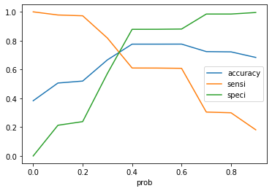
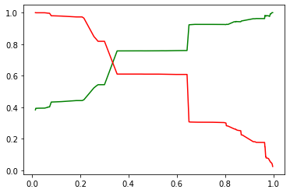
Linear Regression Final Model

Slide 9
MODEL ANALYSIS
Overall accuracy on Test set: 0.7759
Sensitivity of our logistic regression model: 0.609
Specificity of our logistic regression model: 0.878

Slide 10
LINEAR REGRESSION MODEL
Our Logistic Regression Model is decent and accurate enough, when compared to the model derived using PCA, with 77.8 % Accuracy on Test Set, 56.8 % Sensitivity and 88.6 % Specificity. We can vary these parameters by varying the cut-off value and thus predict Hot leads based on scenarios like availability of extra resources and vice-versa

Slide 11
CONCLUSION
X Education Company needs to focus on following key aspects to improve the overall conversion
rate:
Increase user engagement on their website since this helps in higher conversion
Increase on sending SMS notifications since this helps in higher conversion
Get Total visits increased by advertising etc. since this helps in higher conversion
Improve the Olark Chat service since this is affecting the conversion negatively

