Slide 1
Homework 6 : mxnet
Dead line: 05/19

Slide 2
TODO
Use mxnet framework to design a 60 layers network.(Train on fashion mnist and the test accuracy is your homework score)

Slide 3
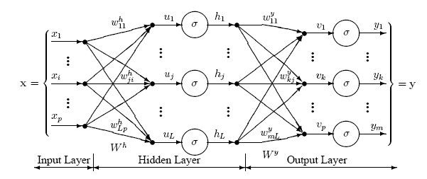
2. Use mxnet framework to design a 60 layers network.(Train on fashion mnist and the test accuracy is your homework score)
Train on fashion mnist dataset
the test accuracy is your homework score
60 layers

