Slide 1
Homework7: Music Generation
Dead line: 06/09

Slide 2
Introduction
In this homework, you will build a Recurrent Neural Network (RNN) for music generation.
We will train a model to learn the patterns in raw sheet music in ABC notation.

Slide 3
Introduction
ABC Notation
Vectorization
Create Training Examples and Targets
Training the Model
Generate Music with RNN

Slide 4
What is ABC Notation?
Information fields:
X: reference number field is used to assign to each tune within a tunebook a unique reference number
T: tune title is the human identifier for the tune
M: meter field indicates the meter
L: unit note length specifies the unit note length
K: key signature
Notes:
The M: field indicates the meter. Apart from standard meters, e.g. M:6/8 or M:4/4, the symbols M:C and M:C| give common time (4/4) and cut time (2/2) respectively. The symbol M:none omits the meter entirely (free meter).
It is also possible to specify a complex meter, e.g. M:(2+3+2)/8, to make explicit which beats should be accented. The parentheses around the numerator are optional.
The example given will be typeset as:

Slide 5
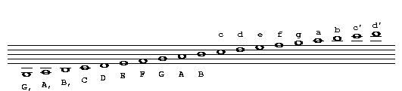
ABC Notation
Tune body
Pitch
Rest |
Repeat/bar symbols :|

Slide 6
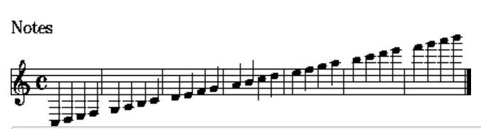
ABC Notation Example
X:191
T: Haenschen klein ging allein
M: 4/4
L: 1/4
K: C major
C, D, E, F,|G, A, B, C|D E F G|A B c d|e f g a|b c' d' e'|f' g' a' b'|]
Notes:
G、A、B、C、D、E、F♯、G

Slide 7
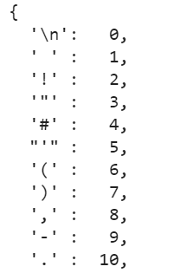
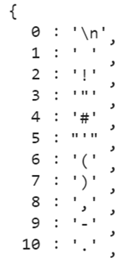
Vectorization
we'll generate two lookup tables: one that maps characters to numbers, and a second that maps numbers back to characters.
Characters to numbers
Numbers to characters

Slide 8
Create Training Examples and Targets
Now you have a sequence of index: [0, 1, 2, 3, 4, 5, 6, 7, 8, 9]
And you want to generate a list of sequence of the desired size (seq_length + 1)
Ex: seq_length=2, [[0, 1, 2], [3, 4, 5], [6, 7, 8]]

Slide 9
Create Training Examples and Targets
With the function split_input_target, you can split the list [[0, 1, 2], [3, 4, 5], [6, 7, 8]]
Into [([0, 1], 2), ([3, 4], 5), ([6, 7], 8)]

Slide 10
Training the Model
You can change the number of RNN units or stack more RNN layer (remember to modify the forwarding function)

Slide 11
Training the Model
List of Optimizer
AdaDelta
AdaGrad
Adam
Adamax
DCASGD
FTML
Ftrl
SGD
…
Hint: use opt.Adam or other optimizer

Slide 12
Generate Music with RNN
Starting string is a list of string such as [‘X’]
You have to transform it into a list of indices

Slide 13
Generate Music with RNN
Generate text with your trained model and a starting string
you can use abc notation to generate music by the strings

Slide 14
Concluding Remarks
Completing those TODO above doesn’t guarantee the success of generating songs as the generated text will have to follow the structure ABC Notation
You need to submit your .ipynb file to ceiba.
The generated music must be in .ipynb file.

