Slide 1
SiTA: Exploiting Sparsity in Tensor-Product for Accelerating Quantum Readout Error Mitigation
Hanyu Zhang¹, Zhiwei Ye², Liqiang Lu^{1∗}, Kaiwen Zhou¹, Fangxu Guo¹, Siwei Tan¹, Fangxin Liu³, Size Zheng⁴, Jianwei Yin¹
¹Zhejiang University ²China Mobile (Suzhou) Software Technology Co., Ltd
³Shanghai Jiao Tong University ⁴Tsinghua University
Notes:
hello everyone, today I’m going to present our work, SiTA: Exploiting Sparsity in Tensor-Product for Accelerating Quantum Readout Error Mitigation.

Slide 2
Outline of Presentation
Background
Motivation
Sparse Dataflow for Readout Error Mitigation
Architecture Design
Evaluation
Notes:
So first, I’ll briefly go through the background.

Slide 3

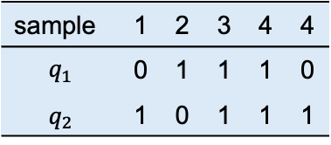



Quantum Readout
Quantum readout reads the information from quantum bits to classical bits.
#Sample = 5000
$$q_{1}$$
sample | 1 | 2 | 3 | 4 | 4
$$q_{1}$$ | 0 | 1 | 1 | 1 | 0
$$q_{2}$$ | 1 | 0 | 1 | 1 | 1
4999 | 5000
1 | 0
1 | 1
$$q_{2}$$
···
Circuit block
$$q_{3}$$
Readout
$$q_{4}$$
Measured bitstrings in different samples
Probability distribution
However, the quantum readout process suffers from readout error.
Notes:
First, let’s briefly introduce quantum readout.
Quantum readout is the process of converting quantum states into classical information through measurement.
However, due to various noise sources during the measurement process, the obtained results can deviate from the actual quantum states and become inaccurate.

Slide 4
Readout Error
Error sources
Long readout
latency
Crosstalk
Imperfect discriminator
Readout error is significant on current quantum hardware.
5.3 X
48.6 X
Error Rate (%)
Noise on 127-qubit IBM Sherbrooke quantum device
Noise on 10-qubit Tianmu quantum device
It is essential to mitigate readout errors to obtain reliable results.
Notes:
Among all these noise sources, readout noise is particularly severe.
It is mainly caused by factors such as long readout latency, crosstalk, and inaccurate discrimination.
For example, on IBM quantum systems, the readout error rate is about 48.6× higher than the noise introduced by single-qubit gates.

Slide 5
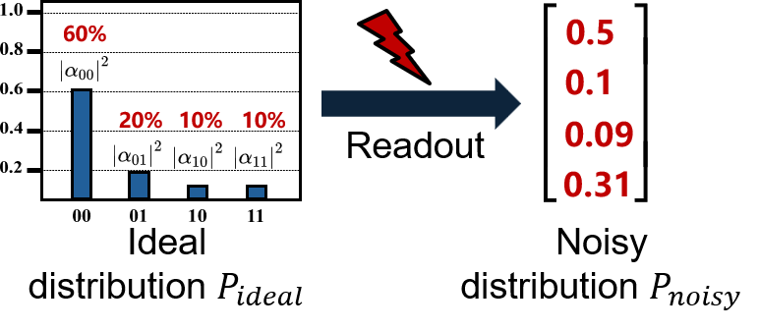
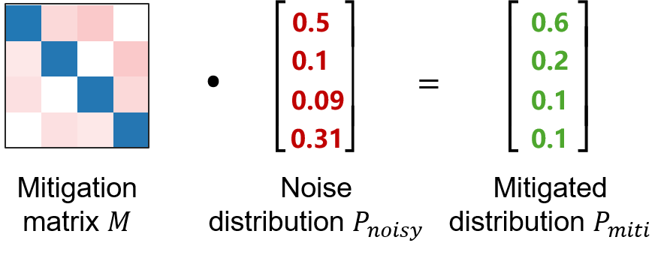




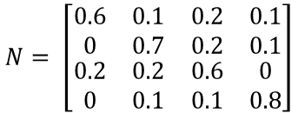
Matrix-Based Readout Mitigation
Readout with Noise ($P_{noisy}=N∙P_{ideal}$)
Perform MVM ($P_{miti}=M∙P_{noisy}$)
How to obtain the mitigation matrix?
Prepares qubits to different basis states and apply measurement.
Fill the noisy matrix
Inverse the noisy matrix
$$N= \left[\begin{matrix}\begin{matrix}0.6 & 0.1 \\ 0 & 0.7\end{matrix} & \begin{matrix}0.2 & 0.1 \\ 0.2 & 0.1\end{matrix} \\ \begin{matrix}0.2 & 0.2 \\ 0 & 0.1\end{matrix} & \begin{matrix}0.6 & 0 \\ 0.1 & 0.8\end{matrix}\end{matrix}\right]$$
$$M=N^{−1}=$$
Mitigation
matrix
prepare to 00
5-qubit mitigation matrix: 2⁵ × 2⁵
prepare to 01
10-qubit mitigation matrix: 2¹⁰ × 2¹⁰
The size exponentially increases!
…
…
Matrix-based readout mitigation is limited in spatial scalability !
Notes:
A common way to mitigate readout noise is to use matrix-based error mitigation.
The basic idea is to construct an error matrix that captures the measurement errors, and then use matrix inversion or matrix-vector multiplication to recover the ideal distribution.
However, the key challenge is scalability.
Since the error matrix grows exponentially with the number of qubits, this approach quickly becomes infeasible for large-scale quantum systems.

Slide 6





Tensor-Product-Based Mitigation
Key Idea: Tensor-Product Approximation
Qubit Group and Sub-Mitigation Matrix
$$P_{miti}=M∙P_{noisy}$$
IBM Mthree ^{[1]} and Google IBU ^{[2]}.
$$≈$$
$$⊗$$
$$⊗$$
$$⊗$$
$$⊗$$
$$P_{miti}=\left(M_{1}⊗{ M}_{2} ⊗…⊗M_{k}\right)∙P_{noisy}$$
Each physical qubit corresponds to a 2x2 meta matrix.
sub-mitigation matrices
Each submatrix shows exponential reduction in size.
Good scalability, low fidelity (crosstalk-unaware).
[1] Nation, Paul D., et al. "Scalable mitigation of measurement errors on quantum computers." PRX Quantum 2.4 (2021): 040326.
[2] Pokharel, Bibek, et al. "Scalable measurement error mitigation via iterative bayesian unfolding." Physical Review Research 6.1 (2024): 013187.
Notes:
To improve scalability, a common solution is tensor-product approximation.
Instead of constructing the full error matrix, it decomposes the problem into small 2x2 matrices for each qubit and combines them using tensor products.
This makes the computation much more scalable. However, since it assumes qubits are independent, it cannot capture correlated errors such as crosstalk, resulting in fidelity loss.
Therefore, multiple iterations are often performed to gradually improve the mitigation accuracy.

Slide 7
Outline of Presentation
Background
Motivation
Sparse Dataflow for Readout Error Mitigation
Architecture Design
Evaluation
Notes:
So the main question we ask is:
Can we further exploit sparsity to accelerate readout mitigation, without hurting accuracy too much?
That’s the motivation of this work.

Slide 8
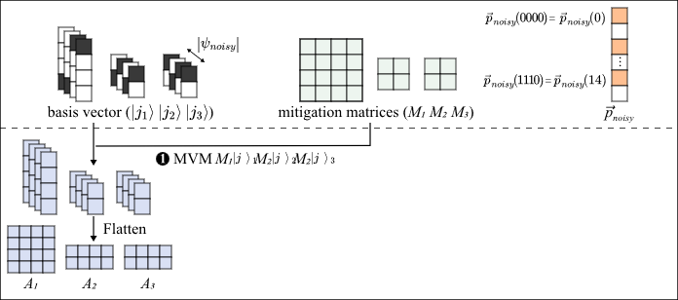
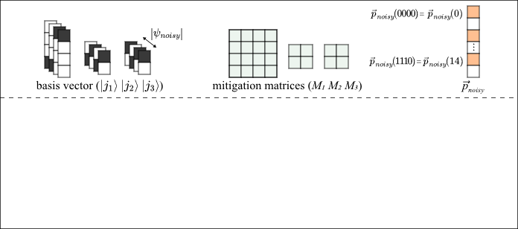
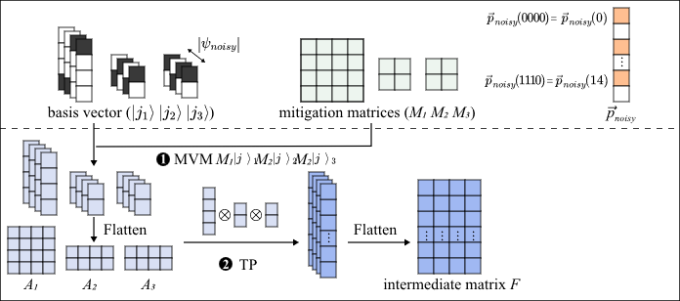
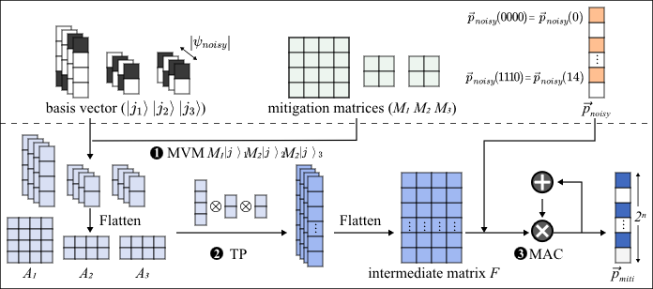
Computation Flow
❶ Matrix-Vector Multiplication (MVM)
❷ Tensor-Product (TP)
❸ Multiply-and-Accumulate (MAC)
Notes:
For tensor-product-based error mitigation, the computation mainly involves three key operations: MVM, TP, and MAC.
MVM applies the mitigation matrix to the measured probability distribution and generates the corrected output.
Among these operations, TP is the most important and also the most computationally intensive part. It builds a high-dimensional mitigation matrix by combining small per-qubit error matrices through tensor-product decomposition.
Finally, MAC is used during iterative refinement, where intermediate results are accumulated and updated over multiple iterations to improve the final accuracy.

Slide 9
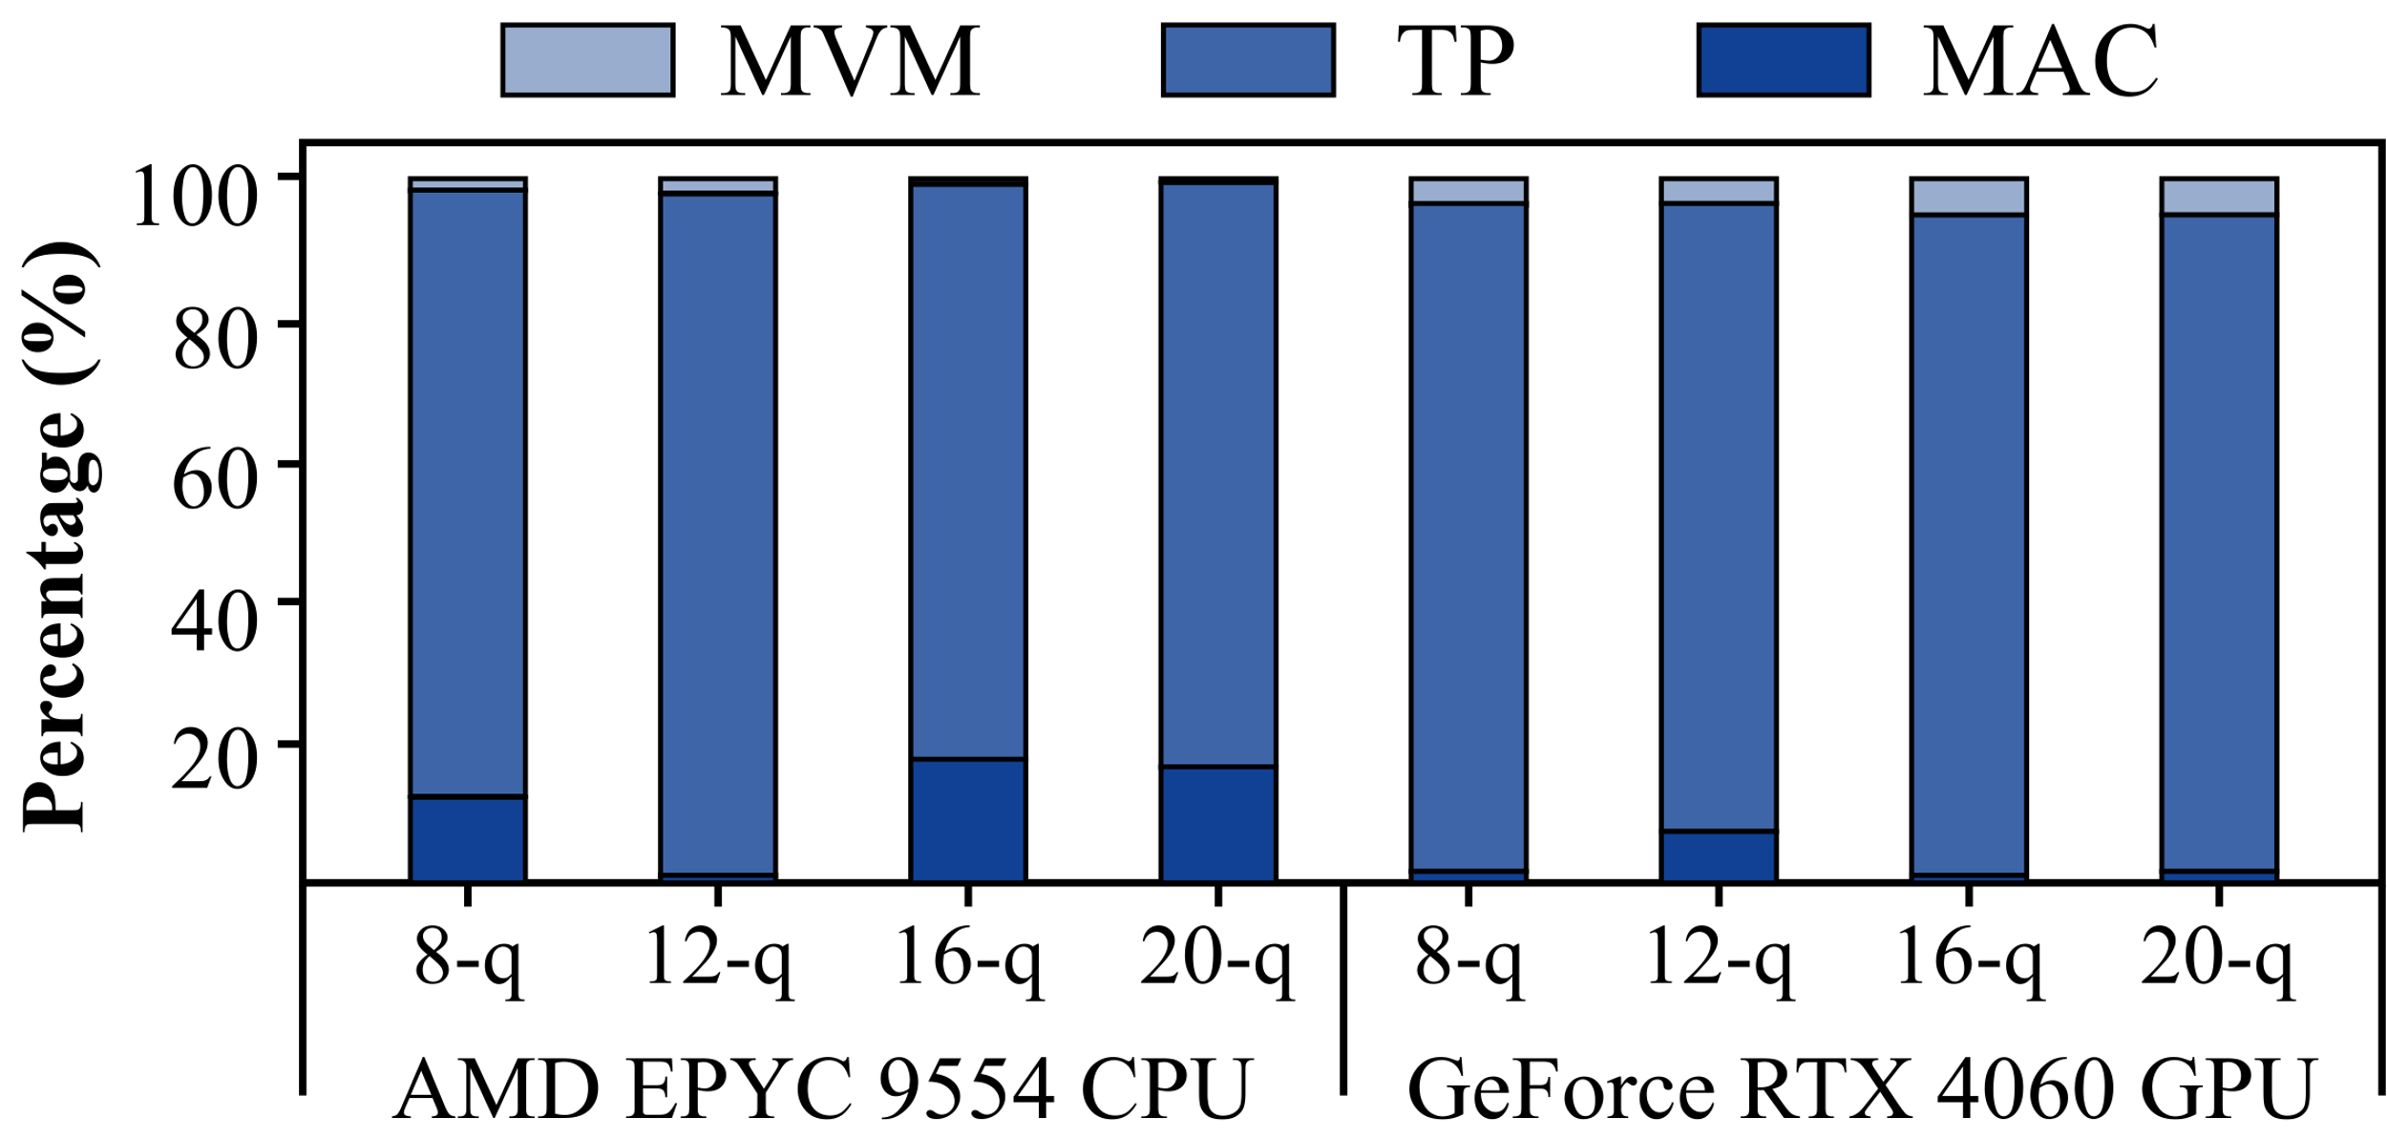



Sparse Opportunities
Latency Breakdown
AMD EPYC 9554 CPU:
MVM, TP, and MAC account for 5.6%, 90.7%, and 1.8%, respectively.
GeForce RTX 4090 GPU:
MVM, TP, and MAC account for 5.6%, 92.6%, and 1.8%, respectively.
The TP operator is the performance bottleneck.
Input Sparsity
Output Sparsity
MVM
TP
MAC
Basis states are unit vectors.
Only a few basis states have nonzero amplitudes.
How can sparsity be exploited to accelerate computation?
Notes:
Here’s the key observation.
First, TP takes the majority of the execution time, making it the main bottleneck in the system.
Second, we observe that the input is highly sparse — since basis states are essentially unit vectors, most entries are zero, and only a few positions are active.
More importantly, we also exploit output sparsity. In the tensor-product computation, although the full output space is exponentially large, in practice only a small subset of output probabilities are actually non-zero. This means we don’t need to compute the full dense result.
By combining input sparsity and output sparsity, we can significantly reduce redundant computation and focus only on the truly active parts of the tensor-product, which motivates our sparse execution design.

Slide 10
Outline of Presentation
Background
Motivation
Sparse Dataflow for Readout Error Mitigation
Architecture Design
Evaluation
Notes:
So based on these observations, we design a sparse dataflow and hardware accelerator called SiTA.

Slide 11
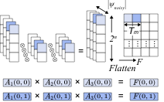
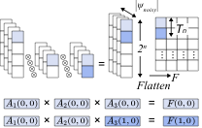
Parallelization for Tensor-Product
Probability-Level Parallelism
State-Level Parallelism
By combining the two parallelization strategies, the system accelerates TP computation at one tile per cycle.
Notes:
For tensor-product computation in SiTA, we further exploit parallelism from two complementary perspectives: probability-level parallelism and state-level parallelism.
At the probability level, we observe that different output probabilities are independent, so we can compute multiple probability entries in parallel without any dependency.
At the state level, each tensor-product operation itself can be decomposed across different qubit groups, allowing us to parallelize across sub-matrix combinations.
By combining these two levels of parallelism, we effectively expose a much larger degree of concurrency in the tensor-product computation.

Slide 12
Leveraging Sparsity
Leveraging Input Sparsity
Leveraging Output Sparsity
[0, 0, 0, 1] is a unit vector
Unit vectors (Basis states) are inherently sparse.
Transform matrix-vector multiplication (MVM) into column extraction.
Two-level backtracking is used to identify the elements with non-zero values.
Leverage output sparsity to compute only nonzero values.
Notes:
Now the key idea here is how we use sparsity.
Since the input is a unit vector, we can turn matrix-vector multiplication into a column lookup problem.
And on the output side, we use a two-level backtracking method to only compute non-zero results.
So we avoid a lot of useless computation.

Slide 13
Outline of Presentation
Background
Motivation
Sparse Dataflow for Readout Error Mitigation
Architecture Design
Evaluation
Notes:
Next, I’ll talk about the hardware architecture.

Slide 14
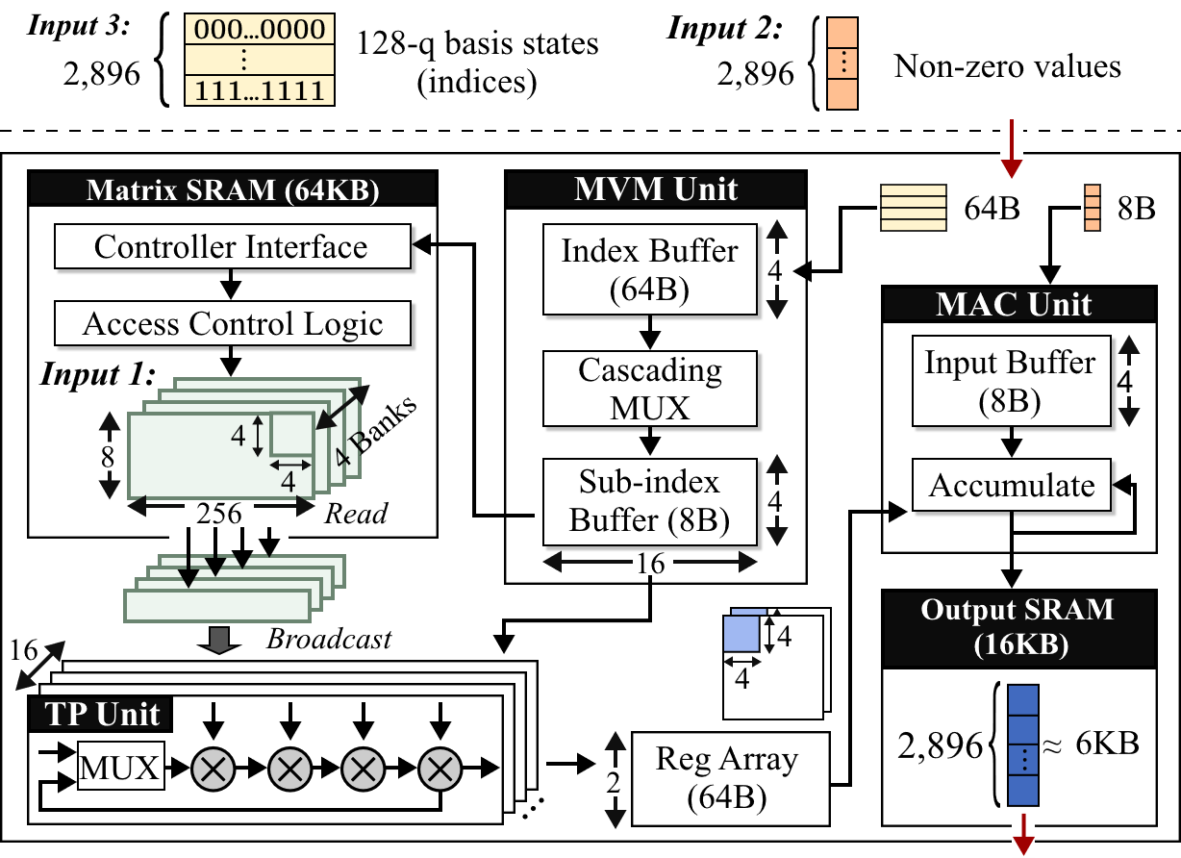
Overall Architecture
Overview of SiTA accelerator
Memory Hierarchy:
On-chip memory: mitigation matrix
Off-chip memory: basis states and non-zero values
Computing Modules:
MVM Unit, TP Unit and MAC Unit
Tailored memory hierarchy + Specialized computing modules!
Notes:
This is the overall SiTA architecture.
We have on-chip memory for the mitigation matrix, and off-chip memory for basis states and sparse values.
And we design three compute units: MVM unit, TP unit, and MAC unit.
The key idea is to match memory hierarchy with sparse computation patterns.

Slide 15
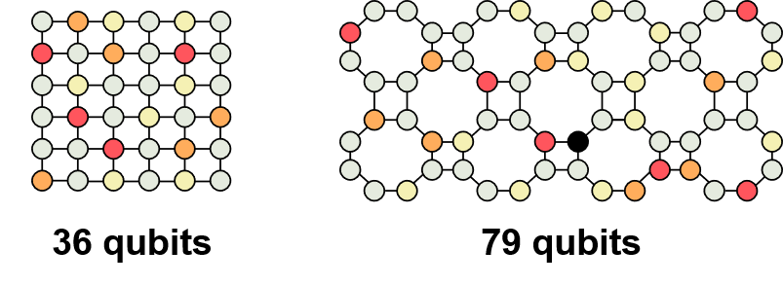
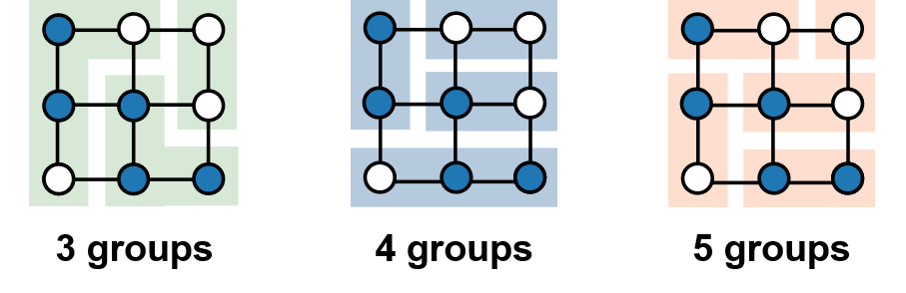
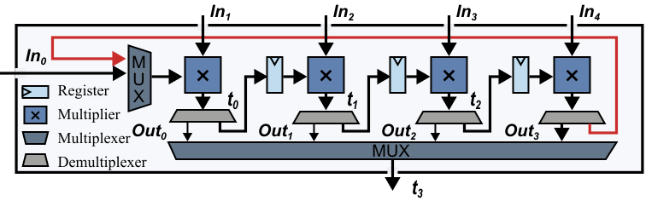
Dynamic Multiplier Chain
A flexible processing unit is needed for chained multiplications of varying lengths:
Systems with different numbers of bits
Systems with different bit grouping schemes
Dynamic Multiplier Chain:
Selectable output point
Feedback Loop
Demultiplexer: outputs the current result or forwards it to the next multiplier.
Multiplexer: feeds back the intermediate result for successive multiplications.
Notes:
Here we introduce the dynamic multiplier chain.
In tensor-product computation, different qubit groupings lead to multiplication chains of varying lengths, which are difficult to handle with a static pipeline.
To address this, we design a dynamic multiplier chain with flexible routing. The demultiplexer decides whether to output or forward intermediate results, while the multiplexer selects between new inputs and previously computed partial results, enabling efficient reuse.
This allows the same hardware to support different chain lengths, improving utilization and adapting to different tensor-product structures without changing the datapath.

Slide 16
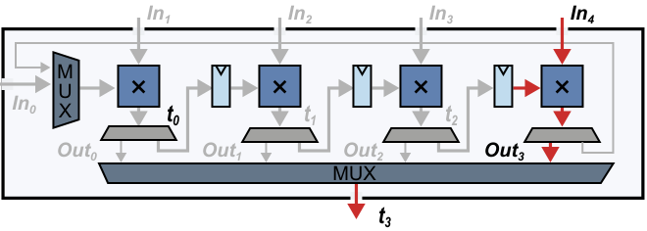
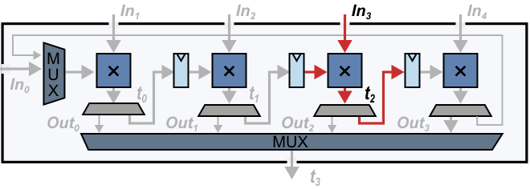
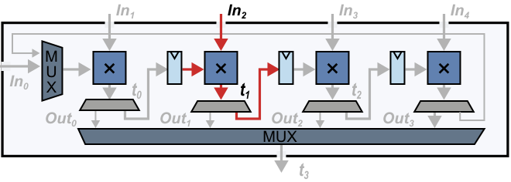
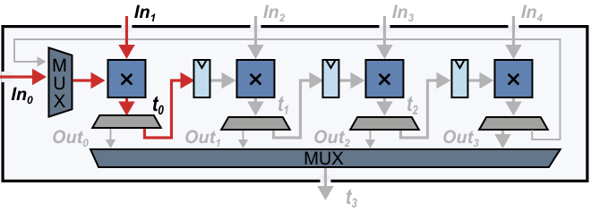
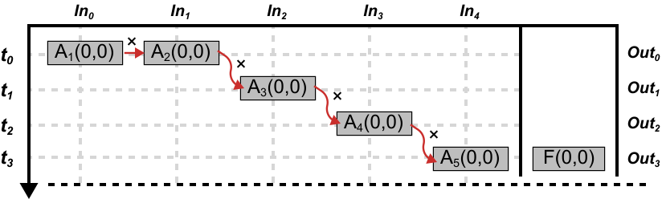
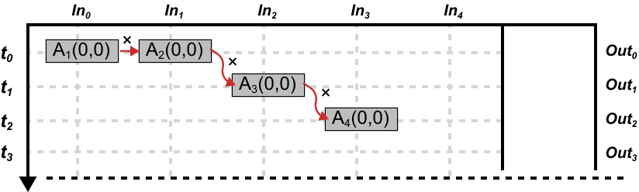
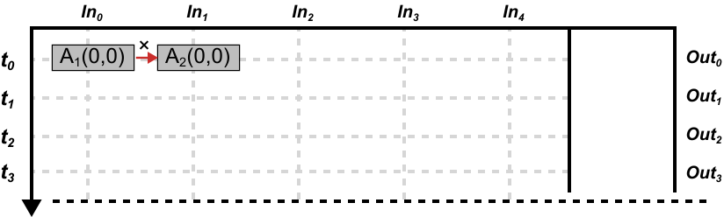
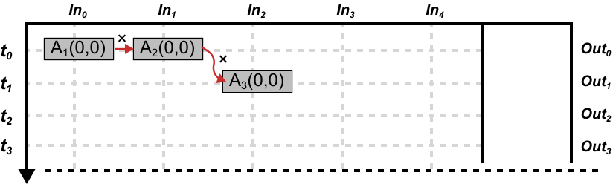
Dynamic Multiplier Chain
Example: An 8-qubit system is divided into 5 qubit groups:
F(0,0) = A₁(0,0) × A₂(0,0) × A₃(0,0) × A₄(0,0) × A₅(0,0)
Example: An 8-qubit system is divided into 5 qubit groups:
F(0,0) = A₁(0,0) × A₂(0,0) × A₃(0,0) × A₄(0,0) × A₅(0,0)
Example: An 8-qubit system is divided into 5 qubit groups:
F(0,0) = A₁(0,0) × A₂(0,0) × A₃(0,0) × A₄(0,0) × A₅(0,0)
Example: An 8-qubit system is divided into 5 qubit groups:
F(0,0) = A₁(0,0) × A₂(0,0) × A₃(0,0) × A₄(0,0) × A₅(0,0)
(a) Hardware Architecture
(b) Processing Pipeline
(b) Processing Pipeline
(b) Processing Pipeline
(a) Hardware Architecture
(b) Processing Pipeline
(a) Hardware Architecture
(a) Hardware Architecture
Notes:
To make the dynamic multiplier chain more concrete, we use an 8-qubit example where the system is decomposed into several qubit groups, each mapped to a small sub-matrix (A1–A5). Computing an entry like F(0,0) is done as a chained multiplication across these groups.
Since different workloads have different tensor structures, we design a dynamic multiplier chain with flexible routing via multiplexers and feedback paths, allowing intermediate results to be reused or forwarded. In execution, the computation runs in a streaming fashion from A1 to A5, improving utilization and avoiding full tensor-product expansion, while supporting different grouping schemes without redesigning the datapath.

Slide 17
Outline of Presentation
Background
Motivation
Sparse Dataflow for Readout Error Mitigation
Architecture Design
Evaluation
Notes:
Now let’s move to evaluation results.

Slide 18
Fidelity
Benchmarks：BV, GHZ, FALQON, VQE, and QAOA
Baselines：IBM Mthree ^{[1]}, Google IBU ^{[2]}, QuFEM ^{[3]}, SpREM ^{[4]}
Quantum hardware platform：79-qubit Rigetti quantum platform (average readout/CZ/XY gate errors: 5.5%/5.2%/4.4%)
Workload | Raw | Mthree | SpREM | IBU | QuFEM | SiTA
BV-16 | 0.22 | 0.47 | 0.48 | 0.60 | 0.61 | 0.68
GHZ-16 | 0.20 | 0.34 | 0.35 | 0.35 | 0.45 | 0.49
QAOA-10-2L | 0.19 | 0.20 | 0.20 | 0.21 | 0.25 | 0.29
QAOA-12-2L | 0.12 | 0.13 | 0.13 | 0.15 | 0.19 | 0.24
VQE-10-2L | 0.39 | 0.40 | 0.41 | 0.42 | 0.48 | 0.51
VQE-12-2L | 0.28 | 0.28 | 0.29 | 0.31 | 0.34 | 0.35
FAL.-10-35L | 0.37 | 0.38 | 0.38 | 0.39 | 0.40 | 0.42
FAL.-12-30L | 0.23 | 0.25 | 0.26 | 0.28 | 0.31 | 0.32
SiTA achieves an average fidelity improvement of 1.1× to 1.4×.
Mitigating only nonzero probabilities avoids noise amplification and improves fidelity.
[1] Nation, Paul D., et al. "Scalable mitigation of measurement errors on quantum computers." PRX Quantum 2.4 (2021): 040326.
[2] Pokharel, Bibek, et al. "Scalable measurement error mitigation via iterative bayesian unfolding." Physical Review Research 6.1 (2024): 013187.
[3] Tan S, Lu L, Zhang H, et al. Qufem: Fast and accurate quantum readout calibration using the finite element method[C]//ASPLOS. 2024: 948-963.
[4] Zhang H, Lu L, Tan S, et al. Sprem: Exploiting hamming sparsity for fast quantum readout error mitigation[C]//DAC. 2024: 1-6.
Notes:
First, fidelity results.
We evaluate on several benchmarks like BV, GHZ, VQE, and QAOA.
Compared with Mthree, IBU, QuFEM, and SpREM, SiTA consistently improves fidelity.
Overall, we get about 1.1× to 1.4× improvement.
The key reason is that we avoid noise amplification from unnecessary computations.

Slide 19
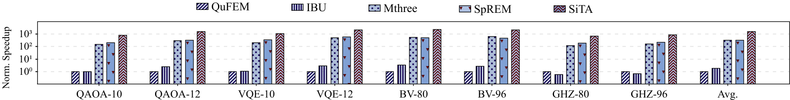
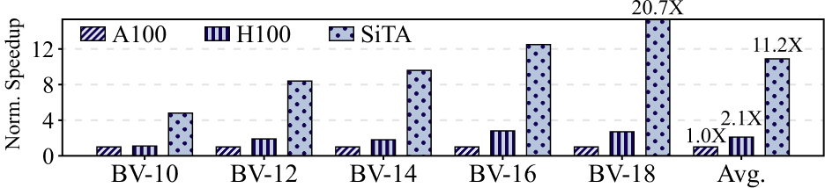
Speedup
SiTA achieves an average speedup of 5.0×, 4.9×, 844×, and 1604× over SpREM, Mthree, IBU, and QuFEM, respectively.
Comparison with SOTA mitigation methods
Comparison with the cuSPARSE library
11.2× speedup over the A100 GPU
5.3× speedup over the H100 GPU
Sparse acceleration + customized accelerator!
Notes:
Finally, performance results.
Compared to existing methods, we also see significant improvements across the board.
SiTA achieves up to 11.2× speedup over A100 and 5.3× over H100.
So overall, SiTA shows that exploiting sparsity with hardware support can significantly accelerate quantum readout error mitigation.

