Slide 1
League of Legends Data analysis
Kaixin Chen
Ruiwen Jin

Slide 2
Introduction to League of Legends
5 vs 5 MOBA game,
Gains gold when take down enemy champion, object or neutral monster. Earning gold help you update your equipment.
Ultimate goal: take down enemy’s nexus

Slide 3
Motivation Research Questions
Viewers can no more understand poor predictions or ambiguous judgements on leads presenters made . We could build a model Analyze Lead on real-time game status.(Based on kills, object taken, etc.)
Late game comp or Early game comp?
Choice between object, monster and kills.
Game length distributions.

Slide 4
DataSet Introduction
Total 8 datasets, main dataset with size 7620*58.
Huge column numbers
Columns we might use:
bKills: List of Blue Team's kills - [Time in minutes, Victim, Killer, Assist1, Assist2, Assist3, Assist4, x_pos, y_pos]
bTowers: List of minutes that Blue Team destroyed a tower and Tower Location
Address: website address the data is scraped from
Golddiff: Gold difference - computed Blue minus Red - by minute

Slide 5
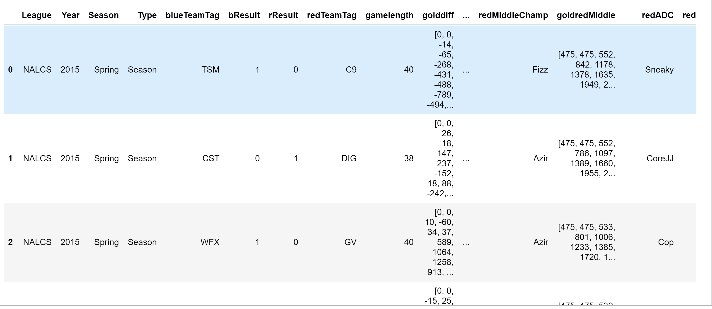
Meta dataset

Slide 6
Data munging and statistical summary
Date transforming:
Change data type to right form
Change form of certain attribute to count of them by features. Merge them all together. Reduced column num.
Outlier handling:
By using isolation forest model modified the outliers and drop them before building models
Data cleanup:
Choose data with minute column between 0-60 minutes(most of game in this time interval)
Dragon was updated to Water ,Wind , Earth and Fire dragon after patch 6.9(2016 preseason), There is 5 column count for dragon now while one is expire. Have to merge number of them in different column together.
Nan value after merging several lists, fill nan value with previous value in their group(group.by multiple values)

Slide 7
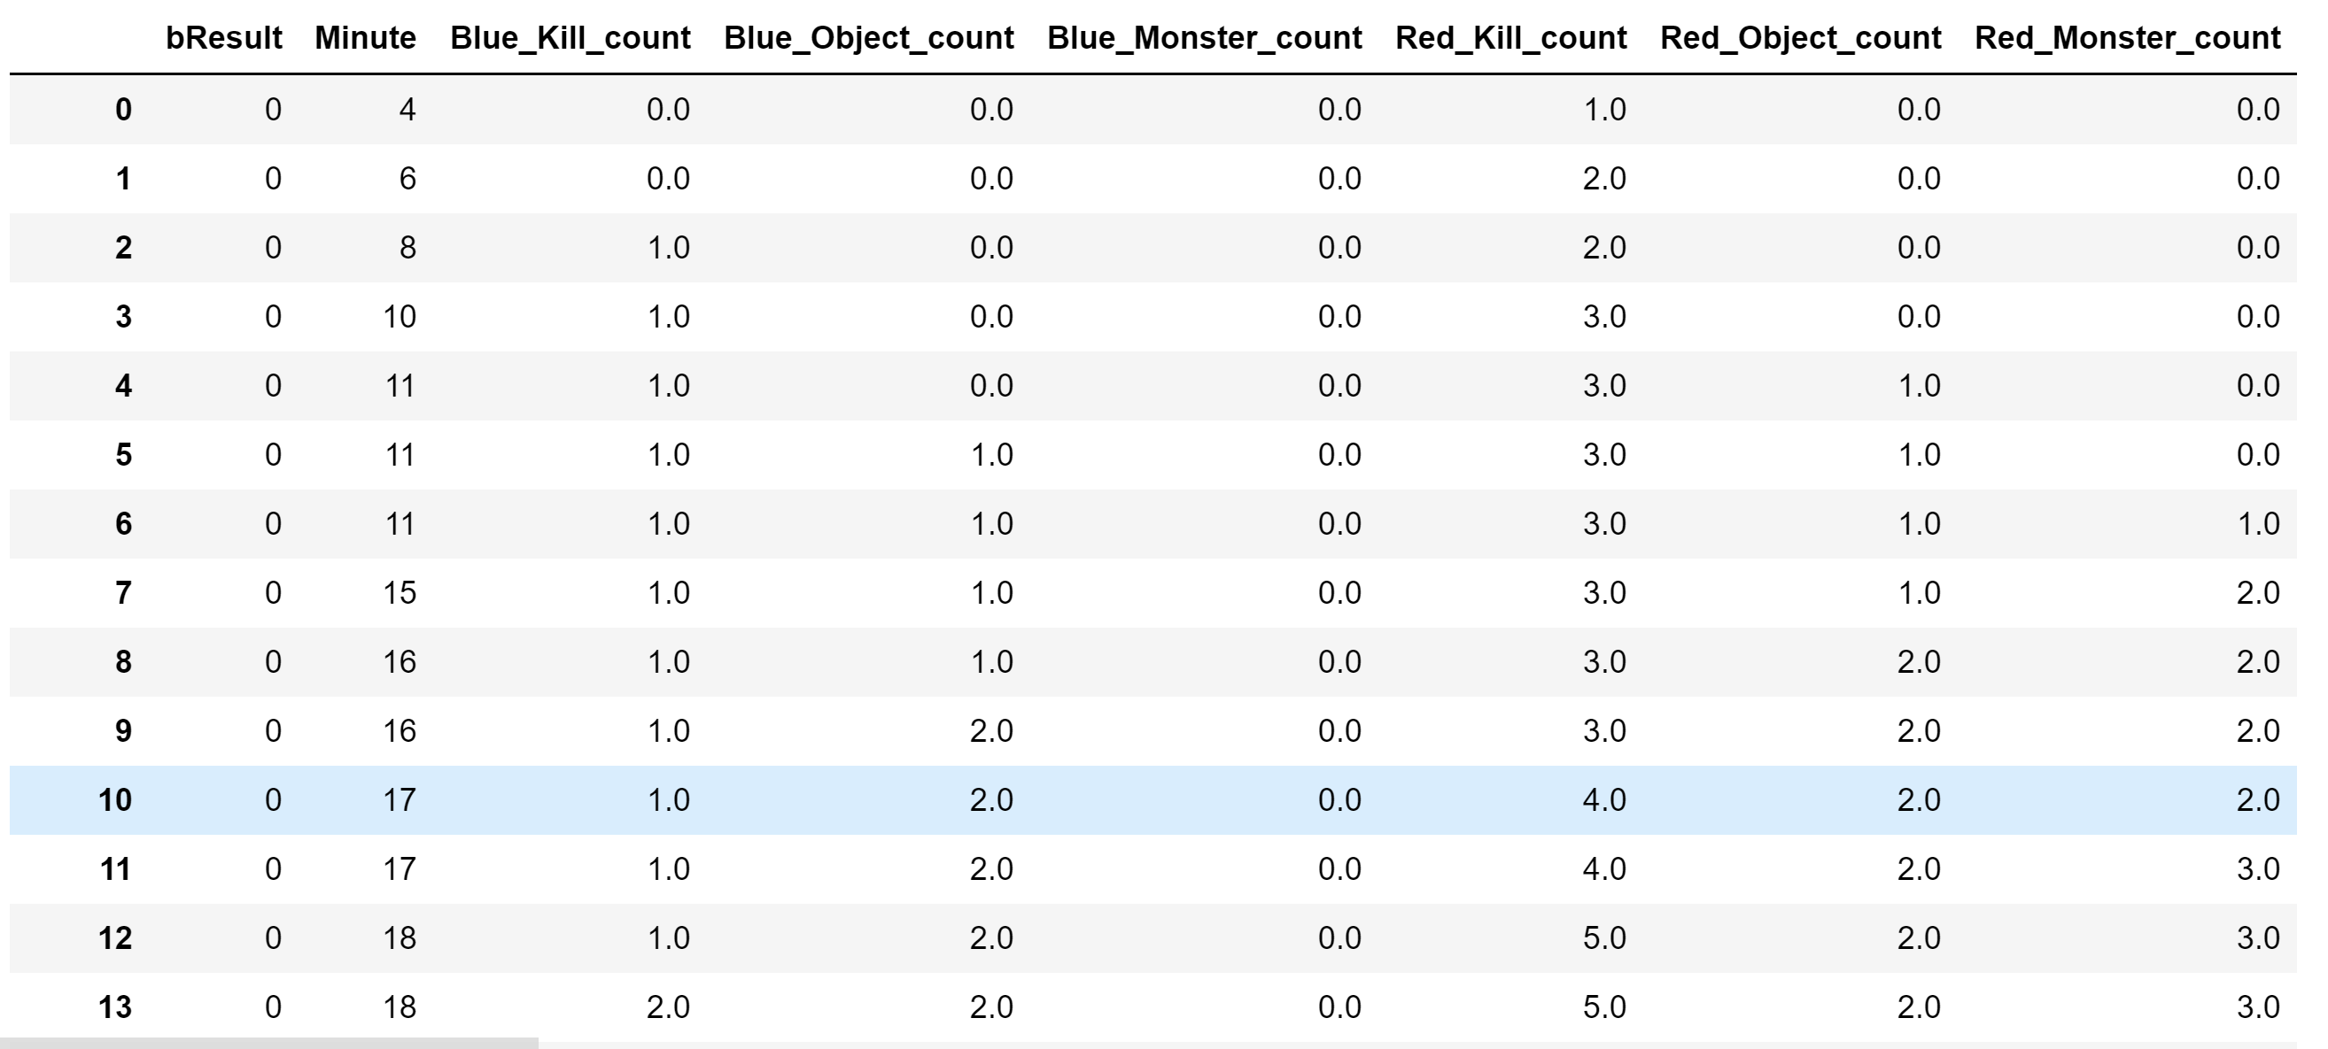
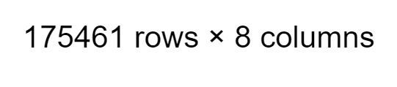
Final data for model Building:

Slide 8
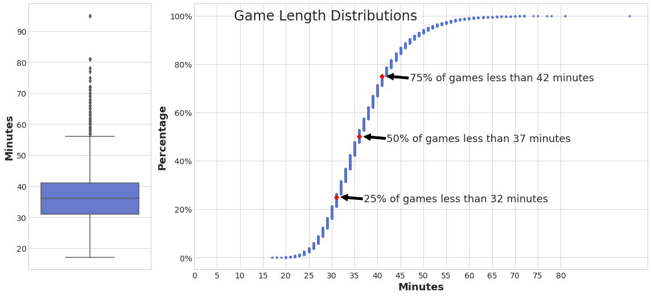
Game Length Distributions
Game Length is the key attribute for our analysis
Half of the game ends between 32-42 minutes.
Only small amount of game takes more than 60 minutes

Slide 9
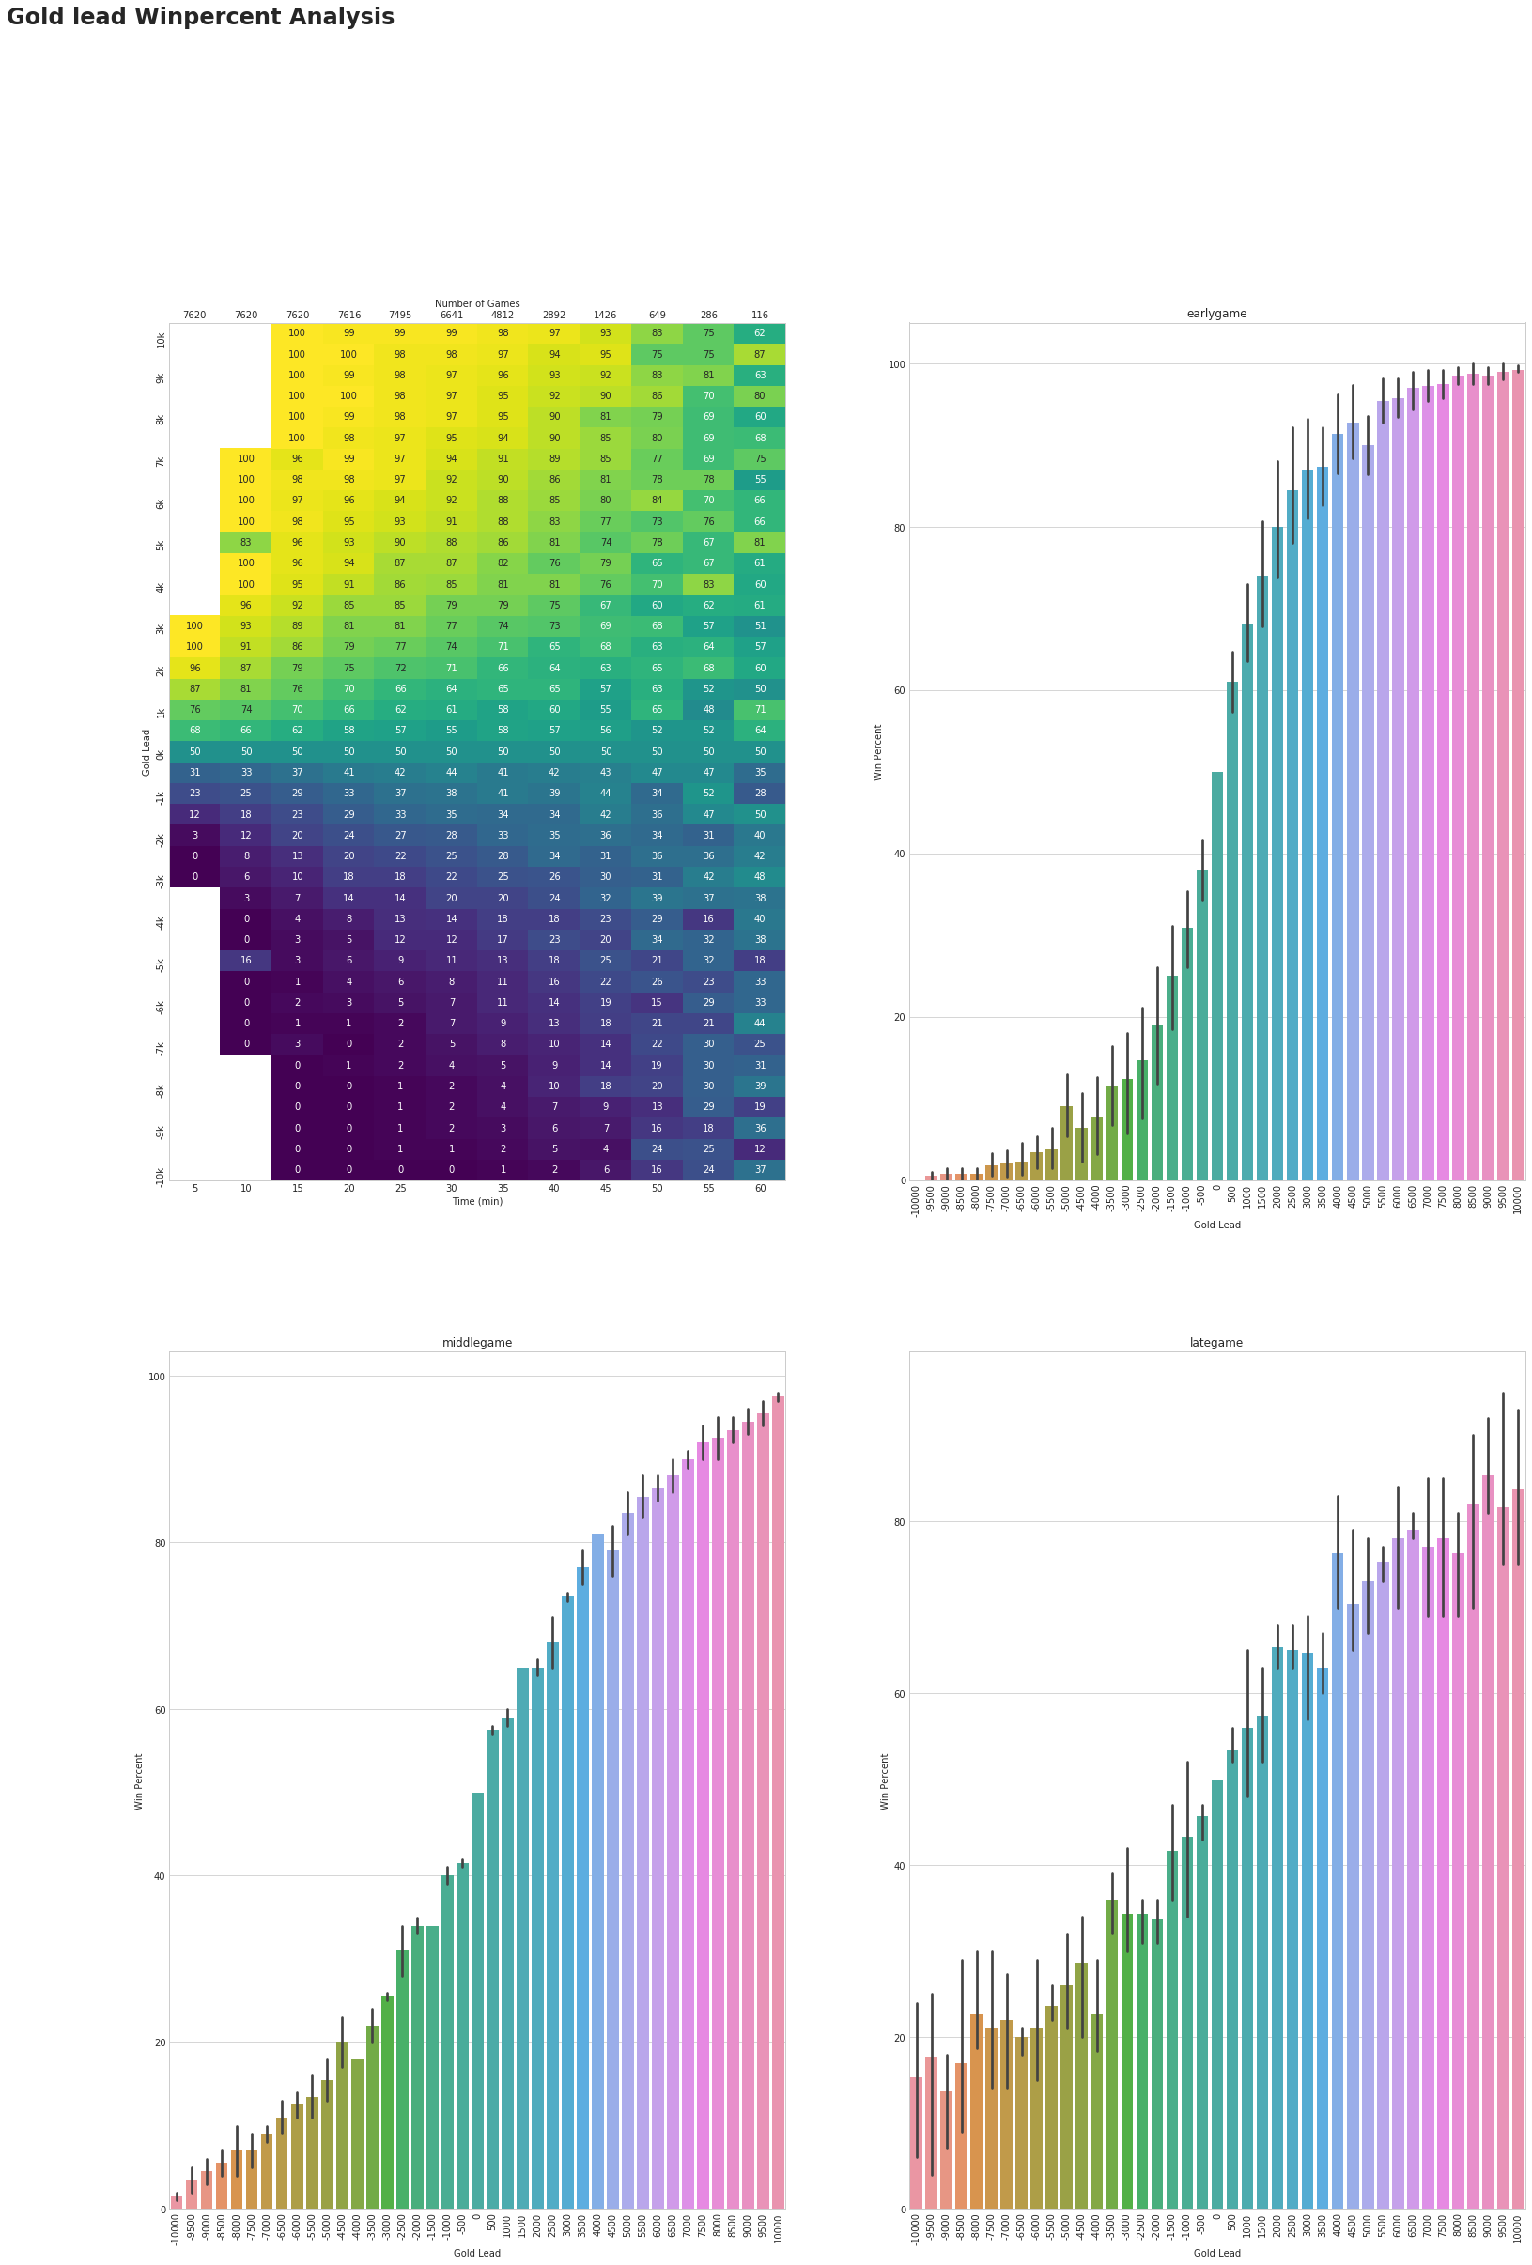
Gold distribution vs winrate

Slide 10
Gold distribution vs winrate
Gold is the direct attribute to reflect Leads
Importance of gold lead(gold diff) between two game become less as game length increase, but doesn’t fall off much.
Team with big gold lead in early period tends to win game straightly.
Conclusion: Early game > Late game

Slide 11
Modelling activity
Hypothesis: Number of object taken by each team influence their win rate the most, on the opposite, number of kills influence their win rate the most
Model based on data of allien kills_count, monster_count, objects_taken_count, and enemy’s those attributes, on each minutes.
Model choose: logistic Model,
Our output(bResult) is a binary value
Shape of previous graphs indicates distribution of datas

Slide 12
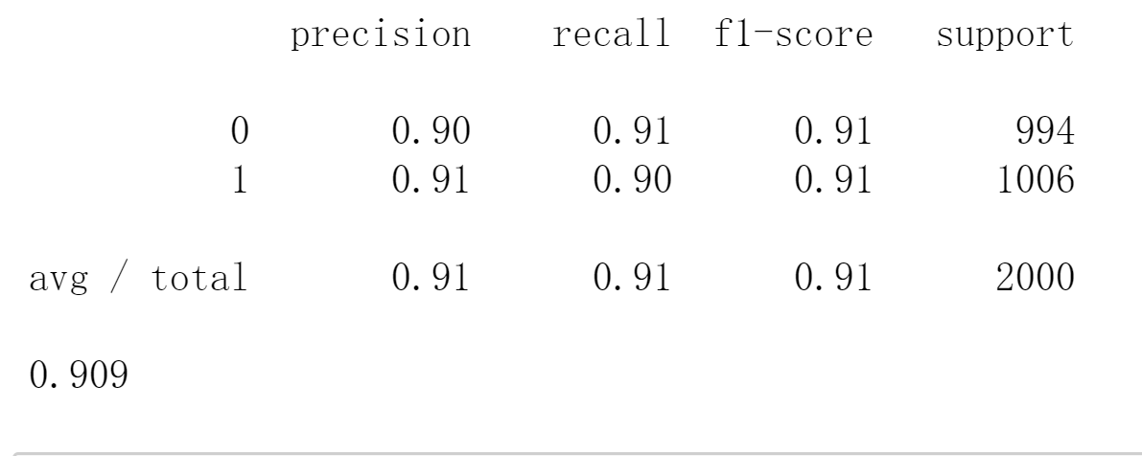
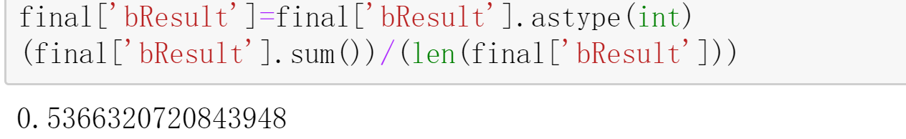
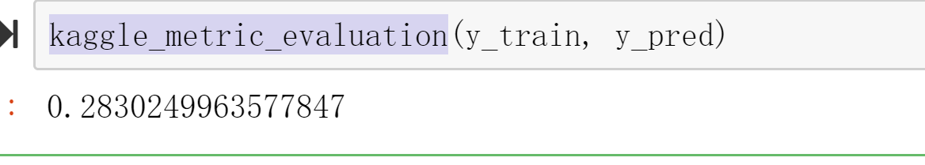
Modelling activity
Model Evaluation:
Accuracy Score based by compare prediction value with test value
Precision, recall, f1-score
Satisfied Basic accuracy requirement.
Train error vs validation error
kaggle_metric_evaluation
Model Selection:
Make classification on dataset
Balanced test, train group that dropped outliers
Stability selection

Slide 13
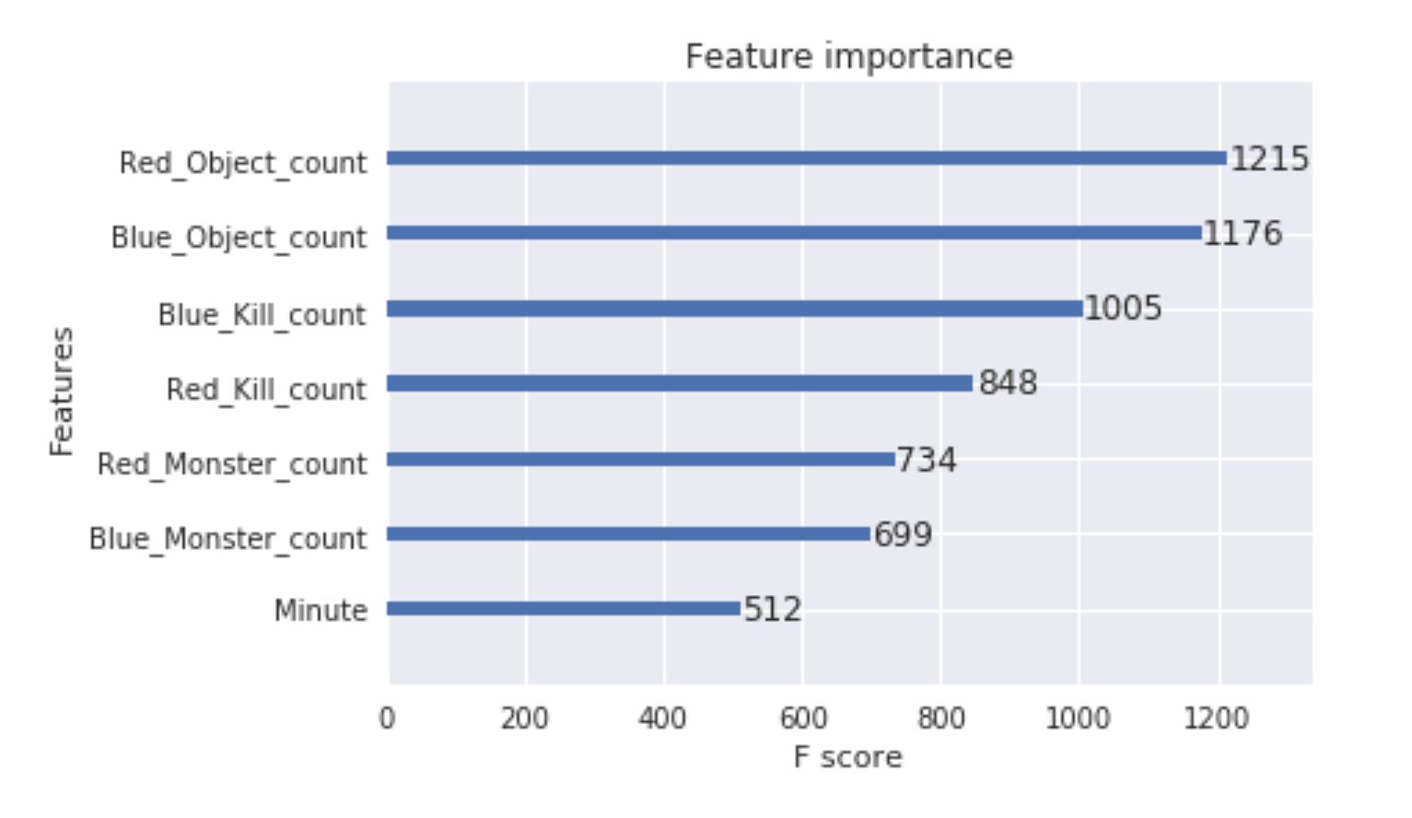
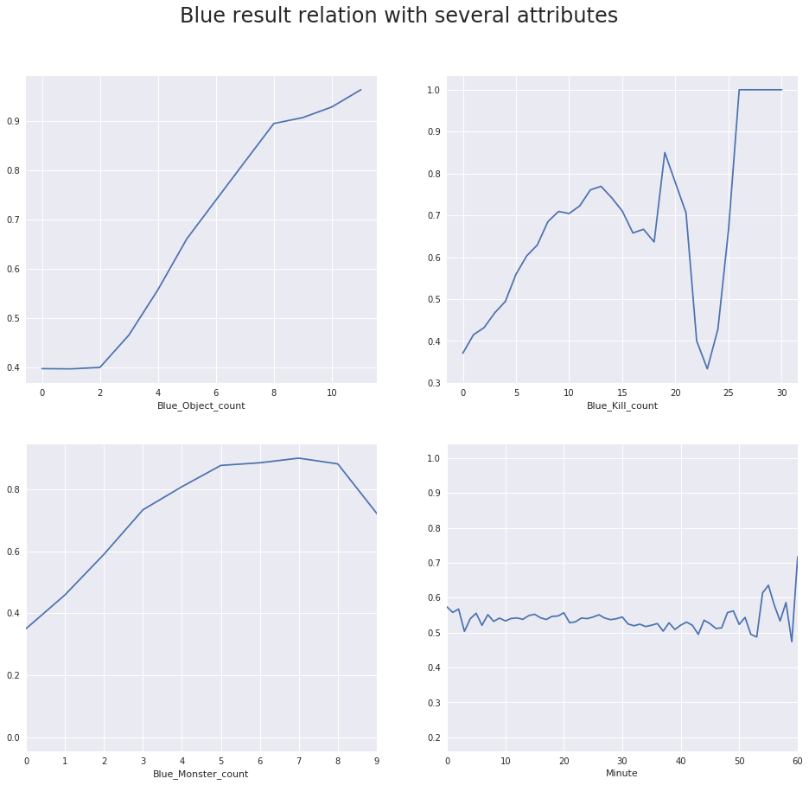
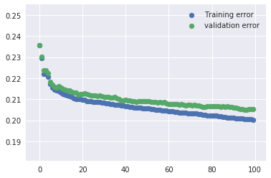
Winrate relation with Several attributes

Slide 14
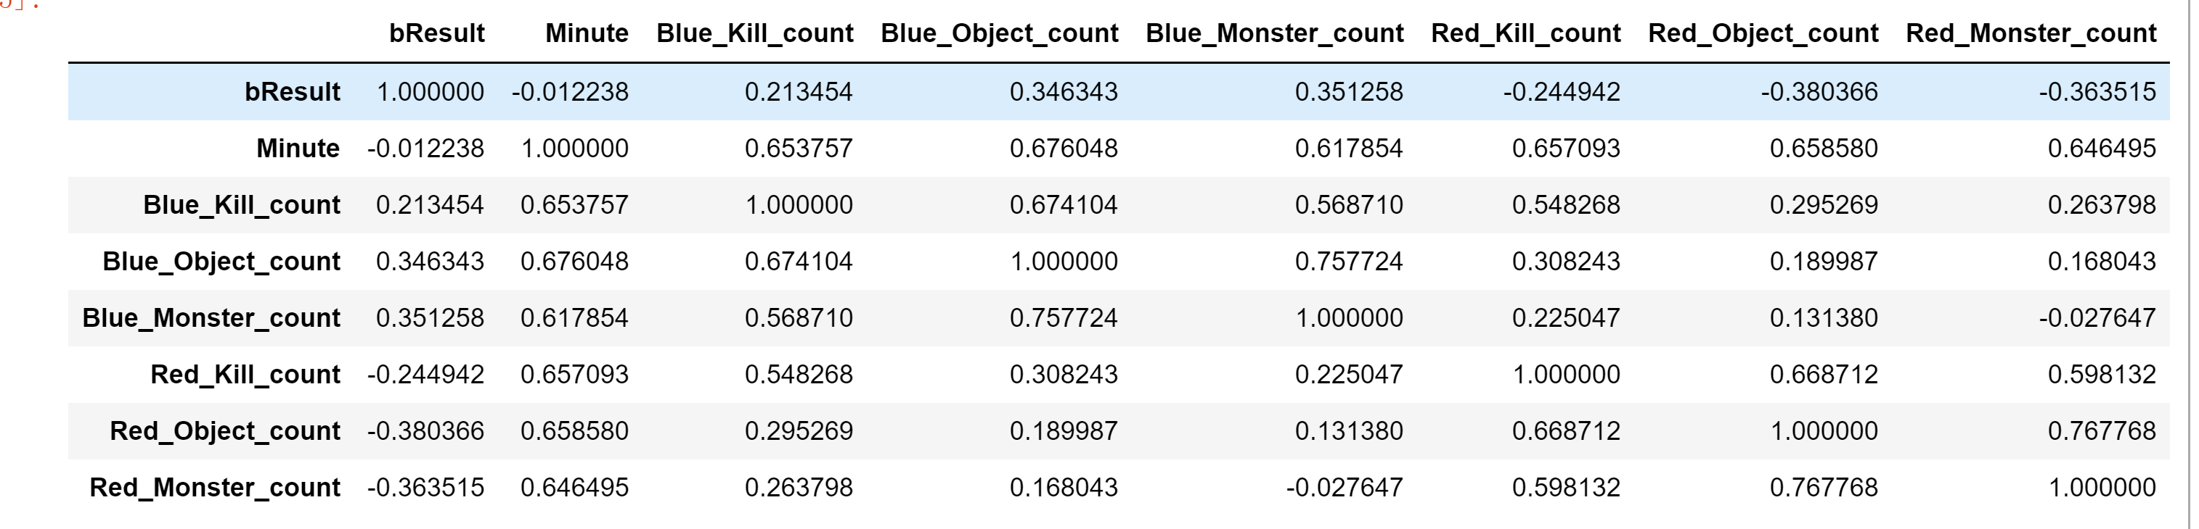
Winrate relation with Several attributes
Bad fit on XGBRegressor
Data proved our hypothesis that number of objects taken reflect win rate the most and number of kills the least.

Slide 15
Conclusion:
Object First!
Early game gold lead is a significant attribute toward win rate.
Blue side has higher winrate (53%) against Red side(47%) on average, However, correlation table and graph tells us blue side’s advantage drops as time goes. We assume Blue team has more early advantage which leads to a lead on over all win rate, proved that advantage early game is more important than late game advantage on the side.
Without gold difference, but only with detailed game status, we could still predict game precisely.
Pro players throws game too?

