Slide 1
FoG-Finder: Real-Time Freezing of Gait Detection and Treatment

Slide 2
Introduction
Freezing of Gait (FoG) is a severe symptom of Parkinson’s Disease (PD) affecting 60% of PD patients, increasing fall risks and lowering quality of life.
Existing treatments like Carbidopa-Levodopa and Deep Brain Stimulation (DBS) reduce FoG symptoms but don't fully address fall risks.
Current real-time treatment systems suffer from high false positive rates.

Slide 3
FoG-Finder System
Freezing of Gait (FoG) is a severe symptom of Parkinson’s Disease (PD) affecting 60% of PD patients, increasing fall risks and lowering quality of life.
It uses Inertial Measurement Unit (IMU) sensors, a smartphone, and vibration therapy devices to detect and treat FoG.
The system achieved a 13.4% higher F1 score, 10.7% higher accuracy, and reduced false positives by 85.8% compared to existing systems.
The system also provides quick treatment activation with an average latency of 427ms (subject-dependent) and 615ms (leave-one-subject-out).

Slide 4
Methodology
FoG-Finder uses IMU data to capture time-series features and transforms them into the frequency domain using Butterworth (BW) filters.
A multi-input Convolutional Neural Network (CNN) is employed to differentiate normal gait and FoG events.
The system collected data from 11 PD patients, accumulating 716 clinically labeled FoG events.

Slide 5
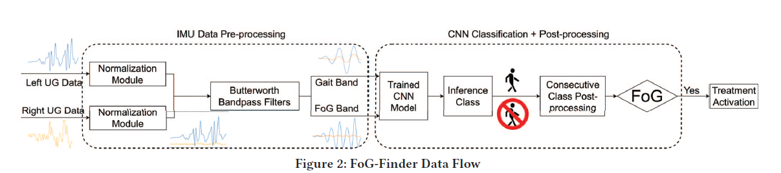
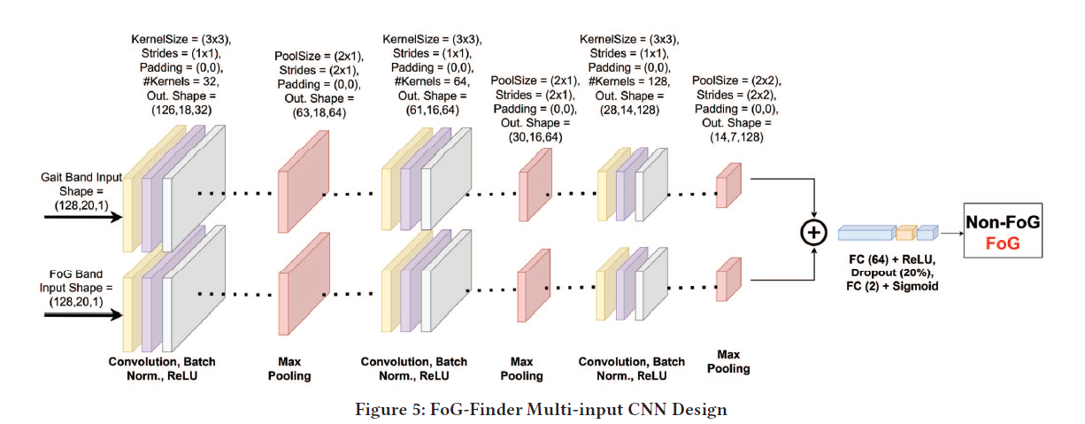

Slide 6
Evaluation
The study compared FoG-Finder against other systems using subject-dependent and leave-one-subject-out evaluations.
FoG-Finder demonstrated superior performance with significantly lower false positive rates and treatment latency suitable for real-world use.

Slide 7
Subject-Dependent Evaluation
Definition: The model is trained and tested using data from the same individuals.
How it works:
  The dataset is split into training and testing sets from each participant's own data.
  For example, in FoG-Finder, Visit 1 data of a patient is used for training, and Visit 2 data of the same patient is used for testing.

Slide 8
Leave-One-Subject-Out (LOSO) Evaluation
Definition: The model is trained on data from all participants except one, and tested on the excluded participant.
How it works:
  The process is repeated so that each participant gets a turn as the test subject.
  This ensures the model is evaluated on completely unseen data.
  Example in FoG-Finder: Data from 10 patients is used for training, and the 11th patient's data is used for testing, and this process rotates for all patients.

Slide 9
Conclusion
FoG-Finder is a viable, portable, and effective system for real-time FoG treatment.
The dataset used in the study will be made publicly available.

