Slide 1
Medication and DBS

Slide 2
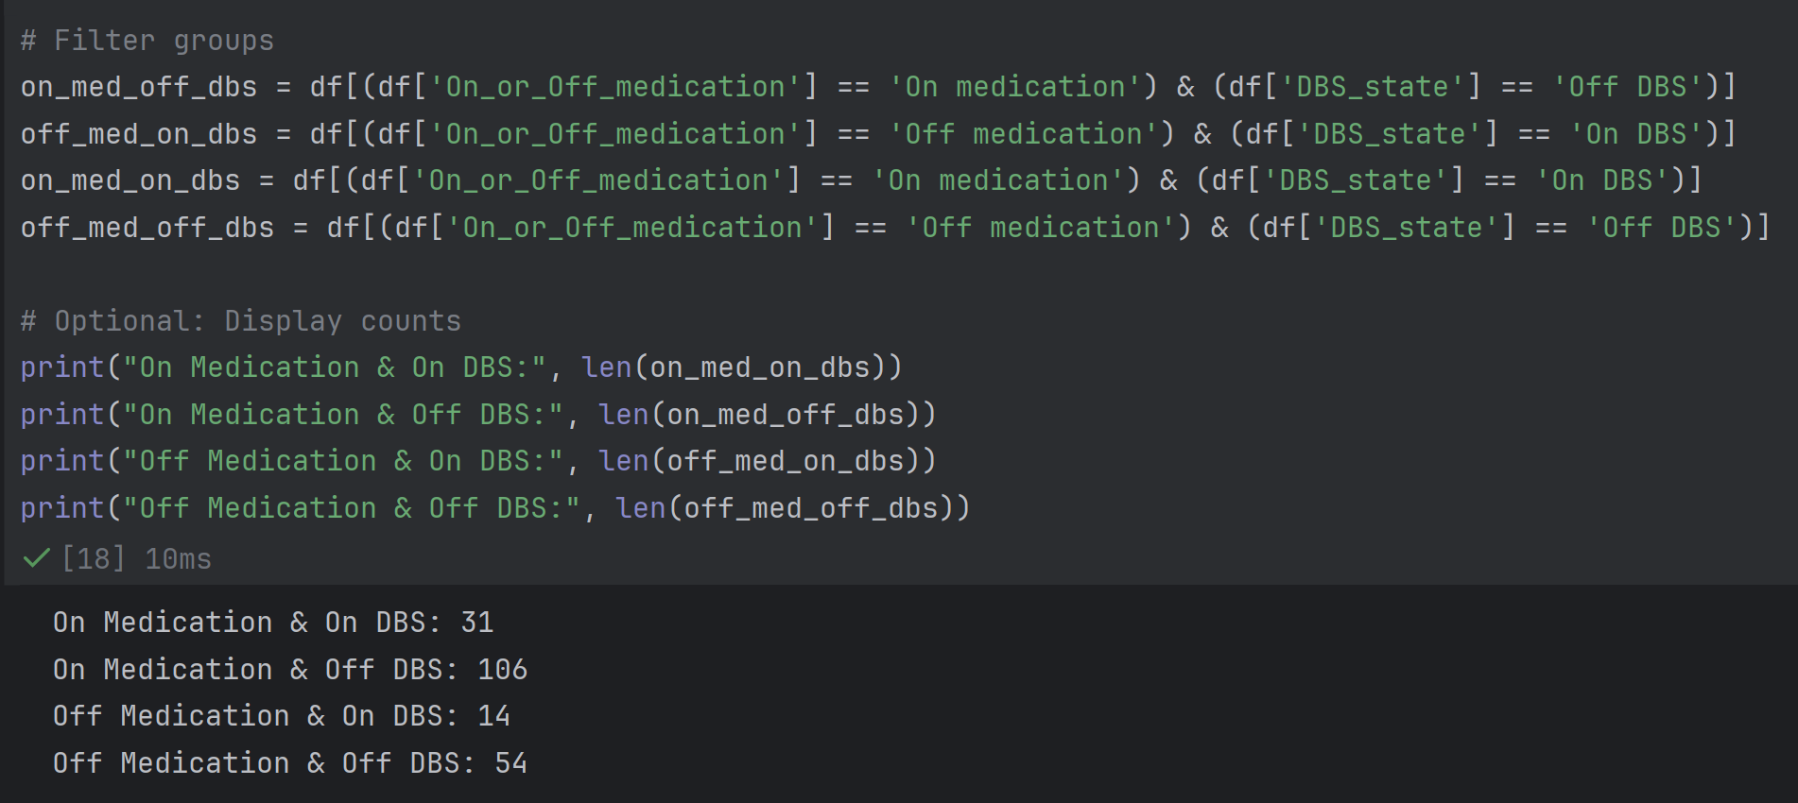
Filter Groups

Slide 3
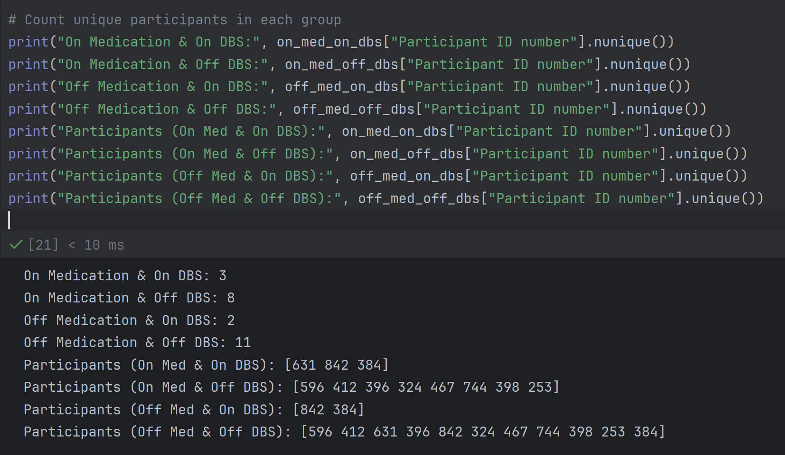
Count unique participants in each group

Slide 4
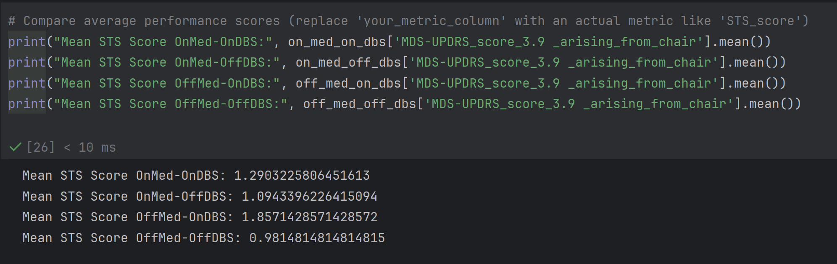
Compare average performance scores

Slide 5
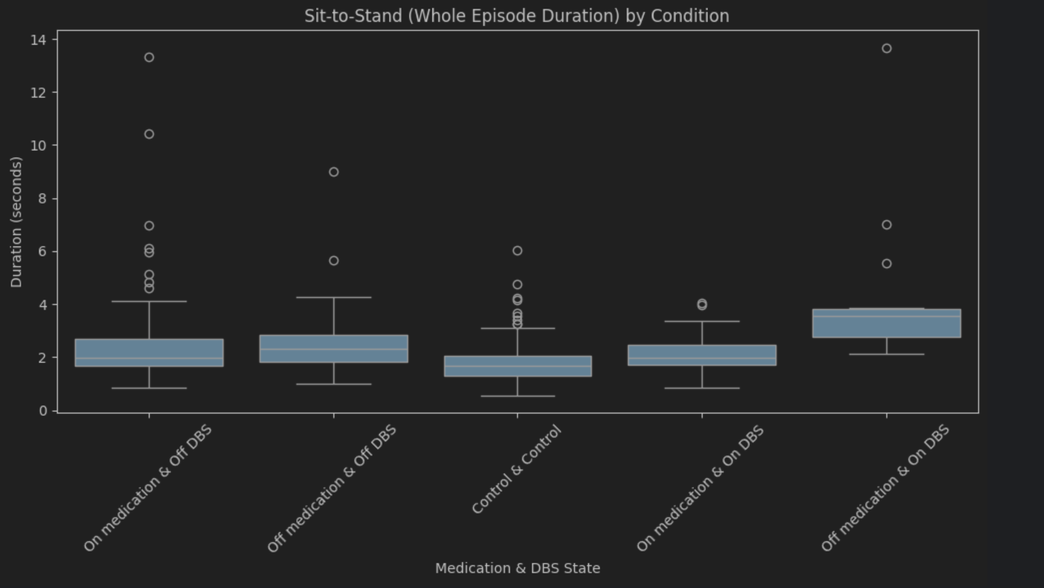
Sit-to-Stand (Whole Episode Duration) by Condition

Slide 6
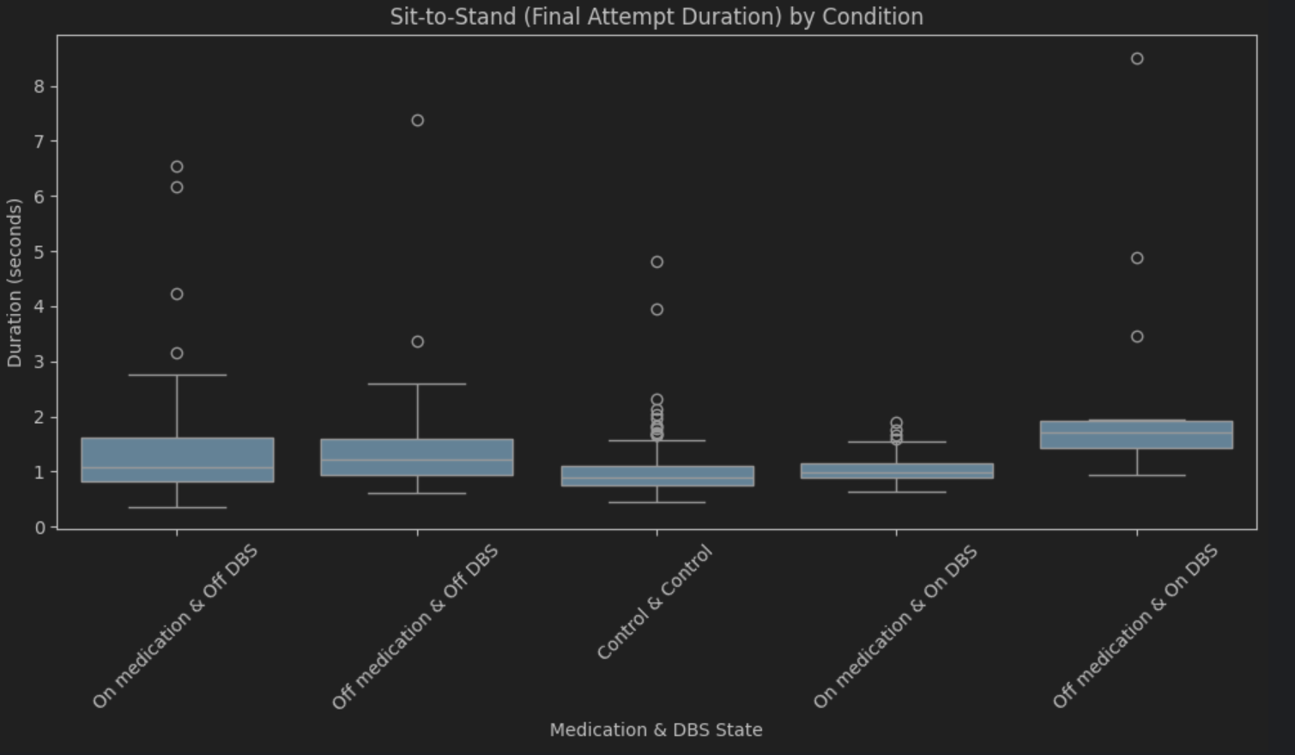
Sit-to-Stand (Whole Episode Duration) by Condition

Slide 7
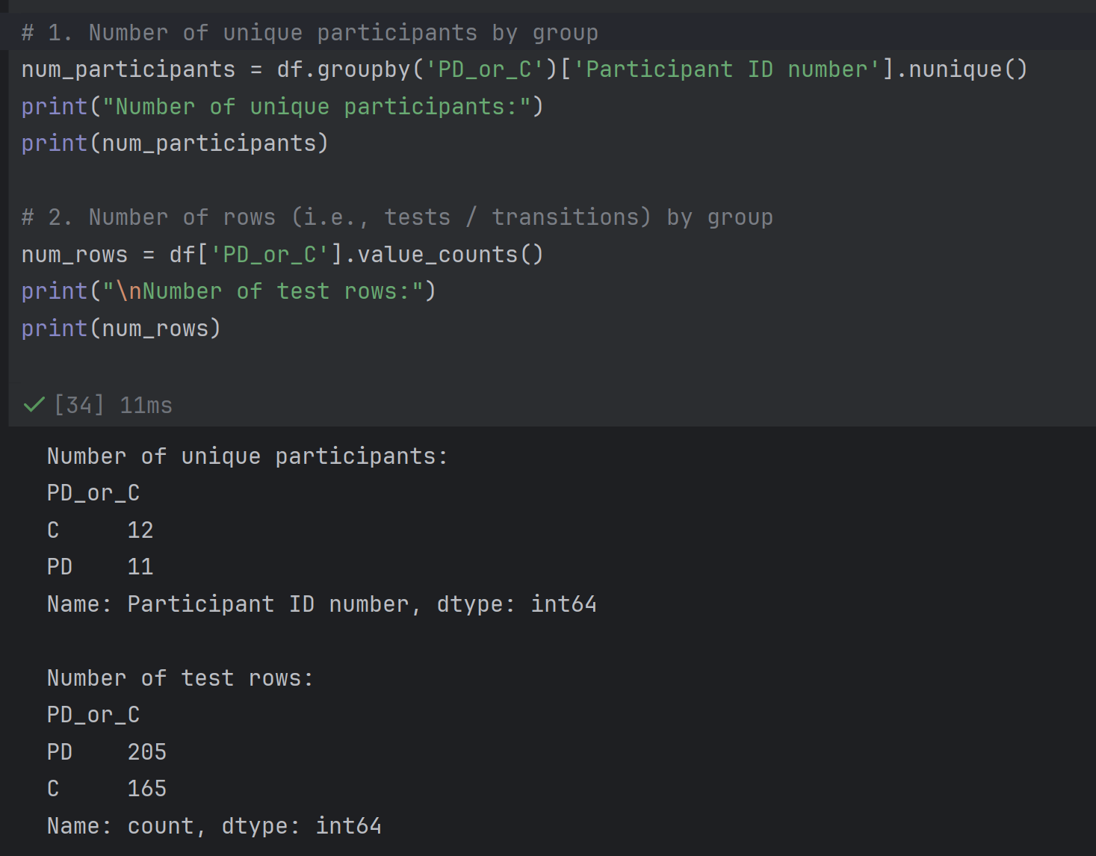
Number of unique participants by group

Slide 8
Ideas : Predicting Parkinson's Severity from Movement Features
Extract interpretable biomechanical features from joint movements:
Turning Data:
  Angular speed and variability: High variability in turning speed might correlate with PD.
  Step symmetry: Differences between left/right movements could indicate motor control issues.
  Path smoothness: Analyze joint trajectories to identify abnormal movements, tremors, or hesitation.
Sit-to-Stand Data:
  Velocity of movement: PD patients might stand up slower or less smoothly.
  Postural instability: Assess trunk lean or head position during the rising phase.
  Compensation strategies: Use of arms, multiple attempts, or leaning forward excessively.

