Slide 1
4/10

Slide 2
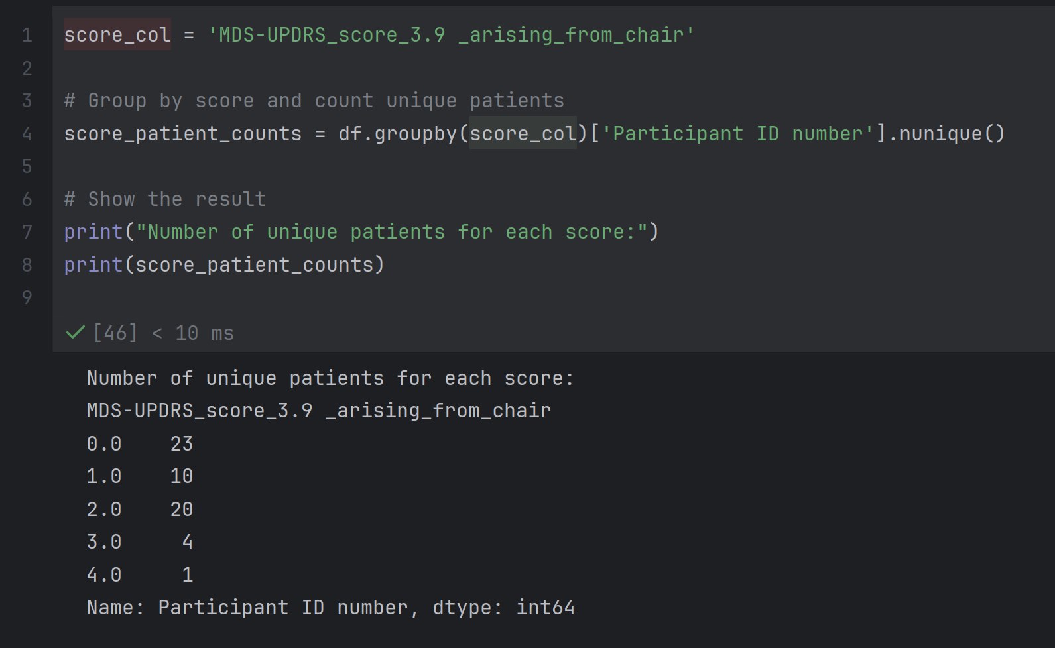
Number of unique patients for each score

Slide 3
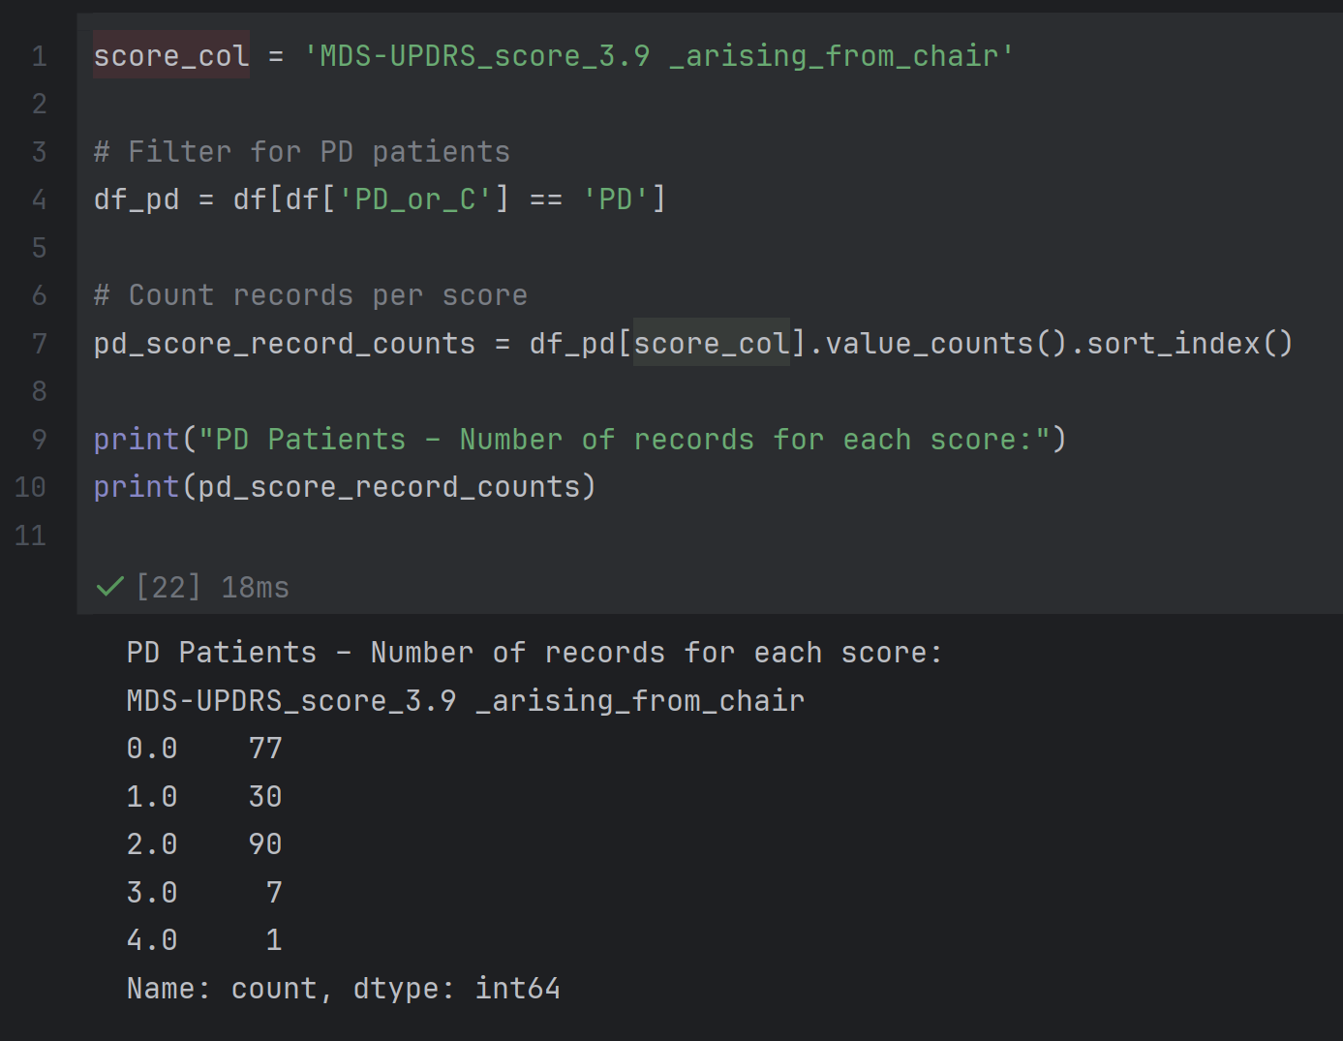
PD Patients – Number of records for each score

Slide 4
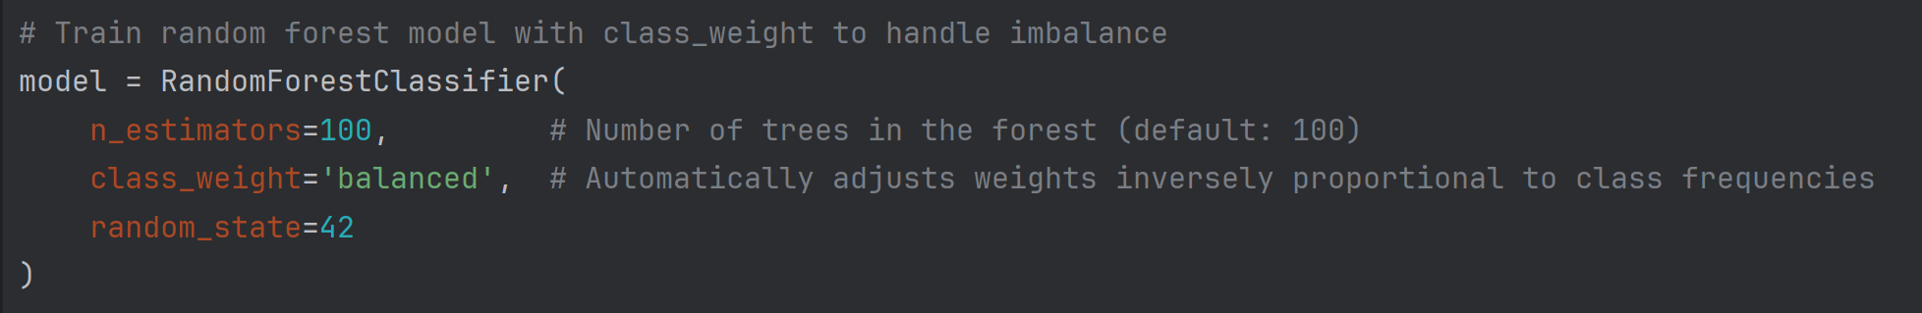
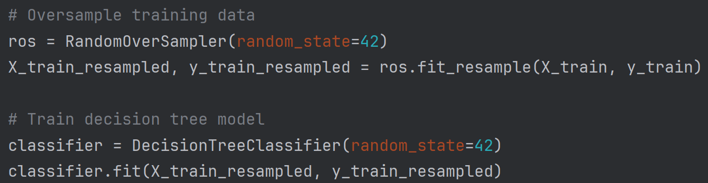
Solutions to address this imbalance
1. Use Class Weights in Models
2. Resampling Techniques

Slide 5
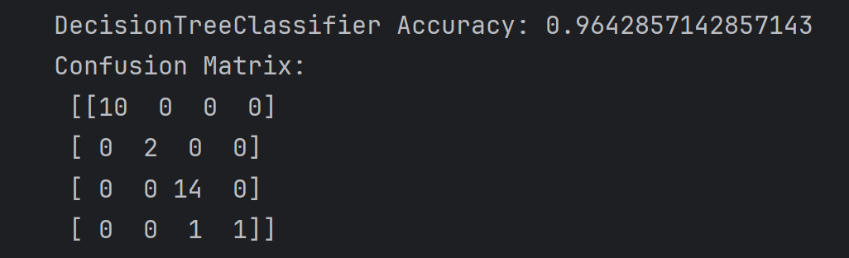
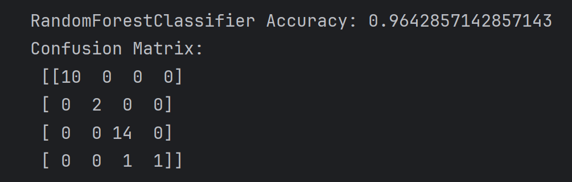
Results

Slide 6
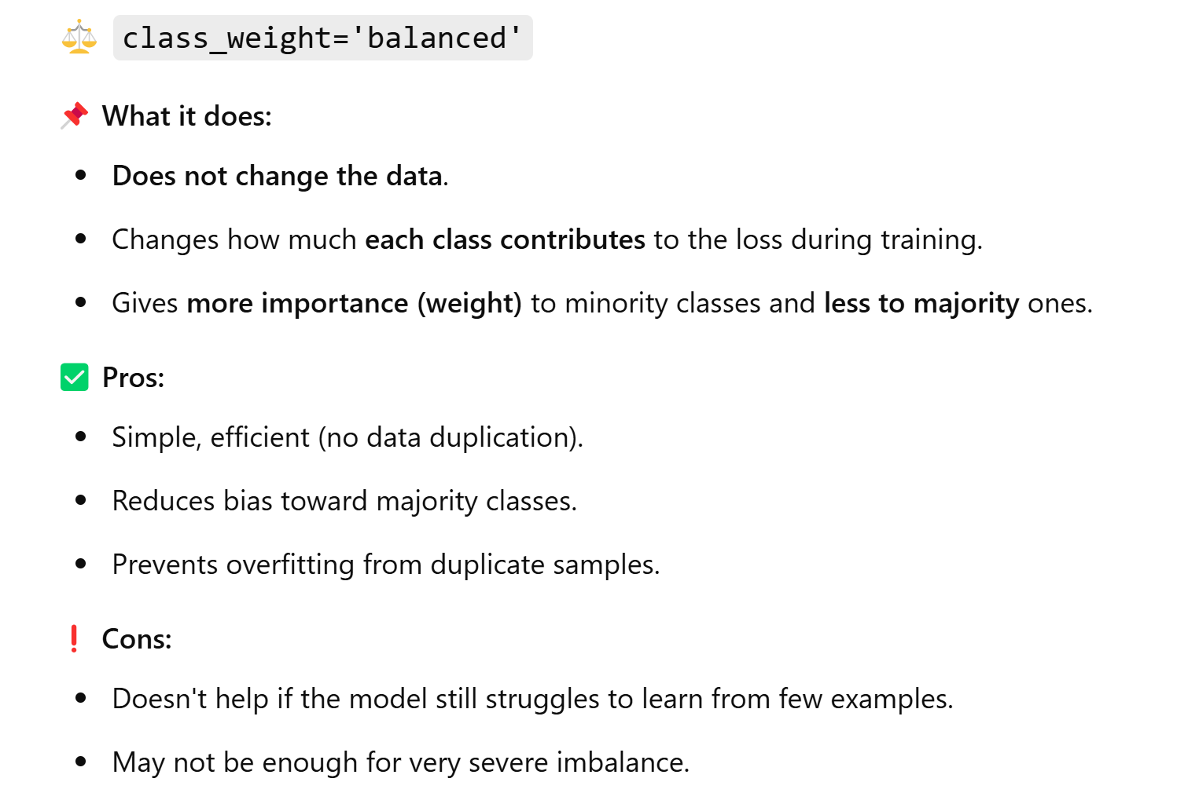
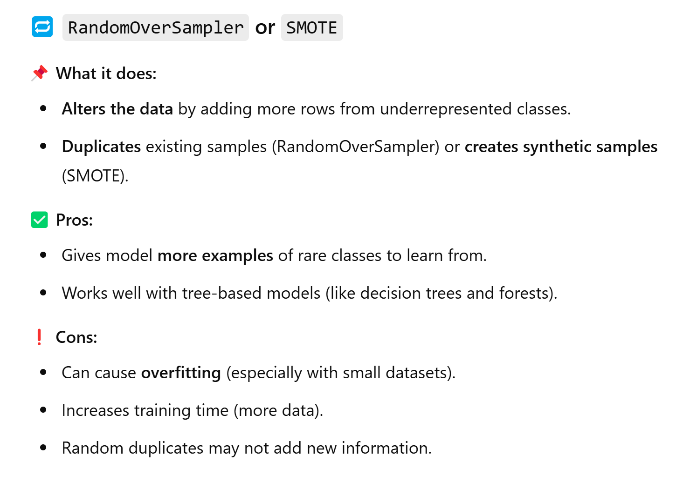
Difference between two methods

Slide 7
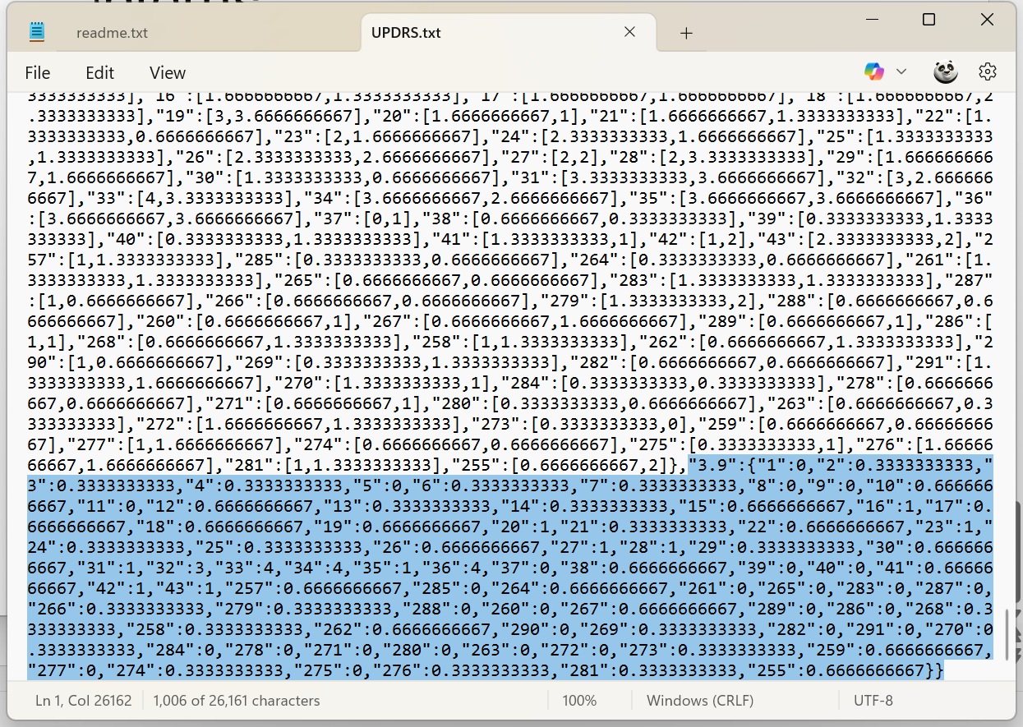
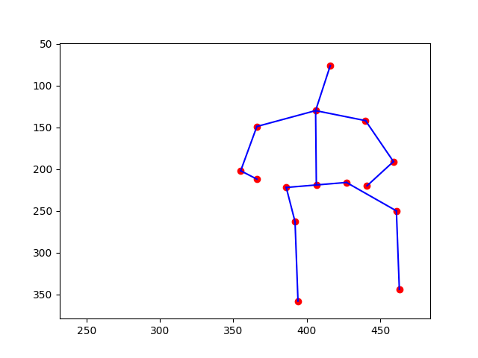
Merge Data Problems

Slide 8
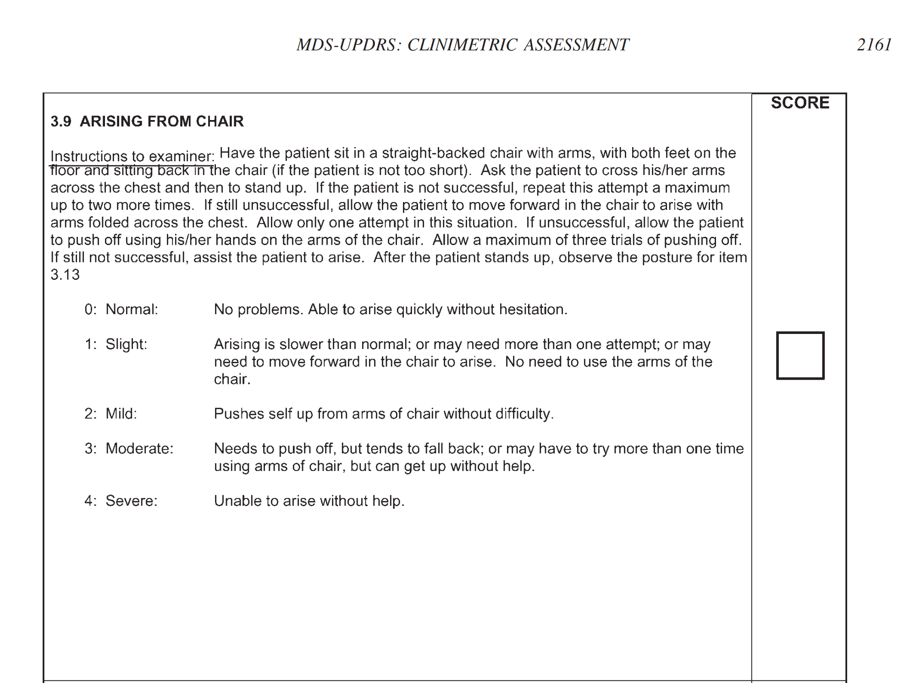
UPDRS

Slide 9
New dataset 1:
Wearables for gait in Parkinson's Disease and age-matched controls (WearGait-PD)
Includes data from 126 participants (61 PD patients, 65 age-matched controls) each performing eight (8) walking and balance tasks. More details on the data can be found in Data Description.

Slide 10
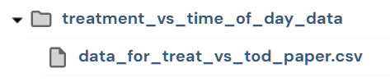
New dataset 2: mPower: Mobile Parkinson Disease Study
Memory: complete a short visuospatial game related to the Corsi block tapping test.
Tapping: repeatedly tap their phone’s screen.
Voice: record themselves saying “aaah” for 10 seconds.
Walking: In this module participants walk back and forth for 20-30 seconds with their smartphone in their pocket. They are then asked to stand still for another 20-30 seconds.

