Slide 1
Weekly Progress Report: Turning Analysis
Name: Kaiyang
Date: May 5, 2025

Slide 2
Introduction & Objectives
Overall Goal: Analyze characteristics of turning movements in Parkinson's Disease (PD) patients compared to Controls using sensor data.
This Week's Objective (Kaiyang): Focus on the 'Turning' action using keypoint data from the REMAP dataset. Load and understand the dataset structure.
Extract relevant kinematic features from skeleton data.
Perform initial comparative analyses: PD vs. Control and PD On vs. Off medication.

Slide 3
Joint connections and Mapping
connections = [[0, 1], [1, 2], [2, 3], [0, 4], [4, 5],
[5, 6], [0, 7], [7, 8], [8, 9], [9, 10],
[8, 11], [11, 12], [12, 13], [8, 14], [14, 15], [15, 16]]
Here is the mapping:
Joint 0: Pelvis / Hip Center
Joint 1: Right Hip
Joint 2: Right Knee
Joint 3: Right Ankle
Joint 4: Left Hip
Joint 5: Left Knee
Joint 6: Left Ankle
Joint 7: Torso / Spine Base
Joint 8: Neck
Joint 9: Nose
Joint 10: Head Top / Site
Joint 11: Left Shoulder
Joint 12: Left Elbow
Joint 13: Left Wrist
Joint 14: Right Shoulder
Joint 15: Right Elbow
Joint 16: Right Wrist

Slide 4
Methodology: Feature Engineering
Developed Python function (calculate_turn_features) to extract quantitative metrics from the 2D keypoint time series.
Applied function to all 1749 turns.
Key Features Calculated:
  Duration (frames, seconds)
  Pelvis (Joint 0) Kinematics: Path Length, Displacement, Avg/Peak Speed, Avg/Peak Acceleration, Avg Jerk
  Trunk Rotation (Shoulders 11 & 14): Total Angle (deg/rad), Avg/Peak Angular Velocity
  Spatial Extent: Bounding Box Width, Height, Area

Slide 5
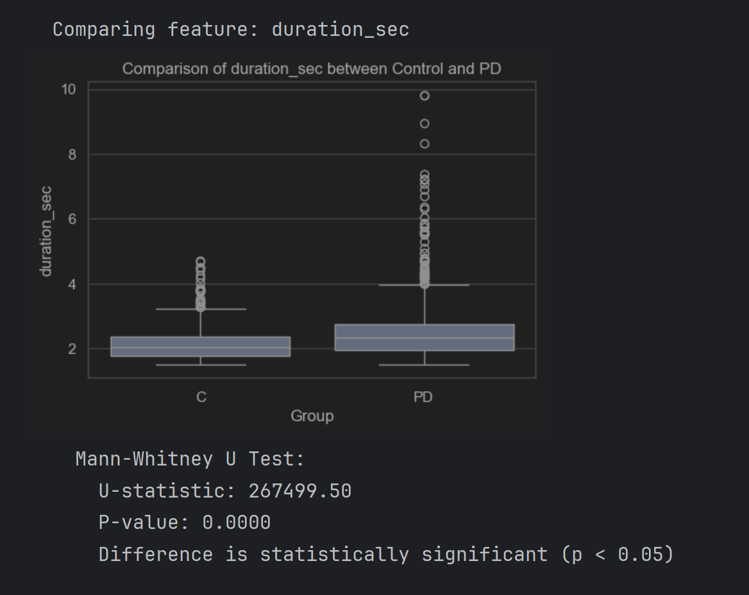
Comparing Features between PD and Control Groups :Number of turns - PD: 963, Control: 786

Slide 6
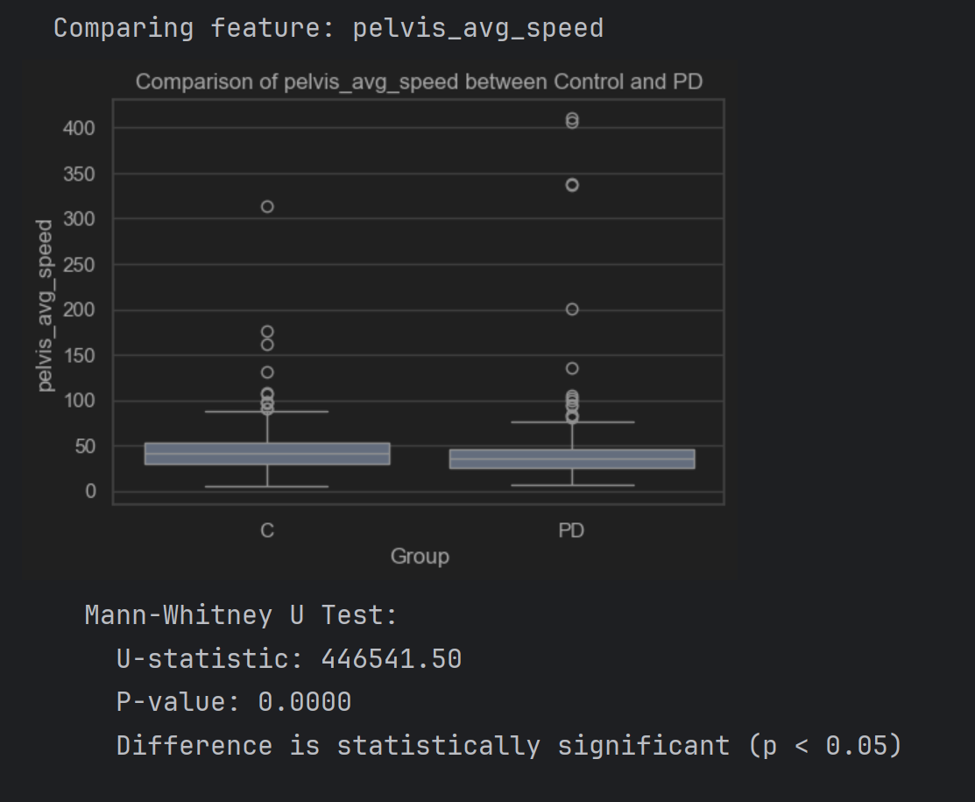
Comparing Features between PD and Control Groups :Number of turns - PD: 963, Control: 786

Slide 7
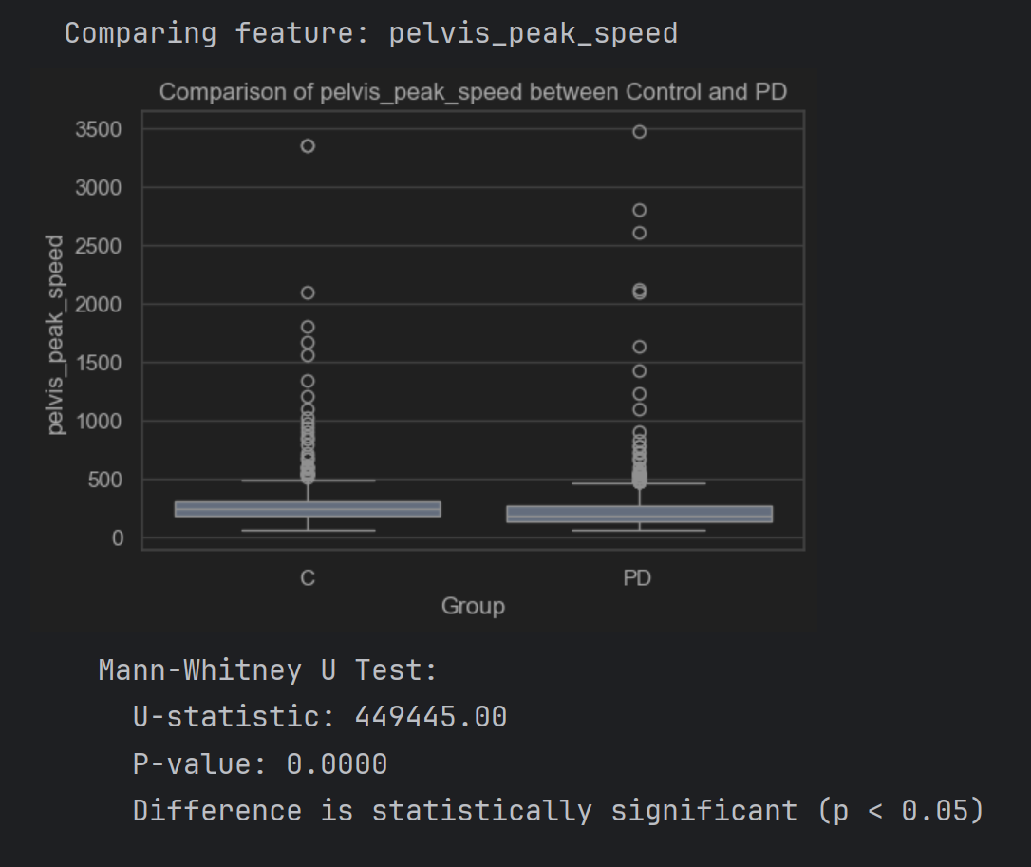
Comparing Features between PD and Control Groups :Number of turns - PD: 963, Control: 786

Slide 8
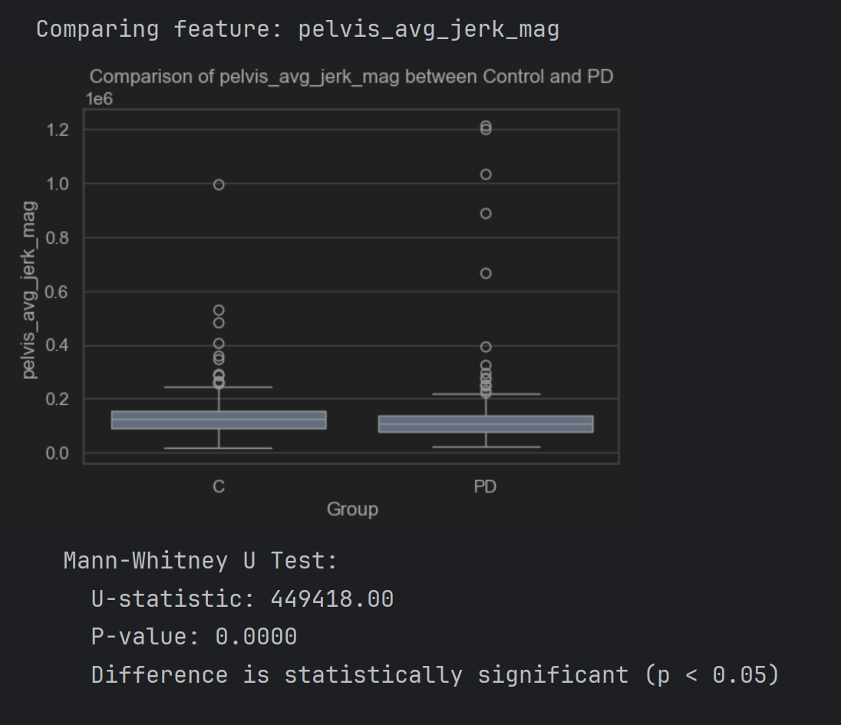
Comparing Features between PD and Control Groups :Number of turns - PD: 963, Control: 786

Slide 9
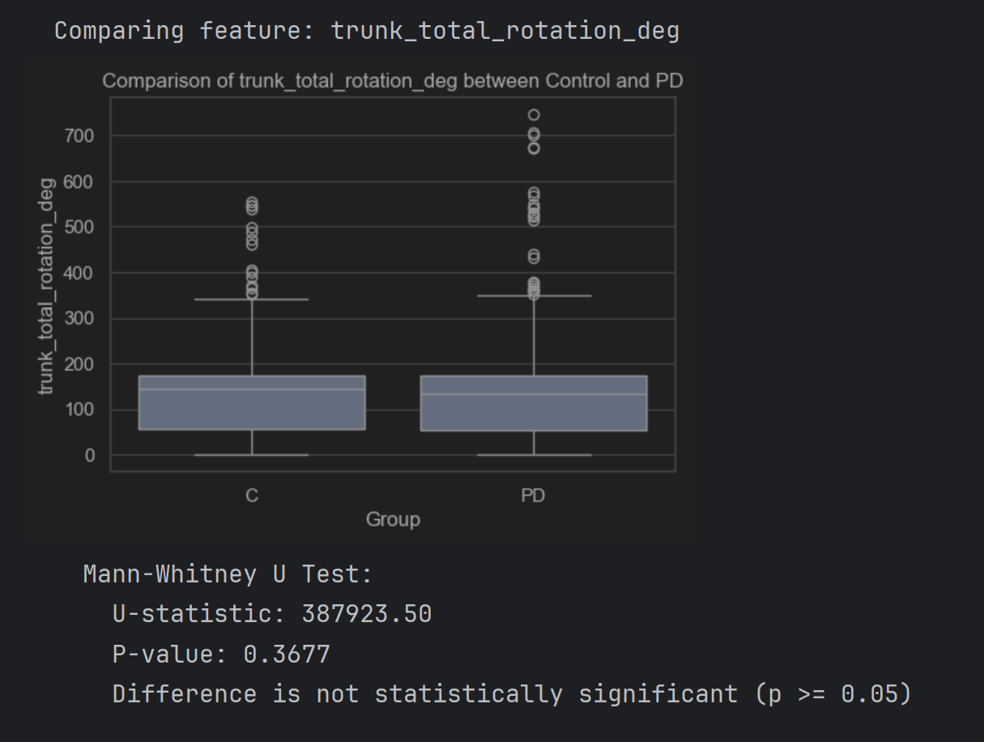
Comparing Features between PD and Control Groups :Number of turns - PD: 963, Control: 786

Slide 10
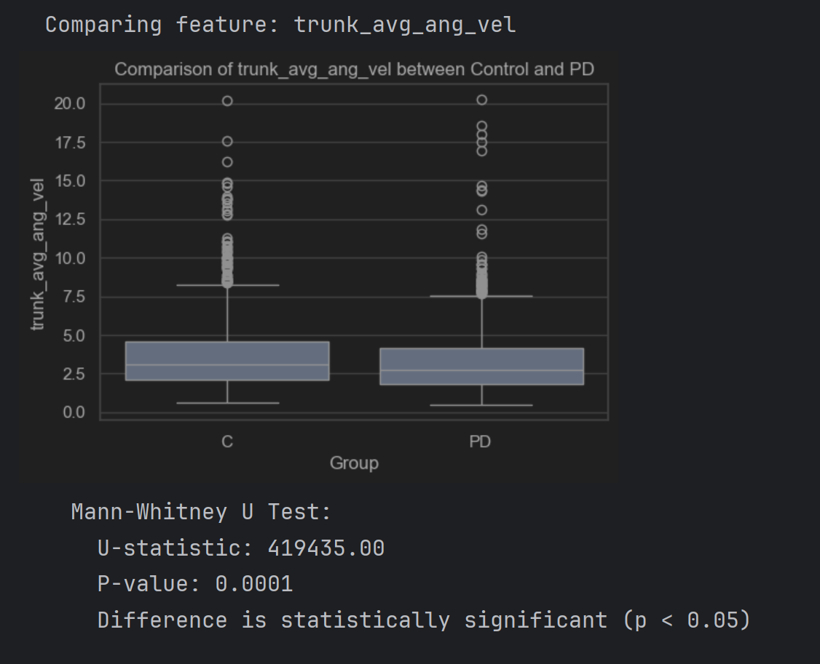
Comparing Features between PD and Control Groups :Number of turns - PD: 963, Control: 786

Slide 11
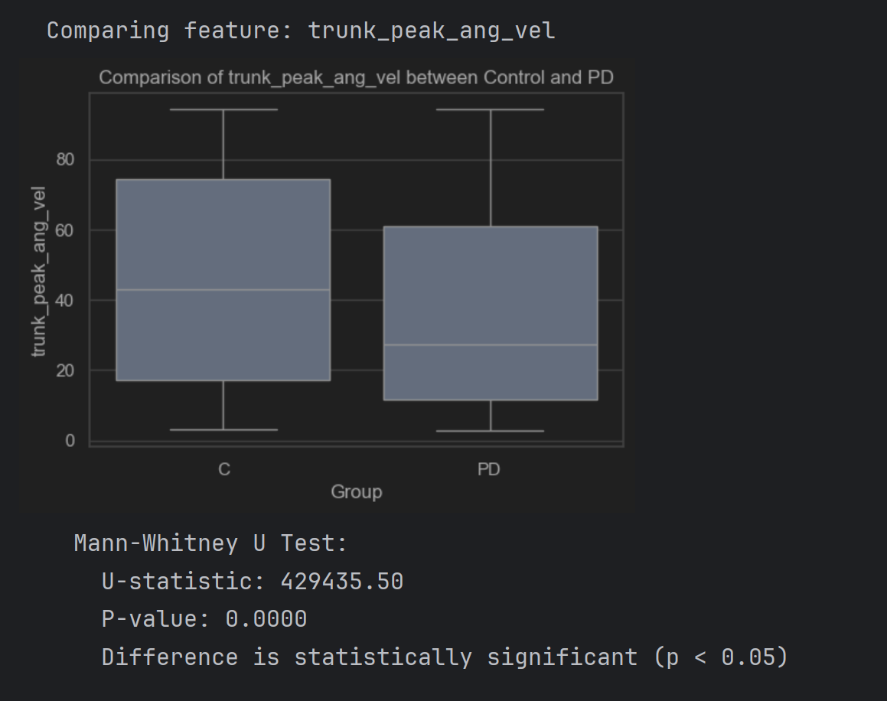
Comparing Features between PD and Control Groups :Number of turns - PD: 963, Control: 786

Slide 12
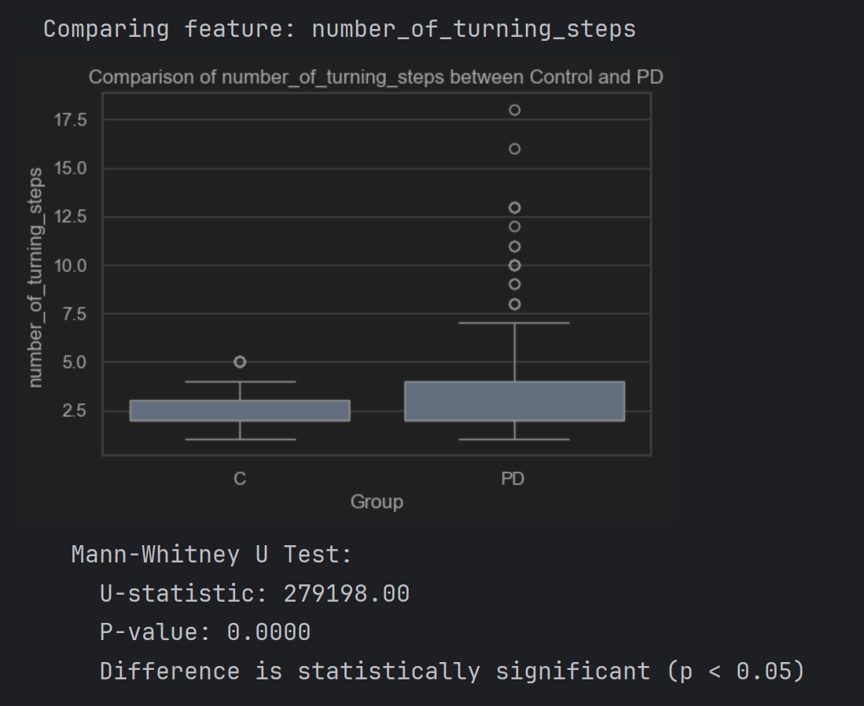
Comparing Features between PD and Control Groups :Number of turns - PD: 963, Control: 786

Slide 13
Summary of Findings (PD vs. Control)
Based on the Mann-Whitney U tests (and assuming the box plots visually support the direction of difference):
Significant Differences (p < 0.05):
  duration_sec: PD group likely takes longer to turn.
  pelvis_avg_speed, pelvis_peak_speed: PD group likely moves slower overall during the turn.
  pelvis_avg_jerk_mag: PD group likely has less smooth pelvic movement (higher jerk usually means less smooth, check box plot direction).
  trunk_avg_ang_vel, trunk_peak_ang_vel: PD group likely rotates their trunk slower.
  number_of_turning_steps: PD group likely uses a different number of steps (probably more, check box plot).

Slide 14
Analyze the effect of medication within the PD group
This will help us understand which aspects of turning performance are potentially improved by medication in this cohort.

Slide 15
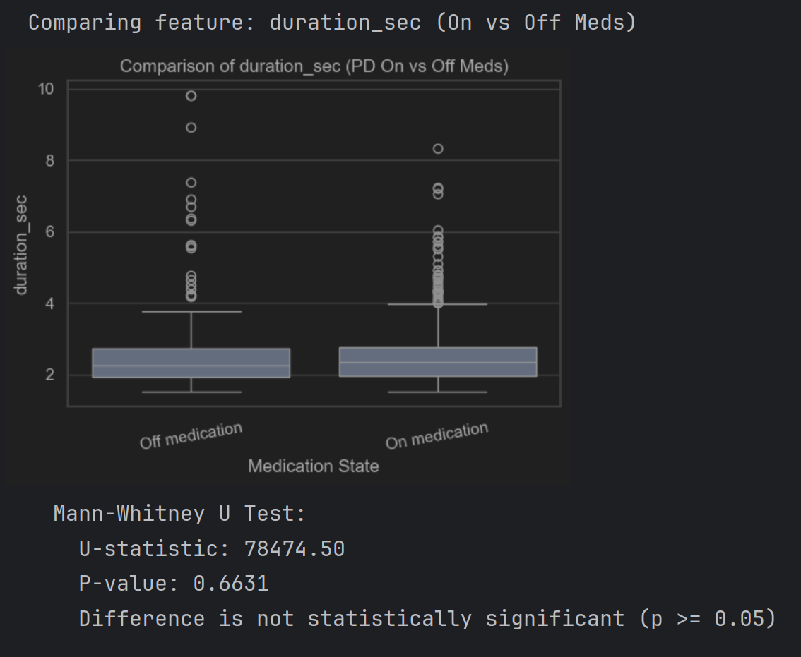
Comparing Features between PD 'On' and 'Off' Medication States-Number of turns - PD On: 748, PD Off: 214

Slide 16
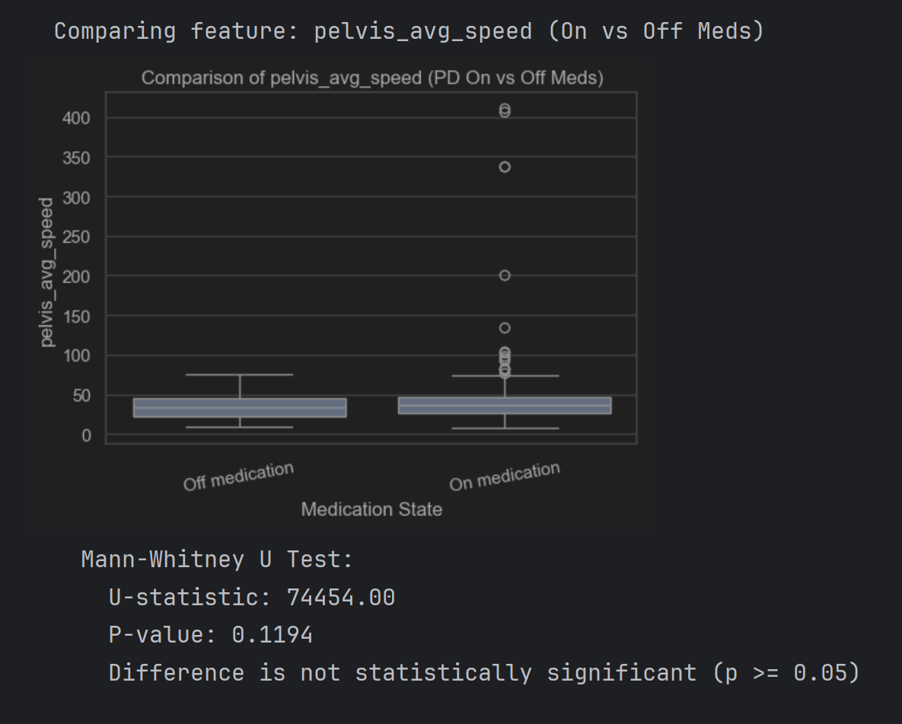
Comparing Features between PD 'On' and 'Off' Medication States-Number of turns - PD On: 748, PD Off: 214

Slide 17
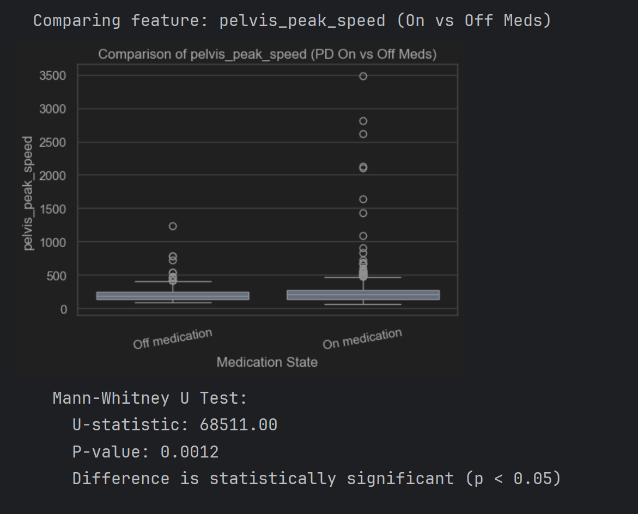
Comparing Features between PD 'On' and 'Off' Medication States-Number of turns - PD On: 748, PD Off: 214

Slide 18
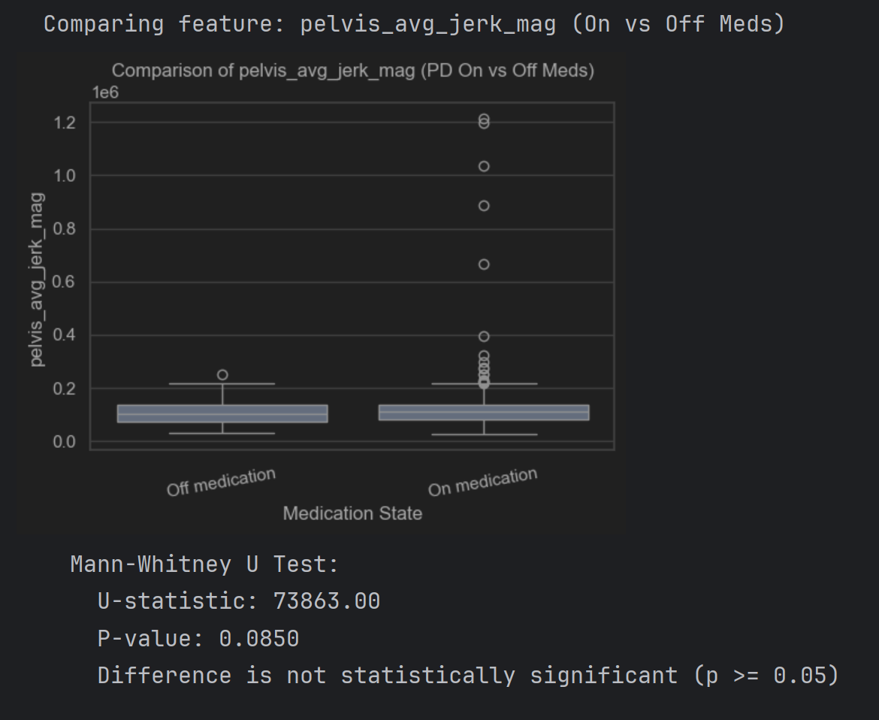
Comparing Features between PD 'On' and 'Off' Medication States-Number of turns - PD On: 748, PD Off: 214

Slide 19
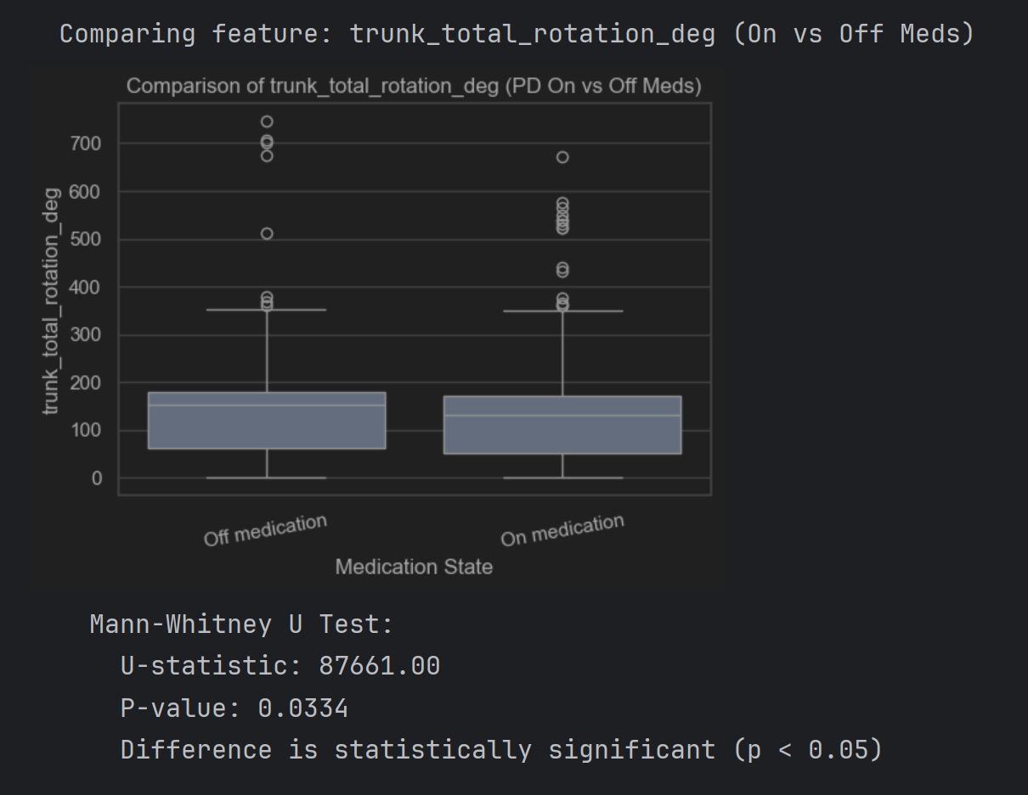
Comparing Features between PD 'On' and 'Off' Medication States-Number of turns - PD On: 748, PD Off: 214

Slide 20
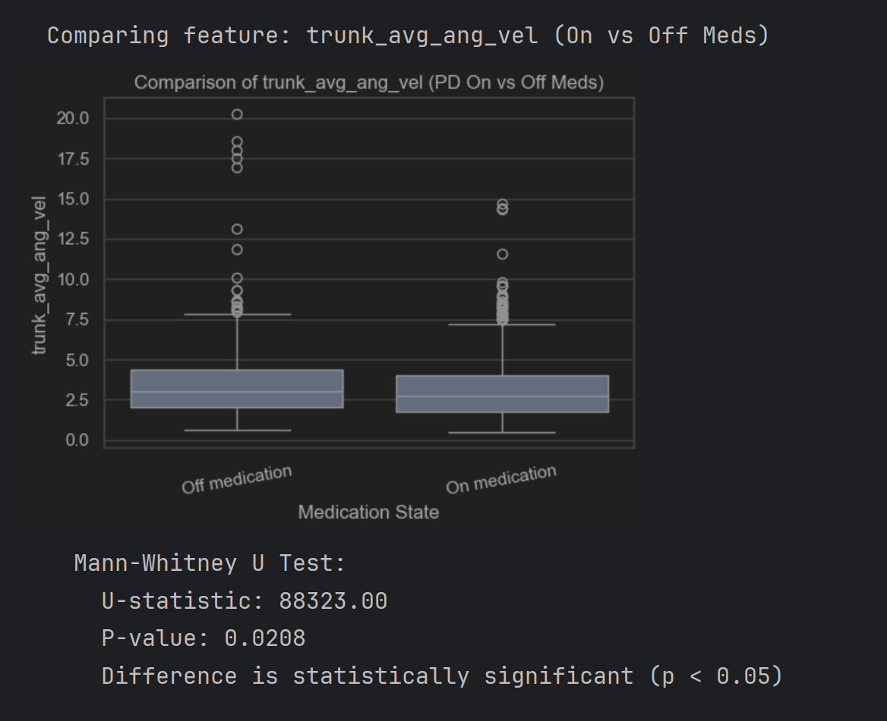
Comparing Features between PD 'On' and 'Off' Medication States-Number of turns - PD On: 748, PD Off: 214

Slide 21
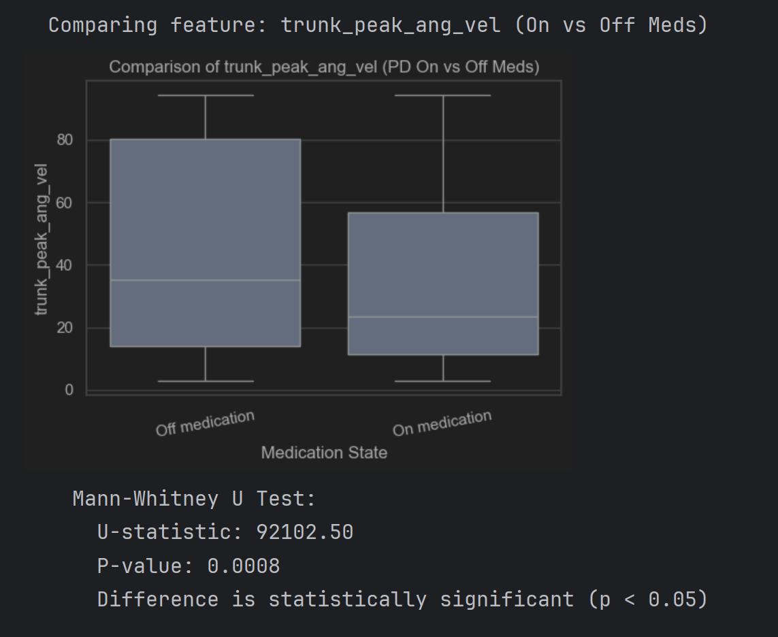
Comparing Features between PD 'On' and 'Off' Medication States-Number of turns - PD On: 748, PD Off: 214

Slide 22
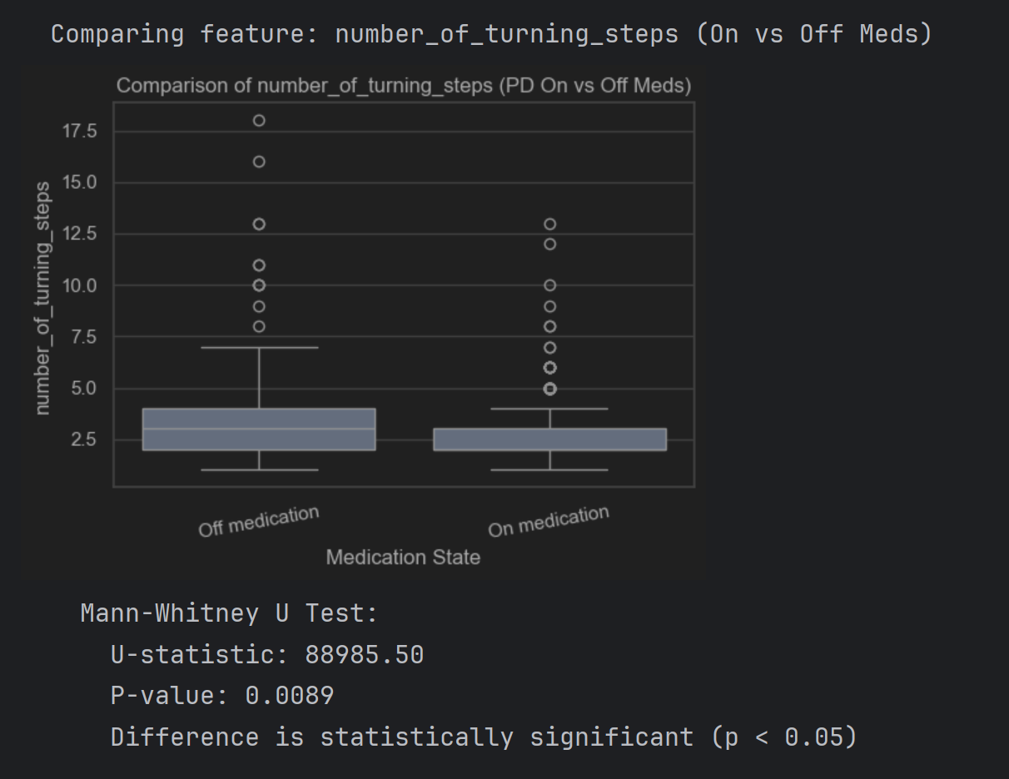
Comparing Features between PD 'On' and 'Off' Medication States-Number of turns - PD On: 748, PD Off: 214

Slide 23
Summary of Findings (PD On vs. Off Medication)
Significant Differences (p < 0.05): Medication state appears to significantly affect:
pelvis_peak_speed: How fast the pelvis reaches its maximum speed during the turn.
trunk_total_rotation_deg: The total amount the trunk rotates.
trunk_avg_ang_vel & trunk_peak_ang_vel: The speed of trunk rotation.
number_of_turning_steps: The stepping strategy used.
No Significant Difference (p >= 0.05): Medication state did not show a statistically significant difference in:
duration_sec: The overall time taken for the turn.
pelvis_avg_speed: The average speed of the pelvis throughout the turn.
pelvis_avg_jerk_mag: The average smoothness (jerk) of the pelvis movement.

Slide 24
Synthetic Data Generation for Parkinson's Disease Turning Movement Analysis
Augmenting Keypoint Trajectory Datasets
Data Used in this Project:** * 2D keypoint data from turning episodes. * Focus on a single representative sample for initial augmentation (`Pt204_C_n_350/input_2D/keypoints.csv`).
Keypoint Data Structure (`keypoints.csv`):** * Each row: A single frame of the turning movement. * Each pair of columns: X, Y coordinates for one of the 17 tracked body joints. * Example: (91 frames, 34 features/coordinates).

Slide 25
Methodology - Data Augmentation
Approach Chosen: Time series data augmentation.
Python Library Used:`tsaug` A library specifically designed for time series augmentation.
Augmentation Techniques Applied:
  Jittering (Noise Addition):`tsaug.AddNoise(scale=JITTER_SCALE)`
    Adds small random values to keypoint coordinates in each frame.
    Simulates minor variations or sensor noise.
  TimeWarping:`tsaug.TimeWarp(n_speed_change=TIME_WARP_N_SPEED_CHANGE)`
    Stretches or compresses segments of the time axis.
    Simulates variations in the speed of movement execution.
Process Overview:
  1. Load original keypoint sequence.
  2. Define an augmentation pipeline combining the chosen techniques.
  3. Apply the pipeline multiple times to the original sequence to generate synthetic samples.
  4. Save each synthetic sample.

Slide 26
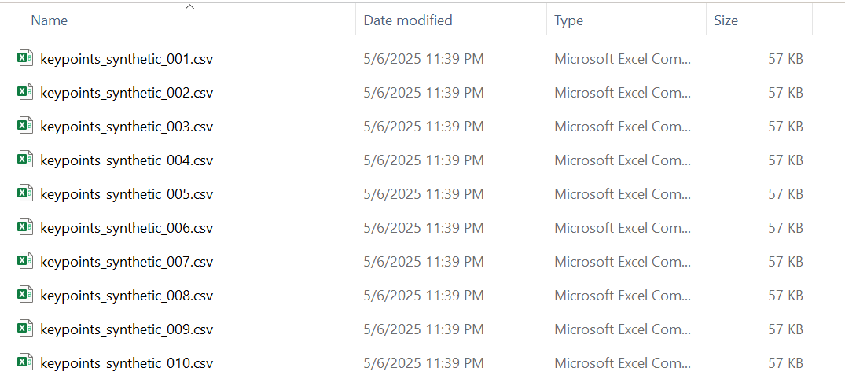
Synthetic Data Generation – Examples: Pt204_C_n_350/input_2D/keypoints.csv

Slide 27
