Slide 1
06/12/2025

Slide 2
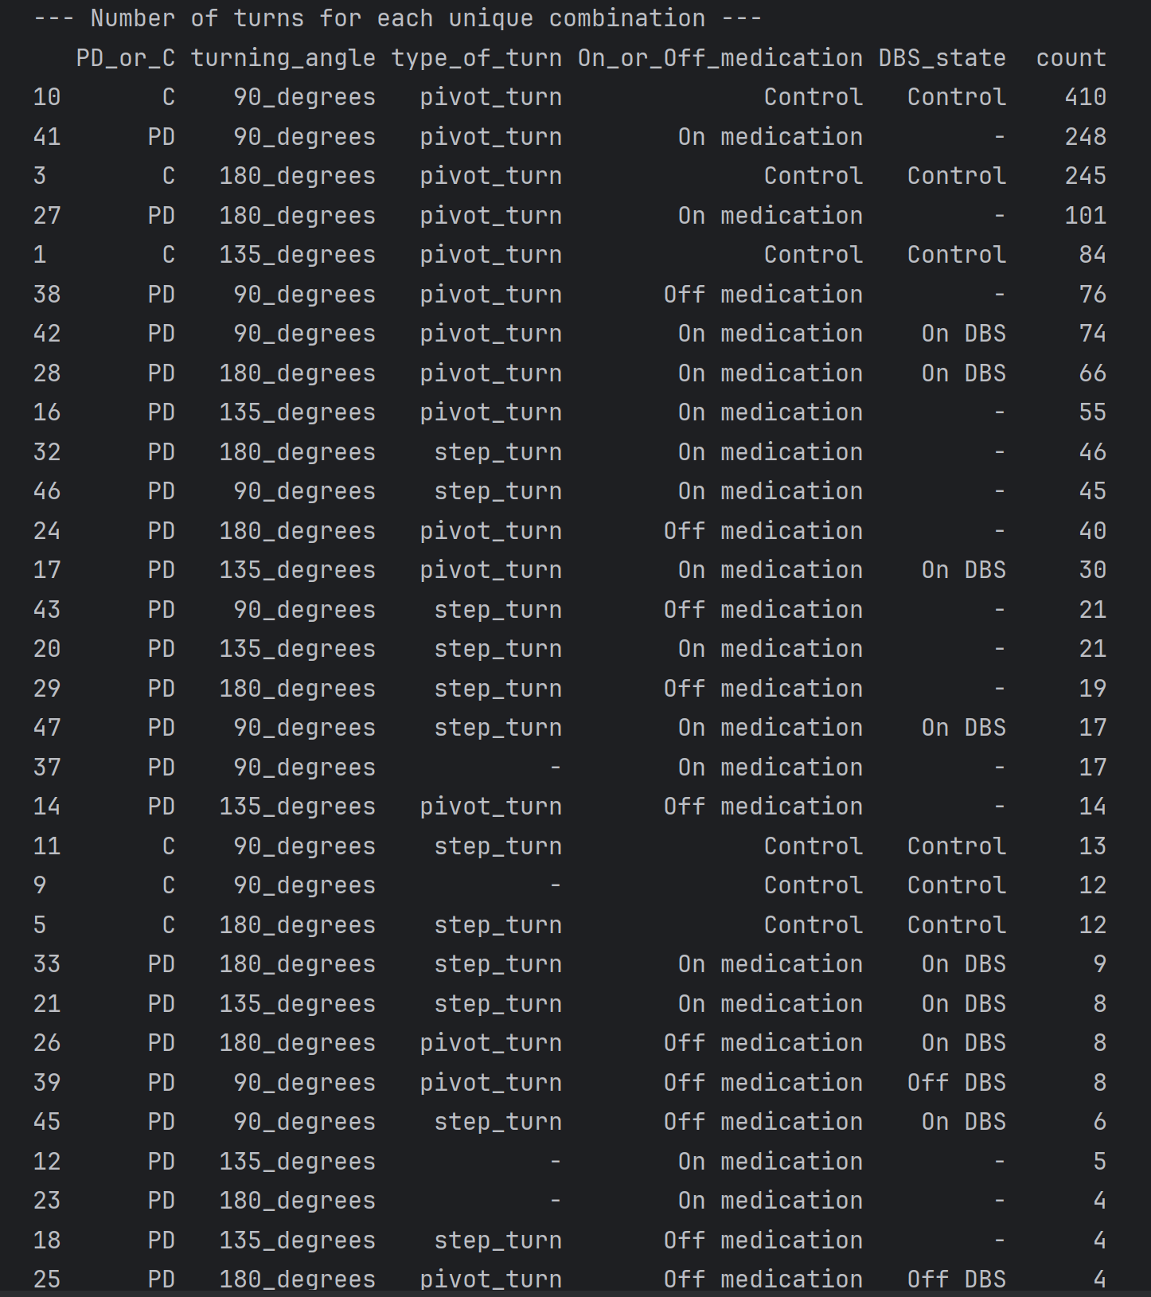
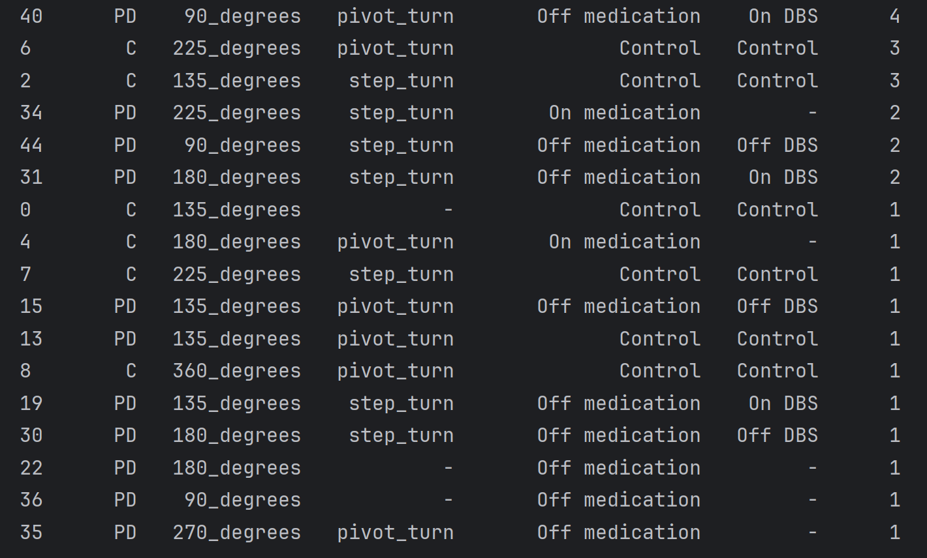
Different Turning Combinations(number of turning steps not included)

Slide 3
2D vs 3D features

Slide 4
https://www.synapse.org/Synapse:syn52540892/wiki/623753
https://www.frontiersin.org/journals/neuroscience/articles/10.3389/fnins.2022.832463/full
https://datadryad.org/dataset/doi:10.5061/dryad.fbg79cp1d

Slide 5
Objective:
To compare two data generation methods - "TSaug data augmentation" and "Transformer+VAE model generation" - on Pelvis Speed in the Sit-to-Stand (STS) task And their similarity to the real data (GT) under different UPDRS 3.9 rating levels.
Task 1: Comparing two data generation methods
    TSaug: Generates new samples from original data using time series augmentation methods like random perturbation and time scaling.​
    Transformer + VAE: Combines Transformer to extract dependencies between features and VAE to model feature distribution, generating more structured samples.

Slide 6
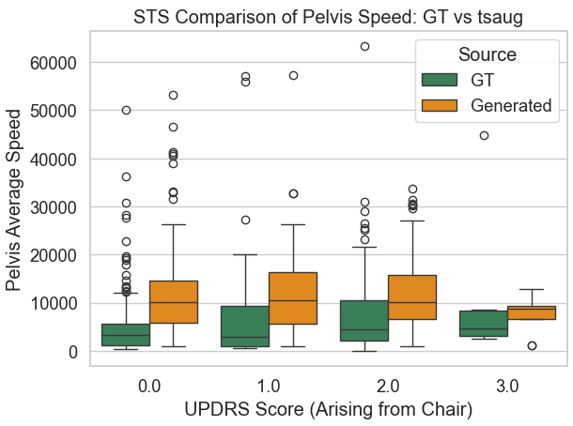
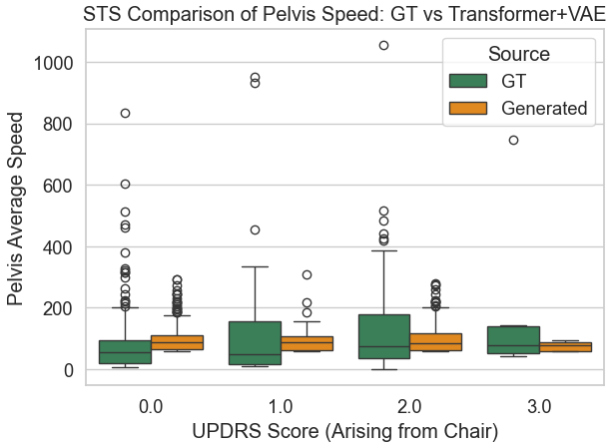
TSaug
Transformer+VAE
Task 1 Result:
"TSaug" generates data by slightly perturbing the original time series, resulting in samples that are too similar to the original. This limits diversity and generalization, especially under class imbalance.
In contrast, "Transformer+VAE" learns from latent space and creates more diverse, realistic samples, improving robustness in UPDRS score prediction.

Slide 7
Task 2: Attempting to Combine IMU and Keypoint Data
Objective:
To align and compare IMU-based event annotations with keypoint-based pose data in the Sit-to-Stand (STS) task. We aim to extract matching action segments from both sources for consistent analysis.
    The REMAP dataset contains keypoint data from clinical Sit-to-Stand tasks. Similar to the IMU modality, we computed temporal motion features such as pelvis speed, acceleration, and jerk to describe dynamic movement characteristics.
    The WearGait dataset contains IMU recordings of Parkinson’s Participants sampling at100 Hz We extracted velocity-related features(e.g., pelvis_avg_speed,ankle_path_length) for further modeling.

Slide 8
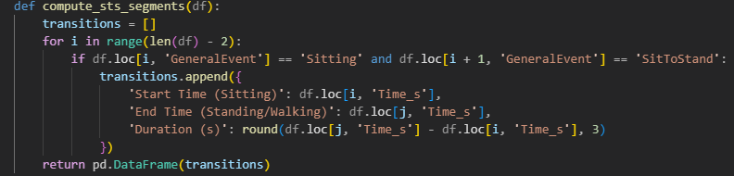
We split the Sit-to-Stand actions into different segments using the compute_sts_segments function. This function identified transitions from Sitting to SitToStand and from SitToStand to either Standing or Walking. It then extracted the start time, end time, and duration for each segment.

Slide 9
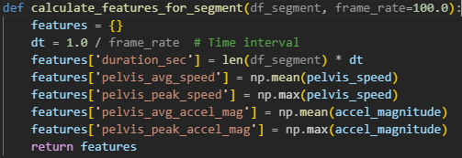
Feature Calculation for Each Segment:
We computed standardized motion metrics from each identified Sit-to-Stand segment. Pelvis speed, acceleration, and jerk were derived from signal magnitudes and temporal derivatives within each segment, forming the foundation for cross-modal fusion.

Slide 10

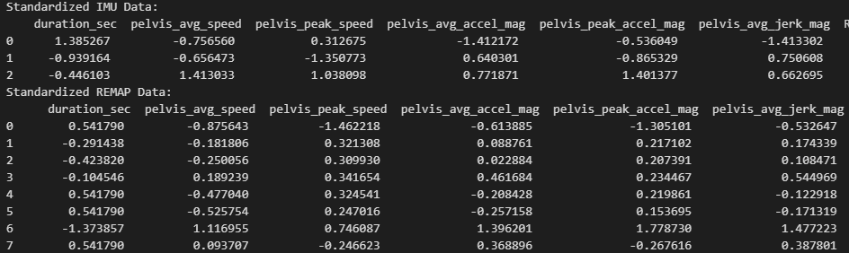
Data Standardization and Results: we standardized the IMU and Keypoint features using StandardScaler to ensure fair comparison and compatibility. This normalization step mitigates scale differences between the two modalities and enables the integration of heterogeneous features into a shared space for machine learning.

Slide 11
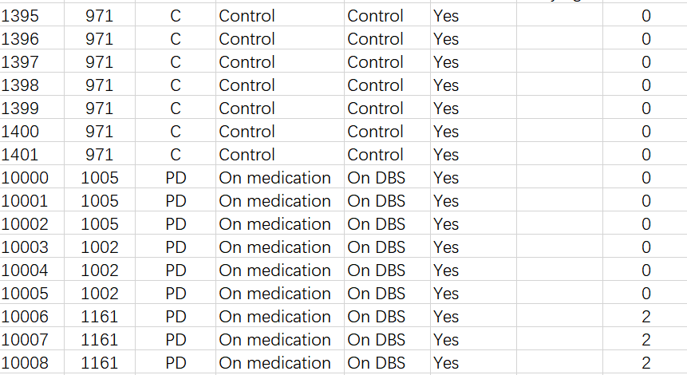
Combining with labels:
REMAP
WearGait IMU

