Slide 1
07/03
Kaiyang Qian

Slide 2
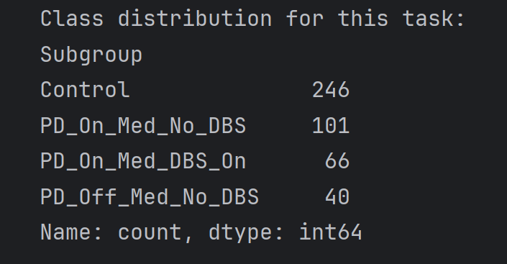
Goal
Last time, we analyzed turning data focusing on 90-degree pivot turns. However, the results appeared counterintuitive. Therefore, this time we are focusing on 180-degree pivot turns to explore whether we can identify any differences.

Slide 3
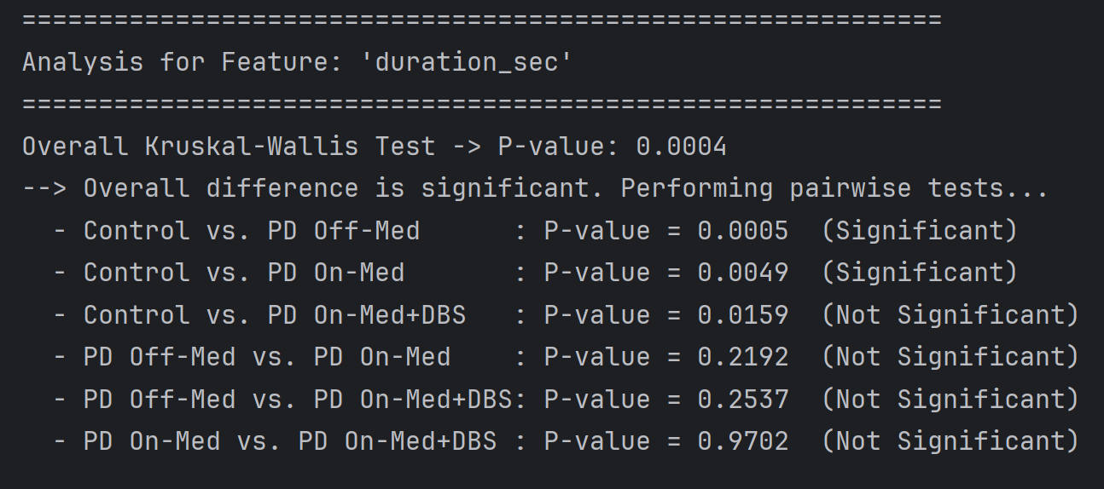
Analysis of 180-Degree Pivot Turns

Slide 4
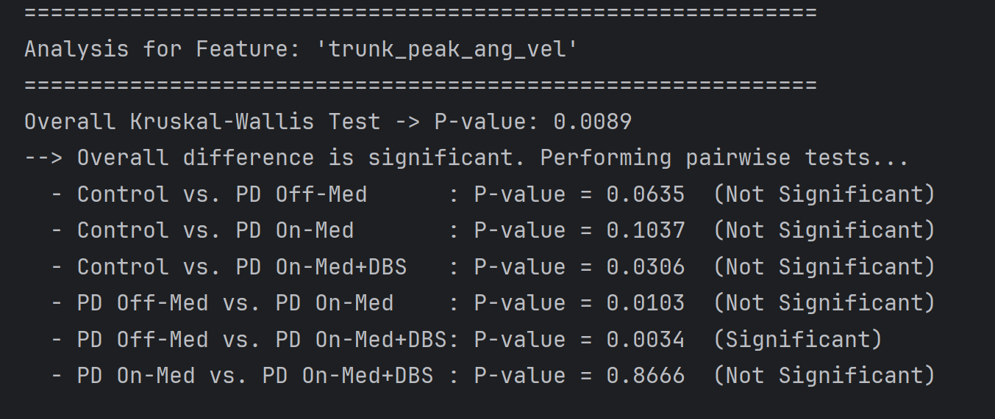
Analysis of 180-Degree Pivot Turns

Slide 5
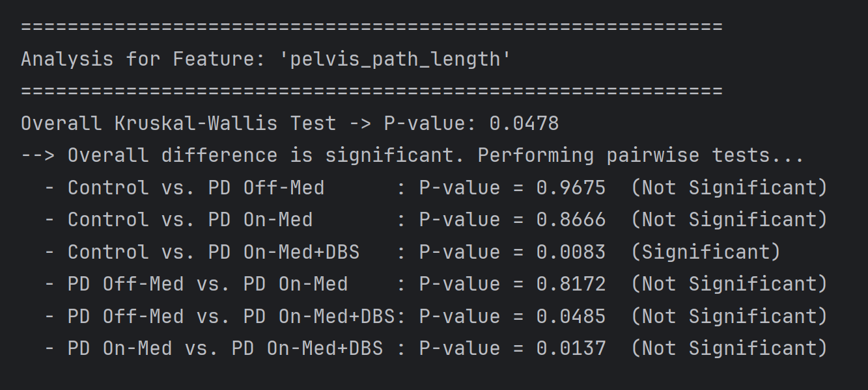
Analysis of 180-Degree Pivot Turns

Slide 6
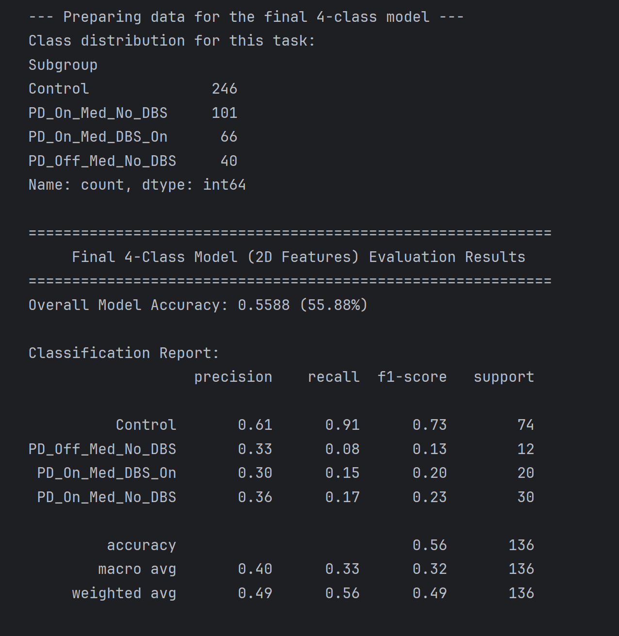
Analysis of 180-Degree Pivot Turns

Slide 7
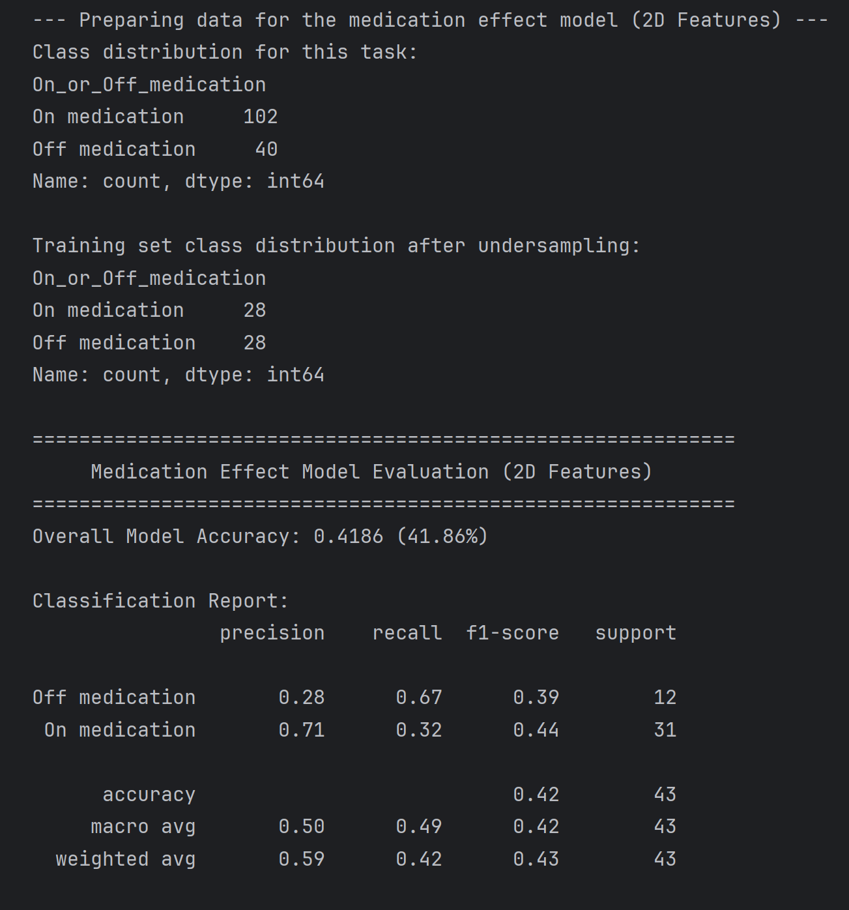
Classification model of On or Off medication

