Slide 1
Visualization of Sit-to-Stand and Turning Movements
07/10

Slide 2
Goal
The previous data appeared counter-intuitive. Therefore, we plan to perform visualization and compare sit-to-stand and turning movements across different subject groups to identify any possible issues or patterns.

Slide 3
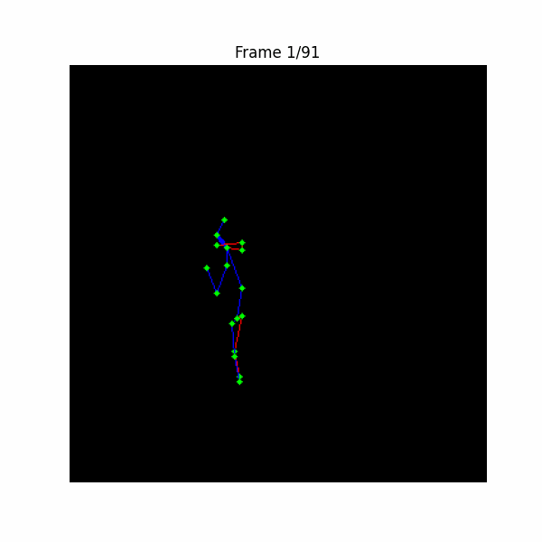
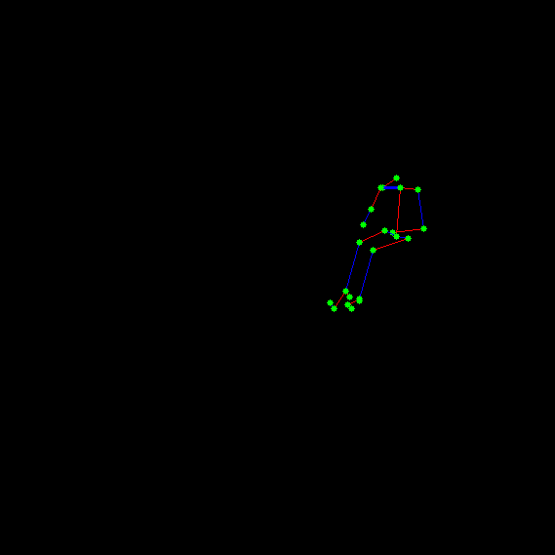
updrs score 2
Pt204_C_n_350 turning
Pt204_C_n_316 sit to stand

Slide 4
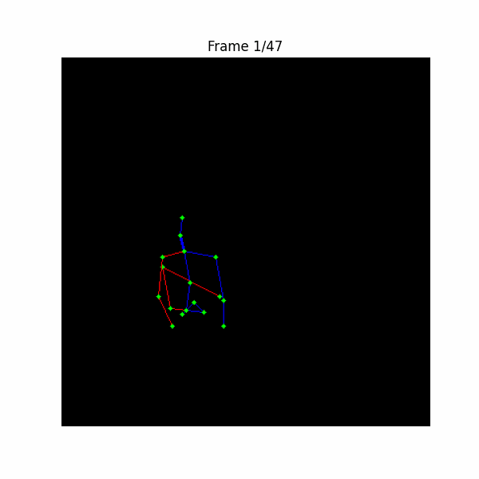
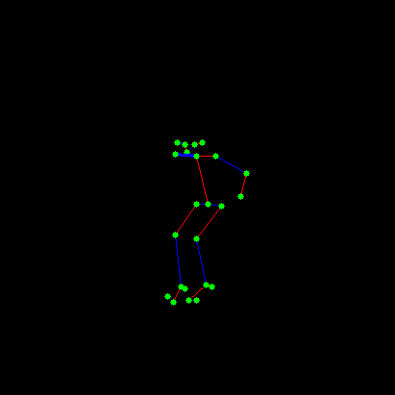
UPDRS score 4
Pt842_PD_n_346 sit to stand Off med Off DBS
Pt842_PD_n_47 180 pivot turn On med On DBS

Slide 5
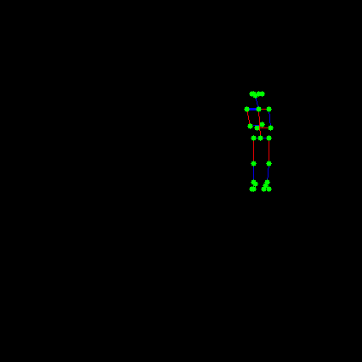
UPDRS score 0
Pt842_PD_n_48 180 pivot turn On med On DBS
Pt842_PD_n_331 sit to stand On med On DBS

Slide 6
Issues
For sit-to-stand, during the second half of the process, the person is already standing still, but data keeps recording as if the movement continues.
For turning, the plotted data appears messy and unreadable.
These issues might affect the accuracy of the motion metrics we previously calculated.

