Slide 1
Automated Detection of Invalid Skeleton Poses
Using Anatomical Constraint Checks
Kaiyang Qian
07/17/2025

Slide 2
Goal
Improve Data Integrity: To ensure that the dataset used for analysis is accurate, clean, and free of nonsensical artifacts.
Ensure Reliable Scientific Analysis: Invalid poses can corrupt calculations of clinical metrics like joint angles, gait speed, or turning stability, leading to incorrect conclusions.
Increase Research Efficiency: Automating the detection of bad data saves countless hours of manual screening and allows researchers to focus on analysis rather than data cleaning.
Enable Robust Modeling: Any machine learning model trained on this data will perform better and be more reliable if it learns from high-quality, valid skeleton poses.

Slide 3
Solution: Anatomical Check
This method defines a set of simple rules based on known anatomical constraints.
The script programmatically iterates through each frame of the 2D keypoint data.
If any frame violates a rule, the entire data file is flagged as "invalid.“
This approach is highly effective at targeting poses that are structurally or physically impossible.

Slide 4
The Core Rules for Vertical Checks
We check for counter-intuitive "up" and "down" joint positions based on two primary rules:
Head Below Pelvis
  Logic: The head joint should not be detected at a lower vertical position than the central pelvis joint.
  Detects: Poses that are completely upside down or severely contorted.
Knee Above Hip
  Logic: The knee joint should not be detected at a higher vertical position than its corresponding hip joint.
  Detects: Errors where legs are unnaturally folded or misidentified.

Slide 5
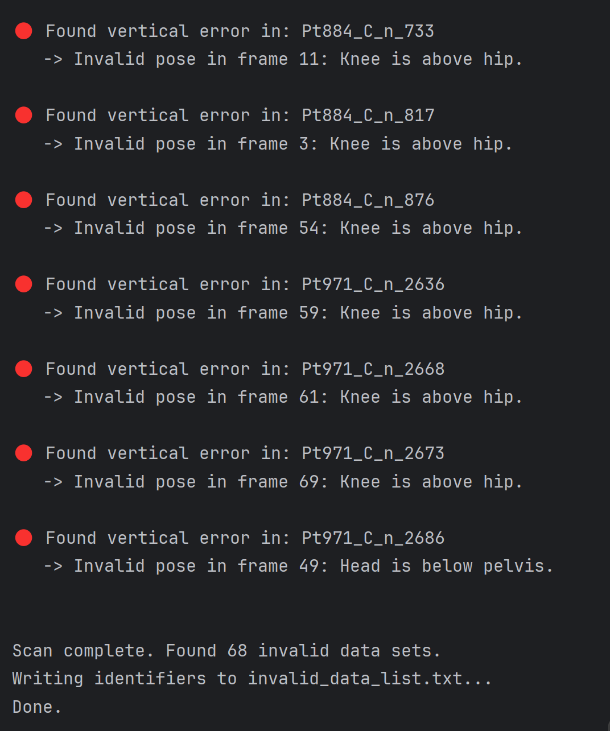
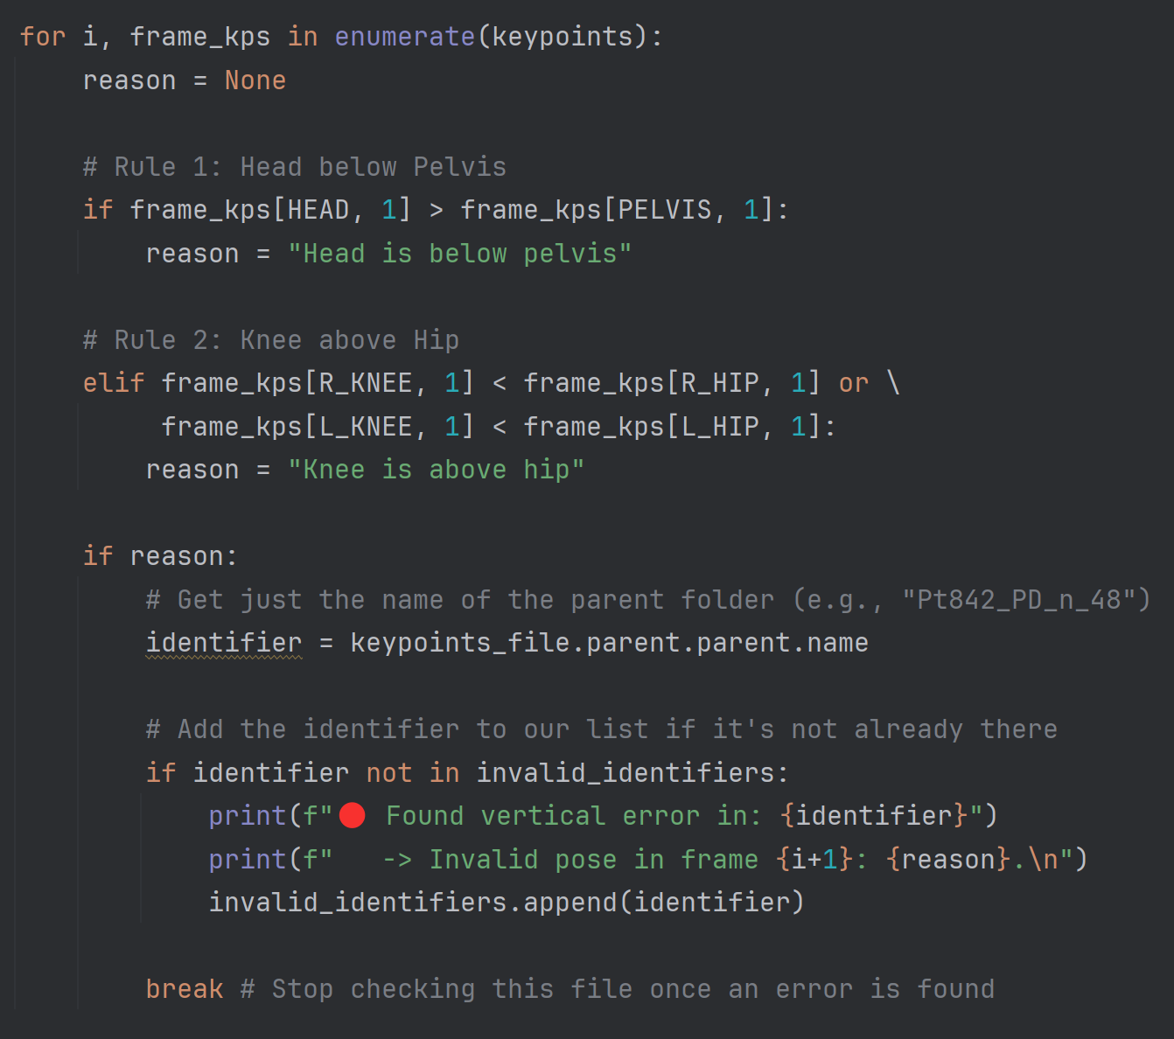
Python Implementation

Slide 6
Output: A List of Invalid Files
The script generates a simple text file (invalid_data_list.txt) containing the unique names of all flagged data sets.
This list serves as the primary output for review.
Example invalid_data_list.txt:
  Pt204_C_n_440
  Pt842_PD_n_48
  Pt971_C_n_2686
  ...

Slide 7
Visual Confirmation of Results
To confirm the errors, a second script uses the generated invalid_data_list.txt.
It loops through the list and automatically generates a GIF animation for each flagged data set.
This provides a quick and efficient way to visually inspect the specific errors that were caught by the anatomical checks. All plots are saved to a single directory for easy review.
File Link

