Slide 1
08/14

Slide 2
GOAL
In the previous attempt, the generated turning data did not distinguish between different types of turns or between PD and healthy participants; all key point data were simply combined into one model, resulting in outputs that were not very meaningful.
This time, we split the data into separate groups — for example, training a model using only PD 90° pivot turning data — so that each model corresponds to a specific scenario.
Next, we can try plotting the generated data to evaluate whether this approach produces useful results.

Slide 3
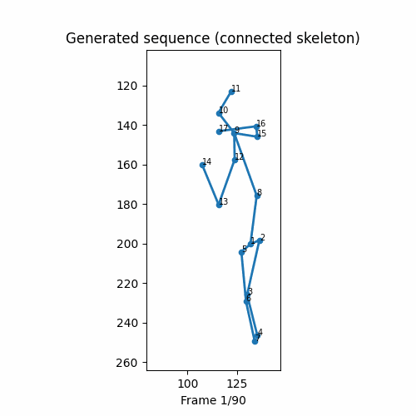
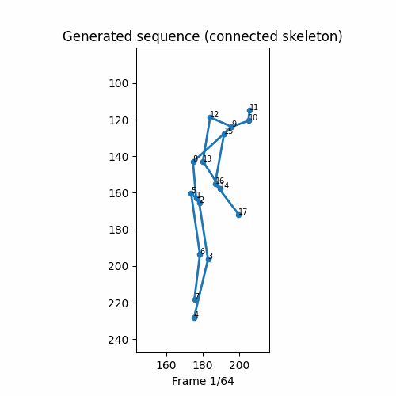
examples
C 135_degrees pivot_turn
Data Augmentation
PD', '90_degrees', 'pivot_turn
Transformer-VAE

Slide 4
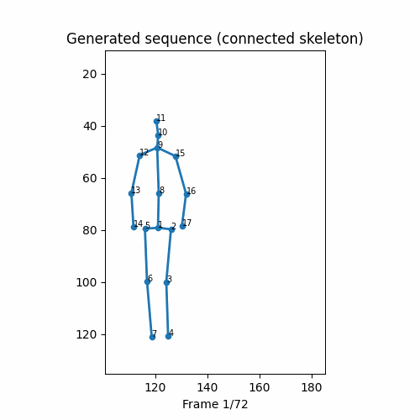
Transformer-VAE data generation
'PD', '180_degrees', 'pivot_turn'

Slide 5
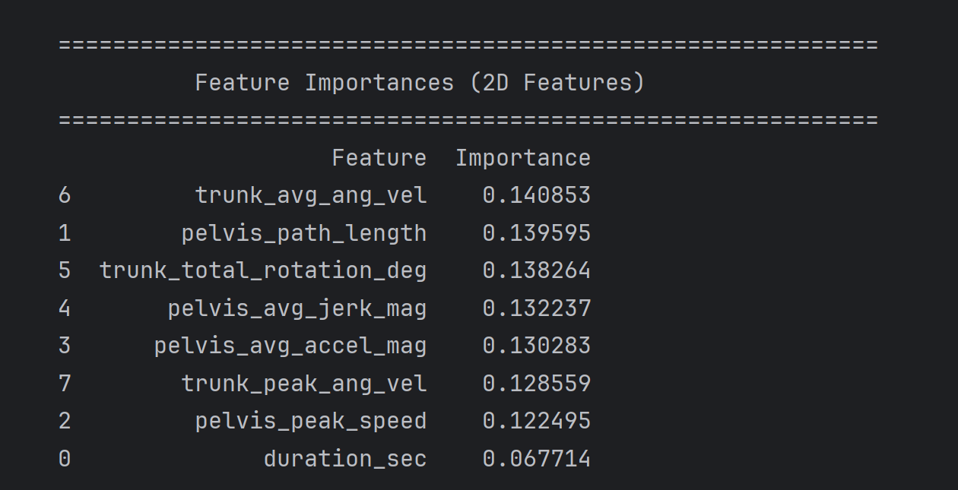
For the "Final 4-Class Model (2D Features, Corrected)"

Slide 6
Different data generation method
Feature | Current Method (Transformer-VAE) | Previous Method (Data Augmentation)
Core Technology | Deep Generative Model | Data Augmentation
Fundamental Idea | To Learn and Create: The model learns the "style" and "rules" of a motion from a large dataset and then generates entirely new data that follows those rules. | To Transform and Imitate: It takes an existing data sample and creates multiple "variants" by applying transformations like adding noise or warping time.
Data Requirement | Requires a large dataset to train a complex deep learning model effectively. | Only needs a single sample to serve as the basis for augmentation.
Generated Result | Completely new, diverse data: The generated data is statistically similar to the training data but is fundamentally new. It can create action sequences that did not exist in the original training set. | Highly similar data: The generated data is fundamentally the same as the original sample, with only minor variations in details and timing.
Complexity | Very high. It requires model design, significant computational resources, and long training times. | Very low. It is simple to implement and generates data very quickly.
Use Case | Ideal when you need to create a large amount of brand-new, diverse data and you have sufficient original data for training. | Ideal when you have a small amount of data and want to quickly expand the dataset with similar samples (e.g., to make a machine learning model more robust).

