Slide 1
Weekly Progress Report - August 21, 2025

Slide 2
Progress Summary
Developed and tested both multi-class and binary machine learning models to classify states using turning kinematics.
Achieved 75% accuracy in a focused binary model distinguishing Control vs. PD Off-Medication.
Performed statistical tests and feature importance analysis to understand the data's underlying patterns.

Slide 3
Key Findings
SMOTE Method Improved Minority Class Detection: The initial 4-class model completely failed to identify the PD Off-Med group (0% precision/recall). After applying the SMOTE technique to balance the training data, the model began to correctly identify this group, increasing its precision from 0% to 23%.
Medication Normalizes Movement: The model finds it extremely difficult to separate Control subjects from PD On-Medication patients, suggesting medication successfully restores turning kinematics to a near-healthy state.
Trunk Rotation is a Key Indicator: In the Control vs. PD Off-Med model, total trunk rotation was the most important feature for classification.

Slide 4
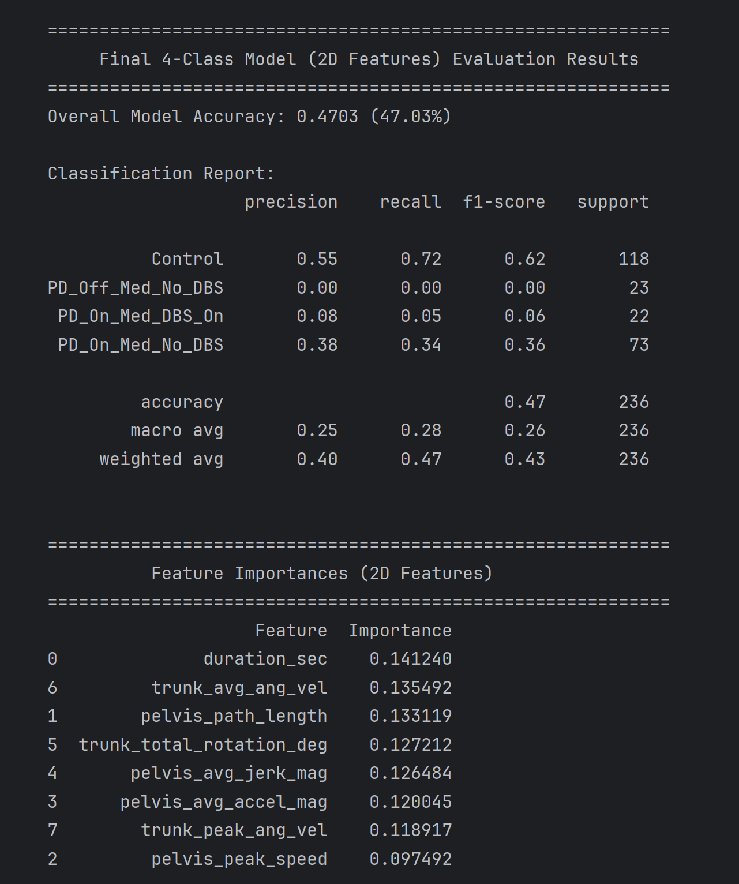
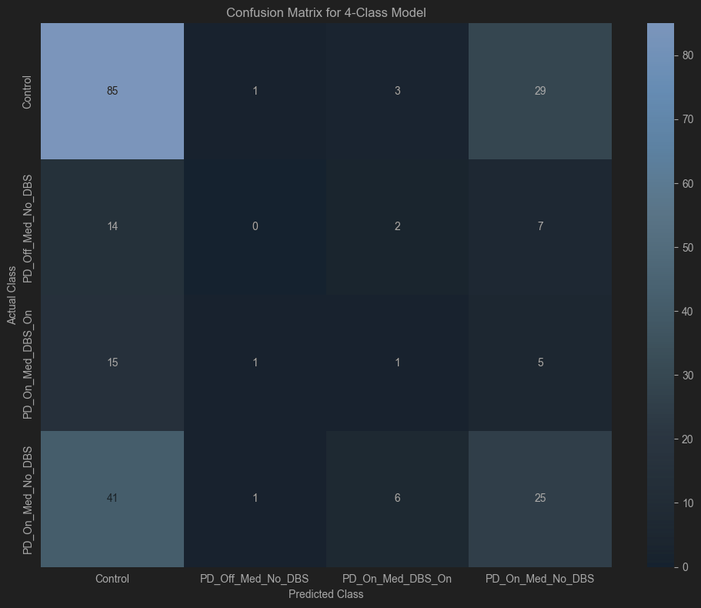
Original Method : Balanced

Slide 5
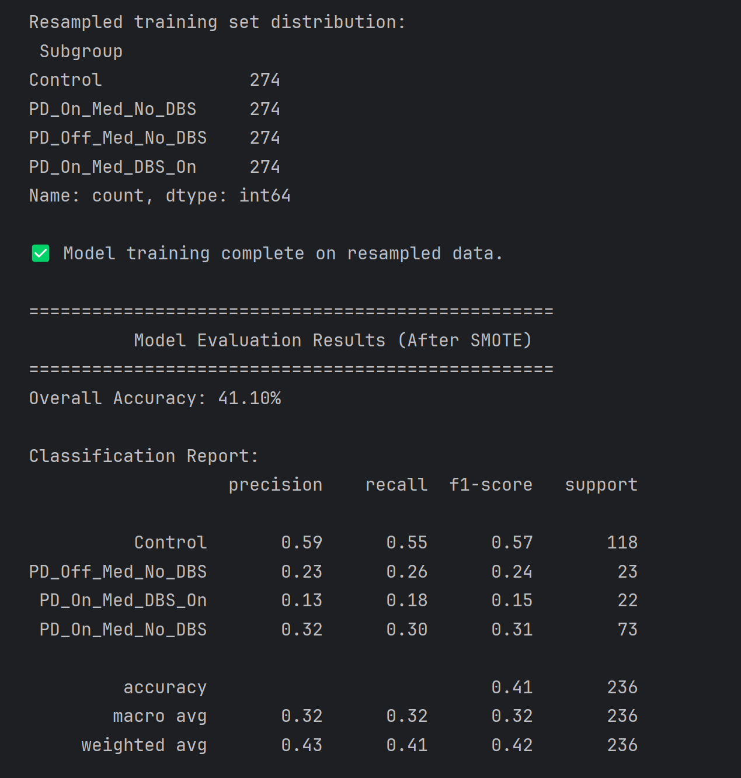
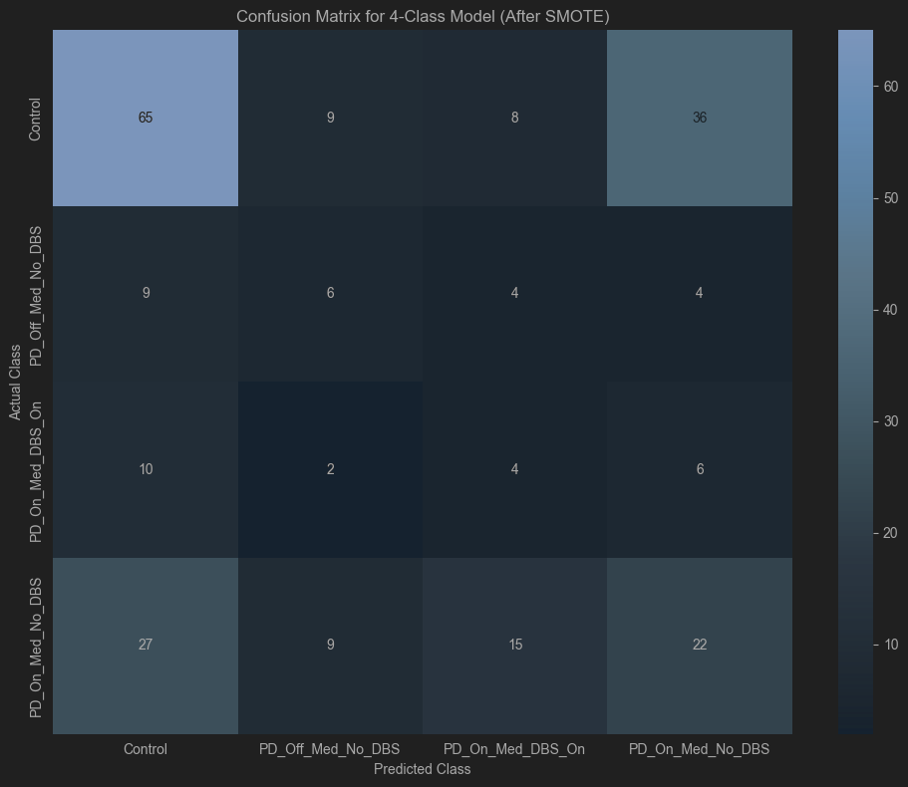
Current Method : SMOTE

Slide 6
Summary of Differences
Feature | class_weight='balanced' | SMOTE
Approach | Algorithm-Level: Changes the model's cost function. | Data-Level: Changes the training dataset.
How it Works | Increases the penalty for misclassifying minority classes. | Creates new, synthetic data points for minority classes.
Effect on Data | The training data remains unchanged and imbalanced. | The training data is expanded and becomes balanced.

Slide 7
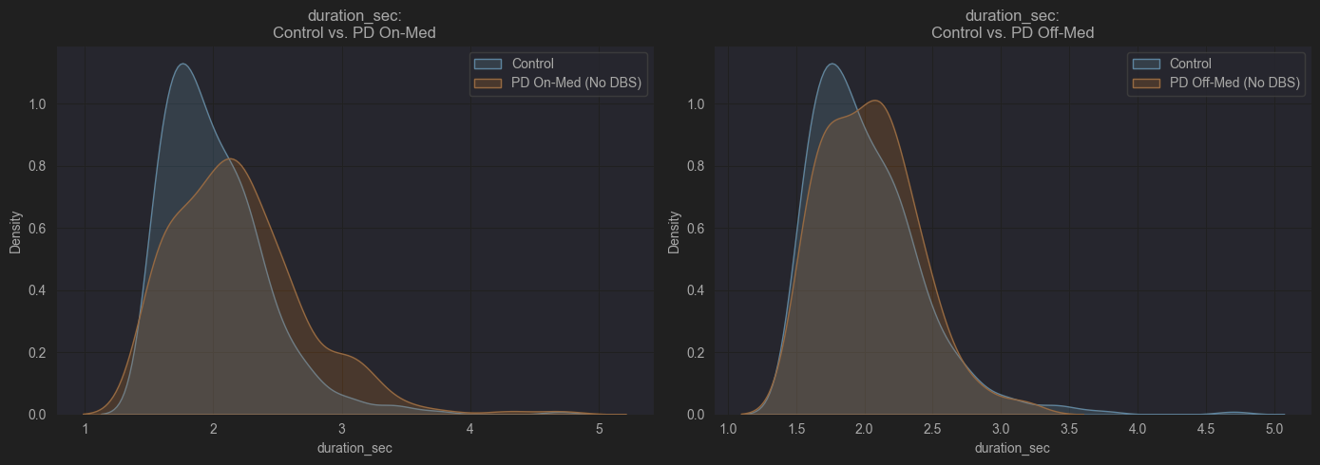
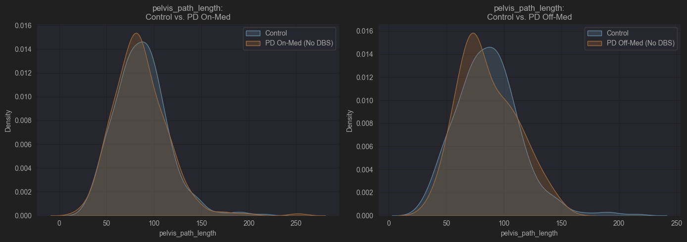
Data Visualization
For each key feature, it will create two comparison plots.

Slide 8
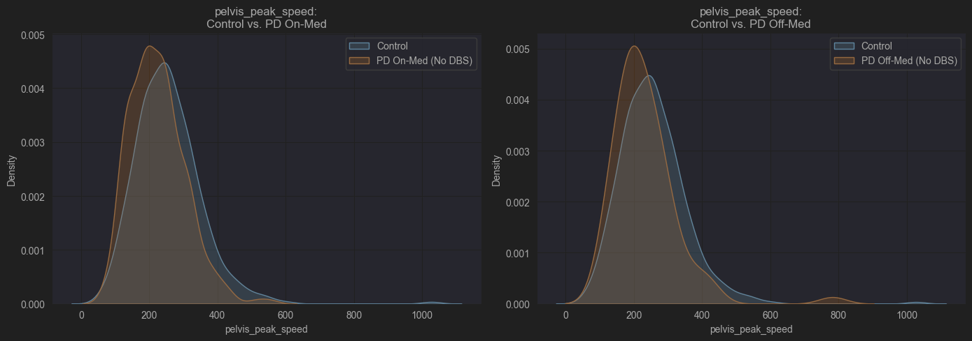
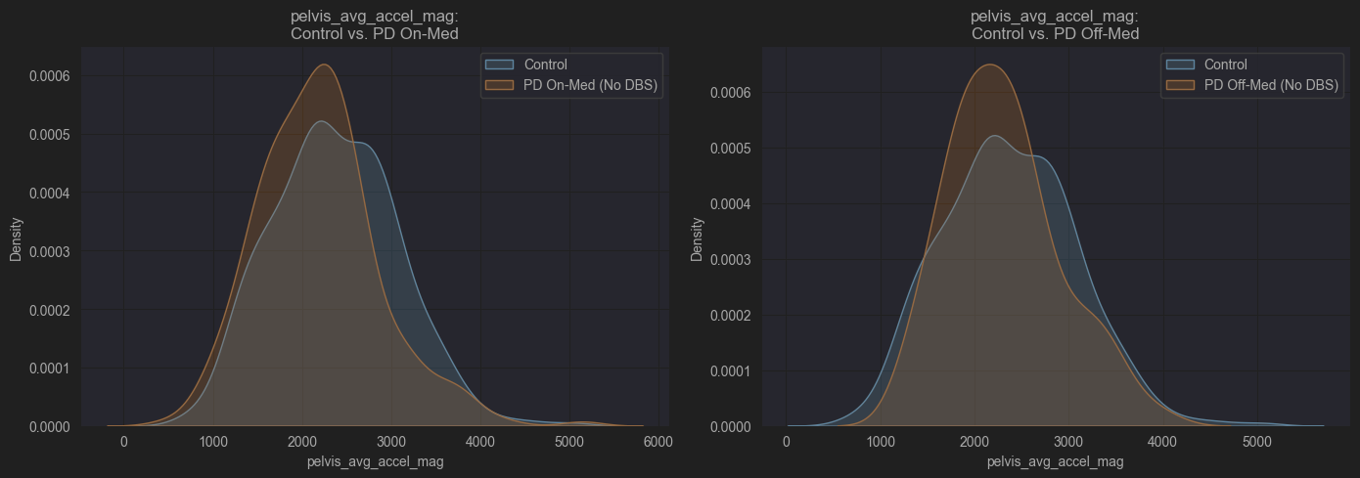

Slide 9
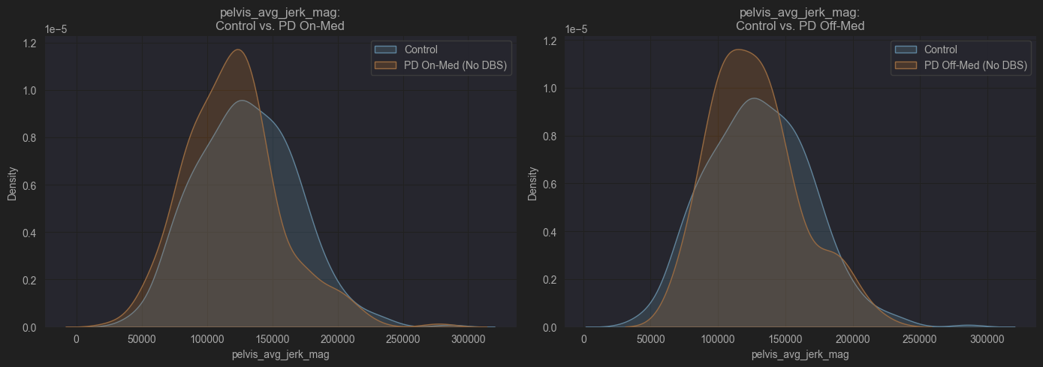
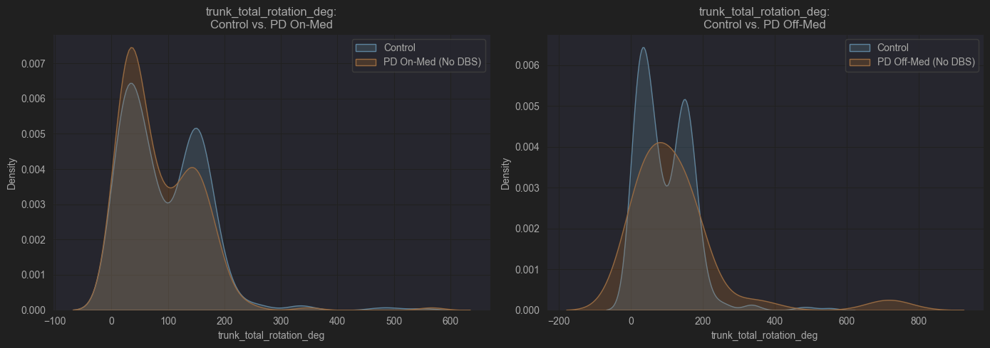

Slide 10
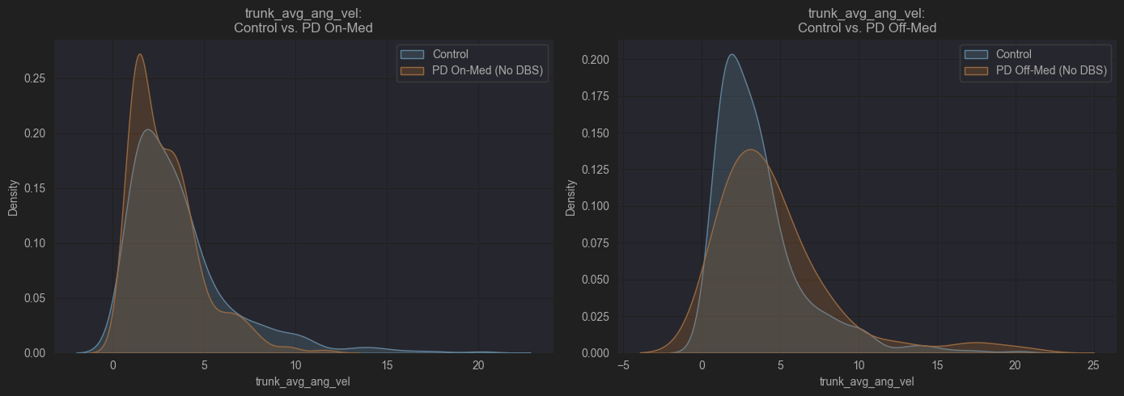
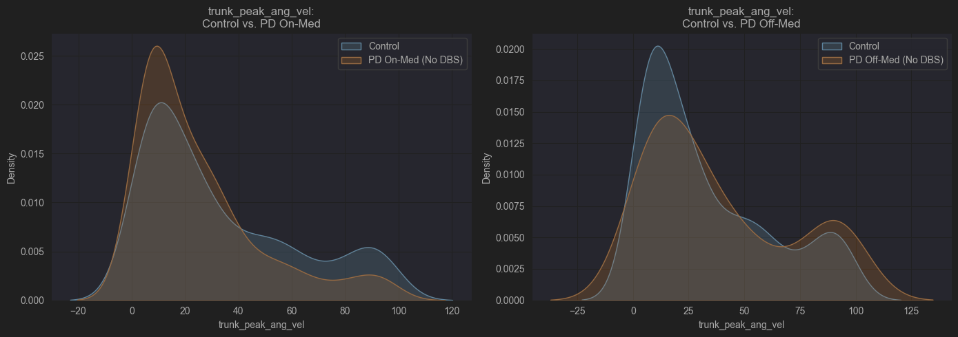

Slide 11
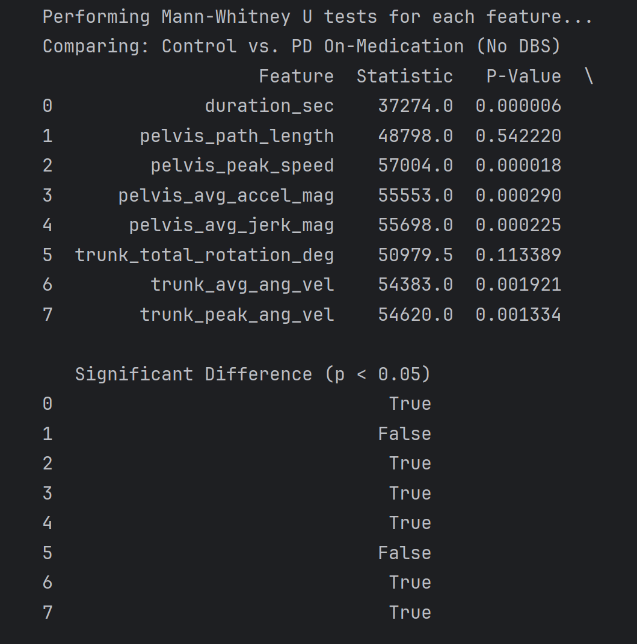

Each feature significant difference
Table 1
Table 2

Slide 12
Key findings
Control vs. PD On-Medication (Table 1)
Surprising Finding: From a purely statistical standpoint, the Control group and the On-Med group are significantly different in most of their movement features (6 out of 8 features show a P-Value < 0.05).
This seems to contradict our idea that they are "very similar." So, why does the machine learning model struggle to separate them?
This is a classic case of "Statistical Significance vs. Practical Significance."
Statistical Significance (What the test shows): With a large number of samples (you have hundreds in each group), even very small, subtle differences in the groups' averages can be detected by a statistical test and flagged as "significant." The test is telling us, with high confidence, that the underlying distributions are not identical.
Practical Significance (What the model sees): Even though the group averages are different, the distributions of the features likely have a massive overlap. Imagine two wide bell curves whose peaks are slightly offset. While statistically different, a large number of individuals from both groups fall into the overlapping area. Your machine learning model gets confused by these individuals, as their feature values could plausibly belong to either group.

Slide 13
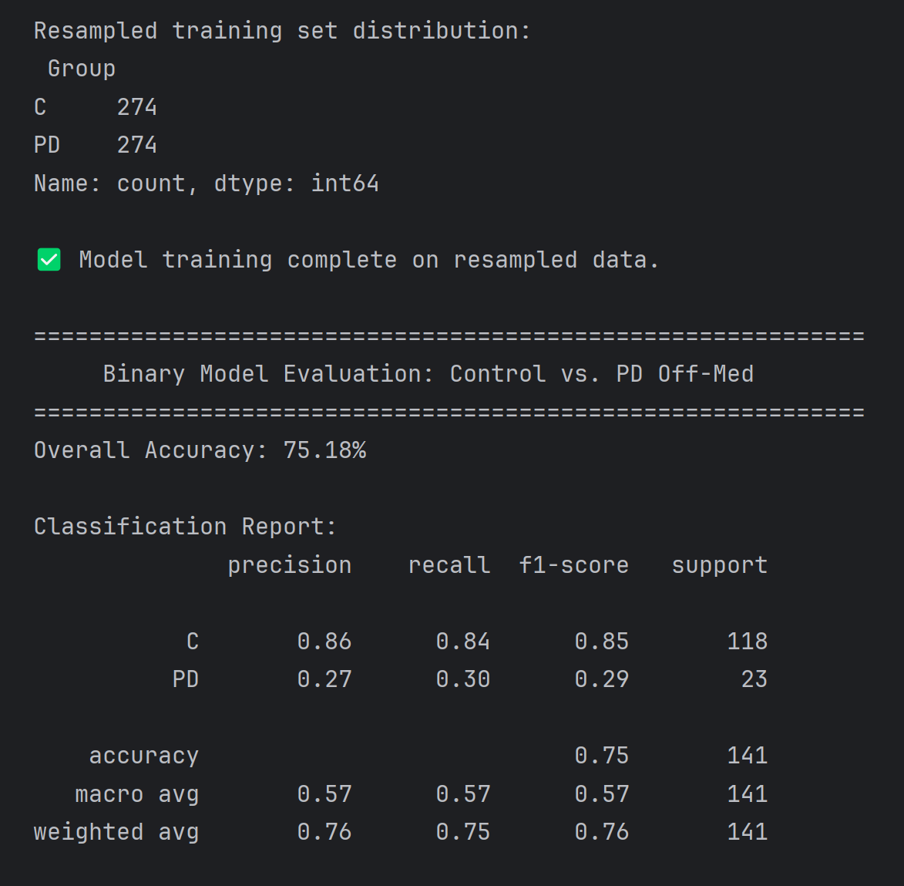
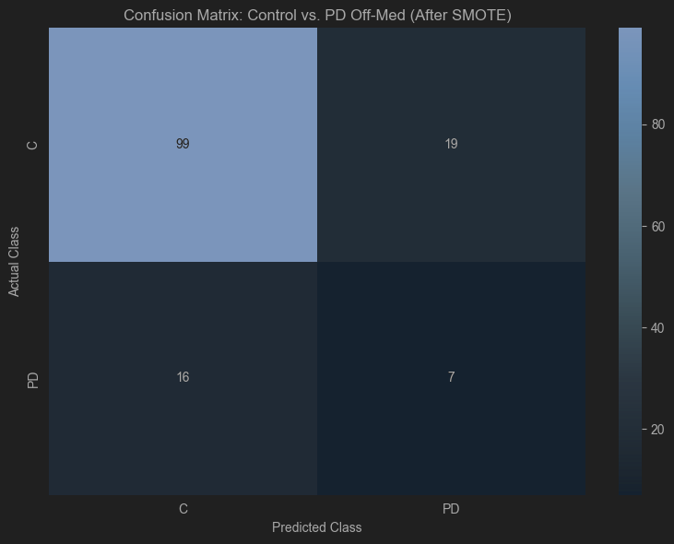
C and PD off-med

Slide 14
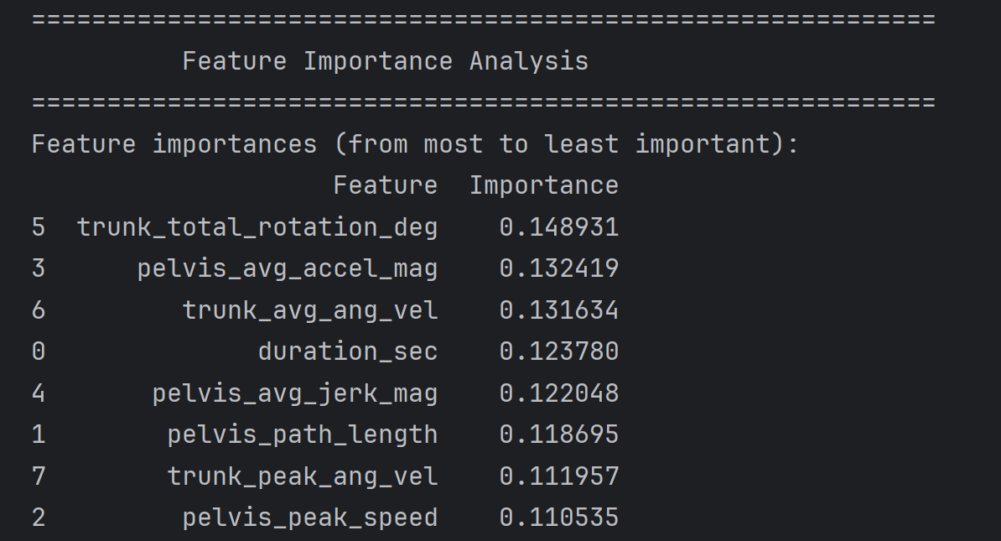
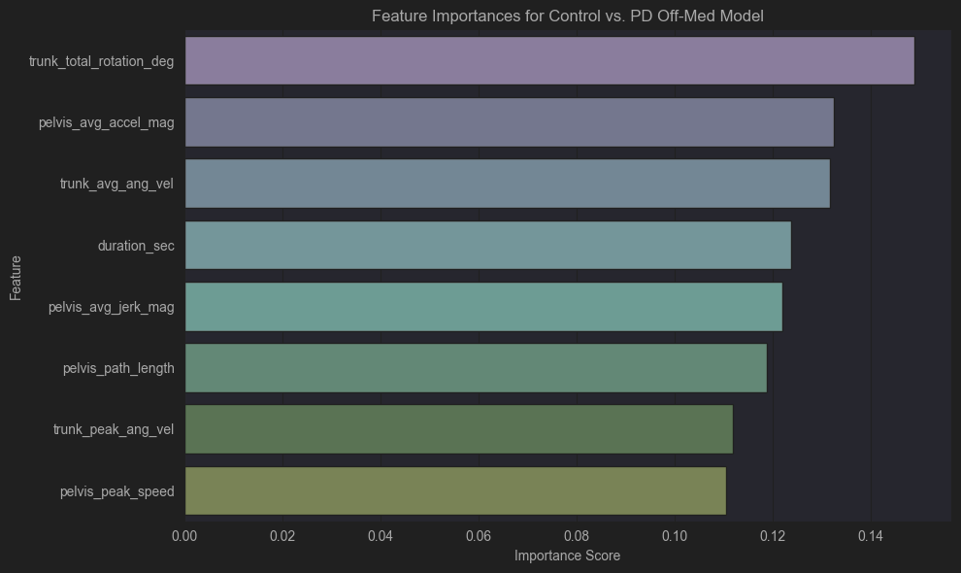

Slide 15
Feature Work
Incorporate 3D Kinematic Data: Analyze the corresponding 3D motion capture data to determine if features related to vertical movement or depth can improve classification accuracy.
Explore Alternative Feature Calculations: Investigate different methods for calculating the existing kinematic features to see if alternative definitions can better capture the differences between groups.

